Slide 1
A Tour of C# 6:
Level up your Productivity

Slide 2

Bill Wagner
C# MVP
Microsoft Regional Director
C# ECMA Standardization Committee
Author, Trainer, Consultant

Slide 3
C# 6.0
I thought this was already there
Wow that’s new
Self Hosted
Open Source
C# 6.0
Productivity
Small Features
Lots of Features
Concise and Clear

Slide 4
Expression Bodied Members
C# Classic
C# 6
public class Point
{
public double X { get; set; }
public double Y { get; set; }
public double Distance
{
get
{
return Math.Sqrt(
X * X + Y * Y);
}
}
}
public class Point
{
public double X { get; set; }
public double Y { get; set; }
public double Distance =>
Math.Sqrt(X * X + Y * Y);
}

Slide 5
Static Usings
C# Classic
C# 6
using System;
namespace TourOfCSharp6
{
public class Point
{
public double X { get; set; }
public double Y { get; set; }
public double Distance =>
Math.Sqrt(X * X + Y * Y);
}
}
using static System.Math;
namespace TourOfCSharp6
{
public class Point
{
public double X { get; set; }
public double Y { get; set; }
public double Distance =>
Sqrt(X * X + Y * Y);
}
}

Slide 6
Static Usings and Extension Methods
using static System.Linq.Enumerable;
var random = new System.Random();
var range = Range(1, 100);
var sequence = from n in range select new Point {
X = random.NextDouble() * 1000,
Y = random.NextDouble() * 1000
};
var sequence2 = range.Select(n => new Point {
X = random.NextDouble() * 1000,
Y = random.NextDouble() * 1000
});
var sequence3 = Select(range, n => new Point {
X = random.NextDouble() * 1000,
Y = random.NextDouble() * 1000
});

Slide 7
Autoimplemented Read Only Property
C# Classic
C# 6
public class Point
{
public double X { get; set; }
public double Y { get; set; }
public double Distance =>
Sqrt(X * X + Y * Y);
}
public class Point
{
public Point(double x, double y)
{
X = x;
Y = y;
}
public double X { get; }
public double Y { get; }
public double Distance =>
Sqrt(X * X + Y * Y);
}

Slide 8
String Interpolation
C# Classic
C# 6
public override string ToString()
{
return string.Format(
"{{{0:F2}, {1:F2}}}, Distance = {2:F2}",
X, Y, Distance);
}
public override string ToString()
{
return string.Format(
"\{X:F2}, \{Y:F2}, Distance = \{Distance:F2}");
}
public override string ToString()
{
return $“{{{X:F2}, {Y:F2}}}, Distance = {Distance:F2}");
}

Slide 9
Dictionary Initializers
C# Classic
var webErrors = new Dictionary<int, string>();
webErrors.Add(404, "Page not Found");
webErrors[302] = "Page moved, but left a forwarding address.";
webErrors[500] = "The web server can't come out to play today.";
C# 6
var webErrors = new Dictionary<int, string>
{
[404] = "Page not Found",
[302] = "Page moved, but left a forwarding address.",
[500] = "The web server can't come out to play today."
};

Slide 10
Exception Filters
int failures = 0;
for (int i = 0; i < 100; i++)
{
try {
var points = SimulatedWebRequest();
foreach (var item in points)
Console.WriteLine(item);
} catch(TimeoutException e) if (failures++ < 10)
{
WriteLine("Timeout error: trying again");
}
}

Slide 11
Exception Filters: logging
int failures = 0;
for (int i = 0; i < 50; i++)
{
try
{
var points = SimulatedWebRequest();
foreach (var item in points)
Console.WriteLine(item);
}
catch (Exception e) if (logException(e)) { }
catch (TimeoutException e) if (failures++ < 10)
{
WriteLine("Timeout error: trying again");
}
}

Slide 12
Exception Filters: logging
private static bool logException(Exception e)
{
var oldColor = Console.ForegroundColor;
Console.ForegroundColor = ConsoleColor.Red;
WriteLine("Error: {0}", e);
Console.ForegroundColor = oldColor;
return false;
}

Slide 13
Exception Filters: Debugging
int failures = 0;
for (int i = 0; i < 50; i++)
{
try
{
var points = SimulatedWebRequest();
foreach (var item in points)
Console.WriteLine(item);
}
catch (Exception e) if (logException(e)) { }
catch (TimeoutException e) if ((failures++ < 10) && (!Debugger.IsAttached))
{
WriteLine("Timeout error: trying again");
}
}

Slide 14

Exception Filters: when vs. is

Slide 15
Null Conditional Operator
C# Classic
C# 6
var vendor = new Company();
var location = default(string);
if (vendor != null)
if (vendor.ContactPerson != null)
if (vendor.ContactPerson.HomeAddress
!= null)
location = vendor.ContactPerson
.HomeAddress.LineOne;
WriteLine(location);
var vendor = new Company();
var location = vendor?.ContactPerson
?.HomeAddress?.LineOne;
WriteLine(location);

Slide 16
Null Conditional Operator idioms
C# Classic
C# 6
var disposable = vendor as
IDisposable;
if (disposable != null)
disposable.Dispose();
(vendor as IDisposable)
?.Dispose();

Slide 17
Await in finally and catch
private async static Task RunAsyncTest()
{
try
{
await DoWebbyThings();
}
catch (Exception e)
{
await GenerateLog(e.ToString());
throw;
}
}

Slide 18
Roslyn.Github.com
It’s Open Source
It’s Cross Platform
It’s Self Hosted

Slide 19
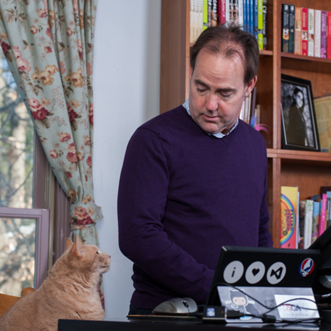
Bill Wagner
bill@thebillwagner.com
@billwagner
http://thebillwagner.com
https://github.com/BillWagner
/TourOfCSharp6

