Slide 1
MakeGATEEvents
Bill Worstell
CapeSym
6/14/2022

Slide 2






Control Lists
GATEDefaultParameters.xls
GATERunParameters.xls
Interactive or
Batch Control
$RunGATE.sh
$RunGATE.mac
$GATE-> GATE
$Root -> Root
GATEDefaultParameters.csv
GATERunParameters.csv
Editor or Excel
Parse Control List
and make series of
System calls to GATE
$GATE –a ([Name1,Val1],
[Name2,Val2] …)]).
./MakeGATEEvents.mac
MakeGATEEvents.mac
$RunGATE.mac
Generate OCTAVE
Outputs (.mat)
and plots )(.png)
AnalyzeGATE.mac
$root -b -q Root2Mat.cc
Root2Mat.cc
Run.mat
Summary.mat
*.png
Run.bin

Slide 3
Control Lists
GATEDefaultParameters.xls
GATERunParameters.xls
Batch Control
GATEDefaultParameters.csv
GATERunParameters.csv
Editor or Excel
Parse Control List
and make series of
System calls to GATE
$GATE –a ([Name1,Val1],
[Name2,Val2] …)]).
./MakeGATEEvents.mac
$RunGATE.mac

Slide 4
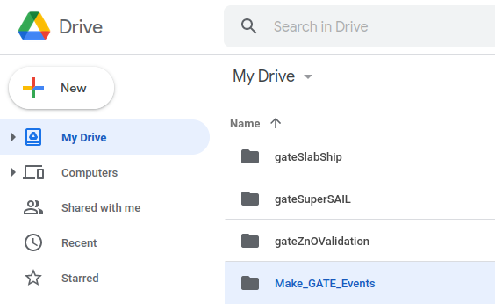
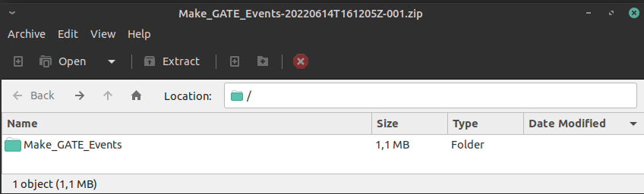
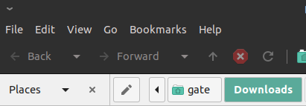
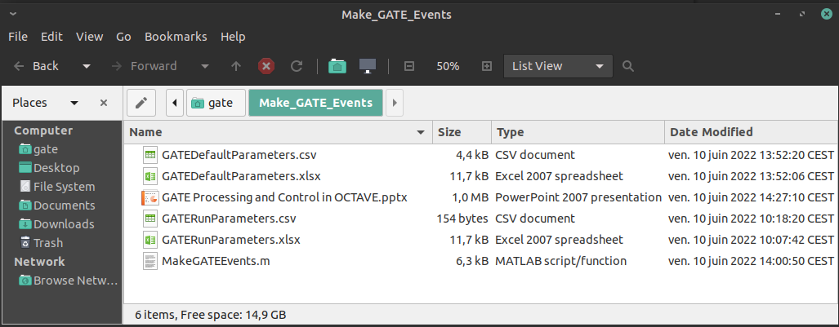

Slide 5
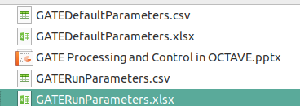
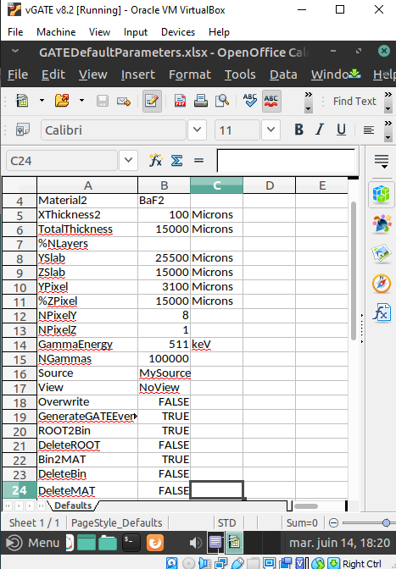
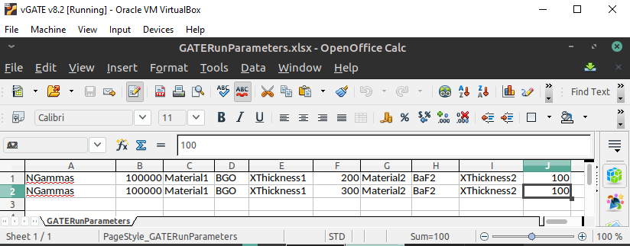

Control Lists
GATEDefaultParameters.xlsx
GATERunParameters.xlsx
GATEDefaultParameters.csv
GATERunParameters.csv
IssueSystem Call
Editor or Excel
Generate System Call
MakeGATEEvents
OutputDirectoryName= GATE_100000_BGO_200_BaF2_100
GATECallString= $gate -a [Material1,BGO] [XThickness1,200] [Material2,BaF2] [XThickness2,100] [TotalThickness,15000] [%NLayers,] [YSlab,25500] [ZSlab,15000] [YPixel,3100] [%ZPixel,15000] [NPixelY,8] [NPixelZ,1] [GammaEnergy,511] [NGammas,100000] [Source,MySource] [View,NoView] [DeleteMAT,0] [OutputDirectoryName,GATE_100000_BGO_200_BaF2_100] ./main/RunGATE.mac
Read
Control Input
From
.xlsx files

Slide 6
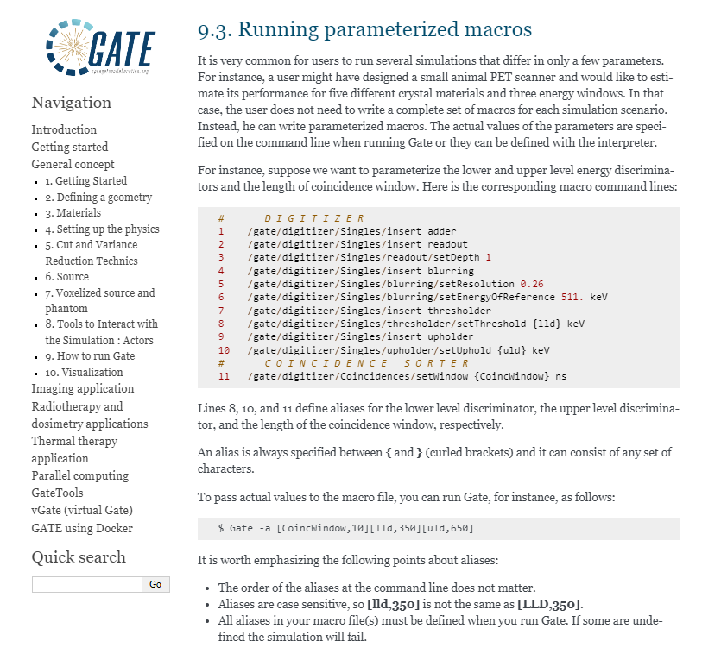
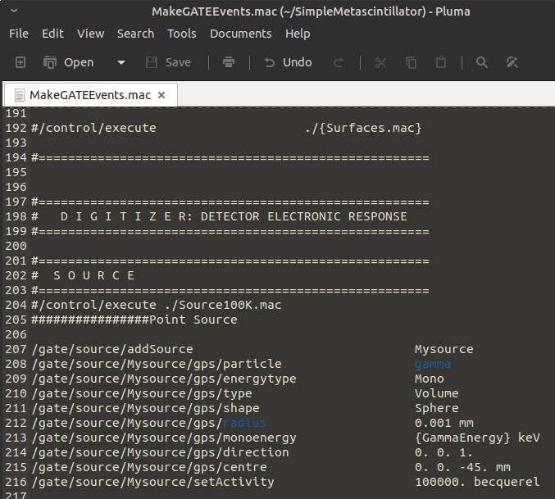
https://opengate.readthedocs.io/en/latest/how_to_run_gate.html#

Slide 7
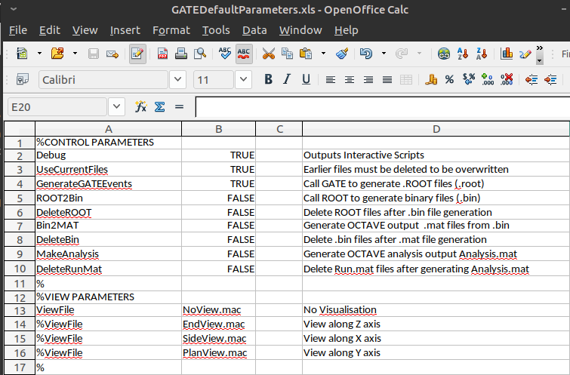
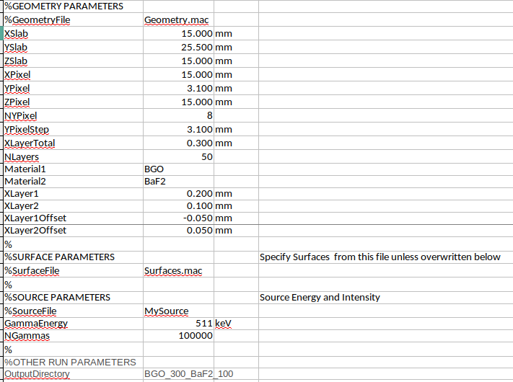
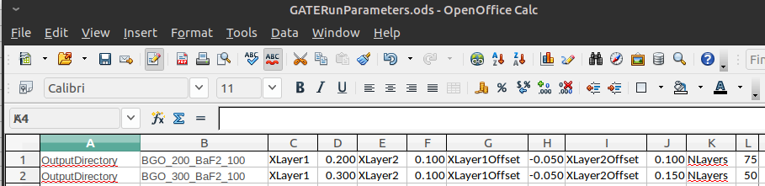

Slide 8
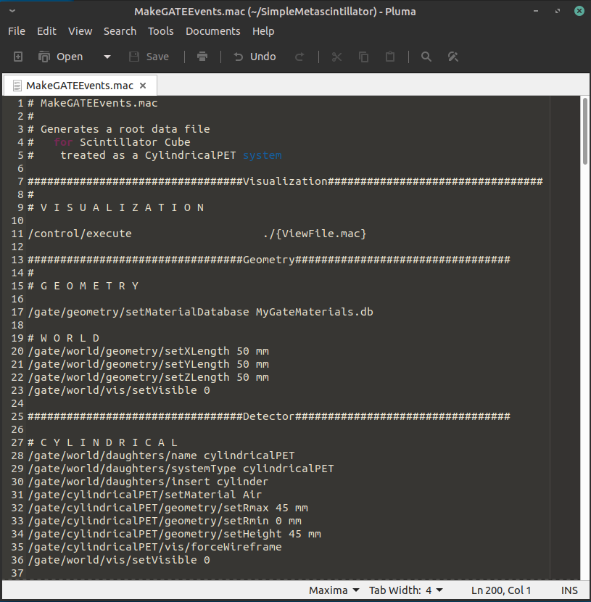
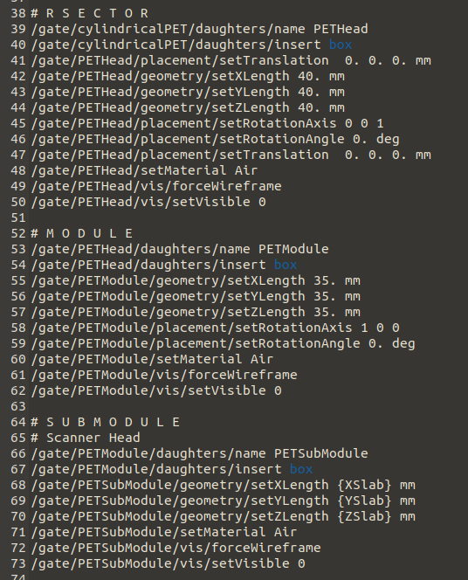

Slide 9
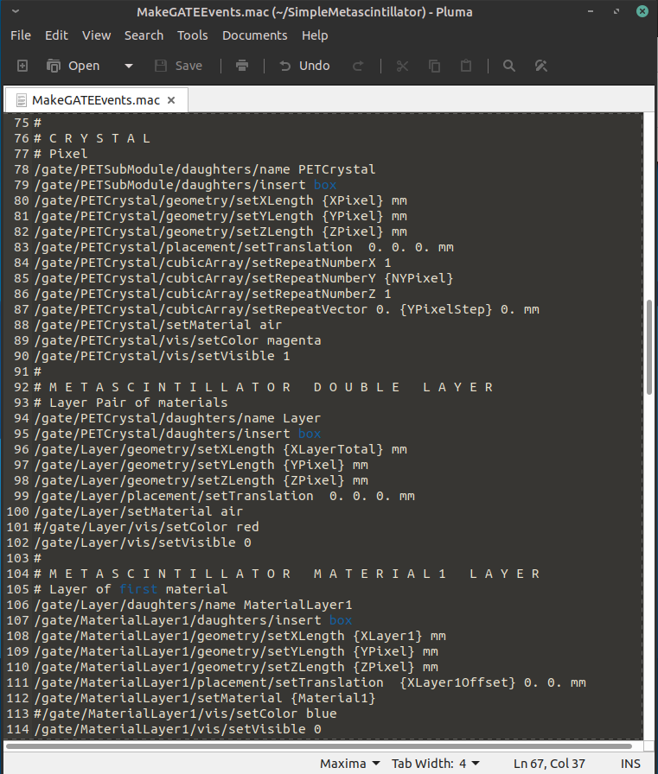
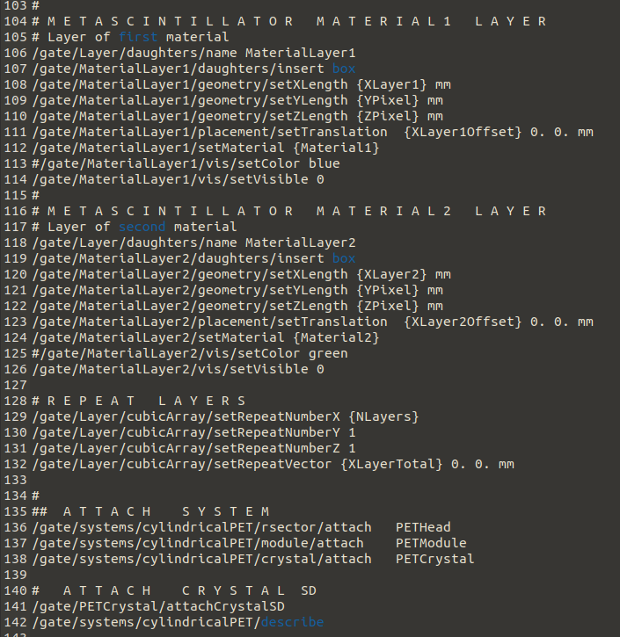

Slide 10
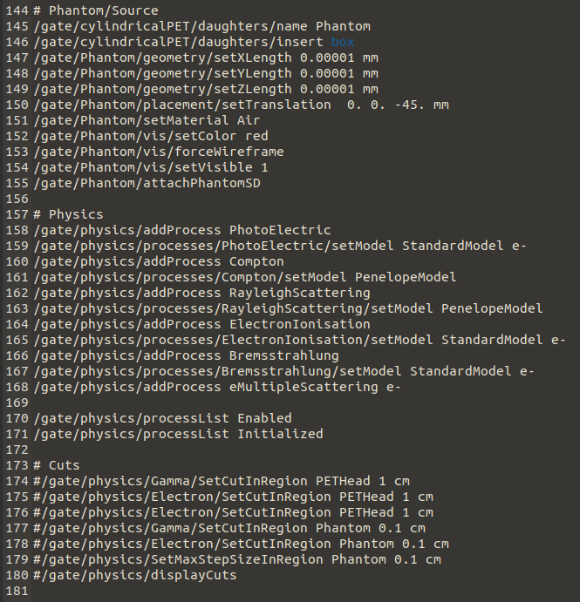
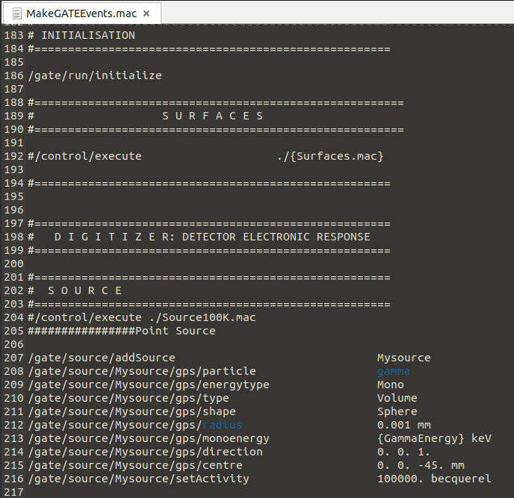

Slide 11
