Slide 1
Integration of OpenPyXL, .xlxs Geometry Spreadsheet and DiffDRR
Bill Worstell
PicoRad -> MGH
12/26/2023

Slide 2
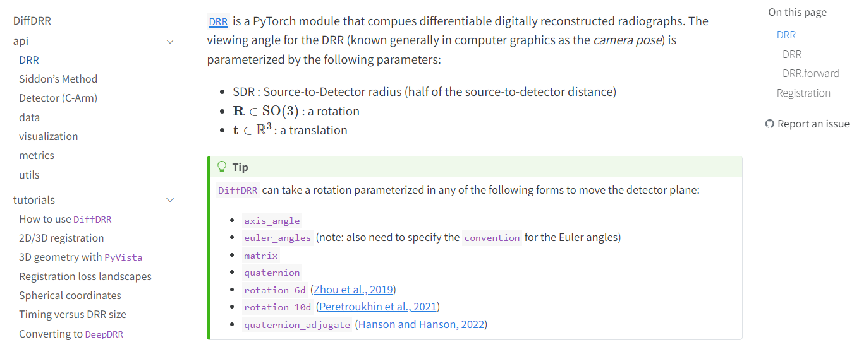
If using Euler angles, the parameters are
alpha : Azimuthal angle
beta : Polar angle
gamma : Plane rotation angle
bx : X-dir translation
by : Y-dir translation
bz : Z-dir translation
convention : Order of angles (e.g., ZYX)
(bx, by, bz) are translational parameters and (alpha, beta, gamma) are rotational parameters. The rotational parameters are detailed in Spherical Coordiantes Tutorial.
https://vivekg.dev/DiffDRR/api/drr.html#drr

Slide 3
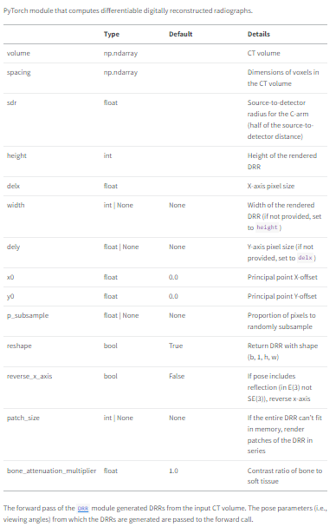
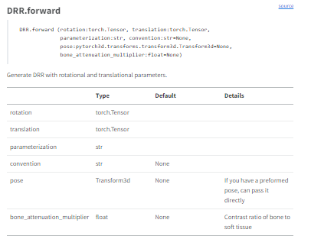
https://vivekg.dev/DiffDRR/api/drr.html#drr
DRR
DRR (volume:numpy.ndarray, spacing:numpy.ndarray, sdr:float, height:int,
delx:float, width:int|None=None, dely:float|None=None, x0:float=0.0,
y0:float=0.0, p_subsample:float|None=None, reshape:bool=True,
reverse_x_axis:bool=False, patch_size:int|None=None,
bone_attenuation_multiplier:float=1.0)

Slide 4
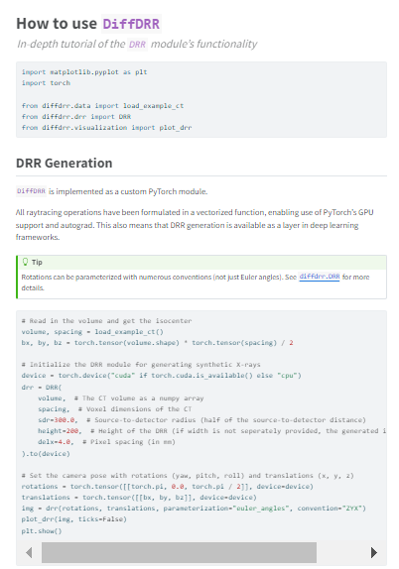
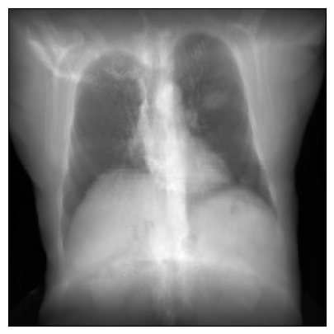
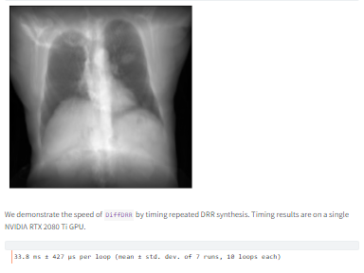
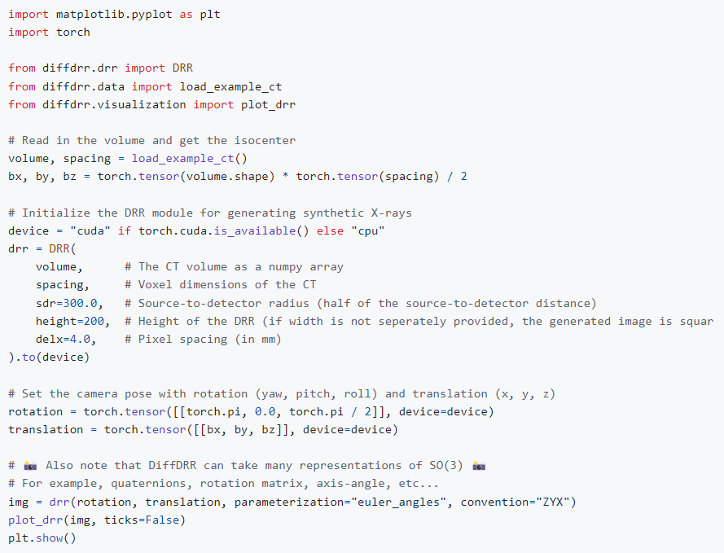
https://vivekg.dev/DiffDRR/tutorials/introduction.html
https://github.com/eigenvivek/DiffDRR

Slide 5
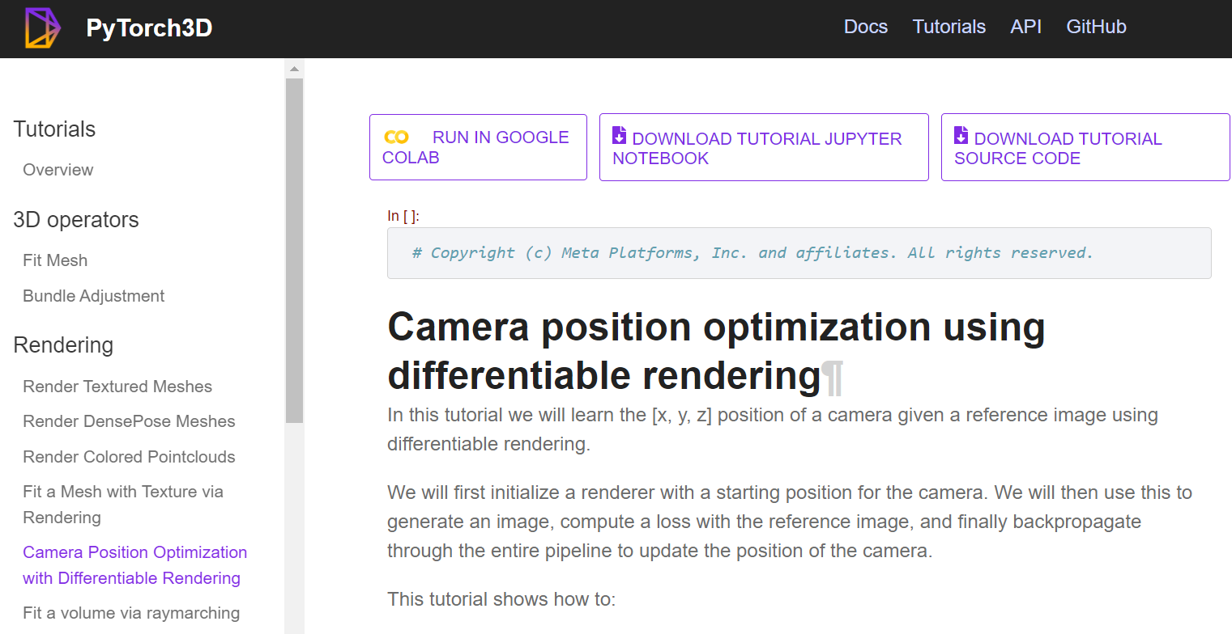
https://pytorch3d.org/tutorials/camera_position_optimization_with_differentiable_rendering

Slide 6
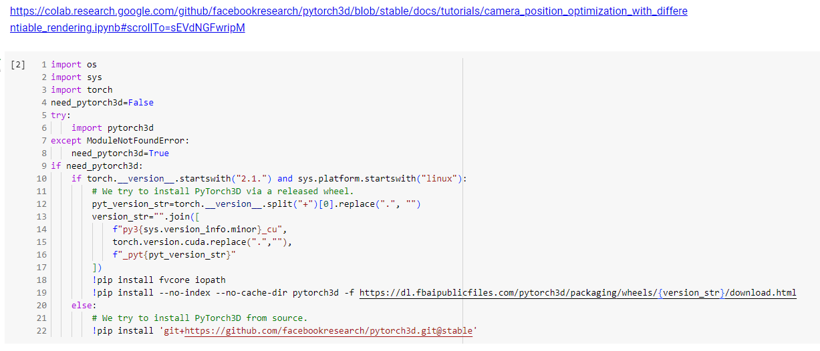
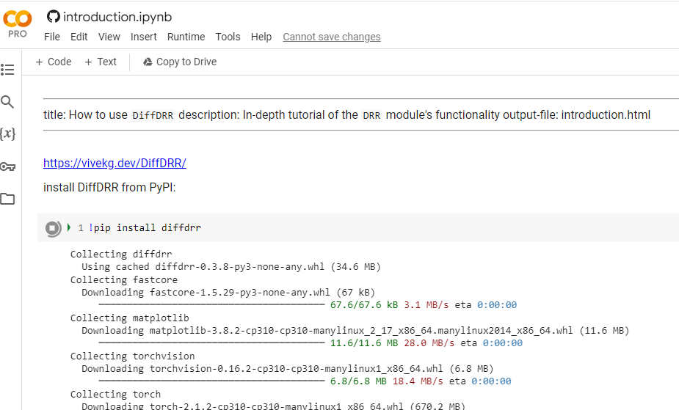

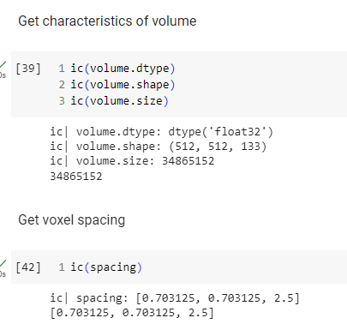
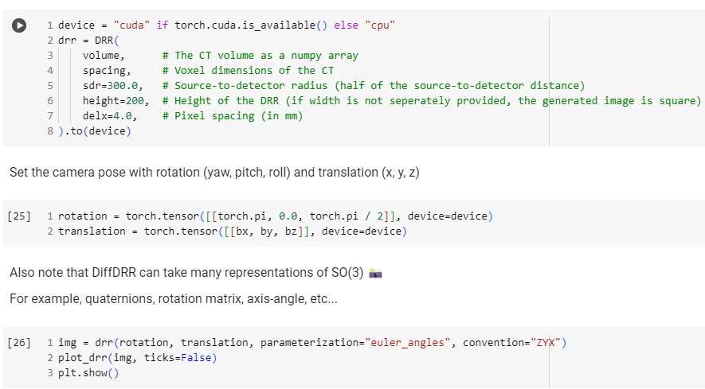
https://colab.research.google.com/github/BillWorstell/DiffDRR/blob/main/notebooks/tutorials/introduction.ipynb
https://github.com/BillWorstell/DiffDRR/blob/main/notebooks/tutorials/introduction.ipynb

Slide 7
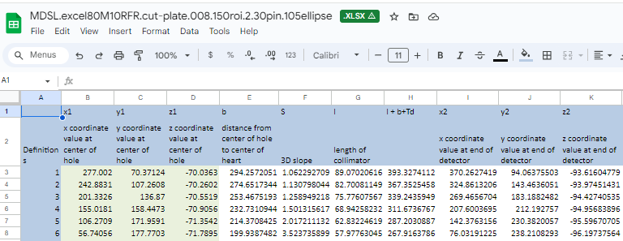
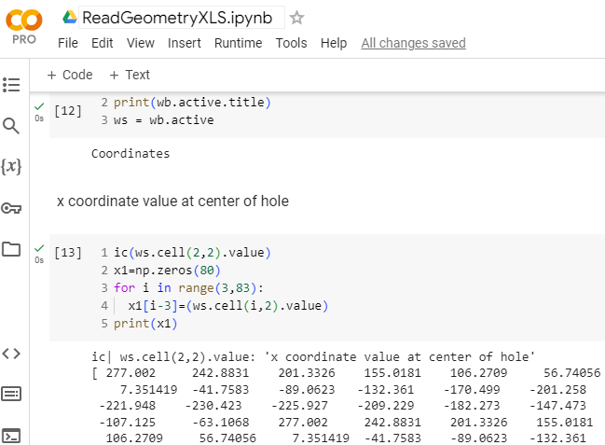
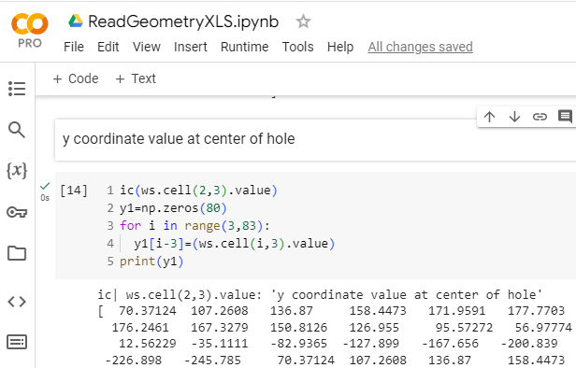
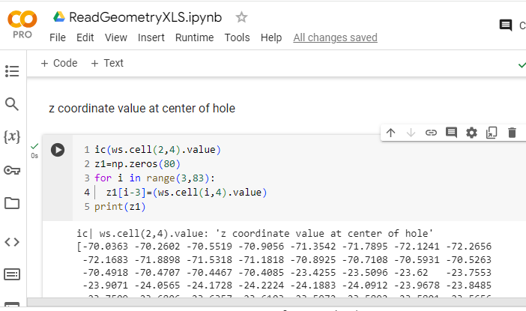

Slide 8
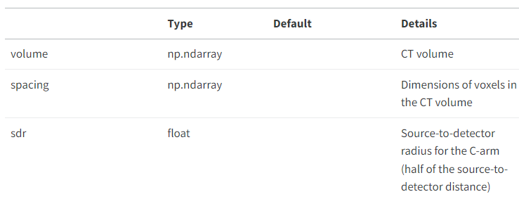
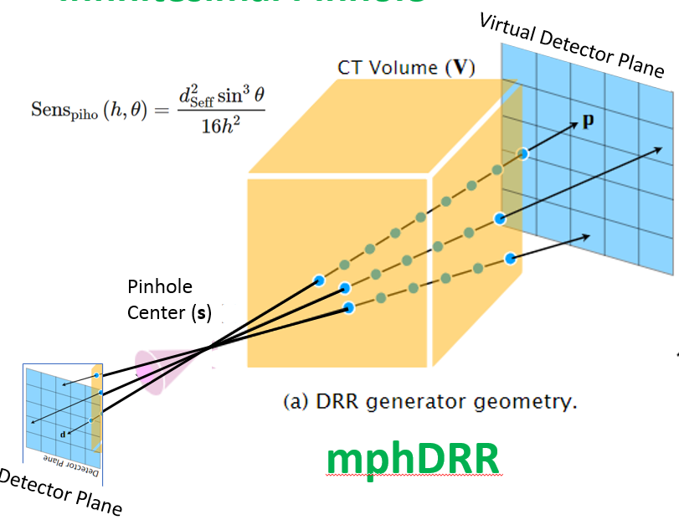
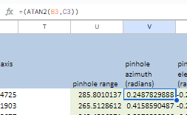
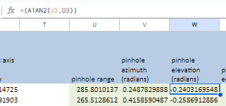
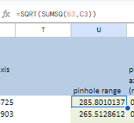
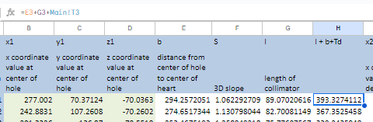
https://vivekg.dev/DiffDRR/api/drr.html#drr
Choose sdr = 5 * [length of collimator]
Magnification M=10
If using Euler angles, the parameters are
alpha : Azimuthal angle
beta : Polar angle
gamma : Plane rotation angle
bx : X-dir translation
by : Y-dir translation
bz : Z-dir translation
convention : Order of angles (e.g., ZYX)
(bx, by, bz) are translational parameters and (alpha, beta, gamma) are rotational parameters. The rotational parameters are detailed in Spherical Coordiantes Tutorial.

Slide 9
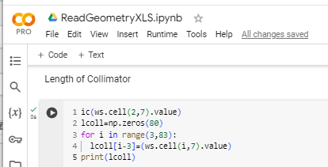

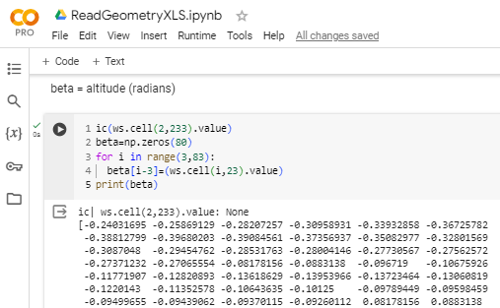

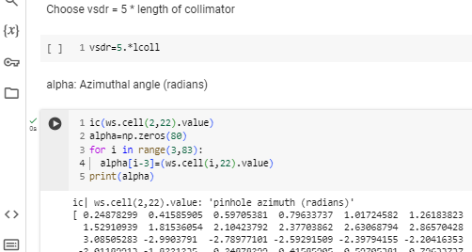

Slide 10
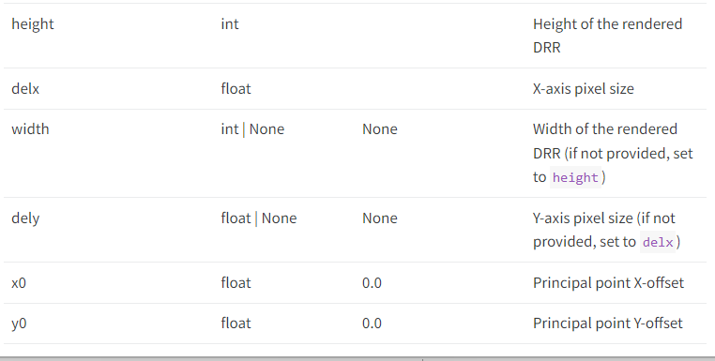

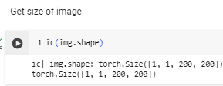
https://vivekg.dev/DiffDRR/api/drr.html#drr
Choose sdr = 5 * [length of collimator] -> ~450mm
Magnification M=10, Source-to-detector -> ~900mm
Length of side of virtual detector crystal = 500 mm
height= 500
delx = 500/200 = 2.5
width = 500
dely = 500/200=2.5
x0=0
y0=0
Volume [X Y Z] is
360 x 360 x 332.5 mm

Slide 11
# Initialize the DRR module for generating synthetic X-rays
device = torch.device("cuda" if torch.cuda.is_available() else "cpu")
drr = DRR(
volume, # The CT volume as a numpy array
spacing, # Voxel dimensions of the CT
sdr=300.0, # Source-to-detector radius (half of the source-to-detector distance)
height=200, # Height of the DRR (if width is not seperately provided, the generated image is square)
delx=4.0, # Pixel spacing (in mm)
).to(device)
# Set the camera pose with rotations (yaw, pitch, roll) and translations (x, y, z)
rotations = torch.tensor([[torch.pi, 0.0, torch.pi / 2]], device=device)
translations = torch.tensor([[bx, by, bz]], device=device)
img = drr(rotations, translations, parameterization="euler_angles", convention="ZYX")
# Initialize the DRR module for generating synthetic X-rays
device = torch.device("cuda" if torch.cuda.is_available() else "cpu")
drr = DRR(
volume, # The CT volume as a numpy array
spacing, # Voxel dimensions of the CT
sdr=vsdr[imod], # Source-to-virtual-detector radius (half of the source-to-virtual-detector distance)
height=500, # Height of the DRR (if width is not seperately provided, the generated image is square)
delx=2.5, # Pixel spacing (in mm)
).to(device)
# Set the camera pose with rotations (yaw, pitch, roll) and translations (x, y, z)
rotations = torch.tensor([alpha[imod],beta[imod],0.], device=device)
translations = torch.tensor([[bx, by, bz]], device=device)
img = drr(rotations, translations, parameterization="euler_angles", convention="ZYX")

Slide 12
