Slide 1
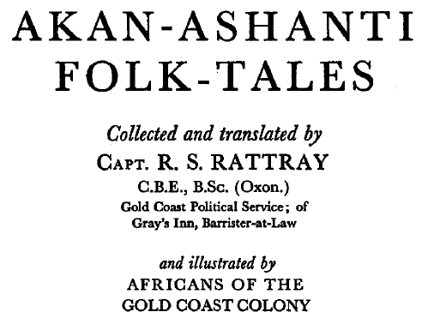
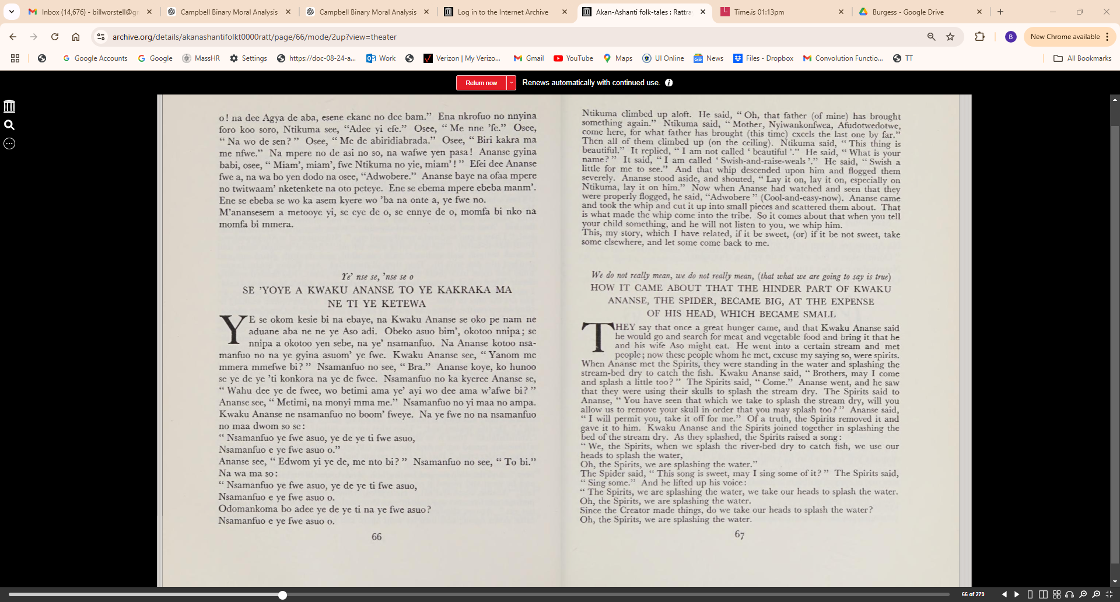

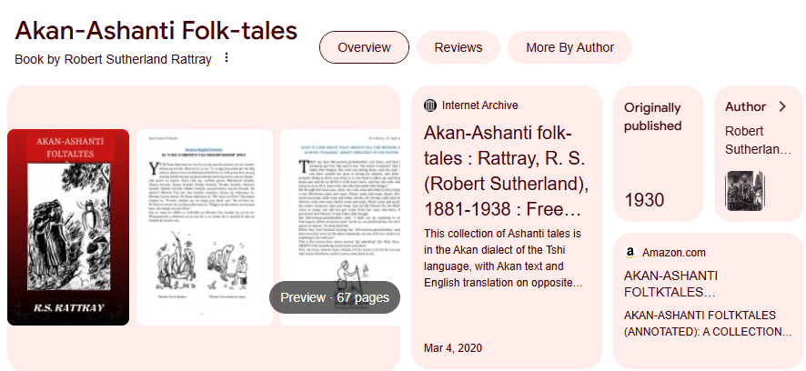
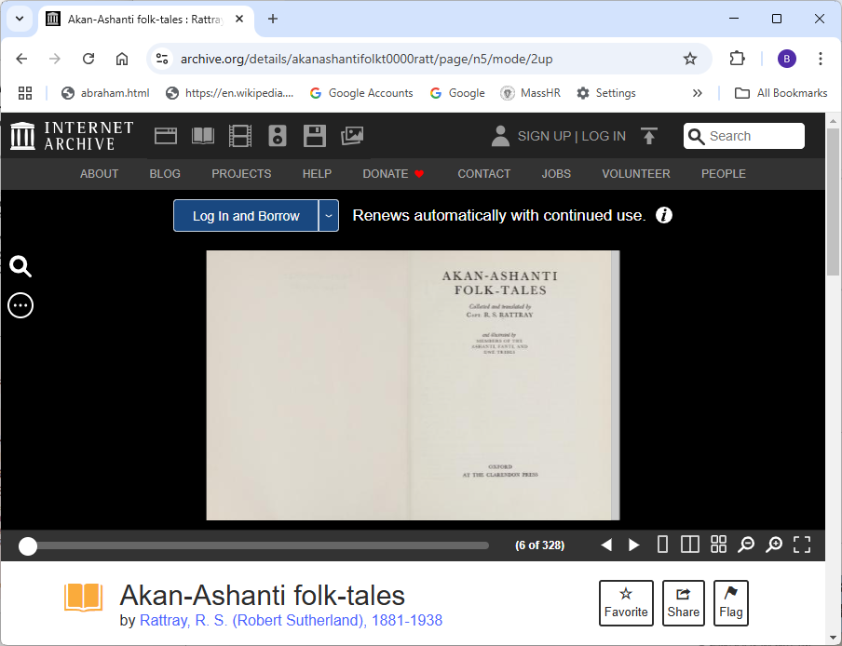
Demo Source Material:
https://archive.org/details/akanashantifolkt0000ratt/page/n5/mode/2up

Slide 2
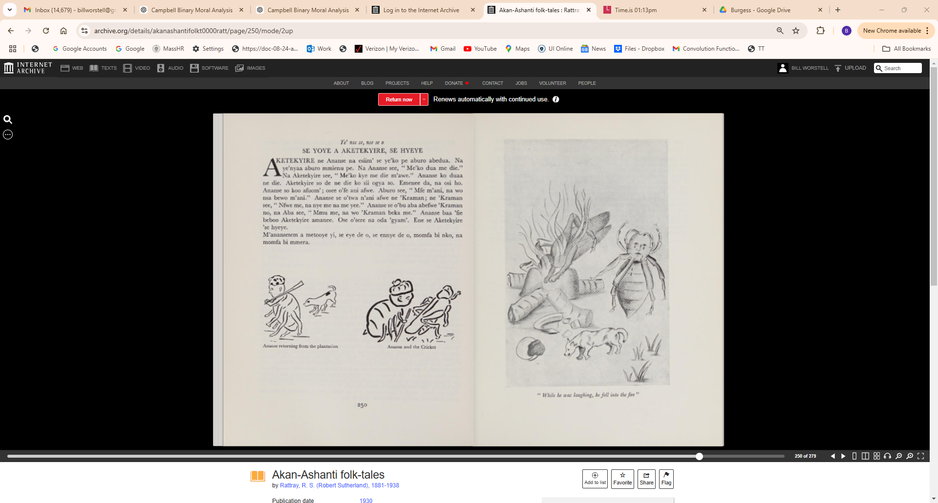

Slide 3
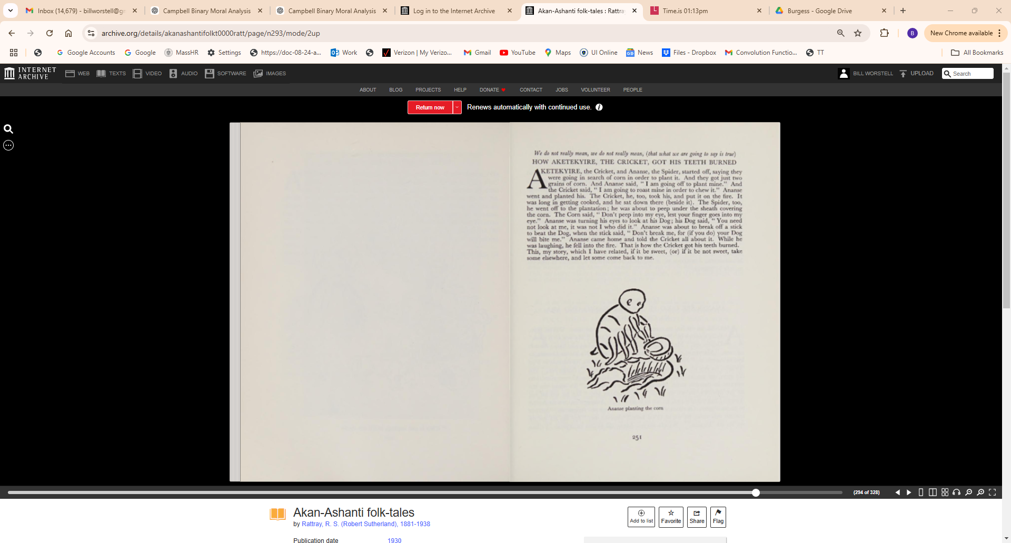

Slide 4
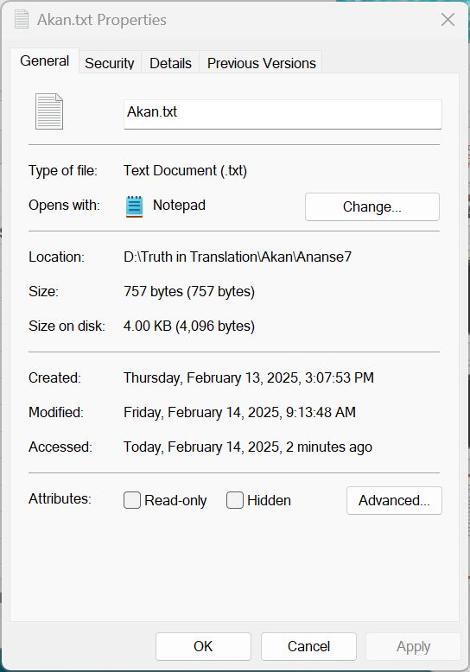
Te' nse se, nse se o
SE YOYE A AKETEKYIRE, SE HYEYE
AKETEKYIRE ne Ananse na esiim' se ye'ko pe aburo abedua. Na ye'nyaa aburo mmienu pe. Na Ananse see, "Me'ko dua me die."
Na Aketekyire see, "Me'ko kye me die m'awe." Ananse ko duaa ne die. Aketekyire so de ne die ko sii ogya so. Emenee da, na osi ho. Ananse so koo afuom'; osee o'fe ani afwe. Aburo see, " Mfe m'ani, na wo nsa bewo m'ani." Ananse se o'twa n'ani afwe ne 'Kraman; ne 'Kraman see, " Nfwe me, na nye me name yee." Ananse se o'bu aha abefwe 'Kraman no, na Aha see, "Mmu me, na wo 'Kraman beka me." Ananse baa 'fie beboo Aketekyire amanee. Ose o'sere na oda 'gyam'. Ene se Aketekyire 'se hyeye.
M'anansesem a metooye yi, se eye de o, se ennye de o, momfa bi nko, na momfa bi mmera.

Slide 5
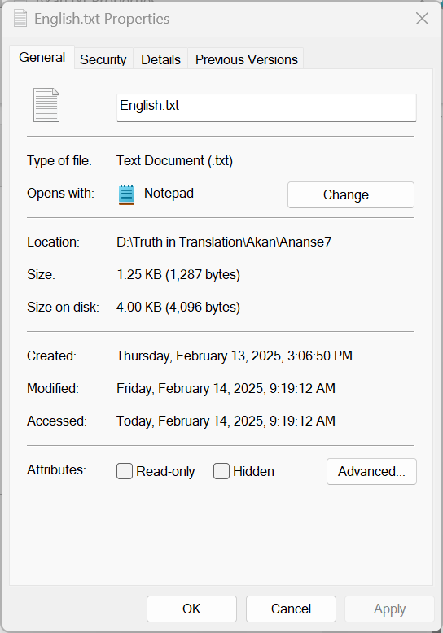
We do not really mean, we do not really mean, (that what we are going to say is true)
HOW AKETEKYIRE, THE CRICKET, GOT HIS TEETH BURNED AETEKYIRE, the Cricket, and Ananse, the Spider, started off, saying they
were going in search of corn in order to plant it. And they got just two
grains of corn. And Ananse said, " I am going off to plant mine." And
the Cricket said, " I am going to roast mine in order to chew it." Ananse
went and planted his. The Cricket, he, too, took his, and put it on the fire. It
was long in getting cooked, and he sat down there (beside it). The Spider, too,
he went off to the plantation; he was about to peep under the sheath covering
the corn. The Corn said, " Don't peep into my eye, lest your finger goes into my
eye." Ananse was turning his eyes to look at his Dog; his Dog said, "You need
not look at me, it was not I who did it." Ananse was about to break off a stick
to beat the Dog, when the stick said, "Don't break me, for (if you do) your Dog
will bite me." Ananse came home and told the Cricket all about it. While he
was laughing, he fell into the fire. That is how the Cricket got his teeth burned.
This, my story, which I have related, if it be sweet, (or) if it be not sweet, take
some elsewhere, and let some come back to me.

Slide 6
AKAN | ENGLISH
Ye' nse se, nse se | We do not really mean, we do not really mean, (that what we are going to say is true)
SE YOYE A AKETEKYIRE, SE HYEYE | HOW AKETEKYIRE, THE CRICKET, GOT HIS TEETH BURNED
AKETEKYIRE ne Ananse na esiim' se ye'ko pe aburo abedua. | AETEKYIRE, the Cricket, and Ananse, the Spider, started off, saying they were going in search of corn in order to plant it.
Na ye'nyaa aburo mmienu pe. | And they got just two grains of corn. And Ananse said, " I am going off to plant mine."
Na Ananse see, "Me'ko dua me die." | And the Cricket said, " I am going to roast mine in order to chew it."
t Na Aketekyire see, "Me'ko kye me die m'awe." | Ananse went and planted his.
Ananse ko duaa ne die. | The Cricket, he, too, took his, and put it on the fire.
Aketekyire so de ne die ko sii ogya so. | It was long in getting cooked, and he sat down there (beside it).
Emenee da, na osi ho. | The Spider, too, he went off to the plantation; he was about to peep under the sheath covering the corn.
Ananse so koo afuom'; osee o'fe ani afwe. | The Corn said, " Don't peep into my eye, lest your finger goes into my eye."
Aburo see, "Mfe m'ani, na wo nsa bewo m'ani." | Ananse was turning his eyes to look at his Dog;
Ananse se o'twa n'ani afwe ne 'Kraman; ne 'Kraman see, "Nfwe me, na nye me na me yee." | his Dog said, "You need not look at me, it was not I who did it."
Ananse se o'bu aba abefwe 'Kraman no, na Aba see, " Mmu me, na wo 'Kraman beka me." | Ananse was about to break off a stick to beat the Dog, when the stick said, "Don't break me, for (if you do) your Dog will bite me."
Ananse baa 'fie beboo Aketekyire amanee. | Ananse came home and told the Cricket all about it.
Ose o'sere na oda 'gyam'. | While he was laughing, he fell into the fire.
Ene se Aketekyire 'se hyeye. | That is how the Cricket got his teeth burned.
M'anansesem a metooye yi, se eye de o, se ennye de o, momfa bi nko, na. momfa bi mmera. | This, my story, which I have related, if it be sweet, (or) if it be not sweet, take some elsewhere, and let some come back to me.

Slide 7
