Slide 1
Mexican10
The Legend of Juan Tul

Slide 2
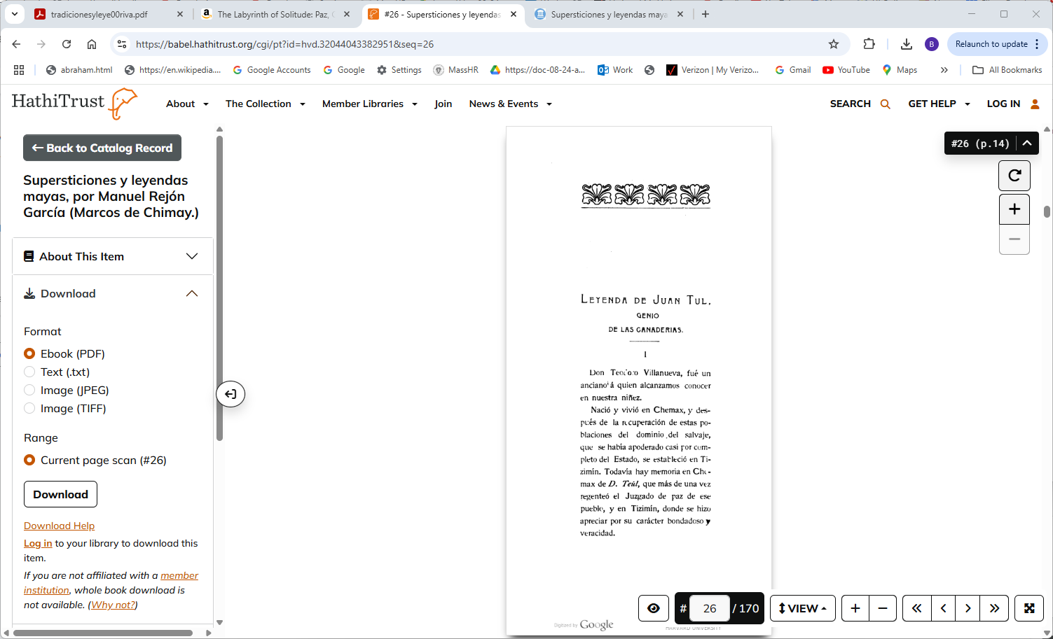
https://babel.hathitrust.org/cgi/pt?id=hvd.32044043382951&seq=26

