Slide 1
Mexican2
The Weeping Woman

Slide 2
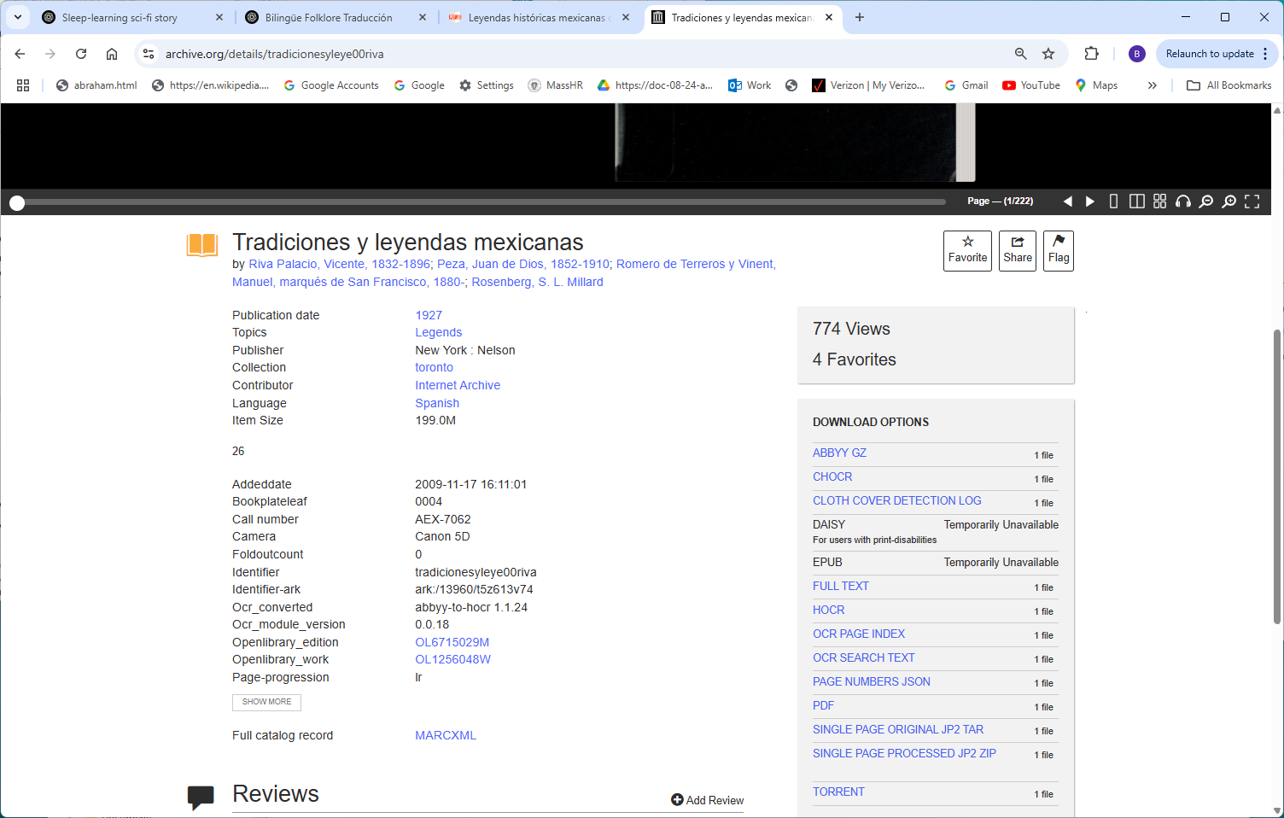
https://archive.org/details/tradicionesyleye00riva

Slide 3
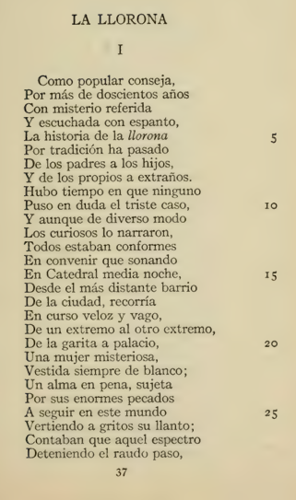
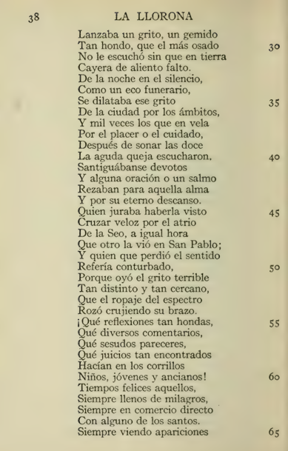
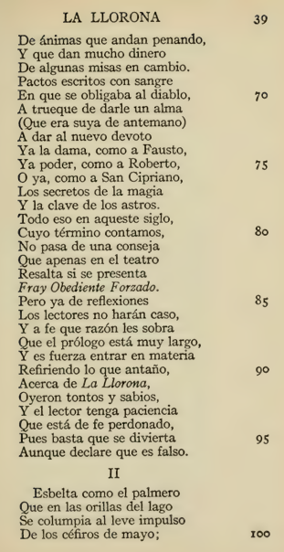

Slide 4
