Slide 1
Mexican3
La Virgen de Guadalupe

Slide 2
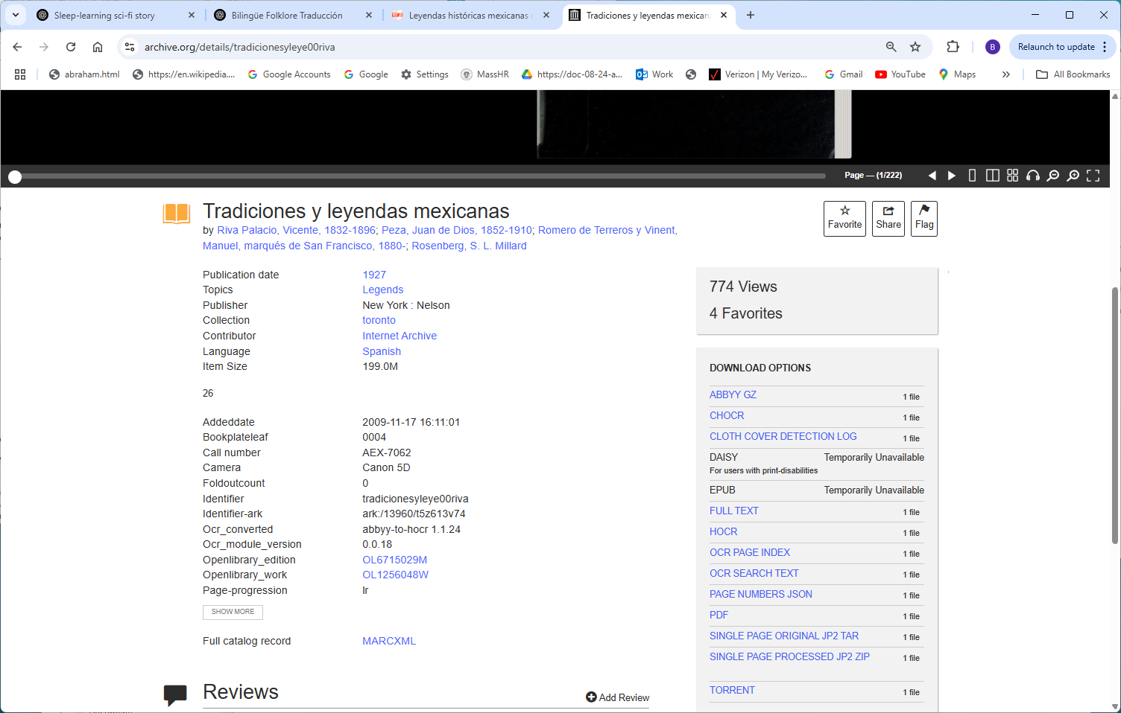
https://archive.org/details/tradicionesyleye00riva

Slide 3
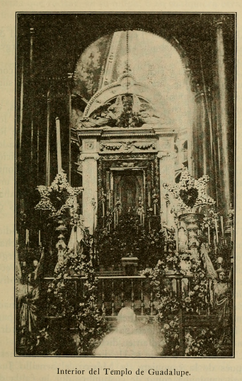
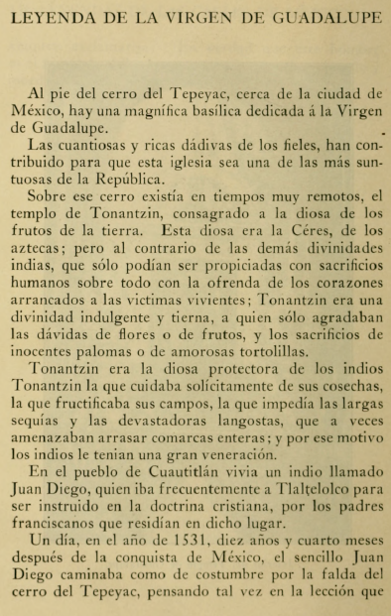

Slide 4
