Slide 1
Mexican4
The Eagle Knight and the Jaguar Knight.

Slide 2
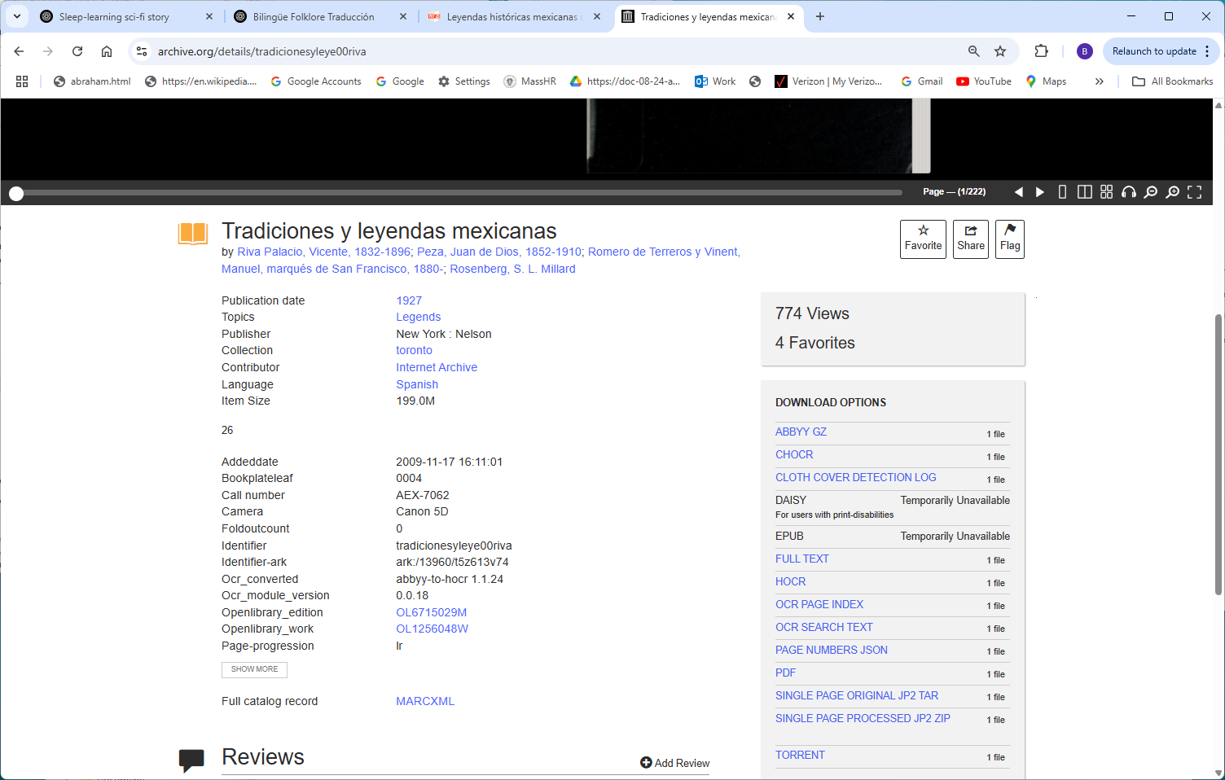
https://archive.org/details/tradicionesyleye00riva

Slide 3
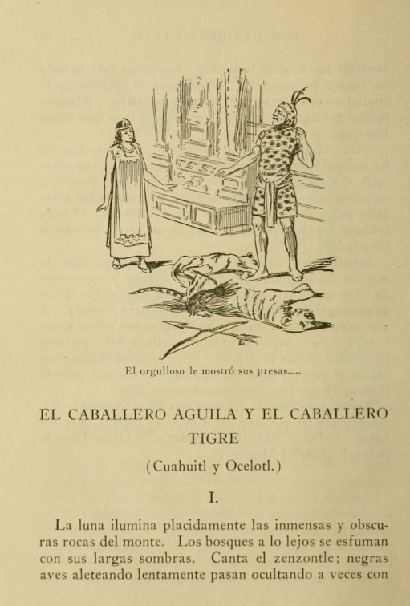
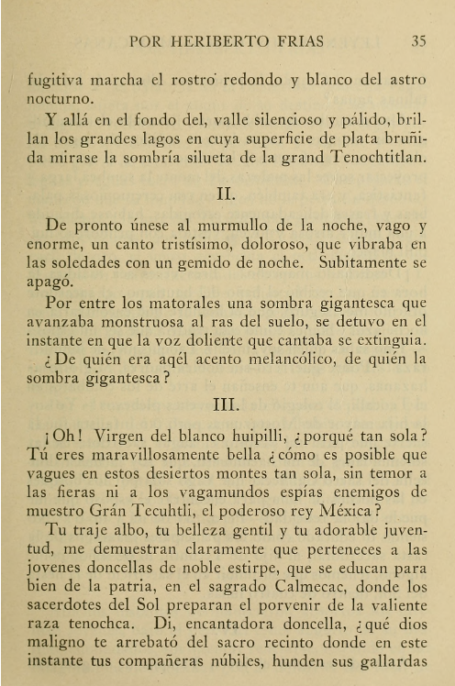

Slide 4
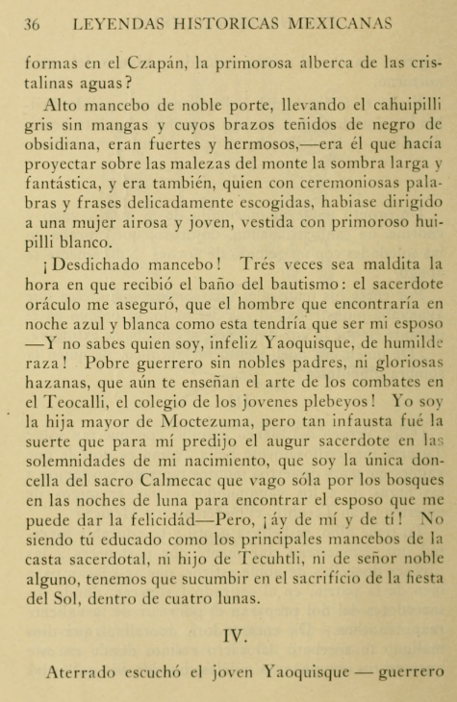
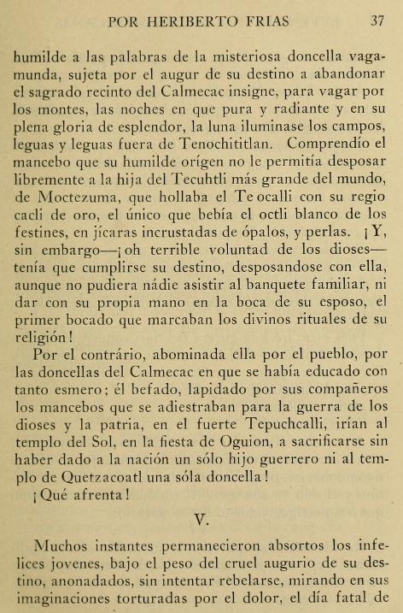

Slide 5
