Slide 1
Mexican5
Ahuizotl, Symbol of Horror.

Slide 2
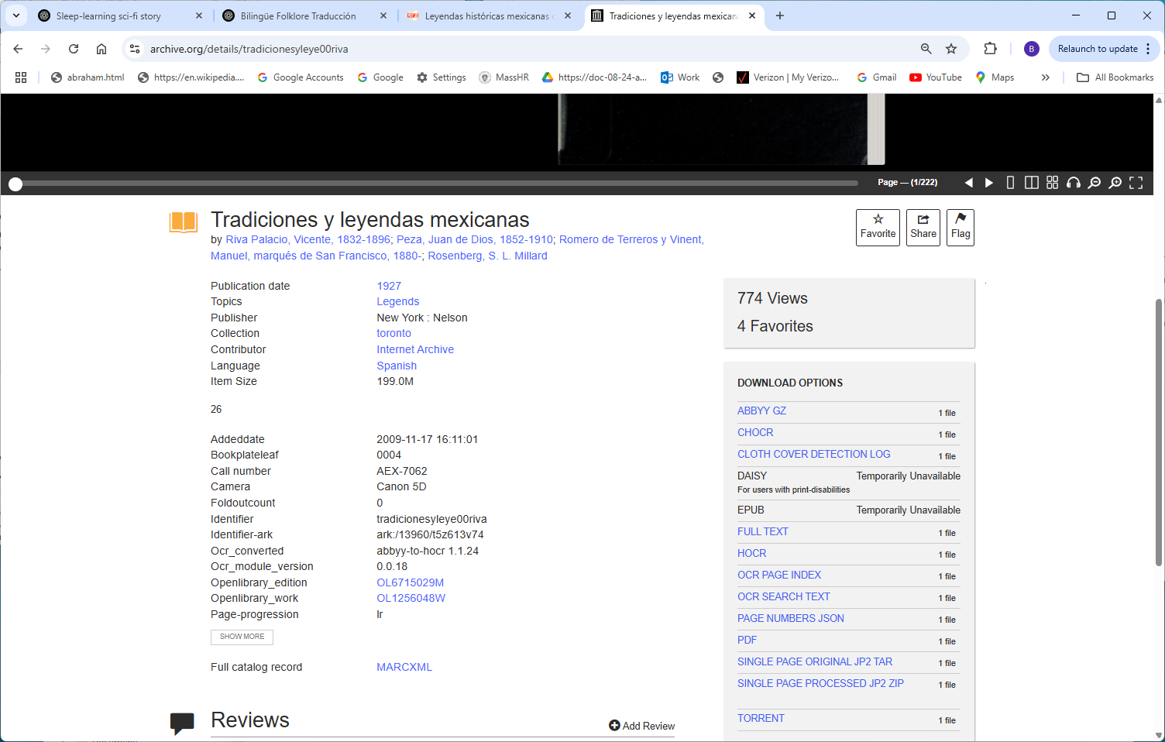
https://archive.org/details/tradicionesyleye00riva

Slide 3
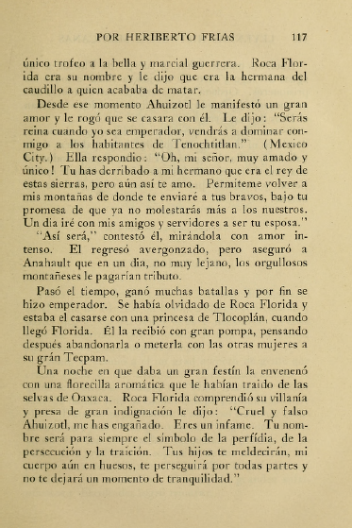

Slide 4
