Slide 1
Mexican7
The Alley of the Armed Man

Slide 2
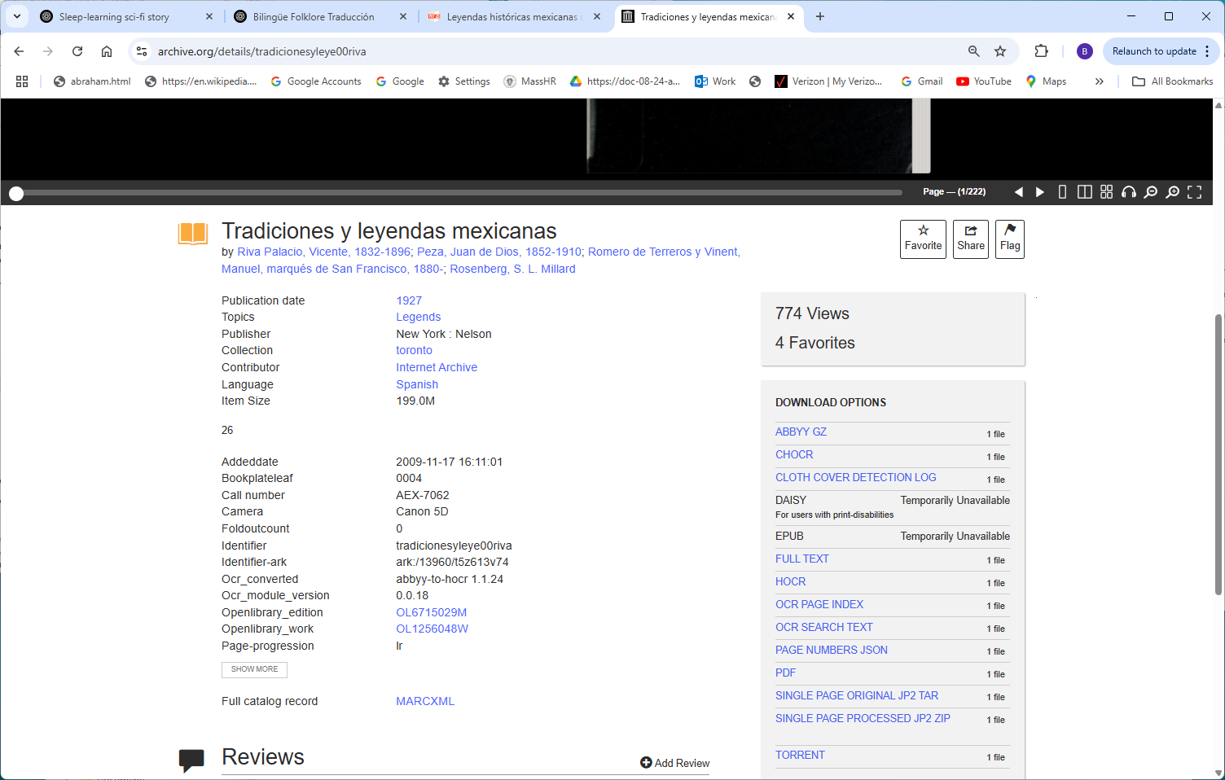
https://archive.org/details/tradicionesyleye00riva

Slide 3
