Slide 1
Mexican8
The Obedient Nun

Slide 2
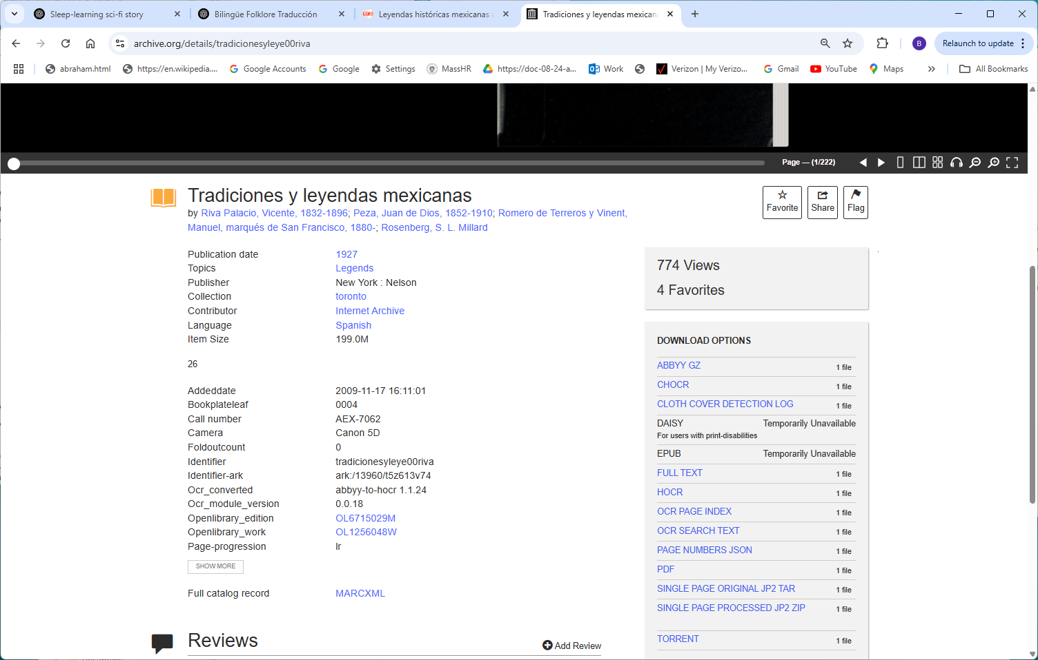
https://archive.org/details/tradicionesyleye00riva

Slide 3
