Slide 1
Mexican9
Alvarado’s Leap

Slide 2
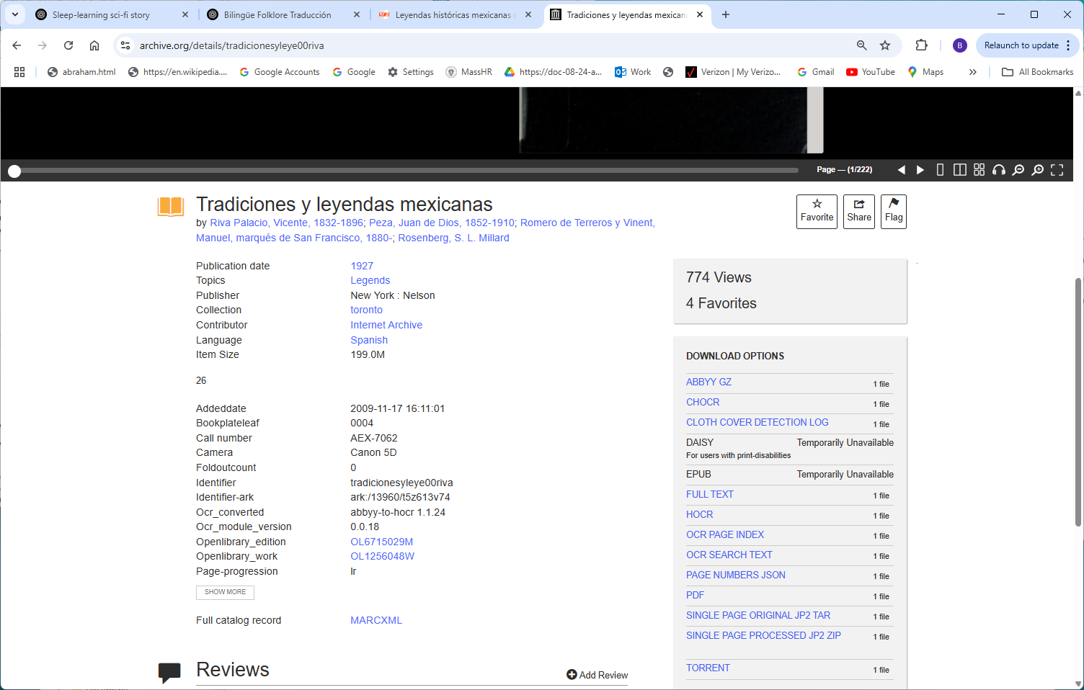
https://archive.org/details/tradicionesyleye00riva

Slide 3
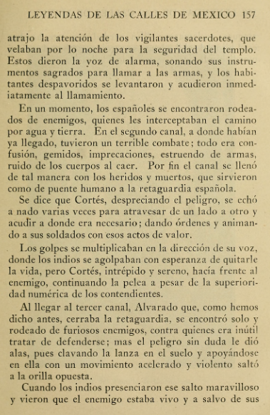
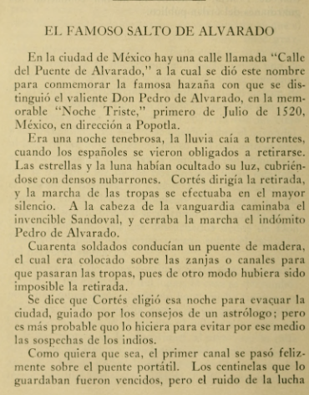

Slide 4


