Slide 1
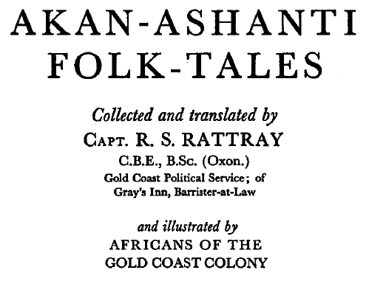
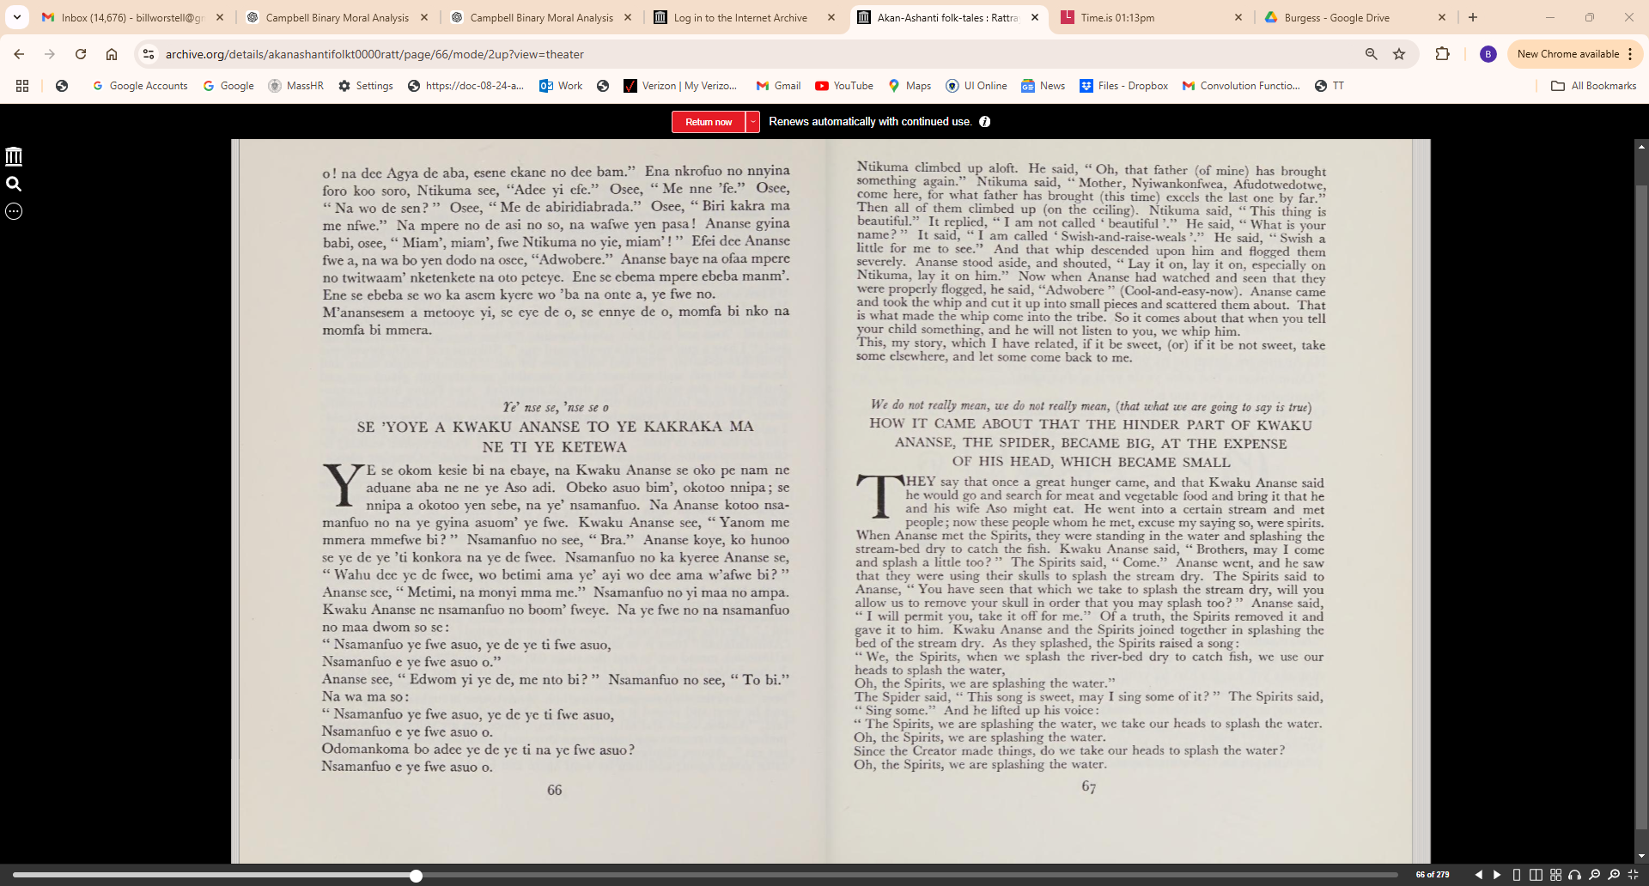

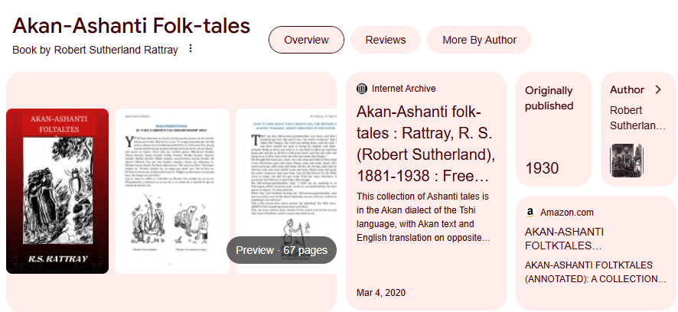
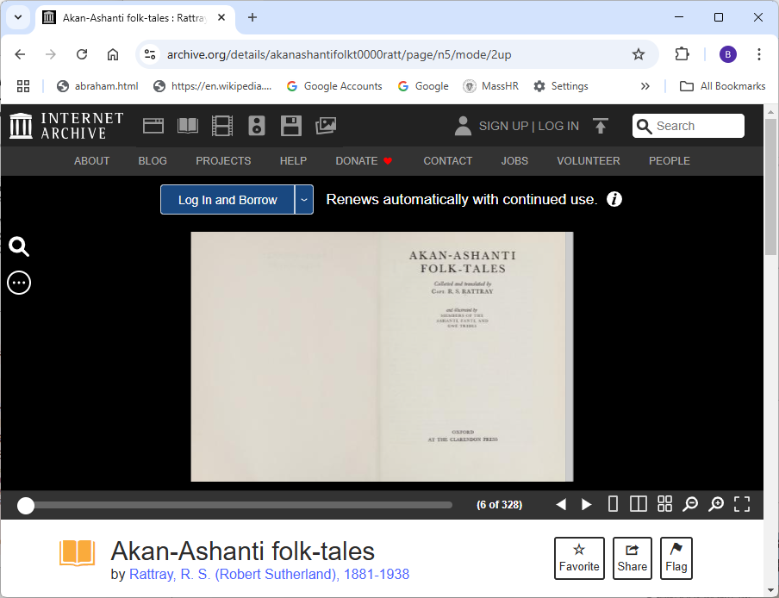
Demo Source Material:
https://archive.org/details/akanashantifolkt0000ratt/page/n5/mode/2up

Slide 2
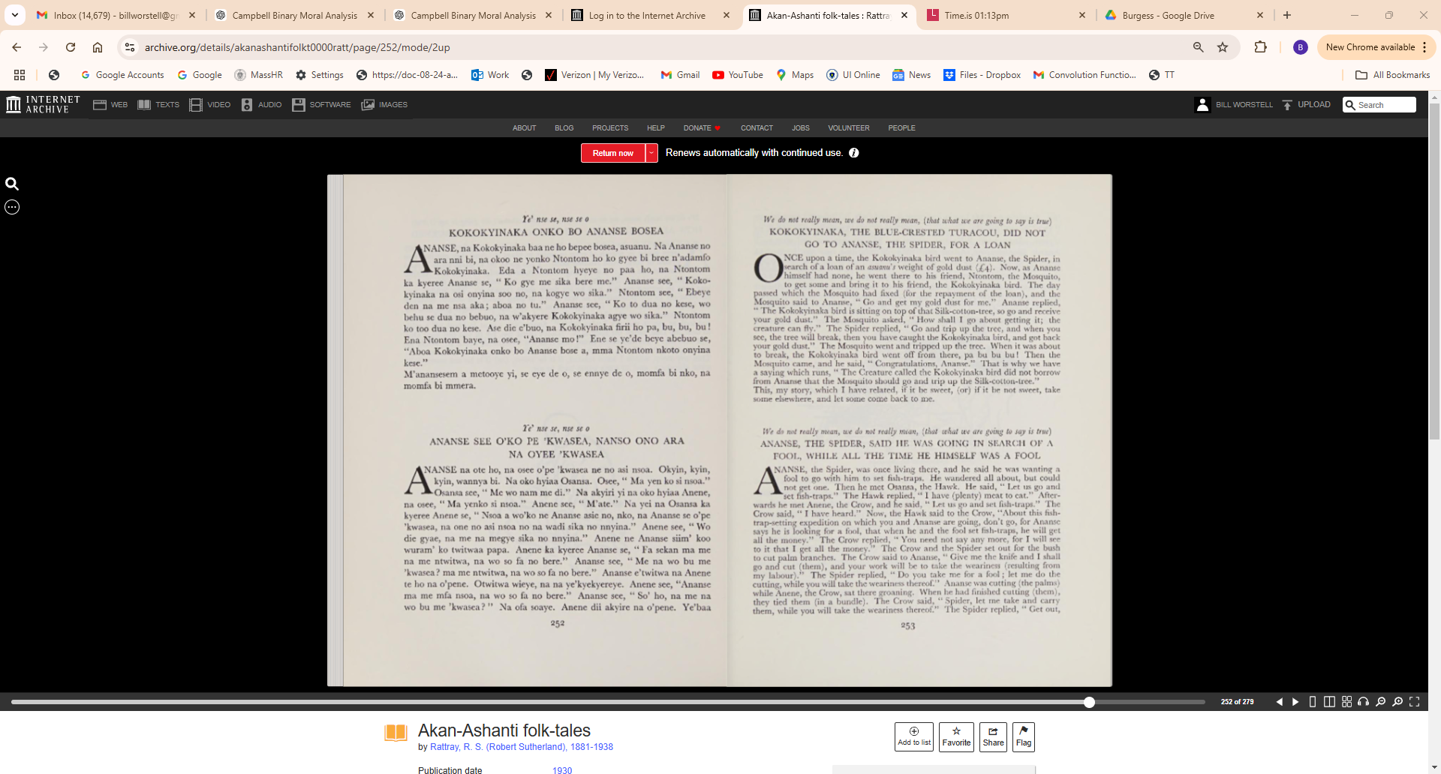

Slide 3
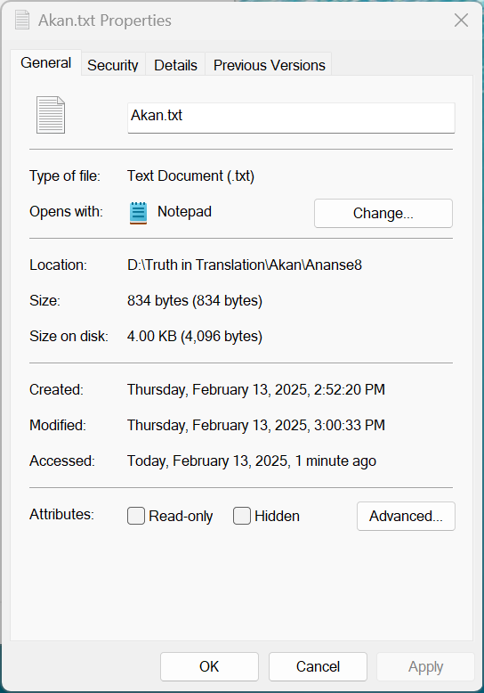
Ye' nse se, nse se o
KOKOKYINAKA ONKO BO ANANSE BOSEA
ANANSE, na Kokokyinaka baa ne ho bepee bosea, asuanu. Na Ananse no
ara nni bi, na okoo ne yonko Ntontom ho ko gyee bi bree n'adamfo
I Kokokyinaka. Eda a Ntontom hyeye no paa ho, na Ntontom
ka kyeree Ananse se, " Ko gye me sika bere me." Ananse see, " Koko
kyinaka na osi onyina soo no, na kogye wo sika." Ntontom see, "Ebeye
den na me nsa aka; aboa no tu." Ananse see, " Ko to dua no kese, wo
behu se dua no bebuo, na w'akyere Kokokyinaka agye wo sika." Ntontom
ko too dua no kese. Ase die e'buo, na Kokokyinaka firii ho pa, bu, bu, bu!
Ena Ntontom baye, na osee, "Ananse mo !" Ene se ye'de beye abebuo se,
"Aboa Kokokyinaka onko bo Ananse bose a, mma Ntontom nkoto onyina
kese."
M'anansesem a metooye yi, se eye de o, se ennye de o, momfa bi nko, na
momfa bi mmera.

Slide 4
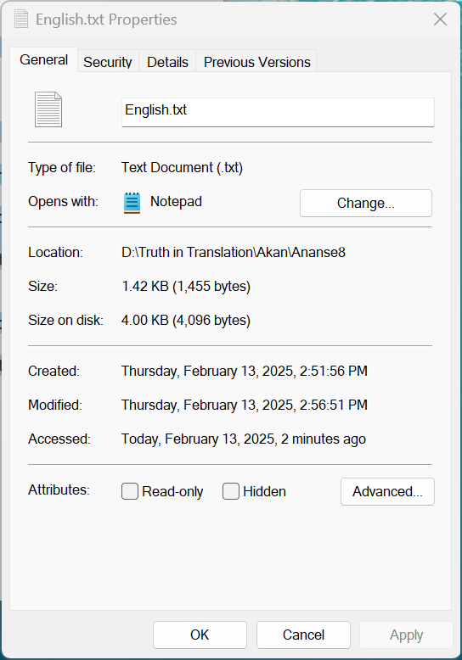
We do not really mean, we do not really mean, (that what we are going to say is true)
KOKOKYINAKA, THE BLUE-CRESTED TURACOU, DID NOT
GO TO ANANSE, THE SPIDER, FOR A LOAN
ONCE upon a time, the Kokokyinaka bird went to Ananse, the Spider, in search of a loan of an asuanu's weight of gold dust (4). Now, as Ananse
himself had none, he went there to his friend, Ntontom, the Mosquito,
to get some and bring it to his friend, the Kokokyinaka bird. The day
passed which the Mosquito had fixed (for the repayment of the loan), and the
Mosquito said to Ananse, " Go and get my gold dust for me." Ananse replied,
"The Kokokyinaka bird is sitting on top of that Silk-cotton-tree, so go and receive
your gold dust." The Mosquito asked, " How shall I go about getting it; the
creature can fly." The Spider replied, " Go and trip up the tree, and when you
see, the tree will break, then you have caught the Kokokyinaka bird, and got back
your gold dust." The Mosquito went and tripped up the tree. When it was about
to break, the Kokokyinaka bird went off from there, pa bu bu bu! Then the
Mosquito came, and he said, " Congratulations, Ananse." That is why we have
a saying which runs, " The Creature called the Kokokyinaka bird did not borrow
from Ananse that the Mosquito should go and trip up the Silk-cotton-tree."
This, my story, which I have related, if it be sweet, (or) if it be not sweet, take
some elsewhere, and let some come back to me.

Slide 5
AKAN | ENGLISH
Ye' nse se, nse se o | We do not really mean, we do not really mean, (that what we are going to say is true)
KOKOKYINAKA ONKO BO ANANSE BOSEA | KOKOKYINAKA, THE BLUE-CRESTED TURACOU, DID NOT GO TO ANANSE, THE SPIDER, FOR A LOAN
ANANSE, na Kokokyinaka baa ne ho bepee bosea, asuanu. | ONCE upon a time, the Kokokyinaka bird went to Ananse, the Spider, in search of a loan of an asuanu's weight of gold dust.
Na Ananse no ara nni bi, na okoo ne yonko Ntontom ho ko gyee bi bree n'adamfo I Kokokyinaka. | Now, as Ananse himself had none, he went there to his friend, Ntontom, the Mosquito, to get some and bring it to his friend, the Kokokyinaka bird.
Eda a Ntontom hyeye no paa ho, na Ntontom ka kyeree Ananse se, " Ko gye me sika bere me." | The day passed which the Mosquito had fixed (for the repayment of the loan), and the Mosquito said to Ananse, " Go and get my gold dust for me."
Ananse see, " Koko kyinaka na osi onyina soo no, na kogye wo sika." | Ananse replied, "The Kokokyinaka bird is sitting on top of that Silk-cotton-tree, so go and receive your gold dust."
Ntontom see, "Ebeye den na me nsa aka; aboa no tu." | The Mosquito asked, " How shall I go about getting it; the creature can fly."
Ananse see, " Ko to dua no kese, wo behu se dua no bebuo, na w'akyere Kokokyinaka agye wo sika." | The Spider replied, " Go and trip up the tree, and when you see, the tree will break, then you have caught the Kokokyinaka bird, and got back your gold dust."
Ntontom ko too dua no kese. | The Mosquito went and tripped up the tree.
Ase die e'buo, na Kokokyinaka firii ho pa, bu, bu, bu! | When it was about to break, the Kokokyinaka bird went off from there, pa bu bu bu!
Ena Ntontom baye, na osee, "Ananse mo !" | Then the Mosquito came, and he said, " Congratulations, Ananse."
Ene se ye'de beye abebuo se, "Aboa Kokokyinaka onko bo Ananse bose a, mma Ntontom nkoto onyina kese." | That is why we have a saying which runs, " The Creature called the Kokokyinaka bird did not borrow from Ananse that the Mosquito should go and trip up the Silk-cotton-tree."
M'anansesem a metooye yi, se eye de o, se ennye de o, momfa bi nko, na momfa bi mmera. | This, my story, which I have related, if it be sweet, (or) if it be not sweet, take some elsewhere, and let some come back to me.

