Slide 1
Grimm01
Der Wolf und die sieben jungen Geißlein
The Wolf and the Seven Young Kids

Slide 2

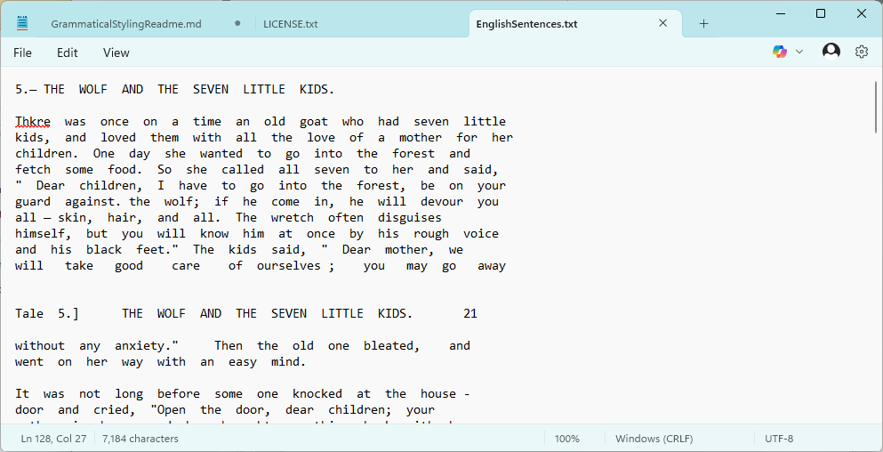

Slide 3
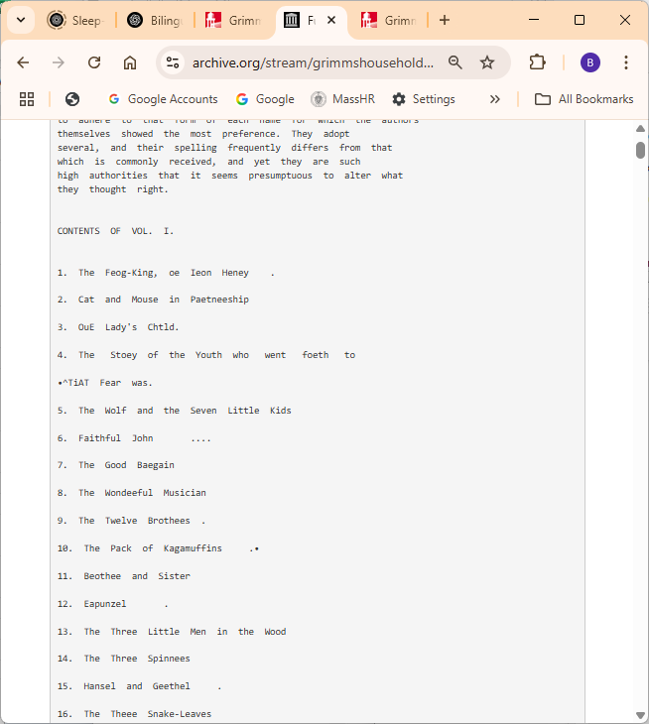
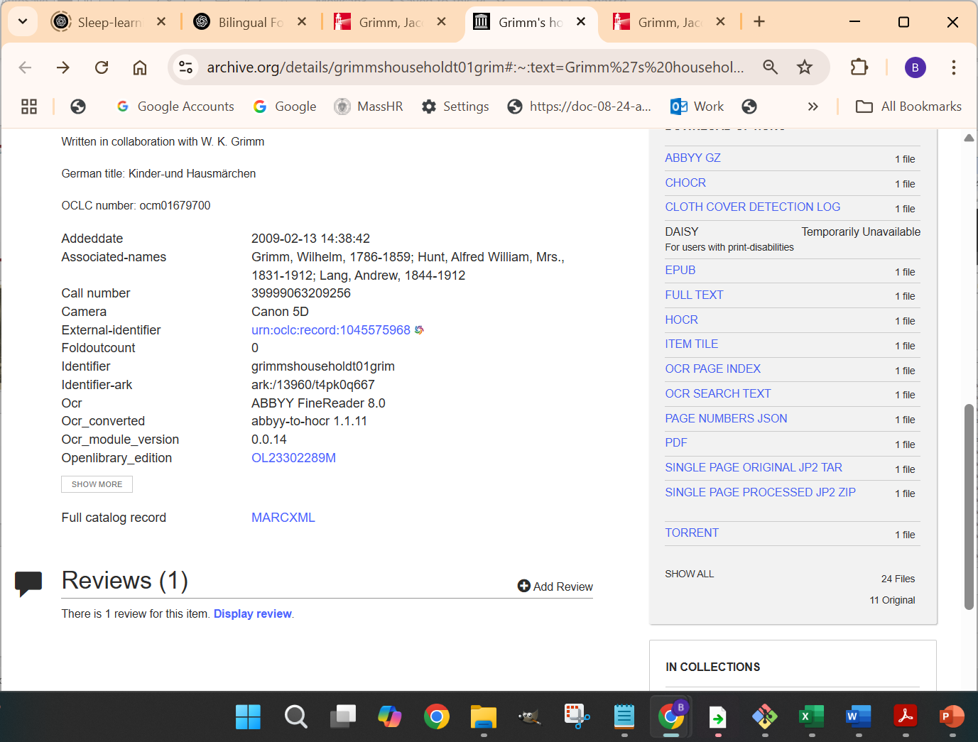
https://archive.org/details/grimmshouseholdt01grim#:~:text=Grimm%27s%20household%20tales%20%3A%20with,Bell%20and%20sons%2C%20limited
https://archive.org/stream/grimmshouseholdt01grim/grimmshouseholdt01grim_djvu.txt

Slide 4
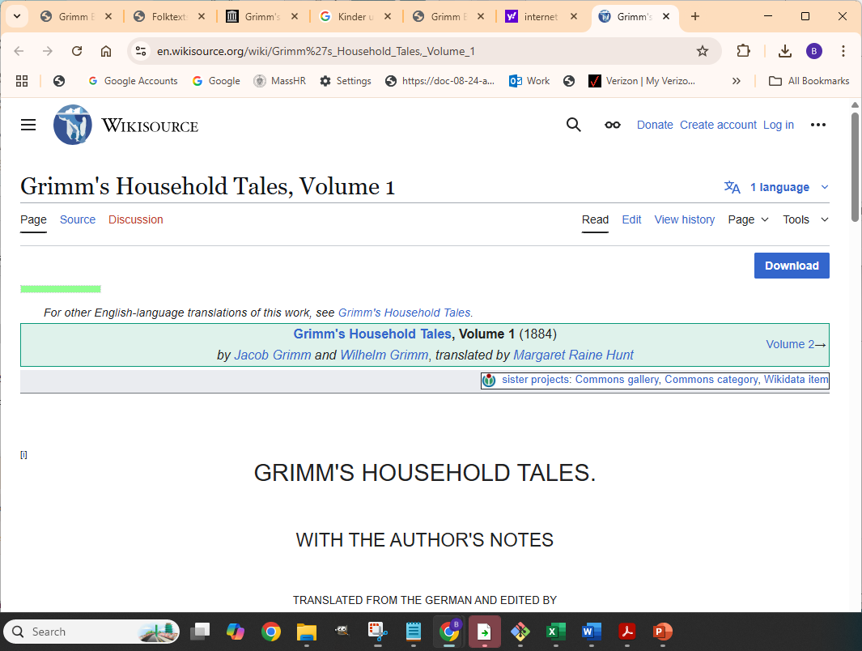
https://en.wikisource.org/wiki/Grimm%27s_Household_Tales,_Volume_1

Slide 5
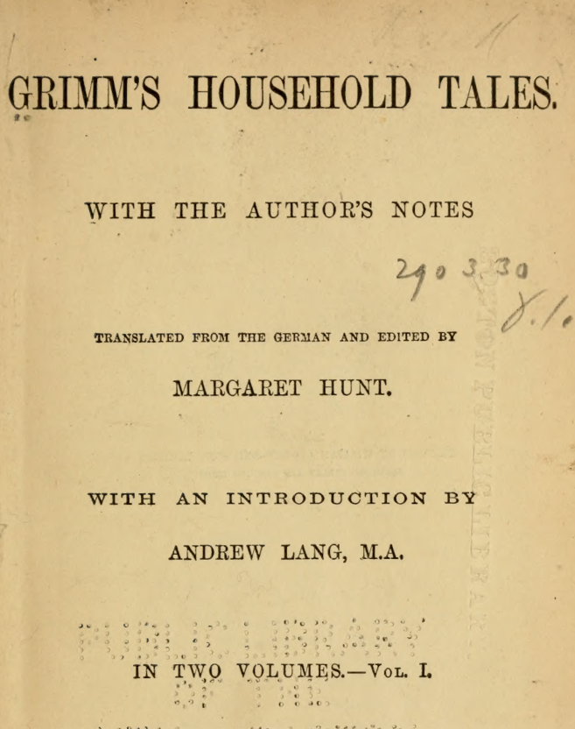

https://dn720305.ca.archive.org/0/items/grimmshouseholdt01grim/grimmshouseholdt01grim.pdf

Slide 6
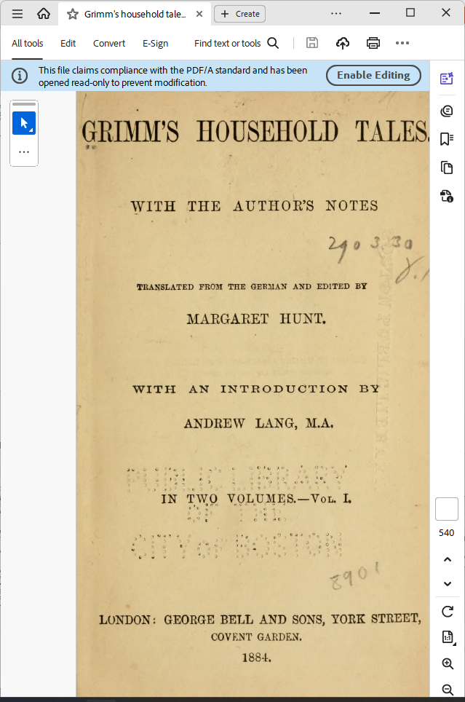
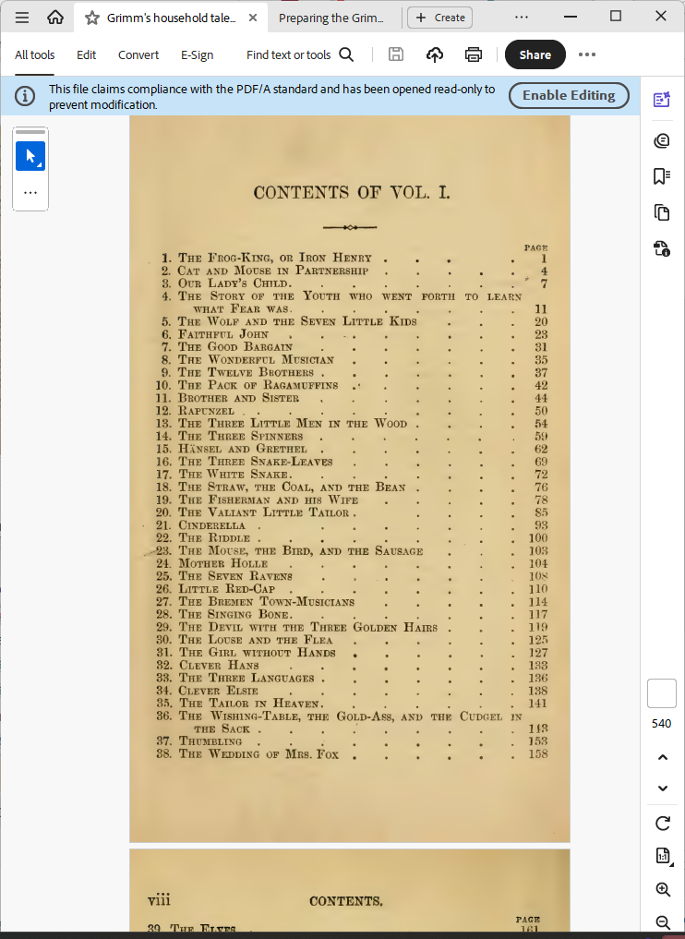
https://archive.org/details/grimmshouseholdt01grim#:~:text=Grimm%27s%20household%20tales%20%3A%20with,Bell%20and%20sons%2C%20limited

Slide 7
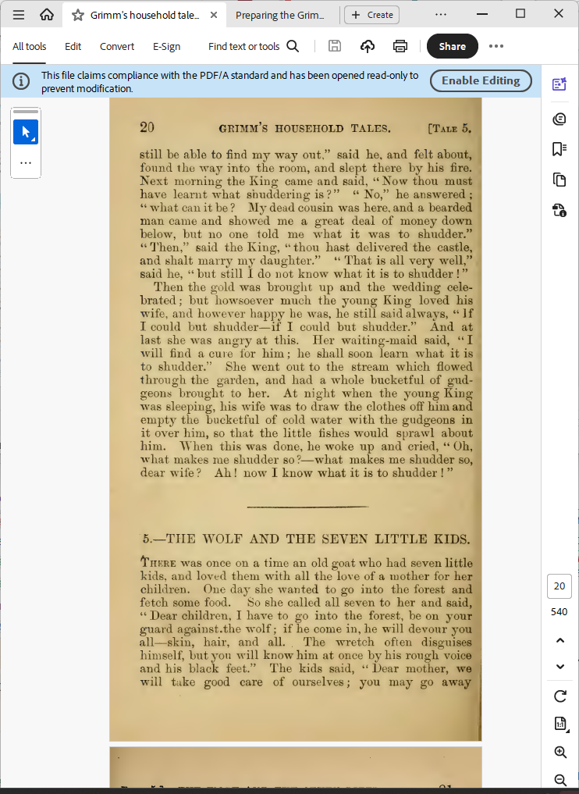
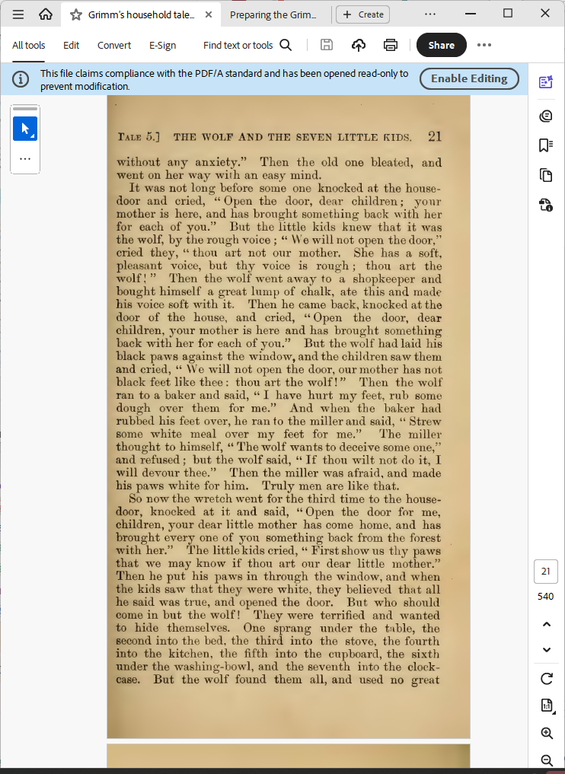

Slide 8
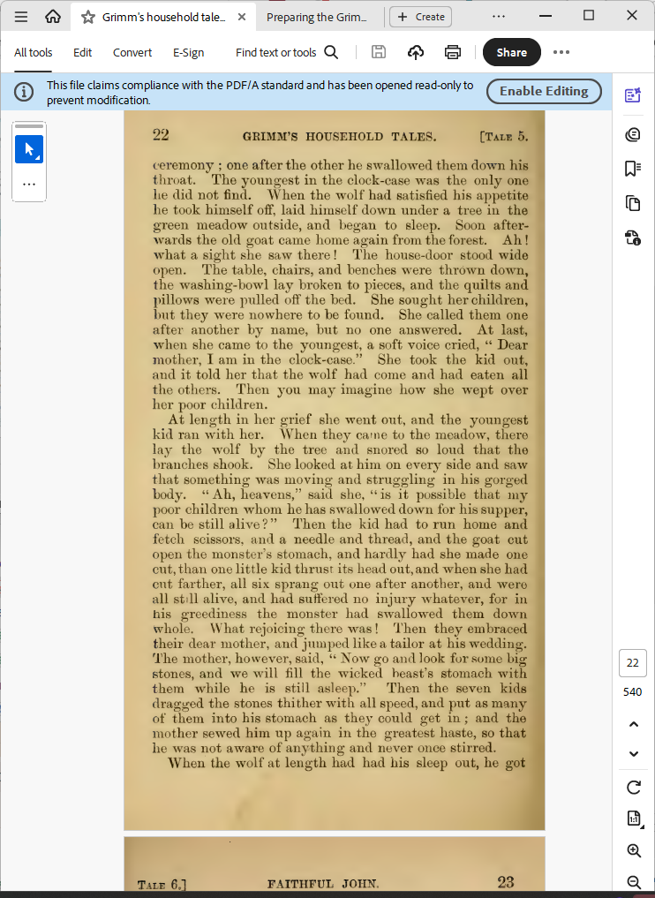
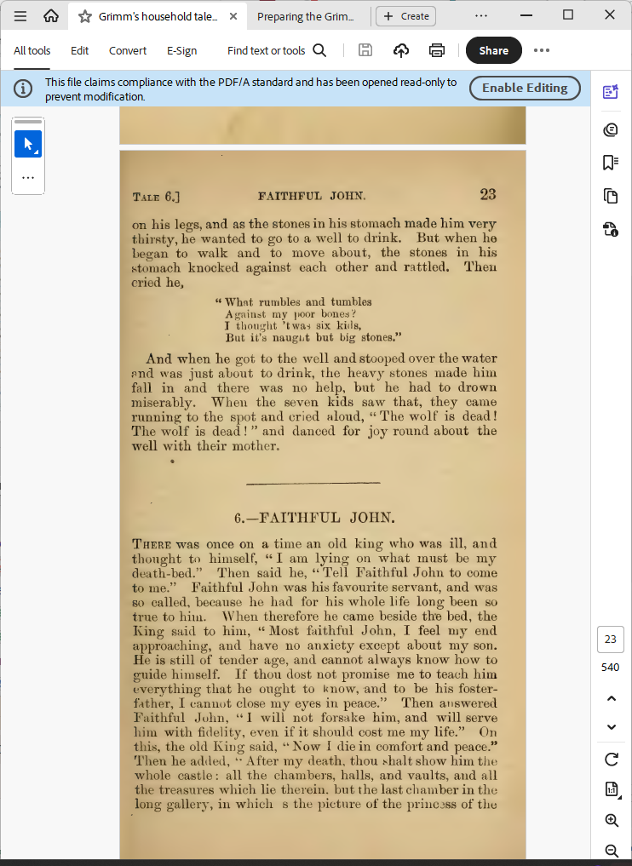

Slide 9
https://archive.org/stream/grimmshouseholdt01grim/grimmshouseholdt01grim_djvu.txt
5.— THE WOLF AND THE SEVEN LITTLE KIDS.
Thkre was once on a time an old goat who had seven little
kids, and loved them with all the love of a mother for her
children. One day she wanted to go into the forest and
fetch some food. So she called all seven to her and said,
" Dear children, I have to go into the forest, be on your
guard against. the wolf; if he come in, he will devour you
all — skin, hair, and all. The wretch often disguises
himself, but you will know him at once by his rough voice
and his black feet." The kids said, " Dear mother, we
will take good care of ourselves ; you may go away
Tale 5.] THE WOLF AND THE SEVEN LITTLE KIDS. 21
without any anxiety." Then the old one bleated, and
went on her way with an easy mind.
It was not long before some one knocked at the house -
door and cried, "Open the door, dear children; your
mother is here, and has brought something back with her
for each of you." But the little kids knew that it was
the wolf, by the rough voice ; " We will not open the door,"
cried they, " thou art not our mother. She has a soft,
pleasant voice, but thy voice is rough ; thou art the
wolf I " Then the wolf went away to a shopkeeper and
bought himself a great lump of chalk, ate this and made
his voice soft with it. Then he came back, knocked at the
door of the house, and cried, " Open the door, dear
children, jour mother is here and has brought something
back with her for each of you." But the wolf had laid his
black paws against the window, and the chiklren saw them
and cried, " We will not open the door, our mother has not
black feet like thee : thou art the wolf! " Then the wolf
ran to a baker and said, " I have hurt my feet, rub some
dough over them for me." And when the baker had
rubbed his feet over, he ran to the miller and said, " Strew
some white meal over my feet for me." The miller
thought to himself, " The wolf wants to deceive some one,"
and refused ; but the wolf said, " If thou wilt not do it, I
will devour thee." Then the miller was afraid, and made
his paws white for him. Truly men are like that.
So now the wretch went for the third time to the house-
door, knocked at it and said, " Open the door for me,
children, your dear little mother has come home, and has
brought every one of you something back from the forest
with her." The little kids cried, " First show us thy paws
that we may know if thou art our dear little mother."
Then he put his paws in through the window, and when
the kids saw that they were white, they believed that all
he said was true, and opened the door. But who should
come in but the wolf! They were terrified and wanted
to hide themselves. One sprang under the table, the
second into the bed, the third into the stove, the fourth
into the kitchen, the fifth into the cupboard, the sixth
under the washing-bowl, and the seventh into the clock-
case. But the wolf found them all, and used no great
22 GRIMM'S HOUSEHOLD TALES. [Tale 5.
ceremony ; one after the other he swallowed them down his
throat. The youngest in the clock-case was the only one
he did not find. When the wolf had satisfied his appetite
he took himself off, laid himself down nnder a tree in the
green meadow outside, and began to sleep. Soon after-
Avards the old goat came home again from the forest. Ah !
what a sight she saw there ! The house-door stood wide
open. The table, chairs, and benches w^ere thrown down,
the washing-bowl lay broken to pieces, and the quilts and
pillows were pulled off the bed. She sought her children,
but they were nowhere to be found. She called them one
after another by name, but no one answered. At last,
when she came to the youngest, a soft voice cried, " Dear
mother, I am in the clock-case." She took the kid out,
and it told her that the wolf had come and had eaten all
the others. Then you may imagine how she wept over
her j)Oor children.
At length in her grief she went out, and the youngest
kid ran with her. When they came to the meadow, there
lay the wolf by the tree and snored so loud that the
branches shook. She looked at him on every side and saw
that something was moving and struggling in his gorged
body. " Ah, heavens," said she, " is it possible that my
j)Oor children whom he has swallowed down for his supper,
can be still alive?" Then the kid had to run home and
fetch scissors, and a needle and thread, and the goat cut
open the monster's stomach, and hardly had she made one
cut, than one little kid thrust its head out, and when she had
cut farther, all six sprang out one after another, and were
all still alive, and had suffered no injury whatever, for in
his greediness the monster had swallowed them down
whole. What rejoicing there was ! Then they embraced
their dear mother, and jumped like a tailor at his wedding.
The mother, however, said, " Now go and look for some bigj
stones, and we will fill the wicked beast's stomach with!
them Avhile he is still asleep." Then the seven kidsj
dragged the stones thither with all speed, and put as many]
of them into his stomach as they could get in ; and the!
mother sewed him up again in the greatest haste, so thatj
he was not aware of anything and never once stirred.
When the wolf at length had had his sleep out, he gotj
Tale 6.] FAITHFUL JOHN. 23
on his legs, and as the stones in his stomach made him very-
thirsty, he wanted to go to a well to drink. But when he
began to walk and to move about, the stones in his
stomach knocked against each other and rattled. Then
cried he,
" Whnt rumbles and tumbles
Ai^ainst my poor bones V
I tlioui^iit 'twas six kids,
But it's naught but big stones."
And when he got to the well and stooped over the water
f>nd was just about to drink, the heavy stones made him
fall in and there was no help, but he had to drown
miserably. When the seven kids saw that, they came
running to the spot and cried aloud, "The wolf is dead!
The wolf is dead ! " and danced for joy round about the
Avell with their mother

Slide 10
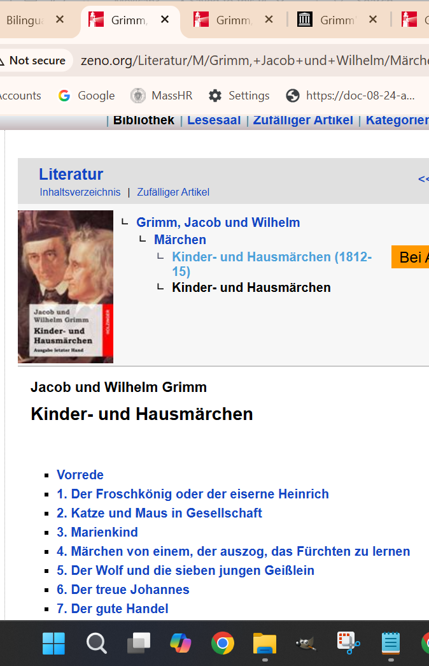
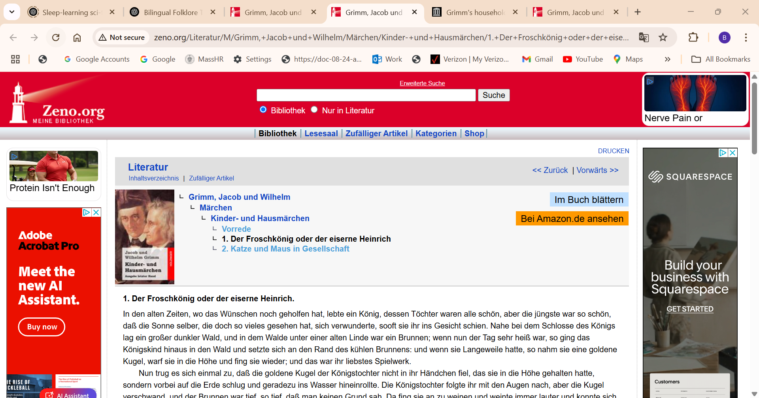
http://www.zeno.org/Literatur/M/Grimm,+Jacob+und+Wilhelm/M%C3%A4rchen/Kinder-+und+Hausm%C3%A4rchen
http://www.zeno.org/Literatur/M/Grimm,+Jacob+und+Wilhelm/M%C3%A4rchen/Kinder-+und+Hausm%C3%A4rchen/1.+Der+Froschk%C3%B6nig+oder+der+eiserne+Heinrich

Slide 11
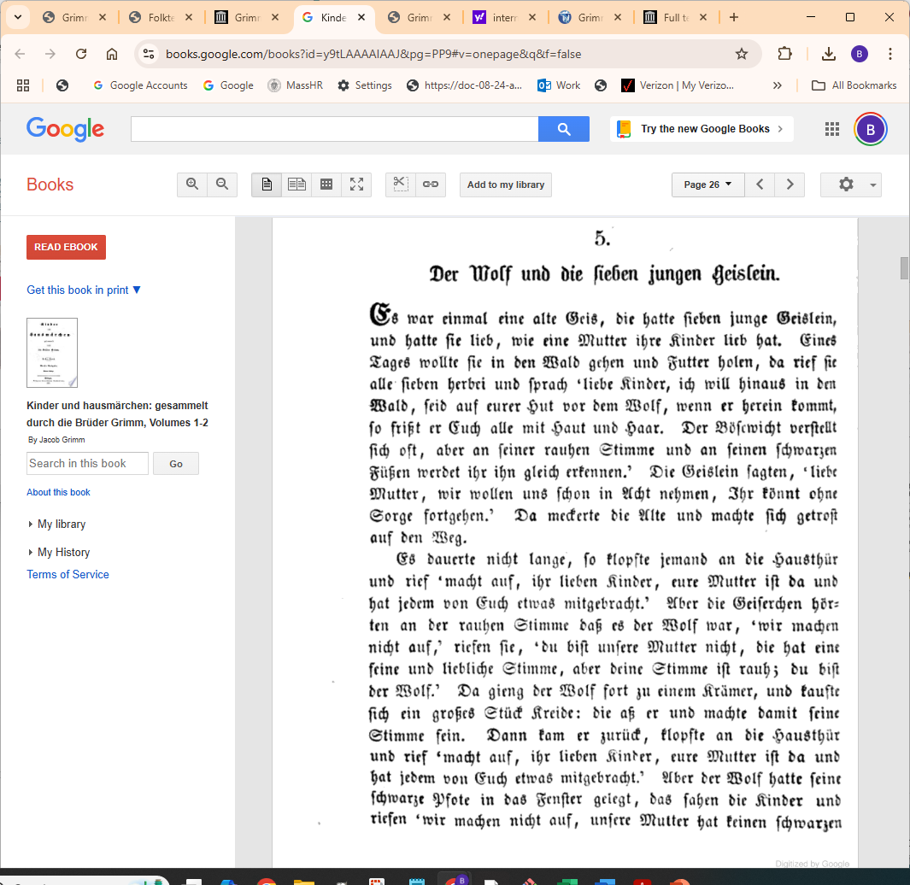
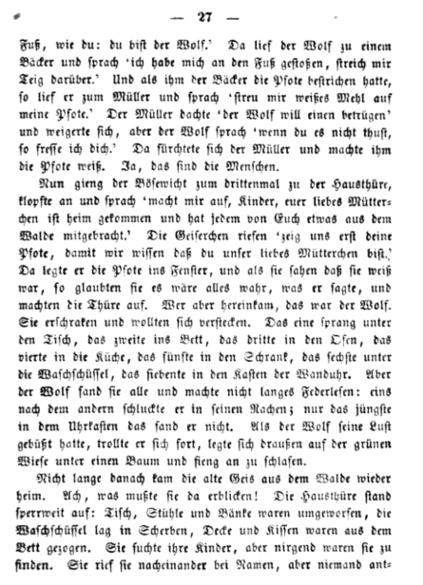
https://books.google.com/books?id=y9tLAAAAIAAJ&pg=PA1#v=onepage&q&f=false

Slide 12
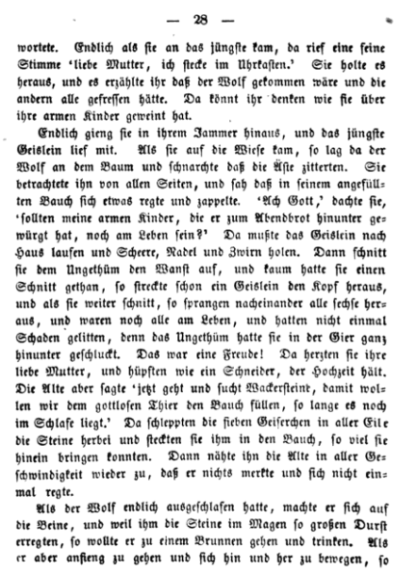
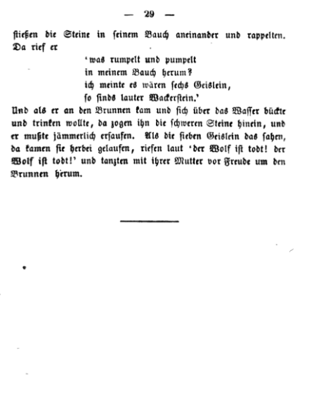

Slide 13
https://archive.org/stream/grimmshouseholdt01grim/grimmshouseholdt01grim_djvu.txt
5.— THE WOLF AND THE SEVEN LITTLE KIDS. There was once on a time an old goat who had seven little kids, and loved them with all the love of a mother for her children. One day she wanted to go into the forest and fetch some food. So she called all seven to her and said, " Dear children, I have to go into the forest, be on your guard against. the wolf; if he come in, he will devour you all — skin, hair, and all. The wretch often disguises himself, but you will know him at once by his rough voice and his black feet." The kids said, " Dear mother, we will take good care of ourselves ; you may go away without any anxiety." Then the old one bleated, and went on her way with an easy mind. It was not long before some one knocked at the house - door and cried, "Open the door, dear children; your mother is here, and has brought something back with her for each of you." But the little kids knew that it was the wolf, by the rough voice ; " We will not open the door," cried they, " thou art not our mother. She has a soft, pleasant voice, but thy voice is rough ; thou art the wolf I " Then the wolf went away to a shopkeeper and bought himself a great lump of chalk, ate this and made his voice soft with it. Then he came back, knocked at the door of the house, and cried, " Open the door, dear children, jour mother is here and has brought something back with her for each of you." But the wolf had laid his black paws against the window, and the children saw them and cried, " We will not open the door, our mother has not black feet like thee : thou art the wolf! " Then the wolf ran to a baker and said, " I have hurt my feet, rub some dough over them for me." And when the baker had rubbed his feet over, he ran to the miller and said, " Strew some white meal over my feet for me." The miller thought to himself, " The wolf wants to deceive some one," and refused ; but the wolf said, " If thou wilt not do it, I will devour thee." Then the miller was afraid, and made his paws white for him. Truly men are like that. So now the wretch went for the third time to the house- door, knocked at it and said, " Open the door for me, children, your dear little mother has come home, and has brought every one of you something back from the forest with her." The little kids cried, " First show us thy paws that we may know if thou art our dear little mother." Then he put his paws in through the window, and when the kids saw that they were white, they believed that all he said was true, and opened the door. But who should come in but the wolf! They were terrified and wanted to hide themselves. One sprang under the table, the second into the bed, the third into the stove, the fourth into the kitchen, the fifth into the cupboard, the sixth under the washing-bowl, and the seventh into the clock- case. But the wolf found them all, and used no great ceremony ; one after the other he swallowed them down his throat. The youngest in the clock-case was the only one he did not find. When the wolf had satisfied his appetite he took himself off, laid himself down under a tree in the green meadow outside, and began to sleep. Soon after- Avards the old goat came home again from the forest. Ah ! what a sight she saw there ! The house-door stood wide open. The table, chairs, and benches were thrown down, the washing-bowl lay broken to pieces, and the quilts and pillows were pulled off the bed. She sought her children, but they were nowhere to be found. She called them one after another by name, but no one answered. At last, when she came to the youngest, a soft voice cried, " Dear mother, I am in the clock-case." She took the kid out, and it told her that the wolf had come and had eaten all the others. Then you may imagine how she wept over her poor children. At length in her grief she went out, and the youngest kid ran with her. When they came to the meadow, there lay the wolf by the tree and snored so loud that the branches shook. She looked at him on every side and saw that something was moving and struggling in his gorged body. " Ah, heavens," said she, " is it possible that my poor children whom he has swallowed down for his supper, can be still alive?" Then the kid had to run home and fetch scissors, and a needle and thread, and the goat cut open the monster's stomach, and hardly had she made one cut, than one little kid thrust its head out, and when she had cut farther, all six sprang out one after another, and were all still alive, and had suffered no injury whatever, for in his greediness the monster had swallowed them down whole. What rejoicing there was ! Then they embraced their dear mother, and jumped like a tailor at his wedding. The mother, however, said, " Now go and look for some big stones, and we will fill the wicked beast's stomach with! them while he is still asleep." Then the seven kids dragged the stones thither with all speed, and put as many] of them into his stomach as they could get in ; and the! mother sewed him up again in the greatest haste, so that he was not aware of anything and never once stirred. When the wolf at length had had his sleep out, he got on his legs, and as the stones in his stomach made him very thirsty, he wanted to go to a well to drink. But when he began to walk and to move about, the stones in his stomach knocked against each other and rattled. Then cried he, " What rumbles and tumbles against my poor bones I thought 'twas six kids, But it's naught but big stones." And when he got to the well and stooped over the water and was just about to drink, the heavy stones made him fall in and there was no help, but he had to drown miserably. When the seven kids saw that, they came running to the spot and cried aloud, "The wolf is dead! The wolf is dead ! " and danced for joy round about the well with their mother

Slide 14
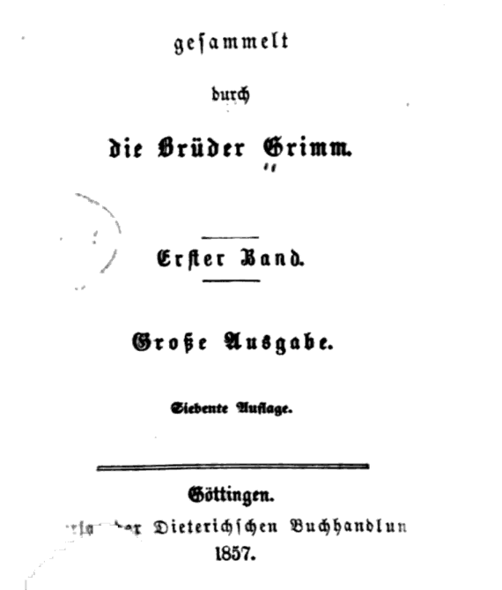
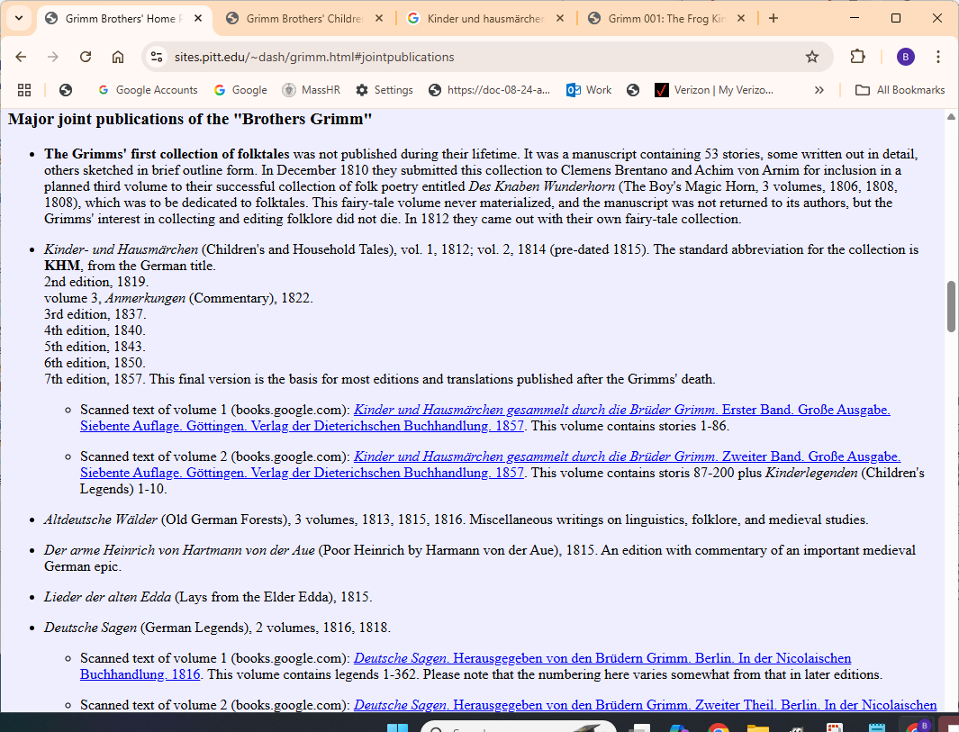
https://sites.pitt.edu/~dash/grimm.html#jointpublications
7th edition, 1857. This final version is the basis for most editions and translations published after the Grimms' death.
Scanned text of volume 1 (books.google.com): Kinder und Hausmärchen gesammelt durch die Brüder Grimm. Erster Band. Große Ausgabe. Siebente Auflage. Göttingen. Verlag der Dieterichschen Buchhandlung. 1857. This volume contains stories 1-86.

Slide 15
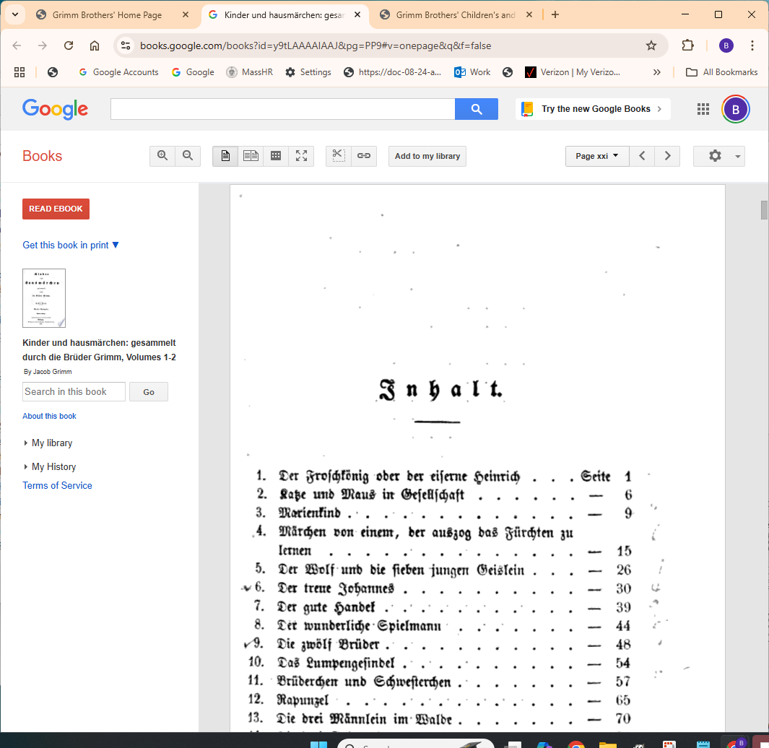
https://books.google.com/books?id=y9tLAAAAIAAJ&pg=PP9#v=onepage&q&f=false

Slide 16

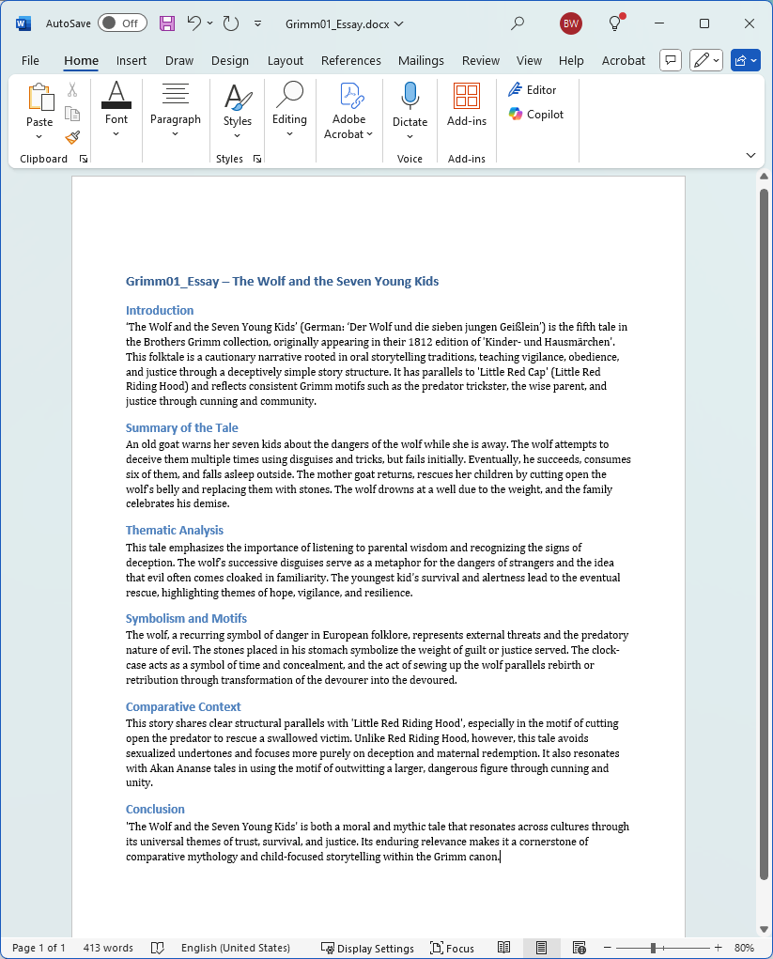

Slide 17
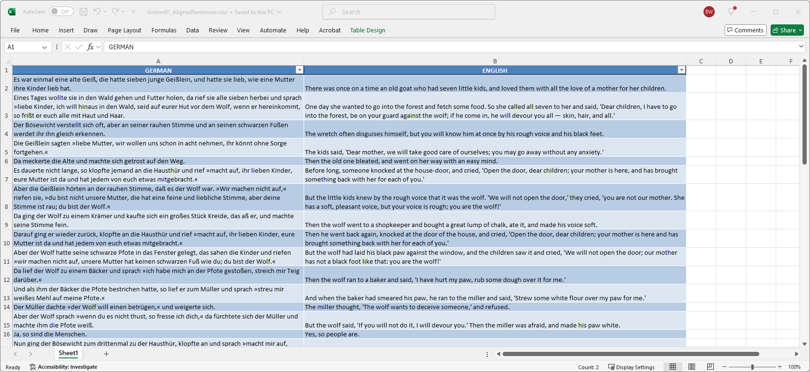

Slide 18
