Slide 1
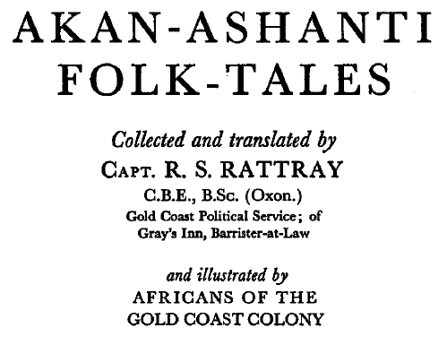
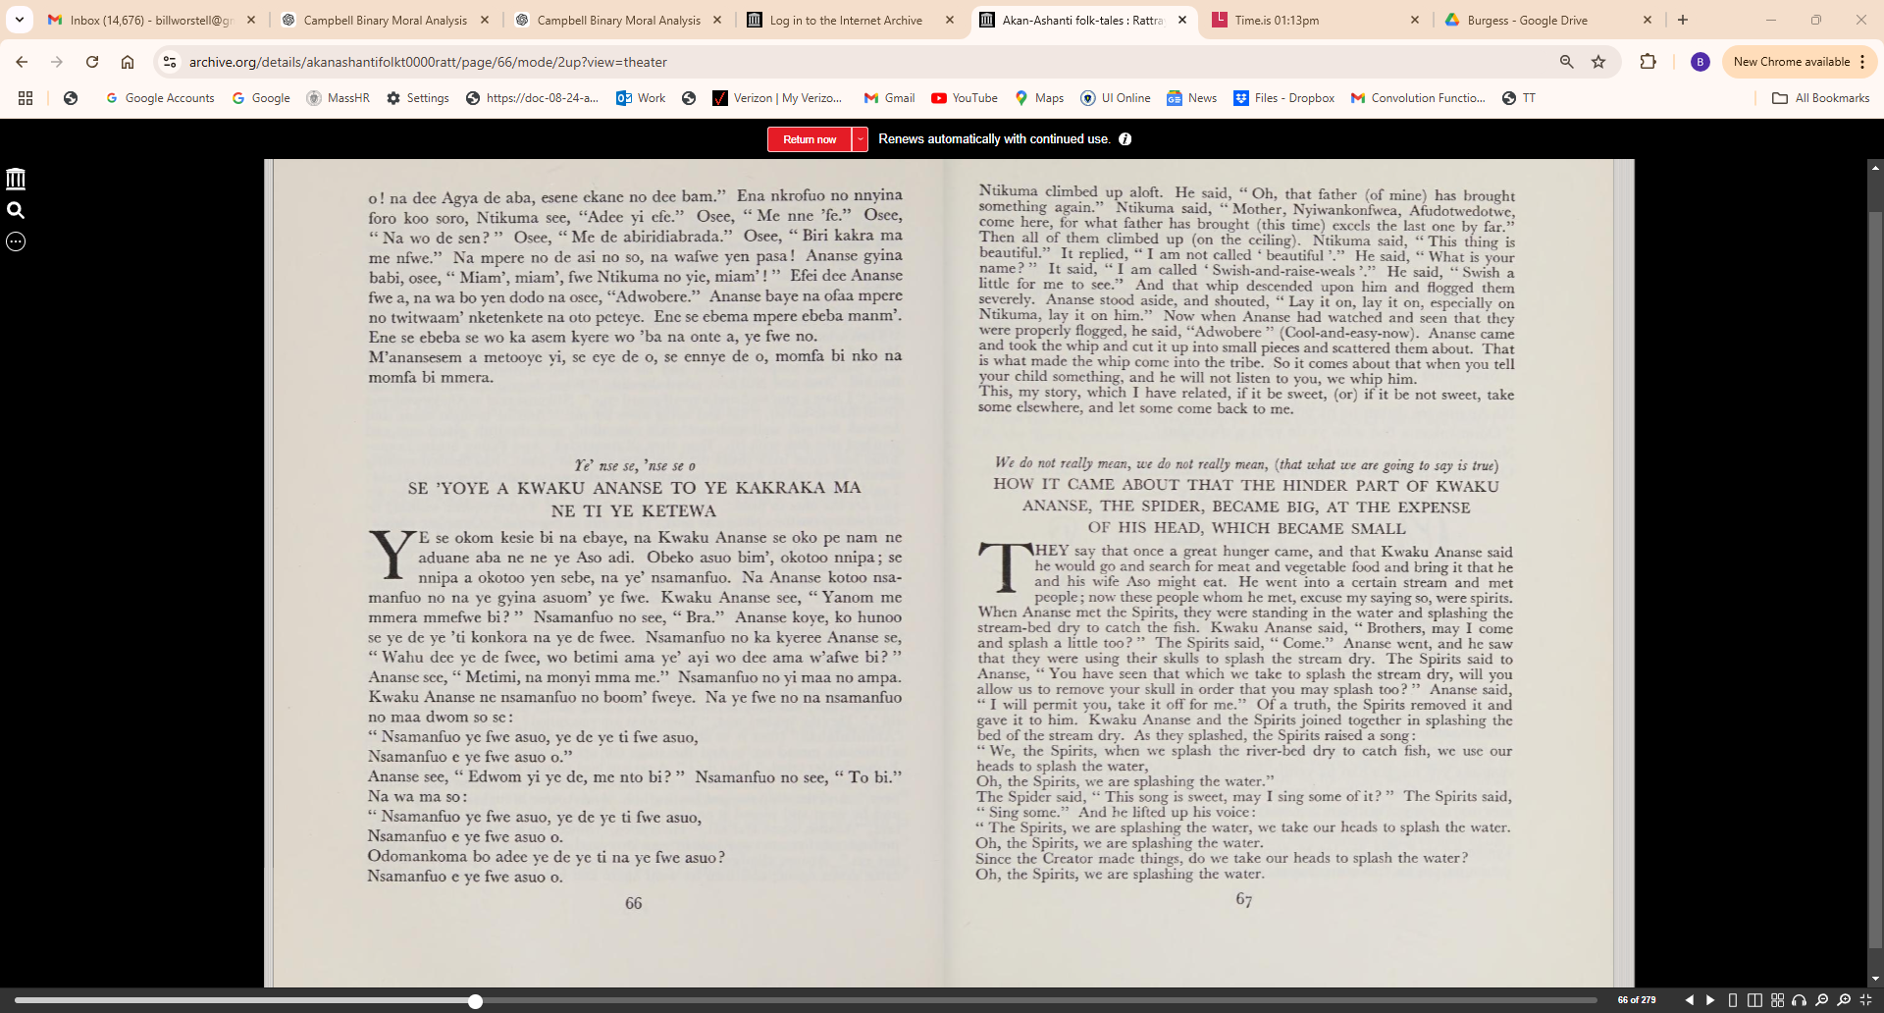

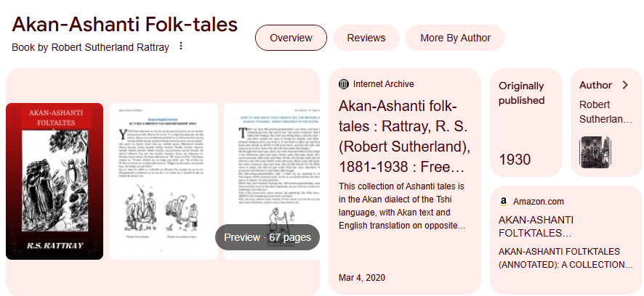
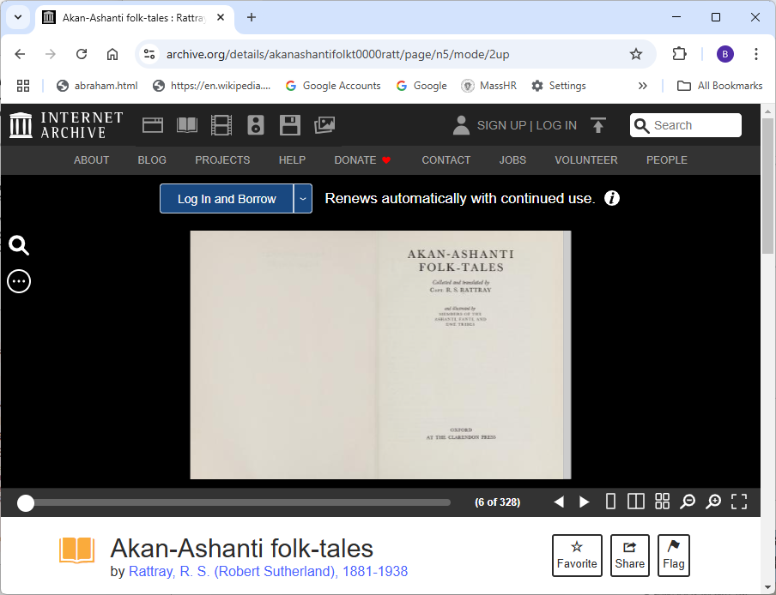
Demo Source Material:
https://archive.org/details/akanashantifolkt0000ratt/page/n5/mode/2up

Slide 2
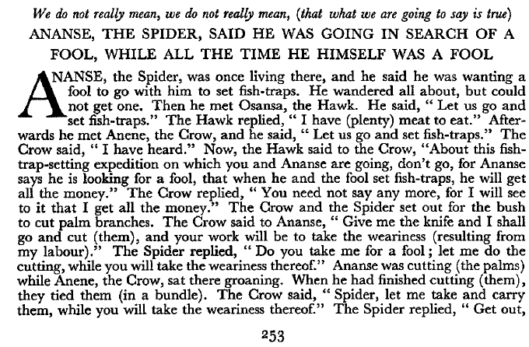

Slide 3
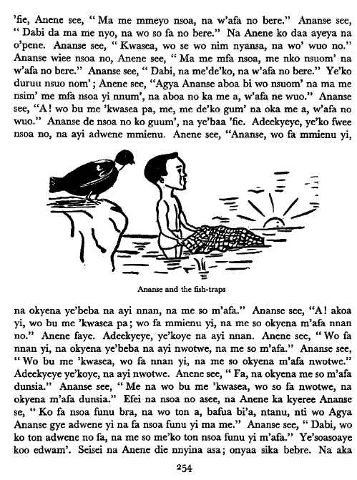
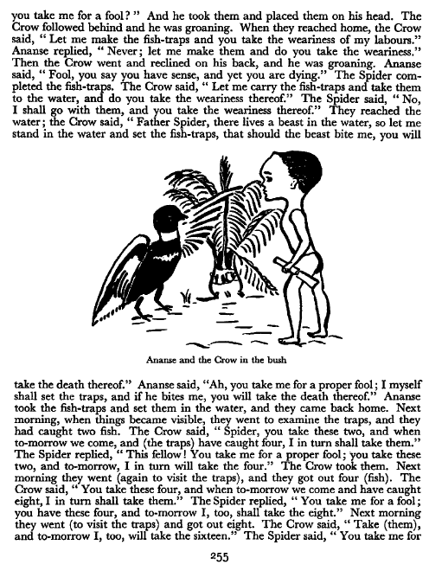

Slide 4
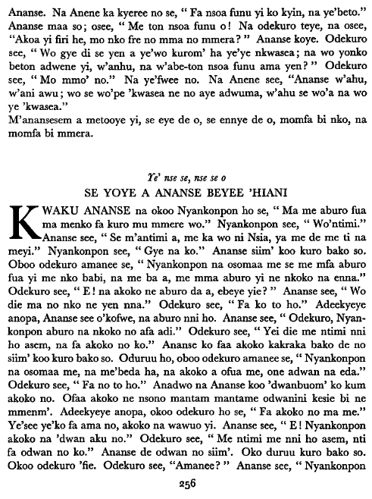
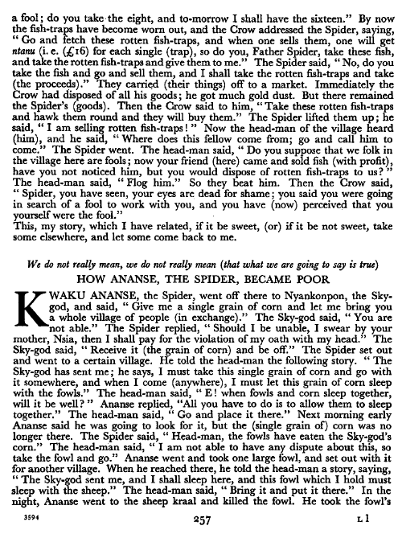

Slide 5
AKAN | ENGLISH
Ye' nse se, n.e se o | We do not really mean, we do not really mean, (that what we are going to say is true)
ANANSE SEE O'KO PE 'KWASEA, NANSO ONO ARA NA OYEE 'KWASEA | ANANSE, THE SPIDER, SAID HE WAS GOING IN SEARCH OF A FOOL, WHILE ALL THE TIME HE HIMSELF WAS A FOOL
ANANSE na ote ho, na osee o'pe 'kwasea ne no asi nsoa. | ANANSE, the Spider, was once living there, and he said he was wanting a fool to go with him to set fish-traps.
Okyin, kyin, kyin, wannya bi. | He wandered all about, but could not get one.
Na oko hyiaa Osansa. | Then he met Osansa, the Hawk.
Osee, " Ma yen ko si nsoa. | He said, " Let us go and set fish-traps."
Osansa see, " Me wo nam me di." | The Hawk replied, " I have (plenty) meat to eat."
Na akyiri yi na oko hyiaa Anene, na osee, "Ma yenko si nsoa." | Afterwards he met Anene, the Crow, and he said, "Let us go and set fish-traps."
Anene see, " M'ate." | The Crow said, " I have heard."
Na yei na Osansa ka kyeree Anene se, "Nsoa a wo'ko ne Ananse asie no, nko, na Ananse se o'pe 'kwasea, na one no asi nsoa no na wadi sika no nnyina." | Now, the Hawk said to the Crow, "About this fish trap-setting expedition on which you and Ananse are going, don't go, for Ananse says he is looking for a fool, that when he and the fool set fish-traps, he will get all the money."
Anene see, "Wo die gyae, na me na megye sika no nnyina." | The Crow replied, "You need not say any more, for I will see to it that I get all the money."
Anene ne Ananse sjim' koo wuram' ko twitwaa papa. | The Crow and the Spider set out for the bush to cut palm branches.
Anene ka kyeree Ananse se, " Fa sekan ma me na me ntwitwa, na wo so fa no bere." | The Crow said to Ananse, " Give me the knife and I shall go and cut (them), and your work will be to take the weariness (resulting from my labour)."
Ananse see, " Me na wo bu me 'kwasea? ma me ntwitwa, na wo so fa no bere." | The Spider replied, " Do you take me for a fool; let me do the cutting, while you will take the weariness thereof."
Ananse e'twitwa na Anene te ho na o'pene. | Ananse was cutting (the palms) while Anene, the Crow, sat there groaning.
Otwitwa wieye, na na ye'kyekyereye. | When he had finished cutting (them), they tied them (in a bundle).
Anene see, "Ananse ma me mfa nsoa, na wo so fa no bere." | The Crow said, " Spider, let me take and carry them, while you will take the weariness thereof."
Ananse see, " So' ho, na me na wo bu me 'kwasea?" | The Spider replied, " Get out, you take me for a fool? "
Na ofa soaye. | And he took them and placed them on his head.
Anene dii akyire na o'pene. | The Crow followed behind and he was groaning.
Ye'baa 'fie, Anene see, "Ma me mmeyo nsoa, na w'afa no bere." | When they reached home, the Crow said, " Let me make the fish-traps and you take the weariness of my labours."
Ananse see, "Dabi da ma me nyo, na wo so fa no bere." | Ananse replied, " Never; let me make them and do you take the weariness."
Na Anene ko daa ayeya na o'pene. | Then the Crow went and reclined on his back, and he was groaning.
Ananse see, "Kwasea, wo se wo nim nyansa, na wo' wuo no." | Ananse said, " Fool, you say you have sense, and yet you are dying."
Ananse wiee nsoa no, Anene see, " Ma me mfa nsoa, me nko nsuom' na w'afa no bere." | The Spider completed the fish-traps.
Ananse see, "Dabi, na me'de'ko, na w'afa no bere." | The Crow said, " Let me carry the fish-traps and take them to the water, and do you take the weariness thereof."
Ye'ko duruu nsuo nom'; | The Spider said, "No, I shall go with them, and you take the weariness thereof."
Anene see, "Agya Ananse aboa bi wo nsuom' na ma me nsim' me mfa nsoa yi nnum', na aboa no ka me a, w'afa ne wuo." | Ananse said, "Ah, you take me for a proper fool;
Ananse see, "A! wo bu me 'kwasea pa, me, me de'ko gum' na oka me a, w'afa no wuo." | I myself shall set the traps, and if he bites me, you will take the death thereof."
Ananse de nsoa no ko guum', na ye'baa 'fie. | Ananse took the fish-traps and set them in the water, and they came back home.
Adeekyeye, ye'ko fwee nsoa no, na ayi adwene mmienu. | Next morning, when things became visible, they went to examine the traps, and they had caught two fish.
Anene see, "Ananse, wo fa mmienu yi, na okyena ye'beba na ayi nnan, na me so m'afa." | The Crow said, " Spider, you take these two, and when tomorrow we come, and (the traps) have caught four, I in turn shall take them."
Ananse see, "A! akoa yi, wo bu me 'kwasea pa; wo fa mmienu yi, na me so okyena m'afa nnan no." | The Spider replied, "This fellow! You take me for a proper fool; you take these two, and to-morrow, I in turn will take the four."
Anene faye. | The Crow took them.
Adeekyeye, ye'koye na ayi nnan. | Next morning they went (again to visit the traps), and they got out four (fish).
Anene see, "Wo fa nnan yi, na okyena ye'beba na ayi nwotwe, na me so m'afa." | The Crow said, "You take these four, and when to-morrow we come and have caught eight, I in turn shall take them."
Ananse see, "Wo bu me 'kwasea, wo fa nnan yi, na me so okyena m'afa nwotwe." | The Spider replied, "You take me for a fool; you have these four, and to-morrow I, too, shall take the eight."
Adeekyeye ye'koye, na ayi nwotwe. | Next morning they went (to visit the traps) and got out eight.
Anene see, "Fa, na okyena me so m'afa dunsia." | The Crow said, "Take (them), and to-morrow I, too, will take the sixteen."
Ananse see, " Me na wo bu me 'kwasea, wo so fa nwotwe, na okyena m'afa dunsia." | The Spider said, " You take me for fool; do you take the eight, and to-morrow I shall have the sixteen."
Efei na nsoa no asee, na Anene ka kyeree Ananse se, "Ko fa nsoa funu bra, na wo ton a, bafua bi'a, ntanu, nti wo Agya Ananse gye adwene yi na fa nsoa funu yi ma me." | By now the fish-traps have become worn out, and the Crow addressed the Spider, saying, " Go and fetch these rotten fish-traps, and when one sells them, one will get ntanu (i. e. (,i6) for each single (trap), so do you, Father Spider, take these fish, and take the rotten fish-traps and give them to me."
Ananse see, "Dabi, wo ko ton adwene no fa, na me so me'ko ton nsoa funu yi m'afa." | The Spider said, "No, do you take the fish and go and sell them, and I shall take the rotten fish-traps and take (the proceeds)."
Ye'soasoaye koo edwam'. | They carried (their things) off to a market.
Seisei na Anene die nnyina asa; onyaa sika bebre. | Immediately the Crow had disposed of all his goods; he got much gold dust.
Na aka Ananse. | But there remained the Spider's (goods).
Na Anene ka kyeree no se, "Fa nsoa funu yi ko kyin, na ye'beto." | Then the Crow said to him, "Take these rotten fish-traps and hawk them round and they will buy them."
Ananse maa so; osee, " Me ton nsoa funu o! | The Spider lifted them up; he said, " I am selling rotten fish-traps! "
Na odekuro teye, na osee, "Akoa yi firi he, mo nko fre no mma no mmera? " Ananse koye. | Now the head-man of the village heard (him), and he s‑aid, "Where does this fellow come from; go and call him to come." The Spider went.
Odekuro see, "Wo gye di se yen a ye'wo kurom' ha ye'ye nkwasea; na wo yonko beton adwene yi, w'anhu, na w'abe-ton nsoa funu ama yen? " | The head-man said, " Do you suppose that we folk in the village here are fools; now your friend (here) came and sold fish (with profit), have you not noticed him, but you would dispose of rotten fish-traps to us? "
Odekuro see, " Mo mmo' no." | The head-man said, " Flog him."
Na ye'fwee no. | So they beat him.
Na Anene see, "Ananse w'ahu, w'ani awu; wo se wo'pe 'kwasea ne no aye adwuma, w'ahu se wo'a na wo ye 'kwasea." | Then the Crow said, "Spider, you have seen, your eyes are dead for shame; you said you were going in search of a fool to work with you, and you have (now) perceived that you yourself were the fool."
M'anansesem a metooye yi, se eye de o, se ennye de o, momfa bi nko, na momfa bi mmera. | This, my story, which I have related, if it be sweet, (or) if it be not sweet, take some elsewhere, and let some come back to me.

