Slide 1
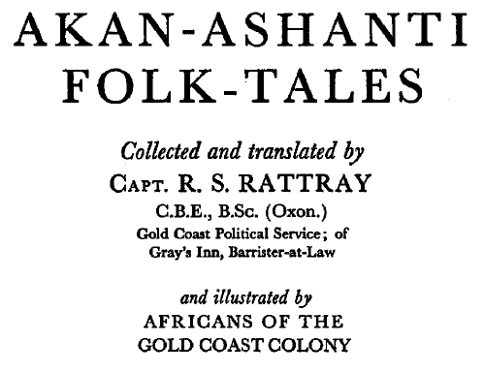
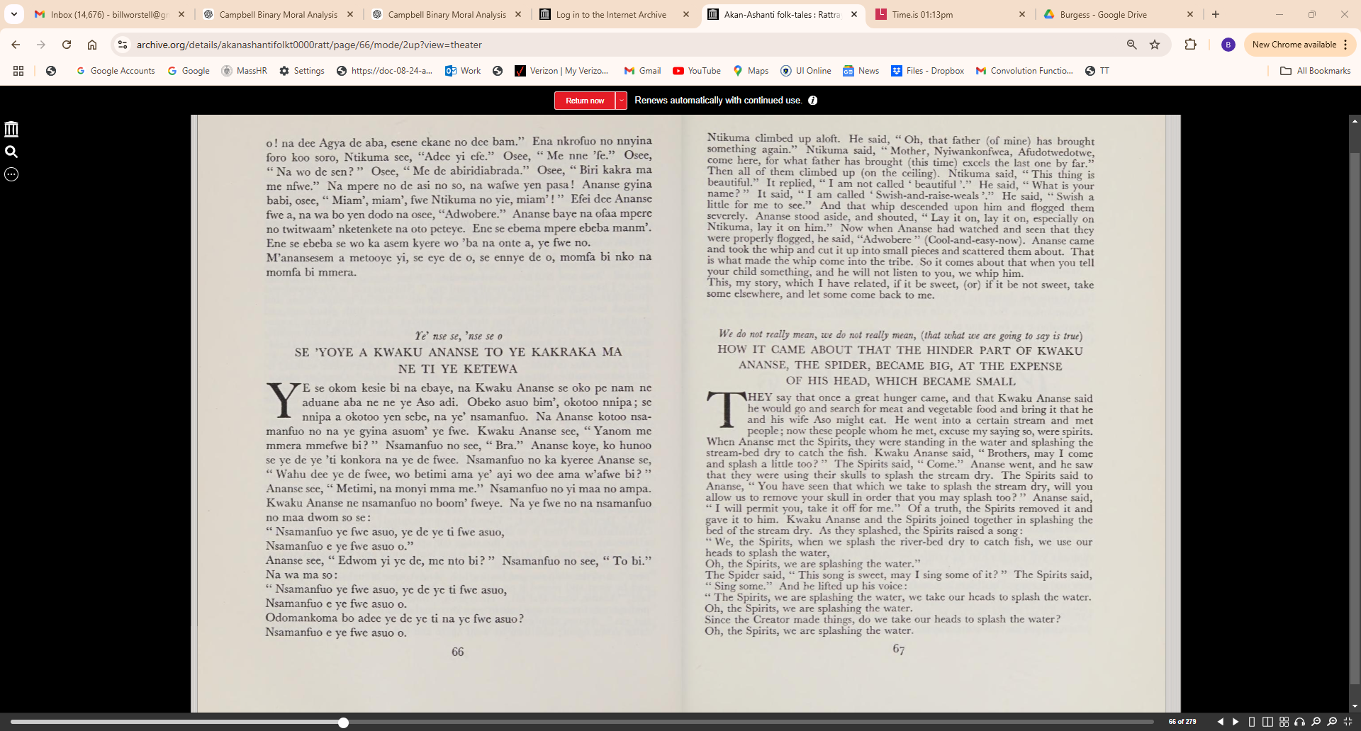

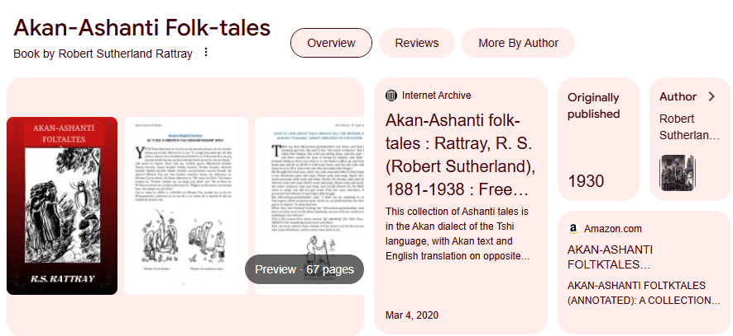
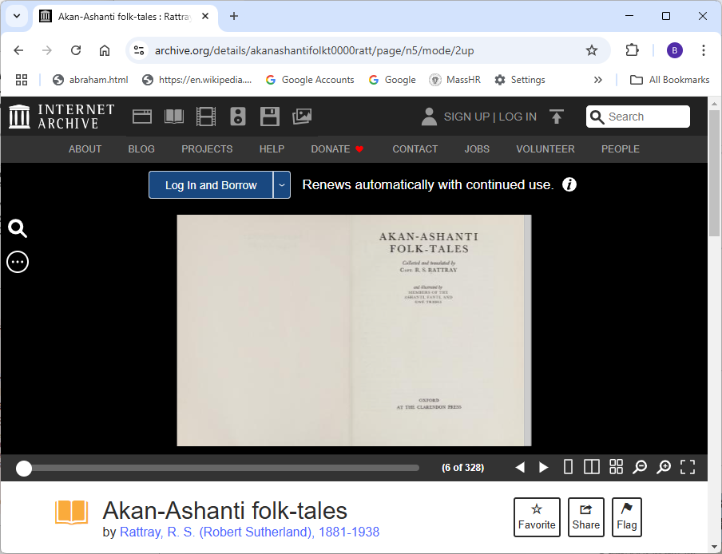
Demo Source Material:
https://archive.org/details/akanashantifolkt0000ratt/page/n5/mode/2up

Slide 2
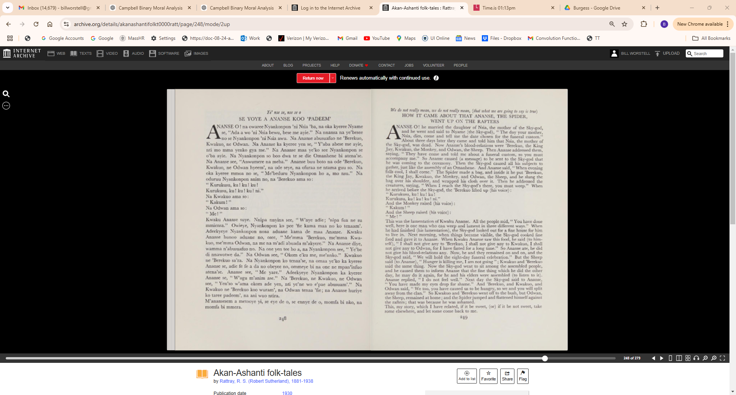

Slide 3
AKAN | ENGLISH
Ye' nse se, nse se o | We do not really mean, we do not really mean, (that what we are going to say is true)
SE YOYE A ANANSE KOO 'PADEEM' | HOW IT CAME ABOUT THAT ANANSE, THE SPIDER, WENT UP ON THE RAFTERS
ANANSE O ! na owaree Nyankonpon 'ni Nsia 'ba, na oka kyeree Nyame se, "Ada a wo 'ni Nsia bewu, bese me ayie." | ANSE O ! he married the daughter of Nsia, the mother of the Sky-god, and he went and said to Nyame (the Sky-god), "The day your mother, Nsia, dies, come and tell me the date chosen for the funeral custom."
Na nnansa na ye'besee nose Nyankonpon 'ni Nsia awu. | About three day later they came and told him that Nsia, the mother of the Sky-god, was dead.
Na Ananse abusuafuo ne 'Berekuo, | Now Ananse's blood-relations were 'Berekuo, the King Jay, Kwakuo, the Monkey, and Odwan, the Sheep.
Kwakuo, ne Odwan. Na Ananse ka kyeree yen se, "Y'aba abese me ayie, nti mo mma yenko gya me." | Then Ananse addressed them, saying, " They have come and told me about a funeral custom, so you must accompany me."
Na Ananse maa ye'ko see Nyankonpon se o'ba ayie. | So Ananse caused (a message) to be sent to the Sky-god that he was coming to the ceremony.
Na Nyankonpon so boo dwa te se die Omanhene bi atena'se. | Then the Sky-god caused all his subjects to gather, just like the assembly of an Omanhene.
Na Ananse see, "Anwumere na meba." | And Ananse said, "When evening falls cool, I shall come."
Ananse buu boto na ode 'Berekuo, Kwakuo, ne Odwan hyeem', na ode seye, na ofuraa ne ntama guu so. | The Spider made a bag, and inside it he put 'Berekuo, the King Jay, Kwakuo, the Monkey, and Odwan, the Sheep, and he slung the bag over his shoulder, and wrapped his cloth over it.
Na oka kyeree mmoa no se, "Me'beduru Nyankonpon ho a, mo nsu." | Then he addressed the creatures, saying, "When I reach the Sky-god's there, you must weep."
Na oduruu Nyankonpon anim no, na 'Berekuo ama so: " Kurukusu, ku! ku! ku! Kurukusu, ku! ku! ku! ni." | When he arrived before the Sky-god, the 'Berekuo lifted up (his voice):" Kurukusu, ku! ku ! ku! Kurukusu, ku! ku! ku! ni."
Na Kwakuo ama so: "Kakum!" | And the Monkey raised (his voice) : "Kakum!"
Na Odwan ama so: "Me!" | And the Sheep raised (his voice): "Me!" .
Kwaku Ananse suye. | This was the lamentation of Kwaku Ananse.
Nnipa nnyina see, " W'aye adie; 'nipa fua ne su mmiensa." | All the people said, " You have done well, here is one man who can weep and lament in three different ways."
Owieye, Nyankonpon ko pee 'fie kama maa no ko tenaam'. | When he had finished (his lamentation), the Sky-god looked out for a fine house for him to live in.
Adeekyeye Nyankonpon noaa aduane kama de maa Ananse. | Next morning, when things became visible, the Sky-god cooked fine food and gave it to Ananse.
Kwaku Ananse hunoo aduane no, osee, "Me'mma 'Berekuo, me'mma Kwa­ kuo, me'mma Odwan, name na m'adi abuada m'akyere." | When Kwaku Ananse saw this food, he said (to him­ self), " I shall not give any to 'Berekuo, I shall not give any to Kwakuo, I shall not give any to Odwan, for I have fasted for a long time."
Na Ananse diye, wamma n'abusuafuo no. | So Ananse ate, he did not give his blood-relations any.
Na one yen tee ho a, na Nyankonpon see,"Ye'be di nnawotwe da." | Now, he and they remained on and on, and the Sky-god said, "We will hold the eight-day funeral celebration."
Na Odwan see, "Okom e'ku me, me'nnko." Kwakuo ne 'Berekuo sa'ra. | But the Sheep said (to Ananse), "Hunger is killing me, I am not going"; Kwakuo and 'Berekuo said the same thing.
Na Nyankonpon ko tenaa'se, na omaa ye'ko ka kyeree Ananse se, adie fe fe a da no obeyee no, ommeye bi na one ne mpan'infuo atena'se. | Now the Sky-god went to sit among the assembled people, and he caused them to inform Ananse that the fine thing which he did the other day, he may do it again, for he and his elders were assembled (to listen to it).
Ananse see, "Me yare." | Ananse replied, "I do not feel well."
Adeekyeye Nyankonpon ka kyeree Ananse se, "W'agu m'anim ase." | Next day the Sky-god said to Ananse, "You have made my eyes drop for shame."
Na 'Berekuo, ne Kwakuo, ne Odwan see, "Yen'so w'ama okom ade yen, nti ye'ne wo e'pae abusuam'." | And 'Berekuo, and Kwakuo, and Odwan said," We too, you have caused us to be hungry, so we and you will split away from the clan."
Na Kwakuo ne 'Berekuo koo wuram', na Odwan tenaa 'fie; na Ananse huriye ko taree padeem', na ani wuo ntira. | So Kwakuo and 'Berekuo went off to the bush, but Odwan, the Sheep, remained at home; and the Spider jumped and flattened himself against the rafters; that was because he was ashamed.
M'anansesem a metooye yi, se eye de o, se ennye de o, momfa bi nko, namomfa bi mmera. | This, my story, which I have related, if it be sweet, (or) if it be not sweet, take some elsewhere, and let some come back to me.

