Slide 1

Anna Johnson
Joe Goldsich
Kyle Son
Bill Yerkes
Analysis for determination of a relationship
between energy demand and weather.
CSEE5590 – Big Data Programming

Slide 2

Content
Introduction:
Goals and Objectives
Motivation
Significance
Iteration 2:
Joe Goldsich: Hive - Hadoop - MapReduce (Weather Data Set)
Anna Johnson: Sqoop - Hadoop - MySQL
Kyle Son: Cassandra - Hive -Hadoop (Merge Table)
Bill Yerkes: Hive - Hadoop - MapReduce (Energy Data Set)
Data Set Link
https://www.kaggle.com/nicholasjhana/energy-consumption-generation-prices-and-weather
Notes:
Joe

Slide 3
Goals and Objectives
Utilize the tools and technologies learned from CSEE 5590 to be able to analyze collected data so that it will be possible to determine if there is a relationship between weather and energy consumption and if a relationship exists determine the possibilities of using that relationship to predict future energy needs.
Notes:
Anna

Slide 4
Motivation
The global population continues to increase, and the weather patterns seem to be getting more extreme, from extending periods of both above and below normal temperatures in various parts of the world and in the United States.
The demand and consumption of energy increase with the population and with the extreme weather, the need for air conditioning in the summer and for heating in the winter.
The recent crisis in Texas has demonstrated what can happen if the energy providers are not able to meet the demands of the consumers.
Being able to forecast accurately future demand and plan accordingly can help prevent or mitigate such crises in the future
Notes:
Kyle

Slide 5
Significance
Better planning of resources for Utility Companies can result in reduced cost to the consumers and more reliable service. This also dips into the area of public safety, as loss of power during extreme weather with no warning can be dangerous for vulnerable groups.
Notes:
Bill

Slide 6
Joe Goldsich
Using Hive, I have practiced making queries on our data sets that might return useful information.
First, I made simple queries like looking for a correlation between total energy load at different temperature ranges.
When attempting more complicated queries there was a considerable dip in performance. So I then tried to take advantage of data partitioning that Hive allows.

Slide 7
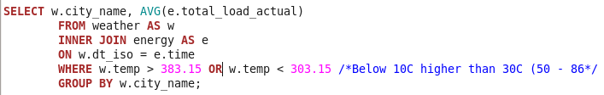
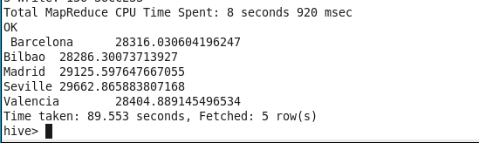
Grab the energy use at temperatures above 30 C or below 10 C (86F, 50F)
This produced:

Slide 8
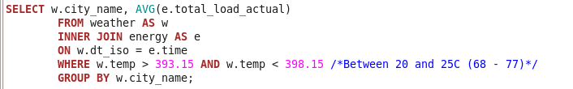
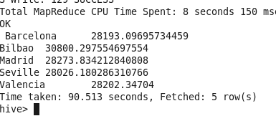
And then compare with temperatures between 20 C and 25 C (68 F to 77 F)
And this produced:

Slide 9
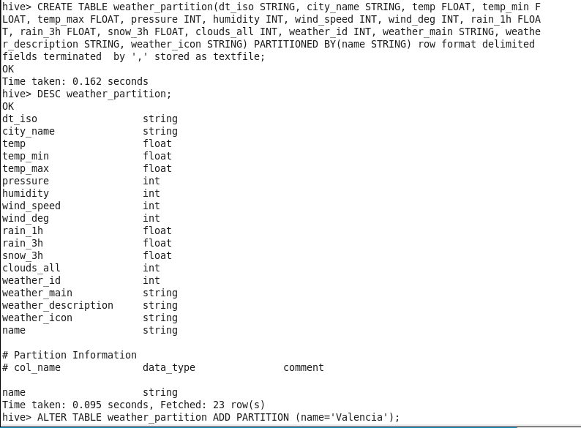
While attempting to conduct slightly more complex queries (nested selects and joins) ran into some significant performance issues (one query took over 10 minutes to execute). So I then tried to partition the data and see if that made for better performance.

Slide 10
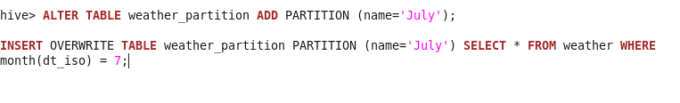
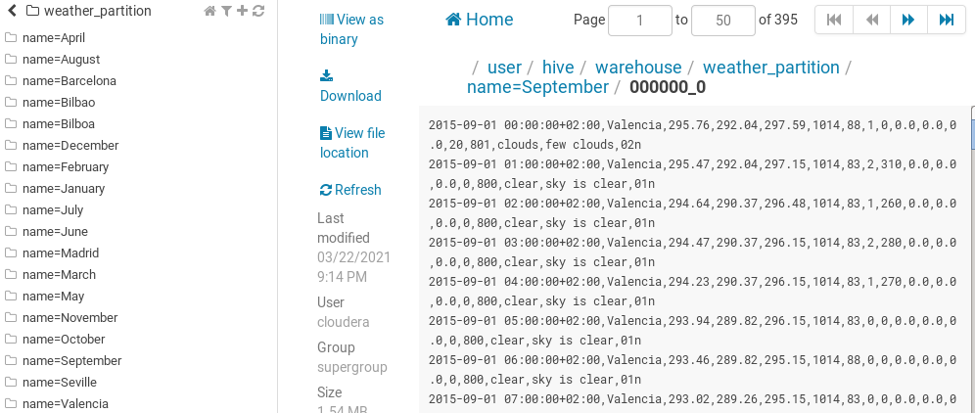
Some partitions examples:

Slide 11
Anna Johnson
In MySQL, I created tables for both the energy and weather features datasets
I populated the tables by loading the data from the csv files
I used MySQL to run queries on the tables to better understand the data
I then used Sqoop to import the tables into HDFS
Sqoop can be used to transfer our databases between the Hadoop/ Hive ecosystem and the relational database system of MySQL, which provides different functionality for querying the data.

Slide 12
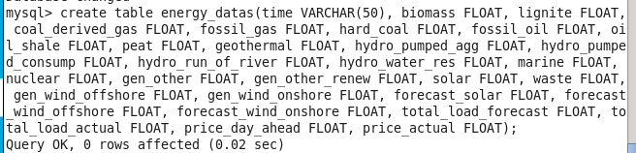
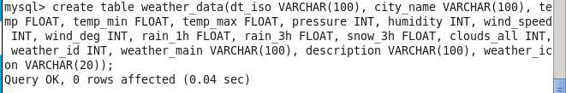
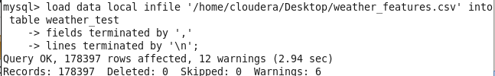
Creating Tables in MySQL
Populating tables with data:

Slide 13
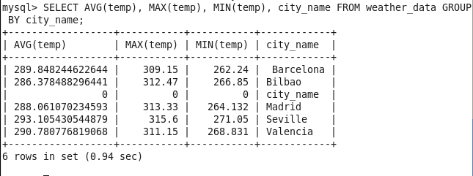
Example Queries in MySQL:
Weather data:

Slide 14
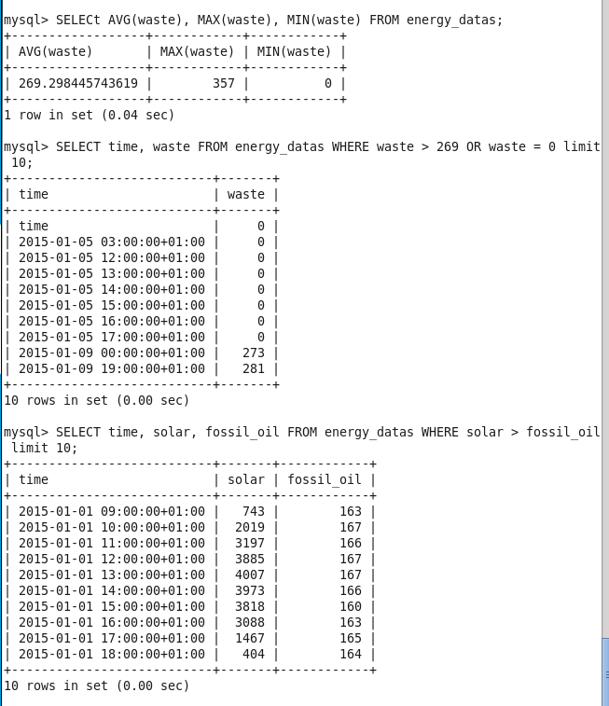
Energy data:

Slide 15

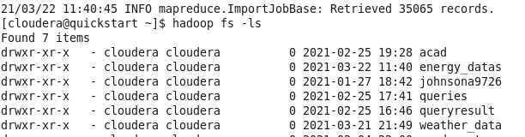
Transferring Data with Sqoop
Importing from MySQL to HDFS:
Exporting between Hive and MySQL:
energy_datas and weather_data in HDFS after importing from MySQL:

Slide 16
Kyle Son
Instead of Hive CLI, I used HIVE beeline for better visualization of table
In Hive, Join two tables on (dt_iso = time) and perform queries on it
Using cassandra, perform some queries on each table
It is not possible to join two tables in cassandra
I used sparksql on intellij with scala for query the data

Slide 17
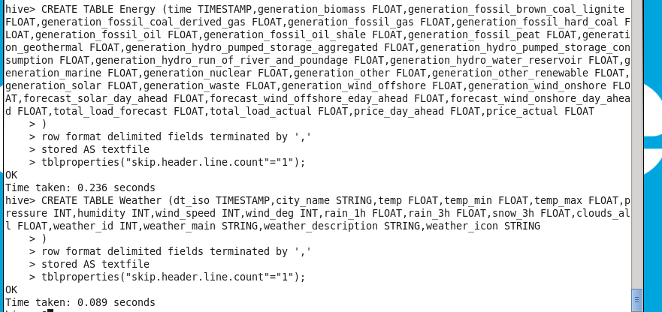
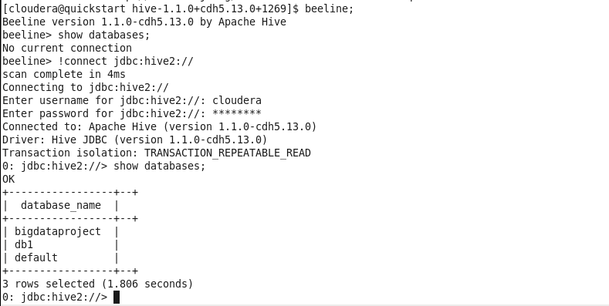
HIVE(Beeline)
create table merged as select * from (select * from Energy e left join Weather w on e.time = w.dt_iso )x
=> From This query, I created a merged table of energy and weather

Slide 18
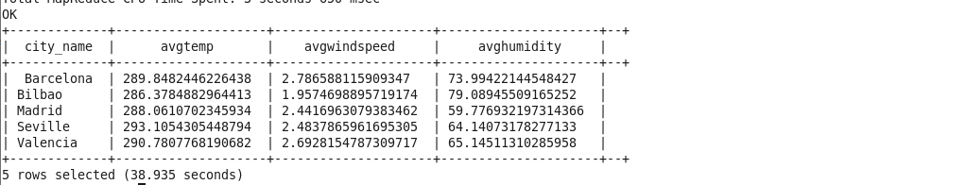
SELECT city_name, AVG(temp) as AvgTemp, AVG(wind_speed) as AvgWindSpeed, AVG(humidity) as AvgHumidity from merged group by city_name;
=> From This query, I displayed each city’s average temperature windspeed and humidity group by city name

Slide 19
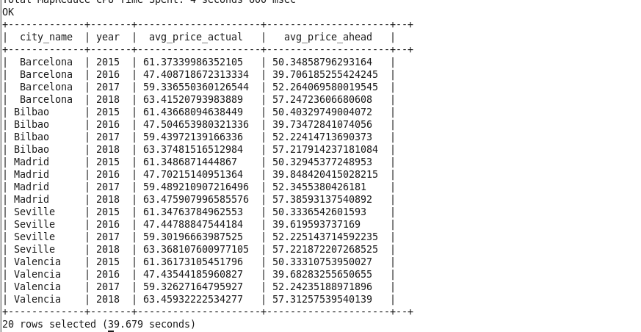
SELECT x.city_name AS city_name, x.year AS year, AVG(x.price_actual) AS avg_price_actual, AVG(x.price_day_ahead) AS avg_price_ahead
FROM (SELECT city_name, YEAR(time) AS YEAR, price_actual, price_day_ahead FROM merged) AS x
GROUP BY city_name, year;
=> From This query, I displayed avg actual price and ahead price group by city and year to show the chronological change of the electricity price

Slide 20
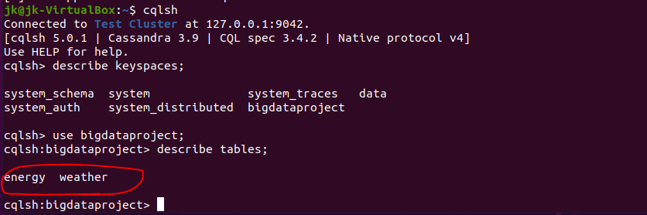
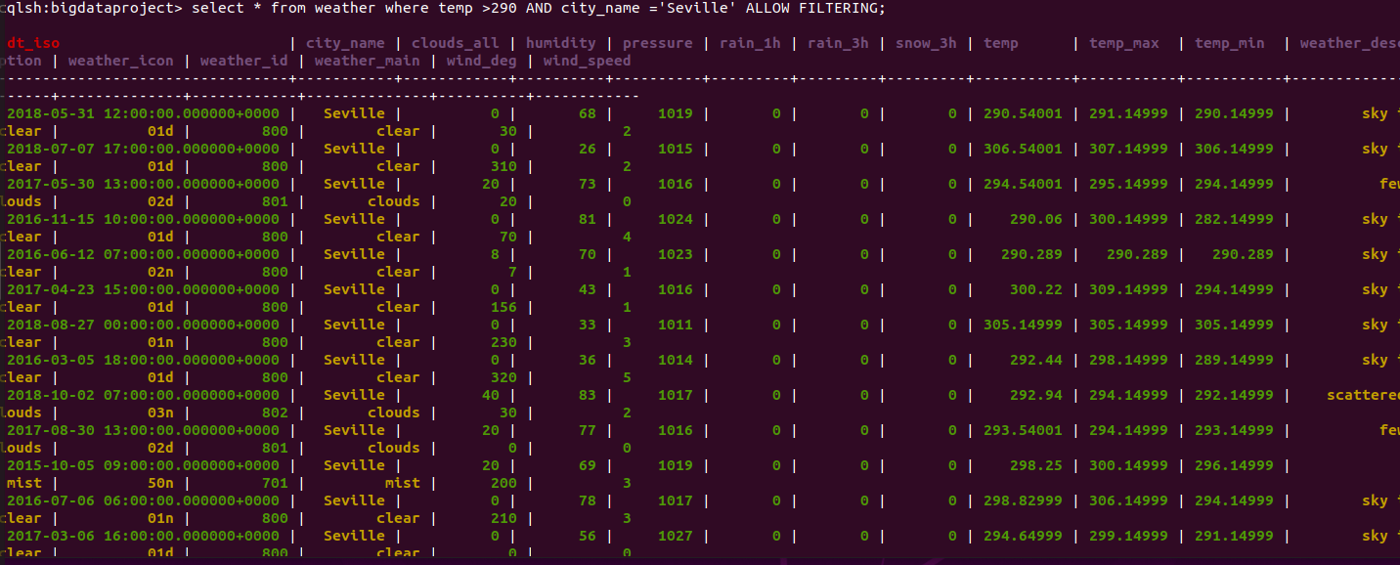
CASSANDRA
=> Created two separate table in cassandra, and perform query for each tables

Slide 21
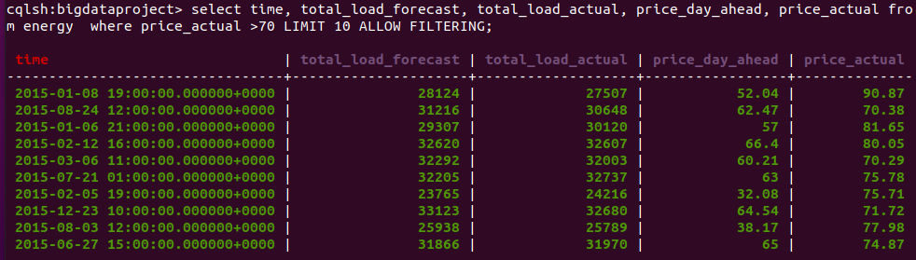
=> From This query, I only display the data where actual price is over 70

Slide 22
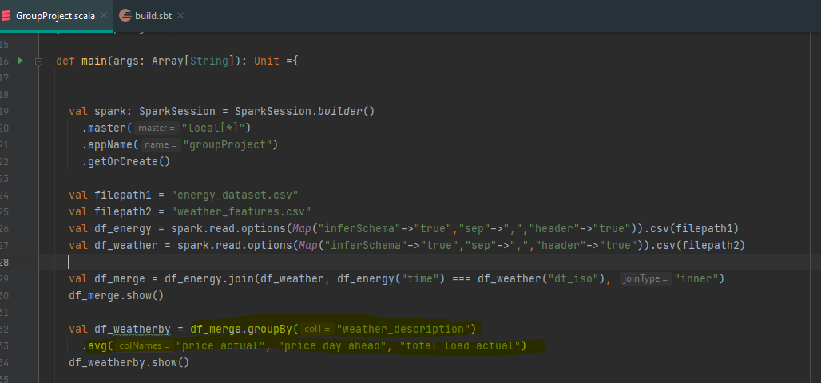
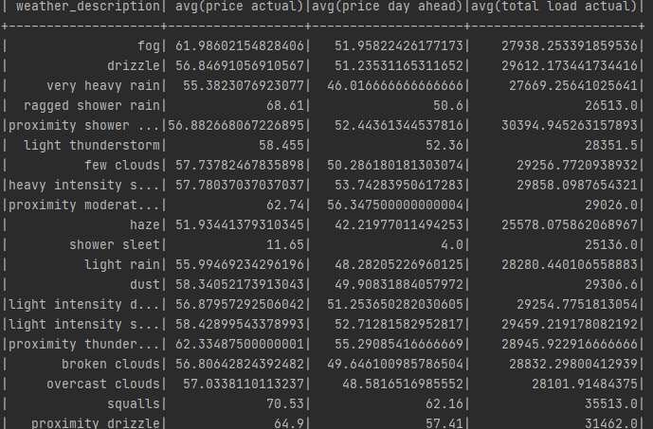
SPARKSQL(Intellij)
=> From This query, I group by weather description and display price information to show the correlation between them

Slide 23
Bill Yerkes
Utilized Hive (Hadoop and MapReduce) to analyse the Energy Data
Created Tables
Imported Data
Ran Queries (MapReduce) to get metrics
Technologies not utilized/required (May used them in the future)
Cassandra (NoSQL DB: do not foresee using.)
Sqoop (Data Migration: probably will use to move to SQL DB for reports.)
Solr (Search Engine: do not foresee using.)

Slide 24
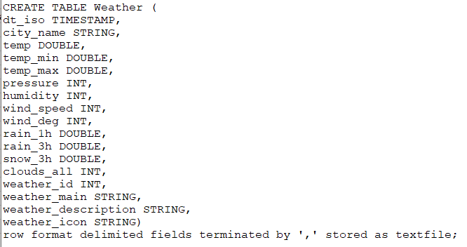
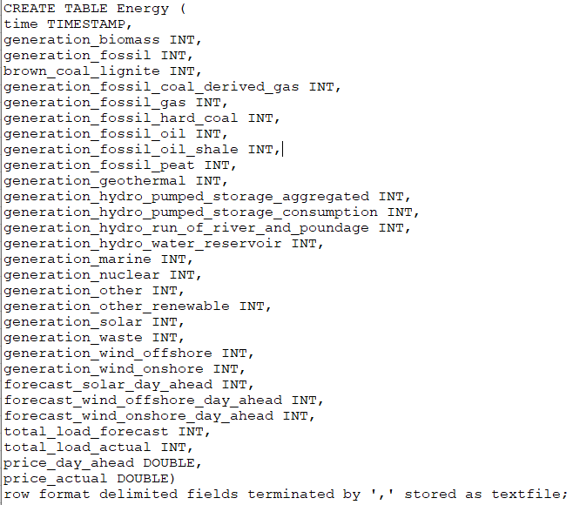
Bill Yerkes

Slide 25
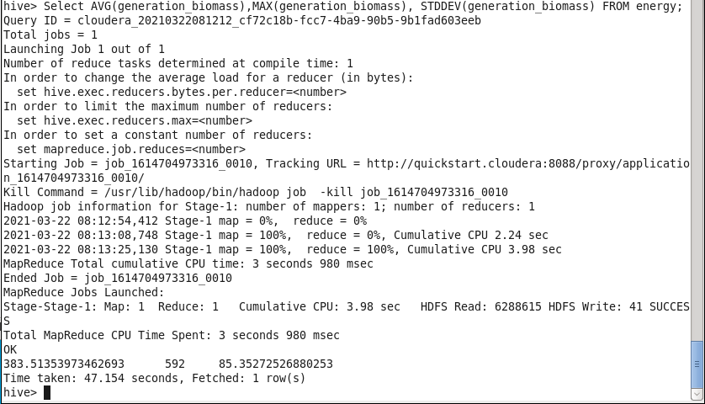
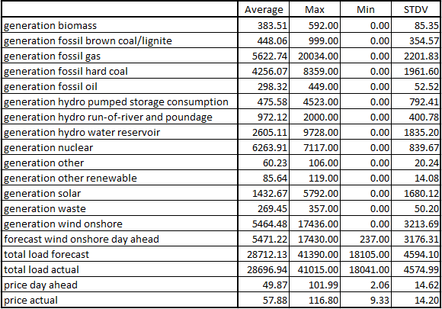
Bill Yerkes
Generate Metrics via Hive (MapReduce)
Select AVG(generation_biomass),MAX(generation_biomass),MIN(generation_biomass), STDDEV(generation_biomass) FROM energy;

Slide 26
Next Steps
Group will pool information about analysis of Data.
Investigate migration of current functions from Hive to Spark.
Investigate future class technologies on how to perform predictions and generate visualizations of data.
Join datasets based on time column and look for the relationships between the two

Slide 27
Q & A

Slide 28
THANK YOU

