Slide 1
Automated Event & Certificate Generation
Streamlining Educational Administration through Robotic Process Automation (RPA)
Biresh Biswas 23BRS1255
Preetham Pemmasani 23BRS1346,
Tanmay 23BRS1222

Slide 2

Problem Statement
The Administrative Burden: Higher Education Institutions face massive overhead in managing workshops and events. Manual data entry for hundreds of participants is slow and inefficient.
Key Issues:
High Error Rate: Manual typing leads to misspelled names on certificates, requiring re issuance.
Latency: Certificates are often issued weeks after an event, reducing attendee engagement.
Lack of Scalability: Human staff cannot easily scale to handle 1000+ attendees instantly.
Verification: No proper verification system

Slide 3


Literature Review: State of the Art
Efficiency Gains (Wijaya et al., 2020)
Accuracy & Fraud (Mukit et al., 2025)
Research on student administration automation found that RPA can reduce data processing time by up to 99.9%. Tasks that took 3 hours manually were completed in 15 minutes by a bot, highlighting the transformational potential of RPA in education.
https://www.researchgate.net/publication/346968981_Muhammad_Zulfiqar_Mahmud_Widayat_Rahmad_Wijaya_2020_Causality_Model_of_Consumer_Purchase_Intention_on_Environmentally_Friendly_Packaging_Beverage_Products
Studies on transcript processing show that automation reduces error rates from 6% to under 1%. Furthermore, integrating RPA with verification standards addresses the growing concern of credential fraud in manual issuance processes.
https://www.researchgate.net/publication/395551667_Design_and_Evaluation_of_a_Hybrid_RPA-AI_Framework_for_Intelligent_Transcript_Processing_in_Higher_Education

Slide 4





Key Research Themes & Gaps
Event Management
Certificate Generation
The Research Gap
Current literature focuses on scheduling and reminders. Tools like Zapier and UiPath are used to trigger emails based on registration data.
Existing research highlights "Mail Merge" style automation. The focus is shifting towards "Verifiable Credentials" using QR codes.
End-to-End Integration: Few studies address a unified workflow that connects pre-event scheduling directly to post-event issuance without human intervention.

Slide 5

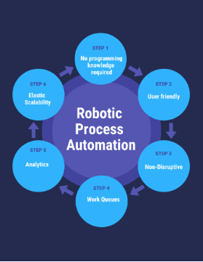
Proposed Methodology
The "Read-Process-Write" Cycle
Our approach follows a standard RPA lifecycle designed for reliability and scalability.
Step 1: Input Analysis – Structured data extraction from Excel / registration forms / check-in logs
Step 2: Attendance Validation – Check eligibility rules (duration, check-in, exclusions) and filter valid participants
Step 3: Certificate Generation – Populate template with name, date, unique ID + embed QR code (with optional blockchain hash)
Step 4: PDF Conversion – Render final certificate design into a downloadable PDF file
Step 5: Email Dispatch – Send personalized PDF certificate to participant email + log delivery status

Slide 6



Technology Stack
Core Logic: UiPath Studio
The primary development environment. Used for its robust selector capabilities with desktop applications and ease of use in academic settings.
Data Layer: Microsoft Excel
Acts as the database. Stores attendee details, registration status, and certificate issuance logs (Success/Fail).
Template Engine: Adobe Photoshop
Used for designing the certificate. The bot utilizes "Find and Replace" activities to inject dynamic user data.

Slide 7
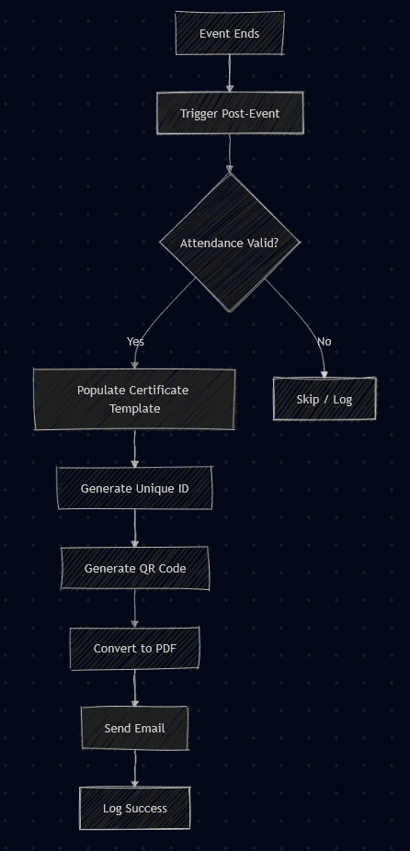
System Architecture
The system is architected as two decoupled automation sequences sharing a common data source.
1. The Scheduler Bot: Reads new rows from Excel > Interacts with Google Calendar > Sends Invites.
2. The Certifier Bot: Triggered post-event > Validates attendance > Populates Photoshop Template > Create QR Code > Converts to PDF > Dispatches Email

Slide 8
Data Flow Execution
Data Entry
Scheduling
Validation
Generation
User registers. Data is logged in Master_Sheet.xlsx.
Bot A reads data, sends Google Calendar invite.
Event occurs. Attendance column updated to "Present".
Photoshop generates PDF & QR and emails it to "Present" users.

Slide 9
ISSUES vs Solutions
Issue | Technical Symptom | Proposed Solution
“Long Name” Overflow | Text bleeds into borders or overlaps the Awarded To label | Dynamic Font Scaling: Set a character threshold (e.g., >20). If exceeded, auto-reduce font size by ~20%.
“Double Line” Shift | Two-line names push Date and Signature off the page | Fixed Anchors: Lock all static text using absolute (X, Y) coordinates so only the name expands into available white space.
Emoji / Special Characters | Accents (á, ö, ñ) or non-Latin scripts render as ? or □ | Unicode-Ready Fonts: Use global UTF-8 fonts like Noto Sans that fully support multilingual glyphs.
Case Inconsistency | Names arrive as JOHN SMITH or john smith, hurting visual polish | String Normalization: Apply TitleCase / ProperCase in UiPath
Pixelated Assets | Logos and seals look blurry after PDF export | Vector Injection: Replace raster images with .SVG or vector .PDF assets.
Bulk Email Blocking | Sending ~1,000 PDFs trips spam or rate-limit filters | Staggered Delivery: Add a 2–5 s delay between emails

Slide 10

Conclusion & Future Scope
Impact Summary
This project demonstrates that RPA can transform educational administration from a bottleneck into a seamless experience.
Zero Errors: Automated data scraping ensures 99.99% accuracy in names.
Instant Gratification: Certificates can be received via email minutes after the event ends.
Future Scope
Integration with Blockchain QR for immutable, verifiable credentials and switching from Excel to a cloud SQL Database for enterprise scalability.

Slide 11
CODE AND OUTPUT

Slide 12
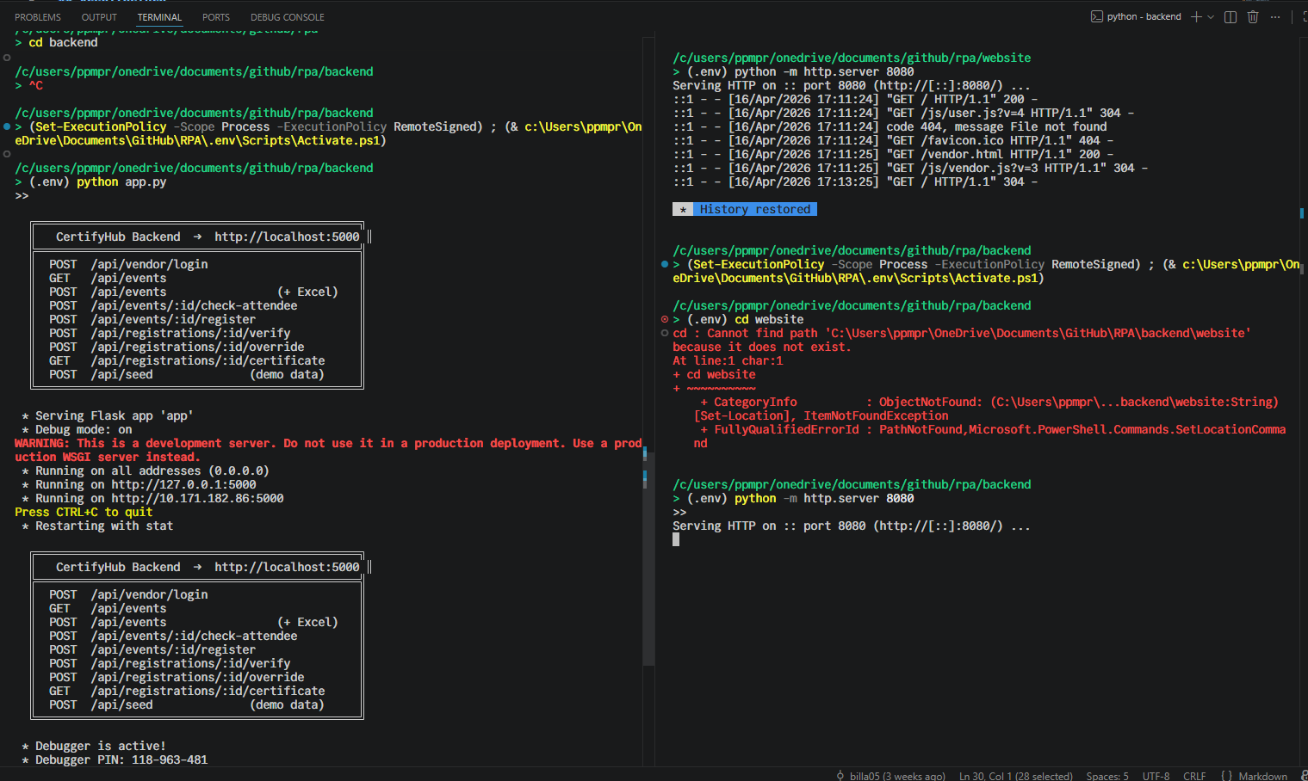

Slide 13


Slide 14
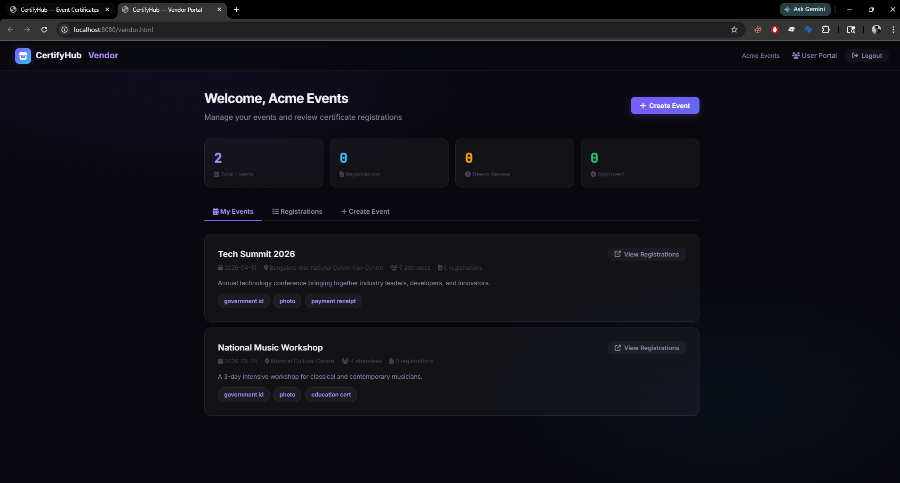

Slide 15
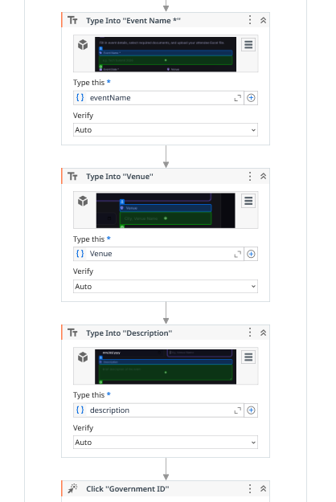
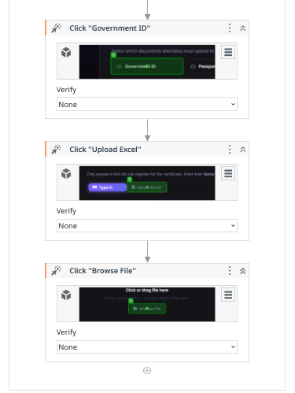
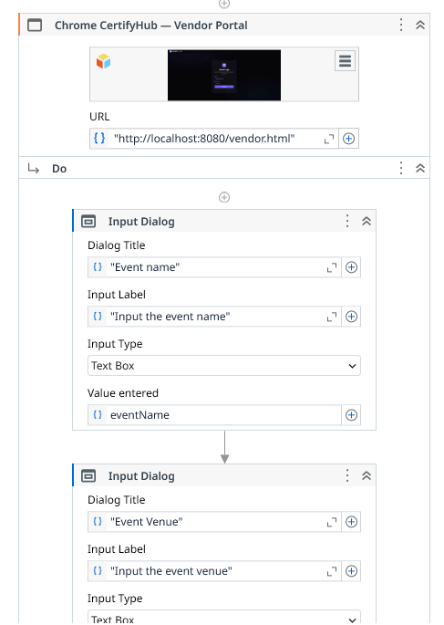
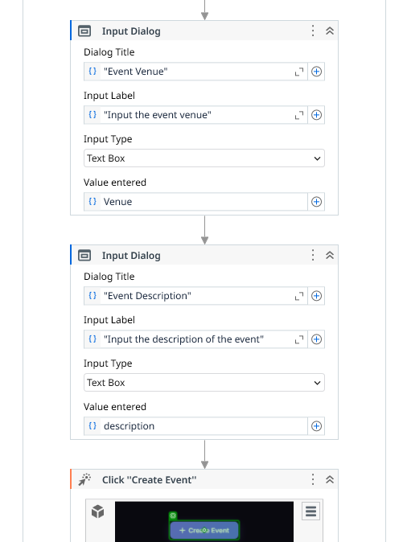

Slide 16
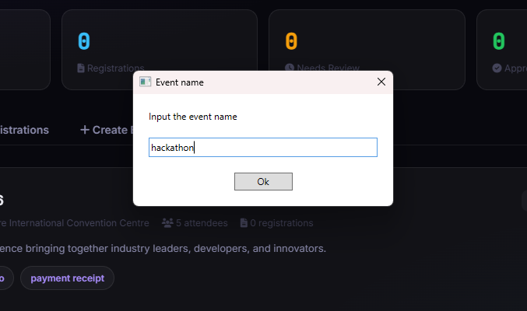
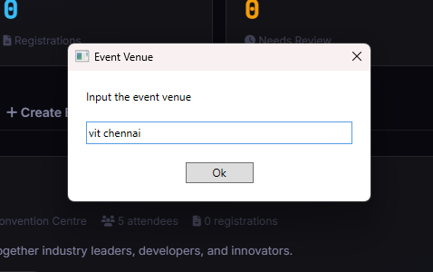
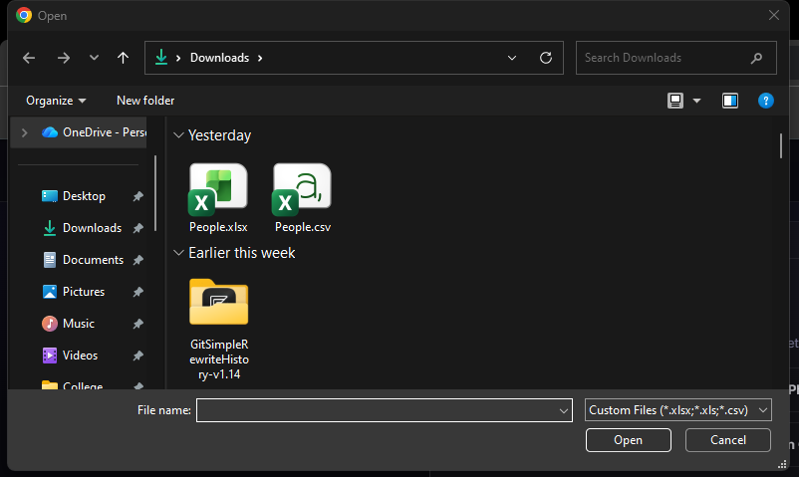
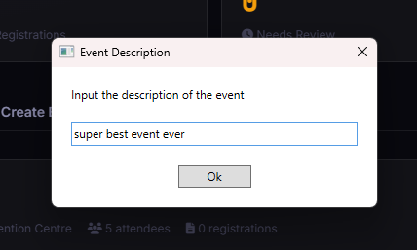

Slide 17
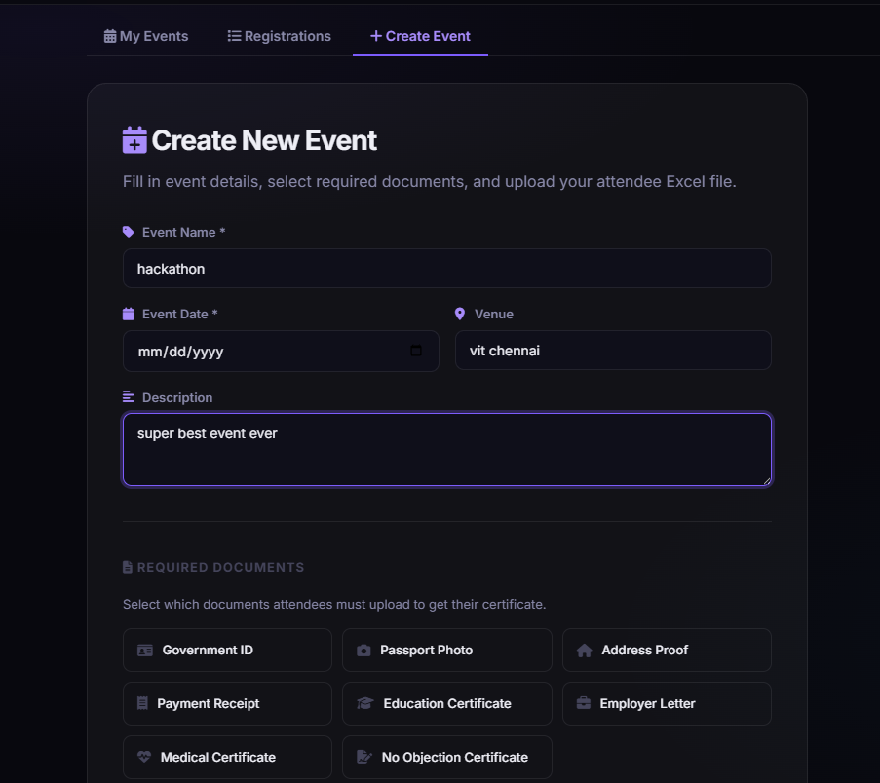
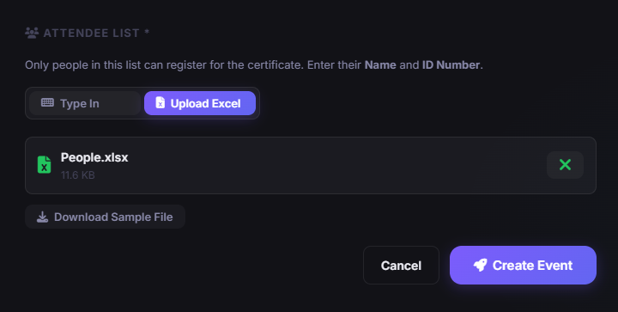


Slide 18
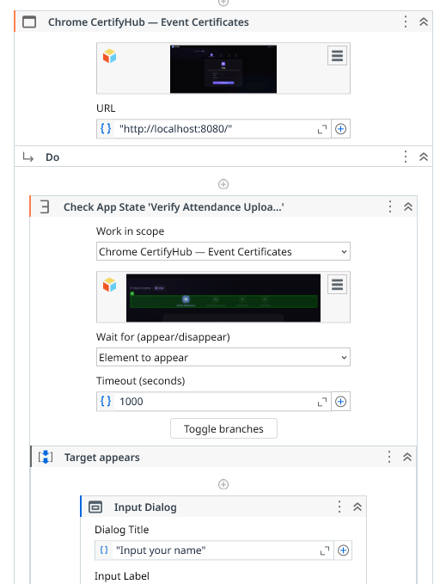
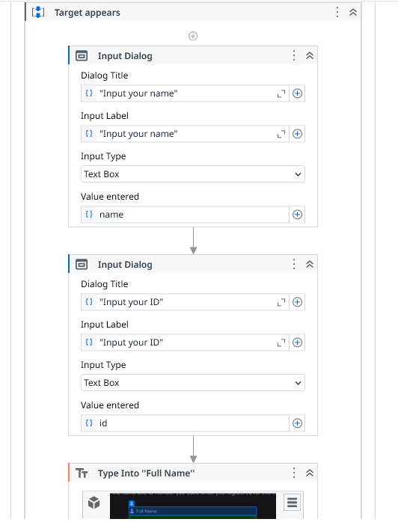
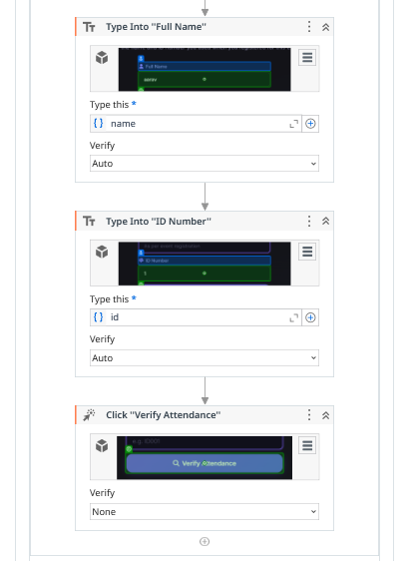

Slide 19
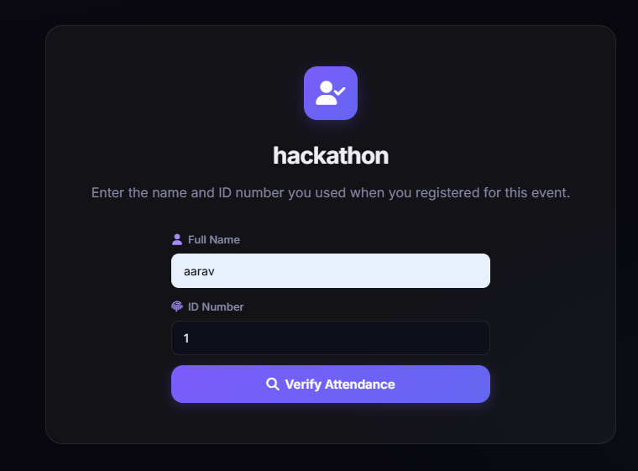

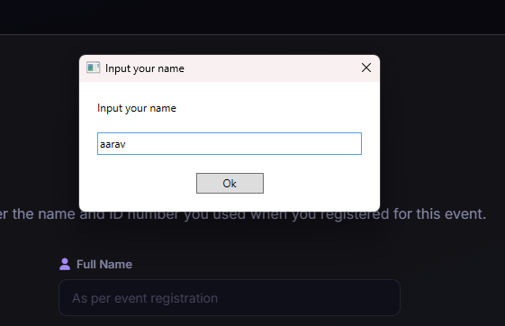
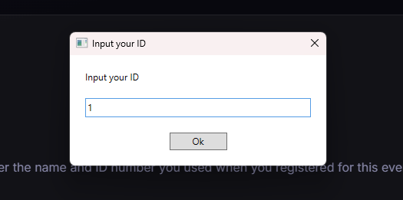

Slide 20
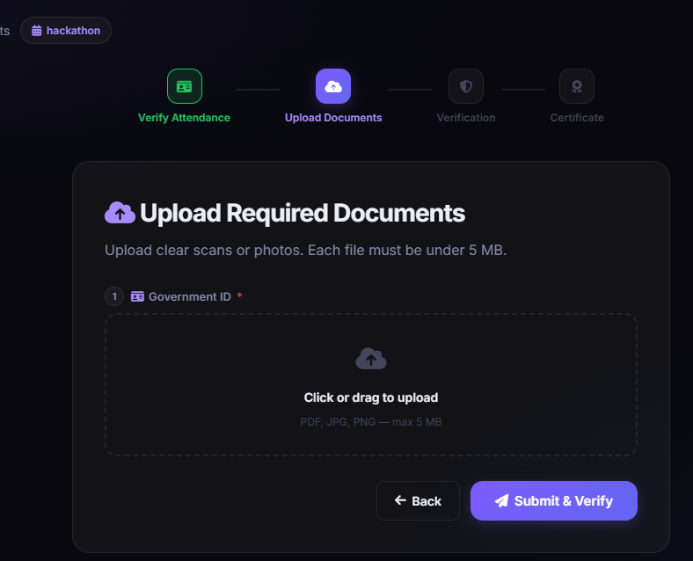
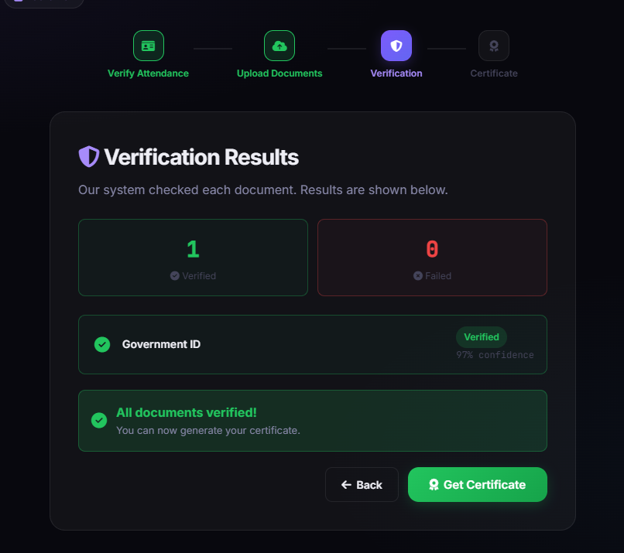

Slide 21
