Slide 1
CHAPTER 1
Why Software Engineering ?

Slide 2
1.1 What Is Software Engineering ?
  Software Is One Way to Solve Problems
    (There are some other ways.)
  Solving Problems Need
    Understanding the Nature of Problems
    If Possible and Appropriate, Using Software to Implement the Solution
  Software Is a Good Way to Solve Complex Problems
  Never Impose computing machinery or techniques on Problem that Comes Our Way

Slide 3
1.1.1 The Process of Solving Problems
  Step 1 :Analyzing(分析)
    Break the Problem into Pieces We Can Understand
    Describe the Problem as a Collection of Small Problems and Their Interrelationships
  Step 2: Solving Small Problems
  Step 3: Construct the Solution through Synthesis(合成)
    Put together of Large Structure from Solutions of Small Problems (from Components that Address the Problem’s Various Aspects )

Slide 4
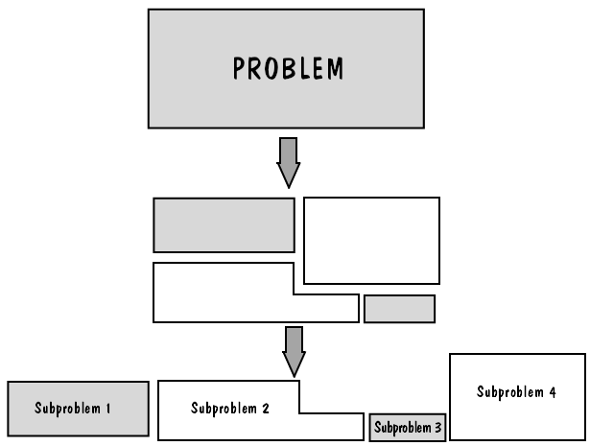
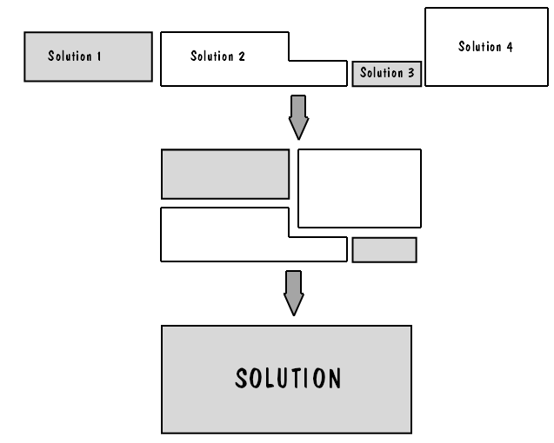
  The Synthesis or Composition from Solutions of Small Problems to The Large Problem May Be as Challenging as Analyzing and Finding Solutions Themselves.
Figure 1.1 The process of analysis.
Figure 1.2 The process of synthesis.

Slide 5

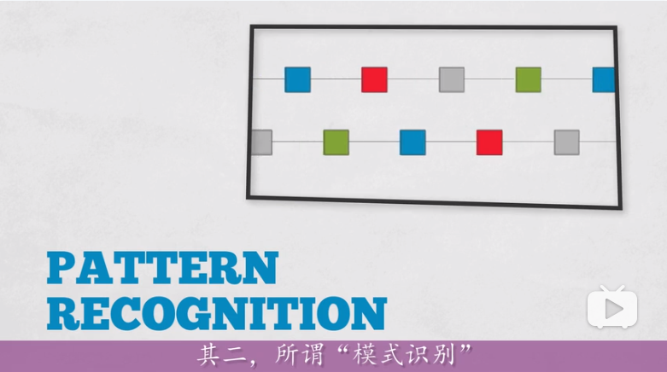
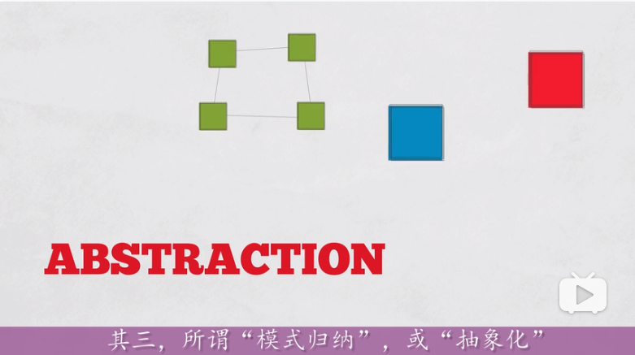
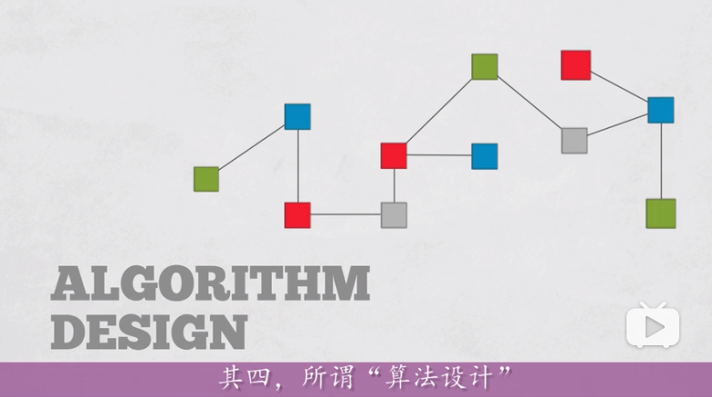
Computational Thinking https://www.bilibili.com/video/av24081690?spm_id_from=333.338.__bofqi.16

Slide 6
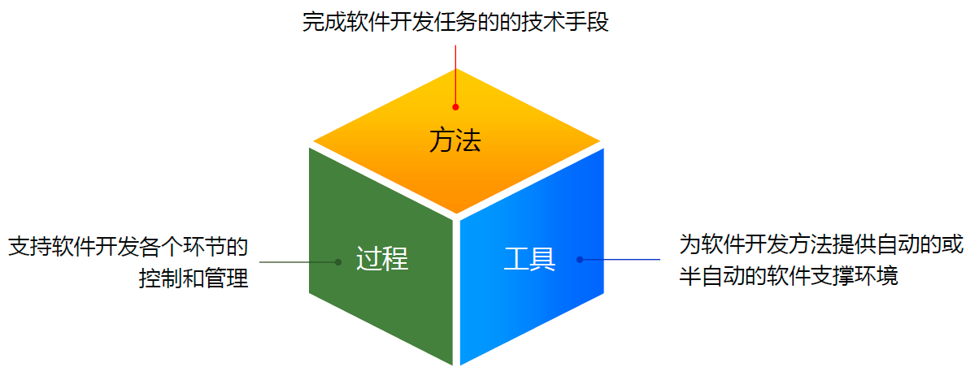
1.1.2 Ingredient for Solving a Problem
Method / Technique
Procedure
Tool

Slide 7
  A Method or Technique 方法/技术
    Is a Formal Procedure for Producing some Useful Result 形式化过程
    Example: Preparing a Sauce May Need and Involve Various Ingredients, Cooking Equipment, Timing,…
    “Hello World” Java程序：1.下载并安装JDK；2.编辑java源程序；3.使用javac.exe编译成字节码文件；4.在JVM中执行。
  A Tool 工具
    Is an Instrument or Automated System for Accomplishing Something in a Better Way.
    “Better Way” : Tools Make Us More Accurate, More Efficient, or More Productive, Or It Enhance the Quality of the Resulting Product.
    Examples: Typewriter, Scissors, 锅、微波炉……
    Examples: Eclipse, Jbuilder, Netbeans…

Slide 8
  A Procedure 过程
    Is a Combination of Tools and Techniques to Produce a Particular Product.
    使用notepad和Eclipse完成一个java程序的过程有所不同
  A Paradigm or Style 模式/风格
    A programming paradigm is a fundamental style of computer programming, serving as a way of building the structure and elements of computer programs.编程范式，计算机编程的基本风格或典范模式
    Programming paradigm 提供了（同时决定了）程序员对程序执行的看法。如果把一门编程语言比作兵器，它的语法、工具和技巧等是招法，它采用的编程范式则是心法
    Example: Procedure vs. OO Programming vs. Functional Programming
    指令式编程、声明式编程、面向对象编程、函数式编程(https://www.bilibili.com/video/av3873315?from=search&seid=15262070634178599152)等
Notes:
函数是"第一等公民“
var print = function(i){ console.log(i);};
[1,2,3].forEach(print);
====
"并发编程"（concurrency）。
var s1 = Op1();
var s2 = Op2();
var s3 = concat(s1, s2);

Slide 9
1.1.3 What is Software Engineering
Software engineers use tools, techniques, procedures, and paradigms to enhance the quality of their software products.
Their aim is to use efficient and productive approaches to generate effective solutions to problems.

Slide 10
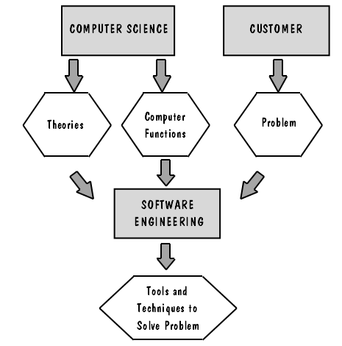
1.1.4 Where Does the SE Fit In ?
Computers and Programming Languages Are Tools
  They are used in designing and implementing a solution to a problem.
  Software engineers focus on the computer as a problem-solving tool.
  Software engineers work with the functions of a computer as part of a general solution, rather than with a the structure or theory of the computer itself.
Figure 1.3 The relationship between computer science and software engineering.

Slide 11
1.2 How Successful Have We Been ?
Writing software is an art as well as a science
  We need programs that may be more efficient, more precise, more robust, easier to use, easier to modify, easier to understand, easier to maintain.
  That is, We need to produce quality programs.

Slide 12
1.2.1 How Successful Have We Been ?
  Software has enabled us perform tasks more quickly and effectively than ever before.
    Example: Word processing, electronic mail, life-sustaining or life-saving in medicine, weather-forecasting, multimedia education, robotics, and more.
  However, software does not always function exactly as expected.
    Example: failure on its maiden flight of Ariane-5 of European Space Agency, On June 4,1996.
    Faults in any program may : be merely annoying, or cost a great deal of time and money, or life-threatening.
    Programs containing faults are not acceptable when developing a system for delivery to a customer.
Notes:
Ability

Slide 13
1.2.2 Terminology for Describing bugs
  A “bug” can be any mistake or error in coding.
  A Fault(缺陷) occurs when a human makes a mistake or error(错误), in performing some software activity.
    Example: a designer may misunderstand a requirement, and create a design that does not match the actual intent of the requirement analyst and the user.
    This design fault is an encoding of the error;
    It can lead to other faults, including errors in other coding or user’s manual.

Slide 14
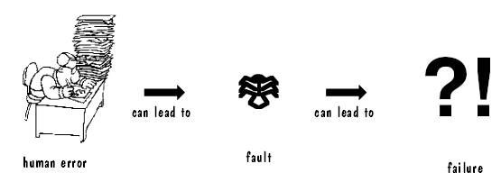
  A Failure(失败) is a departure from the system’s required behavior, usually caused by faults.
    It can be discovered before or after system delivery, during testing, or during operation or maintenance.
    Requirements documentation may contain faults.
  A Fault is an inside view of the system : problems seen by developers.
  A Failure is an outside view : problems seen by users.
  Not every fault corresponds to a failure
    Example : fault code never executed.
  How human error causes a failure (Fig.1.4)

Slide 15
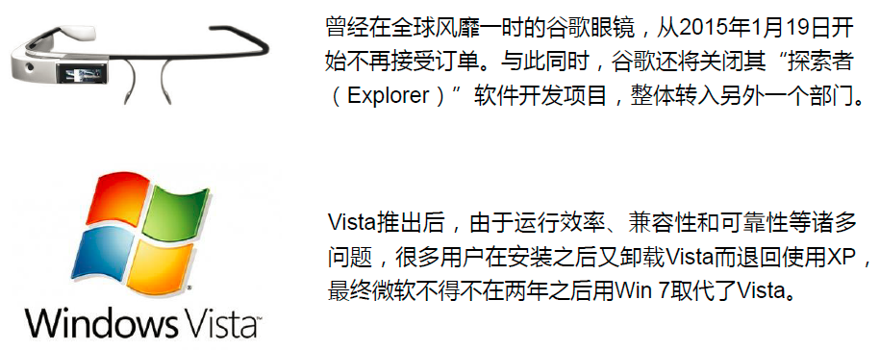
1.2.3 Facts and Backgrounds (some cases)
  1980s: the $4-billion fiasco in USA
    An automated federal income tax form processing system
  Therac-25, a radiation therapy and X-ray machine, when malfunctioned because of its improperly design or programming, killed several patients.

Slide 16
  1985: Strategic Defense Initiative (SDI) heightened the public’s awareness of difficulty of producing a fault-free software.
    Now, as U.S. Congress is asked to allocate funds to build a similar system, many computer scientists and software engineers continue to believe: there is no way to write and test the software to guarantee adequate reliability.
    It is estimated that the system would require at least 10~100 million lines of code. Further more, the reliability constraints would be impossible to test.
  For typical safety-critical systems (any failure poses a threat to life or health), the reliability requirement would as high as at least 10-9 , which means that it would run 109 hours (114,000 years) without failure.

Slide 17
  Manufactures are striving for zero-defect software, in fact most software products are not fault-free. 0-缺陷软件
    Market forces encourage developers deliver products quickly, with little time to test thoroughly.市场压力
    Modification needed to fix known faults sometime are so difficult to make. 变化
    Lack of quality can be costly; the longer a fault goes undetected, the more expensive to correct it.
      correcting an error made during the initial analysis only cost 1/10 of after it is delivered to customer.

Slide 18

1.3 What is Good Software ?
1.3.1 Different Perspectives on Quality
  Transcendental view超越 : quality is something we can recognize but not define.
  User’s view 用户: quality is the fitness for purpose.
    We can measure product quality such as defect density or reliability.
  Manufacturing view制造 : quality is the conformance to software specification.
  Product view产品 : quality is tied to inherent product characteristics.
  Value-based view基于价值 : quality depends on the amount the customer is willing to pay for it.

Slide 19
1.3.2 Consider Quality in at least 3-Ways
  Context helps to determine the answer to software quality.
  3-Ways to consider software quality
    The quality of product itself. 产品角度
    The quality of the process that results in the product. 过程角度
    The quality of the product in the context of the business environment in which the product will be used. 商业环境角度

Slide 20
1．The Quality of Product
  Quality and functionality of a system sometime may intertwined.
  We try to measure software quality
    Identify particular aspects of a system that contribute to the overall quality.
  External characteristics as number of failures and type of failures 产品外部的角度
    Minor Failures, major failures, catastrophic failures
    We expect only minor failures occur.
  Internal characteristics 产品内部的角度
    Numbers and types of faults to reflect the product quality
    Faults found in requirements, design and code
  McCall’s model of quality (see Fig 1.5)

Slide 21
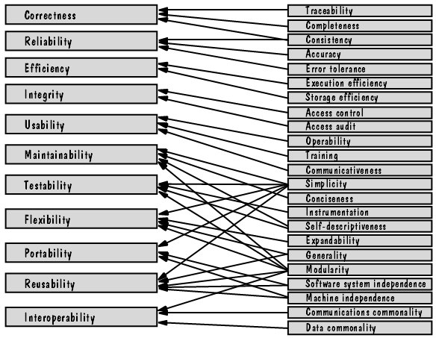
McCall’s product quality model (Fig1.5)
  High Level Quality Measures:
    Correctness, Reliability, Efficiency, Integrity, Usability…
  Low Level Quality Measures:
    Trace-ability, Completeness, Consistency, Accuracy…

Slide 22
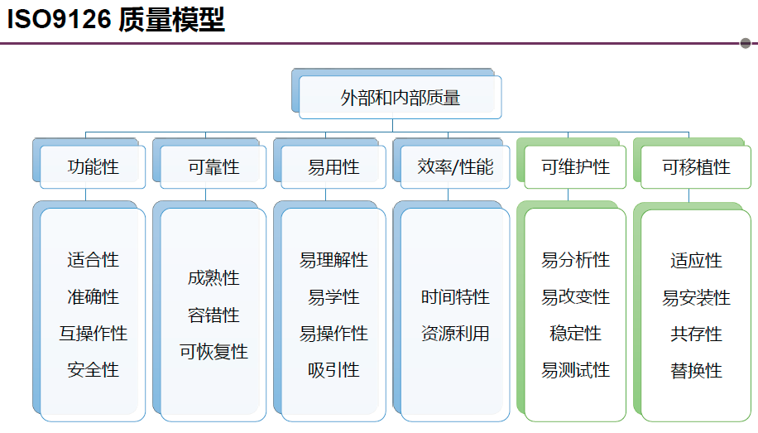

Slide 23
２．The Quality of Process 过程的质量
  Product development activity may affect quality.
  Process modeling can help to find ways to improve quality.
  The concern about process is to Try to find answers
    Where and when to find a particular kind of faults ?
    How can find faults earlier ?
    How can build in fault tolerance to minimize the likelihood that a fault will become a failure ?
    Can we find alternative activities to make the process more effective or efficient at assuring quality ?
  Focus on process modeling and process improvement in SE.
    CMM : Capability Maturity Model
    ISO 9000
    SPICE : Software Process Improvement and capability determination

Slide 24
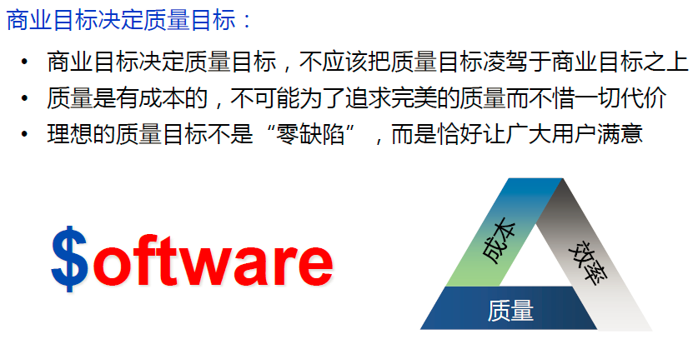
３．Quality in the business environment
  Business value : Return On Investment (ROI)
    Including or considering : original funding, funds earned and plus possible risk
  U.S. Government and U.S. industry interpret ROI in different ways
    Government view : in terms of dollars, looking at reducing operating costs, dollars savings and calculating the cost of employing new technologies
    Industry view : in terms of effort, looking at saving time and using fewer people
    Generally, ROI including : training, schedule, risk, quality, productivity, process, customer, costs, business (Fig 1.6)

Slide 25
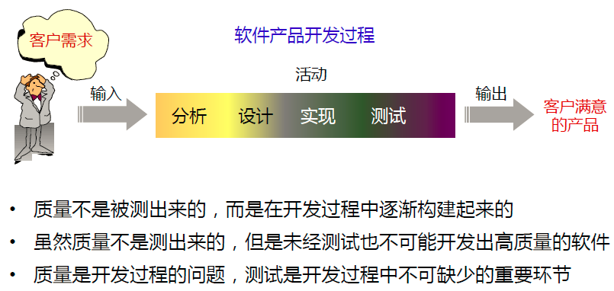
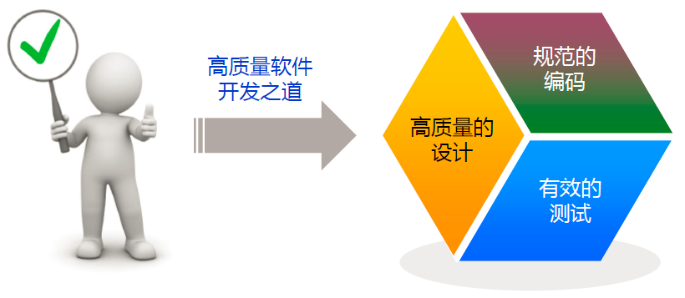

Slide 26
1.4 Who Does SE?
People involved in Software Development
  The number of people working on software development depends on the project’s size and degree of difficulty.
  Roles played through out the life of a software project
    For a large project, one person or a group may be assigned to each roles identified.
Roles played in the development
  Customer (客户): company, organization or person who is paying for the software to be developed.
    In control of the funds, will negotiate the contract and sign the acceptance papers.
  Developer (开发者): company, organization or person who is building the software for the customer.
  User (用户): person or people who will sit at the terminal and actually use the system.

Slide 27
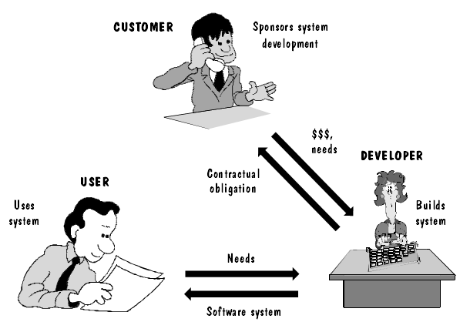
Figure 1.7 Participants in software development.

Slide 28
The simple distinction may become complex
  sometimes the customer is not a user.
  Sometimes an organization or division will at the same time be the customer, developer and user.
  Sometimes, customers and users may have involved in the development process in a variety of ways.
  A developer may choose to use additional developers, called subcontractors. 次承包商
    They build a subsystem and deliver it to the developer to be included in the final product.
    The subsystem may be turnkey system, where the code is an incorporated whole without additional code for integration. 组装完备,可以立即启用的电脑系统 (整套承包系统)

Slide 29
1.5 A Systems Approach 研究“系统”
“系统”的哲学定义
由相互联系、相互作用的若干要素构成的具有位的结构和特定功能的有机整体。本质属性是整体性。
1.5.1 The Elements of a System系统中的元素
(1) Boundary 系统边界
  System is set of components interrelated, and it must interact with outside components as well.
  Boundaries (边界): what is included in the project or system and what is not.

Slide 30
(2) Objects 系统中的对象
  Objects or entities are the elements of a system (对象/实体是系统中的元素)
    An object has its own structure and activities
  Objects are related with each other in some way
  (对象之间以某种方式彼此联系)
(3) Activities 活动
  Activities are also the elements of a system(发生在系统中的事件，通常由某个触发器引发，由多个对象共同参与完成)
    Activities transform one thing to another by changing object characteristics
  Activities normally are attached to some objects 系统中的活动与某些对象关联
    But not necessarily

Slide 31
(4) Relationships among objects and activities 对象和活动之间的关系
  They must be clearly and carefully defined.
  Object definition includes a description of where they are originated or destined.
    Some items reside in other objects that already exist
    Others are created during some activities
    Some objects are used by activities outside the scope of the system.
System is described by its parts and part-relationships (components)
A system is a collection of things:
  a set of objects 对象的集合
  a set of activities 活动的集合
  the relationships among objects and activities 对象和活动之间的联系
  definition of the boundary of system 系统边界的定义

Slide 32
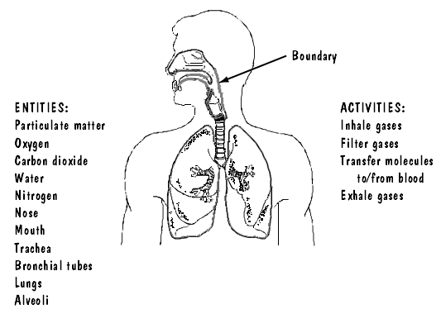
Figure 1.8 Respiratory system.

Slide 33
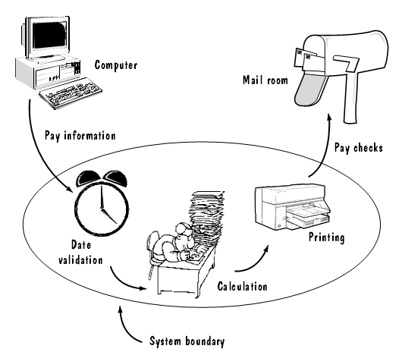
Figure 1.9 System definition of paycheck production.

Slide 34
1.5.2 Interrelated System 相互联系的系统
  Once the boundary of a system is described, we can easily find What is within, without and across the system boundary. （系统边界的重要性）
  A Large system may be composed of with other systems, called sub-systems（系统中包含子系统）
    Treatment of separate, smaller systems makes the system understanding and construction much easier 整个系统更加容易理解和构建
    Sub-system may be replaced with other similar ones子系统可能进一步细分

Slide 35
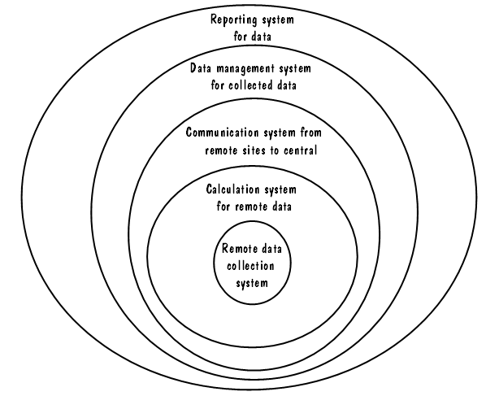
  System is constructed in may different ways
    System may exists inside another system 分子系统开发
    System may be composed of in the form of layers or aggregation 分层的构建方法
    System construction can be an incremental series of intermediate system (incremental development approach) 增量开发方法
Figure 1.10 Layers of a water-monitoring system.

Slide 36
1.6 An Engineering Approach
工程的方法
Engineering development is an artistic approach to use tools and techniques
The process of Building a House
The process of building a software system

Slide 37
1.6.1 Building a House
Customer: Howells 客户
Construction Company: McMullen 建筑商
Events involved in the house building:
  A conference where the Howells can explain what they want. 会议：解释需求
  The Mcmullen draws up floor plans and architect’s rending of the house. 设计平面图
  Discusses and changes are made until approval is given by the Howells to Mcmullen. Construction begins. 讨论和修改；开工
  During the construction process, changes/tests. 修改/测试
  The Howells move in, and Mcmullen maintain the house. 交付、维护

Slide 38
The process of building a house 房屋的建造过程 （模型化）
    Determine and analyzing the requirements 确定和分析需求
    Producing and documenting the overall design 总体设计
    Producing the detailed specification 详细设计
    Identifying and designing the components 设计各部件
    Building each components 组件制造
    Testing each components 组件测试
    Integrating the components to form a whole 集成
    Maintenance 维护

Slide 39
Features of house building房屋建造工程的特征
  Documentation is essential.需求、设计文档
  Modifications are inevitable.变化
  Documentation for maintenance must be provided.维护文档
  Participants should remain flexible and allow changes.允许变化的灵活性
  Thus, house building is a complex task with many opportunities for change in processes, products, or resources along the way.

Slide 40
1.6.2 Building a Software System
The progress is in a similar way to the house building
Involving users, customers and developers

Slide 41
Building a house vs. software
Determining and analyzing requirements
Producing and documenting the design
Detailed specifications
Identifying and designing components
Building components
Testing components
Integrating components
Making final modifications
Continuing maintenance
Requirements analysis and definition
System design
Program design
Writing programs
Unit testing
Integration testing
System testing
System delivery
Maintenance

Slide 42
The process of building a software system
    Requirements analysis and definition需求分析
    System design 系统设计
    Program design 程序设计
    Writing or implementing the program 编程
    Unit testing 单元测试
    Integration testing 集成测试
    System testing 系统测试
    System delivery 交付
    Maintenance 维护
  In reality, many of the process steps are repeated. 现实中，是迭代、重复的过程

Slide 43
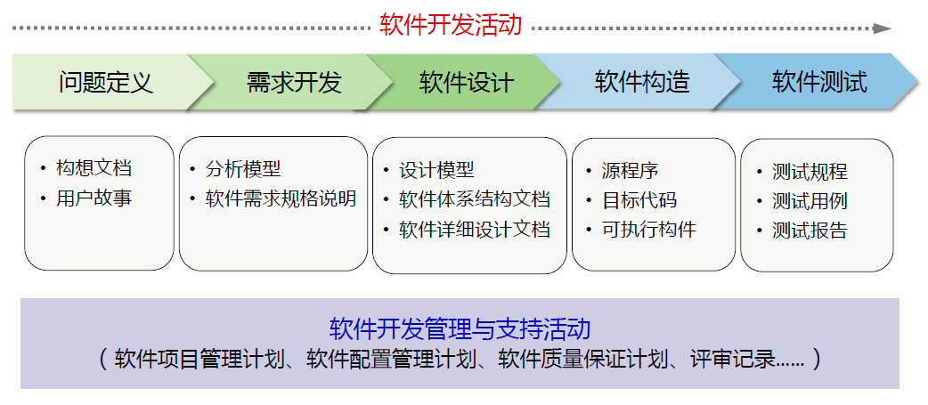
软件开发过程

Slide 44
1.7 Members of development team
Role of the members
  Requirement analysts 需求分析人员
  Designer 设计人员
    generate system-level description
  Programmer 程序员
  Tester 测试人员
  Trainer 培训人员
  Maintainer 维护人员
  Librarians 资料员
    Prepare and store documents, manuals, test data, schedule and more.
  Configuration manager 配置管理人员
    Maintaining correspondence among the requirements, design, code, tests.

Slide 45
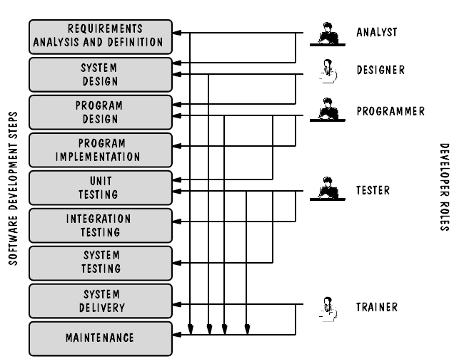
Figure 1.11 The roles of the development team.

Slide 46

1.8 How has SE Changed ? 变化
Difficulties in producing quality software 困难之处
  In the past, developers assumed that the customers knew from the start what they wanted. That stability is not usually the case. 制造业的方法不再可行
  Change of minds is inevitable in every step. 变化无处不在
  As various stages of a project unfold, constraints arise that were not anticipated at the beginning. 无法预料的因素
  Most systems do not stand alone 系统之间交互的复杂性
  It is essential that our software engineering tools and techniques be used with an eye toward flexibility.

Slide 47
1.8.1 The Nature of Change变化的特点
Wasserman(1995) points out that the changes since 1970s have been dramatic.
  Today’s software systems are far more complex.由于技术的进步，当今的系统更为复杂
  The traditional “waterfall” approach to development, which assumes a linear progression of development activities, where one begins only when its predecessor is complete, is no longer flexible or suitable for today’s systems. 瀑布式开发模型不再适应当前的系统

Slide 48
7 key factors that have altered SE practice
At that time Now
Criticality of time-to-market for commercial product 商业产品发布的时间压力
Lower hardware costs and greater development and maintenance costs越来越高的开发和维护成本
Requirement of powerful desktop computing桌面计算能力的需求
Extensive local- and wide-area networking网络的扩展
Adoption of object-oriented technology 面向对象技术的应用
Graphic user interfaces using windows, icons, menus and pointer-devices 图形用户界面
Unpredictability of the waterfall model of software development 瀑布开发模型的不可预知性
√
√
√

Slide 49
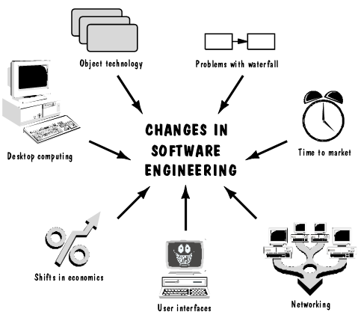
Figure 1.12 The key factors that have changed software development.

Slide 50
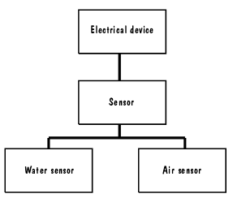
1.8.2 Wasserman’s Discipline
Discipline 1: Abstraction 抽象
  Abstraction is the description of the key aspects of a problem without getting mired in details.
  Abstraction involves identifying classes of objects and their relationships
    We can deal with fewer things and concentrate on the main commonalities or aspects
    We can form hierarchies of abstraction
  Abstraction is different from transformation
Figure 1.13 Simple hierarchy for monitoring equipment.

Slide 51
Discipline 2: Analysis and design methods and notations 分析、设计方法和符号
  Needs a standard notation to help participants communicate and document decisions
  Analysis and design methods offer us more than a communication medium
    Allow us to build models and check them for completeness and consistency
    Help reuse requirements and design components

Slide 52
Discipline 3: User interface prototyping 用户界面原型
  Prototyping : building a small and simple version of a system that can be used to
    Help the user and customer to identify the key requirements of a system
    Demonstrate the feasibility of a design or approach
  Prototyping is often used to design a good user interface

Slide 53
Discipline 4: Software architecture 软件体系结构
A system’s architecture describes the system in terms of a set of architecture units.
The overall architecture of a system is important
  to the ease of implementation and testing, to the speed and effectiveness of maintaining and changing.
  The quality of the architecture can make or break the system. It reflect the principles of good design.
System architecture may be constructed by using architecture styles or design-patterns

Slide 54
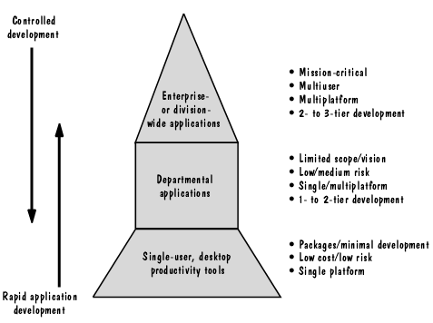
Discipline 5: Software process 软件过程
  Different types of software need different development processes (see Fig 1.14)
  Good tools help great deal in software development
  Large, complex systems need more structure, checks and balances

Slide 55
Discipline 6: Reuse 复用
  Reusing the successful products helps a great deal in software development
    Can gain quantifiable benefit both to the development speed and product quality
  However, several barriers exist
    Sometime building a small one is faster than searching for an existing reusable one
    It may take extra time to make a component more general enough to be reused in other context
    It is difficult to document and assure the quality
    It can be costly and time-consuming to understand and reuse a component written by others

Slide 56
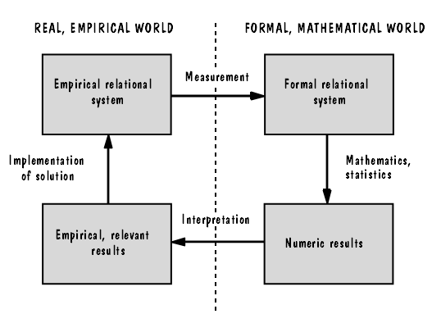
Discipline 7: Measurement 度量
  A quantitative approach permit us to compare different projects, products, processes
Fig 1.15 (Using measurement to help find a solution

Slide 57
Discipline 8: Tools and integrated environments 工具和集成开发环境
  Standardized, integrated developments would enhance software development
    But, different developers use different processes, methods and tools
    Further, venders of tools rarely address the entire development lifecycle, making the use of tools limited within a or several stages.

Slide 58
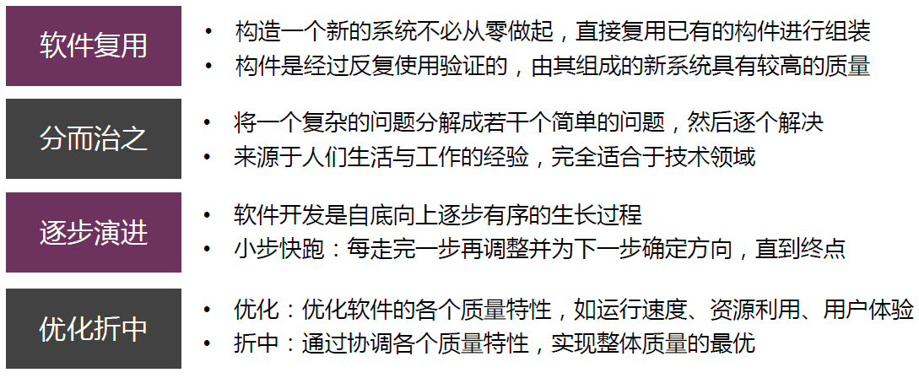
软件开发的基本策略

Slide 59
1.9 Information Systems Example
一个销售某电视台广告时间的软件项目
  难点：电视广告及其费用方面具有大量的规则、规定、约束
    广播委员会对节目时间段、内容、广告等的限制
    电视台必须设定收视率以吸引广告商，收视率根据节目类型、观众类型、时段、电视公司等情况进行报告
    广告费主要由收视率决定，但受其他因素影响，比如根据购买广告时间决定优惠措施
    对特定时间、节目、广告类型的限制（比如酒类广告要在晚上9点以后才允许播出；对某演员的电视剧和广告时间间隔的限制；插播广告的限制等）
    ……
  见图1.17具有系统边界的系统背景图

Slide 60
本章小结
解决问题的一般过程
  Analysis → Construct solution → Synthesis
软件工程及相关概念
  Software Engineering
  Method / Technique
  Tool
  Procedure
  Paradigm / Style
软件工程的作用（与计算机科学定位的区别）

Slide 61
与软件缺陷相关的几个概念及其相互关系 (Terminology for Describing bugs)
  Human Error
  Fault
  Failure
生产零缺陷软件(zero-defect software)的困难
  市场压力、开发过程中的变化和反复、无法预料的情况、与其它系统之间的复杂关系……
由于角度不同，对软件质量的不同观点
从3个方面全面衡量软件质量
  产品本身的质量
  生产过程的质量
  产品在商业环境中的价值

Slide 62
软件项目中的3种基本角色及相互关系
  Customer
  User
  Developer
一个系统的组成成分
  系统边界
  对象
  活动
  对象与活动之间的关系
建造软件系统的工程化过程
  需求分析和定义、系统设计、程序设计、编程、单元测试、集成测试、系统测试、交付、维护

Slide 63
开发队伍的组成角色
  需求分析人员、设计人员、程序员、测试人员、培训人员、维护人员、资料员、配置管理人员
Wasserman所总结的改变软件工程实践的7个主要方面
Wasserman指出的贯穿软件工程过程中的8个原则
  抽象、分析和设计方法/符号、用户界面原型方法、体系结构、软件开发过程、复用、度量、集成开发环境

Slide 64
本章作业
无。

Slide 65
1. The complexity of software is , which causes many issues such as delay of delivery, overrunning of development cost and difficulties in communicating among team members.
A. inherent B. caused by human C. eliminable D. impossible to be reduced
2. Among the following factors, which are the major reasons of software crisis?
① user use software incorrectly ② the inherent characteristics of software ③ unreliability of software
④ wrong understanding ⑤ lack of good method and approach for development ⑥ low efficiency of development
Answers to be selected: A：①③⑥ B：①②④
C：③⑤⑥ D：②⑤⑥

Slide 66
Suppose a library system is being developed. The system has three major subsystems: one that handles the check-out/check-in transactions; one that handles inventories; and one that handles reports. During the development of the system, several problems occur. Identify the problems as errors, faults or failures.
  (1) In the code for calculating late fees, the fine_total variable is not initialized.
  (2) While a librarian is attempting to add a new book title to the inventory, the system shuts down.
  (3) The requirements writer is unaware that a library card is not necessary for the check-in transaction.
  (4) In the requirements document, a late fee is specified as $0.25 per day with a maximum of $15. The code for calculating the late fee does not check for the maximum fee.
  (5) Every evening at 11pm, the library system is supposed to perform a backup of the daily transactions. The backup for Tuesday night did not occur.

