Slide 1

Chapter 7
Writing the
Programs

Slide 2
Contents
7.1 Programming Standards and Procedures
7.2 Programming Guidelines
7.3 Documentation
7.4 The Programming Process

Slide 3
Writing the Program
This task can be daunting
  1. The designers may not have addressed all of the idiosyncrasies of the platform and programming environment 从设计到代码
    Structures and relationships that are easy to describe with charts and tables are not always straightforward to write as code
  2. We must write the code in a way that is understandable可读性
    not only to us, but also to others as the system evolves over time
  3. We must take advantages of the characteristics of the designer’s organization, the data structures, and the programming language’s constructs, while still creating code that is easily reusable 可复用性

Slide 4
7.1 Programming Standards and Procedures
  You must know your organization’s standards and procedures before you begin to write code 理解标准和过程
  Companies usually insist that their code conform to style, format, and content standards
    So the code and the associated documents should be written clear to everyone who will read them

Slide 5
7.1 Programming Standards and Procedures
Standards for you
  methods of code documentation, clear and easy to follow
  Standardized documentation can help you to organize your thoughts and avoid mistakes; also helps in locating faults and making changes
Standards for others
  Integrators, maintainers, testers
  Prologue documentation, Example see p.339
Matching design with implementation
  The most important Standards
  Is the need for a direct correspondence between the program design and the program code
    Any change to the program should be made first to the high-level design and then are traced through lower design levels to the code
  The design characteristics , such as low coupling, high cohesion, and well-defined interfaces should also be program characteristics

Slide 6
7.2 Programming Guidelines
The design is a guide to the function or purpose of each component, but the programmer has great flexibility in implementing the design as code
We will discuss several guidelines that apply to programming in general
  Regardless of the programming languages
Each program component involves
  At least three major aspects: control structures, algorithms, and data structures

Slide 7
7.2.1 Control structures
Program structure should reflect the design 程序结构必须反映出设计的控制结构
  Make the code easy to read可读性
  Build the program from modular blocks模块化编程
  Make the code not too specific, and not too general通用性
  Use parameter names and comments to exhibit coupling among components
    Use global variables as less as possible
    Indicate clearly the parameters being passed to and back
    Dependence among components must visible
    Components should hide calculation details

Slide 8
Example of Control Structures
Control skips around among the program’s statements
    benefit = minimum;
    if (age < 75) goto A;
    benefit = maximum;
    goto C;
    if (AGE < 65) goto B;
    if (AGE < 55) goto C;
    A: if (AGE < 65) goto B;
    benefit = benefit * 1.5 + bonus;
    goto C;
    B: if (age < 55) goto C;
    benefit = benefit * 1.5;
    C: next statement
Rearrange the code
      if (age < 55) benefit = minimum;
      elseif (AGE < 65) benefit = minimum + bonus;
      elseif (AGE < 75) benefit = minimum * 1.5 + bonus;
      else benefit = maximum;

Slide 9
7.2.2 Algorithms
Take great discretion in performance or efficiency of your implementation
  Making the code faster may involve hidden costs
    The cost to write and modify the faster code
    The cost and time to test the code
    The cost of time for users to understand
you should balance execution time with design quality, standards and customer requirements在性能与其他质量因素之间进行平衡
  Compiler may make your seemingly faster optimized code actually slow down

Slide 10
Example
while (expression)
{
A;
if (f) /* f 是个常数表示式。 */
B;
else
C;
D;
}
为了执行效率 ,是不是应该把一个这样的循环 改写成这样
if (f)
while (expression)
{
A;
B;
D;
}
else
while (expression)
{
A;
C;
D;
}
其中 A 跟 D 表示两堆叙述。

Slide 11
7.2.3 Data Structures
  Keeping the program simple
    Data manipulation can influence your choice of data structures
    See example in p.343-344
      The calculation are simplified just by changing the way the data are defined
      This makes the program easier to understand, test and modify
  Using data structures to determine a program structure
    Data structures can influence the organization and flow of a program, including the choice of language

Slide 12
Keep the Program Simple
Example: Determining Federal Income Tax
For the first $10,000 of income, the tax is 10%
For the next $10,000 of income above $10,000, the tax is 12 percent
For the next $10,000 of income above $20,000, the tax is 15 percent
For the next $10,000 of income above $30,000, the tax is 18 percent
For any income above $40,000, the tax is 20 percent
      tax = 0.
      if (taxable_income == 0) goto EXIT;
      if (taxable_income > 10000) tax = tax + 1000;
      else{
      tax = tax + .10*taxable_income;
      goto EXIT;
      }
      if (taxable_income > 20000) tax = tax + 1200;
      else{
      tax = tax + .12*(taxable_income-10000):
      goto EXIT;
      }
      if (taxable_income > 30000) tax = tax + 1500;
      else{
      tax = tax + .15*(taxable_income-20000);
      goto EXIT;
      }
      if (taxable_income < 40000){
      tax = tax + .18*(taxable_income-30000);
      goto EXIT;
      }
      else
      tax = tax + 1800. + .20*(taxable_income-40000);
      EXIT;

Slide 13
Keep the Program Simple Example (continued)
Define a tax table for each “bracket” of tax liability
Simplified algorithm
  for (int i=2; level=1; i <= 5; i++)
  if (taxable_icome > bracket[i])
  level = level + 1;
  tax= base[level]+percent[level] * (taxable_income - bracket[level]);
Bracket | Base | Percent
0 | 0 | 10
10,000 | 1000 | 12
20,000 | 2200 | 15
30,000 | 3700 | 18
40,000 | 55000 | 20

Slide 14
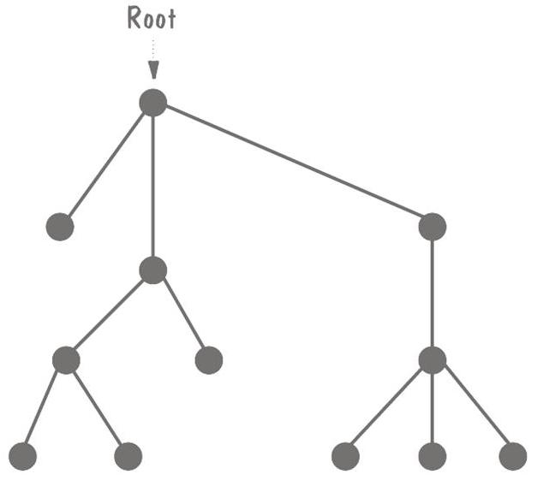
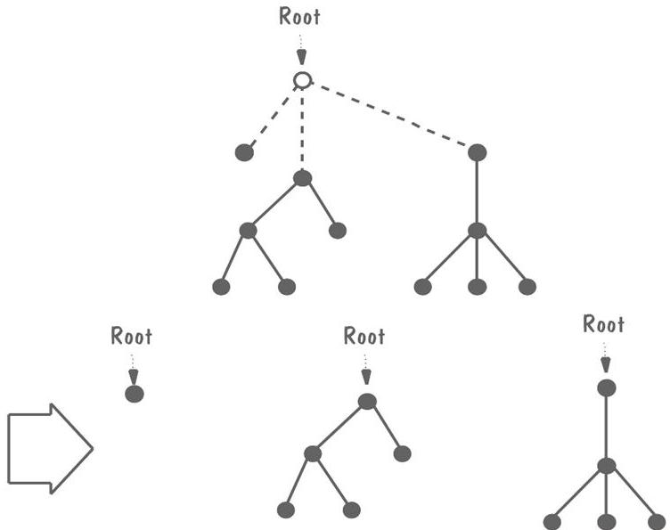
Data Structures Example: Rooted Tree
Recursive data structure
Graph composed of nodes and lines
  Exactly one node as root
  If the lines emanating from the root are erased, the resulting graph is a rooted tree

Slide 15
General Guidelines
Localizing input and output
Including pseudo-code
Revising and rewriting, not patching
Reuse
  Producer reuse
    Creating components to be reused in subsequent applications
  Consumer reuse
    Using components that were originally developed for other projects

Slide 16
Example of Pseudocode
The design for a component of a text processing system states
  COMPONENT PARSE_LINE
    Read nest eighty characters.
      IF this is a continuation of the previous line,
        Call CONTINUE
      ELSE determine command type
      ENDIF
    CASE of COMMAND_TYPE
      COMMAND_TYPE is paragraph: Call PARAGRAPH
      COMMAND_TYPE is indent : Call INDENT
      COMMAND_TYPE is skip line: Call SKIP_LINE
      COMMAND_TYPE is margin : Call MARGIN
      COMMAND_TYPE is new page : Call PAGE
      COMMAND_TYPE is double space : Call DOUBLE_SPACE
      COMMAND_TYPE is single space : Call SINGLE_SPACE
      COMMAND_TYPE is break : Call BREAK
      COMMAND_TYPE is anything else: Call ERROR
    ENDCASE

Slide 17
Example of Pseudocode (continued)
Intermediate pseudocode
    PARAGRAPH:
      Break line, flush line buffer. Advance one line between paragraph. If fewer than 2 line left on page, eject. Set line pointer to paragraph indent.
    INDENT:
      Break line, flush line buffer. Get indent parameter. Set line pointer to indent parameter, set left margin to indent.
    SKIP_LINE:
      Break line, flush line buffer. Get line parameter. Advance (parameter) lines or eject if not enough space left on current page.
    MARGIN:
      Break line, flush line buffer. Get margin parameter. Set line pointer to left margin. Set right margin to margin.
    PAGE:
      Break line, flush line buffer. Eject page. Set line pointer to left margin
    SOUBLE_SPACE:
      Set interline space to 2.
    SINGLE_SPACE:
      Set interline space to 1
    BREAK:
      Break line, flush line buffer. Set pointer to left margin

Slide 18
Example of Pseudocode (continued)
Regrouped
    FIRST:
    PARAGRAPH, INDENT, SKIP_LINE, MARGIN, BREAK, PAGE:
      Break line, flush line buffer.
    SOUBLE_SPACE, SINGLE_SPACE :
      No break line, no flush line buffer.
    SECOND:
    INDENT, SKIP_LINE, MARGIN:
    Get parameter.
    PARAGRAPH, BREAK, PAGE, DOUBLE_SPACE, SINGLE_SPACE:
    No parameter needed.
    THIRD:
    PARAGRAPH, INDENT, SKIP_LINE, MARGIN, BREAK, PAGE:
    Set new line pointer.
    DOUBLE_SPACE, SINGLE_SPACE:
    New line pointer unchanged.
    FOURTH:
    Individual action taken

Slide 19
Example of Pseudocode (continued)
Final pseudocode
    INITIAL:
      Get parameter for indent, skip_line, margin.
      Set left margin to parameter for indent.
      Set temporary line pointer to left margin for all but paragraph; for paragraph, set to paragraph indent.
    LINE_BREAKS:
      If not (DOUBLE_SPACE or SINGLE_SPACE), break line, flush line buffer and set line pointer to temporary line pointer
      If 0 lines left on page, eject page and print page header.
    INDIVIDUAL CASES:
      INDENT, BREAK: do nothing.
      SKIP_LINE: skip parameter lines or eject
      PARAGRAPH: advance 1 line; if < 2 lines or page, eject.
      MARGIN: right_margin = parameter.
      DOUBLE_SPACE: interline_space = 2.
      SINGLE_SPACE: interline_space = 1;
      PAGE: eject page, print page header

Slide 20
Consumer Reuse
Four key characteristics to check about components to reuse
  does the component perform the function or provide the data needed?
  is it less modification than building the component from scratch?
  is the component well-documented?
  is there a complete record of the component’s test and revision history?

Slide 21
Producer Reuse
Several issues to keep in mind
  make the components general
  separate dependencies (to isolate sections likely to change)
  keep the component interface general and well-defined
  include information about any faults found and fixed
  use clear naming conventions
  document data structures and algorithms
  keep the communication and error-handling sections separate and easy to modify

Slide 22
7.3 Documentation
Program documentation
  The written description that explain what the programs do and how they do it
  Internal documentation
    The descriptive material written directly within the code
  External documentation
    All other documentation

Slide 23
7.3.1 Internal Documentation
Header comment block
    What, who, where, when, why, how
    More detailed information
Other program comments
    Statements are formatted clearly
      Comments can break the code into phases
    State the intention, rather than the behavior itself
    Meaningful variable names and statement labels
      Labels, variables and data names are descriptive and easy to distinguish
    Formatting to enhance understanding
      Proper indentation and spacing of statements to reflect the basic control structure
    Update comments to reflect the change

Slide 24
7.3.2 External Documentation
It answers the same questions
  Who, what, why, where, how
  It often includes an overview of the system’s components
  Diagrams with narrative description
    Show how data are shared and used
The contents
  Describing the problem
  Describing the algorithm
  Describing the data

Slide 25
7.4 The programming process
7.4.1 Programming as Problem-Solving
什么样的人能编程？
如果你能确信，自己知道在早上起床后需要做的事情：
如果天冷，则先穿衣服，然后洗漱；
如果天热，则反之；
日复一日直到死亡。
那么你就可以开始编程了。
Four distinct stages of finding a good solution
  Understanding the problem 理解问题
    分析问题元素
    理解解决问题的前提条件
    分解成小规模的、易处理的子问题
  Devising a plan 制定计划

Slide 26
  Devising a plan 制定计划
    识别相似/相关的问题，复用部分解决方案
    重新理解/表述问题
    根据本质，分解问题
  Carrying out the plan 执行计划
    验证解决方案
    评价每个步骤
  Looking back 回顾
    回顾、检查
    评价

Slide 27
7.4.2 Extreme Programming
Two types of participants:
  customers
    定义需要实现的特征
    详细描述的测试活动
    确定场景及其测试的优先级
  Programmers
    根据客户确定的优先级，编程实现应用场景
    估算交付周期

Slide 28
7.4.3 Pair Programming
One of the more radical of the agile method techniques. 极限编程的基本特征
A pair of programmers uses a single keyboard, display, and mouse.
  One person: the driver or pilot, controlling the computer and actually writing the code.
  The other person: the navigator, reviewing the driver’s code and providing feedback.
The two members exchange roles periodically.

Slide 29
Whither Programming?
Documentation is still essential in agile-methods
  Assist the developers in planning, as a roadmap
  Helps describe key abstractions and defines system boundaries
  Assists in communicating among team members

Slide 30
本章小结
Programming standard and process
three major aspects of program
  control structures
  Algorithms
  data structures
General guidelines in preserving design quality in your code
Program documentation
  internal documentation
  external documentation
The programming Process

