Slide 1

Chapter 8
Testing the
Programs

Slide 2
Contents
8.1 Software Faults and Failures
8.2 Testing Issues
8.3 Unit Testing
8.4 Integration Testing
8.5 Testing Object Oriented Systems
8.6 Test Planning
8.7 Automated Testing Tools
8.8 When to Stop Testing

Slide 3
Testing the Program
  There are several types of testing
    They will lead you to delivering a quality system to your customers
    Testing is focused on finding faults
    There are many ways to make testing efforts more efficient and effective

Slide 4
8.1 Software Faults and Failures
Software sometime does not work properly. The reasons are :
  Software systems deal with large number of states with complex formulas, activities and algorithms
  The customer is sometime uncertain of exactly what is needed
  The size of the project and the number of people involved can add complexity

Slide 5
8.1.1 Software Failures
  What do we mean when a software has failed ? 什么是软件失败？
    We mean that the software does not do what the requirements describes 与需求背离
  The failure may be the result of any several reasons 软件失败的原因
    The wrong specification or a missing requirement
    a requirement may be impossible to implement
    The system design may contain faults
    The program design may contain faults
    The code may be wrong

Slide 6
8.1.2 Objective of Testing
Checking Code to make sure correctness
  No matter how capable we write program
  Most views that : Testing is a demonstration that the programs performs properly
  However, testing is to demonstrate the existence of any fault
  Therefore, we consider a test successful only when a fault is discovered, or a failure occurs as a result of the testing
Objective of testing: discover faults
Fault identification 缺陷识别/定位
  The process of determining what caused the failure
Fault correction or removal 缺陷改正
  The process of making changes to the system so that the faults are removed

Slide 7
8.1.3 Types of Faults
Algorithmic Faults 算法缺陷
  When an algorithm does not produce the proper output for a given input
  Typical algorithmic faults include
    Branching too soon or too late
    Testing for the wrong condition
    Forgetting to initialize variables
    Forgetting to test for a particular condition
    Comparing variables of inappropriate data types
    Syntax faults : inappropriate use of the constructs of programming languages

Slide 8
Computation and Precision Faults 计算和精度缺陷
  Improper use of floating-point data, unexpected truncation, or ordering of operations, may result in less-than-acceptable precision
Documentation Faults 文档缺陷
  The documentation does not match what the program actually does
  Such faults may lead to a proliferation of other faults later in the program life

Slide 9
Stress or overload Faults 压力/过载缺陷
  When data structures are filled past their specified capacity
  Queues, buffers, tables, arrays,…
Capacity or Boundary Faults容量/边界缺陷
  When the system’s performance becomes unacceptable as a system activity reaches its specified limit

Slide 10
Timing or Coordination Faults 时间/协同缺陷
  When coordination of several processes or a carefully defined sequence is broken
  This type of faults are hard to identify and correct
    It is difficult to anticipate all possible system states
    Too many factors may be involved with the timing and processing
    It may be impossible to replicate a fault after it has occurred
Throughput or Performance Faults 性能缺陷
  When the system does not perform at the speed prescribed by the requirements

Slide 11
Recovery Faults 恢复能力缺陷
  When a failure is encountered and the system does not behave as the designers desire or as the customer requires
Hardware or system Faults 硬件/系统缺陷
  When the supplied hardware or software do not actually work according to the documented operating conditions and procedures
Standards and Procedure Faults 标准/过程缺陷
  The Code does not follow the organizational standards and procedures

Slide 12
8.1.4 Orthogonal Defect Classification
Historical Information
  Can help us predicate what types of faults is likely to have in our code
    Certain types of faults can warn us that it may be time to rethink the design or requirements
  Many organizations perform statistical fault modeling and casual analysis
Orthogonal defect classification
  An approach to fault tracking, where faults are placed in categories
  This paints a picture of which parts of the development process need attention, because they are responsible for spawning many faults
  See Table 8.1, for the list of types of faults

Slide 13
Orthogonal defect classification
  A Fault of omission : is one that results when some key aspects of the code is missing
    E.g. lack of a variable initialization
  A fault of commission : is one that is incorrect
    E.g. the variable is initialized with the wrong value
  A classification is orthogonal if any item being classified belongs to exactly one category
  Fault classification must be clear and orthogonal
  Fault classification tells us which types of faults are found in which development activities
    See Fig 8.1

Slide 14
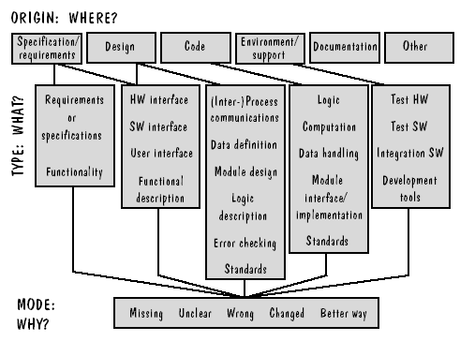
Figure 8.1 HP fault classification(Grady 1997)

Slide 15
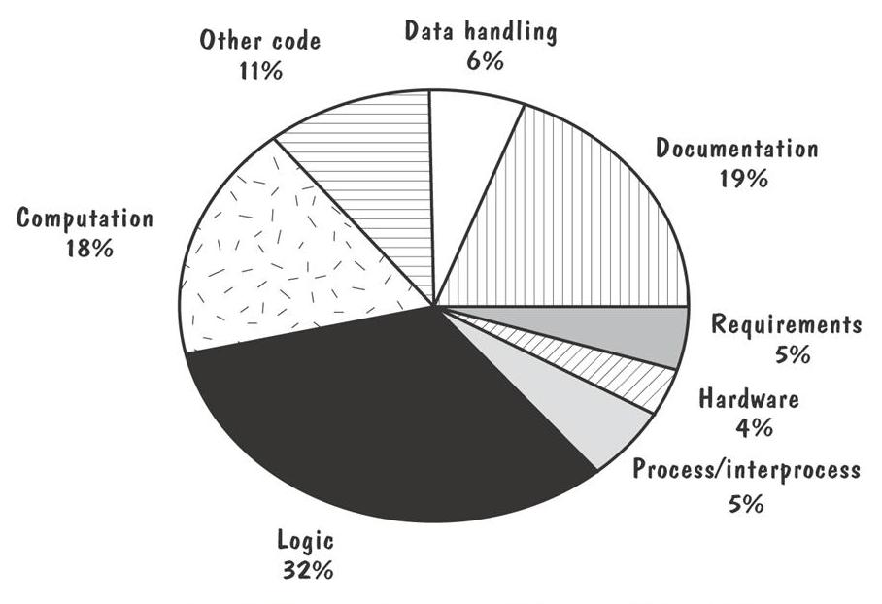
Sidebar 8.1 Faults for one Hewlett-Packard Division

Slide 16
8.2.1 Test Organization
8.2 Testing Issues
1. Module testing/component testing/unit testing 单元测试
  each component is tested on its own, isolated from other components
  This verifies that the very component functions properly
  In addition, the test team checks the internal structures, logic, and boundary conditions for the input and output
2. Integration testing 集成测试
  Is the process of verifying that the system components work together as described in the design specification

Slide 17
3. Function test 功能测试
  To evaluate the system to determine if the functions described be the requirements specification are actually performed by the integrated system
4. Performance Test 性能测试
  Compares the system’s behavior with the non-functional requirements, including other software and hardware requirements
  When the test is performed successfully in an actual working environment, it yields a validated system.
5. Acceptance test 验收测试
  The system is checked against the customer’s requirements description
  The customer will join this test
6. Installation test 安装测试

Slide 18
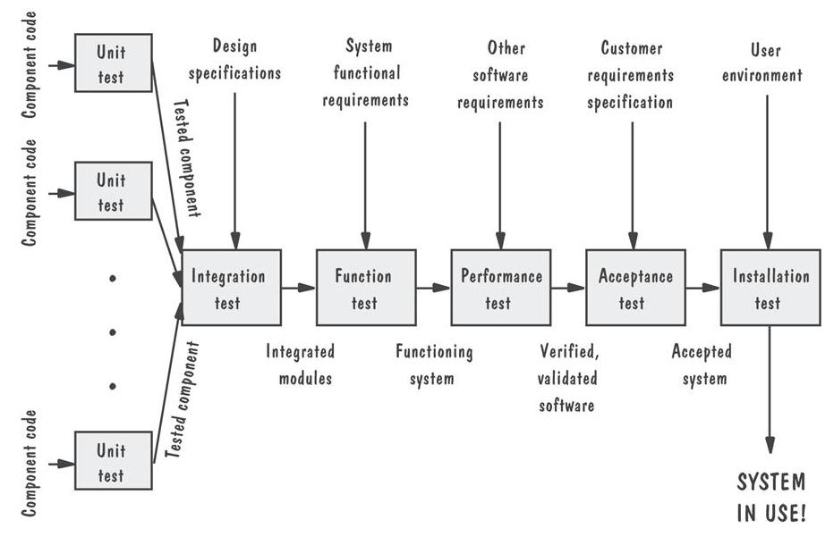
Testing Organization Illustrated

Slide 19
Relationships among different tests
  See Fig 8.3, for test steps
The focus of this chapter
  Is primarily on unit and integration tests
  Chapter 9 will be dedicated mainly to the system testing

Slide 20
8.2.2 Attitudes toward Testing
New programmers’ attitudes
  They usually choose the specific input to persuade others that the code functions well
  As a new programmer, you may consider your program only as a solution to a problem
  Your test data may have been chosen to show just the positive results in certain cases, rather than the absence of all possible faults
Customers
  They are not interested in knowing that the system works properly just under certain conditions
  Rather, they are interested in being sure that the system works properly under all possible conditions
So, Developers
    They should be to eliminate as many faults as possible
    No matter where in the system they occur and no matter who created them (egoless programming)
To viewing testing as a discovery process

Slide 21
  明确的测试目的（发现错误）
  正确的测试态度（客观、无情）
  充分的测试方法（本章主要内容）
  良好的测试
  提高软件质量

Slide 22
8.2.3 Who Performs The Test ?
Use of an independent test team
  We sometime have difficulties removing our personal feelings from the test process
  Then, it is better to use an independent test team to test a system
  In this way, we can
    avoid conflict
    improve objectivity
    allow testing and coding concurrently
Other factors that justify an independent team
  We may inadvertently introduce faults in interpreting the design
  We may be too close to be objective and to recognize some of the more subtle faults

Slide 23
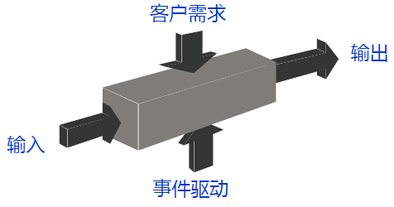
8.2.4 Views of the Test Objects
1. Closed box or black box 黑盒测试
  View the test objects from outside, whose contents are unknown
  The testing feeds input to the box and notes what output is produced
  The test’s goal is to be sure that every kind of input is submitted, and the output observed matches the expected
Advantage
  Is free of the constraints imposed by the internal structure and the logic of the test objects
  Disadvantage
  But, it is not always possible to run a complete test
  For some test objects, it is impossible to generate a set of representative test cases

Slide 24
2. Clear box or white box 白盒测试
  We use the internal structure of the test object to test in different ways
    Example: we can devise test cases that execute all the statements or all the control paths within the components
    To make sure that the test object is working properly
  In general, the strategy can be based on that data, structure, function, or several other criteria
  However, it may be impractical to take this kind of approach
    A component with many branches and loops has many paths to check
    Example in Fig 8.4
      We can use a test strategy to exercise the loop just a few times, checking only a small number of relevant cases that represent the entire set of possibilities

Slide 25
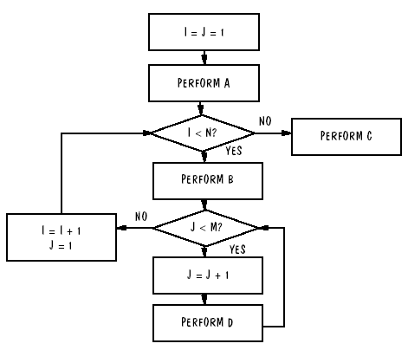
Figure 8.4 Example logic structure

Slide 26
3. Hybrid use of open- and closed boxes
  We can think open box as one end of a testing continuum, and closed box as the other end
    Any test philosophy can lie somewhere in between
In general, the choose of test philosophy depends on many factors
  The number of possible logical paths
  The nature of the input data
  The amount of the computation involved
  The complexity of the algorithm

Slide 27
8.3 Unit Testing
The testing process
  First, you examine the code by reading through it, trying to spot algorithm, data, and syntax faults
  Next, you compile the code and eliminate remaining syntax faults
  Finally, you develop test cases to show the input is properly converted to the desired output

Slide 28
8.3.1 Examining the Code 代码评审
Code review
  It is helpful to ask an objective group of experts to review both your code and its documentation
  for misunderstandings, inconsistencies and other faults
  2 types: code walkthrough and code inspection
Code walkthrough 代码走查
  You present the code and the accompanying documentation to the review team
  Finding faults, but not necessary fixing them
Code Inspection 代码审查
  Similar to walkthrough, but more formal
  Team can review algorithms, computations and interfaces among components for their correctness and efficiency

Slide 29
Success of Code Review
  Reviews have been shown to be extraordinarily successful
    At detecting faults and are often included in an organization’s list of mandatory or best practices
  Extent to which reviews have identified faults
    67 percent of system’s faults were found by inspections
    The inspection group’s code had 38 percent fewer failures than the walkthrough code
    Code inspection removed as many as 85 percent of the total faults found
Discovery Activity | Fault Found per Thousand Lines of Code
Requirements review | 2.5
Design Review | 5.0
Code inspection | 10.0
Integration test | 3.0
Acceptance test | 2.0

Slide 30
8.3.2 Proving Code Correct
Formal Proof Techniques
Symbolic execution
Automated Theorem Proving
Testing versus Proving
  The proving may not involve executing the code, But rather understanding what is going on inside the program
  A proof tells us how a program will work in a hypothetical environment
  Testing gives us information about how a program works in its actual environment

Slide 31
8.3.3 Testing Program Components
This is the process of testing
Choosing test cases 选择测试用例
  Choose input data and conditions, allow the component to manipulate the data, and observe the output
  A test point or test case is a particular choice of input data to be used
  A test is a finite collection of test cases
We can view the code as either closed box or open box, depending on the test objectives
  For closed box, we supply all possible input, and compare the output with what is expected
  For open box, we examine the code’s internal logic, using a careful testing strategy

Slide 32
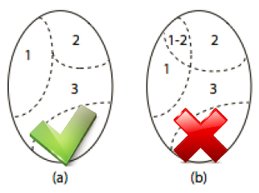
Closed box 黑盒法选择测试用例
  Separate the input into equivalence classes 将输入域划分等价类
    The equivalence classes of data should meet the criteria : 等价类的特征
      The classes cover the entire set of input data, including both valid and invalid values. That is, every input belongs to one of the classes 完备
      No input datum belongs to more than one class, that is, the classes are disjoint 正交
      Any element of the class represents all elements of that class 等价
    It is not always easy or feasible to tell if the last restriction on the classes can be met
  边缘值分析法
  错误推断法

Slide 33
Open box 白盒法选择测试用例
  According to the code’s internal processing, we want to make sure the test data exhibit all possible behaviors
Test Thoroughness 测试的充分性
  We want to make sure the test data exhibit all possible behaviors
  We can choose test cases using at least one of the approaches
    Statement testing 语句测试
    Branch testing 分支测试
    Path testing 路径测试
    Definition-use path testing 定义-使用路径
    All-uses testing 所有-使用测试
    All-predicate-uses / some-computational-uses testing
    All-computational-uses / some-predicate-uses testing

Slide 34
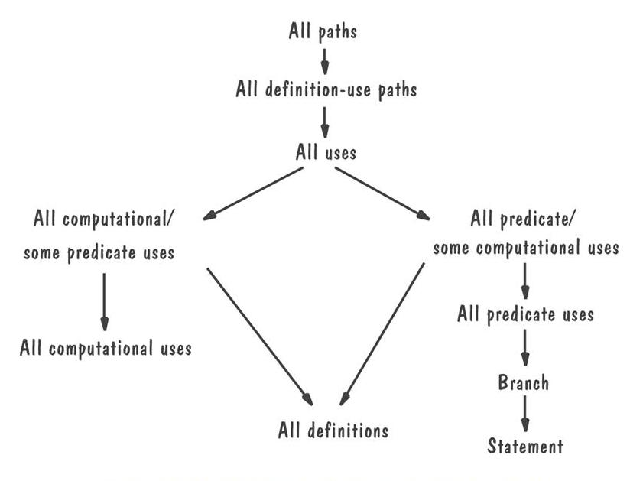
  In general, the stronger the strategy, the more test cases are involved 通常来说，测试策略越强，需要更多的测试用例
  We must always consider the trade-off between the resources available for testing and the thoroughness of the strategy 在可用资源与测试彻底性之间寻求平衡

Slide 35
  It is better to do with a strategy than with random testing
  Test example, see Fig 8.7
    Statement testing : when X > K, we have the test case
      1-2-3-4-5-6-7
    Branch testing : we identify all decision points and traverse each branch at least once. By test cases
      1-2-3-4-5-6-7, and
      1-2-4-5-6-1
    Path testing : test each possible path through the code
      1-2-3-4-5-6-7, and
      1-2-3-4-5-6-1, and 1-2-4-5-6-7, and 1-2-4-5-6-1

Slide 36
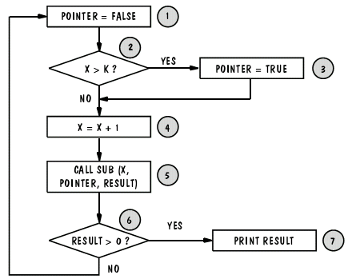
Figure 8.7 Logic flow

Slide 37
  Uncertainty in closed-box/open-box testing
    Closed-box testing suffers from uncertainty about whether the test cases selected will uncover a particular fault.
    Open-box testing always admits the danger of paying too much attention to the code’s internal processing
      We may end up testing what the program does instead of what it should do
    We can combine open- and closed-box testing to generate test data
      Some data are purposely chosen to be improper; we test them to check that the code handles incorrect data gracefully 黑盒
      By viewing the code’s internal structure, we add other cases 白盒

Slide 38
Comparing Techniques
Fault discovery Percentages by Fault Origin
Discovery Techniques | Requirements | Design | Coding | Documentation
Prototyping | 40 | 35 | 35 | 15
Requirements review | 40 | 15 | 0 | 5
Design Review | 15 | 55 | 0 | 15
Code inspection | 20 | 40 | 65 | 25
Unit testing | 1 | 5 | 20 | 0
Effectiveness of fault-discovery techniques
 | Requirements Faults | Design Faults | Code Faults | Documentation Faults
Reviews | Fair | Excellent | Excellent | Good
Prototypes | Good | Fair | Fair | Not applicable
Testing | Poor | Poor | Good | Fair
Correctness Proofs | Poor | Poor | Fair | Fair

Slide 39
8.4 Integration Testing
Combining tested components
  When we are satisfied that individual components are working correctly and meet our objectives, we combine them into a working system
  Test strategies explain why and how components are combined
  The system is again viewed as a hierarchy of components, each belongs to a layer of design
Bottom-up
Top-down
Big-bang
Sandwich testing
Modified top-down
Modified sandwich

Slide 40
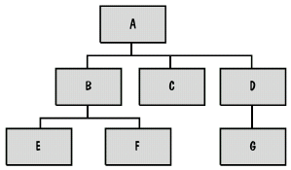
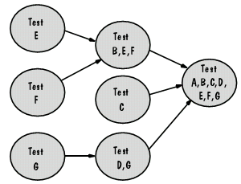
8.4.1 Bottom-Up Integration
自底向上集成测试策略：
1. Each component at the lowest level of the system hierarchy is test individually first;
2. The next components to be tested are those that call the previously tested ones;
3. This approach is followed repeatedly until all components are included in the testing.
See Fig 8.8,p.391, for example

Slide 41
  Because we have no components ready to call the lowest or previous level components, we write special code to aid the integration.
  This is the Component Driver. 驱动模块
  Component Driver : Is a routine that calls a particular component and passes a test case to it
  Unlike the lowest-level components, the next level components are not tested separately
    Instead, they are combined with the components they call (which have already tested)
    Fig 8.9,p.357, shows the sequence of tests and their dependencies

Slide 42
自底向上集成测试的缺点
  The top-level components are usually the most important, but the last to be tested
  The top level directs the major system activities, whereas the bottom level often performs the more mundane tasks
  The top level are more general, whereas the lower level are more specific
  Thus, by testing the bottom levels first, the discovery of major faults is postponed until testing’s end
    Sometimes faults in the top levels reflect faults in design
    Top level components often control or influence timing

Slide 43

8.4.2 Top-Down Integration
In many ways, the reverse of bottom-up
The process 自顶向下集成过程
  1. The top level component is tested by itself
  2. Then, all components called by the tested components are combined and tested as a larger unit
  3. The process is reapplied until all components are incorporated
A component being tested may call another
  That is not yet tested, so we need to write a stub, a special-purpose program to simulate the activity of the missing components
  As with drivers, stubs need not to be complex and logically complete

Slide 44
Advantages 优点
  Many of the advantages of top-down design and coding also apply to this testing
  It allows the test team to exercise one function at a time. In this way, test cases can be defined in terms of the functions being examined
  Design faults or major questions about functional feasibility can be addressed at the beginning instead of the end
  Driver programs are not needed
Disadvantages 缺点
  Writing stubs can be difficult
  Very large number of stubs may be required

Slide 45
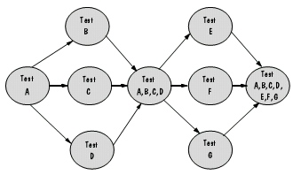
Modified Top-Down Testing
  Rather than incorporate an entire level at a time, we test each level’s components individually before the merger takes place
  See example in Fig 8.11,p.393

Slide 46
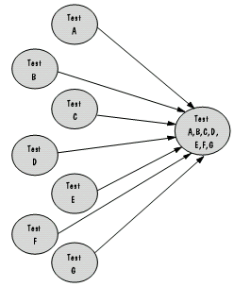
8.4.3 Big-Bang Integration
  When all components are tested in isolation, they mixed together as the final system and see if it works the first time
  This is not recommended for any system
    It requires both stubs and drivers to test the independent components
    All components are merged at once. In this way, it is difficult to find the cause of any failure
    Interface faults cannot be distinguished easily from other types of faults
  See Fig 8.12

Slide 47
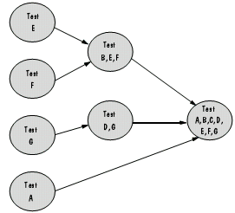
8.4.4 Sandwich Integration
It combines a top-down with a bottom-up strategy to form a testing approach
The system is viewed as 3 layers, just like a sandwich
  The target layer in the middle
  The layers above and below the target
The strategy 集成策略
  A top-down approach is used in the top layer
  A bottom-up approach is used in the lower layer
  The test converges on the target layer

Slide 48
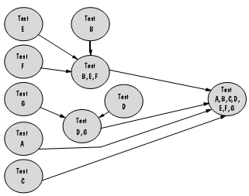
Sandwich Testing
  Properties
    This testing allows integration testing to begin early in the test process
    However, it does not test the individual components thoroughly before integration
  A variation, modified sandwich testing
    It allows the upper-level components to be tested before merging them with others

Slide 49
Comparison of Integration Strategies
The selection of integration strategy
  Choosing an integration strategy depends not only on system characteristics, but also on customer’s expectations
    To see a working version as soon as possible
  A comparison of testing strategies
    See Table 8.7
    The comparison is made according to several system attributes and customer needs.
  No matter what strategy is chosen
    Each component is merged only once for testing
    At no time should a component be modified to simplify testing
    Stubs and drivers are separate, new programs, not temporary modification of existing program, which is very dangerous to the development.

Slide 50
Comparison of Integration Strategies
 | Bottom-up | Top-down | Modified top-down | Bing-bang | Sandwich | Modified sandwich
Integration | Early | Early | Early | Late | Early | Early
Time to basic working program | Late | Early | Early | Late | Early | Early
Component drivers needed | Yes | No | Yes | Yes | Yes | Yes
Stubs needed | No | Yes | Yes | Yes | Yes | Yes
Work parallelism at beginning | Medium | Low | Medium | High | Medium | High
Ability to test particular paths | Easy | Hard | Easy | Easy | Medium | Easy
Ability to plan and control sequence | Easy | Hard | Hard | Easy | Hard | hard

Slide 51
8.5 Testing OO Systems
Many of the techniques we have described for testing systems apply to object-oriented systems.
Graham summarizes the differences between object-oriented and traditional testing in two ways.
1: which aspects of object orientation make testing easier and which make it harder. 测试活动难易区别
  For example, objects tend to be small, and the complexity that might ordinarily reside in the component is often pushed instead toward the interfaces among components.
  This differences means that unit testing is less difficult, but integration testing must be much more extensive. 单元测试更为简单，但是集成测试更为广泛、困难。

Slide 52
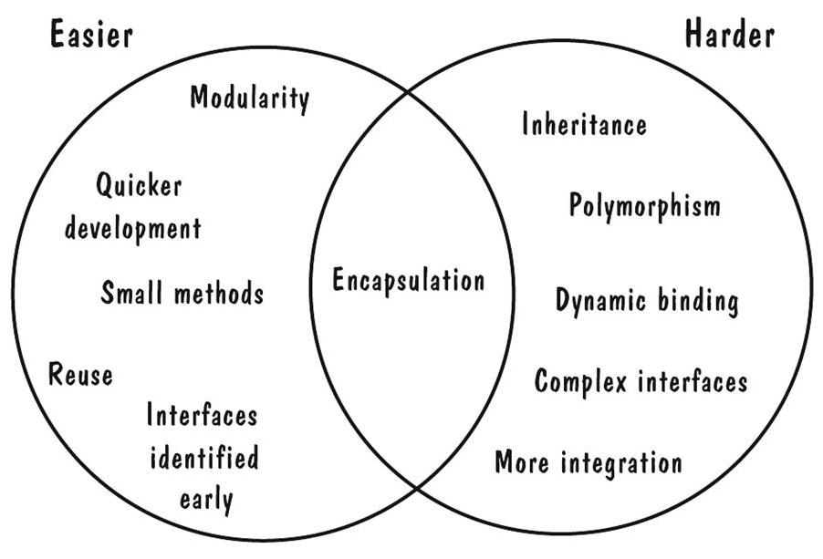
Easier and Harder Parts of Testing OO Systems
OO unit testing is less difficult, but integration testing is more extensive

Slide 53
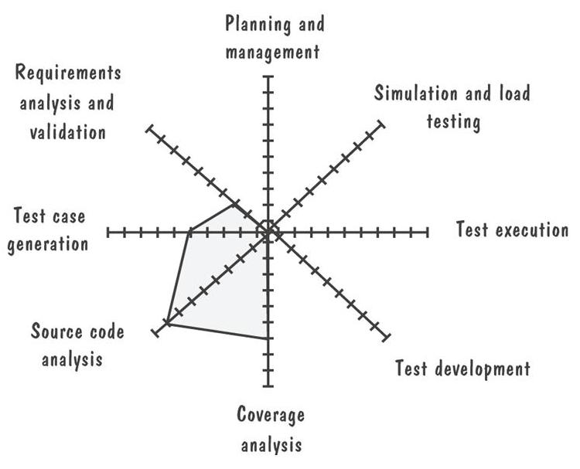
2: the steps in the testing process that are affected by object orientation. 测试过程中的步骤区别
  The diagram compares the differences between object-oriented and traditional testing.
  The farther the gray line is out from the center of the diagram, the more difference between object-oriented and traditional testing.

Slide 54
8.6 Test Planning
  Careful test planning helps us to design and organize the tests.
  Each step of the testing process must be planned.
  We must plan each of these steps: 测试计划
    establishing test objectives 建立测试目标
    designing test cases 设计测试用例
    writing test cases 写出测试用例
    testing test cases 测试测试用例
    executing tests 执行测试
    evaluating test results 评价测试结果

Slide 55
1. Purpose of the Plan
We use a test plan to organize testing activities. 组织测试活动
  The test plan takes into account the test objectives and incorporates any scheduling mandated by the test strategy or the project deadlines.
The plan is a guide to the entire testing activity, explaining
  who does the testing
  why the tests are performed
  how the tests are conducted
  when the tests are scheduled

Slide 56
2. Contents of the plan
Begins with the test objectives
  addressing each type of testing from unit through functional to acceptance and installation testing.
Next, the plan looks at how the tests will be run and what criteria will be used to determine when the testing is complete.
For each stage of testing,the test plan describes in detail the methods to be used to perform each test, also explains how test data will be generated and how any output data or state information will be captured. 详细测试方法
Thus, as we read the test plan, we have a complete picture of how and why testing will be performed.
Many customers specify the test plan’s contents in the requirements documentation

Slide 57
8.8 When to stop Testing
One way to assess the “goodness” of a component is by the number of faults it contains.
  It seems natural to assume that software faults that are the most difficult to find are also the most difficult to correct.
  It also seems reasonable to believe that the most easily fixed faults are detected when the code is first examined,and the more difficult faults are located later in the testing process.

Slide 58
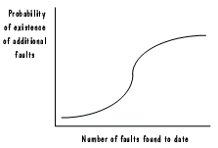
However,Shooman and Bolsky found that this is not the case.
  Sometimes it takes a great deal of time to find trivial faults,and many such problems are overlooked or do not appear until well into the testing process.
  Moreover,Myers reports that as the number of detected faults increases; the probability of the existence of more undetected faults increases,as shown in Figure 8.19.

Slide 59
In addition to being contrary to our intuition,these results also make it difficult to know when to stop looking for faults during testing. 何时停止测试？
  We must estimate the number of remaining faults,not only to know when to stop our search for more faults,but also to give us some degree of confidence in the code we are producing. 估算剩余错误的数量==〉何时停止继续发现错误；评价软件的信任度。
  The number of faults also indicates the likely maintenance effort needed if faults are left to be detected after the system is delivered.

Slide 60
1. Fault Seeding/Error Seeding 错误播种
The basic premise is
  One number of the test team intentionally inserts a known number of faults in a program.
  Then,the other team members locate as many faults as possible.
That is,the ratio of seeded faults detected to total non-seeded faults:
  detected seeded faults detected non-seeded faults
  total seeded faults total non-seeded faults
Thus,if a program is seeded with 100 faults and the test team finds only 70,it is likely that 30 percent of the indigenous faults remain in the code.

Slide 61
We can express this ratio more formally as follows:
  Let S be the number of seeded faults placed in a program.
  Let N be the number of indigenous (nonseeded) faults.
  If n is the actual number of nonseeded faults detected during testing ,and s is the number of seeded faults detected during the testing.
  Then an estimate of the total number of indigenous faults is
  N=Sn/s

Slide 62
  This approach assumes that the seeded faults are of the same kind and complexity as the actual faults in the program.
  We can use two independent test groups to test the same program. Call them Test Group 1 and Test Group 2.
  x ：Group 1发现的错误数量
  y ：Group 2发现的错误数量
  q ：共同的错误数量 （q ≤ x and q ≤ y）.
  n ：错误总数量
  We want to estimate n.

Slide 63
Fault Seeding
The group effectiveness measures the group’s ability to detect faults from among a set of existing faults. 测试能力
  If we assume that Group 1 is just as effective at finding faults in any part of the program as in any other part,we can look at the ratio of faults found by Group 1 from the set of faults found by Group 2.
  That is,Group 1 found q of the y faults that Group 2 found,so Group 1’s effectiveness is q/y.

Slide 64
Fault Seeding
    In other words,
    E1=x/n=q/y
    However,we know that E2 is y/n,so we can derive the following formula for n:
    n=q/(E1* E2)
    We have a known value for q,and we can use estimates of q/y for E1 and q/x for E2 ,so we have enough information to estimate n.
  The test strategy defined in the test plan directs the test team in deciding when to stop testing.The strategy can use this estimating techniques to decide when testing is complete.

Slide 65

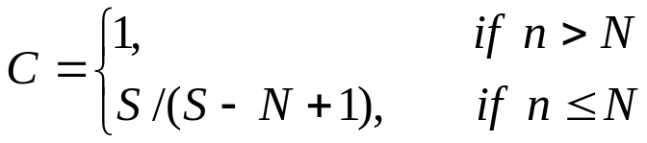
2. Confidence in the Software 信任度
Fault estimate can tell us how much confidence we can place in the software we are testing.
  Confidence,usually expressed as a percentage,tells us the likelihood that the software is fault-free.
  Suppose we have seeded a program with S faults.
  We claim that the code has only N actual faults.
  We test the program until we have found all S of the seeded faults.
  n,is the number of actual faults discovered during testing,then the confidence level can be calculated as

Slide 66
  For example,suppose we claim that a component is fault-free,meaning that N is zero.If we seed the code with 10 faults and find all 10 without uncovering an indigenous fault,then we can calculate the confidence level with S=10 and N=0.
  Thus,C is 10/11,for a confidence level of 91 percent.

Slide 67
  If the requirements or contract mandate a confidence level of 98 percent,we would need to seed S faults,where S/(S-0+1)=98/100.
  Solving this equation,we see that we must use 49 seeded faults and continue testing until all 49 faults were found (but no indigenous faults discovered).

Slide 68
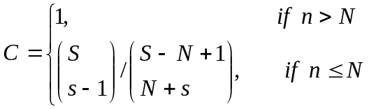
Confidence in the Software
  This approach presents a major problems:We cannot predict the level of confidence until all seeded faults are detected.
    Richards suggests a modification,where the confidence level can be estimated using the number of detected seeded faults,whether or not all have been located.in this case,C is
    These estimation assumes that all faults have an equal probability of being detected,which is not likely to be true.
    If we estimates the number of faults remaining,or if we know how many faults we must find to satisfy a confidence requirement,we have incentive to keep testing for one more fault.

Slide 69
Other Stopping Criteria
The test strategy itself can be used to set stopping criteria for testing.
  For example,when we are doing statement,path,or branch testing,we can track how many statements, paths,or branches need to be executed and determined our test progress in terms of the number of statements paths,or branches left to test.
  The tool may produce a report like the ones in Table 8.8 and 8.9.

Slide 70
Identifying Fault-Prone Code
There are many techniques used to help identify fault-prone code,based on past history of faults in similar applications.For example,some researchers
  For example,some researchers track the number of faults found in each component during development and maintenance.
  Collect measurement about each component,such as size,number of decisions,number of operators and operands,or number of modifications.
  Then,they generate equations to suggest the attributes of the most fault-prone components.
  These equations can be used to suggest which of your components should be tested first,or which should be given extra scrutiny during reviews or testing.

Slide 71
Identifying Fault-Prone Code
Use classification trees to suggest fault-prone components
  Create a decision tree to show which measurements are the best predictors of a particular attribute.
  Include size,number of distinct paths through the code,number of operators,depth of nesting,degree of coupling and cohesion,time to code the component,number of faults found in the component,and more.
  The tree is used to help us decide which components in our current system are likely to have a large number of faults.

Slide 72
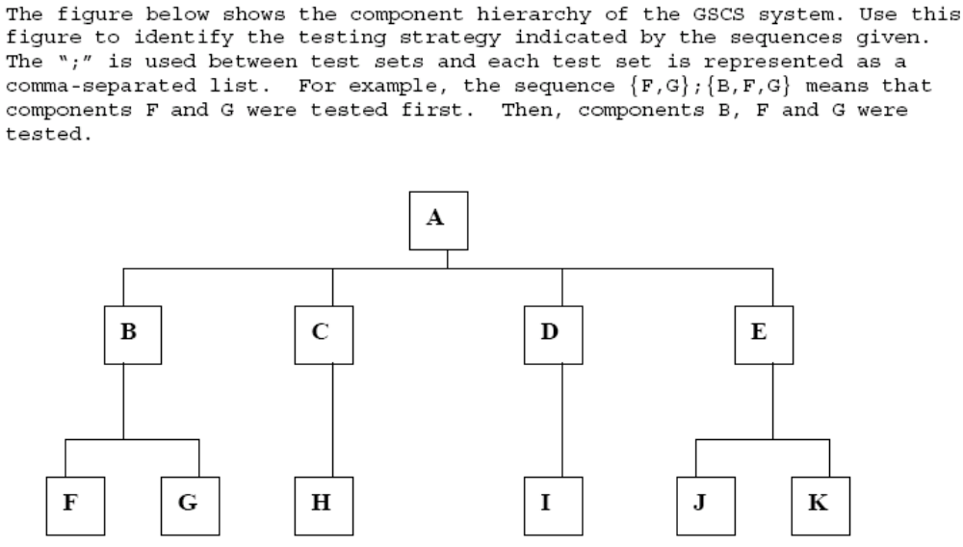
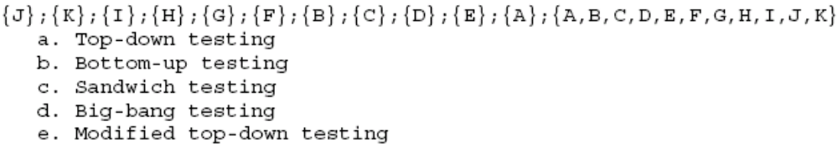

Slide 73
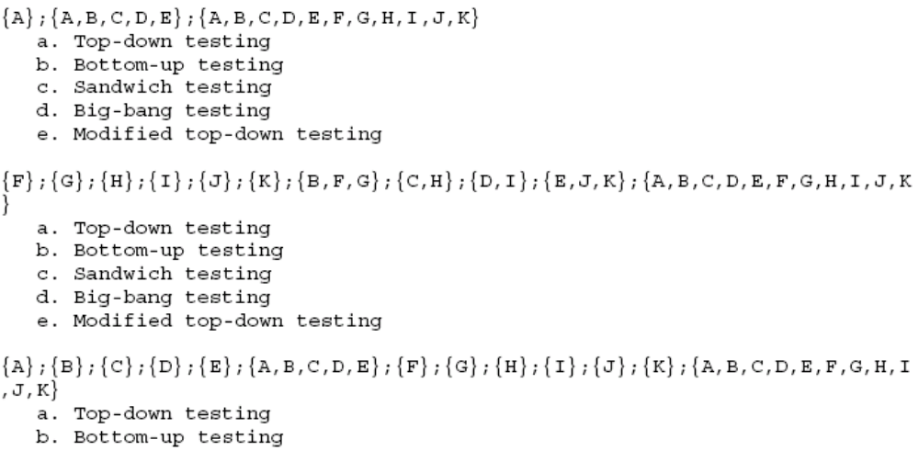
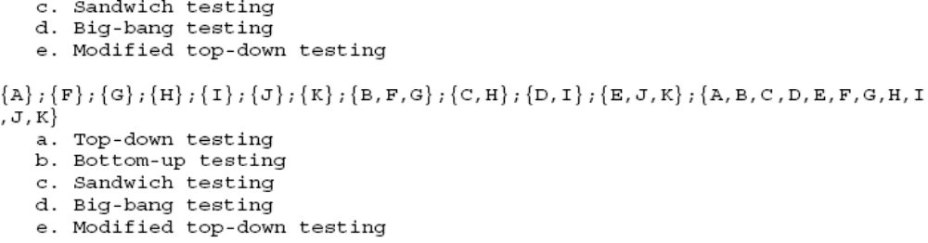

Slide 74
