Slide 1

Chapter 9
Testing the System

Slide 2
Contents
9.1 Principles of system testing
9.2 Function testing
9.3 Performance testing
9.4 Reliability, availability, and maintainability
9.5 Acceptance testing
9.6 Installation testing
9.7 Automated system testing
9.8 Test documentation

Slide 3
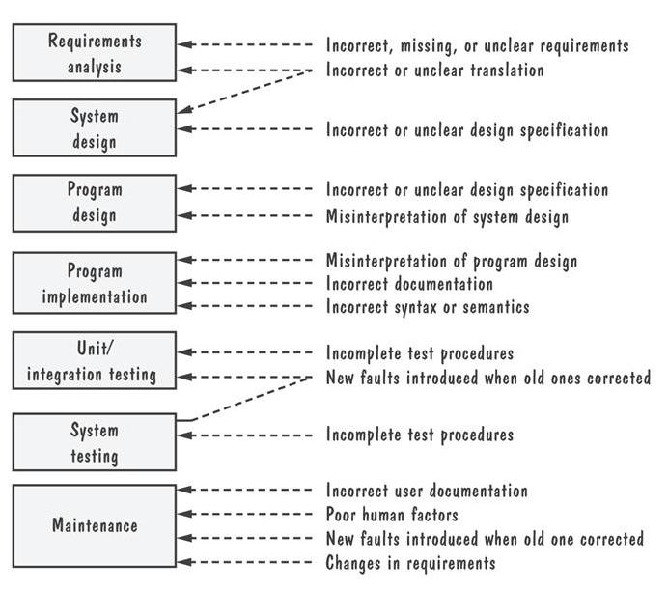
9.1 Principles of System Testing
1. Source of Software Faults During Development
(1)Error, Fault, Failure
(2)Causes of faults(Figure 9.1)

Slide 4
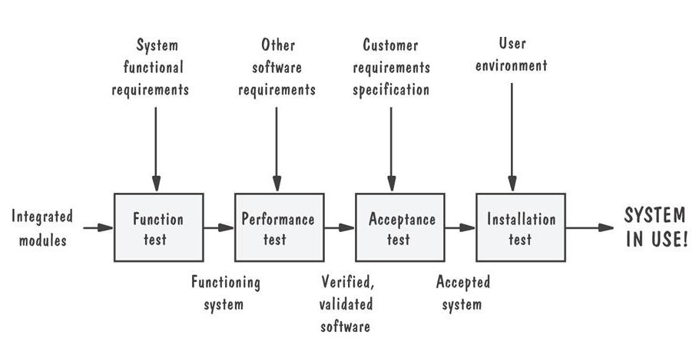
9.1 Principles of System Testing
2. System Testing Process
Pictorial representation of steps in testing process

Slide 5
9.1 Principles of System Testing System
Function testing: does the integrated system perform as promised by the requirements specification?
Performance testing: are the non-functional requirements met?
Acceptance testing: is the system what the customer expects?
Installation testing: does the system run at the customer site(s)?

Slide 6
9.1 Principles of System Testing
3.Configuration management配置管理
System configuration 系统配置
Configuration management配置管理
  Version
  Release
  Production system
  Development system

Slide 7
9.1 Principles of System Testing
Regression Testing回归测试
  Definition on P461.
Identifies new faults that may have been introduced as current one are being corrected
Verifies a new version or release still performs the same functions in the same manner as an older version or release

Slide 8
9.1 Principles of System Testing
Regression Testing Steps
Inserting the new code
Testing functions known to be affected by the new code
Testing essential function of m to verify that they still work properly
Continuing function testing m + 1

Slide 9
9.1 Principles of System Testing
Deltas, separate files and conditional compilation
  Separate files难以保持版本更新和正确；所需存储空间大
  Deltas: main version/variations/delta, 优点：公共部分的修改只用于main version,存储空间小; 缺点：一旦main version丢失/破坏, 难以用delta表示所有版本差异
  一旦版本复杂，难以理解、维护；只能用于code
Change control

Slide 10
9.1 Principles of System Testing
4. Test Team
The test team is often independent of the implementation staff.
Professional testers: organize and run the tests
Analysts: who created requirements
System designers: understand the proposed solution
Configuration management specialists: to help control fixes
Users: to evaluate issues that arise

Slide 11
9.2 Function Testing
1. Purpose and Roles
Compares the system’s actual performance with its requirements
Develops test cases based on the requirements document

Slide 12
9.2 Function Testing
1. Purpose and Roles
Guidelines for function testing 基本原则
  Have a high probability of detecting a fault
  Use a test team independent of the designers and programmers
  Know the expected actions and output
  Test both valid and invalid input
  Never modify the system just to make testing easier
  Have stopping criteria

Slide 13
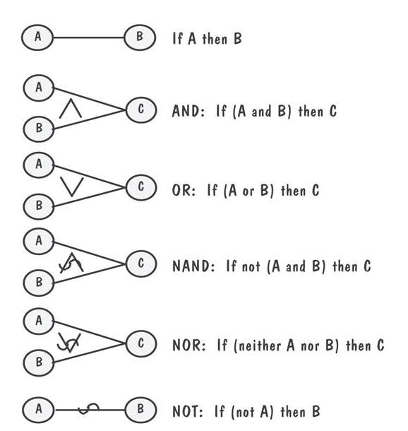
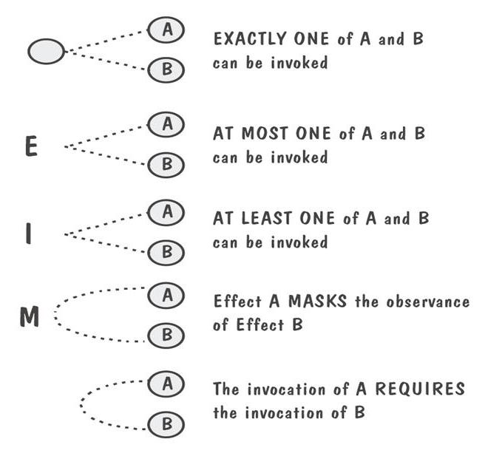
9.2 Function Testing
Cause-and-Effect Graph
A Boolean graph reflecting logical relationships between inputs (causes), and the outputs (effects) or transformations (effects)

Slide 14
9.3 Performance Tests
Purpose and Roles
Used to examine
  the calculation
  the speed of response
  the accuracy of the result
  the accessibility of the data
Designed and administrated by the test team

Slide 15
9.3 Performance Tests
2. Types of Performance Tests
Stress tests压力测试（瞬时并发）
Volume tests容量测试（大数据量）
Configuration tests
Compatibility tests
Regression tests
Security tests
Timing tests
Environmental tests
Quality tests质量测试（可靠性、可维护性、可用性）
Recovery tests
Maintenance tests
Documentation tests
Human factors (usability) tests

Slide 16
9.4 Reliability, Availability, and Maintainability
Definition
Software reliability: operating without failure under given condition for a given time interval
Software availability: operating successfully according to specification at a given point in time
Software maintainability: for a given condition of use, a maintenance activity can be carried out within stated time interval, procedures and resources

Slide 17
9.5 Acceptance Tests
Purpose and Roles
Enable the customers and users to determine if the built system meets their needs and expectations
Written, conducted and evaluated by the customers

Slide 18
9.5 Acceptance Tests
Types of Acceptance Tests
Benchmark test (基准测试)
  客户执行
  使用预先准备的测试用例
  用于评价系统
  并非真实的工作环境
Pilot test: install on experimental basis
Alpha test: in-house test
Beta test: customer pilot
Parallel testing: new system operates in parallel with old system

Slide 19
9.6 Installation Testing
Before the testing
  Configure the system
  Attach proper number and kind of devices
  Establish communication with other system
The testing
  Regression tests: to verify that the system has been installed properly and works

Slide 20
9.7 Automated System Testing
Omitted

Slide 21
9.8 Test Documentation
Test plan: describes system and plan for exercising all functions and characteristics
Test specification and evaluation: details each test and defines criteria for evaluating each feature
Test description: test data and procedures for each test
Test analysis report: results of each test

Slide 22
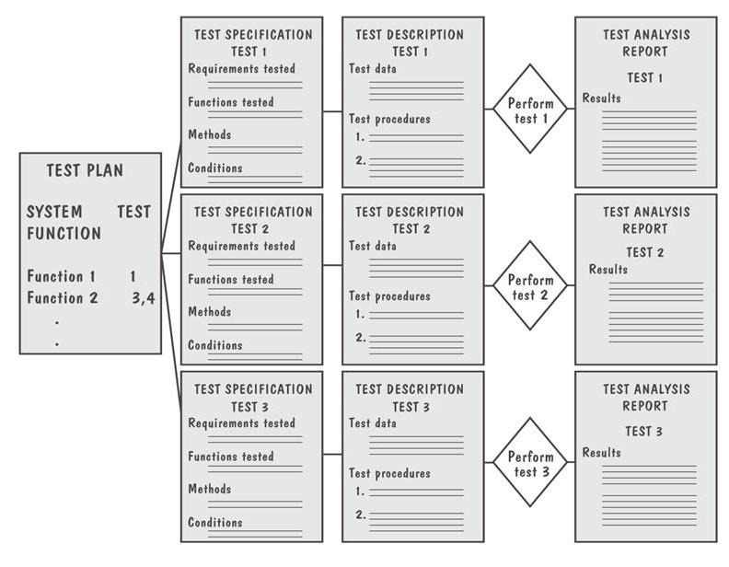
9.8 Test Documentation
Documents Produced During Testing

Slide 23
9.8 Test Documentation
Test Plan
The plan begins by stating its objectives, which should
  guide the management of testing
  guide the technical effort required during testing
  establish test planning and scheduling
  explain the nature and extent of each test
  explain how the test will completely evaluate system function and performance
  document test input, specific test procedures, and expected outcomes

Slide 24
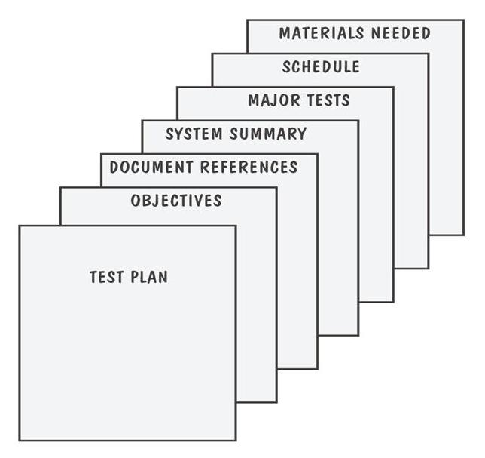
9.8 Test Documentation
Parts of a Test Plan

Slide 25
9.8 Testing Documentation
Test-Requirement Correspondence Chart
Test | Requirement 2.4.1: Generate and Maintain Database | Requirement 2.4.2: Selectively Retrieve Data | Requirement 2.4.3: Produced Specialized Reports
1. Add new record | X
2. Add field | X
3. Change field | X
4. Delete record | X
5. Delete field | X
6. Create index |  | X
Retrieve record with a requested
7. Cell number |  | X
8. Water height |  | X
9. Canopy height |  | X
10. Ground cover |  | X
11, Percolation rate |  | X
12. Print full database |  |  | X
13. Print directory |  |  | X
14. Print keywords |  |  | X
15. Print simulation summary |  |  | X

Slide 26
9.8 Test Documentation
Sidebar 9.8 Measuring Test Effectiveness and Efficiency
Test effectiveness can be measured by dividing the number of faults found in a given test by the total number of faults found
Test efficiency is computed by dividing the number of faults found in testing by the effort needed to perform testing

Slide 27
9.8 Test Documentation
Test Description
Including
  the means of control
  the data
  the procedures

Slide 28
9.8 Test Documentation
Test Description Example
INPUT DATA:
Input data are to be provided by the LIST program. The program generates randomly a list of N words of alphanumeric characters; each word is of length M. The program is invoked by calling
RUN LIST(N,M)
in your test driver. The output is placed in global data area LISTBUF. The test datasets to be used for this test are as follows:
Case 1: Use LIST with N=5, M=5
Case 2: Use LIST with N=10, M=5
Case 3: Use LIST with N=15, M=5
Case 4: Use LIST with N=50, M=10
Case 5: Use LIST with N=100, M=10
Case 6: Use LIST with N=150, M=10
INPUT COMMANDS:
The SORT routine is invoked by using the command
RUN SORT (INBUF,OUTBUF) or
RUN SORT (INBUF)
OUTPUT DATA:
If two parameters are used, the sorted list is placed in OUTBUF. Otherwise, it is placed in INBUF.
SYSTEM MESSAGES:
During the sorting process, the following message is displayed:
“Sorting ... please wait ...”
Upon completion, SORT displays the following message on the screen:
“Sorting completed”
To halt or terminate the test before the completion message is displayed, press CONTROL-C on the keyboard.

Slide 29
9.8 Test Documentation
Test Script for Testing The “change field”
Step N: Press function key 4: Access data file.
Step N+1: Screen will ask for the name of the date file.
Type ‘sys:test.txt’
Step N+2: Menu will appear, reading
* delete file
* modify file
* rename file
Place cursor next to ‘modify file’ and press RETURN key.
Step N+3: Screen will ask for record number. Type ‘4017’.
Step N+4: Screen will fill with data fields for record 4017:
Record number: 4017 X: 0042 Y: 0036
Soil type: clay Percolation: 4 mtrs/hr
Vegetation: kudzu Canopy height: 25 mtrs
Water table: 12 mtrs Construct: outhouse
Maintenance code: 3T/4F/9R
Step N+5: Press function key 9: modify
Step N+6: Entries on screen will be highlighted. Move cursor to VEGETATION field. Type ‘grass’ over ‘kudzu’ and press RETURN key.
Step N+7: Entries on screen will no longer be highlighted.
VEGETATION field should now read ‘grass’.
Step N+8: Press function key 16: Return to previous screen.
Step N+9: Menu will appear, reading
* delete file
* modify file
* rename file
To verify that the modification has been recorded,place cursor next to ‘modify file’ and press RETURN key.
Step N+10: Screen will ask for record number. Type ‘4017’.
Step N+11: Screen will fill with data fields for record 4017:
Record number: 4017 X: 0042 Y: 0036
Soil type: clay Percolation: 4 mtrs/hr
Vegetation: grass Canopy height: 25 mtrs
Water table: 12 mtrs Construct: outhouse
Maintenance code: 3T/4F/9R

Slide 30
9.8 Test Documentation
Test Analysis Report
Documents the result of test
Provides information needed to duplicate the failure and to locate and fix the source of the problem
Provides information necessary to determine if the project is complete
Establish confidence in the system’s performance

Slide 31
9.8 Test Documentation
Problem Report Forms
Location: Where did the problem occur?
Timing: When did it occur?
Symptom: What was observed?
End result: What were the consequences?
Mechanism: How did it occur?
Cause: Why did it occur?
Severity: How much was the user or business affected?
Cost: How much did it cost?

Slide 32
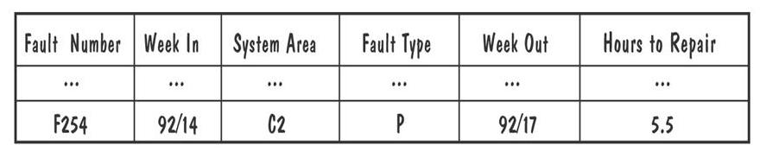
9.8 Test Documentation
Example of Actual Problem Report Forms

Slide 33
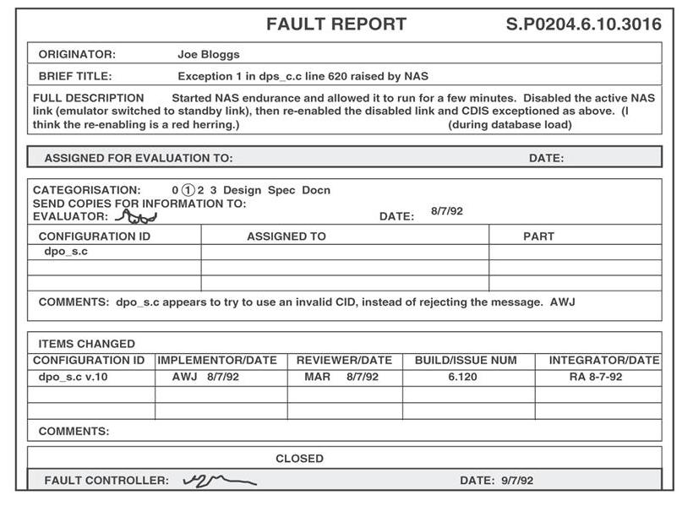
9.8 Test Documentation
Example of Actual Discrepancy Report Forms

