Slide 1
HTML 5
N Satyanarayana
CDAC

Slide 2
HTTP vs HTML
HTML: hypertext markup language
Definitions of tags that are added to Web documents to control their appearance
HTTP: hypertext transfer protocol
The rules governing the conversation between a Web client and a Web server
Both were invented at the same time by the same person

Slide 3
Many application layer protocols are used on the Internet, HTTP is only one
Protocol | Application
HTTP: Hypertext Transfer | Retrieve and view Web pages
FTP: File Transfer | Copy files from client to server or from server to client
SMTP: Simple Mail Transport | Send email
POP: Post Office | Read email

Slide 4
The TCP/IP protocol layers
The application program is king – it gets work done using the lower level layers for communication between the client and server.
Application
Transport
Internet
Data link
Physical
Get useful work done – retrieve Web pages, copy files, send and receive email, etc.
Make client-server connections and optionally control transmission speed, check for errors, etc.
Route packets between networks
Route data packets within the local area network
Specify what medium connects two nodes, how binary ones and zeros are differentiated, etc,

Slide 5
URL
<scheme> : //<host> :<port> /<path> ;<parameters> ?<query> #<fragment>
scheme
The protocol you are using
host
Host name or ip number
port
TCP port number that protocol server is using
path
Path and filename reference of object on server

Slide 6
Web Documents
html
ASCII text
Preformatted
postscript
Images
GIF
JPEG
Video
MPEG
jsp, asp, php etc

Slide 7
Gateways
Translates from one protocol or service to another
HTTP / database query
Database query results / HTTP

Slide 8
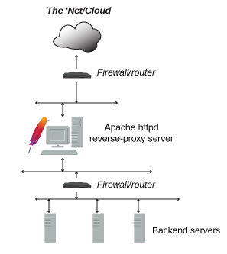
Reverse Proxy Server / Gateway

Slide 9
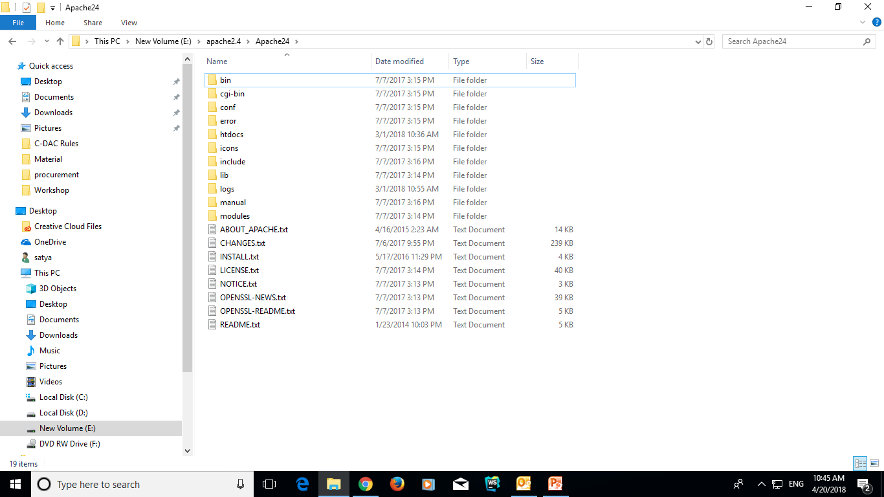
Apache Web Server Folder Structure

Slide 10
Apache Server Directives
Reverse Proxying (For single back end server)
ProxyPass “/img” “http://www.example.com”
ProxyPassReverse “/img” “http://www.example.com”
Clusters (For load balancing)
<Proxy balancer://myset>
BalancerMember http://www2.example.com:8080
BalancerMember http://www3.example.com:8080
ProxySet lbmethod=bytraffic
</Proxy>
ProxyPass "/images/" "balancer://myset/" ProxyPassReverse "/images/" "balancer://myset/"

Slide 11
SSL Configuration
Procedure for generating self-signed certificate
Generate:
openssl req -newkey rsa:2048 -nodes -keyout key.pem -x509 -days 365 -out certificate.pem
Review:
openssl x509 -text -noout -in certificate.pem
Convert .pem to .crt file
openssl x509 -outform der -in {your-cert}.pem -out {your-cert}.crt
Replace {your-cert} with the name of the file

Slide 12
HTTP 1.0
Method
Get
Returns object
Head
Returns information about object
Post
Sends information to be stored on server or as input to script

Slide 13
HTTP 1.0
Method
Put
Sends new copy of existing object to server
Usually not allowed
Delete
Deletes object
Usually not allowed

Slide 14
HTTP 1.0
Other information
User Agent
Kind of browser
If-Modified-Since
Returns object only if more recent than given date
Otherwise returns status code 304

Slide 15
HTTP 1.0
Other information
Accept
Mime types which browser can accept
Multipurpose Internet Mail Extension
text/plain
text/html
application/postscript
image/gif
image/jpeg
audio/basic
video/mpeg
x-world/x-vrml

Slide 16
HTTP 1.0
Other information
Authorization
User password
GET /X/Y/Z.HTML HTTP 1.0
User Agent: Prodigy-WB/1.3e
Accept: text/plain
Accept: text/html
Accept: application/postscript
Accept: image/gif
Accept: */*

Slide 17
HTTP 1.0
HTTP response
Status line
HTTP-version Status-code Reason
Status-codes 1xx - Informational
Reserved for future use

Slide 18
HTTP 1.0
HTTP response
Status line
Status-codes 2xx - Success
The action was successfully received, understood, and accepted
200 OK
201 POST command successful
202 Request accepted
203 GET or HEAD request fulfilled
204 No content

Slide 19
HTTP 1.0
HTTP response
Status line
Status-codes 3xx - Redirection
Further action must be taken in order to complete request
300 Resource found at multiple locations
301 Resource moved permanently
302 Resource moved temporarily
304 Resource has not modified (since date)

Slide 20
HTTP 1.0
HTTP response
Status line
Status-codes 4xx - Client error
The request contains bad syntax or cannot be fulfilled
400 Bad request from client
401 Unauthorized request
402 Payment required for request
403 Resource access forbidden
404 Resource not found
405 Method not allowed for resource
406 Resource type not acceptable

Slide 21
HTTP 1.0
HTTP response
Status line
Status-codes 5xx - Server error
The server failed to fulfill an apparently valid request
500 Internal server error
501 Method not implemented
502 Bad gateway or server overload
503 Service unavailable / gateway timeout
504 Secondary gateway / server timeout

Slide 22
HTTP 1.0
HTTP response
Description of information
Server Type of server
Date Date and time
Content-Length Number of bytes
Content-Type Mime type
Content-Language English, for example
Content-Encoding Data compression
Last-Modified Date when last modified
Expires Date when file becomes
invalid

Slide 23
HTTP 1.0
Problems
HTTP is stateless
Each request requires separate TCP connection
Server doesn’t remember previous requests

Slide 24
Http 1.0 vs 1.1
OPTIONS method
A way for a client to learn about the capabilities of a server without actually requesting a resource
Upgrade
Switch protocols

Slide 25
How it works?
Code that resides on server machine but gets downloaded and executed on client browser.
Programming Language: HTML
Code that resides on server machine but gets executed on server machine.
Programming Language: JSP, ASP, PHP, JS
Both the codes reside on server machine in appropriate folders corresponding to a web application server.
Web Application Server: Apache, Tomcat, Jboss, IIS

Slide 26
HTML5: What is it?
HTML5 is the new standard for HTML, XHTML, and the HTML DOM (document object model).
The previous version of HTML came in 1999. The web has changed a lot since then.
Most modern browsers have HTML5 support.

Slide 27
History of HTML
1991
HTML first published
1995
HTML 2.0
After HTML 4.01 was released, focus shifted to XHTML and its stricter standards.
1997
HTML 3.2
1999
HTML 4.01
XHTML 2.0 had even stricter standards than 1.0, rejecting web pages that did not comply. It fell out of favor gradually and was abandoned completely in 2009.
2000
XHTML 1.0
2002 -2009
HTML5 is much more tolerant and can handle markup from all the prior versions.
XHTML 2.0
HTML5
Though HTML5 was published officially in 2012, it has been in development since 2004.
2012

Slide 28
HTML5: Origins
HTML5 is a cooperation between the World Wide Web Consortium (W3C) and the Web Hypertext Application Technology Working Group (WHATWG).
WHATWG was working with web forms and applications, and W3C was working with XHTML 2.0. In 2006, they decided to cooperate and create a new version of HTML.

Slide 29
HTML5: Ground Rules
Some rules for HTML5 were established:
> New features should be based on HTML,
CSS, DOM, and JavaScript
> Reduce the need for external plugins
> Better error handling
> More markup to replace scripting
> HTML5 should be device independent
> Dev process should be visible to the public

Slide 30
HTML5: New Features
> Canvas element for drawing
> Video/audio elements for media playback
> Better support for local offline storage
> New content specific elements, like article, footer, header, nav, section
> New form controls, like calendar, date, time, email, url, search

Slide 31
It is all about…..
Providing powerful capabilities for Web-based applications with more powerful interaction, video support, graphics, more styling effects, and a full set of APIs.
Evolve as a future Open Web Platform

Slide 32
HTML5: Support
You may well ask: “How can I start using HTML5 if older browsers don’t support it?” But the question itself is misleading.
HTML5 is not one big thing; it is a collection of individual features. You can only detect support for individual features, like canvas, video, or geolocation.

Slide 33
HTML5: Example
HTML5 supports all the form controls from HTML 4, but it also includes new input controls. Some of these are long-overdue additions like sliders and date pickers; others are more subtle...

Slide 34
HTML5: Example
For example, the email input type looks just like a text box, but mobile browsers will customize their onscreen keyboard to make it easier to type email addresses. Older browsers that don’t support the email input type will treat it as a regular text field, and the form still works with no markup changes or scripting hacks.

Slide 35
HTML5: DOCTYPE
The DOCTYPE which comes before the beginning <html> tag is much simpler in HTML 5. Here are some examples of what it looks like now...
<!DOCTYPE HTML>
<!DOCTYPE HTML PUBLIC "-//W3C//DTD HTML 4.01//EN" "http://www.w3.org/TR/html4/strict.dtd">
<!DOCTYPE HTML PUBLIC "-//W3C//DTD HTML 4.01 Transitional//EN" "http://www.w3.org/TR/html4/loose.dtd">
<!DOCTYPE html PUBLIC "-//W3C//DTD XHTML 1.1//EN" "http://www.w3.org/TR/xhtml11/DTD/xhtml11.dtd">

Slide 36
Basic HTML Page Structure
<!DOCTYPE HTML>
<html>
<head>
….
</head>
<body>
….
<p id=“para” onclick=“changecontent()”>Not Ok</p>
….
<script>
function changecontent() {
document.getElementById(“para”).innerHTML = “Ok”;
}
</script>
</body>
</html>

Slide 37
Elements of head tag
title - <title> Yahoo! </title>
style - <style media=“all” type=“text/css”>
h1 {color: #000000;}
</style>
base - <base href=“www.cdac.in” target=“_blank”>
link - <link rel=“stylesheet” type=“text/css” href=”demo.css”>
meta - <meta name="viewport" content="width=device-width, initial-scale=1.0">
script - <script src=“Demo.js” type=“text/javascript”></script>
noscript

Slide 38
HTML5
More focused on semantics of the document structure so that it is more accessible
Encourages separation of presentation stuff (color, style etc.)
Lessens developer efforts on HTML coding (e.g., input validation stuff especially)

Slide 39
Background
HTML was primarily designed as a language for semantically describing scientific documents, although its general design and adaptations over the years have enabled it to be used to describe a number of other types of documents.
The main area that has not been adequately addressed by HTML is a vague subject referred to as Web Applications.
Source: W3C Technical Specification about HTML5

Slide 40
Contd…
HTML5 is targeted specifically at applications that would be expected to be used by users on an occasional basis, or regularly but from disparate locations, with low CPU requirements.
Examples of such applications include
online purchasing systems,
searching systems,
games (especially multiplayer online games),
public telephone books or address books,
communications software (e-mail clients, instant messaging clients, discussion software),
document editing software, etc.

Slide 41
Semantics
A semantic element describes the meaning of the element
Example: <div> and <span>
Example: <form>, <table>, <img>
These definitions allow HTML processors, such as Web browsers or search engines, to present and use documents and applications in a wide variety of contexts that the author might not have considered.

Slide 42
Few Use cases
HTML conveys meaning rather than presentation
Same page may be viewed on different devices
Quick navigation to parts of the document (speech browsers)
Improves indexing of pages by search engines
Table of contents can be generated
Authors must not use elements, attributes, or attribute values for purposes other than their appropriate intended semantic purpose, as doing so prevents software from correctly processing the page.

Slide 43
A simple example
(Usage of disk space) ? Progress : meter
Why?
The progress element represents the completion progress of a task.
The meter element represents a scalar measurement within a known range, or a fractional value

Slide 44
HTML Content
Each HTML element must abide by rules defining what kind of content it can have.
These rules are grouped into content models common to several elements.
HTML conformant document is the one which follows these rules.

Slide 45
Content Categories
Main content categories, which describe common content rules shared by many elements;
Form-related content categories, which describe content rules common to form-related elements;
Specific content categories, which describe rare categories shared only by a few elements, sometimes only in a specific context.

Slide 46
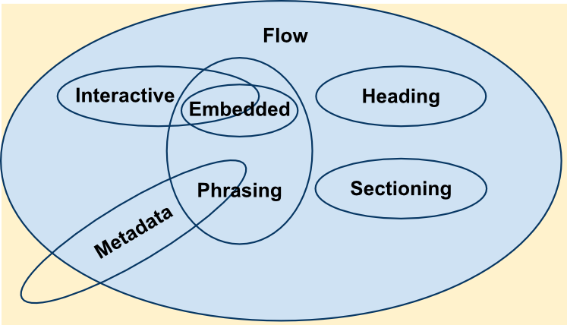
Content Categories
Source: https://developer.mozilla.org/en-US/docs/Web/Guide/HTML/Content_categories

Slide 47



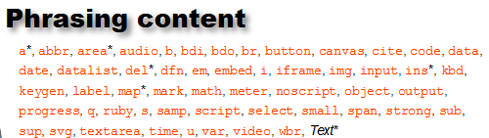


Content Category Description

Slide 48
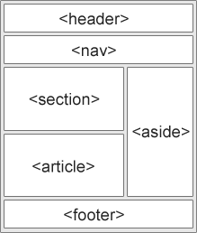
Web page structure

Slide 49
HTML5 - New Elements for better document structure
Tag | Description
<header> | Defines a header for the document or a section
<footer> | Defines a footer for the document or a section
<section> | Defines a section in the document
<article> | Defines an article in the document
<aside> | Defines content aside from the page content
<details> | Defines additional details that the user can view or hide
<dialog> | Defines a dialog box or window
<figcaption> | Defines a caption for a <figure> element
<figure> | Defines self-contained content, like illustrations, diagrams, photos, code listings, etc.

Slide 50
Contd…
Tag | Description
<nav> | Defines navigation links in the document
<progress> | Defines the progress of a task
<summary> | Defines a visible heading for a <details> element
<time> | Defines a date/time

Slide 51
Section Element
A section is a thematic grouping of content, typically with a heading.
<section> <h1>Interfaces</h1> <p>Java doesn’t support true multiple inheritance....</p> </section>

Slide 52
Article Element
This element specifies independent, self-contained content.
It should be possible to read it independently from the rest of the website.
Blog post, Technical article

Slide 53
Nesting of Elements
(Nesting of elements) ? Possible : Not Possible
<section> elements can have <article> elements
<article> elements can have <sections> elements

Slide 54
HTML5: MIME types
Every time your web browser requests a page, the web server sends “headers” before it sends the actual page markup. Headers are important, because they tell your browser how to interpret the page markup that follows.
MIME = Multipurpose Internet Mail Extensions

Slide 55
HTML5: MIME types
The most important header is called Content-Type, and it looks like this:
Content-Type: text/html
“text/html” is called the “content type” or “MIME type” of the page.

Slide 56
HTML5: MIME types
This header is the only thing that determines what a particular resource truly is, and therefore how it should be rendered. Images have their own MIME types (image/jpeg for JPEG images, image/png for PNG images, and so on). JavaScript files have their own MIME type. CSS stylesheets have their own MIME type. Everything has its own MIME type. The web runs on MIME types.

Slide 57
Form Submission
(Input validation) ? Client Side : Server Side
If java script enabled – Client Side
If java script not enabled – Server Side
In HTML5, no java script required for client side input validation

Slide 58
Input Types
Form
Date (Works with chrome but not with Firefox)
Number
Fixed Increment
Placeholder
Output – Displays out put return by a script
Required
Type can be one of datetime, time, week, month, range with min and max attributes etc.

Slide 59
Media Elements
HTML5 supports following video formats
Ogg
Mpeg-4 (Mp4)
WebM
HTML5 supports following video formats
MP3, WAV and Ogg

Slide 60
Media Elements
Before HTML5 there was no standard for showing videos on a web page
HTML5 video tag specifies a standard way to embed a video in a web page
Example:
<video width="320" height="240" controls> <source src="movie.mp4" type="video/mp4"> <source src="movie.ogg" type="video/ogg"> Your browser does not support the video tag. </video>

Slide 61

DOM Tree

Slide 62
Document Object Model
The W3C Document Object Model is a platform and language-neutral interface that allows programs and scripts to dynamically access and update the content, structure and style of a document.
In DOM, each HTML element is considered as an object. Through object one can set/get the properties of an HTML element by using corresponding methods and event listeners.

Slide 63
Example
document.getElementById(“para”).innerHTML = “Ok”;
Above statement should be run in a script tag
<script type=“text/javascript” src=“demo.js” async|defer></script>
<noscript>Enable JavaScript in your browser </noscript>

Slide 64
DOM Examples
Change html element attribute value
var para = document.getElementById(‘para’);
para.setAttribute(“innerHTML”,”Ok”);
para.style.color=“red”;
Adding event listener
document.getElementById(“para”).addEventListener(“click”, displayDate);
document.getElementById(“para”).addEventListener(“click”, displayName);

Slide 65
Adding New Element
var lielem = document.createElement(“li”);
var text = document.createTextNode(“DoE”);
lielem.appendChild(text);
document.getElementById(“cdac”).appendChild(lielem);

Slide 66
Event Propagation
Bubbling
In this case, the innermost element’s event will be executed first than the outer one.
Capturing
In this case, the outmost element’s event will be executed first than the inner one.

Slide 67
Cascading Style Sheet
Used for presentation – how web pages have to be styled or laid out etc.
CSS Rules usually consists of
Set of properties with values
Selector to apply the updated values to
Can be referenced from web page in one of
<link rel=“stylesheet” href=“style.css” /> | external reference
<div style=“color:red;”> </div> | inline
<style> p{color:red;} </style> | using html tag
ways

Slide 68
Cascading Style Sheet
body { background-color: powderblue; } h1, h2, h3 { color: blue; } p { color: red; #text color
border: 1px solid blue; #border color
padding: 30px; #space between text and border
margin: 20px; #space outsider border }

Slide 69
Cascading Style Sheet
To define css style for a specific element use id attribute
#p01 { color: blue; }
<p id=“p01”>This is cdac</p>
To define css style for a class of elements use class attribute
.para { color: blue; }
<p class=“para”>This is cdac</p>

Slide 70
Cascading Style Sheet
Element Positioning
CSS Properties:
position: static | relative | absolute | fixed | sticky
Helper Properties:
top | left | right | bottom | z-index
Note: Helper properties doesn’t work without position or position: static

Slide 71
Cascading Style Sheet
position: relative;
An element’s new position relative to its normal position.
When position attribute value is non-static, its helper properties also must be set to see the effect.
position: absolute;
In this case, the element will be removed from the document flow and will get placed relative to its parent element.

Slide 72
Cascading Style Sheet
Animation Properties
div {
position: relative;
animation-name : moveltr;
animation-duration : 10s;
}
@keyframes moveltr {
from { left: 0px; }
to { left: 200px; }
}

Slide 73
Application Programming Interfaces

Slide 74
HTML5 Canvas
Canvas element is used to draw graphics on the fly via scripting
It is only a container for graphics and use some scripting to actually draw on the canvas
Example: <canvas id="myCanvas" width="200" height="100" style="border:1px solid #000000;">
The getContext() method returns an object of type canvas which has several methods to be invoked on it for drawing purpose.

Slide 75
HTML5 Drag and Drop
Steps:
Make an element draggable by setting draggable attribute to true. <img draggable=true>
Set an event listener for dragstart that stores the data being dragged.
Set an event listener for drop event
Example

Slide 76
Geo Location & Web Storage
Locate user’s geo location
Get the location of this PC
getCurrentPosition() method is used to get the user’s position.
See the example code for displaying different types of maps
HTTP State Maintenance
Before HTML5 :
The cookie specifications require that browsers must meet the following requirements in order to support cookies:
Can support cookies as large as 4,096 bytes in size
Can store at least 50 cookies per domain (i.e. per website)
Can store at least 3000 cookies in total

Slide 77
Contd…
HTTP State Maintenance
After HTML5
Local Storage
Can store up to 5MB data
Information is never transferred to the server
Similar to persistent cookies concept
Session Storage
Similar to session cookies
Difference is information stored would not be shared between new and old window/tab unlike in the case of session cookie.

Slide 78
Web DB
User agents need to store large numbers of objects locally in order to satisfy off-line data requirements of Web applications.
Web Storage is useful for storing pairs of keys and their corresponding values
Limitation with web storage is
does not provide in-order retrieval of keys,
efficient searching over values,
storage of duplicate values for a key.

Slide 79
Web Worker
Through webworker we can run scripts in background threads without interfering with the user interface.
Worker can communicate with the JavaScript which initiated the web worker by posting messages to an event handler specified by that code (and vice-versa).
Sample Program

Slide 80
Contd…
Worker’s context is different from that of window context, it is represented by DedicatedWorkerGlobalScope or SharedWorkerGlobalScope.
Rules
You can run any JavaScript code inside a worker
You can’t manipulate DOM inside a worker
Can’t access some default methods or properties of window object
For a list of methods and properties that can be accessed from
https://developer.mozilla.org/en-US/docs/Web/API/ Web_ Workers_API/Functions_and_classes_available_to_workers

Slide 81
Web API (Few more) Performance Measurement
User latency is an important quality bench mark for Web applications.
<html>
<head>
<script type="text/javascript">
var start = new Date().getTime();
function onLoad() {
var now = new Date().getTime();
var latency = now - start; alert("page loading time: " + latency); }
</script>
</head>
<body onload="onLoad()">
<!- Main page body goes from here. --> </body>
</html>
It does not give information about the time it takes to get the page from the server (details about end to end latency).

Slide 82
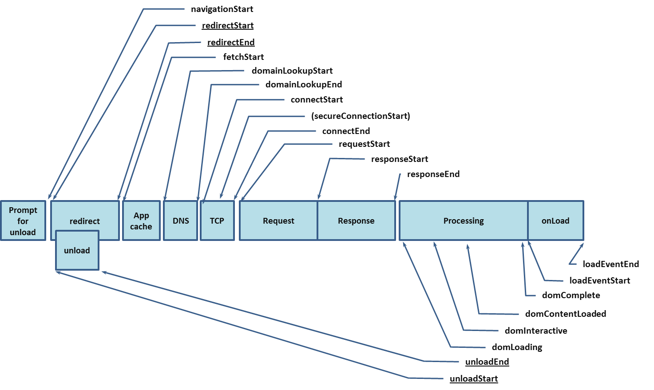
Sequence of Page Loading Events

Slide 83
Navigation Timing
<html>
<head>
<script type="text/javascript">
function onLoad() {
var now = new Date().getTime();
var page_load_time = now - performance.timing.navigationStart;
alert("User-perceived page loading time: " + page_load_time);
}
</script>
</head>
<body onload="onLoad()">
<!- Main page body goes from here. -->
</body>
</html>

Slide 84
eXtensible Markup Language
Designed for storing and transporting data
XML document can be read by both human and machine
XML does not use predefined tags as in the case of HTML

Slide 85
Sample XML Code
<?xml version=“1.0” encoding=“utf-8”?>
<nitf>
<head>
<title> CDAC </title>
</head>
</nitf>

Slide 86
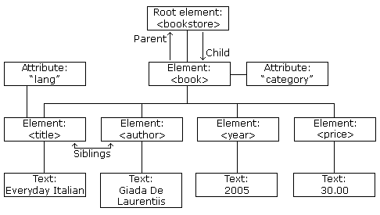
XML Tree

Slide 87
XML Rules
Attribute values must always be quoted
XML elements must be properly nested
Tags are case sensitive
XML Prolog (<?xml version=“1.0” encoding=“utf-8” ?>) is optional
The document must contain a root element
Comments syntax is same as that of HTML.

Slide 88
Entity References
Certain symbols such as >, < etc., cannot be used in XML. Instead corresponding entity reference have to be used to avoid parsing errors.
&lt; <
&gt; >
&amp; &
&apos; ‘
&quot; “

Slide 89
XML Document
XML documents can be extended by some more information any time.
The application using the XML document will not crash or break if it is extended with some more information.
Example:
<note> <date>2008-01-10</date> <to>CDAC CHN</to> <from>CDAC HYD</from> </note>

