Slide 1
RAMIFY OS v11.0.6
Client feedback alignment
Deterministic product truth, bounded agent authority and signed decision lineage.
01
FastAPI/Python scope
02
Release result
03
Main direction
Go feedback was not used for this build. The fixes target David's 26-28 August FastAPI feedback.
379 passed, 4 optional skipped, 1,312 subtests, 0 failures.
Consistency, hardening and proof - not feature sprawl.
RAMIFY OS v11.0.6 - FastAPI/Python final evidence
1

Slide 2
PROBLEM
AI shopping needs a trust boundary
A language model can interpret or explain, but it must not become product-trust or purchase authority.
A
Risk
B
Boundary
C
RAMIFY answer
Probabilistic text could be mistaken for verified product truth.
LLM output cannot set posture, reason code, permitted action or purchase authority.
Deterministic evidence checks and signed receipts control what can happen next.
RAMIFY OS v11.0.6 - FastAPI/Python final evidence
2

Slide 3
ARCHITECTURE
Interpretation outside; RAMIFY core inside
1
AI layer
2
Deterministic core
3
Authority layer
LangGraph/Ollama may identify known catalogue candidates and explain sealed results.
→
RESOLVE identifies; RATIFY verifies evidence-derived product truth.
→
Agent policy may only narrow; Action Gate enforces permitted actions.
Client proof
Same product facts stay the same. Different actors may only narrow what happens next, and every authority is sealed in a receipt.
RAMIFY OS v11.0.6 - FastAPI/Python final evidence
3

Slide 4
FIVE PRIMITIVES
The core proof uses the backend sequence
01
identify
02
resolve
03
status
04
verify
05
assess
→
→
→
→
one known subject
canonical product
standing / unknown
seven RATIFY checks
posture + authority
Feedback covered
Technical UI, documentation and presentation now use identify -> resolve -> status -> verify -> assess. RATIFY stays visible inside verify, not merged into RESOLVE.
RAMIFY OS v11.0.6 - FastAPI/Python final evidence
4

Slide 5
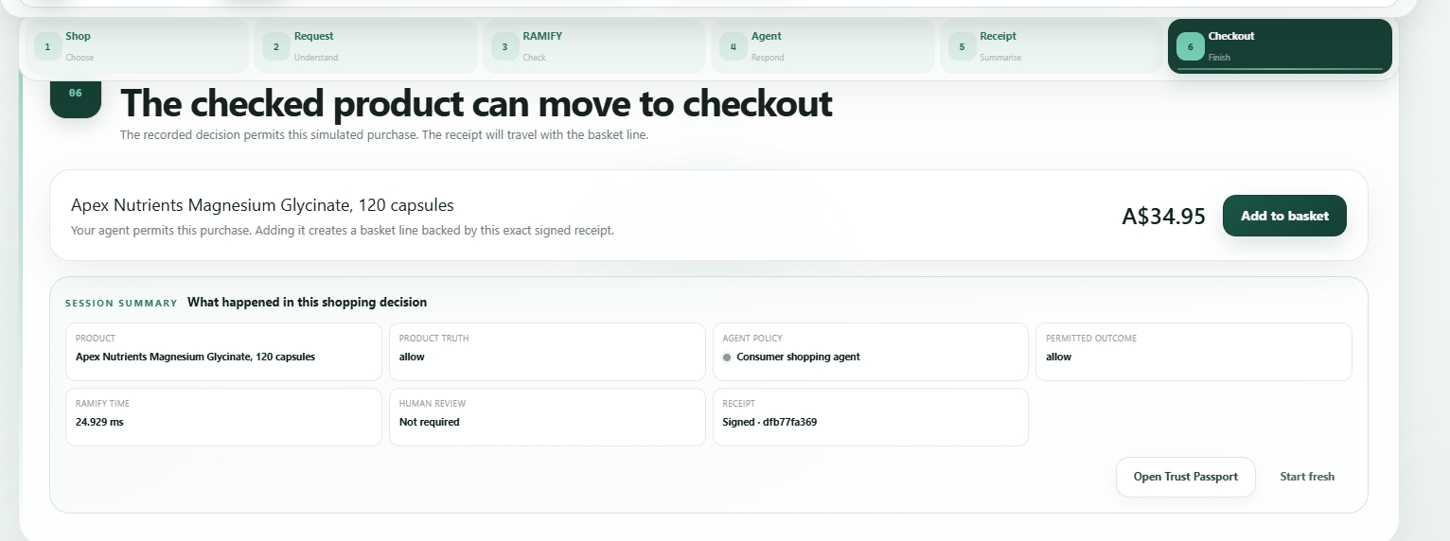
LIVE EVIDENCE
Product result and Action Gate flow
A signed allow receipt can move to checkout only while the receipt remains intact purchase authority.
1
What this proves
The product decision is separate from purchase authority.
2
Why it matters
The Action Gate re-reads and verifies the signed receipt before basket/checkout.
3
Client alignment
Receipt is not just a report; it constrains the next simulated action.
RAMIFY OS v11.0.6 - FastAPI/Python final evidence
5

Slide 6
MULTI-AGENT PROOF
One objective truth, different authorised actors
A
Consumer actor
B
Procurement actor
C
Meaning
Northbeam objective result: allow. Consumer can proceed.
Same objective result: allow. Procurement narrows to hold due to approved-vendor policy.
Different action authority without changing product truth.
Feedback covered
Actor policy is applied only after the objective posture and can move only toward a more restrictive outcome.
RAMIFY OS v11.0.6 - FastAPI/Python final evidence
6

Slide 7
EVIDENCE CHAIN
RATIFY now verifies artefacts, not just metadata
1
artefact bytes
2
SHA-256 hash
3
issuer Ed25519 signature
4
subject/scope binding
5
RATIFY finding
6
signed receipt
verified before trust result
→
verified before trust result
→
verified before trust result
→
verified before trust result
→
feeds receipt
→
feeds receipt
Key fix
This closes David's biggest FastAPI gap: evidence signatures now participate in the trust computation instead of sitting as attached metadata.
RAMIFY OS v11.0.6 - FastAPI/Python final evidence
7

Slide 8
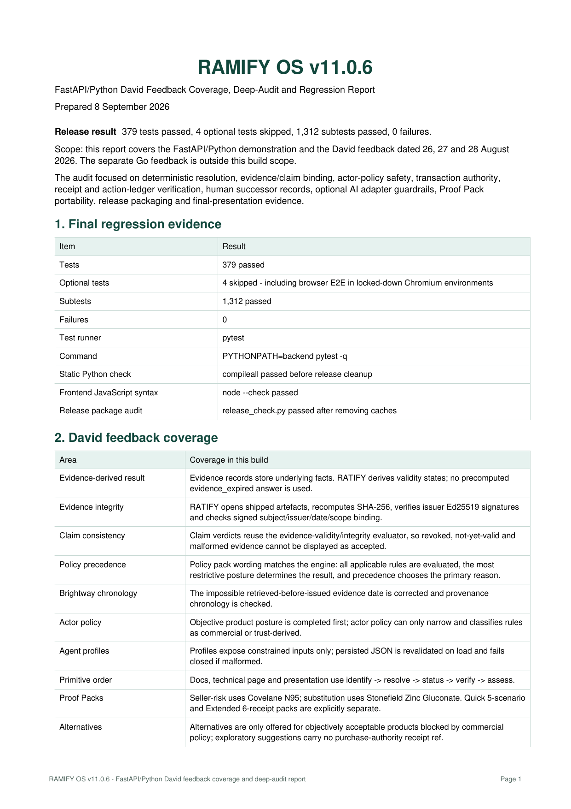

REGRESSION EVIDENCE
Current v4 validation result
1
Tests
2
Subtests
379 passed
4 optional skipped
1,312 passed
0 failures
3
Timing
4
Checks
Median 4.452 ms
P95 8.802 ms
compileall, JS syntax, release audit
Final evidence note
Run capture_release_evidence.py from the final Git checkout to capture commit SHA and clean/dirty state.
RAMIFY OS v11.0.6 - FastAPI/Python final evidence
8

Slide 9
SCOPE
Strong demo claims, careful security claims
1
Real mechanics
2
Synthetic boundary
3
Not claimed
Canonical JSON, SHA-256, Ed25519, tamper evidence.
Demo data, issuers, evidence and keys are invented.
No production key custody, immutable ledger, payment, supplier or real certification.
Why this helps
The honest boundary makes the prototype more credible, not weaker.
RAMIFY OS v11.0.6 - FastAPI/Python final evidence
9

Slide 10
CLOSE
RAMIFY keeps agentic shopping controllable
1
Evidence-derived truth
2
Constrained authority
3
Verifiable lineage
The system reasons from facts and verified artefacts.
Agents can only narrow and Action Gate enforces the receipt.
Machine, human and transaction records remain linked and tamper-evident.
Take-away: AI helps communicate; RAMIFY decides, constrains and records.
RAMIFY OS v11.0.6 - FastAPI/Python final evidence
10

