Slide 1
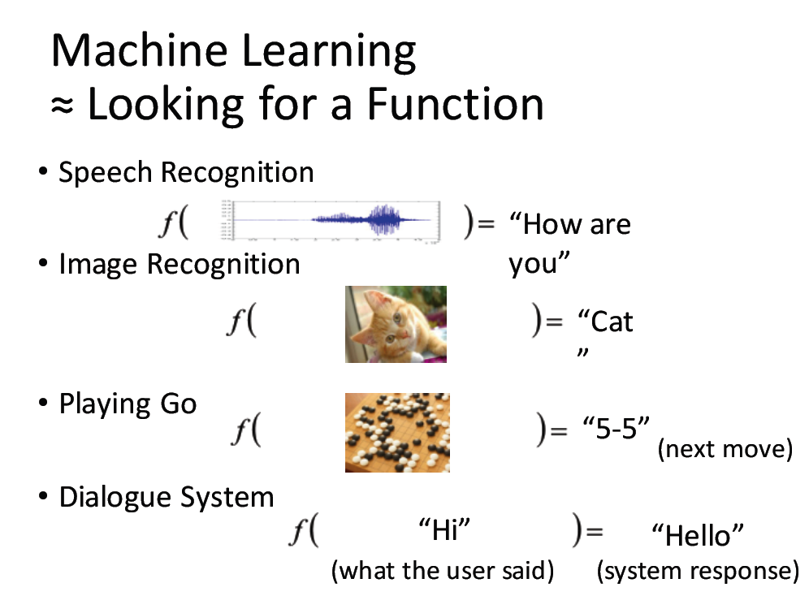
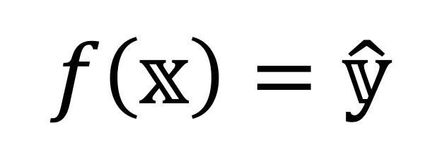
$$f\left(𝕩\right)=\hat{𝕪}$$

Slide 2
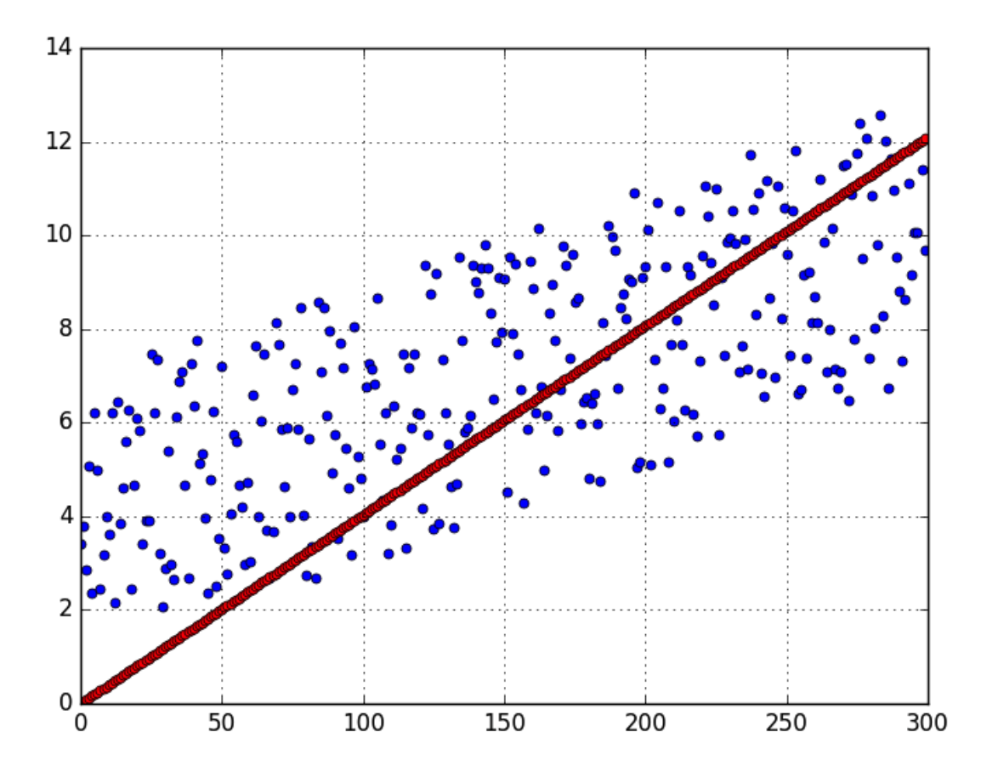
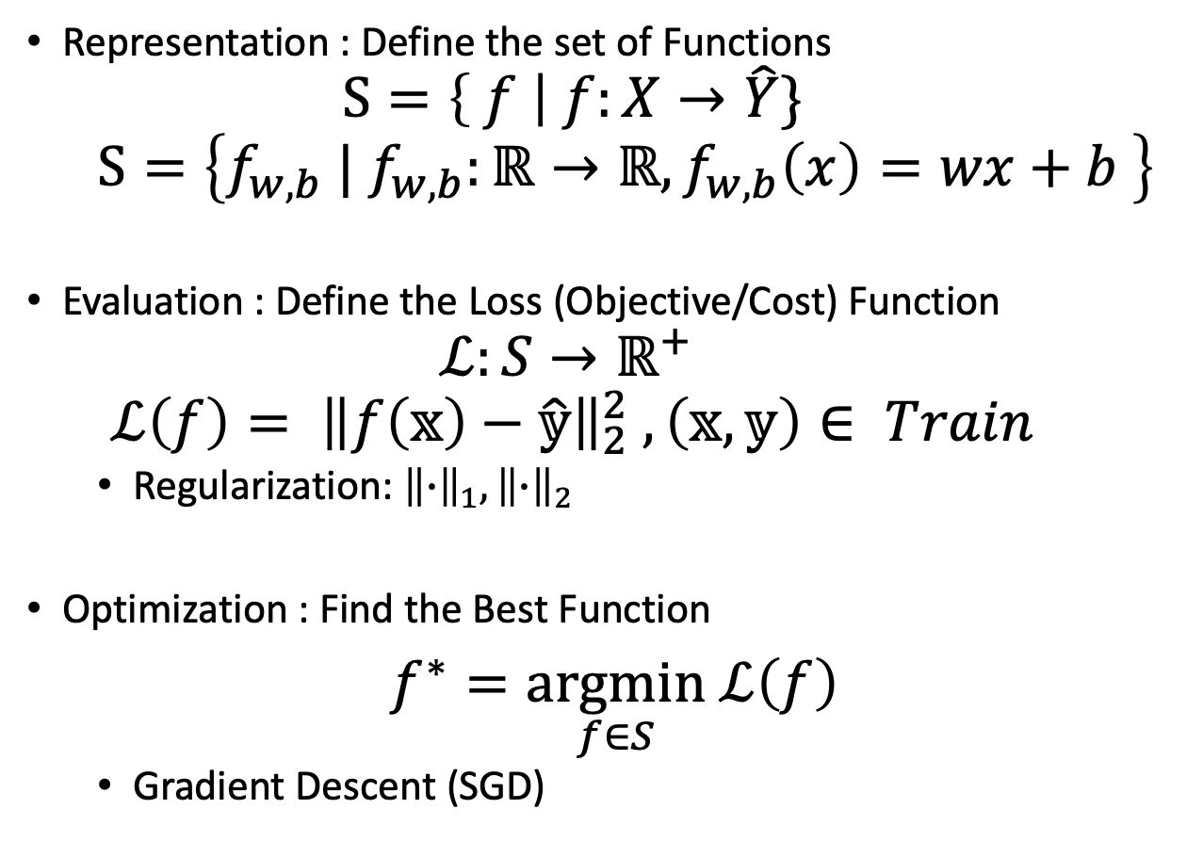

3 Steps :$f\left(𝕩\right)=\hat{𝕪}$
Representation : Define the set of Functions
$$S=\left\{ f \right| f:X→\hat{Y}\}$$
$$S=\left\{f_{w,b}{ | f}_{w,b}:ℝ→ℝ,f_{w,b}\left(x\right)=wx+b \right\}$$
Evaluation : Define the Loss (Objective/Cost) Function
$$ℒ:S→ℝ^{+}$$
$$ℒ\left(f\right)= {\left\|f\left(𝕩\right)−\hat{𝕪}\right\|}_{2}^{2} ,\left(𝕩,𝕪\right)∈ Train$$
Regularization: ${\left\|∙\right\|}_{1},{\left\|∙\right\|}_{2}$
Optimization : Find the Best Function
$f^{∗}=\underset{f∈S}{argmin} ℒ\left(f\right)$
Gradient Descent (SGD)

Slide 3
Ｑ＆Ａ
Overfitting (Variance)v.s. Underfitting (Bias)
Overfitting : Regularization/early stop
Training (70%-80%),Test(20%-30%),Cross Validation

Slide 4
Supervised
Regression
Classification
Generative Model
Logistic Regression
SVM
Decision Tree
Unsupervised
Cluster: KNN, Hierarchical Agglomerative, GMM
PCA
Ensemble
Bagging, Random Forest
Boosting, Adaboost

Slide 5
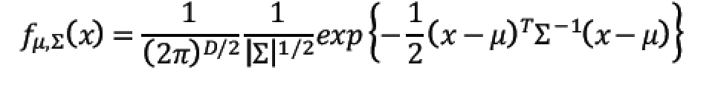
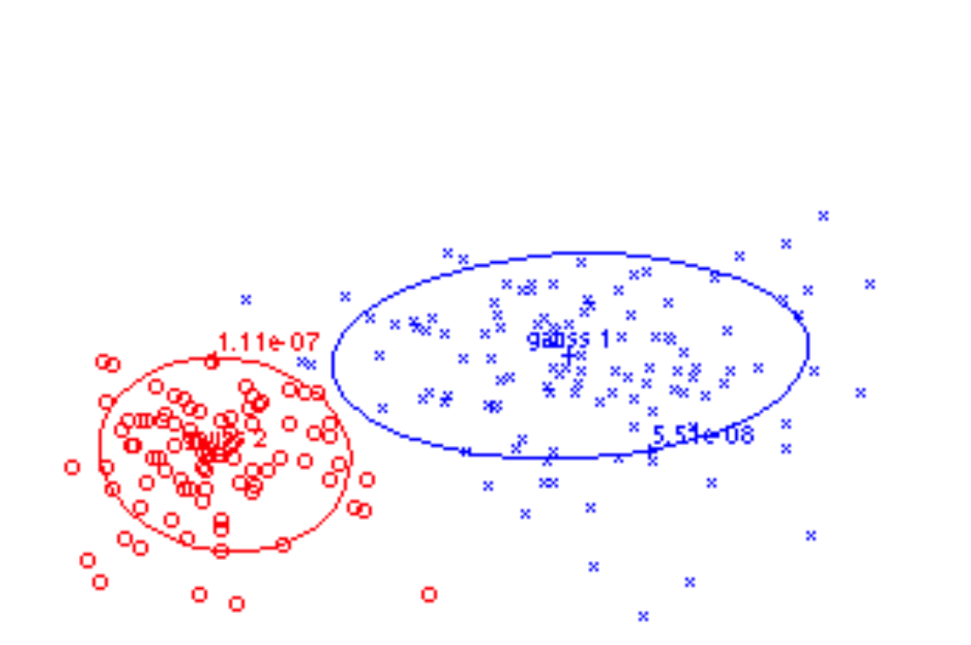
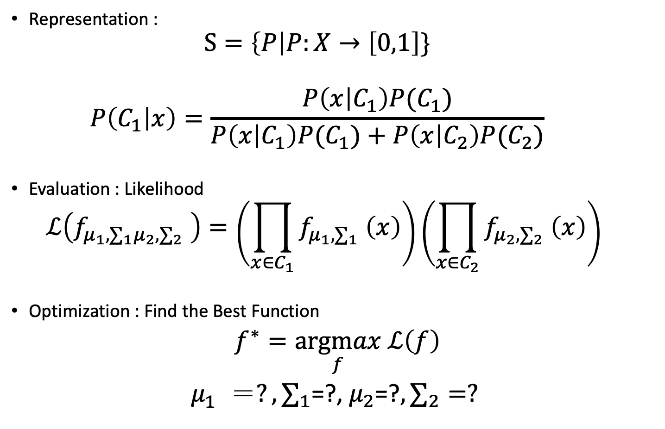

Supervised- Generative Model,$\hat{ Y}$={0,1}
Representation :
$$S=\left\{P\right|P:X→\left[0,1\right]\}$$
$$P\left(C_{1} | x\right)=\frac{P\left(x | C_{1}\right)P(C_{1})}{P\left(x | C_{1}\right)P(C_{1})+P\left(x | C_{2}\right)P(C_{2})}$$
Evaluation : Likelihood
$$ℒ\left(f_{μ_{1}, ∑_{1}μ_{2}, ∑_{2}} \right)=\left(\prod_{x∈C_{1}}{f_{μ_{1}, ∑_{1}} \left(x\right)}\right)\left(\prod_{x∈C_{2}}{f_{μ_{2}, ∑_{2}} \left(x\right)}\right)$$
Optimization : Find the Best Function
$f^{∗}=\underset{f}{argmax} ℒ\left(f\right)$
$μ_{1}^{} ＝?, ∑_{1}$=?, $μ_{2}$=?$, ∑_{2}=?$

Slide 6
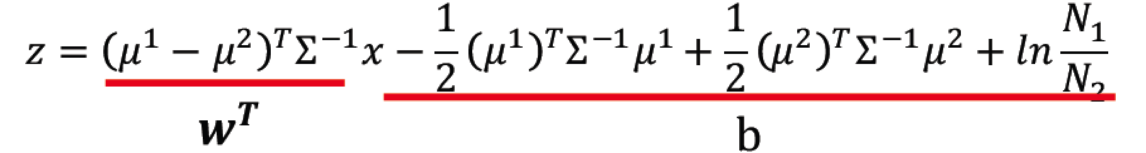
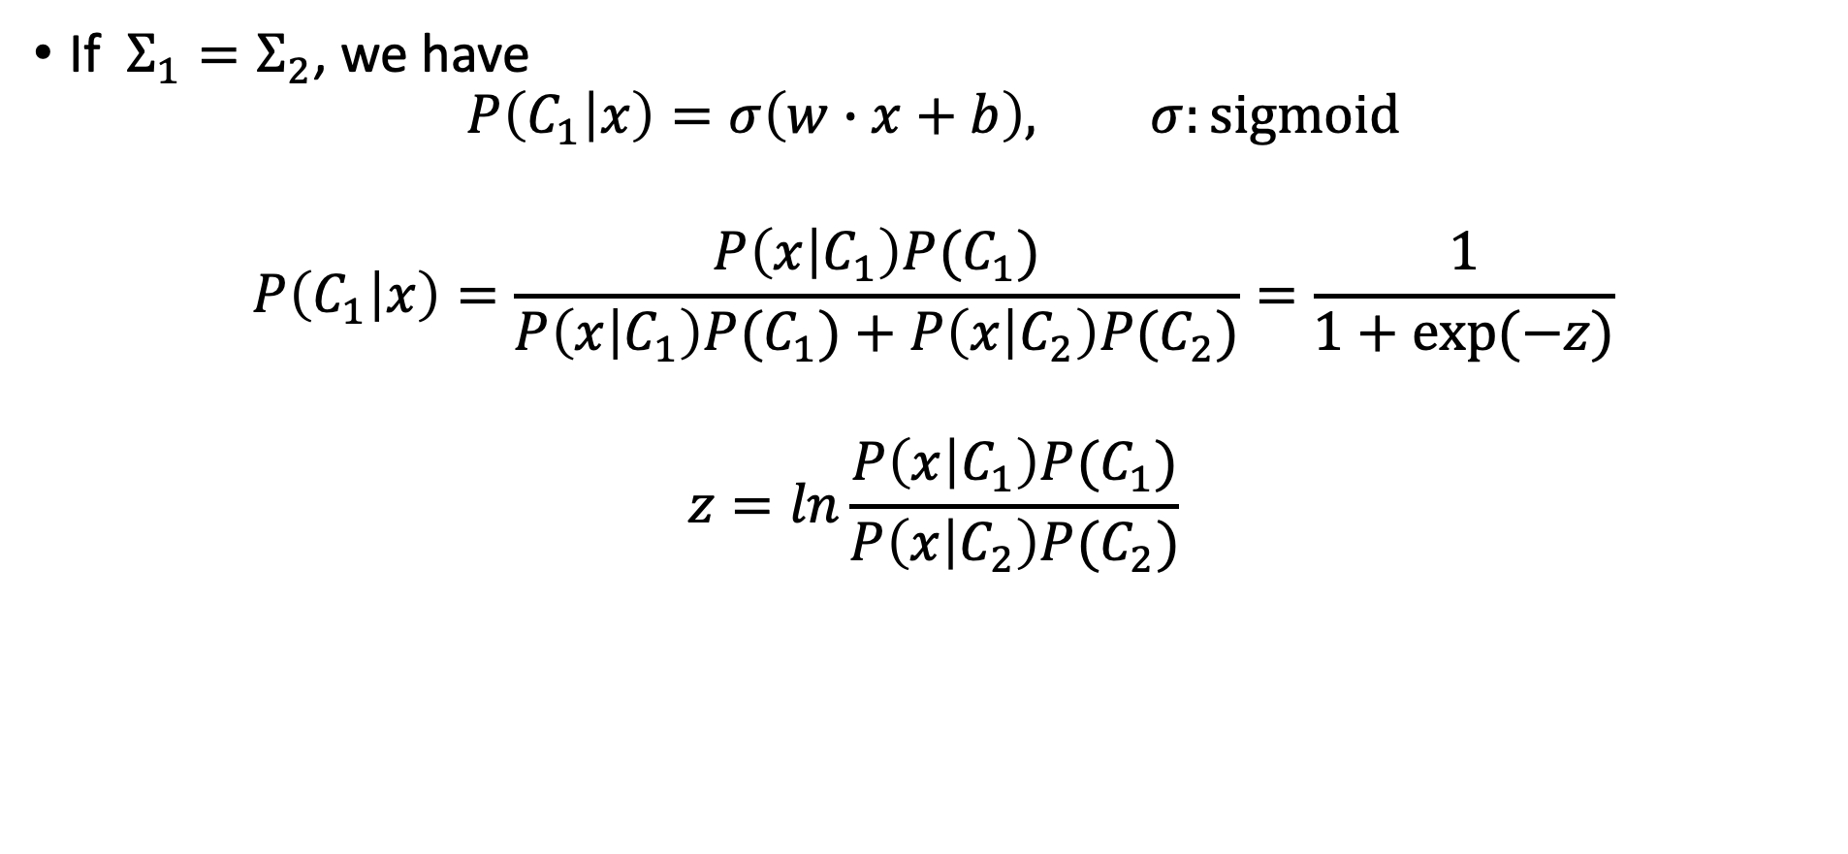
Ｑ＆Ａ- Generative Model
If $Σ_{1}=Σ_{2}$, we have $P\left(C_{1} | x\right)=σ\left(w∙x+b\right), σ:sigmoid$
$$P\left(C_{1} | x\right)=\frac{P\left(x | C_{1}\right)P(C_{1})}{P\left(x | C_{1}\right)P(C_{1})+P\left(x | C_{2}\right)P(C_{2})}=\frac{1}{1+exp⁡(−z)}$$
$$z=ln\frac{P\left(x | C_{1}\right)P(C_{1})}{P\left(x | C_{2}\right)P(C_{2})}$$

Slide 7
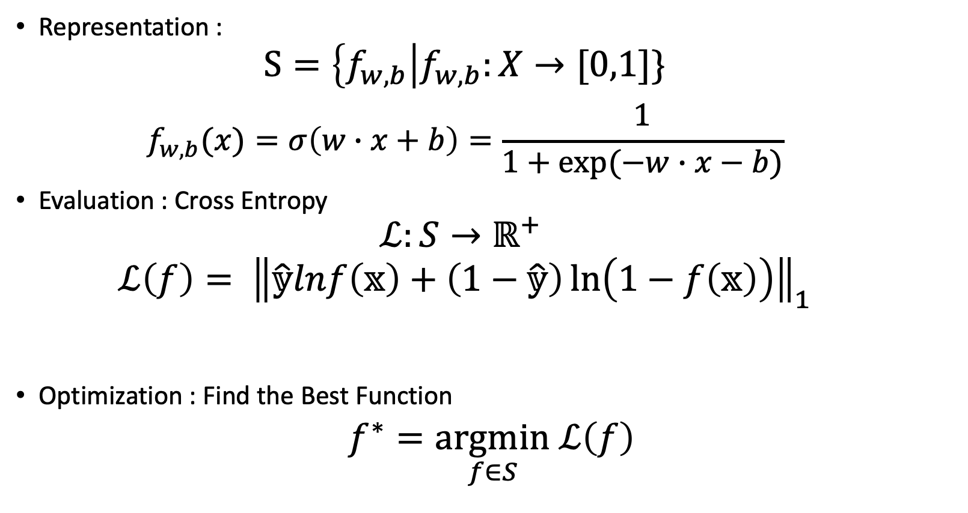
Supervised- Logistic Regression
Representation :
$$S=\left\{f_{w,b}\right|f_{w,b}:X→[0,1]\}$$
$$f_{w,b}(x)=σ\left(w∙x+b\right)=\frac{1}{1+exp⁡(−w∙x−b)}$$
Evaluation : Cross Entropy
$$ℒ:S→ℝ^{+}$$
$$ℒ\left(f\right)= {\left\|\hat{𝕪}lnf\left(𝕩\right)+\left(1−\hat{𝕪}\right)\ln\left(1−f\left(𝕩\right)\right)\right\|}_{1}$$
Optimization : Find the Best Function
$f^{∗}=\underset{f∈S}{argmin} ℒ\left(f\right)$

Slide 8
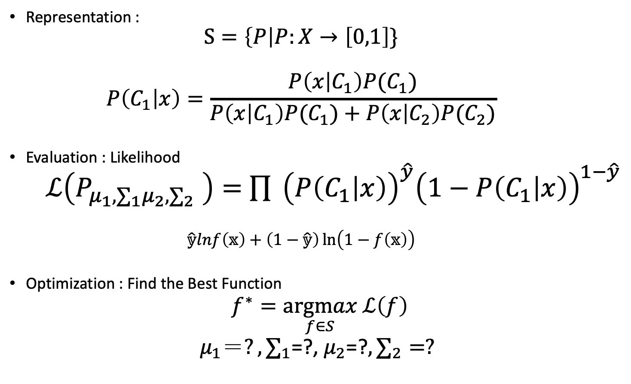

Q&A:3- Generative Model,$\hat{ Y}$={0,1}
Representation :
$$S=\left\{P\right|P:X→\left[0,1\right]\}$$
$$P\left(C_{1} | x\right)=\frac{P\left(x | C_{1}\right)P(C_{1})}{P\left(x | C_{1}\right)P(C_{1})+P\left(x | C_{2}\right)P(C_{2})}$$
Evaluation : Likelihood
$ℒ\left(P_{μ_{1}, ∑_{1}μ_{2}, ∑_{2}} \right)=$ $\prod{ {\left(P\left(C_{1} | x\right)\right)}_{ }^{\hat{y}}{\left(1−P\left(C_{1} | x\right)\right)}_{ }^{1−\hat{y}}}$
$$\hat{𝕪}lnf\left(𝕩\right)+\left(1−\hat{𝕪}\right)\ln\left(1−f\left(𝕩\right)\right)$$
Optimization : Find the Best Function
$f^{∗}=\underset{f∈S}{argmax} ℒ\left(f\right)$
$μ_{1}＝?, ∑_{1}$=?, $μ_{2}$=?$, ∑_{2}=?$

Slide 9
Ｑ＆Ａ- Logistic Regression
Regression
Entropy
Deep Learning

Slide 10
Supervised
Regression
Classification
Generative Model
Logistic Regression
SVM
Decision Tree
Unsupervised
Cluster
PCA
Ensemble
Bagging
Boosting

