Slide 1
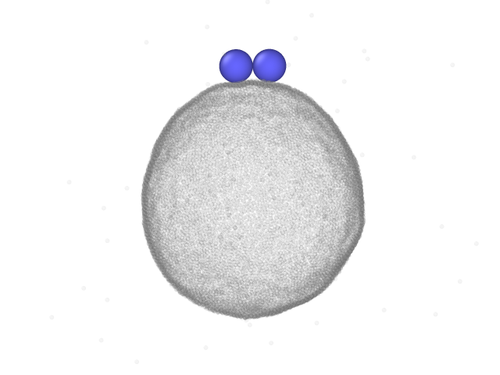
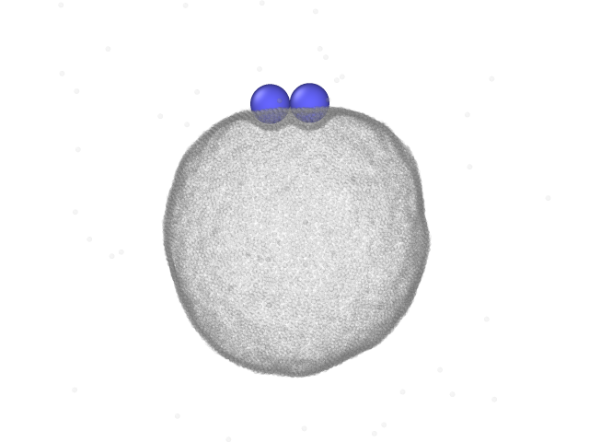
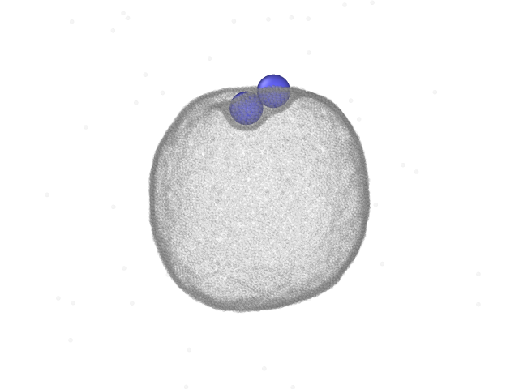
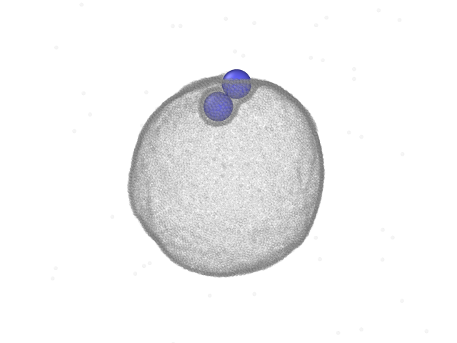
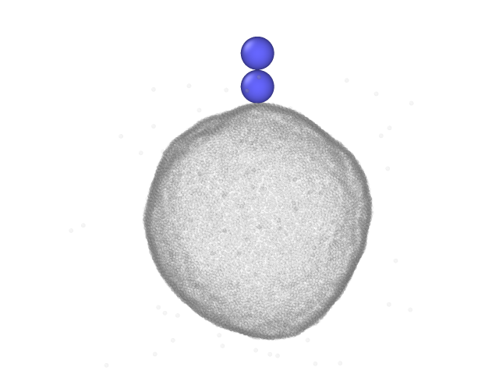
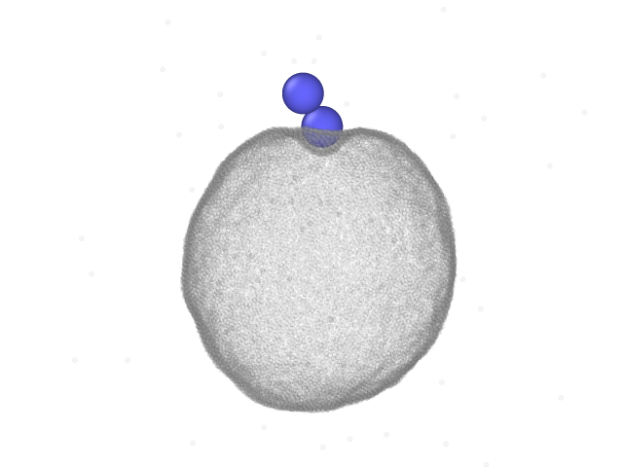
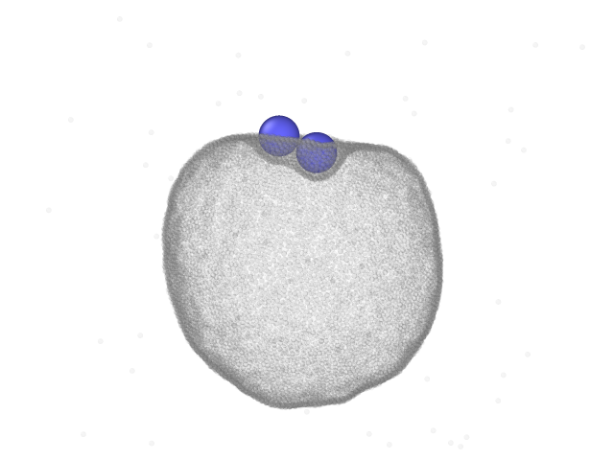
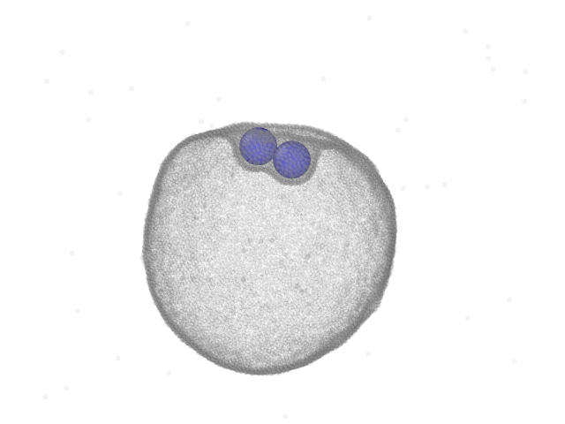
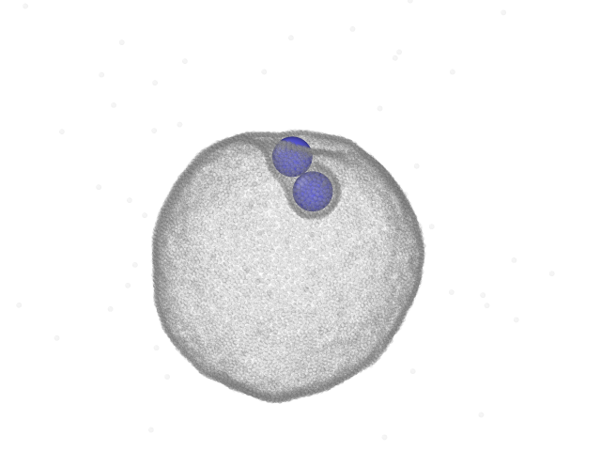
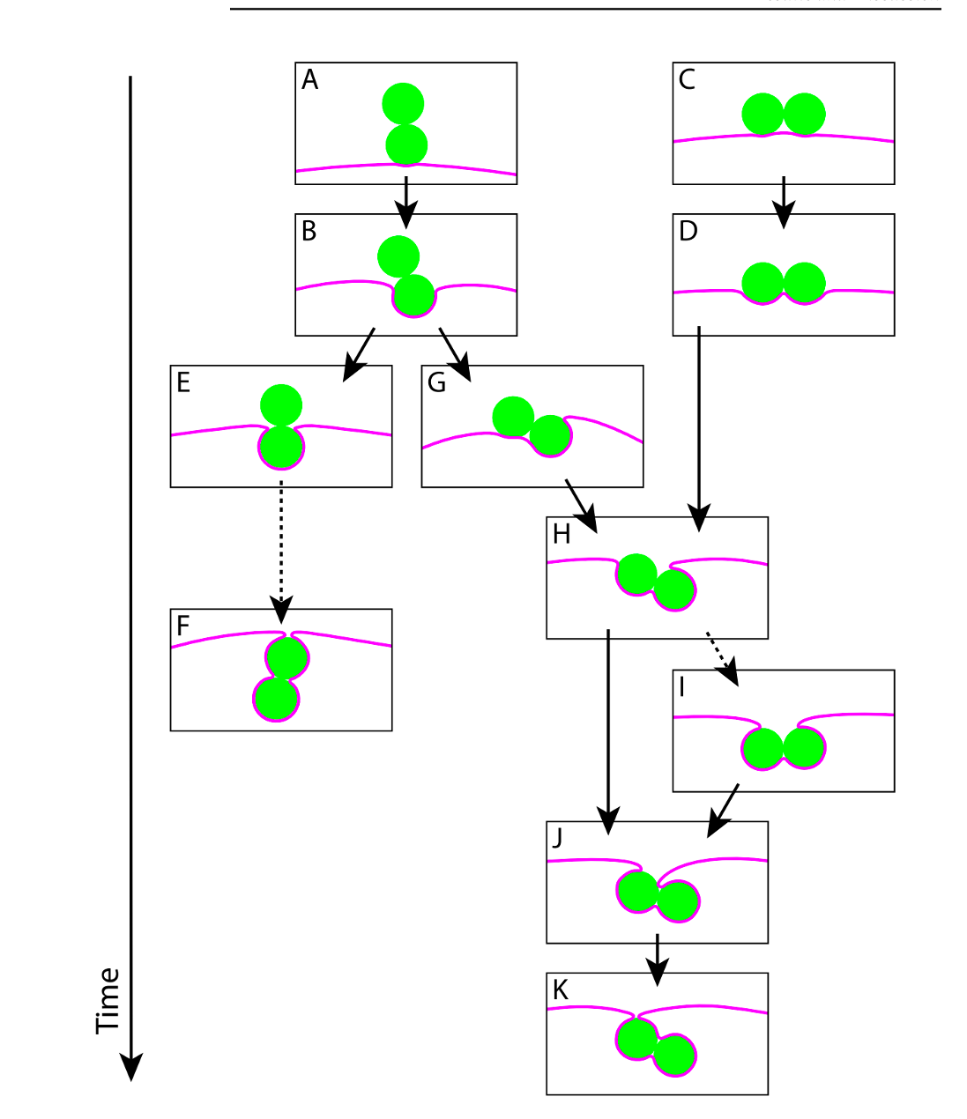







$$∆τ_{CD}$$
$$∆τ_{DH}$$
$$∆τ_{HJ}$$
$$∆τ_{BG}$$
$$∆τ_{AB}$$
$$∆τ_{GH}$$
$$∆τ_{HJ}$$
Dumbbell diameter = 75nm
Vesicle diameter = 500 nm
Tension = 0 (no solute particles)
C
D
H
J
A
B
G
H
J

Slide 2


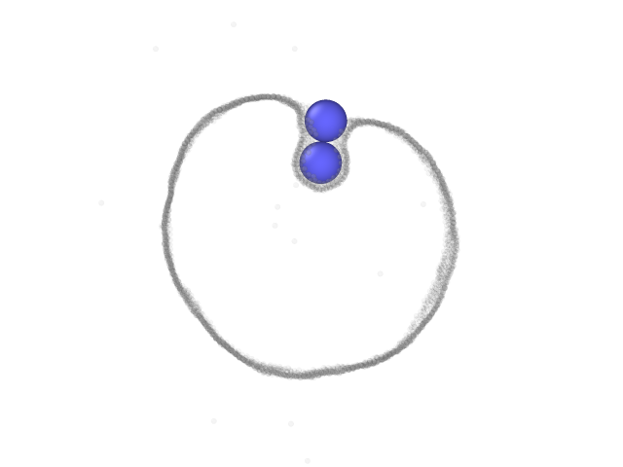
Results with mass
Starts vertical
Starts horizontal
Starts vertical
Starts horizontal

Slide 3
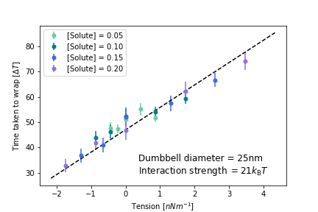
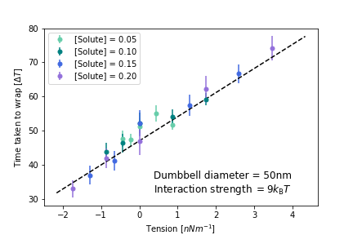

Slide 4
Simulation
Theory
Notes:
-if virus wanted to get faster and was a sphere, it would get smaller, but if it was a dumbbell, it would get bigger!
-all because of neck term

Slide 6
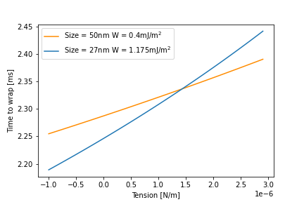
Theory
Simulation
Defining ‘wrapped’ as number of membrane beads bound to dumbbell

Slide 7
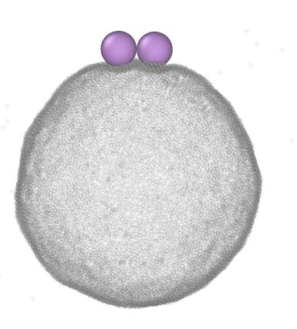
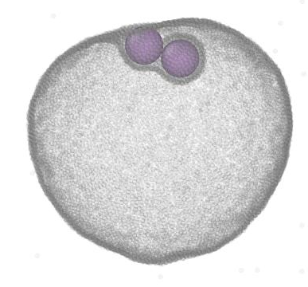
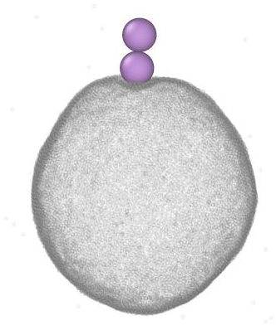
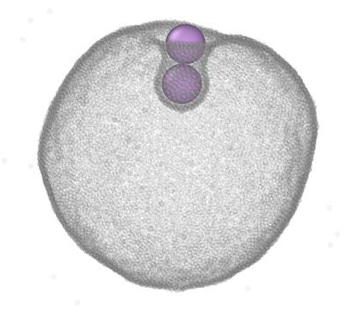

Slide 8
a)
b)

Slide 9
C
D
H
J
A
B
G

Slide 10
C
D
H
J
A
B
G

Slide 11
a)
C
A
b)
D
B
H
G
c)
J

Slide 12
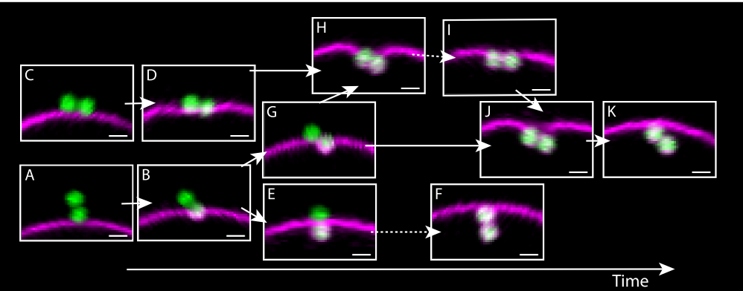
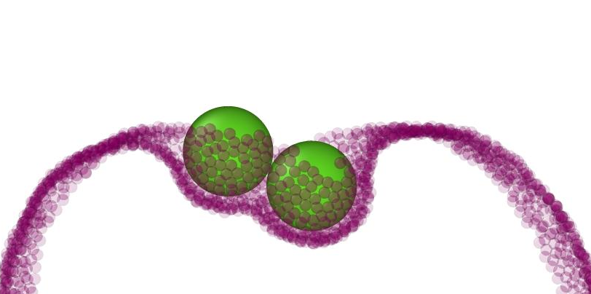
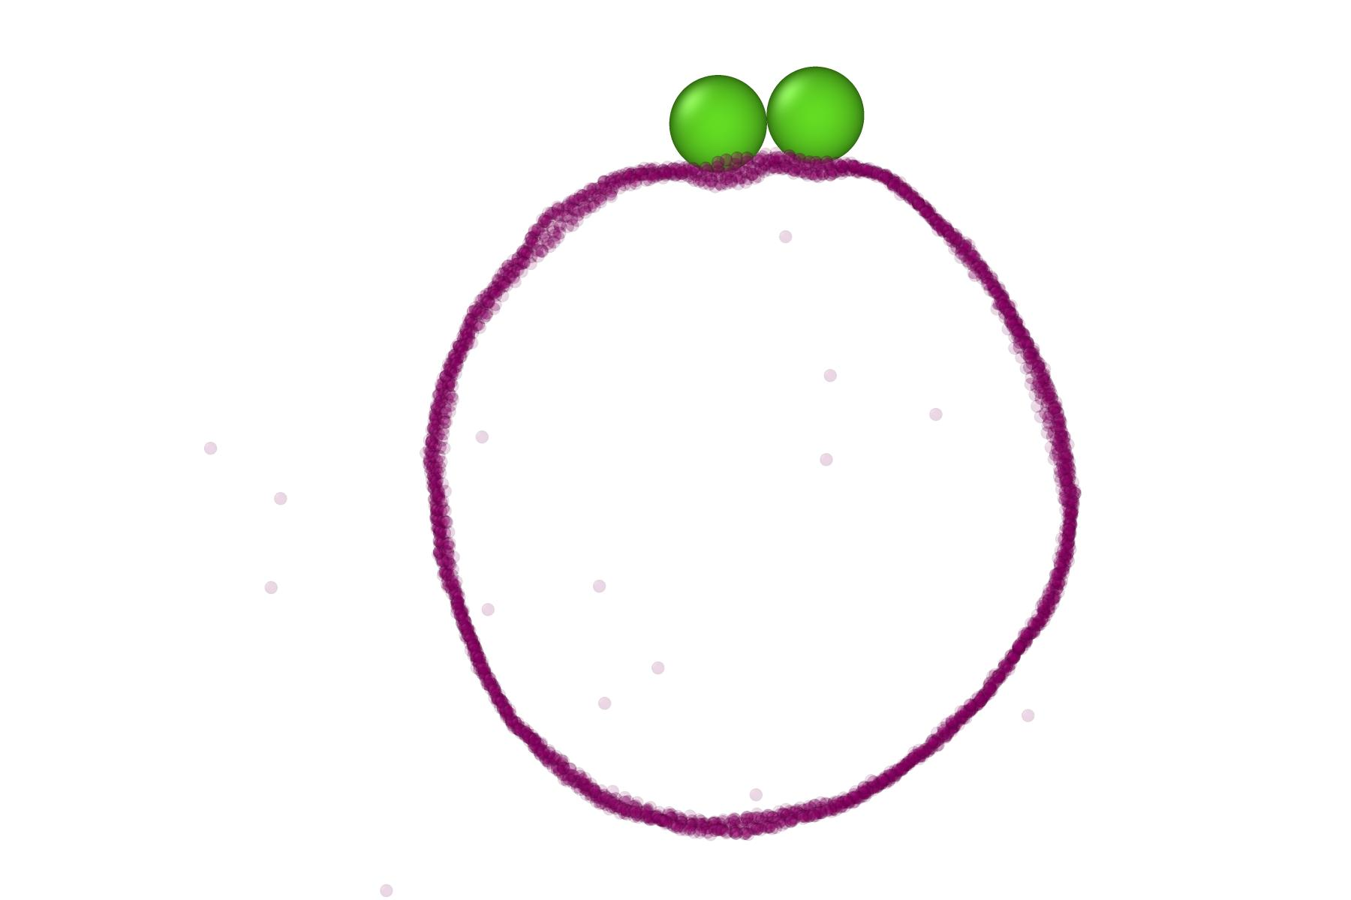
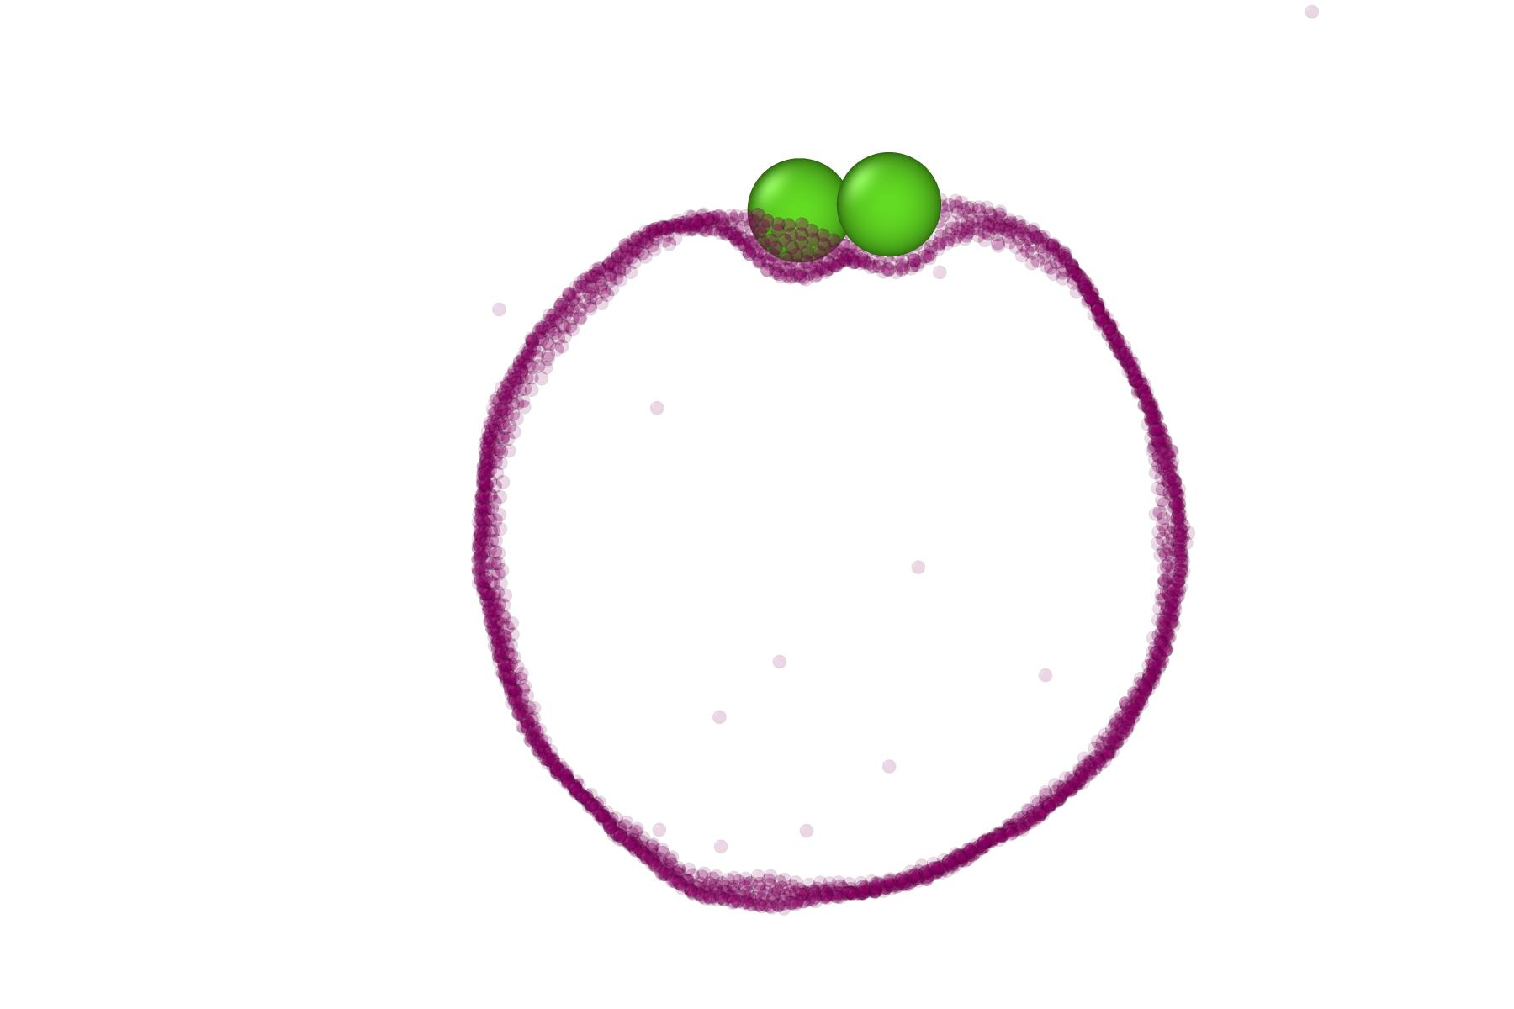
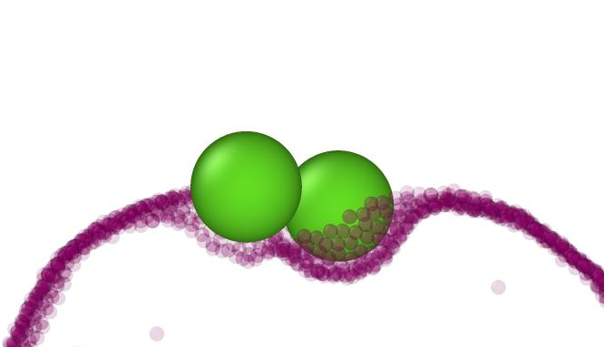
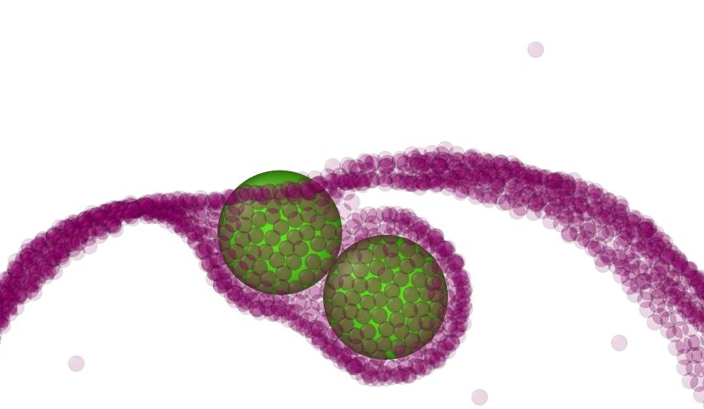
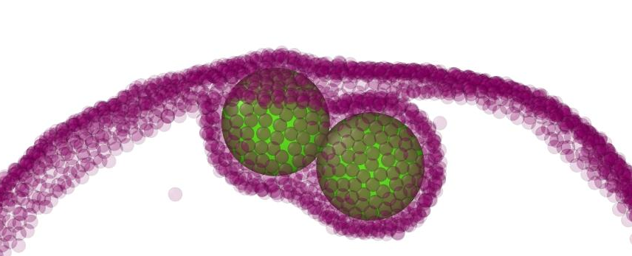
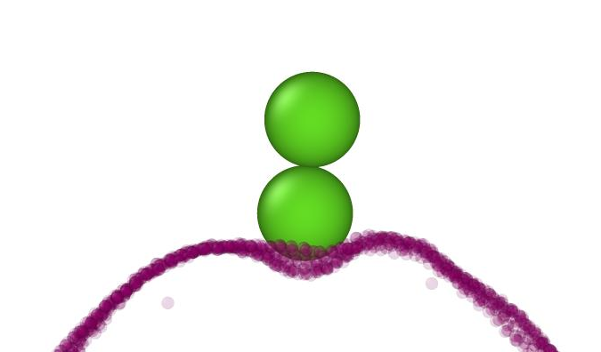
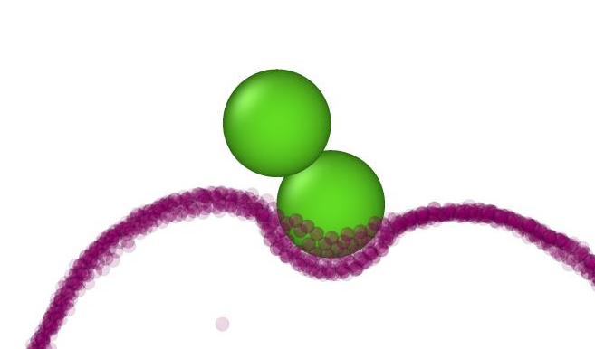
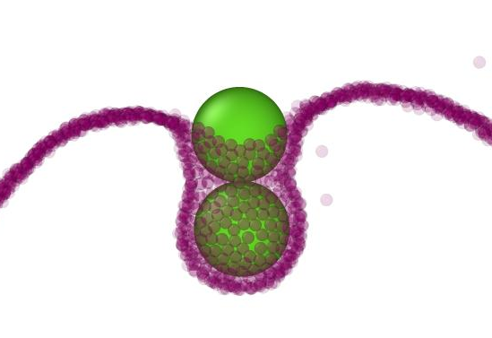
Experiment
Simulation
H
C
D
G
J
K
A
B
E

Slide 13
