Slide 1
Three Material Decomposition for Duel Energy CT
Gengxin Shi

Slide 2
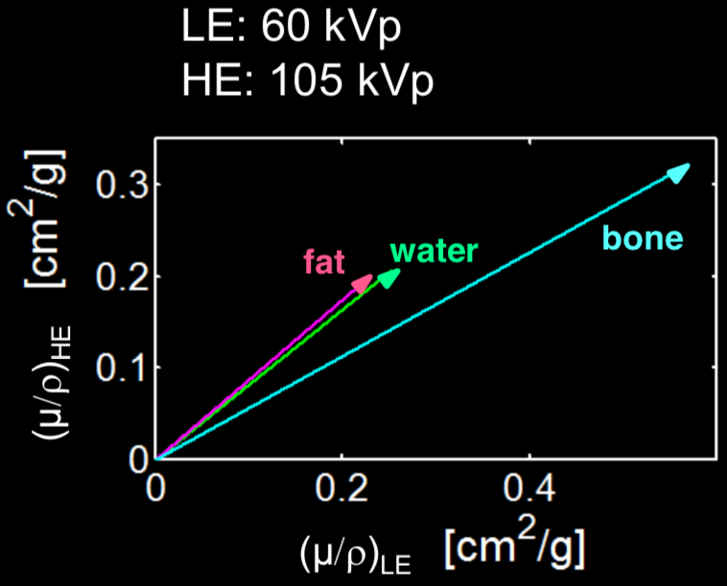
Background
X-ray image is produced due to attenuation of X-ray passing through materials
  Higher attenuation = less x-ray come through
Attenuation value depend on both material and energy
  Attenuation of the same material at different energy is linearly correlated
Can’t separate mixture of materials with one CT scan
Can separate different materials and mixtures if have images at two energies

Slide 3
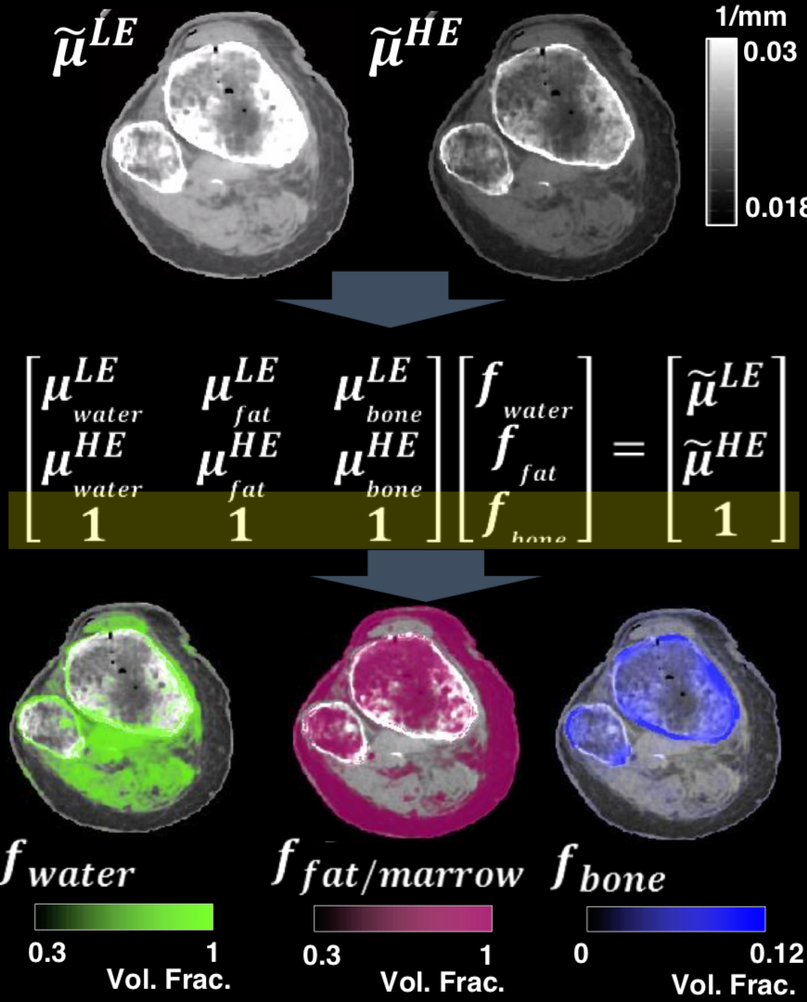
Decomposition Implementation
Two Images at different energy
Sampling 3 attenuation value at region only one of the three material exists at both energy (pure materials)
Assume the three percent content at each pixel add up to one (only three materials)
Find percent content of each material at each pixel (Material distribution)

Slide 4
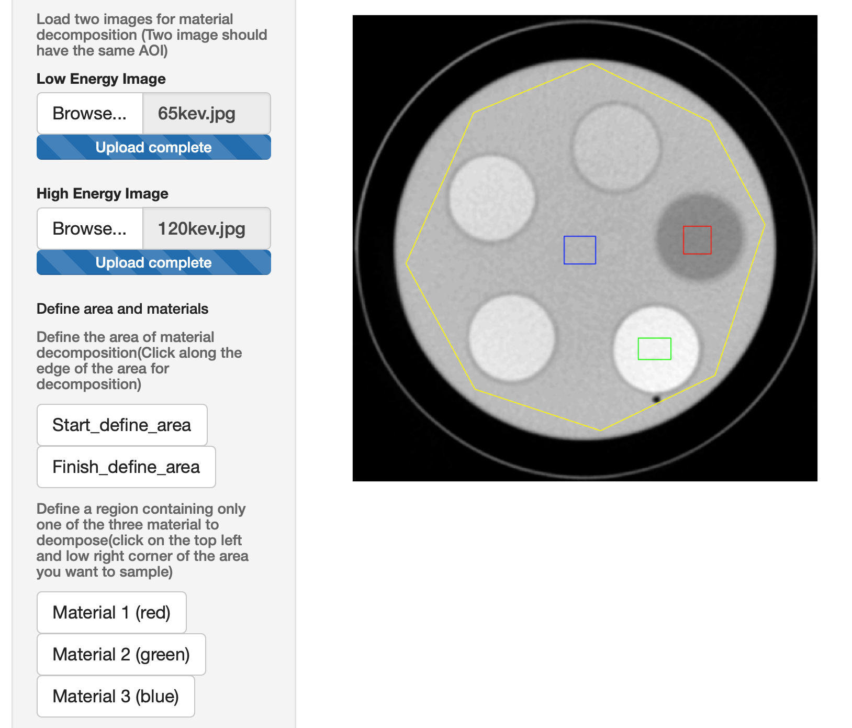
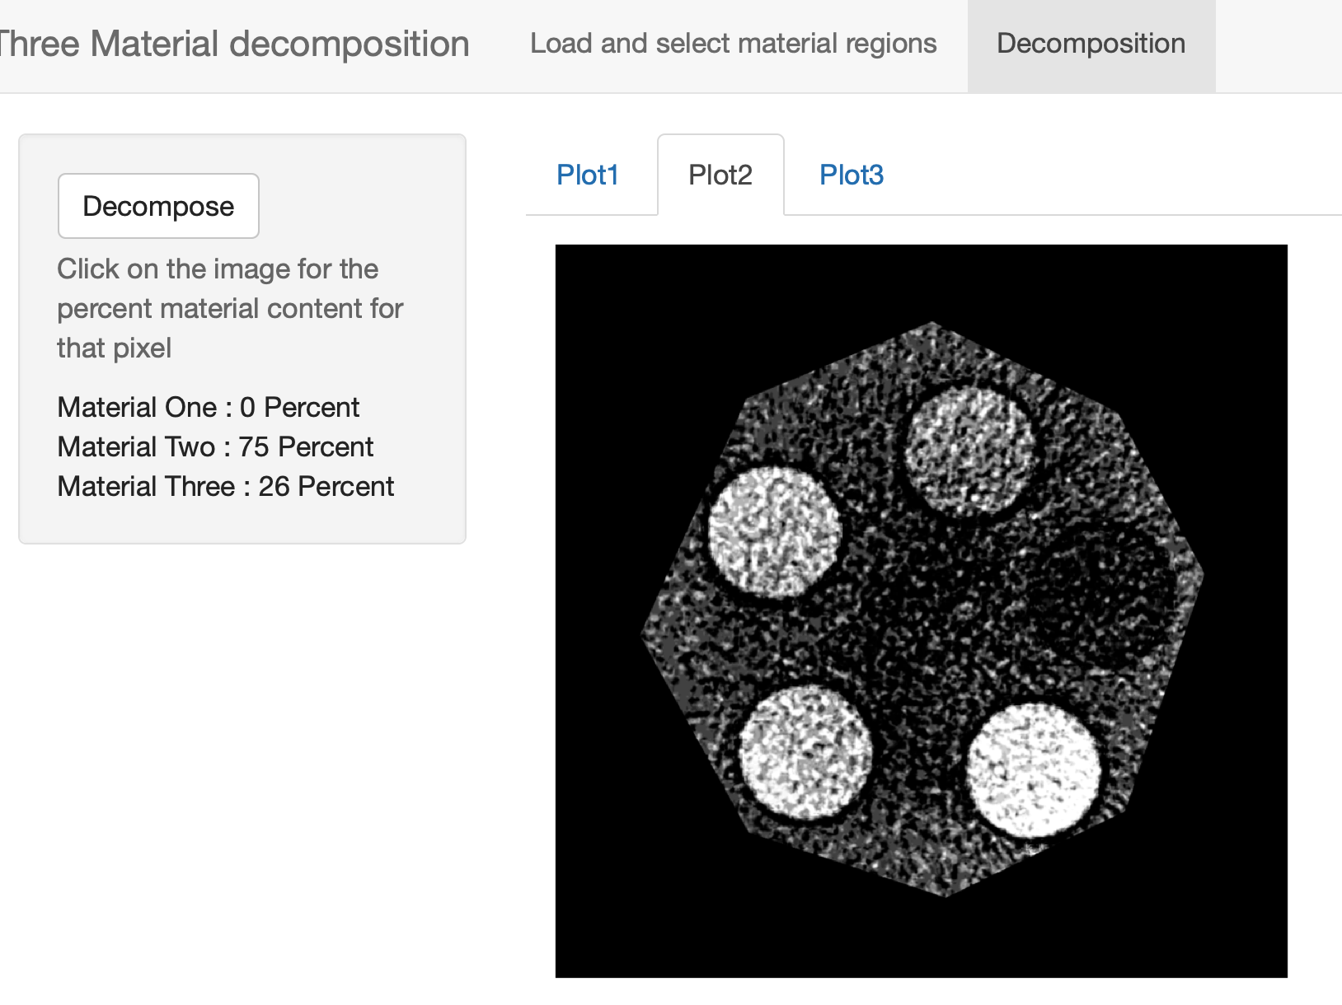
Shiny app
1. Take in two CT images
2. Ask user to Define area for decomposition
3. Ask user Sample the three pure materials
4. Perform decomposition
5. Output material percent content map as images
6. show percent content of each material at user defined pixel
1,2,3
Demonstration
https://billllllly.shinyapps.io/Duel_Energy_Decomposition/
4,5

