Slide 1
Three Material Decomposition for Duel Energy CT
Gengxin Shi

Slide 2
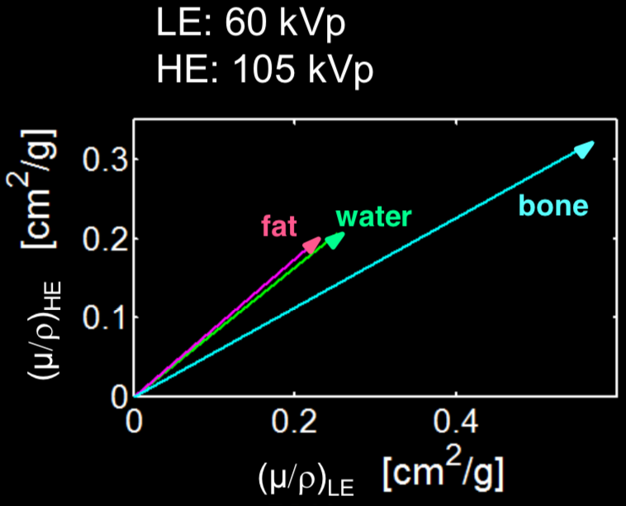
Background
X-ray image is produced due to cumulative attenuation of X-ray passing through materials
Higher attenuation and longer path -> less x-ray come through
Attenuation value depend on both material and energy
Attenuation of the same material at different energy is linearly correlated
Can’t separate mixture of materials with one CT scan
Can separate different materials and mixtures if have images at two energies

Slide 3
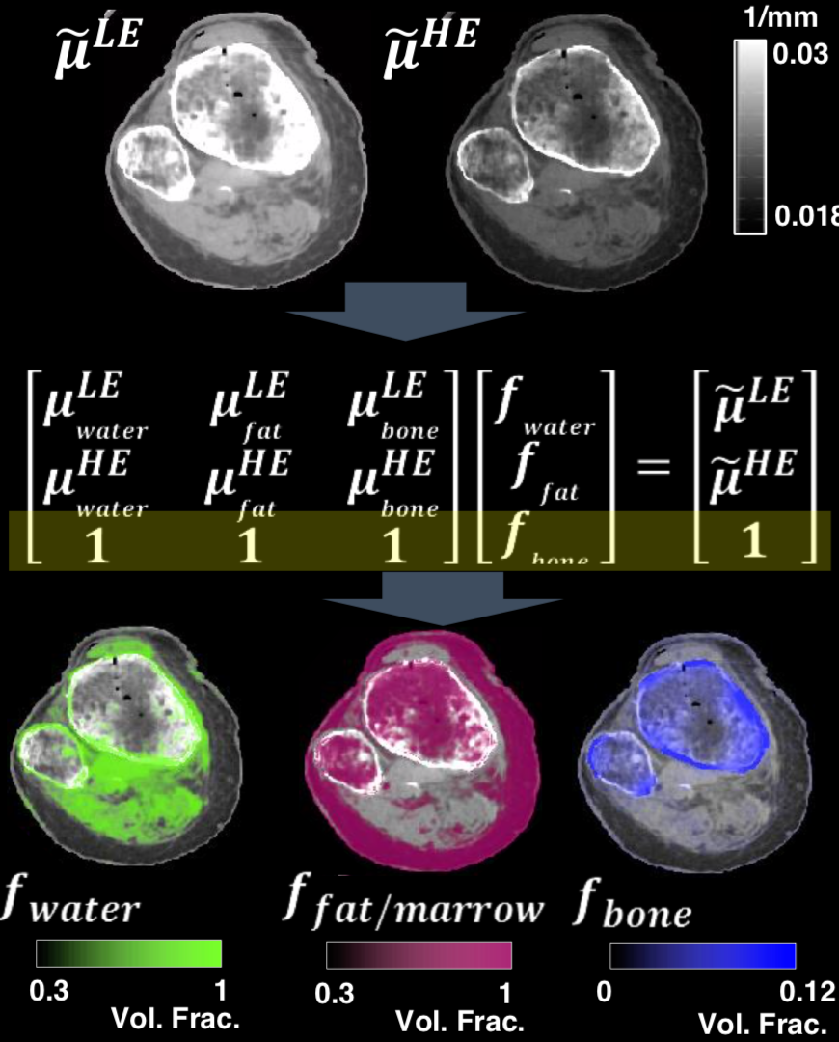
Decomposition Implementation
Two Images at different energy
Sampling the 3 material’s pure attenuation value at region only that single material exists in both images
Assume Three material’s percent content at each pixel add up to one (only these three materials exists in the whole image)
Percent content of each material at each pixel (Material distribution map)

Slide 4
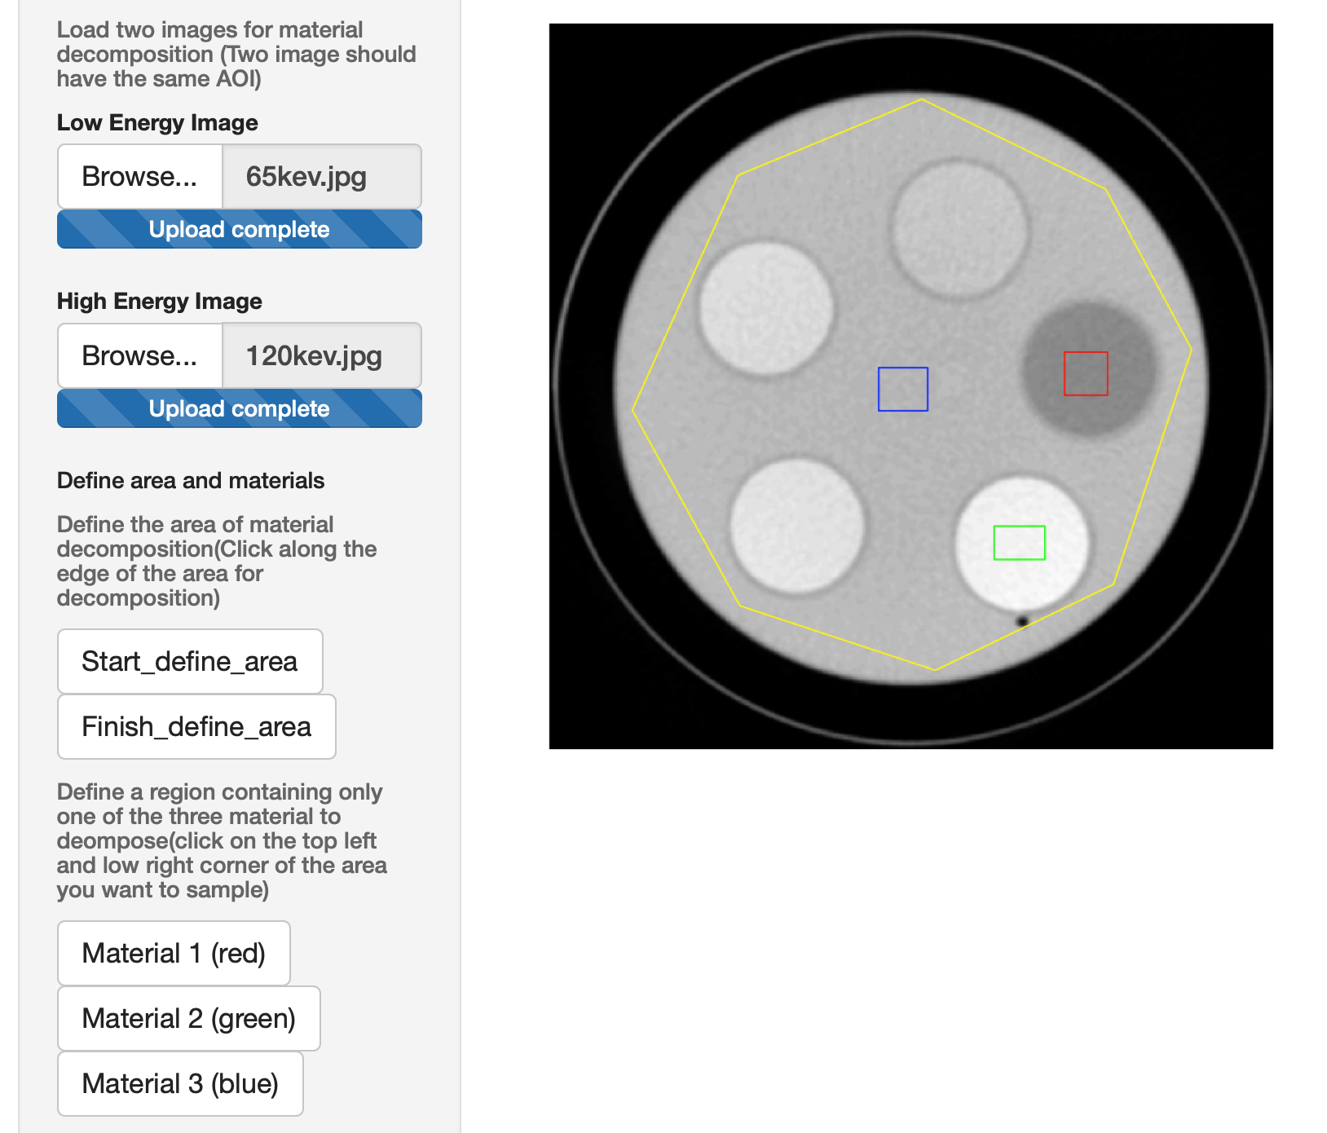
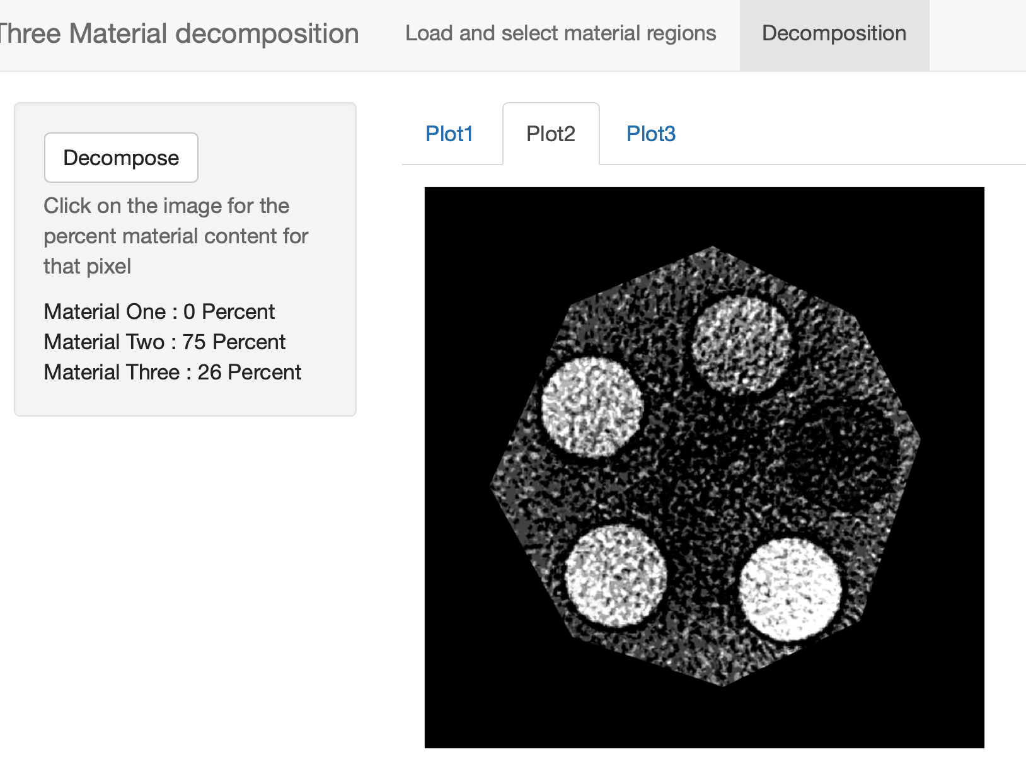
Shiny app
1. Take in two CT images
2. Ask user to Define area for decomposition
3. Ask user Sample the three pure materials
4. Perform decomposition
5. Output material percent content map as images
6. When user click on image, show percent content of each material at that pixel
1,2,3
Demonstration
https://billllllly.shinyapps.io/Duel_Energy_Decomposition/
https://photos.app.goo.gl/p1sp2d77ff7PjcLb9
4,5

