Slide 1
ICS 211 Introduction
Session 1

Slide 2
Memory Upload
0
Success tips
Self introduction
Syllabus
Computer athlete training tips
Recycling e-waste

Slide 3
Introduction
ICS 211: Introduction to Computer Science II
William Albritton, walbritt@hawaii.edu
Leeward Community College
Mathematics and Natural Sciences Division
Information and Computer Sciences Department

Slide 4

Success Tips
How to be successful in this class:
Give effort (mindset, attitude)
Mental toughness to persevere (be stubborn, relentless, don’t give up)
Be responsible to do what’s required

Slide 5

Success Tips
Can invest or spend your time
Invest time: make good grades, volunteer, work, take ICS 211
Spending time: video games
You reap what you sow: things worthwhile take hard work
You will get out of this class what you put into it

Slide 6
Success Tips
Making mistakes is the best way to learn
Life is about learning from adversity
Need to stick to your goals, even when you make mistakes

Slide 7
Success Tips
Every day, you choose: are you selling positive or negative?
Always present confidence
I was a student just like you

Slide 8
Success Tips
To be successful, you need discipline
Do what you’re supposed to do
When you’re supposed to do it
The way it’s supposed to be done
See Alabama coach Nick Saban's 2011 Football Camp speech on YouTube for more inspiration

Slide 9


Jikoshoukai
Self Introduction
Grew up in LA (Lower Alabama)
Majored in Physics & Japanese at Oberlin College in Ohio
JET (Japan Exchange and Teaching) Program in Chiba, Japan
Scuba Instructor in Maui
MA in ICS at UH Mānoa

Slide 10
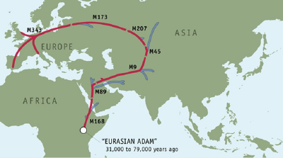
Genetic Journey

Slide 11

Family Crest
Notes:
We can trace our ancestors back to John Knox and further back to Robert II, King of Scotland.

Slide 12
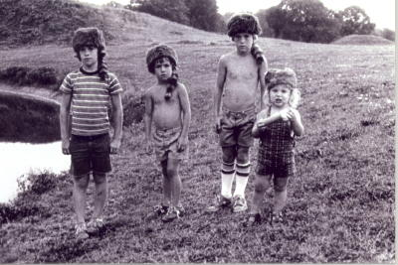
Four Brothers

Slide 13
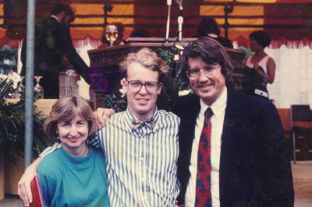
College Graduation

Slide 14
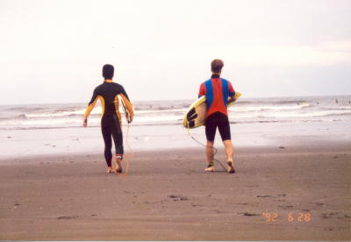
Kujukuri Beach, Japan

Slide 15
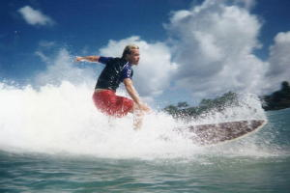
Pāʻia Bay, Maui

Slide 16

MA in ICS at UH Mānoa

Slide 17

Nobel Peace Prize
Notes:
Oslo, 10 December 07 – The United Nations’ Intergovernmental Panel on Climate Change (IPCC), which comprises more than 2,000 leading climate change scientists and experts, and Albert Arnold (Al) Gore Jr. were awarded of the Nobel Peace Prize "for their efforts to build up and disseminate greater knowledge about man-made climate change, and to lay the foundations for the measures that are needed to counteract such change".

Slide 18
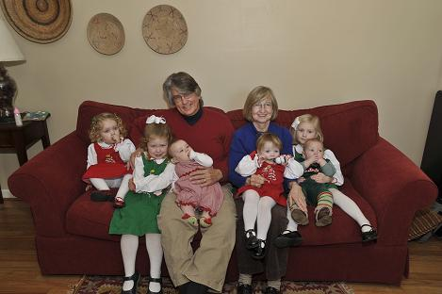
Family

Slide 19
Syllabus
Note: See current online syllabus for most updated information!!
Changes may have been made since the filming of this show
For this semester’s information, see the course web site

Slide 20
Prerequisites
ICS 111 and ICS 141 or equivalent, all with a grade of "C" or better, or instructor consent.
This is a second course in computer programming which builds upon the skills developed in ICS 111 and the concepts learned in ICS 141.

Slide 21
Textbooks & other Resources
Data Structures: Abstraction and Design Using Java (2nd edition, Publisher: Wiley, ISBN: 978-0-470-12870-1)
By Elliot B. Koffman & Paul A. T. Wolfgang

Slide 22
Textbooks & other Resources
Online resources
The Java Tutorials
Online tutorials by Oracle
Introduction to Programming Using Java
Online textbook by Dr. David J. Eck

Slide 23
Student Learning Outcomes
Upon completion of ICS 211, the student should be able to:
Recognize the use of arrays, lists, stacks, queues, and other data structures.
Select the appropriate searching or sorting algorithm based on the algorithm’s behavior.
Develop recursive algorithms and programs.

Slide 24
Student Learning Outcomes
Upon completion of ICS 211, the student should be able to:
Select appropriate data structure for a given application.
Use advanced object-oriented programming techniques (polymorphism, inheritance, and encapsulation) and standard libraries.

Slide 25
Student Learning Outcomes
Upon completion of ICS 211, the student should be able to:
Produce robust programs using exception handling and extensive program testing.
Create simple graphical user interface (GUI) program.

Slide 26
Grading Policy
Assignments: 10 points each, 25 total
Final project: 50 points each, 1 total
Optional Assignments: 5 points each, roughly 3 total
Grade calculation: (sum of your scores) / (total points)

Slide 27
Grading Policy
Course grades
The percent grading scale is A = 103.00% – 90.00% B = 89.99% – 80.00% C = 79.99% – 70.00% D = 69.99% – 60.00% F = 59.99% & below.
The final grades will not be scaled.

Slide 28
Grading Policy
Course grades
There is no extra credit.
Your current grade (including your course grade) is calculated in the Laulima Gradebook.

Slide 29
Grading Policy
Late assignments
Two (2) points are deducted for late assignments.
Two (2) points are deducted for assignments turned in on time, and re-submitted for re-grading after the due date.
No late assignments will be accepted after the last day of classes.

Slide 30
Student with Disabilities
Leeward Community College abides by Section 504 of the Rehabilitation Act of 1973 and the Americans with Disabilities Act of 1990, which stipulate that no student shall be denied the benefits of an education "solely by reason of a handicap."

Slide 31
Student with Disabilities
Students with documented disabilities who believe that they may need accommodations in this class are encouraged to contact the Coordinator of the KAKO‘O ‘IKE (KI) program as soon as possible to ensure that such accommodations are implemented in a timely fashion.
The KI office is located in the Learning Commons building, 2nd floor or call for information at 455-0421.

Slide 32
Assessment for Student Work
With the goal of continuing to improve the quality of educational services offered to students, Leeward CC conducts assessments of student achievement of course, program, and institutional learning outcomes.
Student work is used anonymously as the basis of these assessments, and the work you do in this course may be used in these assessment efforts.

Slide 33
Freedom of Speech
Discrimination in the classroom based on race, ethnicity, national origin, religion, age, sex, physical-related challenges, learning-related challenges, sexual orientation, hate speech, and obscene language will not be tolerated.
Refer to the University of Hawaiʻi's Policy of Nondiscrimination and Affirmative Action in Leeward Community College's catalog for more information.

Slide 34

Hoʻoulu
Hoʻoulu is the Native Hawaiian Career and Technical Education Program at Leeward Community College and is located at Halau 'Ike o Pu'uloa in the DA Building.

Slide 35
Hoʻoulu
Hoʻoulu provides financial support for cooperative education and internships, peer counseling, assistance in career and vocational planning, and opportunities to gain work experience.
See their web site at: http://emedia.leeward.hawaii.edu/hooulu/

Slide 36

Learning Resource Center
The Learning Resource Center is a friendly place where students can develop confidence in their own abilities, get help with their courses, and strengthen their learning skills.

Slide 37
Learning Resource Center
The LRC offers a variety of types of help, including tutoring and many other services.
See their website at: http://emedia.leeward.hawaii.edu/lrc

Slide 38

Communication
All communication will be through Laulima (https://laulima.hawaii.edu) and your UH email (https://mail.hawaii.edu).
Email from other accounts will not be accepted.

Slide 39
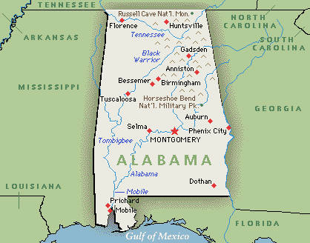
Required software
Your program must compile and run using the jGRASP IDE (integrated development environment)

Slide 40
Optional Assignment #1
See Laulima for details
Introduce yourself to your fellow class members by answering some questions and post an image of yourself

Slide 41
Training Tips
Computer Athlete Training Tips
"No sort of exercise is so helpful or harmless that it does not cause serious disorders, that is, when overdone."
Bernardino Ramazzini (1633-1714), Founder of Occupational Medicine

Slide 42
Training Tips
Repetitive Strain Injury (RSI) risk factors
Over 2 hours of keyboard use a day
Marathon keyboard use (deadlines, video games)
High stress work
Sitting for a long time
Poor posture

Slide 43
Training Tips
RSI symptoms (in neck, shoulders, back, arms, or hands)
Tightness
General soreness
Dull ache
Numbness
Loss of strength

Slide 44
Training Tips
How to avoid RSI
Avoid long sessions & take frequent breaks
Proper position (back straight, head over shoulders, elbows at right angle, wrists straight, fingers curved)
Type lightly
Get plenty of rest & sleep

Slide 45
Training Tips
How to avoid RSI
Drink plenty of water
Invest in ergonomic devices for your computer
Avoid playing computer games during the school semester
Go outside and get some exercise!

Slide 46
Recycling E-waste
Electronic waste: discarded TVs, computers, printers, scanners, fax machines, mice, keyboards, and cell phones
Environmental Protection Agency (EPA) estimates for e-waste in U.S.
Roughly 2.4 million tons in 2009
Only 25% of e-trash is recycled

Slide 47
Recycling E-waste
What is inside your computer?
Lead, mercury, arsenic, cadmium, and other toxics
These chemicals are linked to brain, kidney, liver, and lung damage
Many governments now ban e-trash
However, e-trash is now smuggled into many developing countries

Slide 48

Recycling E-waste
High-Tech Trash
National Geographic article about the world’s e-trash and the toxic materials in your computer
Places to recycle e-waste
See Recycling Computers link on the class webpage for details

Slide 49
Memory Defragmenter
Success tips
Self introduction
Syllabus
Computer athlete training tips
Recycling e-waste

Slide 50
Task Manager
Before the next class, you need to:
Visit the class website
Read over the syllabus
Email me any questions
Complete the optional assignment in Laulima

