Slide 1
Shimmer IMU sensors
Ευαγγελία Αθανασακη

Slide 2
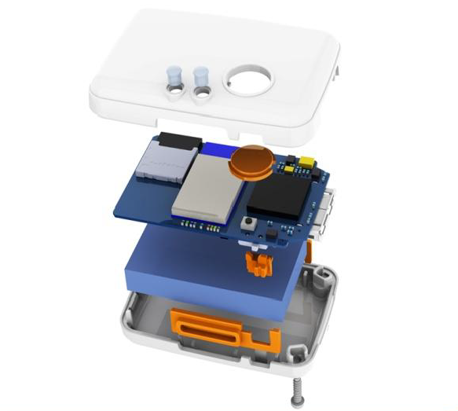
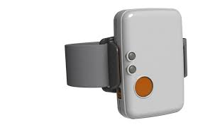
HARDWARE
Shimmer Device:
Sensors included in each device:
Accelerometer (3D), measures changes in velocity
Gyroscope (3D), measures angular velocity
Magnetometer (3D), measures strength of the magnetic field

Slide 3
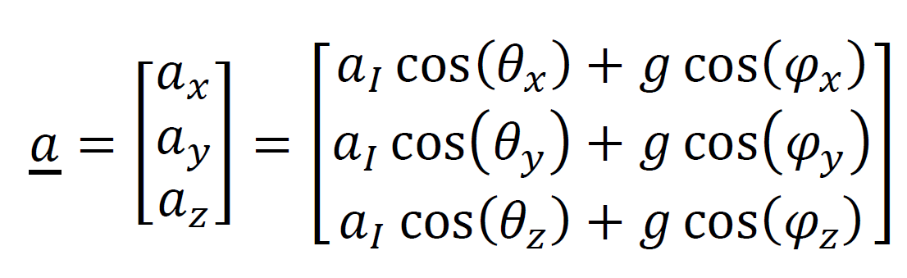
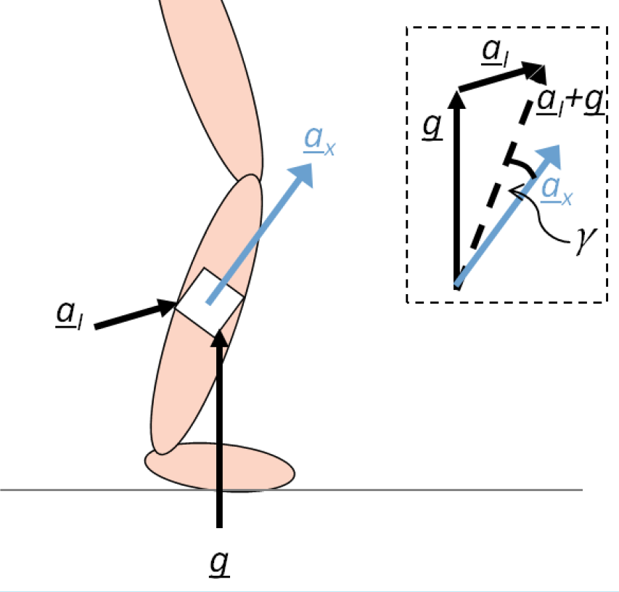
HARDWARE
ACCELEROMETER
Figure 1. Shimmer3 default axis directions
Figure 2. total acceleration vextor
Figure 3. Uni-axial magnetometer attached to a leg segment

Slide 4

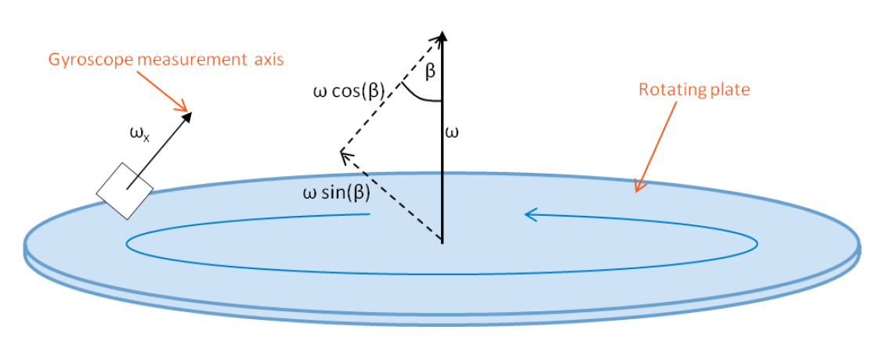
HARDWARE
GYROSCOPE
ω
ω =
ω
ω cos(β )
ω cos(β )
ω cos(β )
x
x
ω =
y
y
z
Figure 1. Shimmer3 default axis directions
z
Figure 2. tri-axial gyroscope rate
Figure 3. Uni-axial rate gyroscope attached to a rotating plate

Slide 5
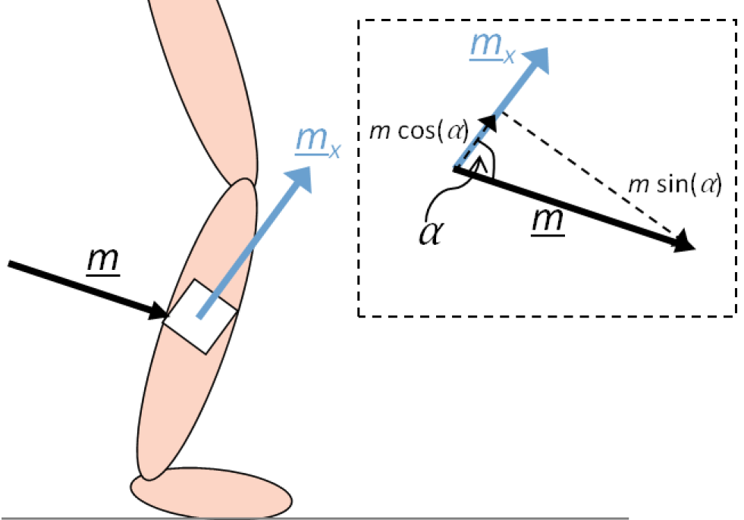
HARDWARE
MAGNETOMETER
m
m =
m
m cos(α )
m cos(α )
m cos(α )
x
x
m=
y
y
z
z
Figure 1. Shimmer3 default axis directions
Figure 2. tri-axial magnetometer rate

Slide 6
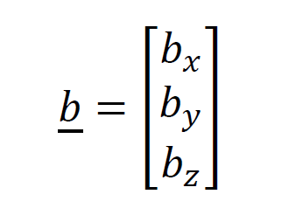
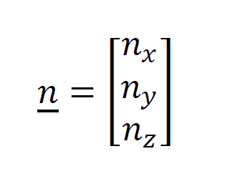
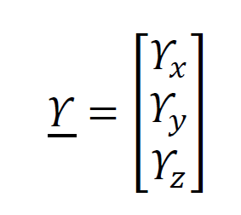
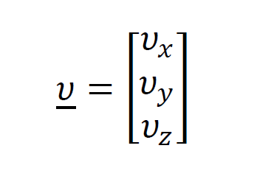
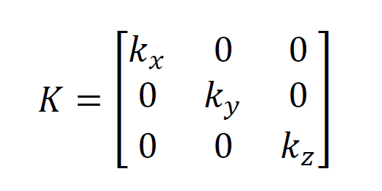
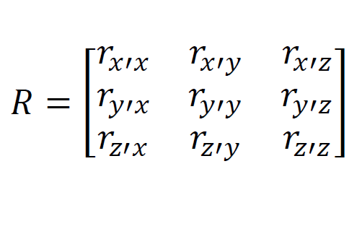
SOFTWARE
The output Y for each sensor (acc/gyr/mag) is:
Y = Kru + b + n
K | Sensor’s scale factor (the change in output per unit of input Volts/g) | Estimated by calibration
r | is the rotation matrix which defines the actual sensor axes | Estimated by calibration
u | value of the sensed phenomenon | Defined in use
b | value of the sensor output when the sensed phenomenon is equal to zero | Estimated by calibration
n | is the noise vector | Defined by manufacturer

Slide 7
SOFTWARE
Data we actually get from each device have this format
(m/s )
(deg/sec)
(local flux)
TIMESTAMP (ms)
1024566650390 1044097900390 1063629150390 3954254150390 3973785400390 3993316650390
ACCELEROMETER |  |  | GYROSCOPE |  |  | MAGNETOMETER
X axes | Y axes | Z axes | X axes | Y axes | Z axes | X axes | Y axes | Z axes
-0.6381260517 -0.6380077624 -0.5673273650 0.21909503347 0.23075359958 0.27738063488 | -0.85463565892 -0.81825331906 -0.79494647771 4.72064493121 4.72026912372 4.79104052609 | 9.99691863372 10.0087475664 9.93393015842 8.81426530854 8.78964565140 8.69044442106 | -1.30603847151 -1.06992021997 -0.83719184135 1.24207108972 1.79285476800 0.98309672126 | 0.77993576999 0.84110720293 0.91757149411 1.66692154763 1.03991435999 0.55054289646 | -1.71018442341 -1.11508475673 -0.85897238112 1.24207108972 1.79285476800 0.98309672126 | 0.61133603238 0.61133603238 0.61133603238 0.61740890688 0.61740890688 0.61740890688 | -0.64372469635 -0.64372469635 -0.62348178137 0.02834008097 0.02834008097 0.02834008097 | 0.72 0.72 0.72 0.81500000000 0.815000000001 0.81500000000
2
Units are in International System of Units

Slide 8
MOVEMENT IDENTIFICATION
RIGHT
9
RIGHT
RIGHT
RIGHT
Final Dataset composed of each movement’s subset
LEFT
LEFT
LEFT
LEFT
Num of samples
DOWN
DOWN
repetitions of
RIGHT movement
DOWN
DOWN
UP
UP
repetitions of
LEFT movement
UP
UP
ACC |  |  | GYR |  |  | MAG
x | y | z | x | y | z | x | y | z
-0.63812 -0.63807 -0.56732 |  |  | -0.63866 0.638007 0.567327 |  |  | 0.638126 0.638007 0.567327
repetitions of
UP movement
Num of samples
repetitions of
DOWN movement

Slide 9
Data we actually analyze
n-by-p data matrix
n: number of observations (28 = 4movements * 7experiments )
p: features used (4 from each device 36 features )
mean |  |  |  |  |  |  |  |  | rms |  |  |  |  |  |  |  |  | std |  |  |  |  |  |  |  |  | meadian
acc |  |  | gyr |  |  | mag |  |  | acc |  |  | gyr |  |  | mag |  |  | acc |  |  | gyr |  |  | mag |  |  | acc |  |  | gyr |  |  | mag
x | y | z | x | y | z | x | y | z | x | y | z | x | y | z | x | y | z | x | y | z | x | y | z | x | y | z | x | y | z | x | y | z | x | y | z
up
28
observations
4
movements
7
repetitions of each
movement
down
left
right

Slide 10

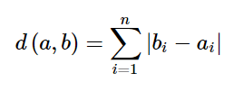
CLUSTER ANALYSIS METHOD
Kmeans
Parameters
Dataset: 28 observations by 36 features matrix
k=4
Distance metric: cityblock
Why Cityblock?
Is better in calculating distances in more than two dimensions
Defined on
, i = 1,2,…,36 features
where a is the centroid of the cluster and b is an observation

Slide 11





Raw data
Observations and features
70%
30%
Train set
Test set
kmeans
Actual
clustering
Predicted
clustering
clusters
Classify each
observation
in a cluster
up
up
up
left
up
down
Final result
down
compare
down
down
…% success
right
left
left
left
left
right
up

Slide 12
RESULTS
100% success
Cross-validation (7 different training/testing sets) came up
with 100% success on characterizing hand movements

