Slide 1
Audio Super Resolution
By
Bharath Subramanyam

Slide 2
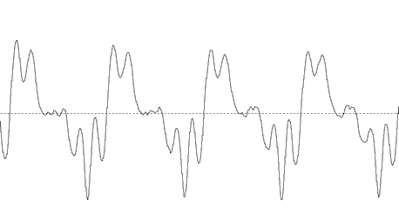

Audio Signals
$s\left(t\right):\left[0,T\right]⇾ℝ$ where T is the duration of the signal and s(t) is the amplitude.
$s\left(t\right)$is a continuous function.

Slide 3
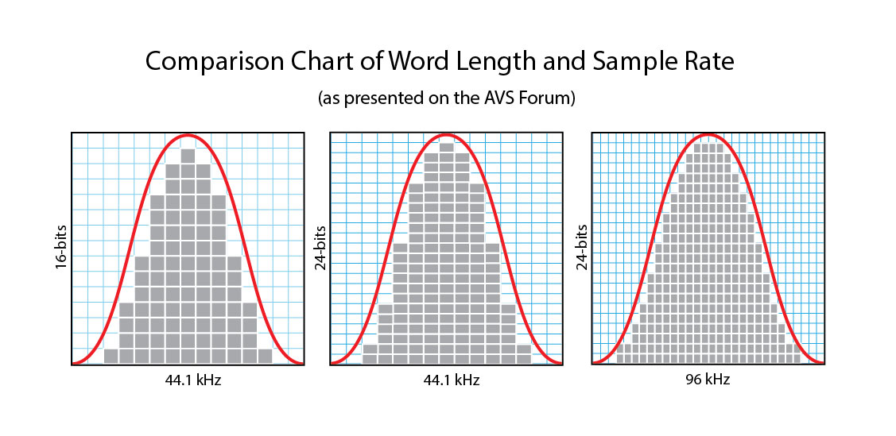

Audio Resolution
However the continuous waveform of the audio signal needs to be discretized when it needs to be stored digitally in a computer.
The function s(t) is discretized to $x\left(t\right):\left[\frac{0}{R},\frac{1}{R},…\frac{R.T}{R}\right]⇾ℝ$ where R is the sampling rate.
Greater the sampling rate, greater the resolution

Slide 4
Goal
To predict values in between the samples that are close to the value of the original sound waves

Slide 5
Techniques
Hand Crafted Features: Here, hand crafted features were extracted from the low resolution audio and is mapped to the high resolution audio using a dictionary.
Deep Networks: Auto Encoder

Slide 6
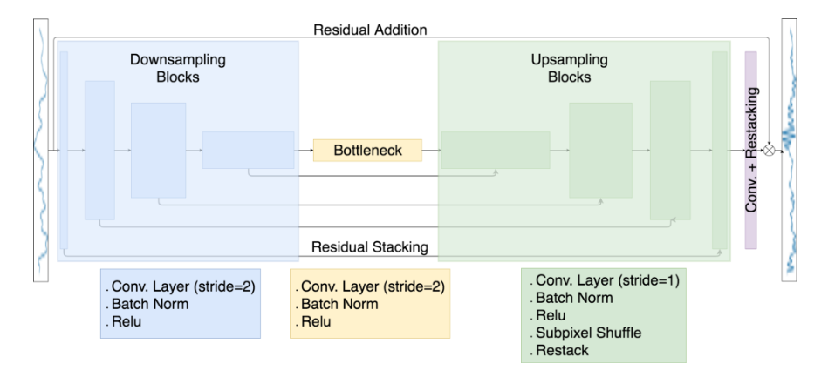
Auto Encoders
Kuleshov, Volodymyr, S. Zayd Enam, and Stefano Ermon. "Audio Super-Resolution using Neural Networks." (2017).

Slide 7
Auto Encoder
The downsampled waveform was sent through 8 downsampling blocks of convolutional layers with a stride of two. The number of filter banks was doubled while the waveform was reduced by half.
The reconstruction is done by a symmetric series of upsampling blocks.
Skip connections were added which allows the use of low resolution features while upsampling.
Loss function: Mean Squared Error

Slide 8
Inspiration – Image Super Resolution
Both image and audio are signals.
Image can be considered a 2D signal with 3 channels(RGB)
Audio can be considered a 1D signal with 1 (mono) or 2 (stereo) channels

Slide 9
Idea
Use the SRCNN (which works well on images) on audio.
Change the 2D convolutions to 1D convolutions.
This model does not need to explicitly learn dictionaries for the mapping between the low resolution patch and the high resolution patch because the mapping is achieved by the hidden layers and we get end to end mapping.

Slide 10
The Model
3 layer convolutional neural network
1st and 2nd layers have relu
The third layer does not have an activation function
9X64
(Relu)
1X32
(Relu)
3X1
(No active)

Slide 11
Procedure
Dataset - VCTK
Training Sample – 50 audio clips of 5 speakers. Subsample the audio clips to generate training data.
Sampling Rate: 48KHz Channels:1
Slice each audio clip into array of length 500. (Total number slices is around 25,000)
Upscale the audio clips using cubic splines and pass it to the model

Slide 12
Normalizing the array
The values of the data which corresponds to the amplitude in the array can vary from -8,388,608 to 8,388,607.
If you run the model without normalizing the data between -1 and 1, the error function becomes undefined and the weights can not be calculated from backpropagation.
First, I tried normalizing the data by dividing it with 8,388,608. However, most of the data lies in the range between 0 to 20,000 and only a few points go over a million. So, by dividing with 8,388,608, most of the data points come close to 0. I ran the model and it was not able to converge and the output was noise.

Slide 13

Normalizing the array
To solve that problem, I normalized the data using
If x[i] > 0
$x\left[i\right]=\log\left(x\left[i\right]+1\right)/log⁡(8,388,608)$
Else
$x\left[i\right]=−\log\left(−x\left[i\right]+1\right)/log⁡(8,388,608)$

Slide 14
Training
Initialized weights using a normal distribution and std dev 10^-3
Adam Optimizer with learning rate 10^-4
Loss function: Mean Squared Error
70 epochs

Slide 15
Testing
10 audio clips of 2 speakers.
Each audio clip is sliced up into arrays of length 500 and passed through the model.
The enhanced audio pieces are stitched up to form the clip.

Slide 16
Evaluation
Calculated the signal to noise ratio: 10 log(P_signal/P_noise) = 10.log(|s|^2 / |s-x|^2)
Conv Net SNR : 17.3 dB
Cubic Interpolation SNR: 17.1 dB
Auto Encoder: 20.1dB

Slide 17
Adding a Fully Connected Layer
Added a fully connected layer after the second convolutional layer
Trained for 50 epochs
Didn’t really work. The weights didn’t converge.
SNR = 5.3dB

Slide 18
Possible Improvements
Finding a better way to normalize audio data.
Trying state of the art GAN of image SR on audio.

Slide 19
Thank You
Questions?

