Slide 1
DAR ES SALAAM INSTITUTE OF TECHNOLOGY
DEPARTMENT OF COMPUTER STUDIES
BACHELOR OF ENGINEERING IN COMPUTER ENGINERING
PROJECT TITLE: | DEVELOPMENT OF CLOUD-BASED HOTSPOT MANAGEMENT AND BILLING SYSTEM
CASE STUDY: | MARKET AREA (KARUME MARKET)
STUDENT’S NAME: | SHABILU ALLY HAMISI
SUPERVISOR NAME: | MR. NOEL MAGANGA
REGISTRATION NO: | 220242427383
DATE: | 20th may 2026

Slide 2
BACKGROUND OF THE STUDY
Internet access is essential in karume marketplaces for business, communication, and mobile money services.
Hotspot providers may operate multiple routers in different areas, but most routers are managed separately.
Lack of centralized multi-router management makes it hard to monitor router availability, connected users and payments.
Manual billing through cash, vouchers, or manual mobile money confirmation causes delays, errors, and poor revenue tracking.
This project developed a cloud-based multi-router hotspot management and billing system for centralized router monitoring, captive portal access, automated billing, alerts, and reporting.

Slide 3
PROBLEM STATEMENT
Marketplace hotspot services are often unreliable and difficult to monitor.
Manual billing causes payment delays, errors, and poor revenue tracking.
Hotspot routers are managed separately, making multi-router control difficult.
Shared passwords and manual access control reduce security.
Service expansion is difficult without centralized management.
A cloud-based system is needed to manage users, billing, routers, alerts, and reports efficiently.
Notes:
Bullet way

Slide 4
MAIN OBJECTIVE
To Develop a cloud-based hotspot billing and management system.

Slide 5
SPECIFIC OBJECTIVE
To implement a captive portal billing module integrated with mobile money payment platforms.
To design a cloud-based architecture for centralized management of multiple Wi-Fi hotspot routers.
To implement a router monitoring module for reporting router availability to the cloud server.

Slide 6
SIGNIFICANCE OF THE STUDY
Reduces manual work in billing, access control, and router monitoring.
Improves centralized management of multiple hotspot routers and users.
Enables convenient self-service Internet purchase and renewal through mobile money.
Improves service reliability through router availability monitoring.
Supports scalable hotspot deployment across different locations.

Slide 7
SCOPE OF THE PROJECT
Development of a cloud-based hotspot management and billing system.
Centralized management of multiple Wi-Fi hotspot routers.
Captive portal for user authentication, plan selection, and Internet access control.
Billing module with mobile money payment support.
Router monitoring module for reporting router availability.
Reports for users, payments, routers, sessions, and service performance.
Project Limits:
The project does not cover full ISP infrastructure, physical marketplace-wide deployment, advanced ISP-level bandwidth optimization, or full production mobile money API integration during prototype testing.

Slide 8
LITERATURE REVIEW
Summary of Previous Studies
Study | Focus Area | Key Contribution
Wiederkehr (2009) | Hotspot Authentication & Security | - Discussed hotspot login mechanisms - Introduced AAA (Authentication, Authorization, Accounting) framework - Compared captive portal vs 802.1X/EAP security models
Owoh (2024) | Usage-Based Billing Using MikroTik | - Developed system to track user data consumption - Integrated MikroTik RouterOS with backend system - Generated billing reports based on usage

Slide 9
Existing Local Hotspot System
Standalone routers
Shared Wi-Fi passwords
Manual voucher systems
Cash or manual mobile money payments
No centralized monitoring

Slide 10
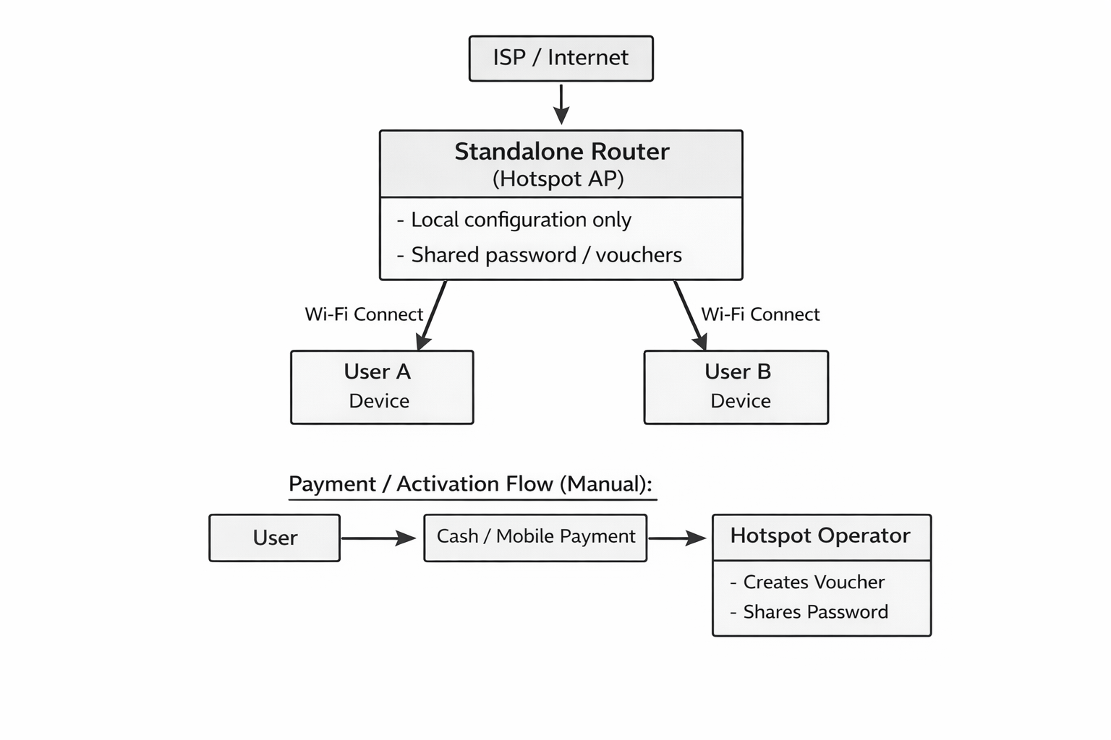
BLOCK DIAGRAM OF EXISTING SYSTEM

Slide 11
Problems in Existing System
Weak security
No centralized control
Manual payment verification
Poor scalability
No real-time monitoring

Slide 12
PROPOSED CLOUD-BASED SYSTEM
Cloud-based authentication
Automated billing system
Mobile money integration
Router monitoring module
Multi-location management

Slide 13
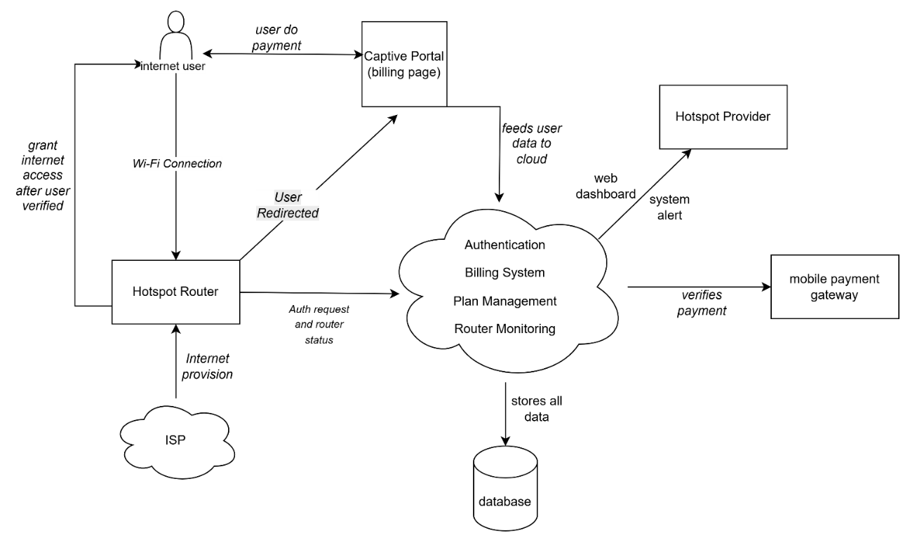
BLOCK DIAGRAM OF PROPOSED SYSTEM

Slide 14
METHODOLOGY
This project used the Prototyping Model for system development.
Data was collected using primary and secondary data collection methods.
Primary data was collected through a closed-ended questionnaire.
Secondary data was collected through review of books, journals, previous studies, project reports, and technical documentation.
System development involved requirement analysis, system design, prototype development, testing, and refinement.
The final deliverables included a cloud-based admin dashboard, captive portal billing module, router monitoring module, and system reports.

Slide 15
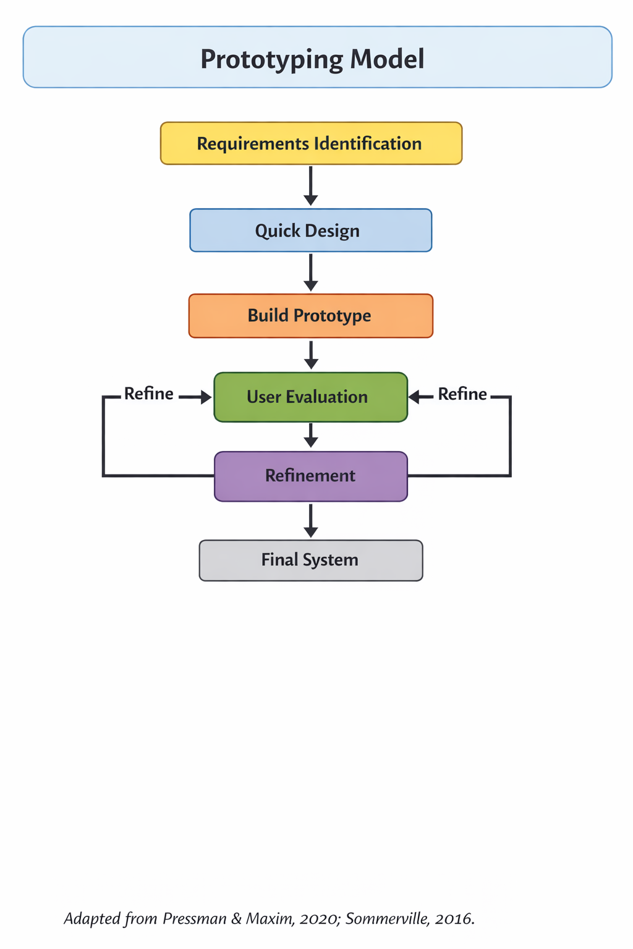
Prototyping Model Overview

Slide 16
SYSTEM DEVELOPMENT TOOLS AND TECHNOLOGIES
React / Vite — used to develop the captive portal and admin dashboard.
Spring Boot — used to develop the backend system logic.
PostgreSQL — used to store users, routers, payments, plans, and sessions.
OpenWrt / openNDS — used for hotspot router testing and captive portal redirection.
REST API — used for communication between frontend, backend, router, and payment module.
GNS3 / VirtualBox — used to simulate and test the network environment.
Draw.io — used to design system diagrams.

Slide 17
PRIMARY DATA COLLECTION METHOD
Collected directly from respondents in marketplaces like Karume Market.
Structured closed-ended questionnaire (Yes/No, multiple choice, rating scales).
Respondents: Wi-Fi providers/hotspot operators, and Internet users.
Topics that focused:
Hotspot management practices
Billing/payment methods
Authentication mechanisms
Bandwidth and network monitoring challenges
User satisfaction

Slide 18
Secondary Data Collection
Uses existing research, reports, and technical documentation.
To understand cloud architecture, centralized management, and client-server communication from cloud computing and computer networking books. Online
To study hotspot authentication, captive portal access, billing mechanisms, and user access control from academic journals and research papers. Like. Wiederkehr (2009); Saliu et al. (2013)
To identify gaps in multi-router management, mobile money payment, and router monitoring from previous Internet billing project reports. Example: Owoh (2024)
To guide hotspot router configuration, captive portal redirection, and router-server communication using technical documentation. Examples: MikroTik Documentation; OpenWrt Documentation; openNDS Documentation

Slide 19
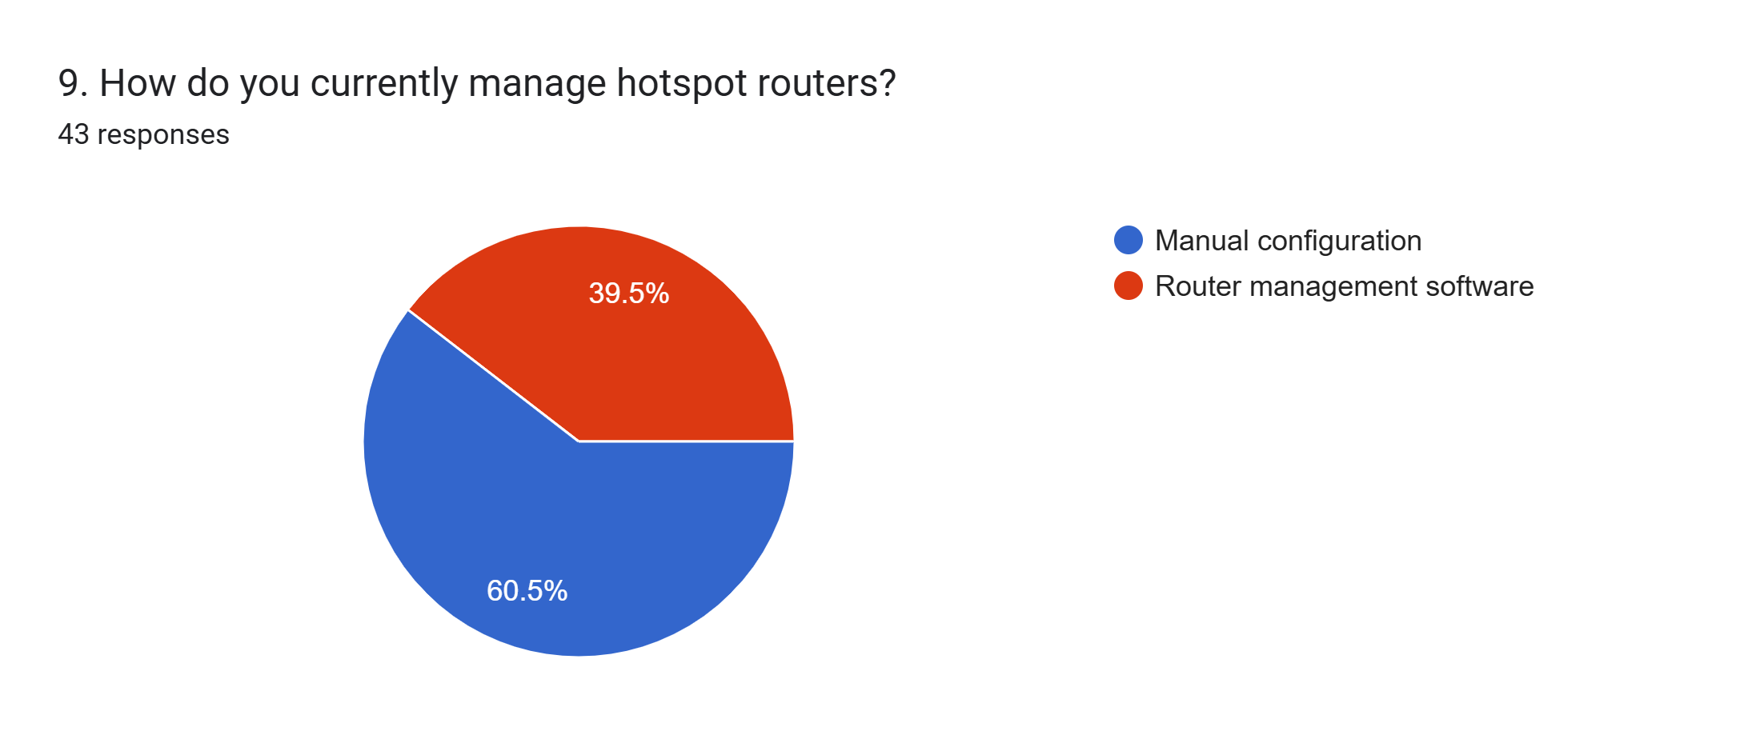
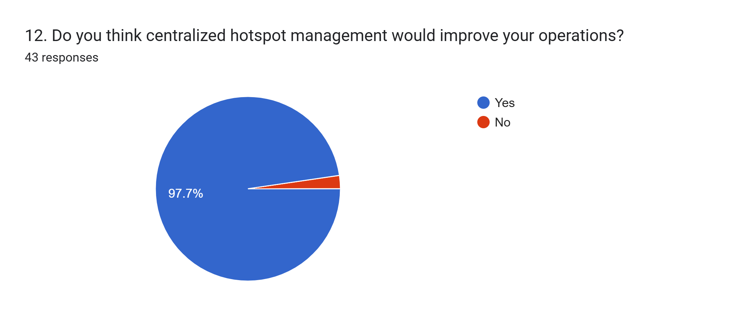
DATA ANALYSIS
CENTRALIZED MULTI-ROUTER MANAGEMENT

Slide 20
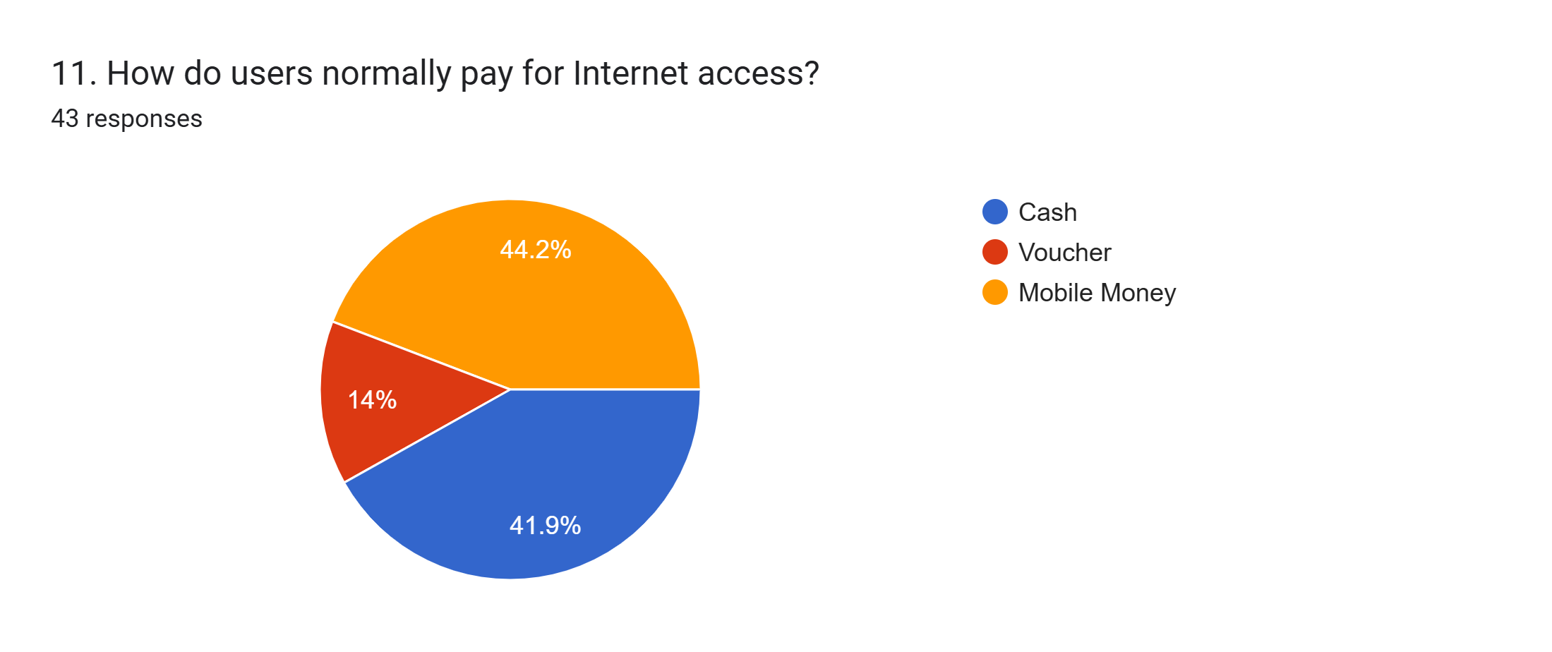
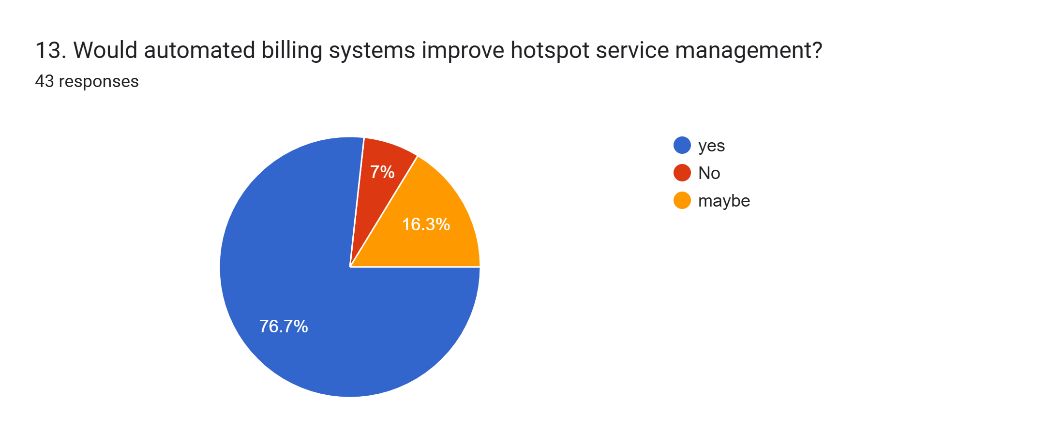
DATA ANALYSIS
CAPTIVE PORTAL AND BILLING

Slide 21
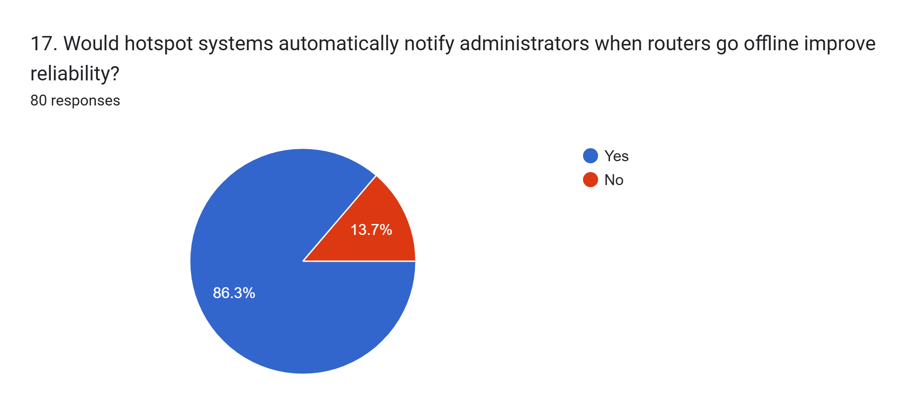
DATA ANALYSIS
ROUTER MONITORING

Slide 22
DATA ANALYSIS
Functional Requirements
User connects to Wi-Fi and opens captive portal.
User selects Internet plan.
User pays through mobile money.
System activates Internet access after payment.
Admin manages routers, users, plans, payments, and reports.
Router sends online/offline status to cloud server.
Non-Functional Requirements
Easy to use
Secure login and payment records
Fast response time
Reliable router monitoring
Scalable for many routers
Available through cloud access

Slide 23
Main Modules
Captive Portal Module
Billing Module
Payment Module
Router Management Module
Router Monitoring Module
Admin Dashboard
Reports Module

Slide 24
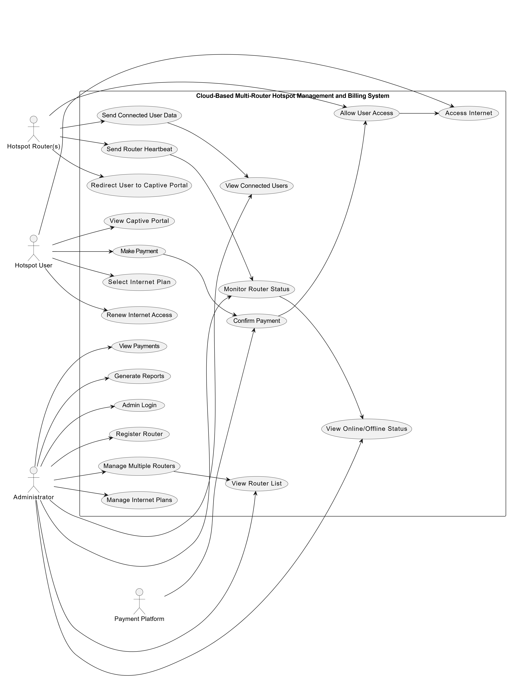
USE CASE DIAGRAM

Slide 25
USE CASE DIAGRAM
Actors
Hotspot User
Administrator
Hotspot Router(s)
Payment Platform
Main Use Cases
Hotspot User
View Captive Portal
Select Internet Plan
Make Payment
Access Internet
Renew Internet Access
Administrator
Admin Login
Register Router
Manage Multiple Routers
View Router List
Monitor Router Status
View Online/Offline Status
View Connected Users
Manage Internet Plans
View Payments
Generate Reports
Hotspot Router(s)
Redirect User to Captive Portal
Send Router Heartbeat
Send Connected User Data
Allow User Access
Payment Platform
Confirm Payment

Slide 26


THANK YOU

Slide 27
CHAPTER 5
System Requirement Specification

Slide 28
5.1 Introduction to Chapter Five
Purpose
▸ Define WHAT the system must do before design begins.
▸ Target users: hotspot customers and marketplace operators.
Problem Context
▸ Standalone routers with no unified monitoring.
▸ Manual voucher billing with no digital payment trail.
▸ Shared Wi-Fi passwords – no per-user access control.
Chapter Structure
▸ 5.3 – Proposed System
▸ 5.4 – Functional Requirements (FR-01 … FR-09)
▸ 5.5 – Non-Functional Requirements
▸ 5.7 – System Requirements
▸ 5.8 – Feasibility Study
▸ 5.9 – Use-Case Diagram

Slide 29
5.3 Proposed System
Centralized Cloud Portal
▸ All routers forward unauthenticated users to a single cloud portal.
▸ One dashboard manages all routers, customers, and payments.
RADIUS Bandwidth Shaping
▸ Per-plan speed profiles (e.g. 5 Mbps / 2 Mbps).
▸ Limits enforced automatically on FreeRADIUS.
OTP Phone Verification
▸ Users verify their phone via 6-digit OTP before plan purchase.
▸ MAC address paired with verified phone – prevents sharing.
Router Heartbeat Monitoring
▸ Shell agent on each MikroTik sends regular heartbeats.
▸ Backend marks router DEGRADED (2 min) or OFFLINE (5 min).
ClickPesa Mobile Money
▸ Automated payment via M-Pesa, Tigo Pesa, Airtel Money.
▸ Webhook confirmation triggers instant RADIUS activation.
SMS Offline Alerting
▸ Africa's Talking SMS gateway notifies admin immediately.
▸ Alert delivered within 10 seconds of OFFLINE detection.

Slide 30
5.4 Functional Requirements
FR-01 (Redirection): System shall redirect unauthenticated users to the captive portal. FR-02 (OTP Verify): System shall send a 6-digit OTP to the user's phone number. FR-03 (Plan Display): System shall show plan name, price, speed, and duration. FR-04 (Auto Payment): System shall accept ClickPesa webhooks and confirm payments. FR-05 (Bandwidth): System shall apply RADIUS speed profiles upon plan activation. FR-06 (Monitoring): System shall track router heartbeats every minute. FR-07 (Admin Mgmt): System shall allow admin to manage sites, routers, and block devices. FR-08 (Reporting): System shall generate revenue reports per site, router, day, month, or year. FR-09 (SMS Alert): System shall send SMS to the admin when a router goes OFFLINE.

Slide 31
5.5 Non-Functional Requirements
Security (NFR-01)
▸ BCrypt-hashed admin passwords.
▸ Stateless JWT tokens for all admin API requests.
▸ MAC-address locking prevents session sharing.
Availability (NFR-04)
▸ Cloud-hosted on VPS: target 99.9% uptime.
▸ Frontend served via static hosting (Vercel).
Performance (NFR-02)
▸ API response times < 2 seconds under normal load.
▸ OTP SMS delivery within 5 seconds.
Scalability (NFR-05)
▸ RADIUS design supports dozens of routers without schema changes.
▸ Site grouping allows geographic multi-location growth.
Reliability (NFR-03)
▸ Cron schedulers auto-expire sessions and retry heartbeats.
▸ Flyway migrations guarantee schema consistency.
Usability (NFR-06)
▸ Swahili captive portal interface for local users.
▸ Responsive admin dashboard on mobile and desktop.

Slide 32
5.7 System Requirements
Hardware
▸ MikroTik RouterBoard hAP ax2 / ac2 (RouterOS v7+).
▸ Admin PC: Intel Core i5, 8 GB RAM, SSD.
▸ VPS server with Ubuntu 22.04 for cloud hosting.
Network
▸ ISP uplink gateway + local WLAN bridge per router.
▸ MikroTik REST API accessible from cloud backend.
▸ FreeRADIUS for AAA (Authentication, Authorization, Accounting).
Software
▸ Backend: Java 21, Spring Boot 4.0.5, Maven.
▸ Frontend: React 19, Vite 7, TypeScript 5.8, Bootstrap 5.
▸ Database: PostgreSQL (schema managed by Flyway).
Integration APIs
▸ ClickPesa: mobile money payment webhooks.
▸ Africa's Talking: SMS gateway for OTP and alerts.

Slide 33
5.8 Feasibility Study
Technical
▸ Team skilled in Java, React, Linux networking, and MikroTik.
▸ All frameworks and APIs are open-source / freemium.
▸ MikroTik REST API is well-documented.
Legal
▸ Phone OTP verification complies with local telecom regulations.
▸ User data hashed and not shared with third parties.
Economic
▸ Zero licensing cost (open-source stack).
▸ Standard MikroTik hardware widely available in Tanzania.
▸ ClickPesa charges per-transaction only on live payments.
Schedule
▸ Completed within academic semester timeline.
▸ Integration testing conducted in sandboxed environment.
▸ Buffer weeks included for review and documentation.
Operational
▸ Eliminates manual voucher printing.
▸ Operators access dashboard on any browser.
▸ Minimal training needed for admin portal use.

Slide 34
5.9 Use-Case Diagram
Actors
▸ Hotspot User
▸ Hotspot Router
▸ Payment Gateway (ClickPesa)
▸ Administrator
Administrator Use Cases
▸ Login to Admin Dashboard
▸ Register & Monitor Routers
▸ Block Suspicious Devices
▸ View Payments & Sessions
▸ Generate Reports (by Site / Router / Period)
Hotspot User Use Cases
▸ Connect to Wi-Fi → Redirected to Portal
▸ Verify Phone (OTP)
▸ Select Internet Plan
▸ Pay via Mobile Money
▸ Access the Internet
System / External
▸ Router: Capture MAC, Send Heartbeat
▸ ClickPesa: Confirm Payment Webhook
▸ Africa's Talking: Deliver OTP & Alerts

Slide 35
CHAPTER 6
System Design

Slide 36
6.1 Introduction to Chapter Six
Purpose
▸ Define HOW the system will be built based on Ch. 5 requirements.
▸ Map functional specs to architectural components.
Design Approach
▸ Three-tier client–server architecture.
▸ RESTful API communication between all layers.
▸ PostgreSQL relational database with Flyway migrations.
Chapter Structure
▸ 6.2 – System Architecture
▸ 6.3 – Data Flow Diagrams
▸ 6.4 – Database Design (ERD)
▸ 6.5 – Sequence Diagrams
▸ 6.10 – System Flowchart
▸ 6.11 – Security Design

Slide 37
6.2 System Architecture (Three-Tier)
Presentation Layer – React SPA
▸ Captive portal (mobile-first, Swahili UI).
▸ Admin dashboard with KPI widgets, reports, router list.
▸ Built with React 19 + Vite 7 + Bootstrap 5.
Data Layer – PostgreSQL
▸ Normalized relational schema (16 Flyway migrations).
▸ Repositories: PaymentRepository, RouterNodeRepository, etc.
▸ FreeRADIUS database shares credentials with app DB.
Application Layer – Spring Boot API
▸ PortalContextService, RouterNodeService, PaymentService.
▸ RadiusProvisioningService, RouterStatusScheduler.
▸ SmsSender (Africa's Talking) & ClickPesaPaymentProvider.
Integration Targets
▸ MikroTik REST API (router control & user management).
▸ FreeRADIUS (AAA – speed profiles).
▸ ClickPesa webhook endpoint.
▸ Africa's Talking SMS API.

Slide 38
6.3 Data Modeling – DFD (Level 0 & Level 1)
Context Diagram (Level 0)
▸ Single system boundary.
▸ Inputs: User requests, router heartbeats, ClickPesa webhooks.
▸ Outputs: Internet access grant, SMS alerts, reports.
Level 1 – Process 2.0 (Billing)
▸ Receives ClickPesa webhook → marks payment PAID.
▸ Triggers RADIUS provisioning.
Level 1 – Process 3.0 (Access Control)
▸ Creates RADIUS account with speed limits.
▸ Signals MikroTik to allow MAC address.
Level 1 – Process 1.0 (Identity)
▸ Validates OTP → links MAC to customer account.
▸ Data store: customers, devices, otp_verifications.
Level 1 – Process 4.0 (Monitoring)
▸ Aggregates heartbeats → detects DEGRADED / OFFLINE.
▸ Dispatches SMS alert via Africa's Talking.

Slide 39
6.4 Database Design – Entity Relationships
Customer (1) ──── (N) Device — each customer owns multiple MAC-locked devices Device (1) ──── (N) AccessSession — timed internet slots per device Payment (1) ──── (1) AccessSession — 1-to-1 ensures audit traceability RouterNode(1) ──── (N) AccessSession — records which router served the session Site (1) ──── (N) RouterNode — groups routers geographically Plan (1) ──── (N) Payment — links purchased packages to transactions Key Constraints: • MAC address UNIQUE across devices (prevents duplicate registrations) • payment_id UNIQUE in access_sessions (prevents double-activation) • provider_reference UNIQUE in payments (ClickPesa idempotency) Flyway migration V1–V16 applied in sequence on startup.

Slide 40
6.5 Sequence Diagram – User Purchase Journey
Step 1 – Connection & Redirect
▸ Router captures MAC address on first connection.
▸ Unauthenticated user → Captive portal landing page.
Step 4 – Payment Confirmation
▸ User confirms mobile money PIN on phone.
▸ ClickPesa sends webhook to /api/payments/clickpesa/webhook.
▸ Backend sets payment status → PAID.
Step 2 – OTP Verification
▸ User enters phone number.
▸ Backend sends 6-digit OTP via Africa's Talking.
▸ User submits OTP → MAC linked to verified customer.
Step 5 – Access Provisioning
▸ RadiusProvisioningService creates RADIUS account.
▸ Speed profile applied (e.g. 5 Mbps download).
Step 3 – Plan Selection & Payment
▸ Plans displayed with price, duration, and speed.
▸ User selects plan → ClickPesa STK Push initiated.
Step 6 – Access Granted
▸ Portal displays Continue button with RADIUS token.
▸ MikroTik accepts credentials → internet enabled.

Slide 41
6.10 Flowchart of the Working System
START 1. User connects to Hotspot AP 2. Is device MAC known? YES → Does device have ACTIVE session? YES → Show Active Session countdown page ──► END NO → Show Plan Selection NO → Redirect to Captive Portal Landing Page 3. Phone Verified? YES → Show Plan Selection NO → Prompt phone entry → Send OTP → Verify OTP 4. User selects Plan → ClickPesa payment initiated 5. Payment Successful? YES → Create RADIUS account → Grant Internet Access ──► END NO → Show payment failure page ──► END END

Slide 42
6.11 Security Design
Authentication & Authorization
▸ Admin login: BCrypt-hashed password + JWT token.
▸ Stateless JWT secured APIs (Spring Security filter chain).
▸ Role-based access: SUPER_ADMIN controls all resources.
Transaction Integrity
▸ ClickPesa webhooks carry a signed reference ID.
▸ provider_reference is UNIQUE in DB – prevents replay attacks.
▸ Pending payments auto-expire after a configurable timeout.
Device Access Control
▸ MAC-address binding: users cannot share purchased plans.
▸ Admin can instantly block a device (status: BLOCKED).
▸ Blocked devices are immediately redirected to a block page.
Data Protection
▸ User phone numbers stored; OTP codes stored as BCrypt hashes.
▸ No plaintext passwords in database or logs.
▸ Sensitive config loaded from environment variables (.env).

Slide 43
CHAPTER 7
System Implementation, Testing & Results

Slide 44
7.1 Introduction to Chapter Seven
Purpose
▸ Verify the system was built, tested, and works as specified.
▸ Show transition from design (Ch. 6) to a working system.
Chapter Highlights
▸ 7.2 – Development environment & tools.
▸ 7.4 – Module implementation.
▸ 7.5 – Testing strategy.
▸ 7.6 – Test cases and results.
▸ 7.7 – Results and discussion.
▸ 7.9 – Live system screenshots.

Slide 45
7.2 – 7.3 Development Environment & Tools
Development Environment
▸ OS: Windows 11 (dev) / Ubuntu 22.04 (VPS server).
▸ IDE: IntelliJ IDEA (backend), VS Code (frontend).
▸ Version Control: Git hosted on GitHub.
▸ API Testing: Swagger UI / Postman.
Frontend Tools
▸ React 19, Vite 7, TypeScript 5.8, Bootstrap 5.
▸ Vitest 3 + React Testing Library for unit tests.
Backend Tools
▸ Java 21, Spring Boot 4.0.5, Maven, Flyway.
▸ Spring Security, Spring Data JPA, Hibernate.
Infrastructure & APIs
▸ PostgreSQL 15 (cloud VPS).
▸ FreeRADIUS (hotspot AAA).
▸ ClickPesa Sandbox API (payment simulation).
▸ Africa's Talking Sandbox (SMS simulation).

Slide 46
7.4 Implementation of Modules
OTP & Device Module (FR-02)
▸ Generates, BCrypt-hashes, and validates 6-digit OTPs.
▸ Links MAC address to verified customer on success.
▸ Key file: OtpService.java
Router Monitoring (FR-06)
▸ Shell heartbeat agent runs on each MikroTik router.
▸ Cron marks DEGRADED at 2 min, OFFLINE at 5 min.
▸ Key file: RouterStatusScheduler.java
ClickPesa Payment Module (FR-04)
▸ Initiates STK Push via ClickPesa REST API.
▸ Webhook controller confirms status → PAID.
▸ Key files: ClickPesaPaymentProvider.java, ClickPesaWebhookController.java
SMS Alerting (FR-09)
▸ Africa's Talking gateway dispatches SMS on OFFLINE transition.
▸ Admin phone number stored per router in DB.
▸ Key file: AfricasTalkingSmsSender.java
RADIUS Provisioning (FR-05)
▸ Creates FreeRADIUS account with speed-limit attributes.
▸ Credentials embedded in MikroTik continue URL.
▸ Key file: RadiusProvisioningService.java
Reporting Engine (FR-08)
▸ SQL aggregations by site, router, plan, and period.
▸ Groups by DAY / MONTH / YEAR on-the-fly in Java.
▸ Key file: ReportsService.java

Slide 47
7.5 Testing Strategy
Unit Testing
▸ RouterNodeServiceTest – verifies OFFLINE status marking logic.
▸ JwtServiceTest – validates token generation and expiry.
▸ PlanStatusPage.test.tsx – React component render tests.
▸ Tools: JUnit 5, Mockito, Vitest, React Testing Library.
System Testing
▸ End-to-end flow: connection → OTP → payment → access grant.
▸ MikroTik sandbox environment for redirect simulation.
▸ ClickPesa sandboxed webhooks for payment confirmation tests.
Integration Testing
▸ Flyway schema applied to test PostgreSQL instance.
▸ Spring Boot @SpringBootTest context integration.
▸ API endpoints tested via MockMvc + Swagger UI.
User Acceptance Testing (UAT)
▸ Simulated real marketplace user purchasing a 1-hour plan.
▸ Tested on iPhone, Android phone, and laptop browsers.
▸ Verified Swahili UI readability and mobile responsiveness.

Slide 48
7.6 Test Cases – Sample Execution Results
TC-01 Unauthenticated MAC redirect → Captive portal loading PASS TC-02 Valid OTP verification → Customer set ACTIVE PASS TC-03 ClickPesa PAID webhook received → Session activated, RADIUS set PASS TC-04 Router heartbeat missed for 5 min → Status OFFLINE, SMS sent PASS TC-05 Report filtered by Site + MONTH → Correct revenue aggregation PASS TC-06 Blocked device portal access → Redirected to blocked page PASS TC-07 OTP expired (> 5 min old) → Error shown, re-send required PASS TC-08 Duplicate ClickPesa reference → DB constraint rejects replay PASS Overall Test Pass Rate: 8 / 8 (100%)

Slide 49
7.7 – 7.8 Results & Discussion
Performance Results
▸ Captive portal page load: < 1.2 seconds.
▸ OTP SMS delivery: < 5 seconds via Africa's Talking.
▸ ClickPesa webhook → access activation: < 1.5 seconds.
▸ Router OFFLINE detection: < 2 minutes.
Discussion
▸ System performs reliably within specified constraints.
▸ MAC-locking eliminates the shared-password problem.
▸ ClickPesa integration removes need for manual payment verification.
▸ SMS alerts remove the need for admins to continuously monitor.
Functional Results
▸ All 9 functional requirements (FR-01…FR-09) met.
▸ RADIUS speed enforcement confirmed per plan profile.
▸ Reports correctly aggregated by Day, Month, and Year.
Known Limitations
▸ Live ClickPesa requires production merchant account.
▸ Africa's Talking sandbox used for demonstration (not live).
▸ Physical multi-router deployment not yet done at Karume.

Slide 50
7.9 System Screenshots – Overview
Screenshot 1: Captive Portal – Swahili Landing Page → Lupe Ps General Supply branding, phone input form (Swahili text) Screenshot 2: Plan Selection Page → Plan cards with price, speed (Mbps), and duration Screenshot 3: Admin KPI Dashboard → Revenue cards, connected users, router status (ONLINE/OFFLINE/DEGRADED) Screenshot 4: Router Management List → WAN/LAN IPs, uptime, model name, status badges Screenshot 5: Refined Reports Page → Site/Router filter dropdowns, Group By (Daily/Monthly/Yearly), ClickPesa Health widget, Plan Popularity grid Screenshot 6: SMS Alert Notification → Phone receiving 'ALERT: Router [Name] has gone OFFLINE!' message

Slide 51
THANK YOU
Questions & Discussion
Shabilu Ally Hamisi | DIT – Computer Engineering | 2026

