Slide 1
School of Computer Science and Engineering
Improvement of SVF based on Graph Database
Xuanzhi Liu
UNSW Sydney
Supervisor: Zhengyi Yang
4/03/2024

Slide 2
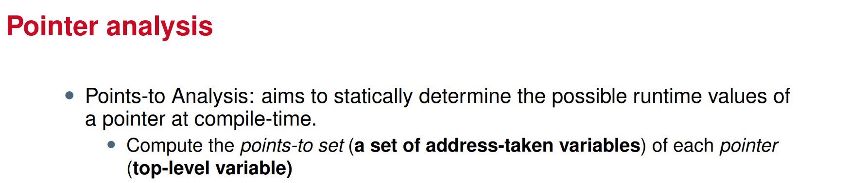
Definition of Pointer Analysis
[1]. https://github.com/SVF-tools/Teaching-Software-Analysis/blob/slides/slides/Data-Dependence.pdf Page 3-4

Slide 3

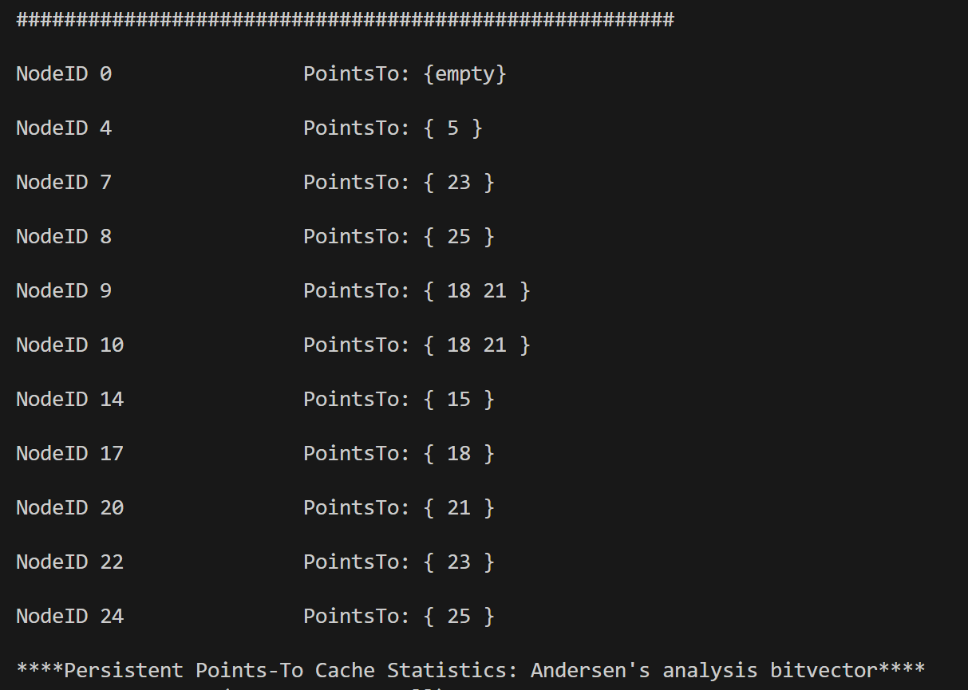
An Example

Slide 4
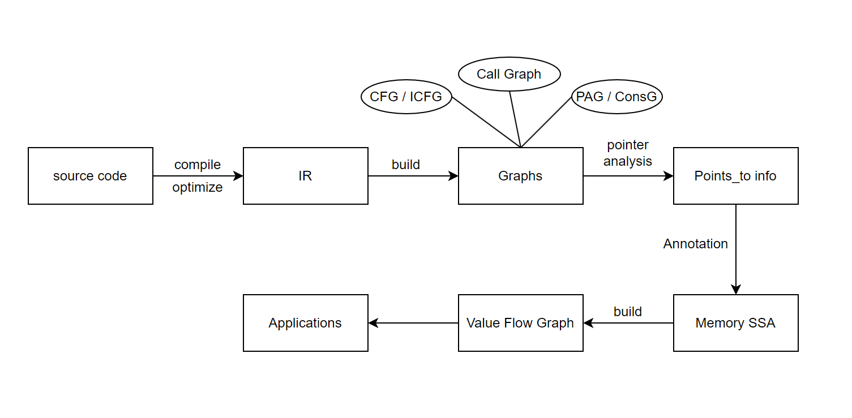
The basic framework of SVF

Slide 5
The basic framework of SVF

Slide 6
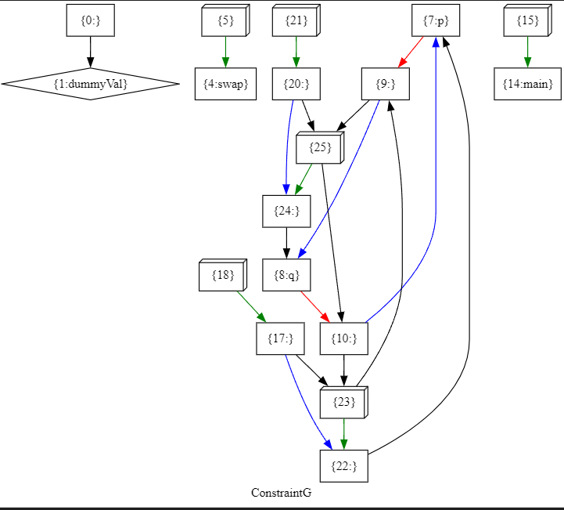
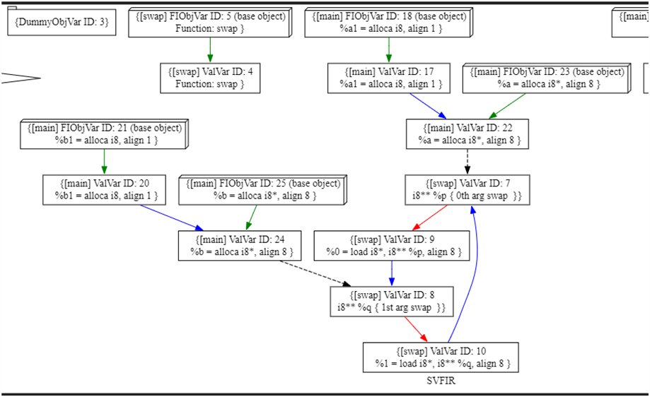
An Example
How to get more information DIRECTLY from graph ?

Slide 7
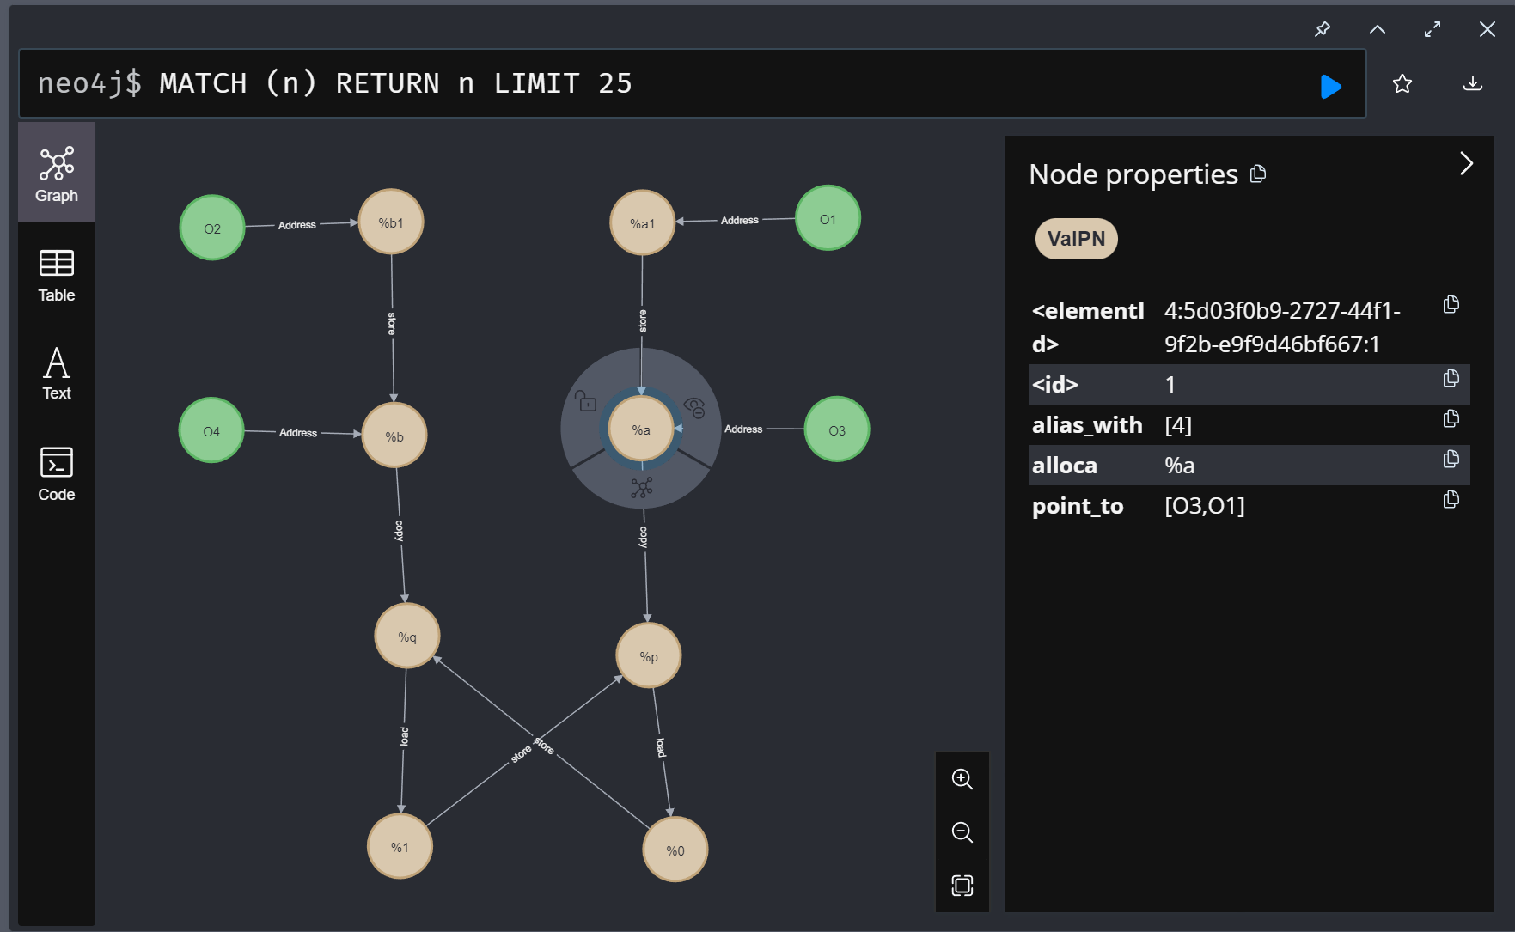
When use Graph Database

Slide 8
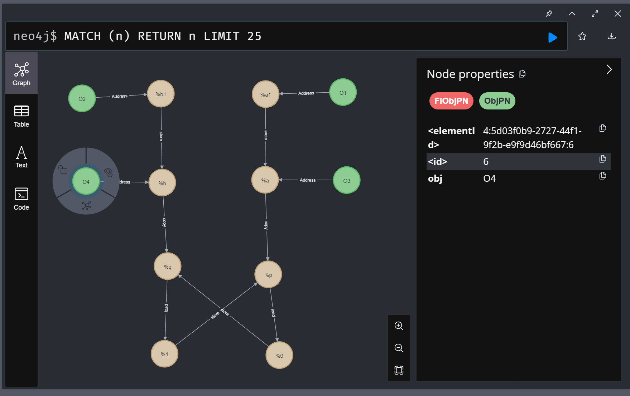
When use Graph Database

Slide 9
Advantages
Easy to find information.

Slide 10
Question
Can Cypher (Neo4j) be used instead of (or customize) some analysis function in SVF?

Slide 11
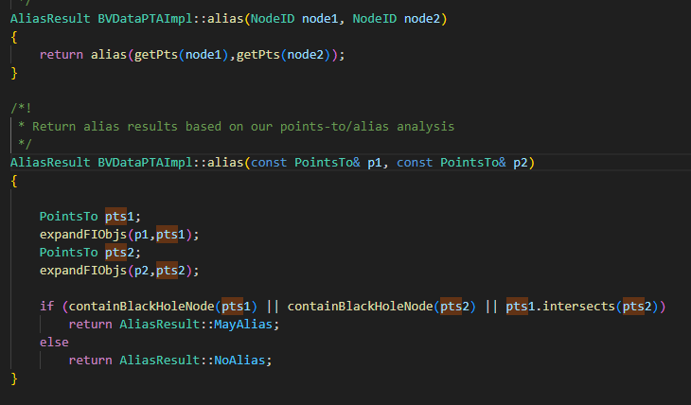
Get alias in SVF
Need to design many functions for a structure

Slide 12
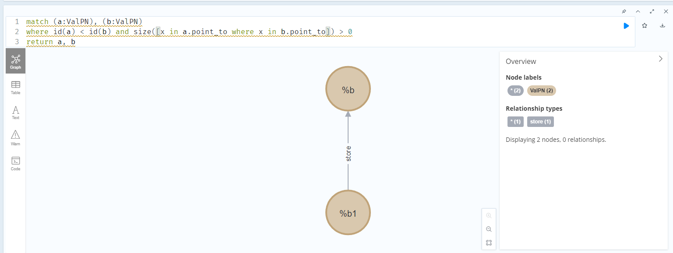
Find alias

Slide 13
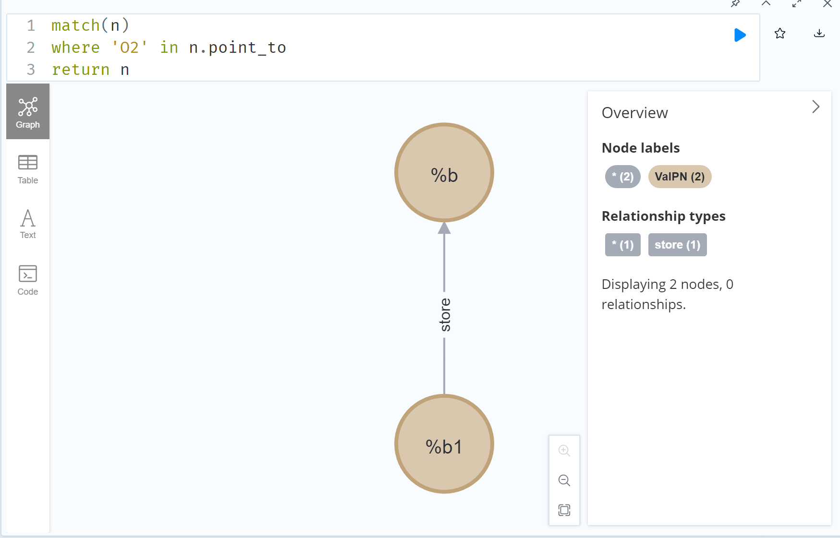
When use Graph Database

Slide 14
Advantages
Easy to find information.
Provide more customization.

Slide 15
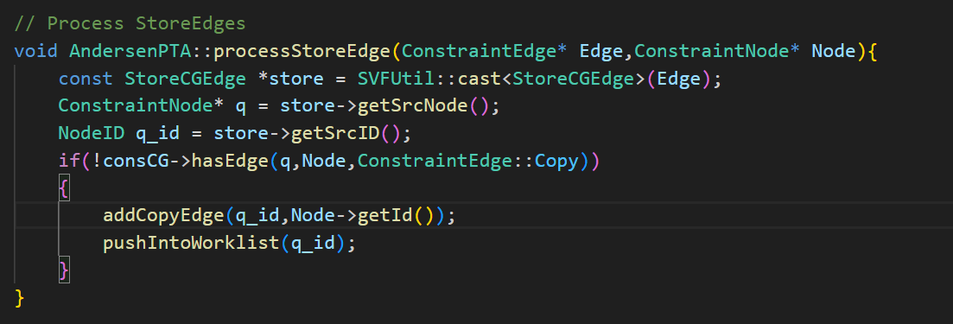
Add edge in SVF
Different functions have different input

Slide 16
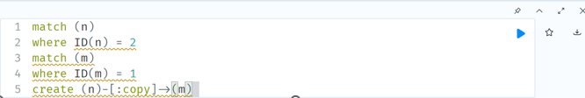
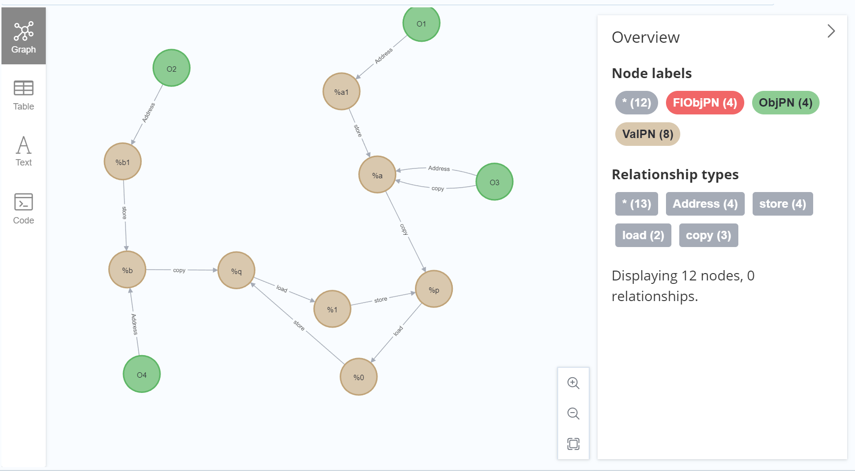
Add an edge between nodes

Slide 17
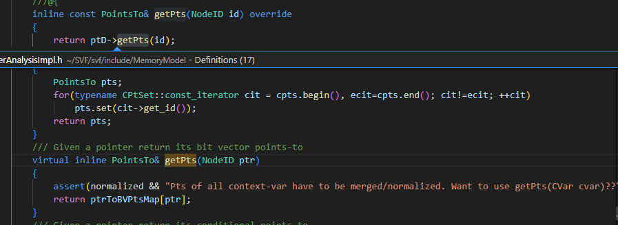
Get points-to info in SVF
Needs separate data structure and methods

Slide 18
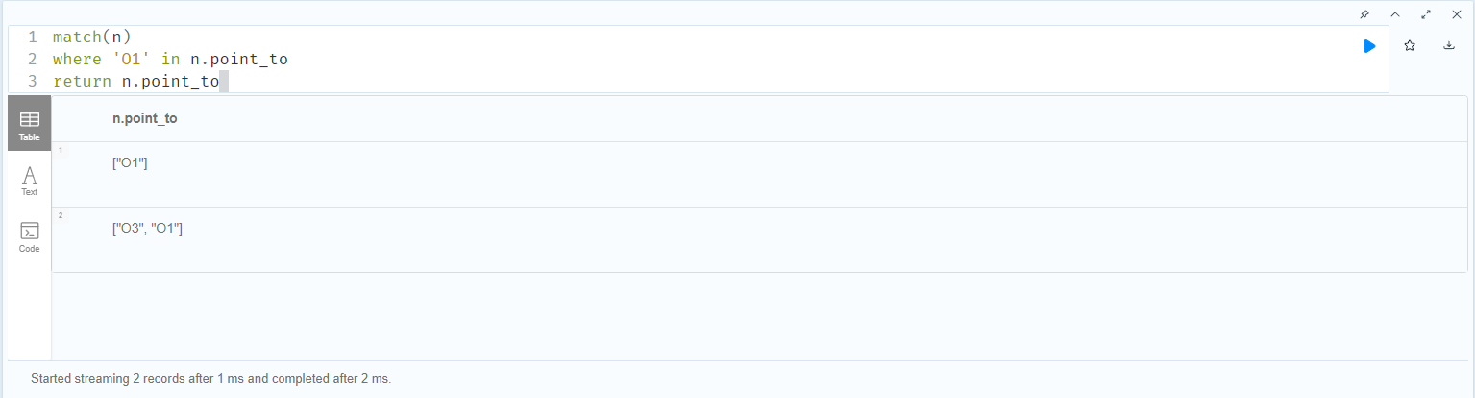
Get points-to info

Slide 19
Advantages
Easy to find information.
Provide more customization.
Simplify commonly used functions

Slide 20
Question
Can Cypher (Neo4j) be used instead of C codes to create a graph dynamically? How efficient is it?

Slide 21
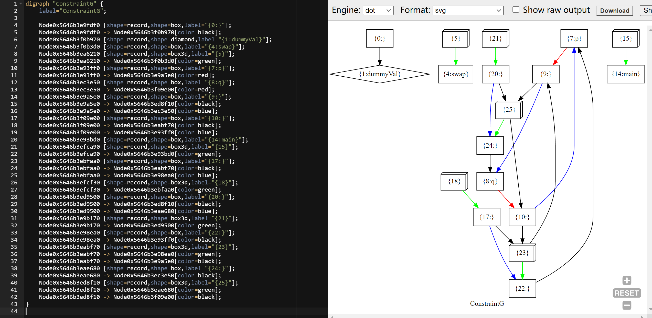
Graph in SVF

Slide 22
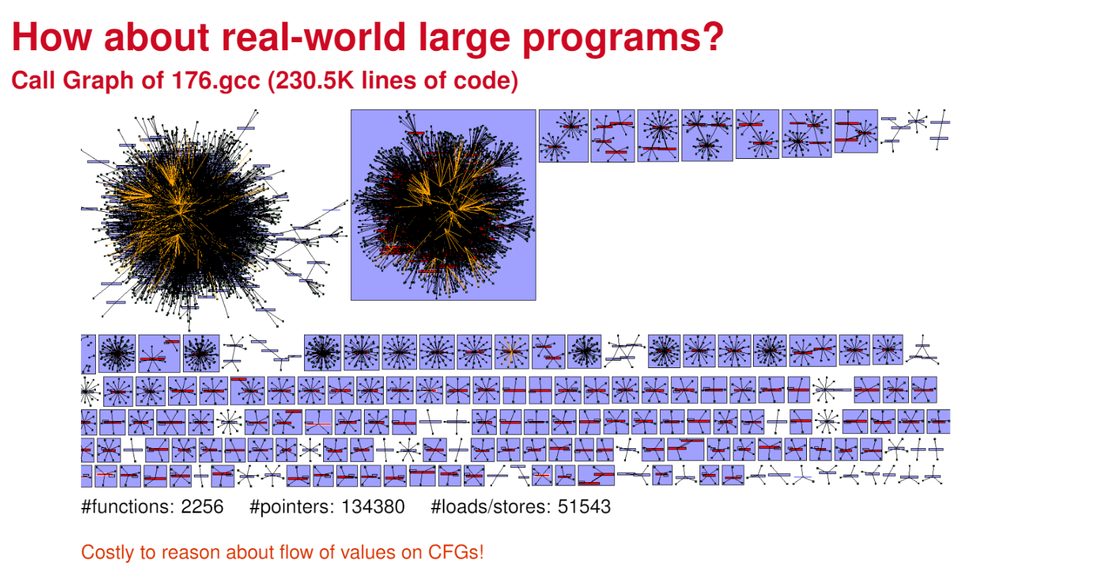
Programs in real-world
[2]. https://github.com/SVF-tools/Teaching-Software-Analysis/blob/slides/slides/Introduction%20to%20Software%20Analysis.pdf Page 16

Slide 23
original code
changed code
void swap(char **p, char **q){
char* t = *p;
*p = *q;
*q = t;
}
int main(){
char a1, b1, c1;
char *a = &a1;
char *b = &b1;
char *c = &c1;
//difference at here
*a = *b + *c;
swap(&a,&b);
}
void swap(char **p, char **q){
char* t = *p;
*p = *q;
*q = t;
}
int main(){
char a1, b1;
char *a = &a1;
char *b = &b1;
swap(&a,&b);
}

Slide 24
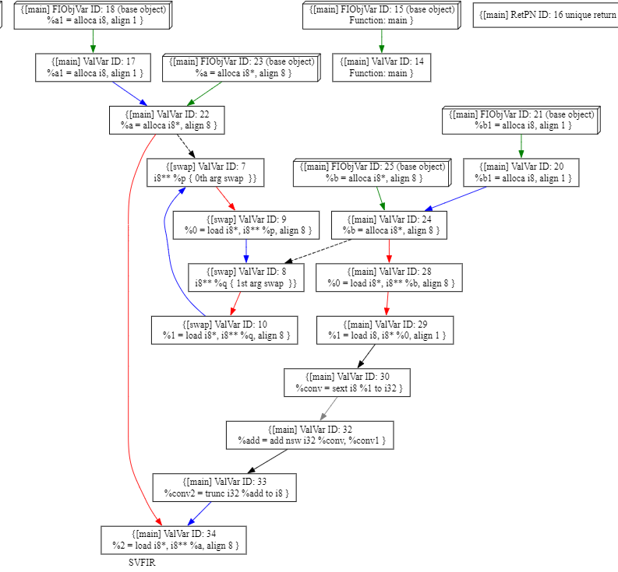
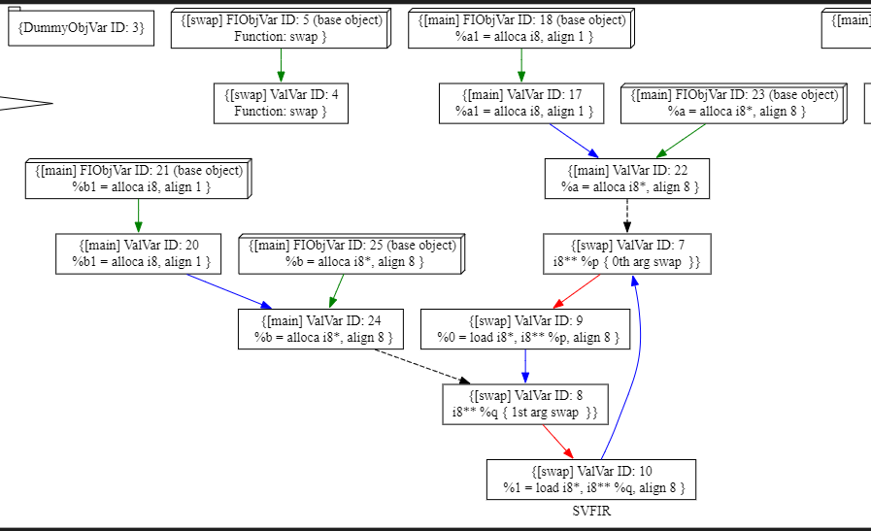

Slide 27
Advantages
Easy to find information.
Provide more customization.
Simplify commonly used functions.
The Graph is dynamic and more efficiency

Slide 28
Summarize
Question | Solution | Advantage
How to get more information DIRECTLY from graph ? | Using features as attributes of nodes | Improving the readability of graphs
How to achieve more functions | Replacing functions with Cypher queries | Simplify data structure and reduce maintenance and development costs
How to realize the dynamic graph | Inserting nodes using cypher | For large projects, improve the efficiency of generating graphs

Slide 29
Future Work
 | C/C++ | Cypher
Recreate file | Which one is the most efficiency? What is the approximate amount of code for the critical?
Dynamic Insert
Method 1. Create CSV based on the .dot in SVF and import it into Neo4j
Method 2. Connect HTTP or Bolt to insert the node/edge dynamically.

Slide 30
Thank you

