Slide 1
School of Computer Science and Engineering
Improvement of SVF based on Graph Database
Xuanzhi Liu
UNSW Sydney
Supervisor: Zhengyi Yang
22/03/2024

Slide 2
Outline
Related Work
SVFNeoGraph
Future work

Slide 3
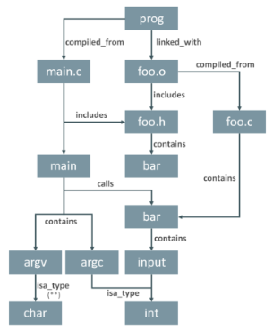
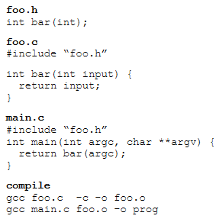
$${\text{Frapp}\text{é: }\text{Querying} \text{the} \text{Linux} \text{Kernel} \text{Dependency} \text{Graph} }^{[1]}$$
[1] Nathan Hawes, Ben Barham, and Cristina Cifuentes. 2015. Frappé: Querying the Linux Kernel Dependency Graph. In Proceedings of the GRADES'15 (GRADES'15). Association for Computing Machinery, New York, NY, USA, Article 4, 1–6. https://doi.org/10.1145/2764947.2764951

Slide 4
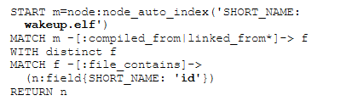

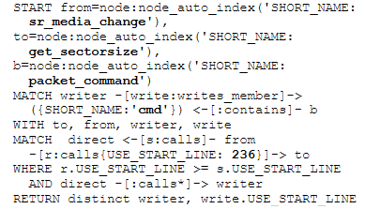

$${\text{Frapp}\text{é: }\text{Querying} \text{the} \text{Linux} \text{Kernel} \text{Dependency} \text{Graph}}^{}$$
Code Search
Cross Referencing and Code Navigation
Code Debug
Code Comprehension

Slide 5
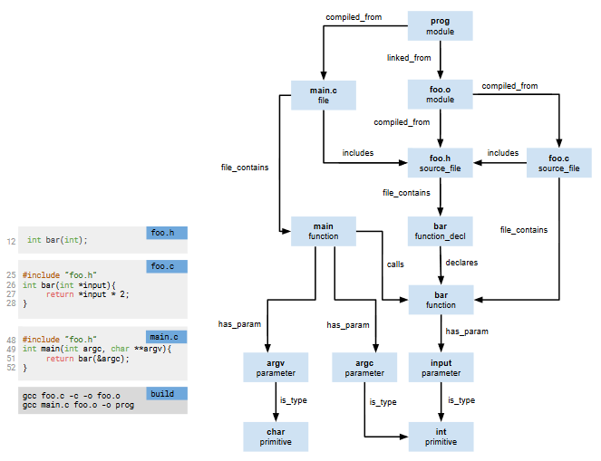
Difference and Similarities:
It is not a framework based on the pointer analysis level

Slide 6
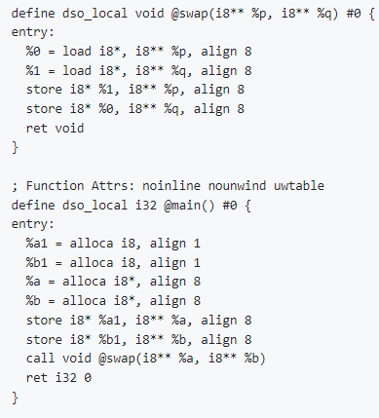
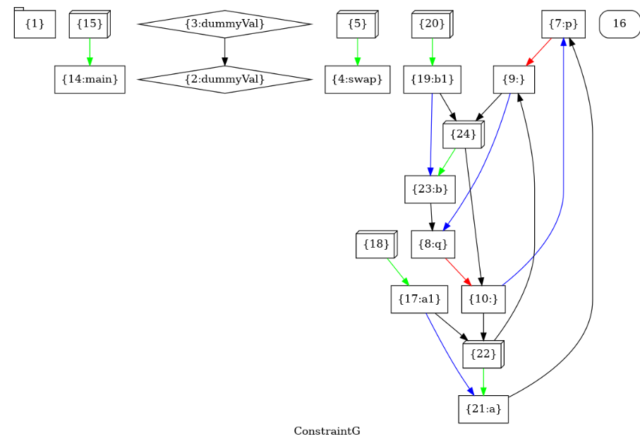
Difference and Similarities:
It is not a framework based on the pointer analysis level

Slide 7
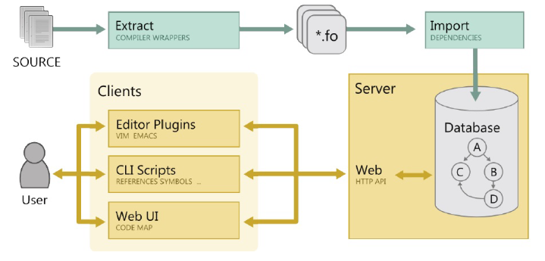
Difference and Similarities:
It proposes the extractor->interface->graph database model

Slide 8
Difference and Similarities:
It proposes the extractor->interface->graph database model
Future work
SVF
IR
.dot

Slide 9
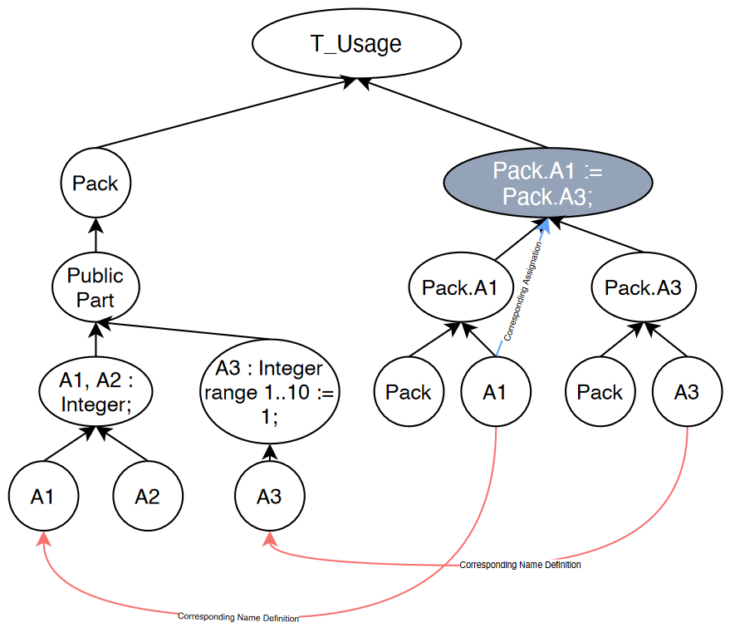
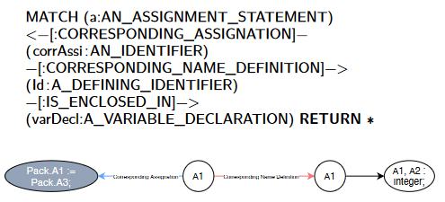
$${\text{Use} \text{of} \text{graph} \text{databases} \text{for} \text{static} \text{code} \text{analysis}}^{[2]}$$
This article explores the use of Neo4j in analyzing Ada language programs
Use Code Property Graph (CPG) to represent the code rather than Abstract Syntax Tree(AST). A CPG is a directed graph where nodes and edges can have properties.
[2] Dauprat, Q., et al. "Use of graph databases for static code analysis." Ada User Journal 43.3 (2022).

Slide 10
$$\text{Use} \text{of} \text{graph} \text{databases} \text{for} \text{static} \text{code} \text{analysis}$$
Database has advantages in terms of scalability and response time
Cypher is lengthy, Database takes longer to populate than building an AST

Slide 11
Summary
There are different program analysis tools deployed to achieve different functions behind the data because of the different functions they implement.
The more dominant current practice is the use of CPG (although some articles point out the limitations of this)

Slide 12
Next step: Reference to ${Joern}^{[3]}$
 | Same | Difference
SVF(with CPG) | Using a graphical database to store the results of code analysis | Focus on value flows, memory leaks, data contention and other security vulnerabilities in programs
Joern |  | Specialized in malware analysis and advanced vulnerability detection
[3]. https://github.com/joernio/joern

Slide 13
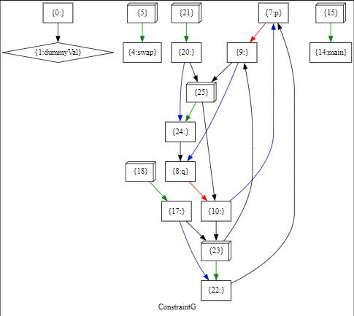
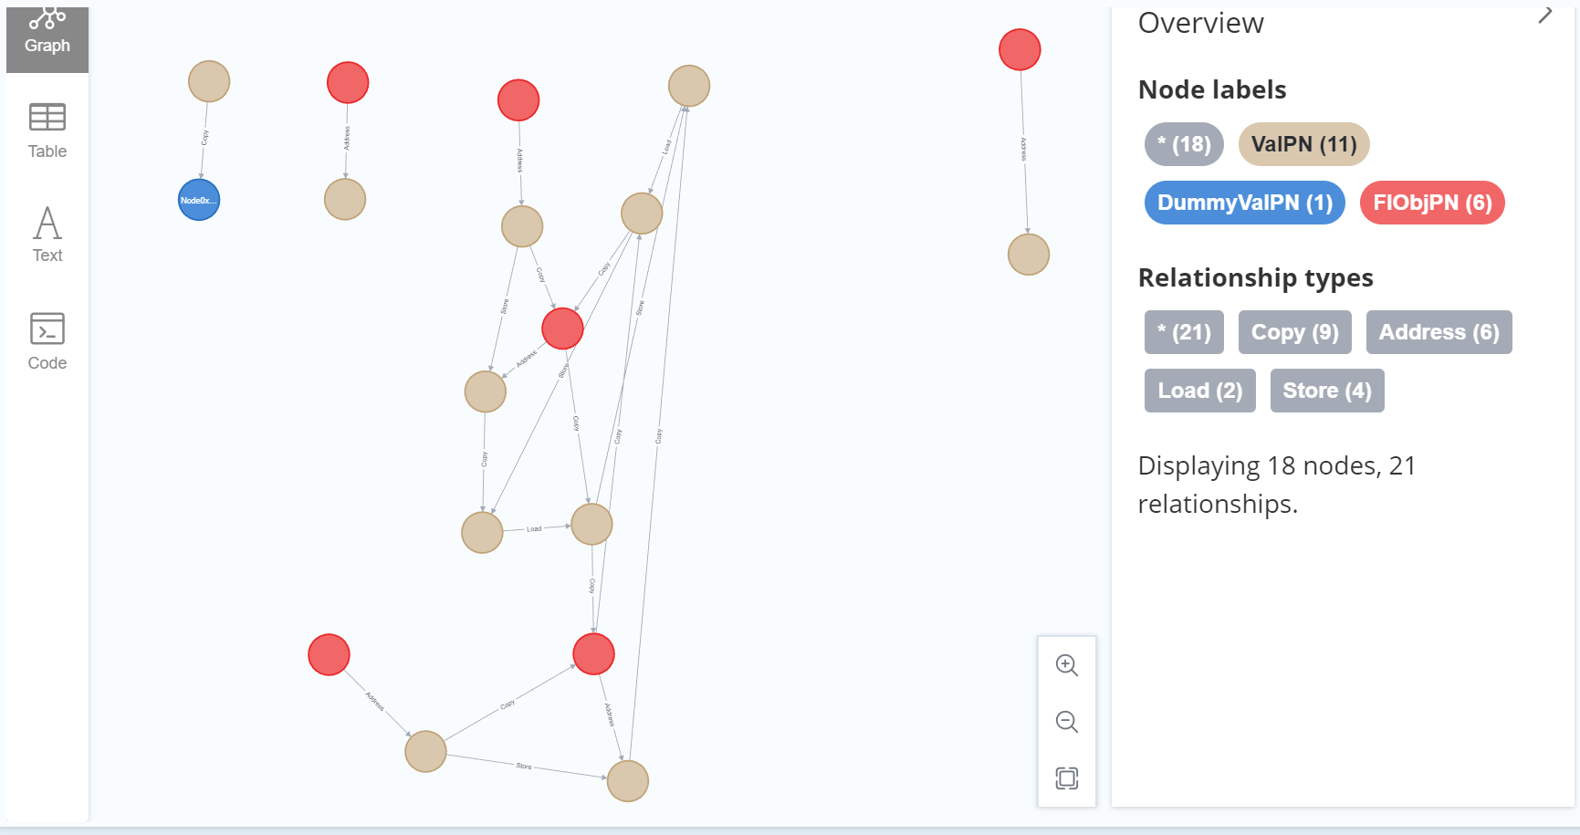
SVFNeoGraph: import .dot file from SVF to your local Neo4j Client

Slide 14
${SVFNeoGraph }^{[4]}$: import .dot file from SVF to your local Neo4j Client
From Neo4j import GraphDatabse
Import dot2csv
nodes.csv edges.csv
.dot
database
[4]: https://github.com/Billxzliu/SVFNeoGraph

Slide 15
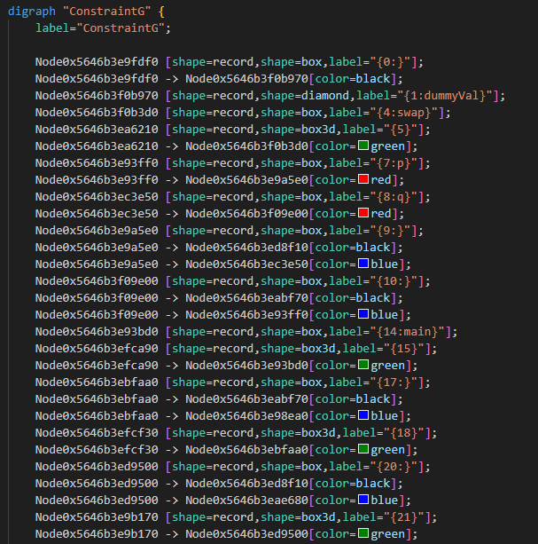
Future work
Add more properties to the .dot file and then import it into Neo4j
Use a similar method to import more graphs from SVF into Neo4j

Slide 16
Thank you

