Slide 1
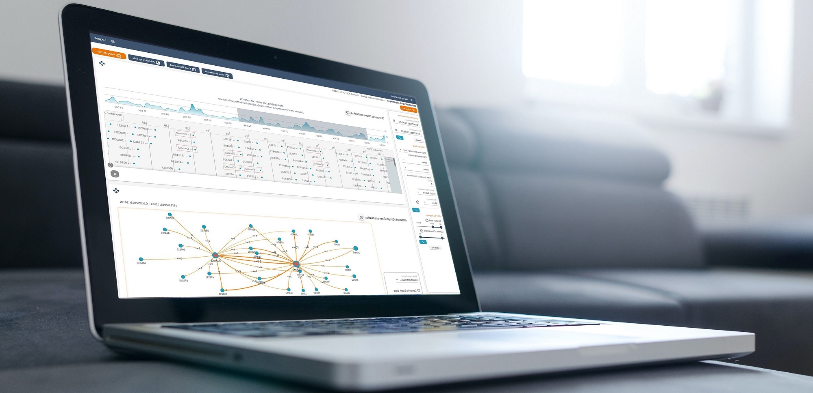
Company Profile
AEGIS IT RESEARCH GmbH

Slide 2
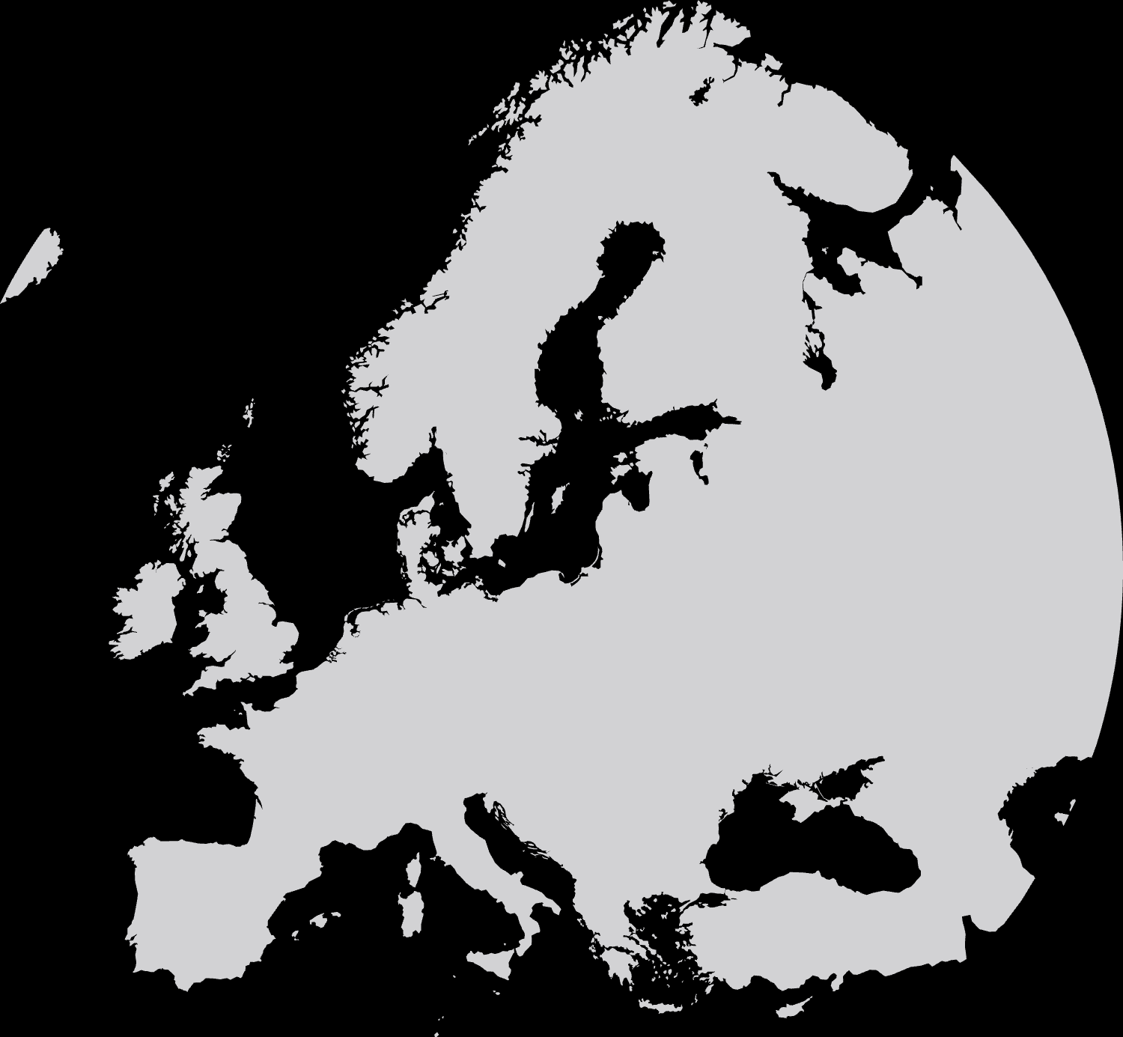
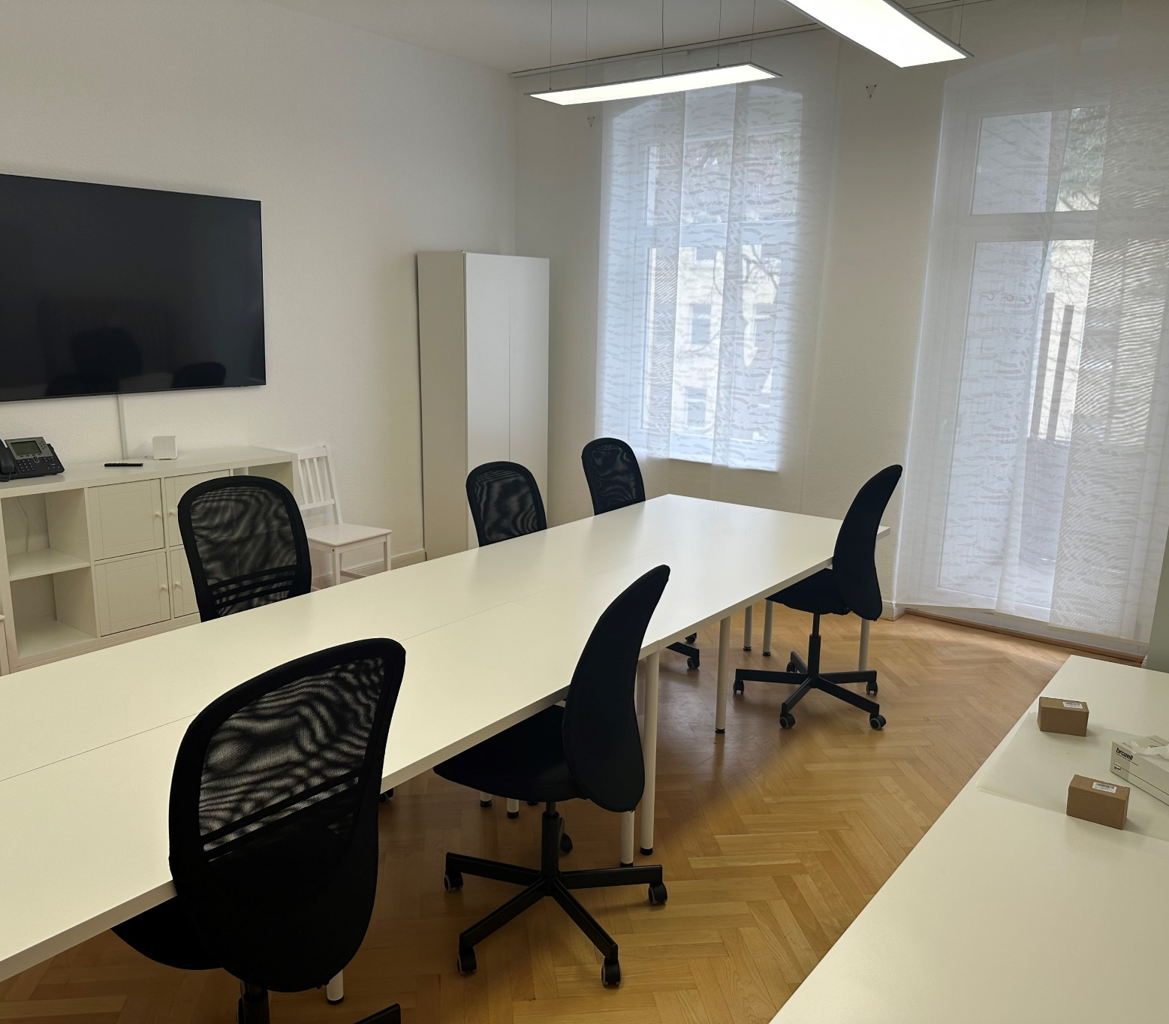
A center of innovation and excellence!
ICT SME based in Germany
A multidisciplinary group of more than 40 experts
Turn world-class research and innovation in Computer Science into products
Highly skilled personnel of ICT Researchers, Project Managers, S/W Developers, Security Experts, SSH, Legal and Ethics Advisors
General Director: Prof. Vassilis Prevelakis

Slide 3

AEGIS Roadmap
2024
Optimising Business Offerings for multiple market stakeholders
2021
Visualisation Toolkit is published at BDVA Marketplace
2018
First research grant from the EU is secured
2017
Year of company establishment

Slide 4

Areas of excellence and expertise
Cyber Security Solutions
Develop cutting-edge software products in the fields of cyber security and digital forensics investigation
Data-driven Visualisations
Deliver adaptive big data visualizations for informed long-term decision making
Domain-specific Customisations
Provide services for complete software development lifecycle to address real business needs
Unbiased advice & assistance
Assist industrial and public bodies in achieving their goals on effective and secure data governance

Slide 5

Our Products & Services
Developing and managing innovative IT solutions

Slide 6




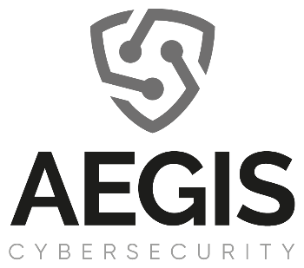




Solutions Overview
SOC Managed Services
Digital forensics
Multi-sided data monitoring
Security Testing & Vulnerability assessment
Security event detection
Cyber Threat Intelligence Management
Incident management & handling
Cybersecurity awareness & training

Slide 7
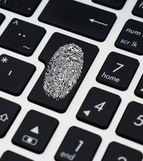
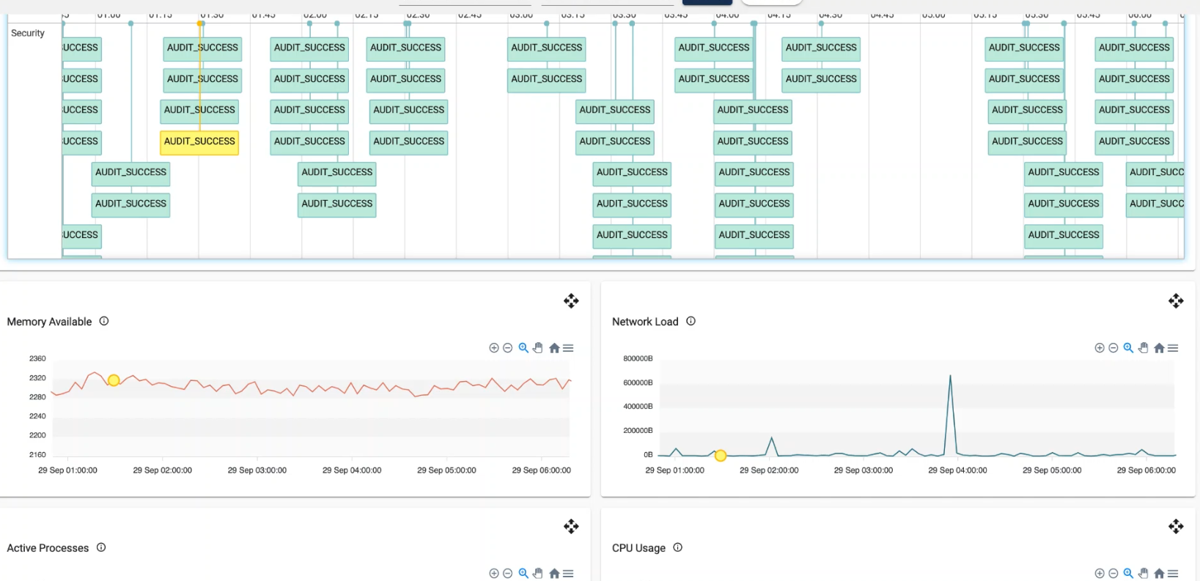



Forensics Visualisation Toolkit (FVT)
Integration of physical and cyber forensics services and algorithms
Timeline analysis of large numbers of heterogeneous events
Close to real-time incident mitigation and threat hunting
A versatile solution for digital forensics investigations, analysis of situational awareness evidence and advanced visualisations to assist in handling security related incidents
Adaptive visualisations based on preconfigured views

Slide 8
Security Assessment
A set of services for assessing the maturity of security measures
Tool-based analysis of vulnerabilities on the IT infrastructure and link to potential risks
Penetration Testing for testing the security measures applied in the IT infrastructure and spotting potential security holes
Outcome: A report on security gaps and recommendations to ensure compliance with regulations and policies

Slide 9


Awareness and Training
Thematic-driven Training
Cyber Range
Cybersecurity, Digital Forensics, Anti-Phishing awareness and training for experts
Infrastructure for on-site experts’ training / demo

Slide 10

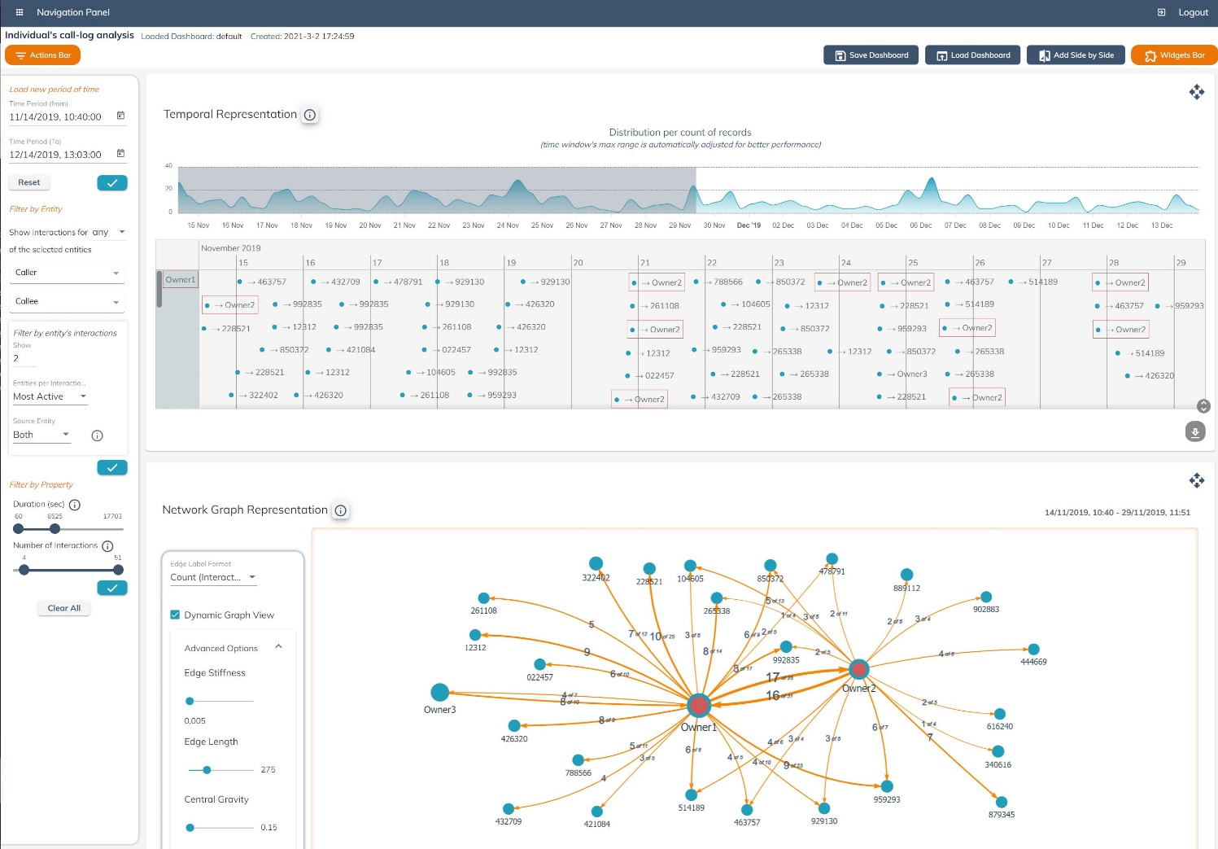


Advanced Visualization Toolkit (AVT)
Business-driven situational awareness and insights gain
Multimodal data integration sources for adaptive visualisation and user reporting needs
An extensible toolkit with a wide scope, from Digital Forensic analysis to Data analytics
Watch our demo cases:
https://avt.aegisresearch.eu/
Integration of real-time and historical information

Slide 11
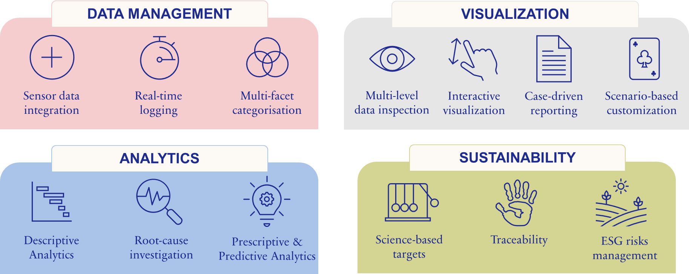
A data-driven solution

Slide 12
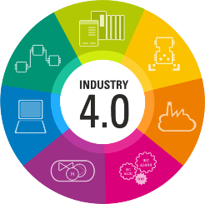


Examples of Use
Predictive Maintenance & Digital Forensics
Real-time insights on production assets health monitoring
Threats avoidance & detection on connected smart assets
Energy Management and Efficiency
Optimization of renewable energy usage for production and supply chain operations
Scenario driven data exploration
Enhanced quality and security surveillance across business operations

Slide 13
The Autocrime Platform
Automate and accelerate criminal investigations
considering experts’ feedback
Multi-source and multimodal evidence processing & analytics
1
Using state-of-art AI-based technologies for speaker recognition, text data mining, video analysis and network analysis
Intuitive Visualisations
2
Dashboarding and visualization widgets and filtering capabilities to provide key insights on unique speakers, mentioned entities, topics and their connections

Slide 14

Our Innovation Activities
Key role in ICT innovation through EU and national funds

Slide 15



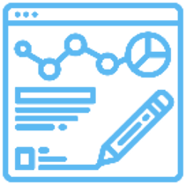

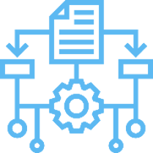
Our Research Experience
Digital Forensics Services
Custom S/W Development
Fast root-cause identification
Digital evidence correlations
Threat hunting
Knowledge Base management
Recommendation engine
Anti-phishing mechanisms
Mobile app development
Cyber Security
Software Integration
Security Incidents & Events Management, Log analysis, Risk analysis, Mitigation strategies, Training & Consultation
Data Integration
Migration from legacy systems
SOA Architectures
Advanced Data Visualizations
Current Research
Timeline analysis, graph-based network analysis, spatio-temporal data representations
Secure embedded platforms
Access Control – Network and Application Security in Cyber Systems
Blockchain-based auditing

Slide 16
















Involvement in Projects

Slide 17







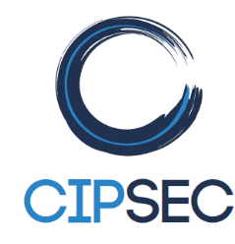
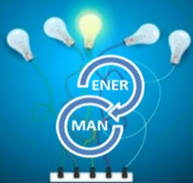
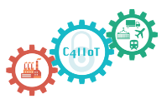
Involvement in Projects
CONTOUR

Slide 18




































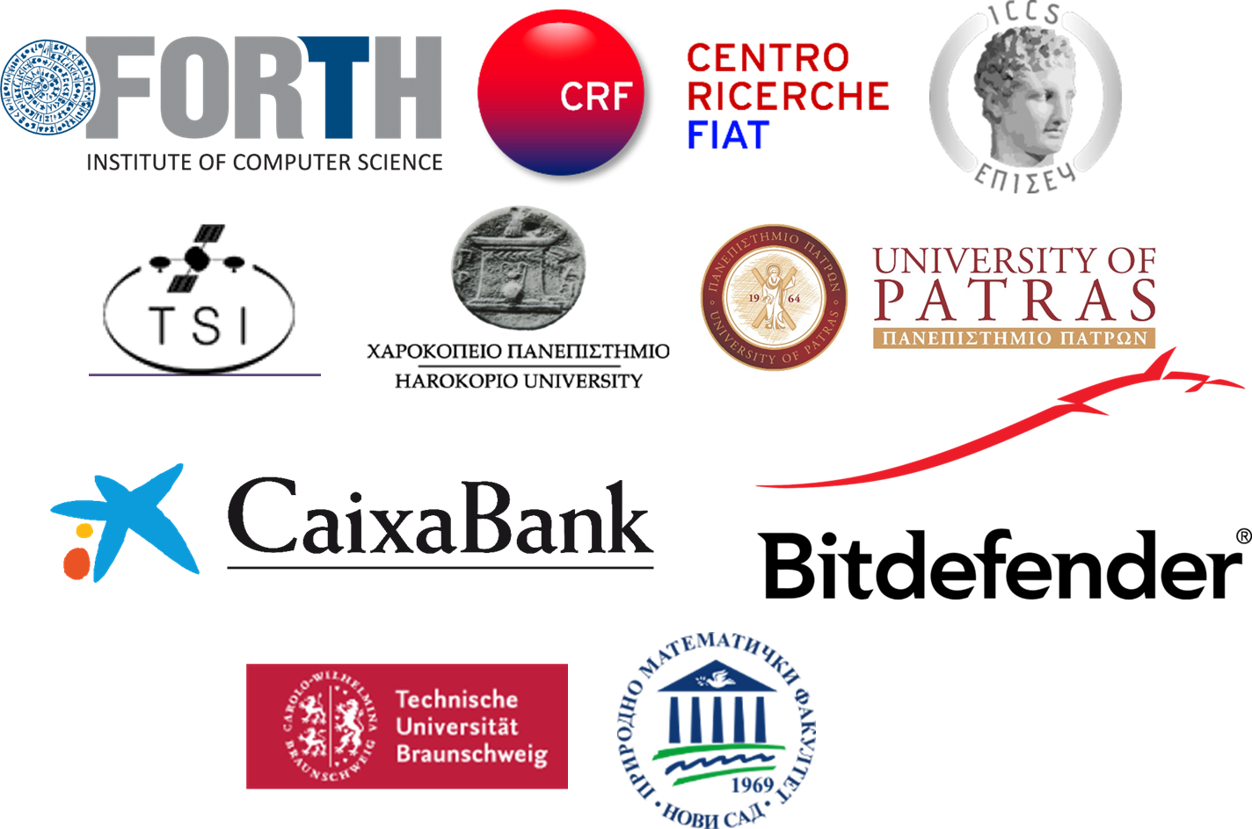












Research Partners Network
Extensive network of research partnerships and business alliances coming from more than 10 countries, representing the Industry, the Research community, the Academia and other Organizations of public interest

Slide 19
CoEvolution involvement
T1.1 | Project coordination and reporting
T1.4 | Innovation tracking and data management
T1.5 | Ethical principles and European regulations, fundamental rights, and social sciences
T2.1 | Outreach planning, Communication and Dissemination
T2.4 | Exploitation activities and long-term sustainability
T2.5 | End user internal organization training activities
T3.1 | State-of-the-Art, Threat model and Technical Specifications
T3.2 | Use-Case specifications and Requirements
T3.3 | CoEvolution Reference Architecture
T3.4 | Data requirements and Collection
T5.1 | STR AI Model Bills-of-Material Definition, Design and Management
T5.2 | Security Runtime Monitoring
T5.5 | Evolutionary strategies for context-awareness adaptation
T6.1 | CoEvolution hub Integration and Implementation
T6.3 | Pilot Deployment, Testing and Demonstration

Slide 20
CoEvolution AEGIS involvement
D1.2 | Data Management Plan
D1.3 | Innovation management and ethics oversight report
D1.4 | Analysis of the legal and ethical issues
D2.1 | Plan for impact delivery

Slide 21
CoEvolution AEGIS team
Project Manager: Marinos Tsantekidis
Developer: Stella Markopoulou

Slide 22



Get in touch
OUR WEBSITE
https://aegisresearch.eu
OUR ADDRESS
Humboldt Street, 25, Braunschweig, 38106, Germany
info@aegisresearch.eu
@aegis-it-research
@AegisITResearch
@AEGISITCompany
AEGIS IT Research

