Slide 1

T2.1 - Outreach planning, Communication and Dissemination
Project Meeting
Graz, Austria
25-26 June 2025
Jihane Najar

Slide 2
Outreach planning, Communication and Dissemination

Slide 3
T2.1 - Objectives
Establish a structured framework to document communication and dissemination efforts.
Develop a flexible and adaptive strategy to adjust outreach efforts in real-time.
Ensure consistent communication across various channels to keep stakeholders informed.
Enhance project visibility and outreach through various tools and platforms to effectively engage the target audience.
Assess the impact of these activities against the project's KPIs.

Slide 4
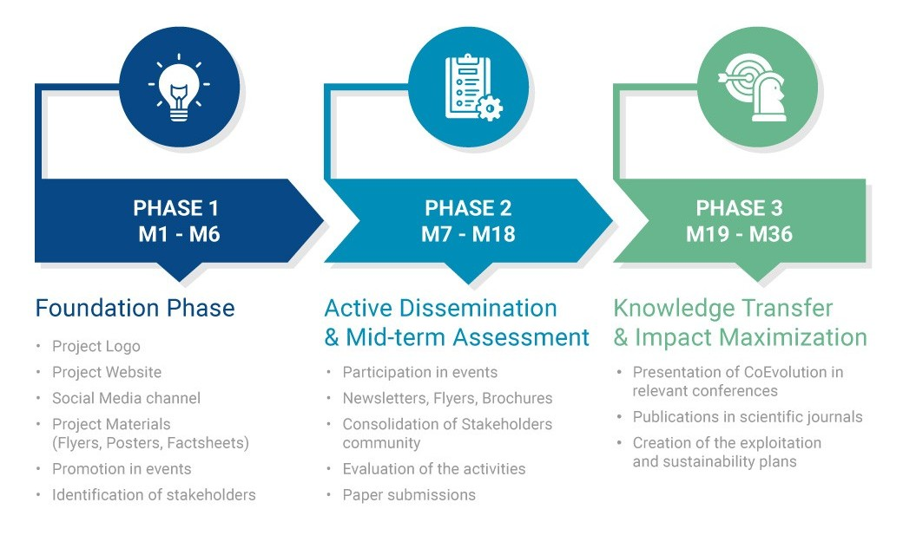
Dissemination & Communication Roadmap

Slide 5
Progress M6-M8
Actions | Month | Status
1st Press Release | M6 | Completed
1st Introductory Video | M6 | Completed
D2.1 | M6 | Completed
Roll up Banner | M7 | Completed
Flyer | M7 | Completed
12 Blogs on the website | M7 | Completed
The 1st CoEvolution Newsletter released | M8 | Completed
Active on Social Media | Ongoing | Ongoing
Poster | M8 | Completed

Slide 6





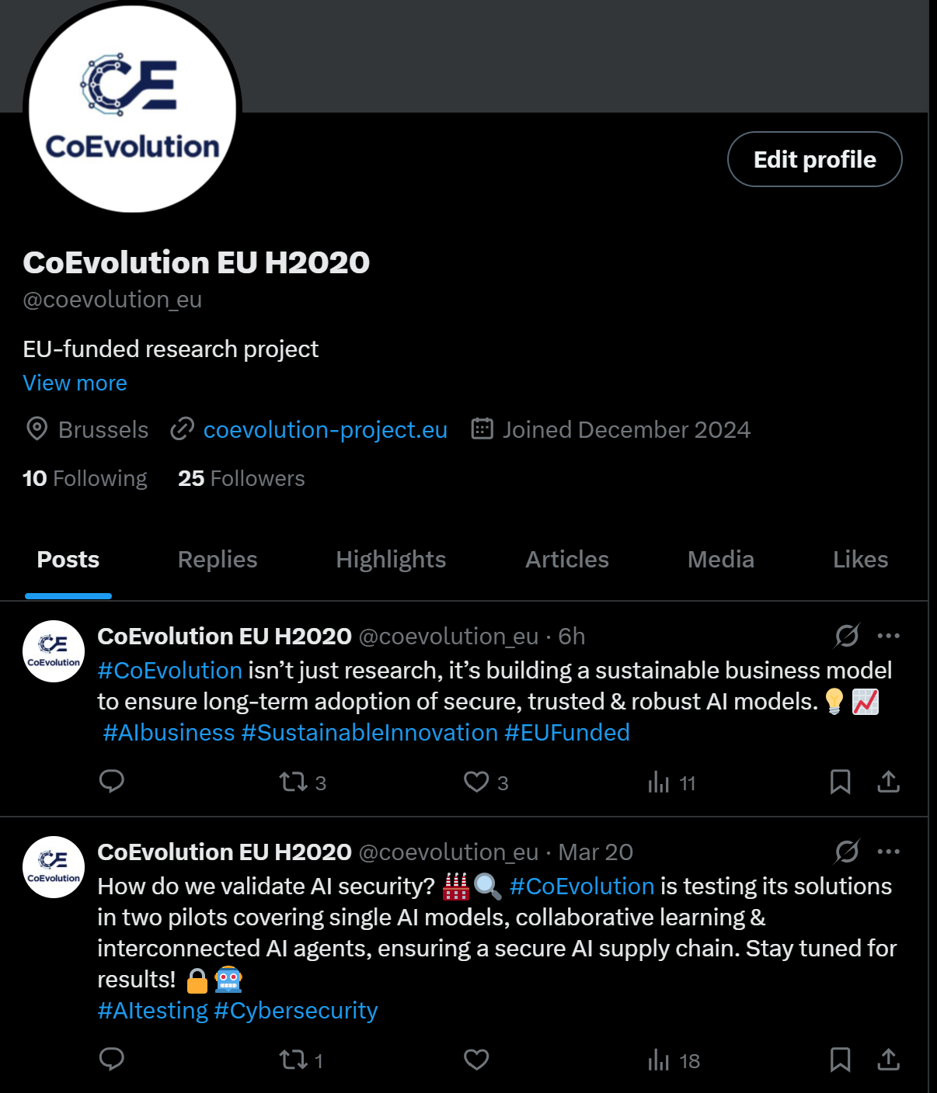
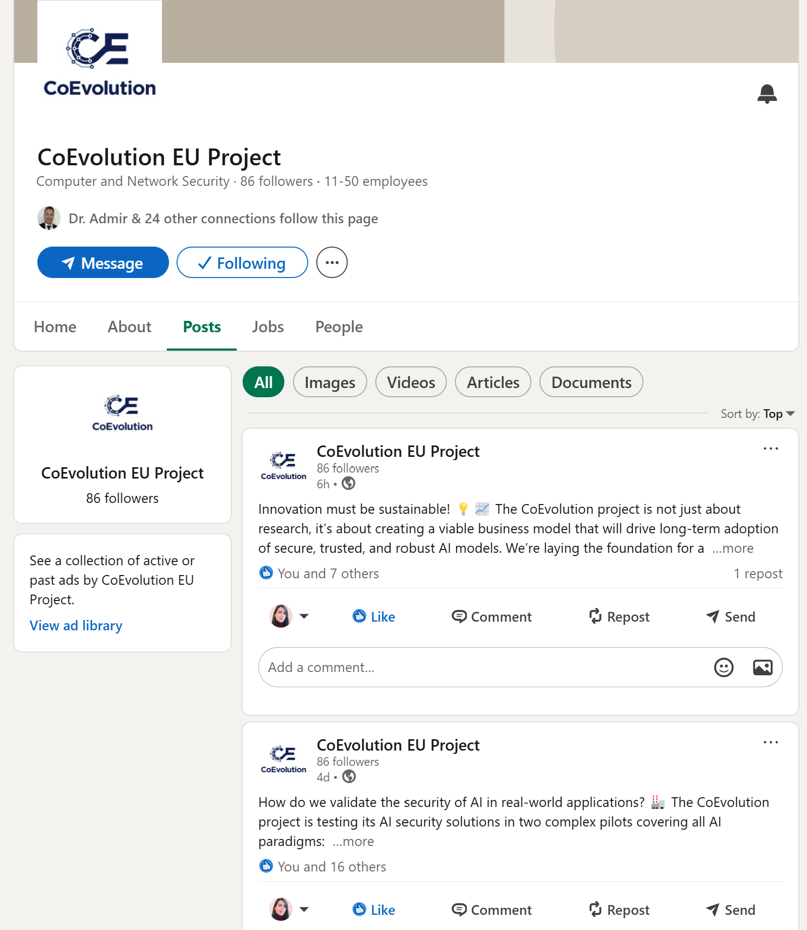
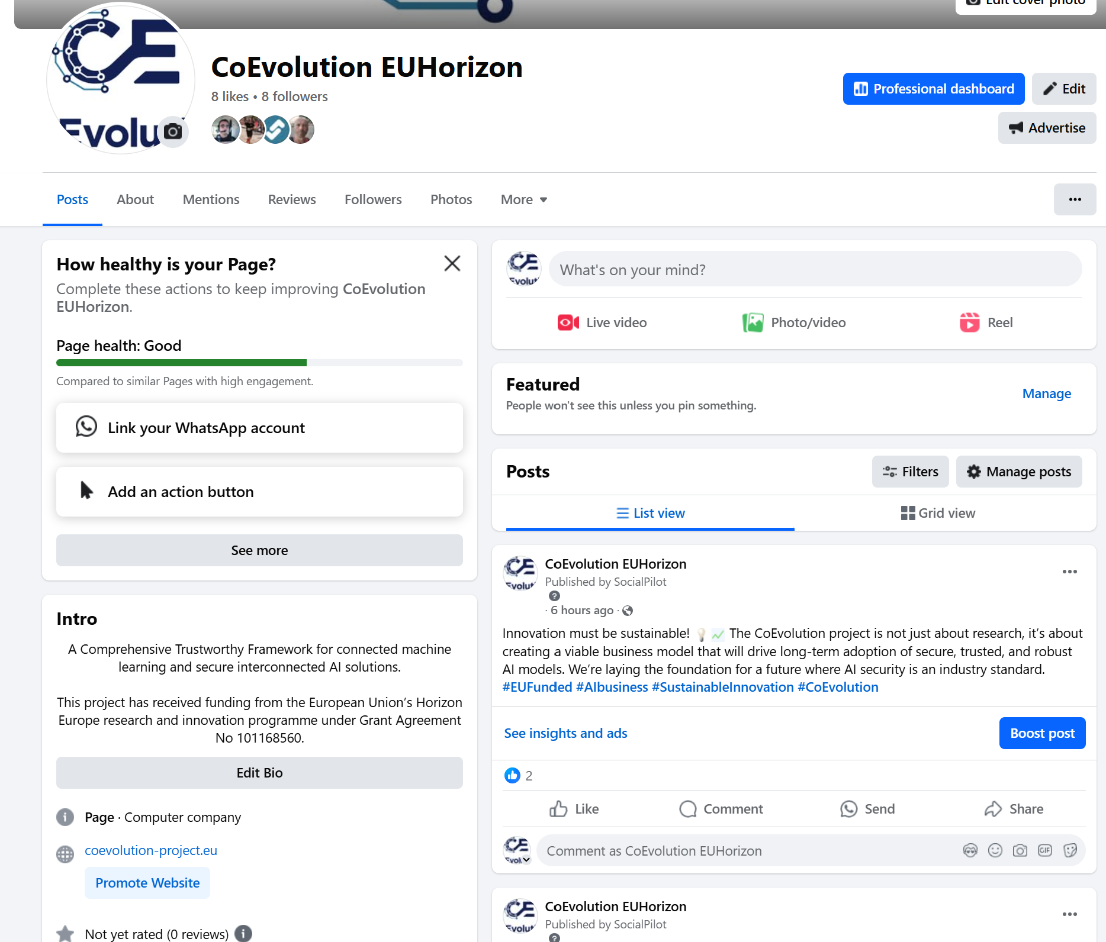
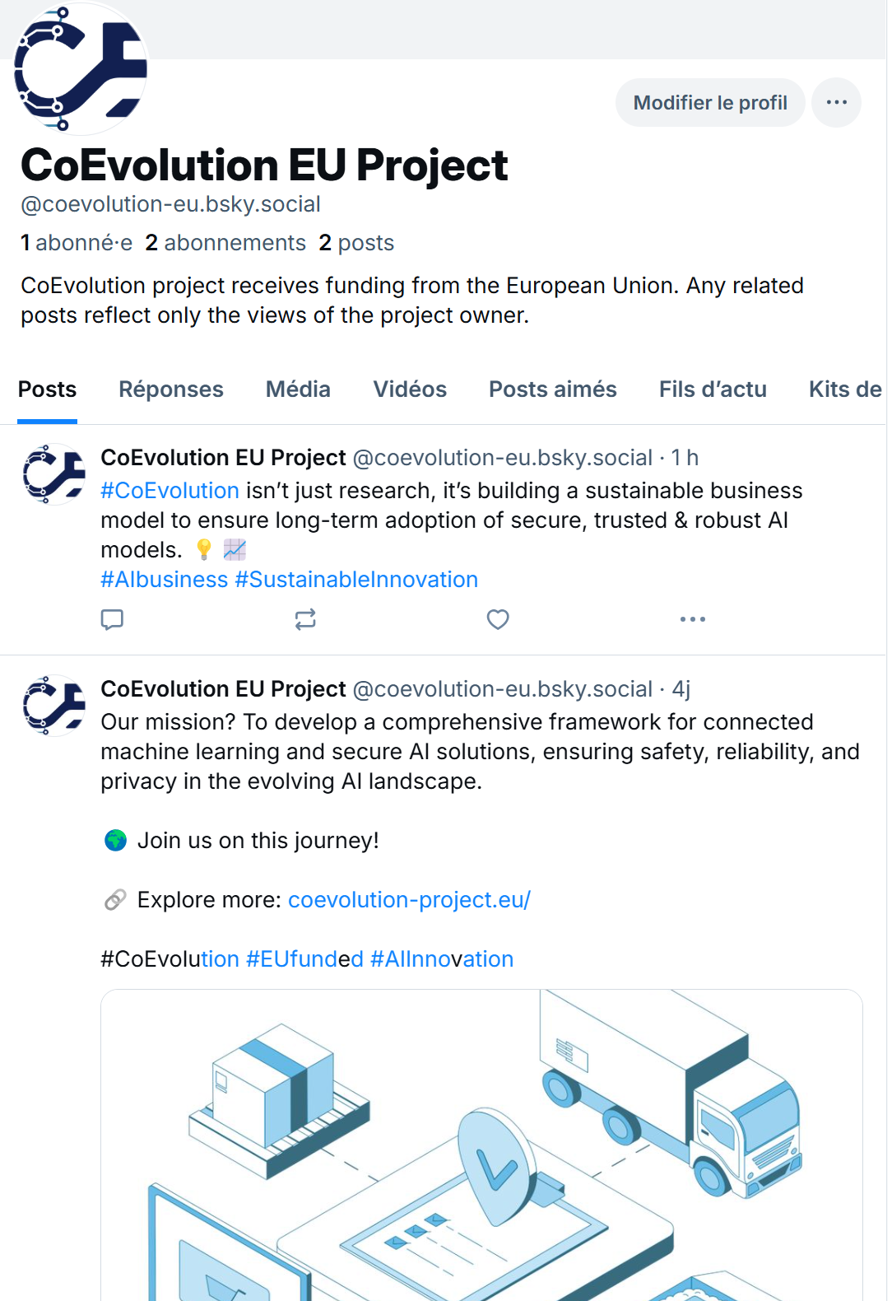
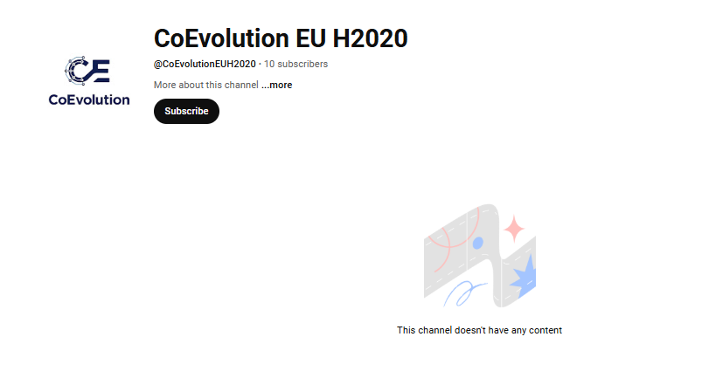

Social Media Channels
Followers: 294/2000
Posts: 188
https://x.com/coevolution_eu
https://www.linkedin.com/company/106186299
https://www.facebook.com/profile.php?id=61572810781073
https://bsky.app/profile/coevolution-eu.bsky.social
https://www.youtube.com/@CoEvolutionEUH2020
Followers: 50
Followers: 123
Followers: 91
Followers: 13
Subscribers: 17

Slide 7
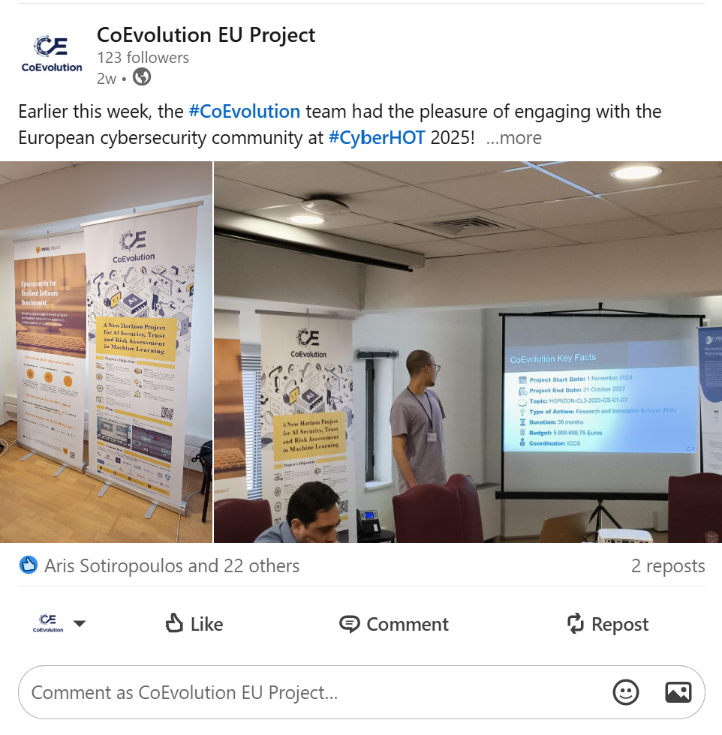



Social Media Posts

Slide 8

Social Media Plan
Posting plan:
2 posts per week to ensure consistent engagement and visibility.
Progress So Far
1st campaign: Introduction of all project partners (AVL, BEVD)
Introducing the project
Report Participation to events
What’s Next
Continuing to post about the CoEvolution project, focusing on:
Informing the public about our objectives.
Highlighting upcoming activities and achievements.
Sharing relevant updates to keep stakeholders engaged.
Your support is needed!
Partners are kindly requested to provide content for social media posts (once per month).
Use this form to submit your contributions: https://coevolution-project.eu/contribution-to-coevolution-social-media-form/

Slide 9

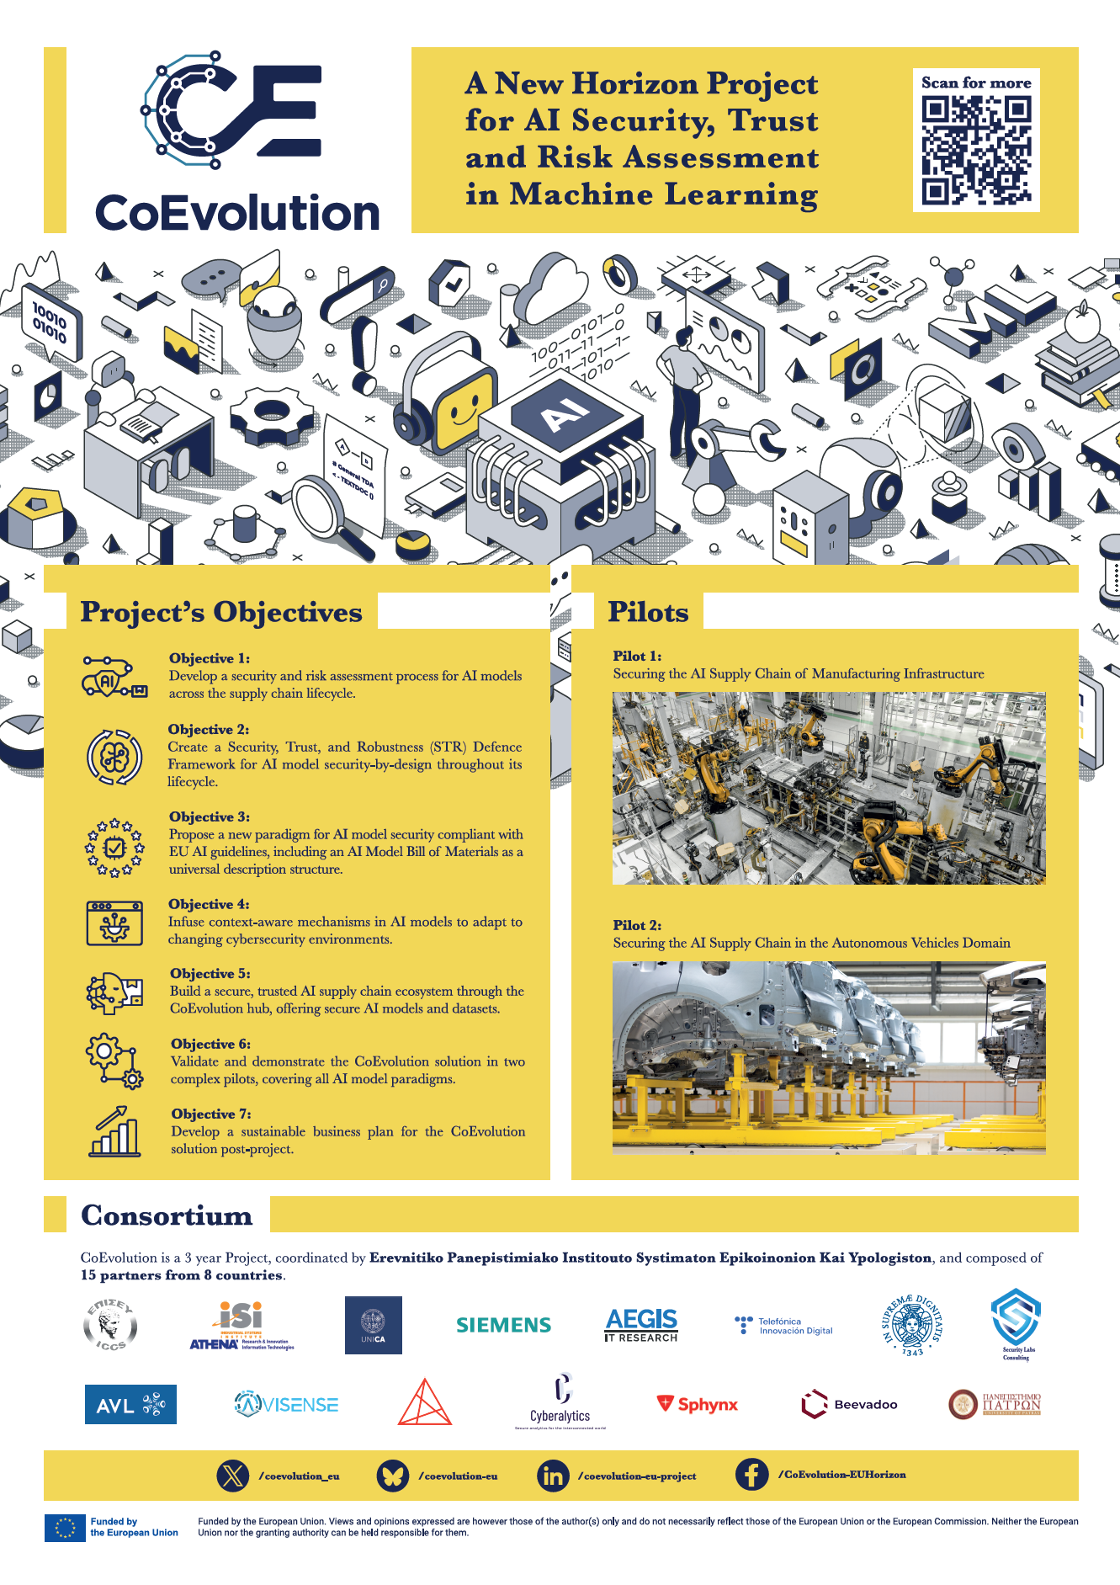

CoEvolution Dissemination Materials
CoEvolution Website
Sharepoint
Promotional material KPIs |  | Threshold | M7
KPI 34 | No. of hard copies (i.e., brochures, flyers, posters, etc.) distributed | >2.000 | 50
KPI 35 | Roll-up Banners | >4 | 1
Notes:
KPI 35 - Roll-up banner versions or presentation of the roll up banner in >4 events??

Slide 10
CoEvolution D&C Tracker
Purpose
Ensure efficient reporting and documentation of dissemination and communication activities.
Centralize all project-related contributions in one location.
Partner Responsibilities
All partners are expected to update the tracker regularly.
Access the tracker file here.
Tracker Structure
Publications: Record any publications acknowledging the CoEvolution project (Ensure all columns are completed).
Attended Events: Report events where CoEvolution was presented including (Ensure all columns are completed and uploading photos is mandatory).
Future events: Lists upcoming events that may be of interest to the CoEvolution project and partners
Dissemination Materials: List materials created by your organization that mention CoEvolution.
Collaborations: Document interactions with other projects or initiatives (managed by ISI).
Social Media Posts: Record social media posts related to the project, including links.
Blog Articles: Include details about published or planned blog articles for the website.
OS Repositories: add all Open Source Repositories

Slide 11
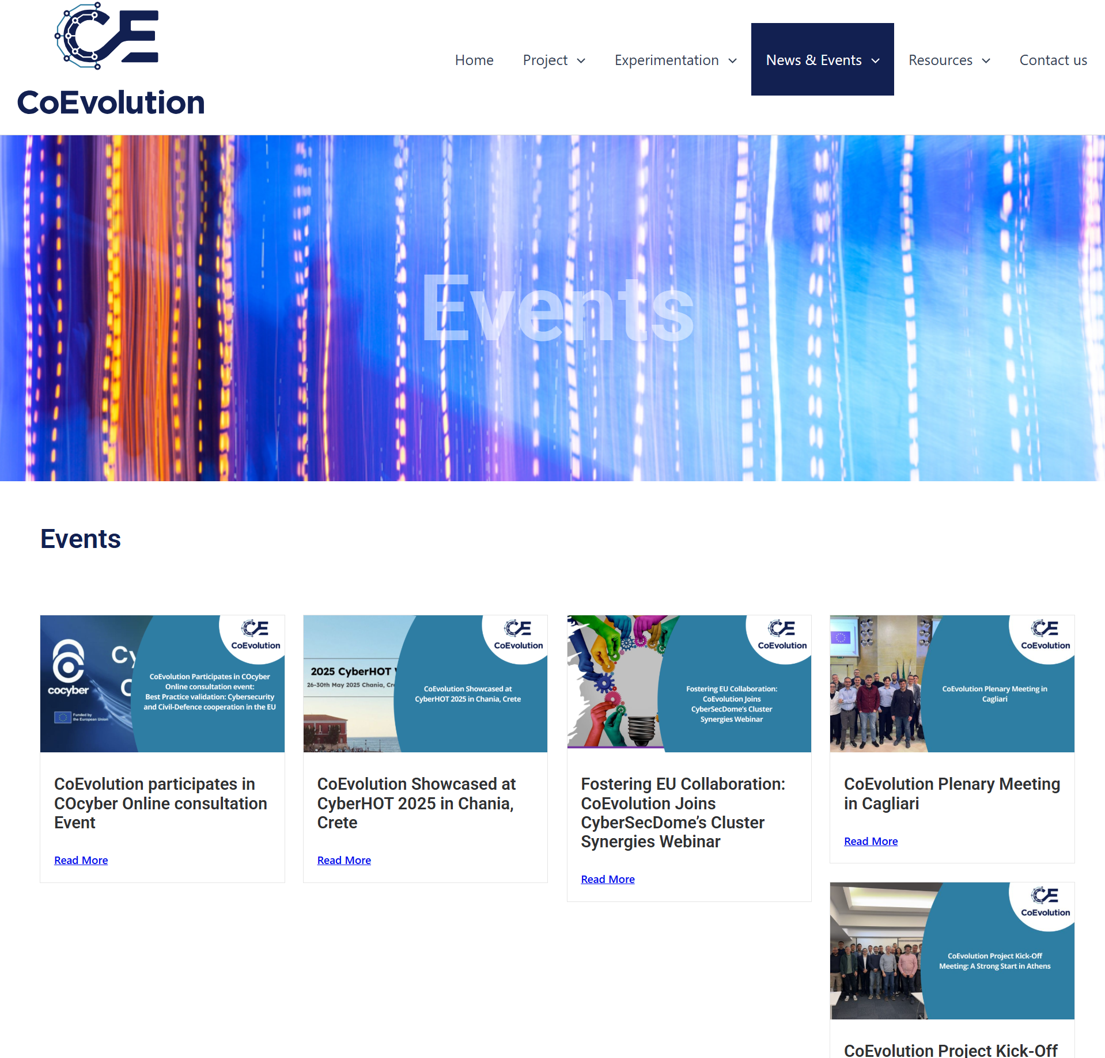
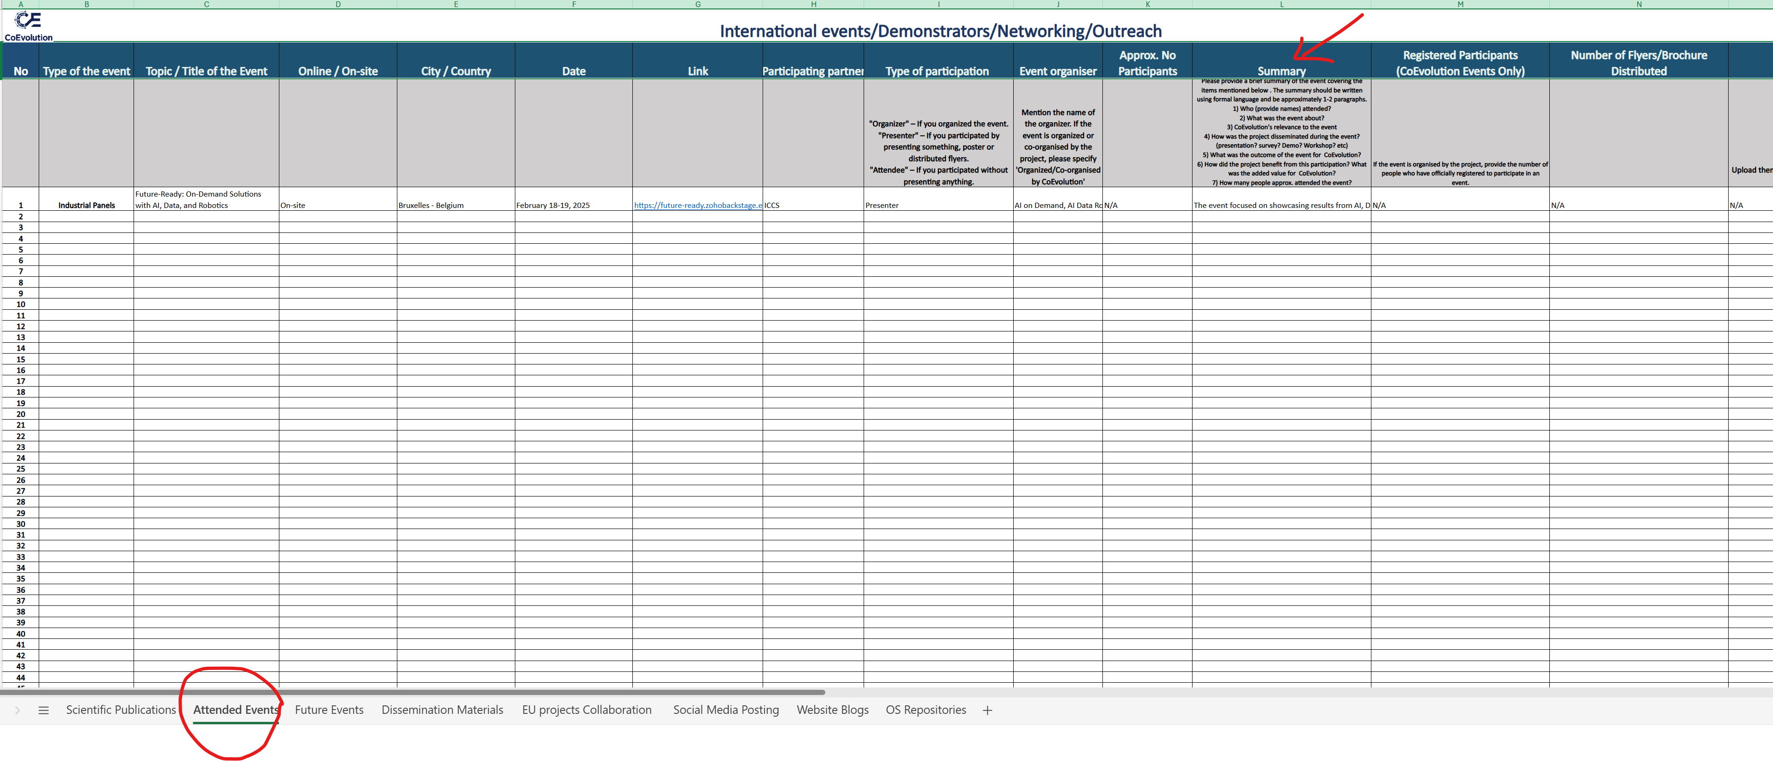
Website – Events & News Blogs

Slide 12

Website Engagement & Technical Content Plan
Objective: Reach the following KPIs by M36
KPI 3: ≥ 10 Published Technical Articles
KPI 24: > 10,000 Website Visitors
Blog Articles Series - Plan
1 Article per month (Follow the GA order)
Technical Articles
Guidelines:
Each article should be 1–2 pages maximum
Topic is up to each partner and should reflect their area of expertise
Technical partners and academic institutions must include technical content
ICCS | July 2025
UNICA | August 2025
ISI | September 2025
SIE | October 2025
AEGIS | November 2025
TID | December 2025
UNIPI | January 2026
SLC | February 2026
AVL | March 2026
AVI | April 2026
DIE | May 2026
CBRL | June 2026
STS | July 2026
BEVD | August 2026
Upatras | September 2026

Slide 13
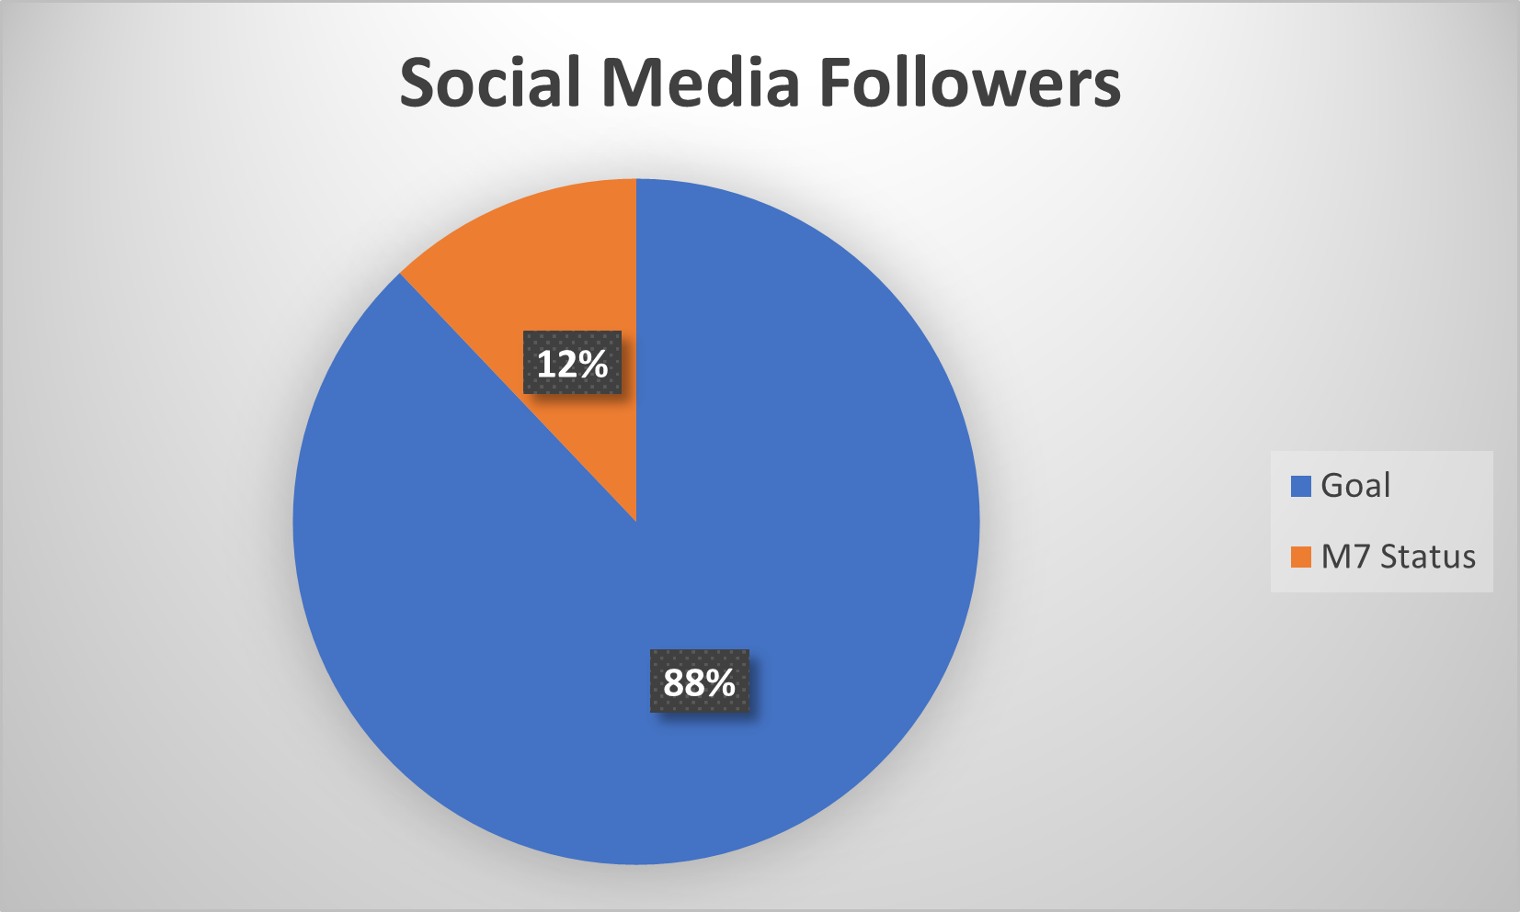
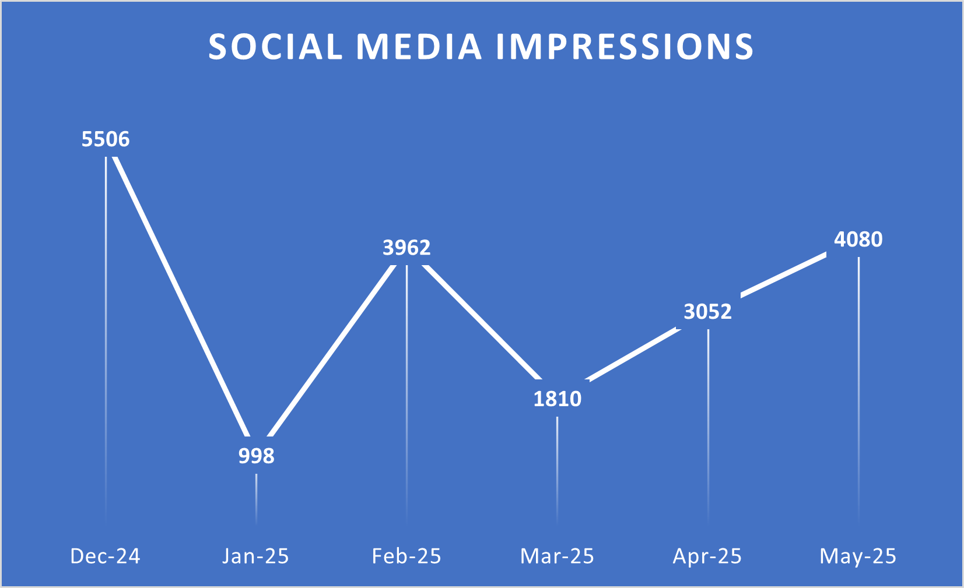

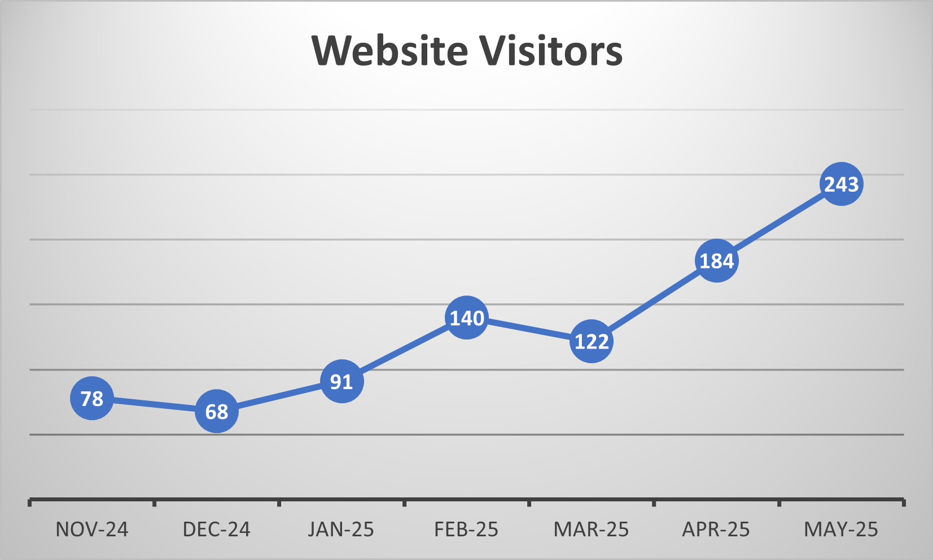
Website & SM KPIs
Project Website KPIs |  | Threshold | M7 Status
KPI 23 | Online by: M01 | M1
KPI 24 | Visitors at M36 | >10.000 | 926
Social Media KPIs
KPI 25 | Social media followers (by M36) | >2.000 | 275
KPI 26 | No. of impressions (monthly average) | >500 | 3234
e-Newsletters and Email Campaigns KPIs
KPI 27 | e-Newsletters contributed/released | >6 | 1
KPI 28 | Total Mailing List Contact Points | >1.000 | 39
Multimedia KPIs
KPI 36 | Number of promotional videos | >3 | 1
KPI 37 | Number of interviews produced | >6 | 0
KPI 38 | views | >3.000 | 28
Notes:
KPI 28 - Circulate the Form and add QR code to all Dissemination materials

Slide 14
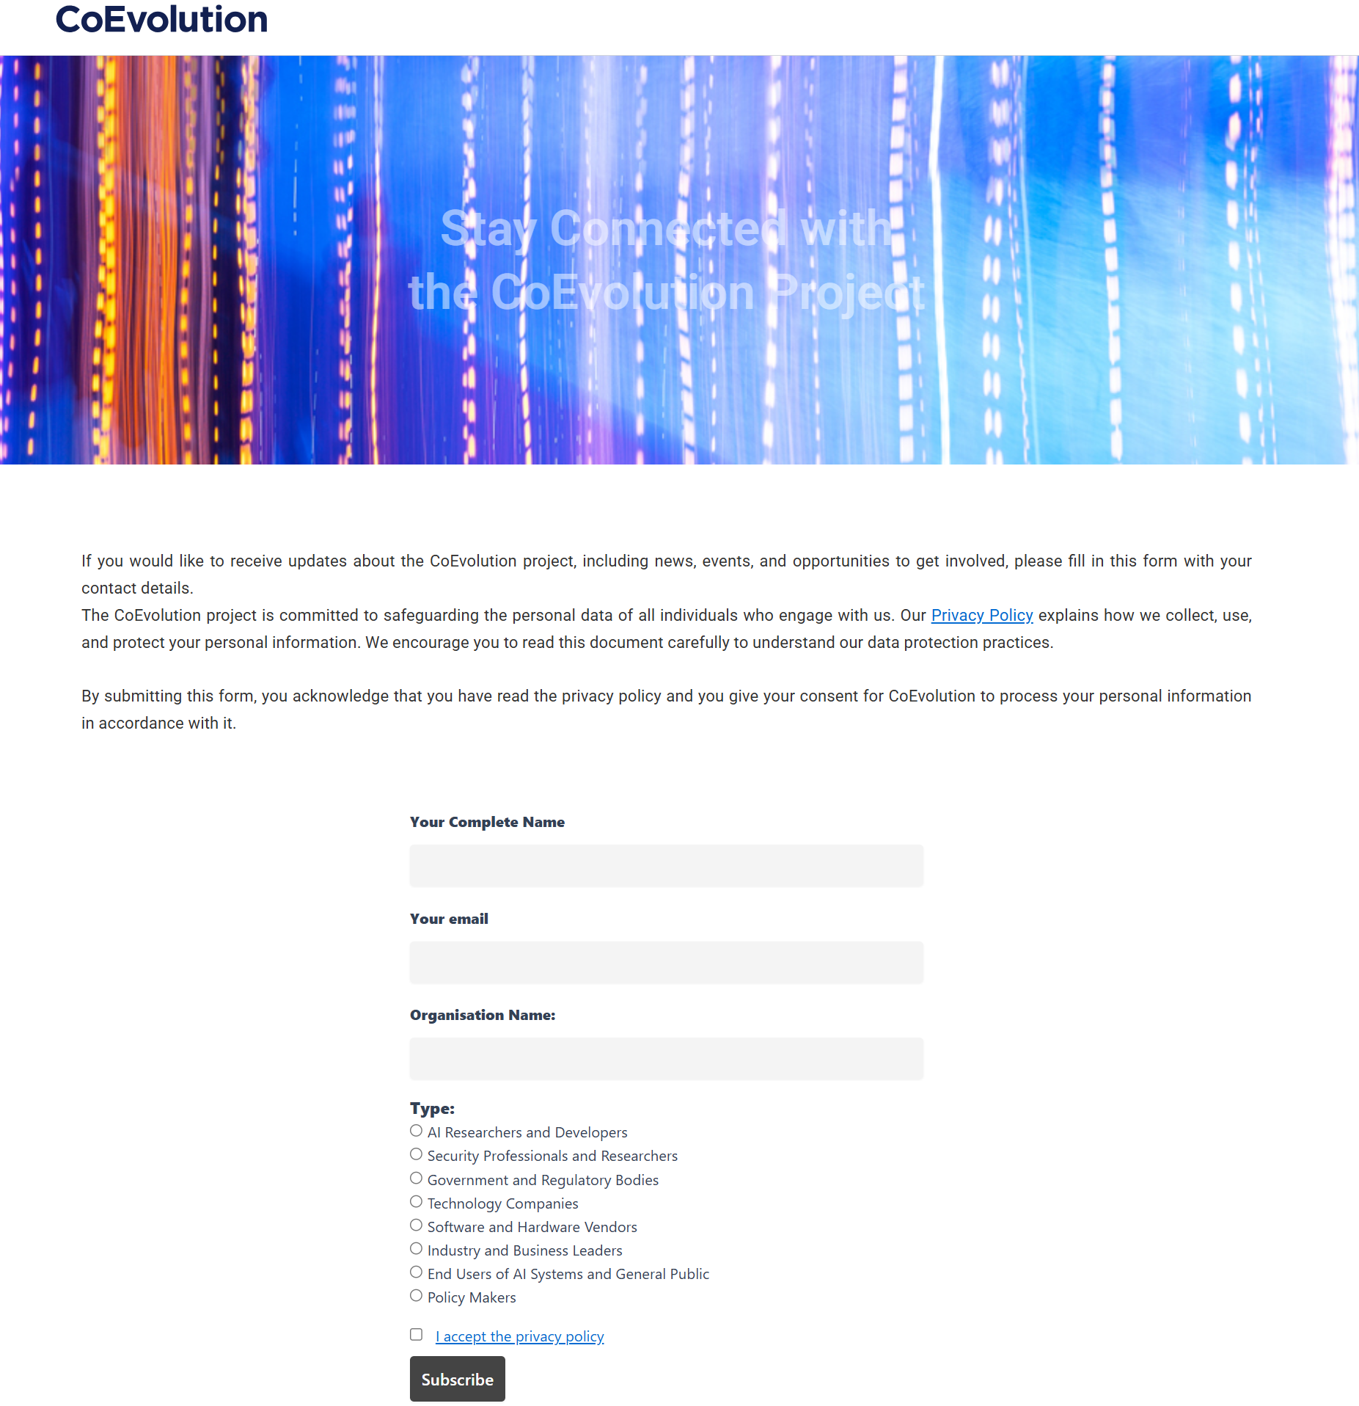
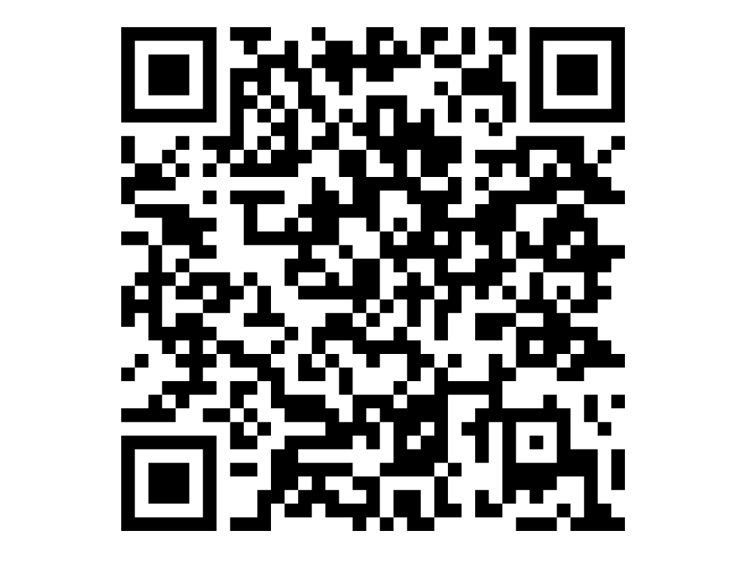
Join CoEvolution Community
https://coevolution-project.eu/stay-connected-with-the-coevolution-project/
KPI 28: >1.000 Total Mailing List Contact Points

Slide 15
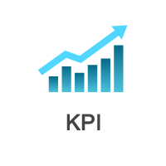
Participation in Events
The CoEvolution project was presented at three key events. These are listed below:
Industrial Panels | Participation | Future-Ready: On-Demand Solutions with AI, Data, and Robotics | KPI 19
Webinars | Participation | Fostering EU Collaboration: CoEvolution Joins CyberSecDome’s Cluster Synergies Webinar | ?
Workshop | Co-Organisation | CyberHOT 2025 | KPI 15
Workshops, webinars, and trainings KPIs (organized) |  | Threshold | M7
KPI 11 | Use Case Workshops | 2 | 0
KPI 12 | Technical Workshops | 2 | 0
KPI 13 | Average number of attendees per workshop | >50 | 0
KPI 14 | Online Training Tutorials | 3 | 0
KPI 15 | Summer schools | 2 | 1
KPI 16 | Webinars | 3 | 0
KPI 17 | Industrial panels | 3 | 0
KPI 18 | Enrolled users | >500 | 0
Showcases KPIs |  | Threshold | M7
KPI 8 | Showcasing events | ≥4 | 0
KPI 9 | Different Countries Involved | ≥4 | 0
KPI 10 | Participants | >400 | 0
Industrial exhibitions, Trade Fairs KPIs |  | Threshold | M7
KPI 19 | Industrial exhibitions targeted | ≥10 | 1
KPI 20 | Roll-up banners | 2 | 0
KPI 21 | Brochures to stakeholders | >1.000 | 0
Public Talks KPIs |  | Threshold | M7
KPI 39 | Public events at universities | ≥6 | 0
KPI 40 | Students per event | >100 | 0
KPI 41 | Open days | ≥6 | 0
KPI 42 | Visitors/open day | >50 | 0
Online Publishing KPIs |  | Threshold | M7
KPI 29 | Press releases | ≥10 | 1
KPI 30 | Events organised by local authorities | ≥3 | 0
KPI 31 | People per event | >50 | 0
Notes:
KPI 20 – Roll up banner presented in Industrial Exhibition?

Slide 16
Overview of Events to Be Organised by M18
Event | Deadline | Responsible Partner
Workshop on technologies for autonomous driving in the context of 2025 IEEE International Smart Cities Conference | M7-M12 | ISI, AVI
FRAME: 5th Workshop on Flexible Resource and Application Management on the Edge | M9 | ICCS
1st Technical Workshop | M10-M12 | ?
1st InfoDay (Webinar) | M12 | AEGIS?
1st Online Training Tutorial | M14-M18 | ?
1st Industrial Panel | M14-M18 | ?

Slide 17
Publications
Conference Paper:
CoEvolution: A comprehensive trustworthy framework for connected machine learning and secure interconnected AI solutions (Not reported on the D&C Tracker file yet)
Scientific Publications KPIs |  | Threshold | M7 Status
KPI 1 | Scientific papers in peer-reviewed Journals | ≥10 | 0
KPI 2 | Presentations in Scientific Conferences | ≥20 | 1 | 0
Technical Publications & White Papers KPIs
KPI 3 | Published Technical articles | ≥10 | 0
KPI 4 | White papers/factsheets | ≥10 | 0
Source Code Repository KPIs
KPI 5 | Public Deliverables | 10 | 1
KPI 6 | Open-source code: Publish to 2 repositories (e.g., GitHub, GitLab) | 2 | 1

Slide 18
Other KPIs
Push results to Communities, fora, alliances, and associations KPIs |  | Threshold | M7 | Responsible
KPI 7 | High-impact communities/associations where to push CoEvolution results | >15 | 0 | ISI?
Standardisation KPIs |  | Threshold | M7 | Responsible
KPI 22 | Number of standardization contributions to different SDOs with adoption status | ≥4 | 0 | CBRL
Links and liaisons KPIs |  | Threshold | M7 | Responsible
KPI 32 | Number of DIH and clusters to contribute | 10 | 0 | ISI
KPI 33 | Liaisons with other relevant projects | ≥5 | 0

Slide 19
Short Term Plan
Updating the website
Create social media posts
Track all Partners activities via the D&C tracker
Prepare the plan for the Interviews (KPI >6)
Start the Blog Article Series (ICCS, UNICA,ISI)
Start writing White papers/factsheets (ISI)

