Slide 1

UNIVERSITY OF ULM
Presentation
Bachelor Thesis
Investigating the Impact of an Intervention
that Increases Users’ Awareness of Phubbing
by Ronja Lehle
Media Informatics| 2024

Slide 2

Introduction
1
Phubbing (v) The act of snubbing someone in a social setting by looking at your phone instead of paying attention.
[McCann, 2013]
→ Phubbing in 62 out of 100 observed 10-minute face-to-face conversations
[Vanden Abeele et al., 2019]

Slide 3
Negative Effects of Phubbing
→ Perceived as Disrespect and Desinterest
→ Feeling of Social Exclusion and Abadonment [Klein, 2014]
→ Reduction in the Relationship Quality
([Pancani et al., 2020], [Lutz & Knop, 2020], [David & Roberts, 2021])
01
Introduction
Phubbing is an unconscious Behavior (mostly)
→ Even in Opposition to own Expectations
[Aagaard, 2020]
02
03
No Methods to counteract Phubbing yet

Slide 4
Make unconscious behavior conscious
→ Use Intervention in the Moment of Phubbing
[Prochaska et al., 1982]
Research Question
Investigating the Impact of an Intervention
that Increases Users’ Awareness of Phubbing

Slide 5
01
Duration of 2 Weeks
Two conditions, each 1 Week
→ Control Mode without Intervention
→ Treatment Mode with Intervention
02
User Study
03
Counterbalanced, Within-Subject Field Study

Slide 6
04
Participation in Groups of Two
→ See each other at least twice a Week
20 Participants
→ 10 female, 10 male
→ Age between 21-56 Years
(mean = 31.45, SD = 8.99)
05
User Study
06
App that displays an Intervention
when Smartphone is used during a Social Interaction

Slide 7
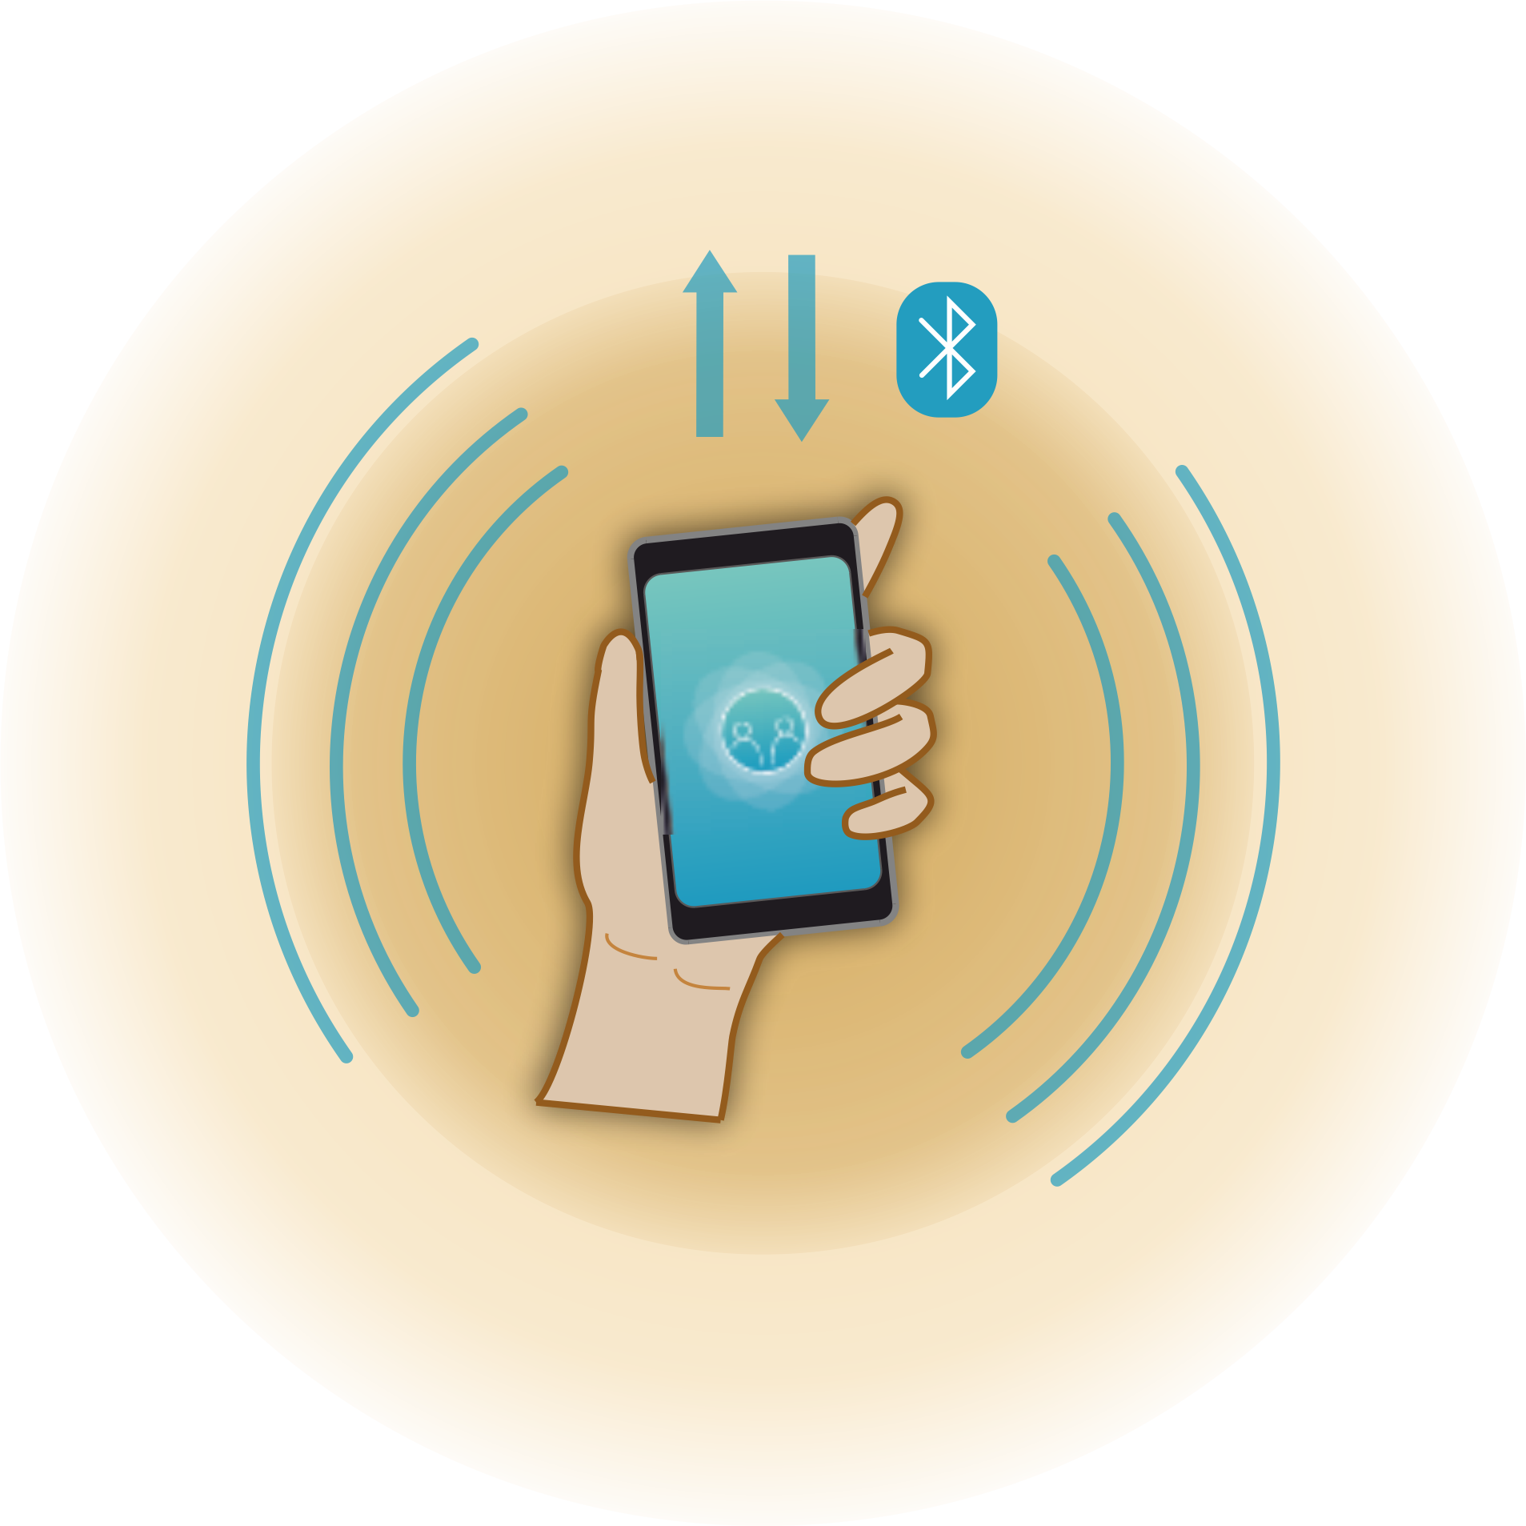
How it Works
→ App-Service runs in the background
→ Sends Beacon via BLE
→ Scans for Beacons within a radius of 3.6 m (social distance)
[Hall, 1966]

Slide 8
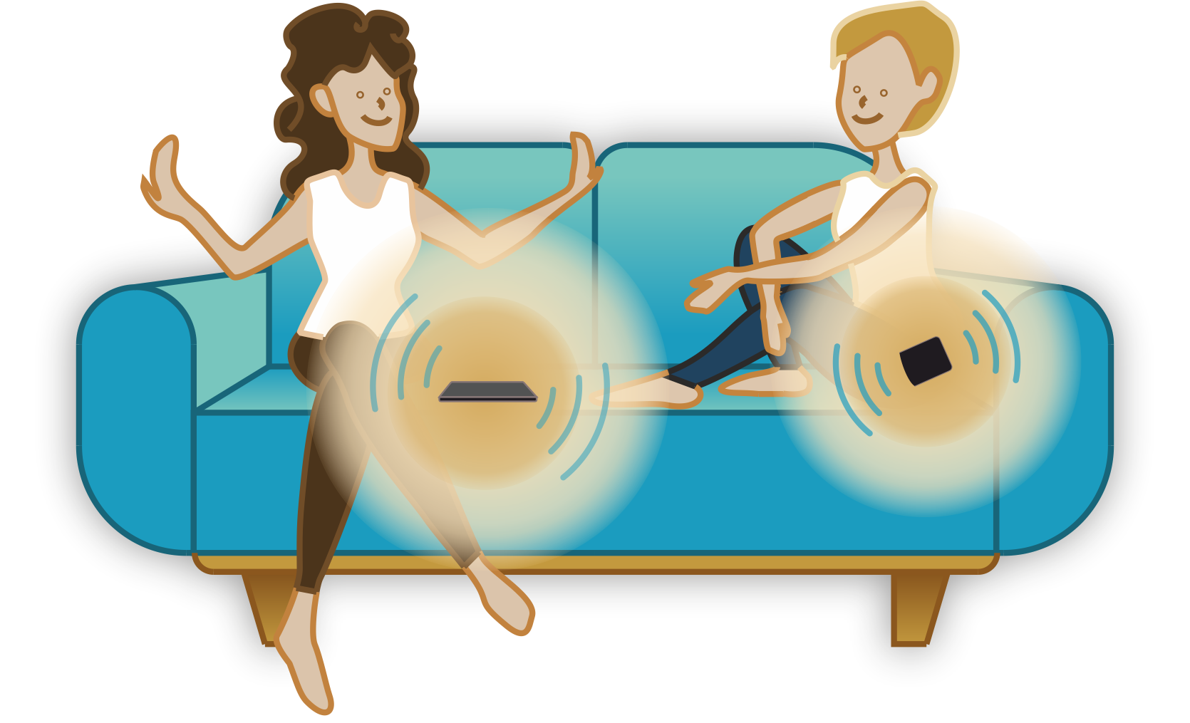
→ Detects other Beacon and registers a social interaction

Slide 9
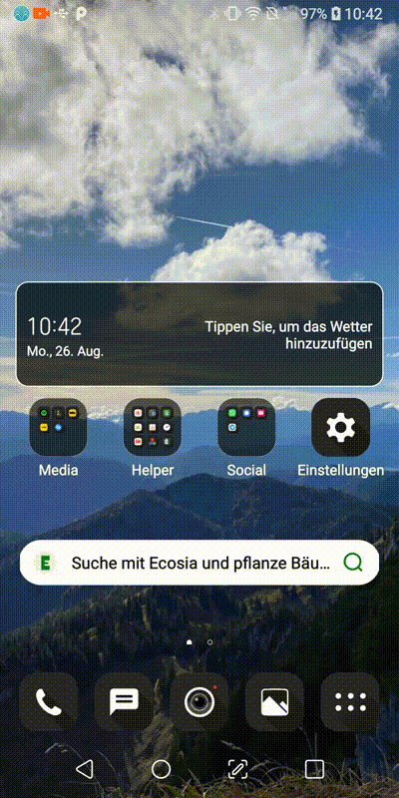
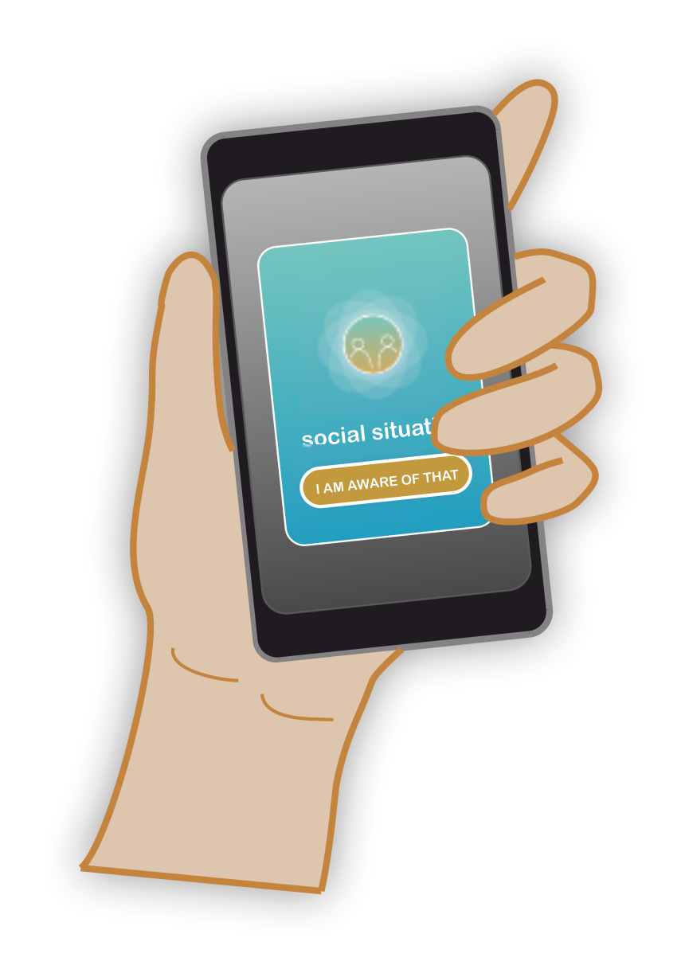
Intervention
→ Displays intervention if unlock screen while social interaction
→ Intervention closeable after 3 seconds

Slide 10
01
Mixed-Method Data Collection
Quantitative Data
→ Questionnaires after each Social Interaction
(RSHCI [Ehrenbrink et al., 2018], PCI and PDSO [Vanden Abeele et al., 2019],
PS and SAS [Karadag et al., 2015], PISO [Aron et al., 1992])
→ Durations of Smartphone Use and Social Interactions
02
Data Collection
03
Qualitative Data
→ Interviews of 10 Minutes with each Participant

Slide 11
01
Quantitative Data
→ Descriptive Statistic
02
Qualitative Data
→ Reflexive Inductive Thematic Analysis
Data Analysis

Slide 12
NECESSITY OF THE INTERVENTIONS
EFFECTS OF THE INTERVENTIONS
Results
FUTURE WORK

Slide 13
Experiences of Participants confirm Related Work
→ The Problem of Phubbing actually exists
→ Phubbing mainly by Friends, Relationship Partners, Family
01
Necessity
for the Interventions
“I think if people don't phub but talk to you and try to interact, then you automatically get to know each other better. But if someone is always on their smartphone, you have a barrier that blocks that.”
[Participant 7B]
02
The phubbed Person shouldn’t have to ask not to be phubbed
→ Phubbers should change their behavior

Slide 14
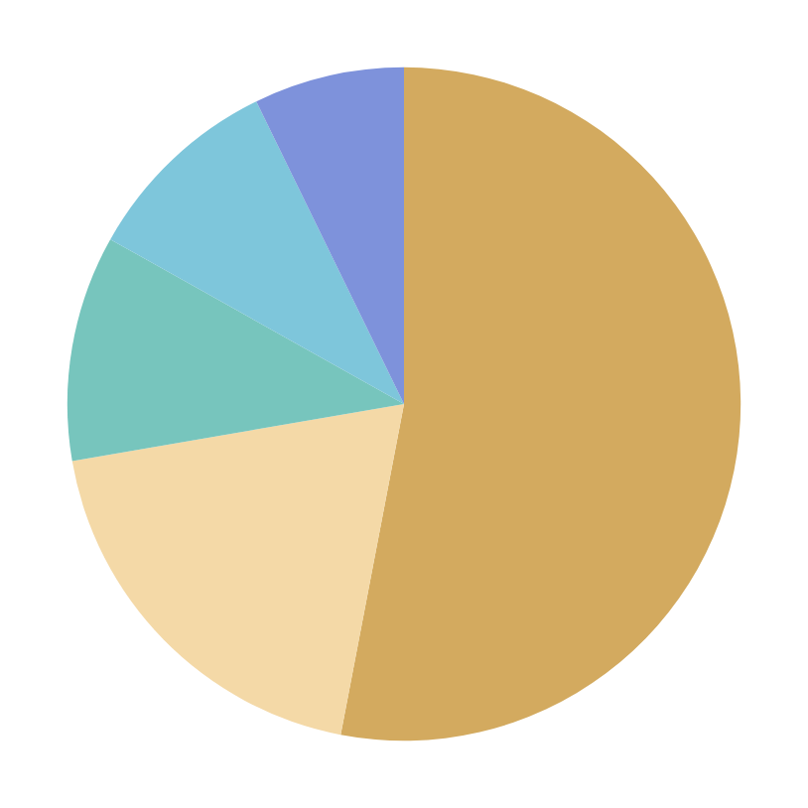

Types of the Social Interactions or Activities while Using Phone
7.2 %
9.6 %
eating or drinking coffee together
chilling together
10.9 %
53 %
talking to each other
doing activities together
(cooking, shopping, etc.)
19.3 %
working or studying together

Slide 15
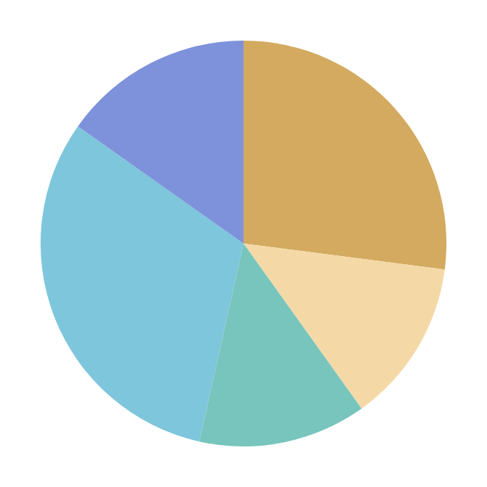
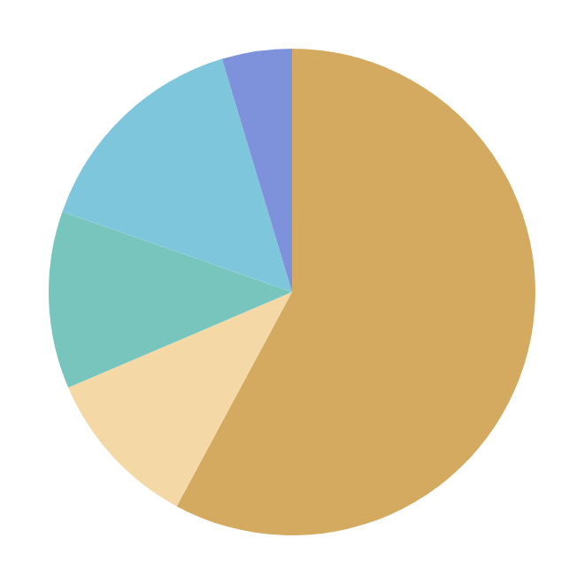
Percentage Duration of Phone Uses While Social Interactions
without Intervention
with Intervention
total unlocks: 329
total unlocks: 280
4.6 %
15.2 %
27 %
15 %
0-15 sec
11.8 %
57.9 %
31.3 %
13.1 %
0-15 sec
10.7 %
13.1 %
0-15 sec
15-30 sec
30-60 sec
1-5 min
>5 min

Slide 16
01
Reduction of Phubbing Behavior
Effects
of the Interventions
02
Better Awareness of Own Phubbing Behavior
“I noticed during the study that I sometimes just take my phone out. And when I saw this message, I thought about why I had taken it out. If what I was about to do was really necessary to do now (in social interaction). It's such an additional barrier and you use it more consciously because of that.”
[Participant 7B]

Slide 17
01
Individually Customizable Interventions
02
Future Work
Phubbing depends on Context of the Conversation
→ Optimization of the Phubbing Detection

Slide 18
Conclusion
Study results show that...
→ the Interventions increase Awareness of Phubbing behavior
→ the Interventions reduce frequency of Phubbing moments
→ Measures against Phubbing are necessary
I think that Phubbing can be effectively reduced through individually adaptable, context-dependent interventions.

Slide 19
UNIVERSITY OF ULM
THANK YOU
Presented by Ronja Lehle
Media Informatics | 2024

