Slide 1

Academic Result
Study and research on student

Slide 2

Table of content
Introduction
Problem Statement
Data Cleaning
Machine Learning Models
Machine Learning Performance
Machine Learning Evaluation
Source/Appendix
Q&A

Slide 3


Introduction:
I am a counselor, looking to help student on their academic score based on the data/information.
The topic will be on student on their academic results in Spain.
The goal is to look into the different demographics on students, based on academic behavior, family background, social and other relevant factors.

Slide 4
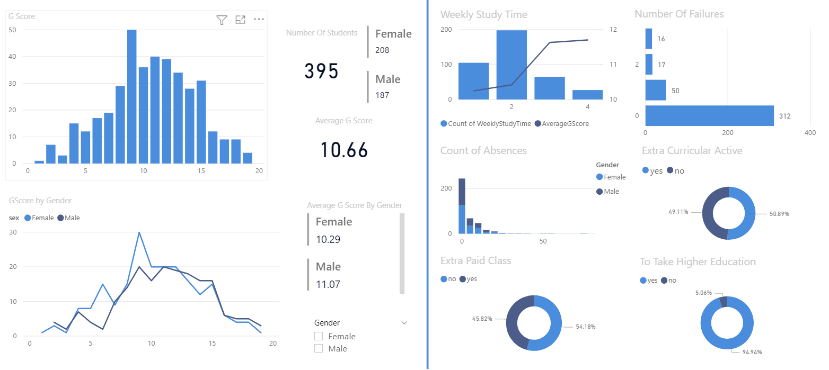
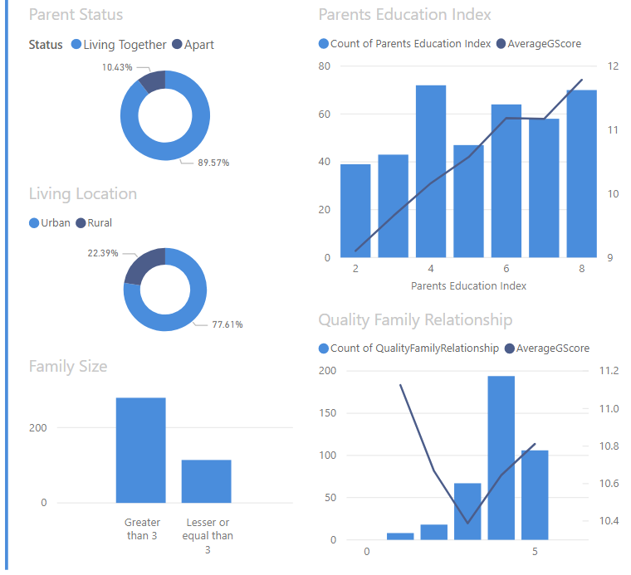
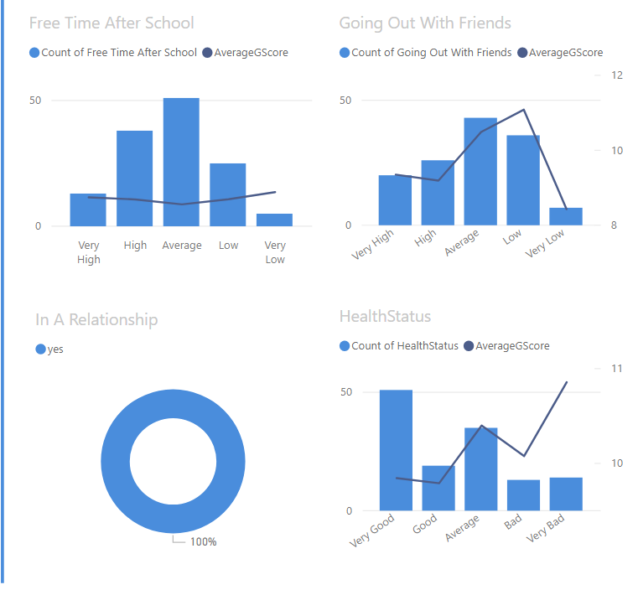
Problem statement: - able to predict their score based on the information/data we have. - we want to know which area are important for prediction
In the previous project, we have dashboards which were built and grouped into different groups on academic, family background and social segments.
We want to know how to determine the score of student based on their behaviors, background and activities, using ML.

Slide 5
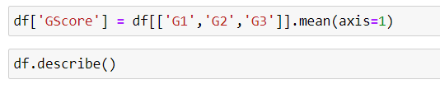
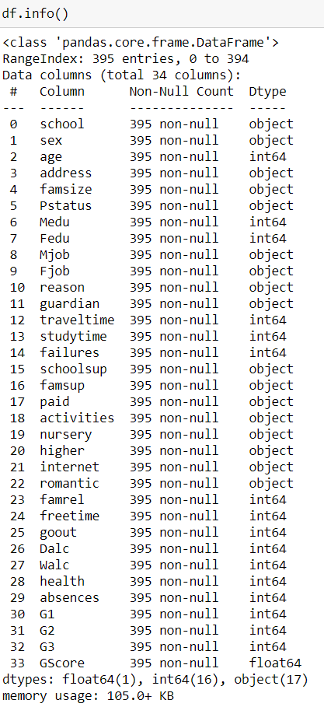
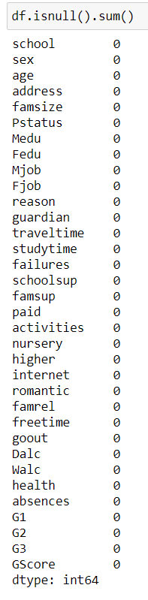
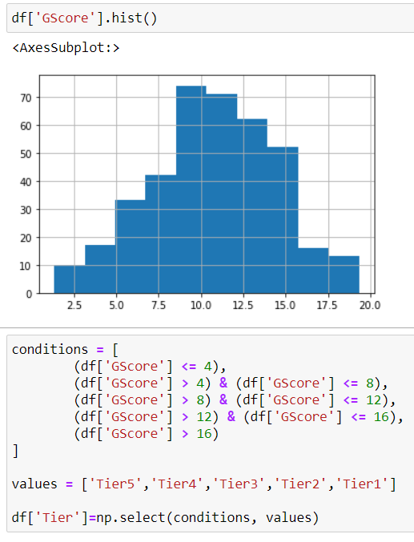
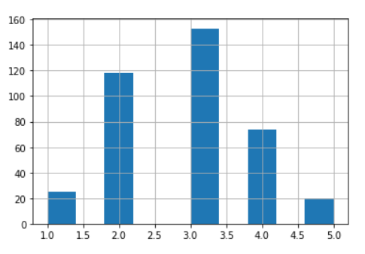
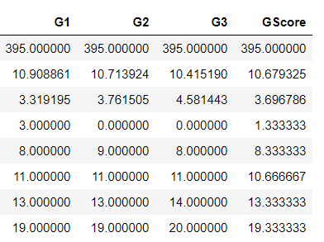
Data Cleaning
- Feature Engineering
(adding new columns on averaging out G Score and new ‘Tier’)
- Check on null value and invalid data.
‘Tier’ will be the category which I want to be able to predict. (Classification issue)

Slide 6
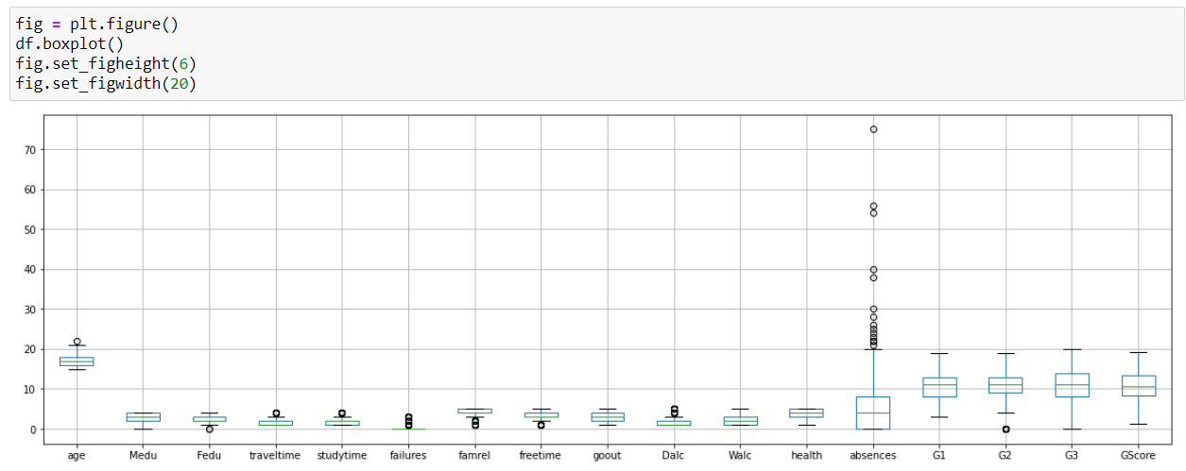
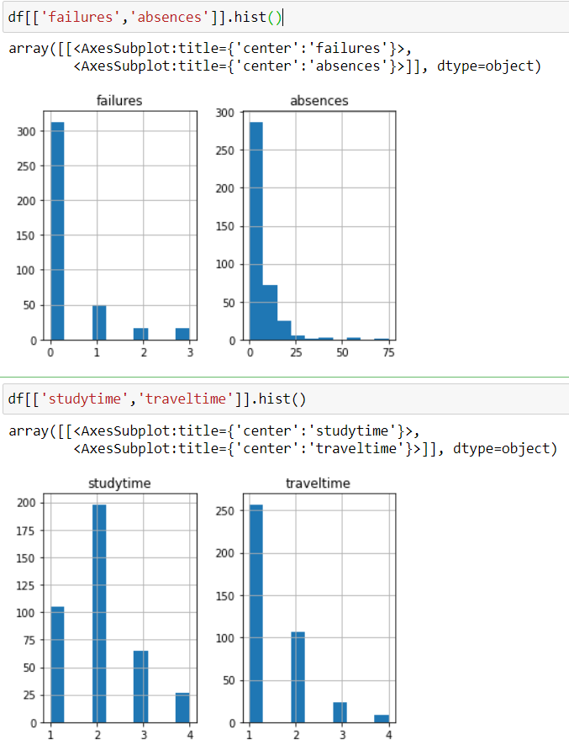
Data Cleaning
Checking and decision on removing outlier
Using the box plot on data frame as a reference to detect outlier.
Plotting histograms on affected columns, and made decision to remove outlier on ‘absences’ column.

Slide 7
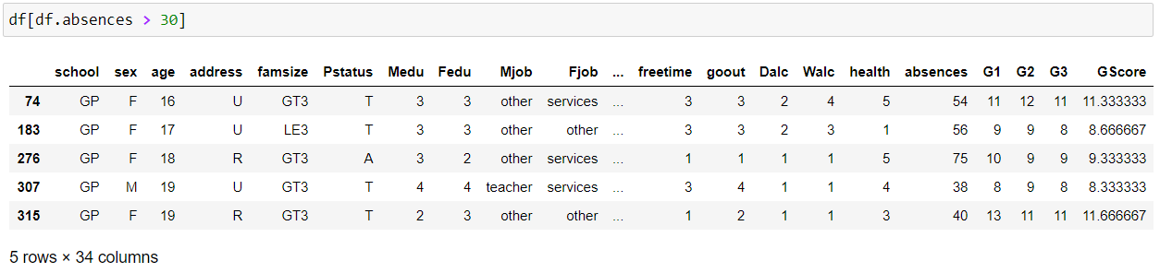
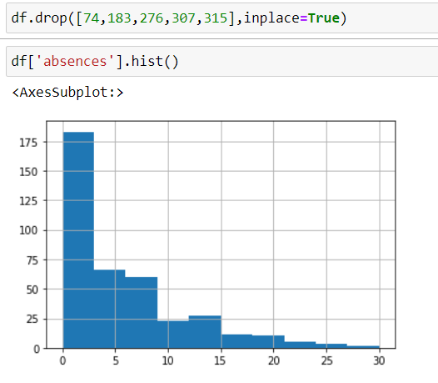
Data Cleaning
Checking and decision on removing outlier
Removing outlier using the row indexes.
Outlier on feature ‘absences’ is removed.

Slide 8
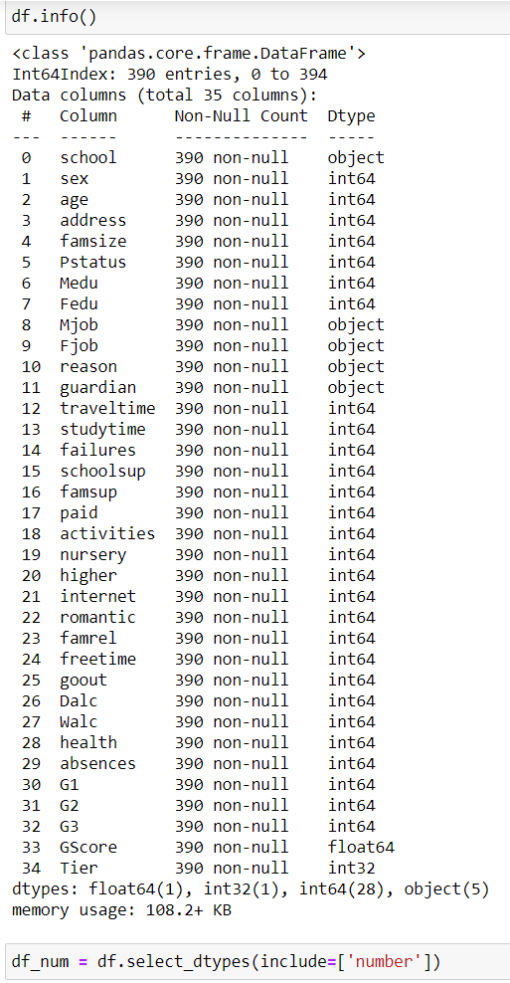
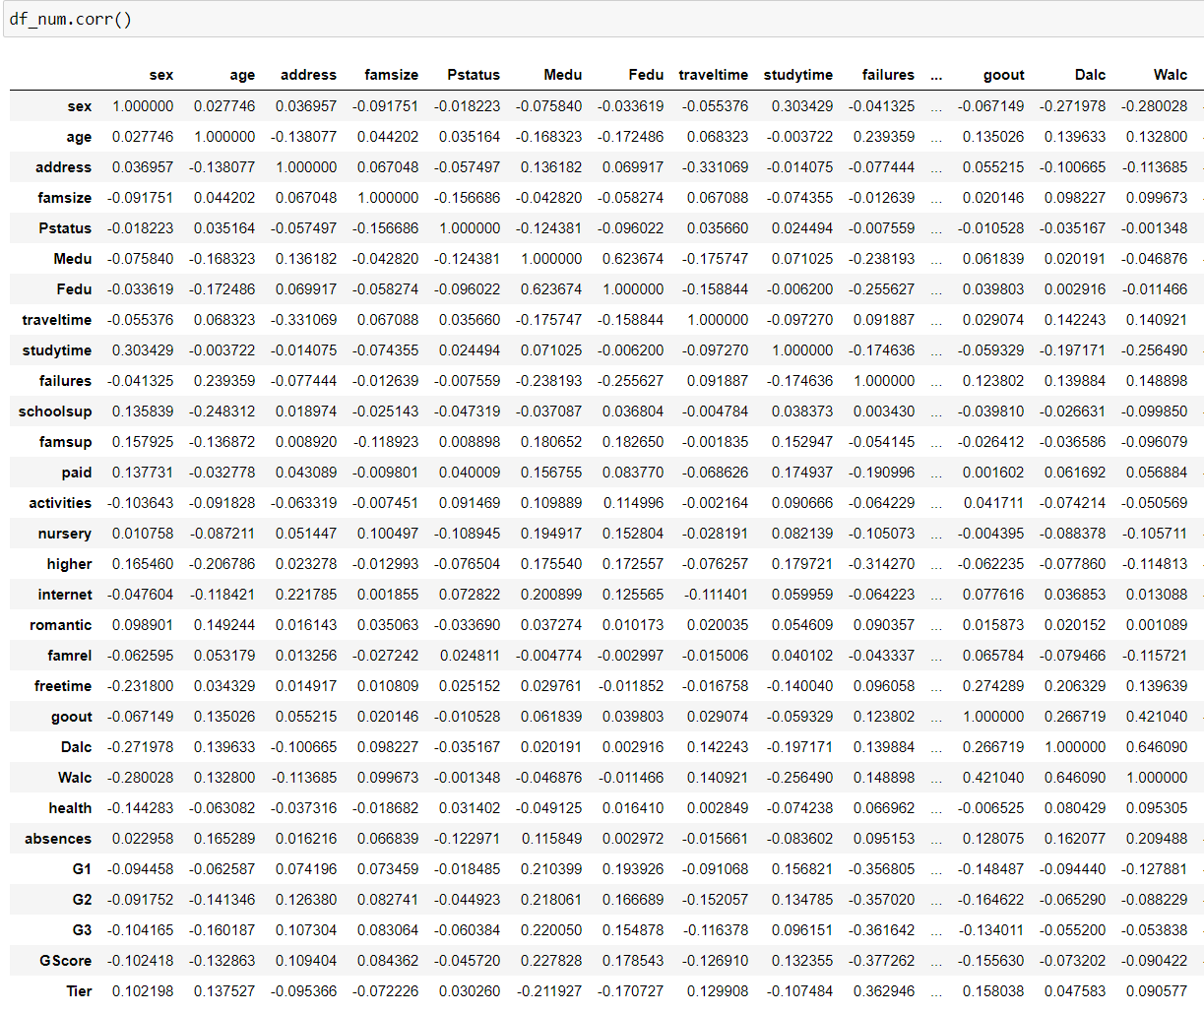
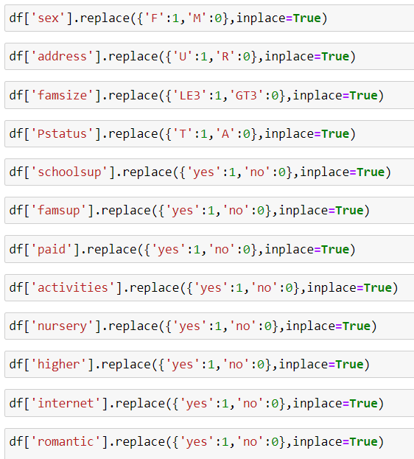
Data Cleaning
Correlation features
Replacing numerical values on features
Execution on correlation after cleaning

Slide 9
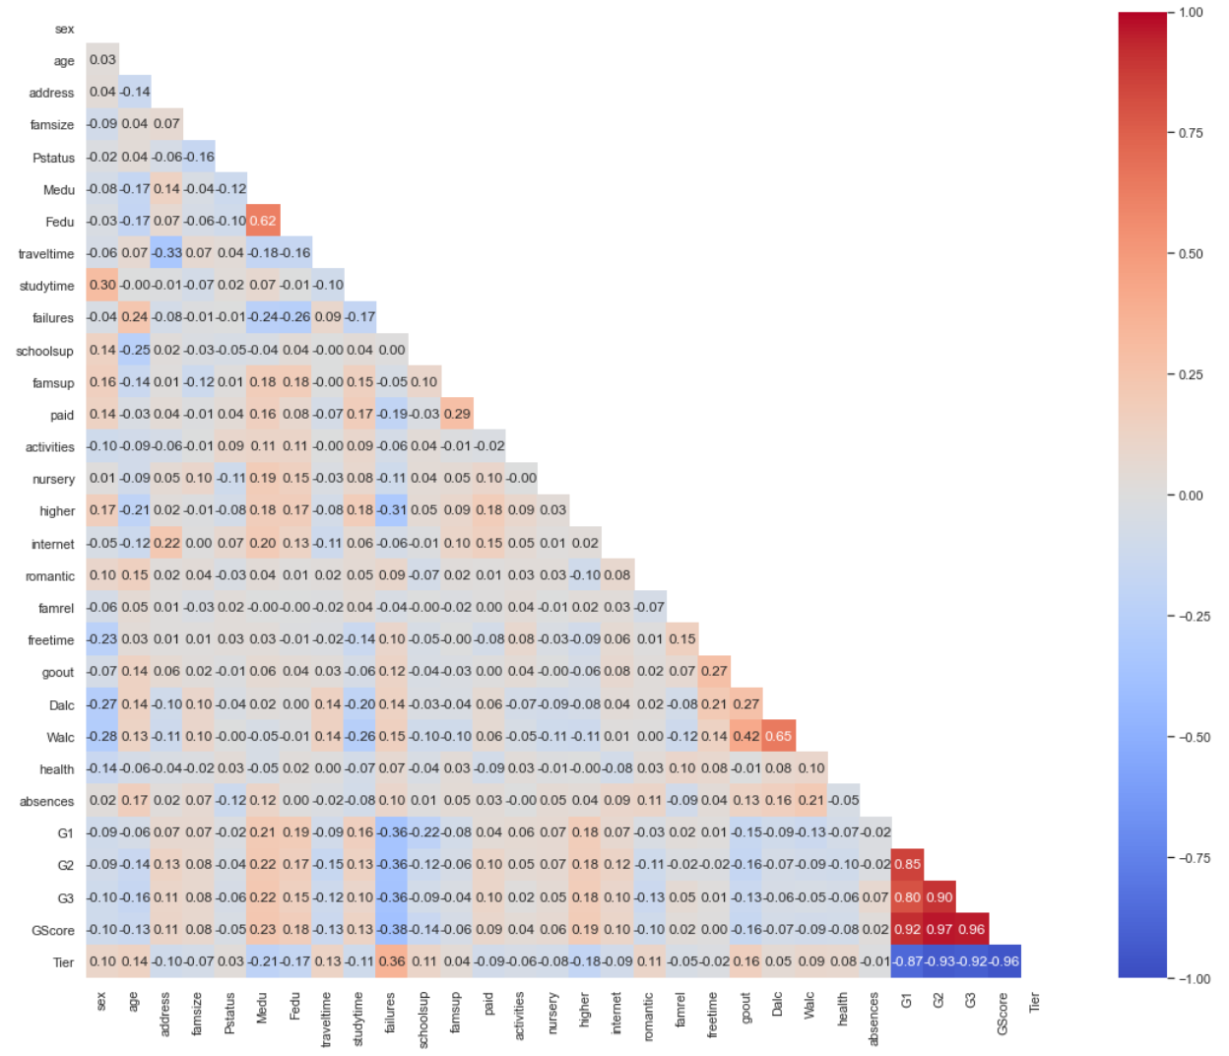

Data Cleaning
- Checking and decision on correlation features
Combining feature on ‘Fedu’ and ‘Medu’, both are education level of father and mother of student.
Will not be including ‘Failure’, ‘address’ and ‘Dalc’ fearure in our MLD. ‘Walc’ is identical to ‘Dalc’, ‘Failure’ is correlated with ‘Tier’, ‘address’ is correlated with ‘traveltime’.
Only be using ‘Tier’ feature to represent scores

Slide 10
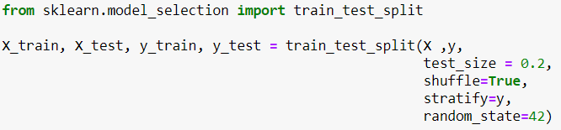
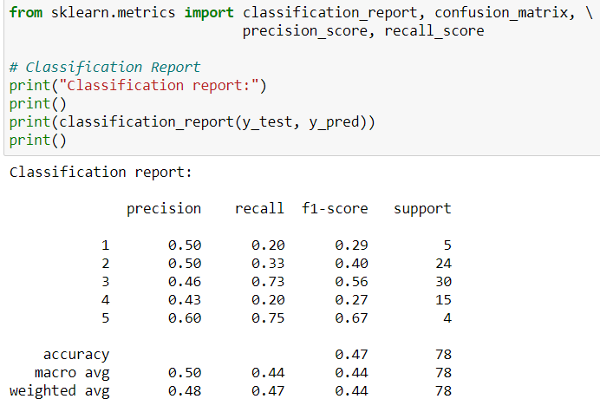
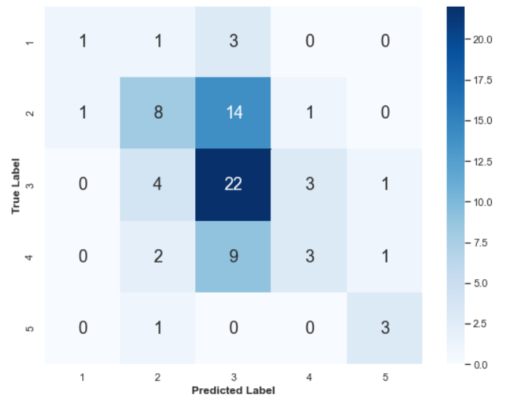
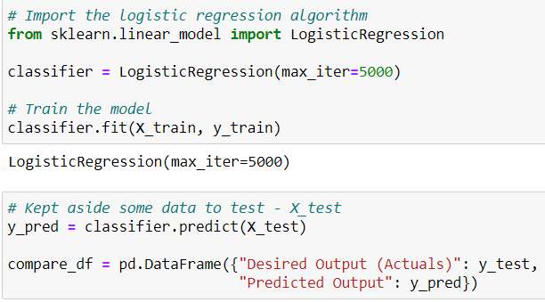
Machine learning models
Logistic Regression (baseline)
Observations
Overall average performance on prediction at 47% accuracy.
Only the prediction on Tier 3 and 5 has shown some good level of accuracy.
* Will be introducing MLP and Random Forest model to compare results.

Slide 11
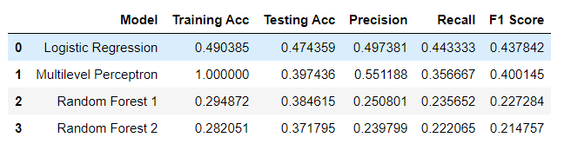
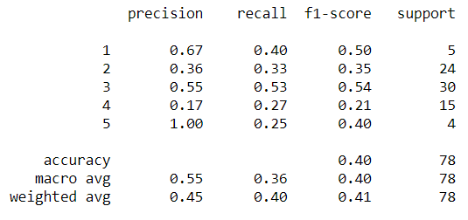
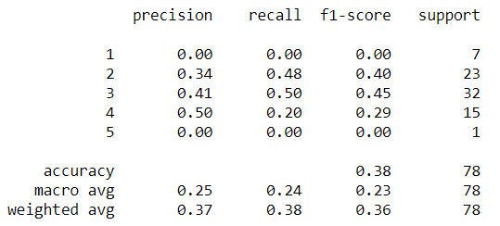
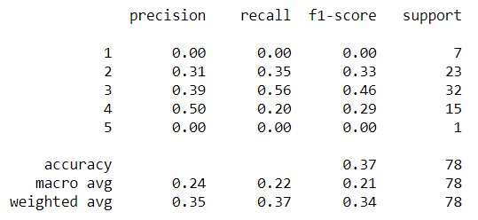
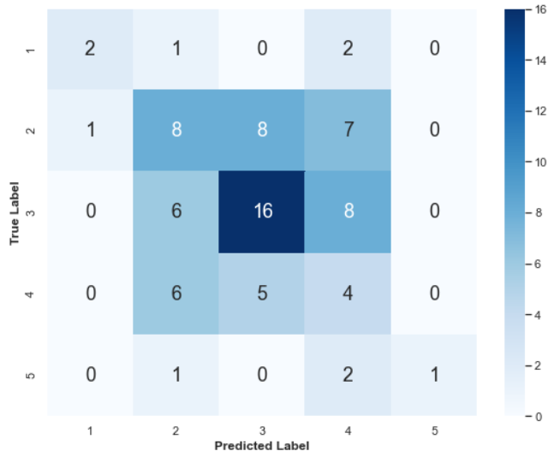
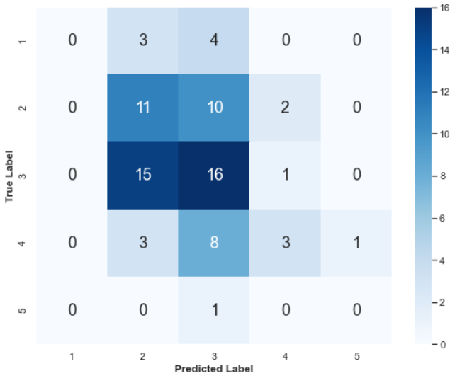
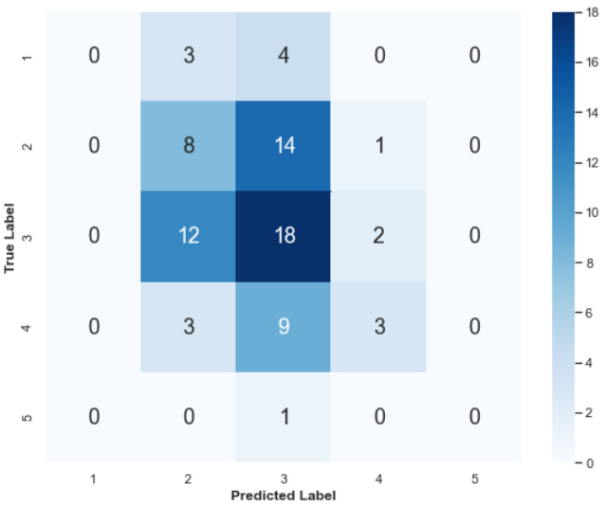
Machine learning models
MLP
Random Forest
Random Forest (GridSearchCV)
Observations
Overall 3 models has lower accuracy than logistic regression (47%)
All 3 models shows better prediction on classification on Tier 3.
* Will be introducing Select Best K to narrow the features, to see if accuracy can be improve.
*Random Forest 2 is using GridSearchCV

Slide 12
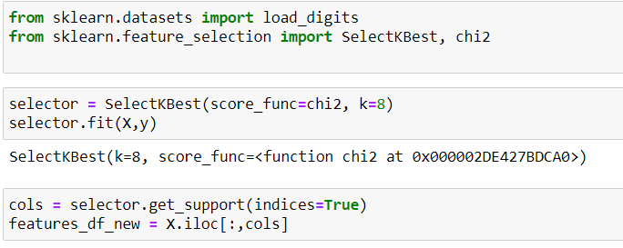
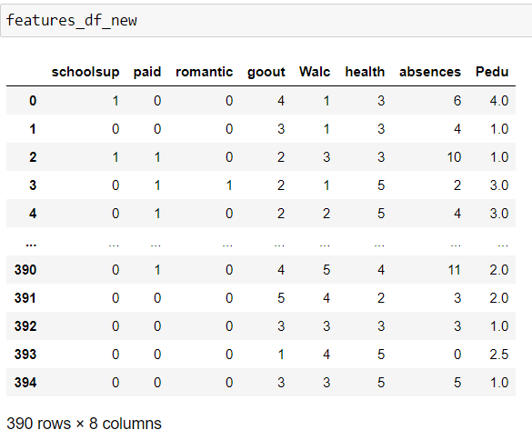
Machine learning models
Using SelectionKBest to narrow down the best features
Selection on best 8 features
schoolsup - extra educational support (binary: yes is 1 or no is 0)
paid - extra paid classes within the course subject (binary: yes is 1 or no is 0)
romantic - with a romantic relationship (binary: yes is 1 or no is 0)
goout - going out with friends (numeric: from 1 - very low to 5 - very high)
Walc - weekend alcohol consumption (numeric: from 1 - very low to 5 - very high)
health - current health status (numeric: from 1 - very bad to 5 - very good)
absences - number of school absences (numeric: from 0 to 93)
Pedu - average of parent education level (numeric: from 0 to 5)

Slide 13
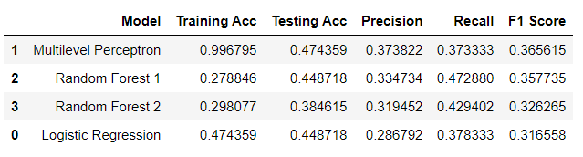
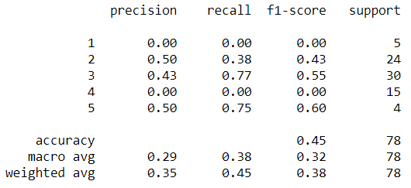
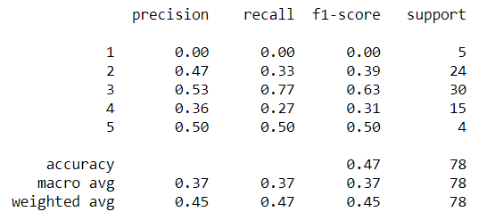
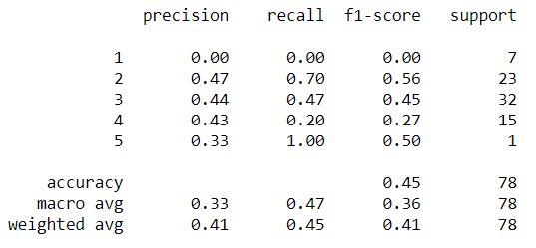
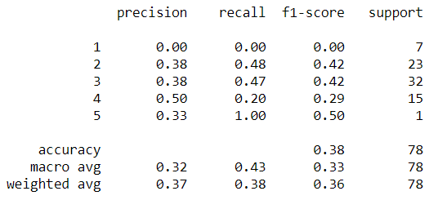
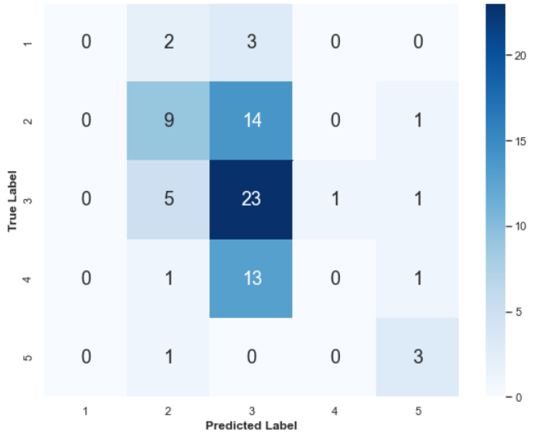
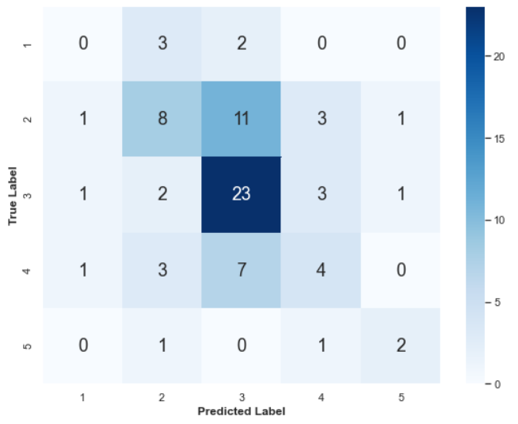
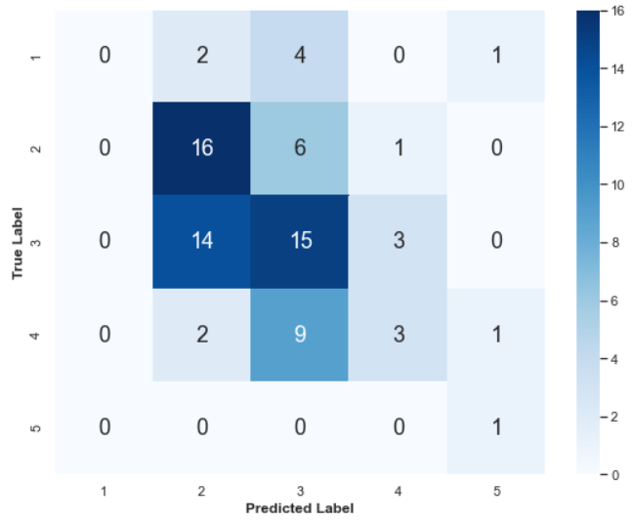
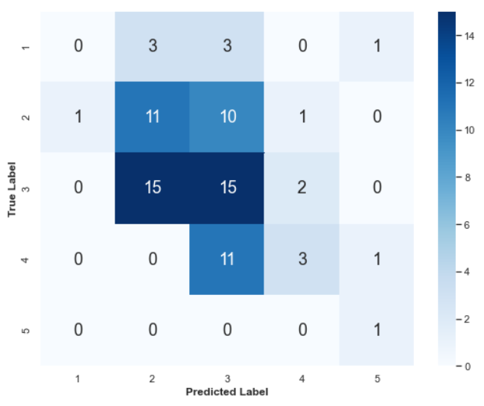
Machine learning Performance
*After using the SelectionKBest best 8 features
Observations
Overall 3 models perform better using less features.
Logistic Regression model accuracy has drop slightly.
Logistic Regression
MLP
Random Forest
Random Forest (GridSearchCV)
*Random Forest 2 is using GridSearchCV

Slide 14
Machine learning evaluation
Using the original features
Observations after using SelectionKBest and other models
Overall 3 models perform better after using less features.
Logistic Regression model accuracy has drop slightly after using less features.
After using multiple machine learning model, it is likely that the nature of the data and features we have, are unable to provide high accuracy on predicting ‘Tier’.
Conclusion on selection on models
Will be using MLP (after feature reduction using Kbest)
Higher accuracy overall
Uses less features (easier to implement)
*Moving forward, I can try using multiple regression to test on the selected KBest features on their coefficient.
After using the SelectionKBest best 8 features
*Random Forest 2 is using GridSearchCV

Slide 15






Source/Appendix:
https://data.world/data-society/student-alcohol-consumption

Slide 16



