Slide 1

Rotation Of Image Around Any Point
Rotation Of Image Around Any Point
With Affine Transformation
STEPS:
1. Choosing the rotation center
2. Translate Rotation Center to Origin
3. Apply Rotation Matrix
4. Translate Origin Back to Original Center
Subhadeep Bhadra
Date: 28 May 2024

Slide 2
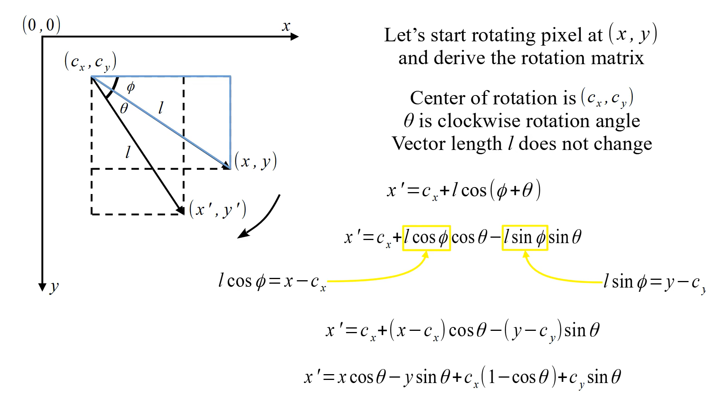
Rotation Of Image Around Any Point

Slide 3
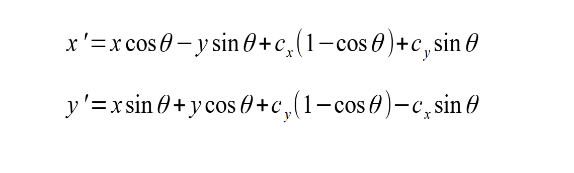
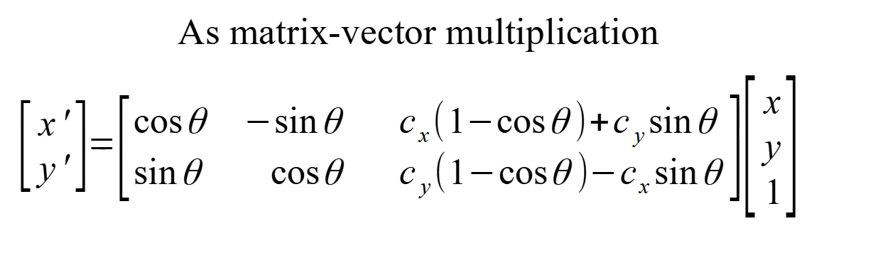
Rotation Of Image Around Any Point

Slide 4
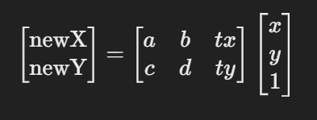
Affine Transformation With User defined Function
Translation
The calculation of the translation values tx and ty is essential for centering the rotated image within its dimensions.
float tx = cx - (cx * static_cast<float>(cos(radians)) - cy * static_cast<float>(sin(radians))) ;
cx and cy are the coordinates of the center of the original image.
cosTheta and sinTheta are the cosine and sine of the rotation angle in radians, respectively.
The expressions calculate the new coordinates of the center after rotation.
Affine-transformation matrix
Defining the transformation matrix and using the translated values i.e tx and ty.
matrix = {cosTheta, -sinTheta, tx},
{sinTheta, cosTheta, ty}
Getting the new value of x and y
Expr newX = matrix[0][0] * cast<float>(x) + matrix[0][1] * cast<float>(y) + matrix[0][2];
Expr newY = matrix[1][0] * cast<float>(x) + matrix[1][1] * cast<float>(y) + matrix[1][2];

Slide 5
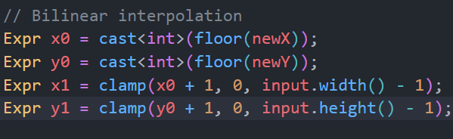
Affine Transformation With User defined Function
Bilinear Interpolation
clamp(value, min, max): This function ensures
that the resulting coordinates are within the
valid range of the image dimensions.
Used clamp function in x0 and y0.
Used the input function to get the pixels values, it took 3 arguments x, y and the channel index.And clamped it.
input(x0, y0, c): Top-left corner of the grid cell.
input(x1, y0, c): Top-right corner of the grid cell.
input(x0, y1, c): Bottom-left corner of the grid cell.
input(x1, y1, c): Bottom-right corner of the grid cell.
Lastly used the select () to black the out of bounded part.

Slide 6
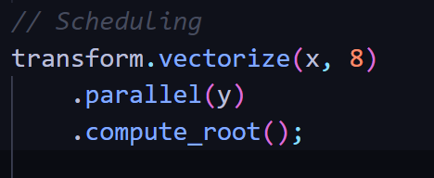
Scheduling Optimisation Technique
Optimisation Of The Affine Transformation
Using Vectorize function in the code. This directive tells Halide toprocess 8 pixels at a time along the x dimension. This can significantly speed up the computation by making use of the vector registers in the CPU.
Using Parallel function in the code.This parallelizes the computation along the y dimension. Each row of pixels can be processed in parallel and can be executed concurrently.
Using Compute_root computes the entire function at the root level, ensuring efficient use of memory and avoiding redundant and un-necessary computations.

Slide 7
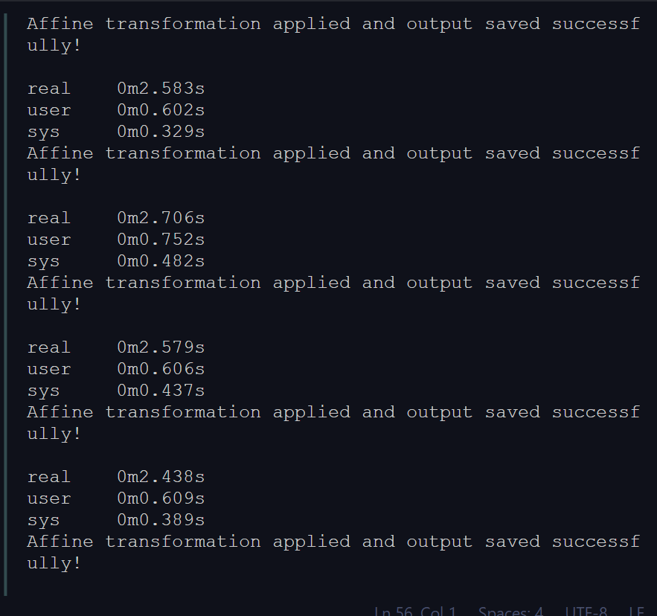
Time Consumption :-
Optimisation Of The Affine Transformation
Description | Size | Type | In-Built wrapAffine Function(sec) | Used Scheduling Technique(sec) | Without Scheduling Technique(sec)
Tree | 258 x 256 | Color | 0.593 | 1.718 | 2.763
House | 257 x 256 | Color | 0.527 | 1.814 | 2.808
Girl | 512 x 512 | Color | 0.554 | 1.919 | 2.790
Sailboat | 512 x 512 | Color | 0.590 | 1.891 | 2.159
Avg time of Optimised Code is approx 1.8355 sec
Avg time of inbuilt function is approx 0.566 sec
Avg time of without optimisation is approx 2.63 sec
First five iterations result of pictureTree

Slide 8
Algorithm: Affine Image Transformation Using Bilinear Interpolation
Initialization
Extract dimensions width, height, and channels from the input buffer.
Find the new height and width of the rotated image.
Declare Halide variables x, y, and c to represent the pixel coordinates and channel index.
Declare a Halide function transform to represent the transformation.
Affine Transformation Calculation
Formation of the affine transformation matrix and compute the transformed coordinates newX and newY using the affine transformation matrix:
Expr newX = matrix[0][0] * cast<float>(x) + matrix[0][1] * cast<float>(y) + matrix[0][2];
Expr newY = matrix[1][0] * cast<float>(x) + matrix[1][1] * cast<float>(y) + matrix[1][2];
Bilinear Interpolation Setup
Compute the integer coordinates surrounding the transformed coordinates using:
X0=cast<int>(floor(newX))
y0=cast<int>(floor(newY))

Slide 9
Algorithm: Affine Image Transformation Using Bilinear Interpolation
Bilinear Interpolation Calculation:
Compute the bilinearly interpolated pixel value using the surrounding pixel values and the weights:
value = (1 - a) * (1 - b) * input(clamp(x0, 0, input.width() - 1), clamp(y0, 0, input.height() - 1), c) +
a * (1 - b) * input(clamp(x1, 0, input.width() - 1), clamp(y0, 0, input.height() - 1), c) +
(1 - a) * b * input(clamp(x0, 0, input.width() - 1), clamp(y1, 0, input.height() - 1), c) +
a * b * input(clamp(x1, 0, input.width() - 1), clamp(y1, 0, input.height() - 1), c);
Boundary Handling:
Set the pixel to black if the transformed coordinates are out of bounds and the rest pixel will be remain same using:
transform(x, y, c) = select( newX >= 0 && newX < input.width() && newY >= 0 && newY < input.height(), cast<uint8_t>(clamp(value, 0.0f, 255.0f)),cast<uint8_t>(0);
Using Scheduling Techniques
.vectorize(x, 8) : This line applies vectorization. Vectorization leverages the capabilities of modern processors that can perform the same operation on multiple pieces of data simultaneously.
.parallel(y) : This line applies parallelization. Parallelization utilizes multiple cores or processors available in your computer to execute different parts of the computation concurrently.
.compute_root() : This likely refers to the concept of a computation to reduce un-necessary computation.

Slide 10
Affine Transformation With User defined Function
Realize Output:
Initialize the output buffer with the same dimensions and channels as the input:
excute the transformation and store the result in the output buffer made with the newHeight and
newWidth.
transform.realize(output).
References:
1. https://halide-lang.org/
2. Image source link : https://web.archive.org/web/20110526212755/http://sipi.usc.edu/database/database.php?volume=misc
2. Halide: A Language and Compiler for Optimizing Parallelism
3. Introduction to algorithms, by Cormen

Slide 11
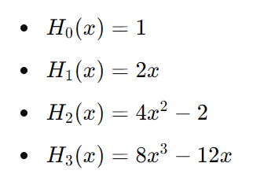
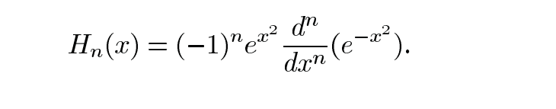

Define Hermite Polynomials
Image rotation with Hermite Expansion
Rodrigues' formula:
This is the "Hermite polynomials" where n >= 0 and some of the hermite polynomial for n=0 , n=1, n=2 and n=3 so on...
Recurrance Relation is given by.

Slide 12

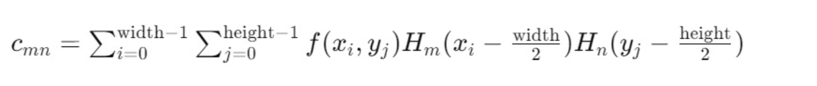
Discretize the Image
Image rotation with Hermite Expansion
Here the image is represented as a function 𝑓(𝑥,𝑦) defined on a grid. This can be expanded as a series of Hermite polynomials, where cmn is the expansion function:
Finding the expansion coefficients with this formula
The Hermite expansion coefficients are computed by summing over the product of the image pixel values and the Hermite polynomial values.

Slide 13

Rotate Image
Image rotation with Hermite Expansion
Define the Rotation Transformation
Apply the Transformation to the Hermite Polynomials
Transform the Hermite polynomial expansion to the rotated coordinates (𝑥′,𝑦′) (x′,y′):
Reference:
Accurate Image Rotation Using Hermite Expansions Wooram Park, Student Member, IEEE, Gregory Leibon, Daniel N. Rockmore, and Gregory S. Chirikjian, Senior Member, IEEE

Slide 14
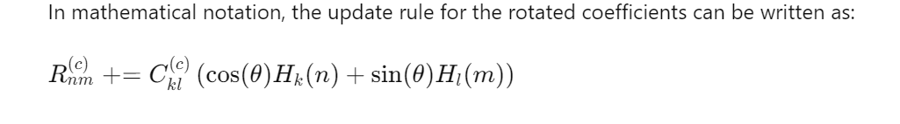
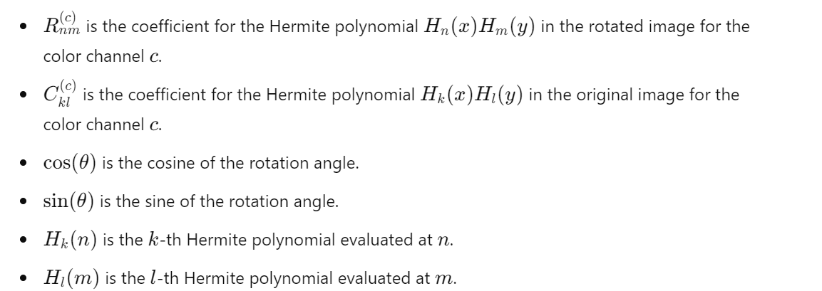

Slide 15
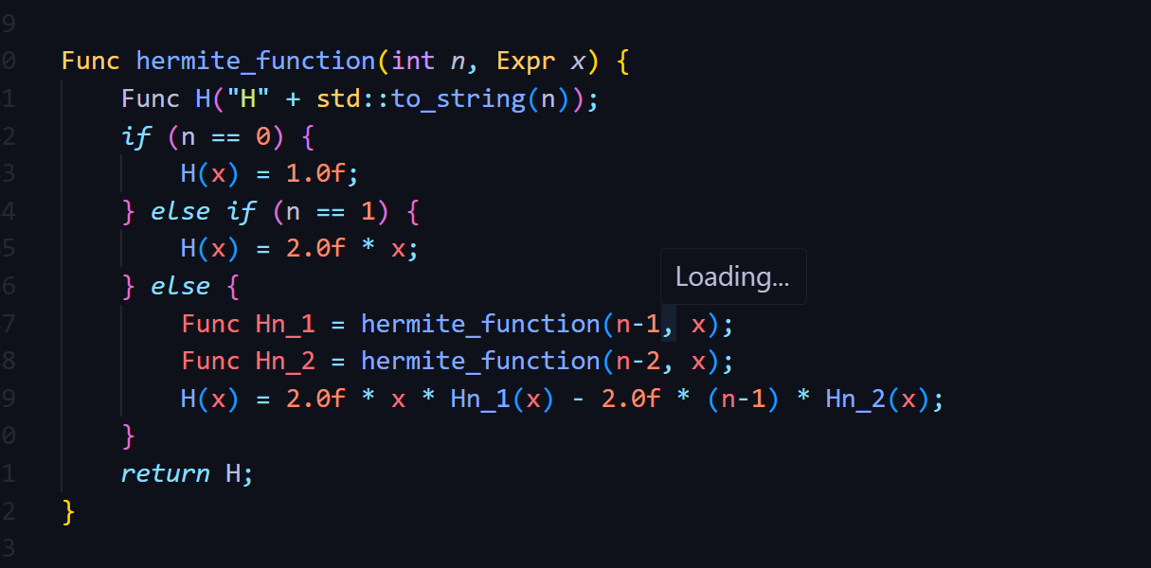
Using recursion implemented the hermite function

Slide 16
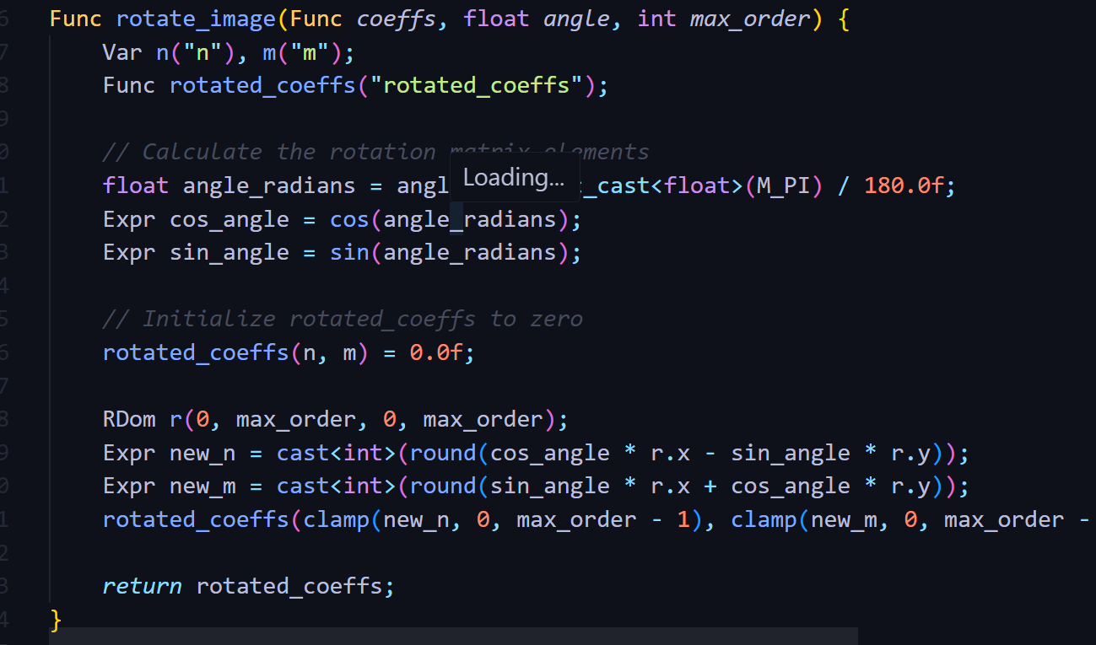
Rotate hermite

Slide 17
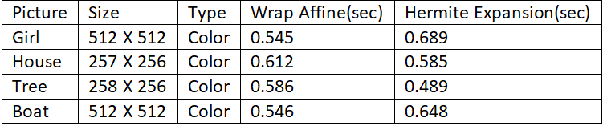
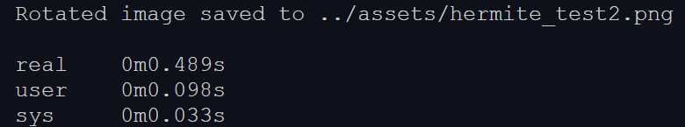
Time Consumption:-
Image rotation with Hermite Expansion using Cpp and OpenCV
Avg time of image rotation using hermite expansions is approx 0.602 sec
Avg time of wrap_affinefunction is approx 0.572 sec
Difference : 0.03 sec
Time of the rotation of image Tree (Best result)

Slide 18
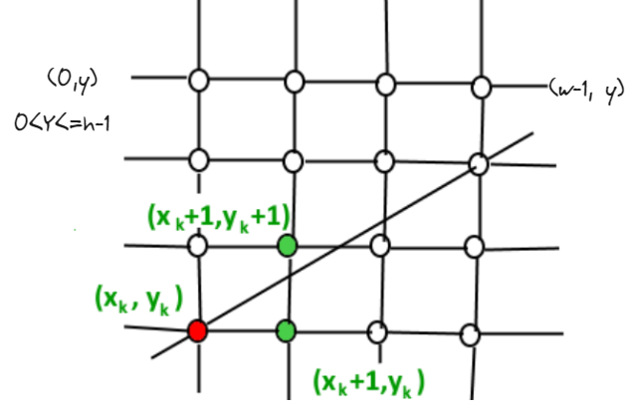
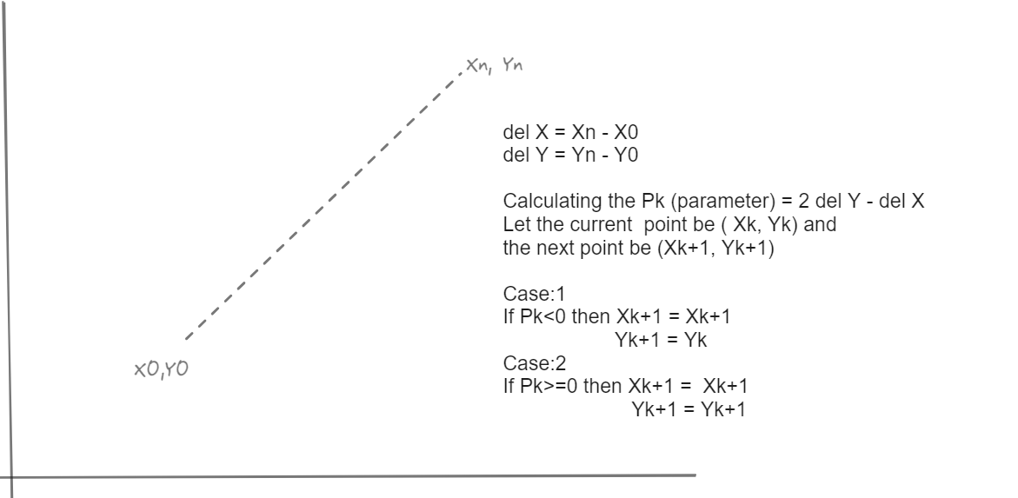
Bresenham algorithm
It determines the intermediate points that should be plotted to form a close approximation to a straight line between the start and end points.

Slide 19
Approach
At first we have to find all the points lying between the staring point (X0,Y0) and the end points (Xn,Yn) with the bresenham algorithm and store it in a data-structure.
After getting all the coordinates between the two respective points, we can use the rotation matrix to rotate the pixels and find the new x and y.
Lastly We can use the interpolation if there is any pixel is missing after rotation.

Slide 20
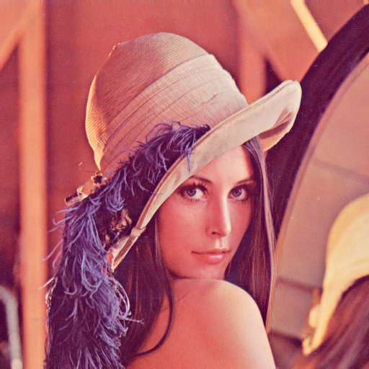
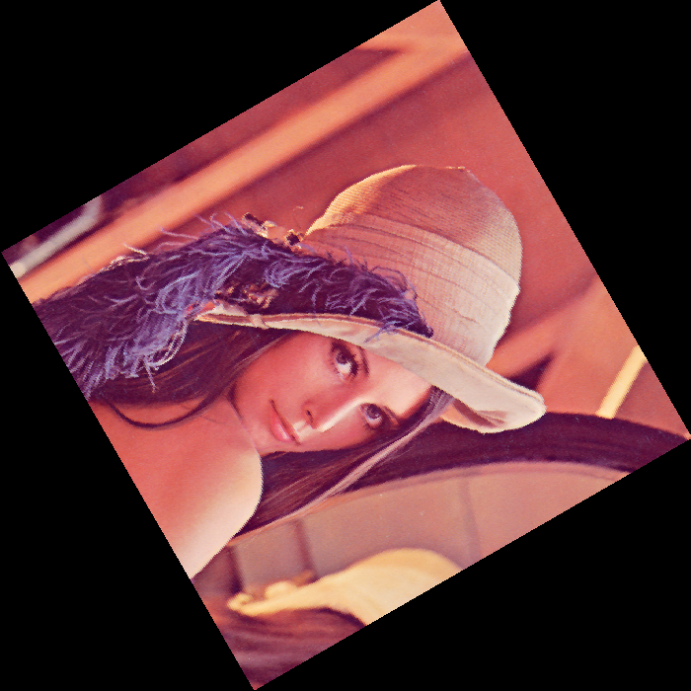
Comparison of DLR approach with Wrap Affine
Results for Low Dimension Pictures -:
Photo | Type | Dimension | Wrap_affine(sec) | DLR(sec)
Girl | Color | 512 x 512 | 0.5352 | 0.4489
House | Color | 257 x 256 | 0.5123 | 0.4287
Tree | Color | 258 x 256 | 0.5231 | 0.4213
Fish | Gray | 192 x 81 | 0.4421 | 0.4134
Average for Wrap_affine is 0.5031 sec
Average for DLR approach is 0.4280 sec

Slide 21
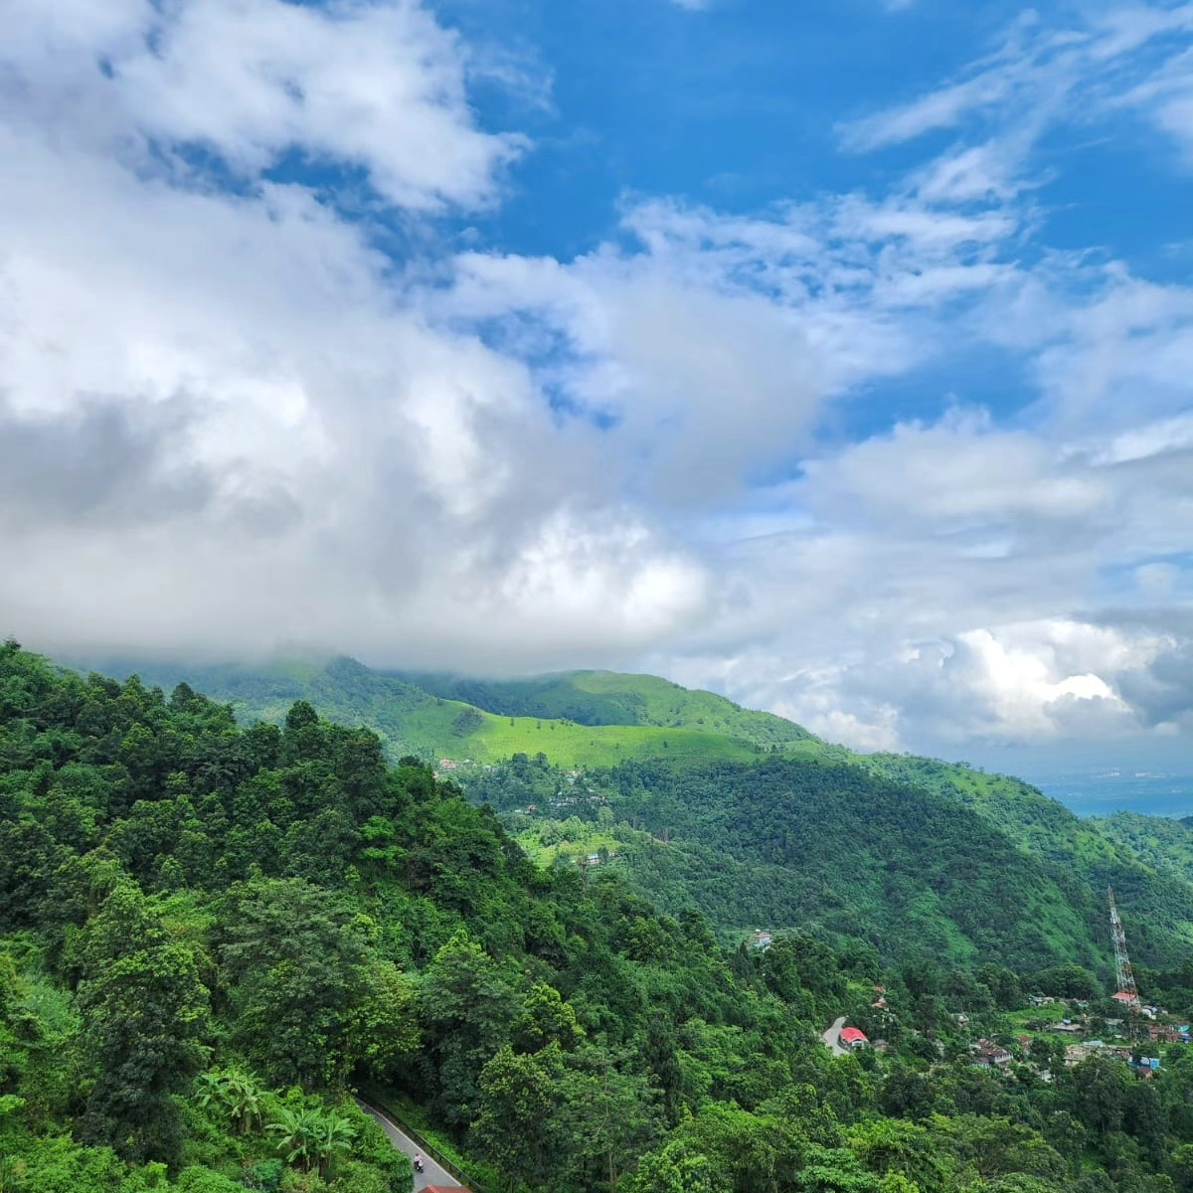
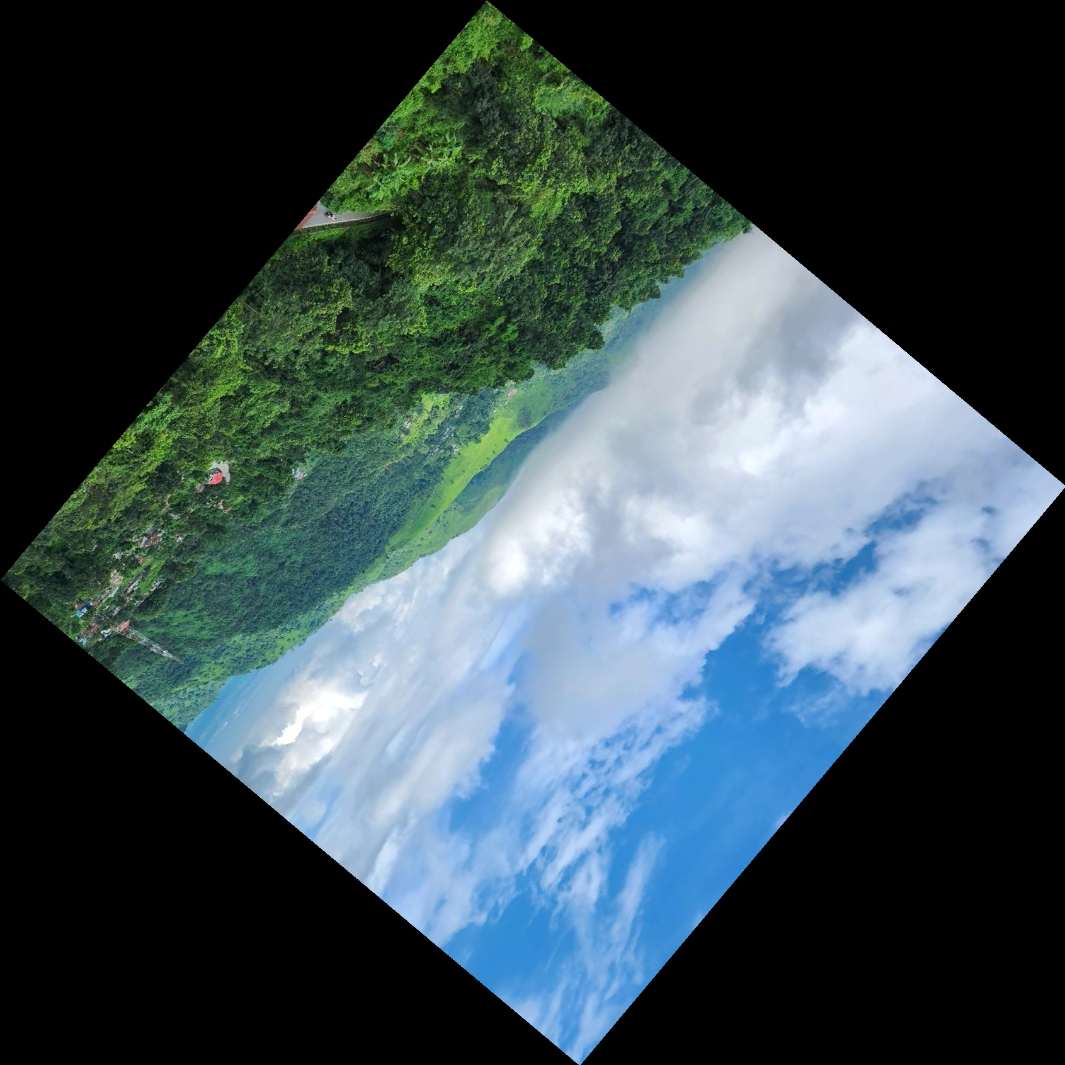
Results for High Dimension Pictures :-
Comparison of DLR approach with Wrap Affine
Landscape
Rotated Landscape
Photo | Type | Dimension | DLR(sec) | Wrap_affine(sec)
5am | Color | 3024 x 4032 | 1.972 | 2.210
Landscape | Color | 1200 x 1200 | 0.863 | 0.972
Kurseong | Color | 4160 x 2339 | 1.024 | 1.286
Church | Color | 4032 x 2268 | 1.563 | 1.612
Mountain | Color | 4096 x 2303 | 1.391 | 1.564
Down Hill | Color | 2268 x 4032 | 1.568 | 1.653
Average for DLR approach is 1.396 sec
Average for Wrap_affine is 1.549 sec

Slide 22
Thank you

