Slide 1

Fast Parallel Image Rotation Algorithm
Worklet: 24VI24KIIT
Dhrubajyoti Mandal
May 28, 2024

Slide 2
Optimizing performance
The primary cause of slow processing speeds in traditional image rotation methods is the fact that they are always serialized.
Halide offers a variety of scheduling methods that provide explicit control over how computations are performed, enabling significant performance optimizations.
Here’s a list of the various scheduling options that Halide provides:
.parallel(var);
.vectorize(var, width);
.tile(x, y, xo, yo, xi, yi, x_factor, y_factor);
.unroll(var, factor);
.fuse(var1, var2, fused_var);
.reorder(vars...);
Ref: https://halide-lang.org/tutorials/tutorial_lesson_05_scheduling_1.html
Notes:
Method: .parallel(var)
Description: Splits the computation of a function along a specified variable, allowing different portions to be computed concurrently on multiple CPU cores.
Method: .vectorize(var, width)
Description: Breaks down a computation into SIMD (Single Instruction, Multiple Data) operations that can be executed in parallel within a single CPU core.
Method: .tile(x, y, xo, yo, xi, yi, x_factor, y_factor)
Description: Divides the computation into small, manageable tiles that fit into the CPU cache, improving data locality and cache performance.
Method: .unroll(var, factor)
Description: Expands a loop by a specified factor, duplicating the loop body to reduce loop overhead and increase instruction-level parallelism.
Method: .fuse(var1, var2, fused_var)
Description: Combines two variables into a single loop, enabling joint scheduling and parallelization of the resulting fused loop.
Method: .reorder(vars...)
Description: Changes the nesting order of loops, potentially improving cache locality and exposing opportunities for vectorization and parallelism.
Comparison with Traditional Methods
Traditional image processing often relies on simple, straightforward loop-based computations with limited optimizations:
Single-threaded: By default, traditional loops are single-threaded, not utilizing multiple CPU cores.
No Vectorization: Without explicit SIMD programming, traditional loops miss out on the parallelism offered by SIMD instructions.
Poor Cache Usage: Large, unoptimized loops can lead to poor cache performance due to frequent cache misses.
Manual Optimization: Any parallelization, vectorization, or cache optimization requires manual effort and expertise, leading to complex and less maintainable code.

Slide 3
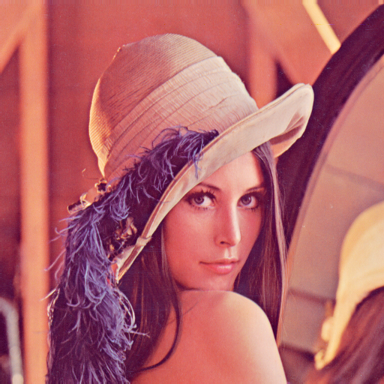
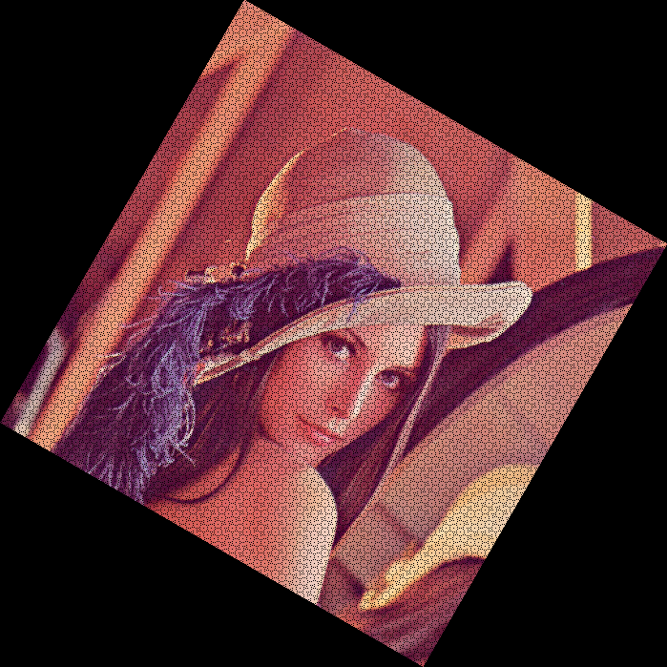
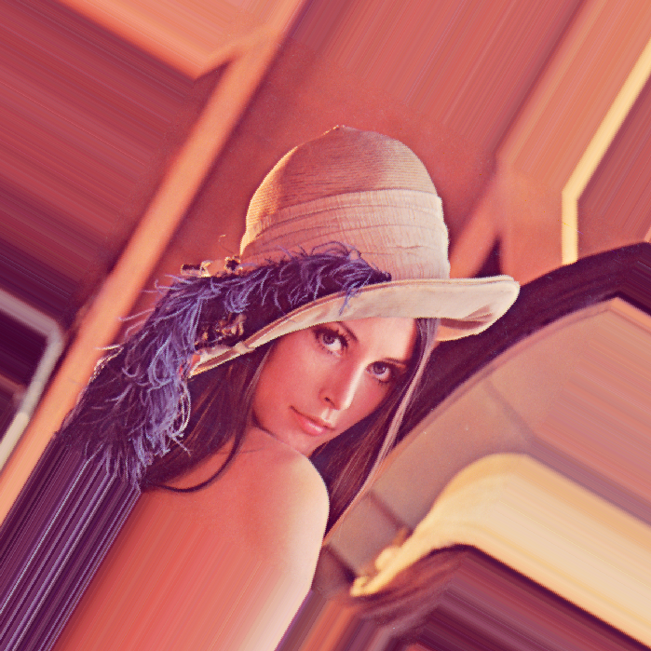
Interesting Observations
input image
output from OpenCV Avg execution time: 0.302s
output from Halide Avg execution time: 0.795s
Tests run on an Intel i7-10750H (12) @ 5.000GHz, all under similar workloads Input is a 512*512 png image ColorSpace_ICC: RGB Each of the output images turned out to be 699*699 px in dimensions
Angle of rotation: 30 degrees, about center of image Loop nest used in Halide: [using plain rotation matrix]
for c:
parallel y:
for x.x:
vectorized x.v0 in [0, 7]:
rotated(...) = ...
Notes:
Interestingly enough, even with no optimisation done, the average execution time remained the same. In some other examples, it even increased a lot of the times. The first program executing faster than the second one, despite the advanced scheduling in the second, can happen for several reasons:
Overhead of Parallelism: The overhead of managing threads and synchronization can sometimes outweigh the benefits of parallel execution, especially for relatively simple computations
Cache Behavior: Tiling is supposed to improve cache locality, but if the tile size does not align well with the cache size or if there are too many threads causing cache thrashing, performance can degrade.
Vectorization and Unrolling: These optimizations are beneficial for complex computations but might not show significant improvements for simple operations. The overhead of setting up these optimizations might not be worth it for such a straightforward calculation.
Processor and Memory Bandwidth: For very large data sizes, the memory bandwidth can become the bottleneck. The simple program might be benefiting from better cache and memory access patterns that are disrupted by the more complex scheduling in the second program.

Slide 4
Logs
$ echo "OpenCV" && for i in {1..20}; do time ./darotator; done
OpenCV
./darotator 0.29s user 0.02s system 98% cpu 0.317 total
./darotator 0.30s user 0.03s system 98% cpu 0.333 total
./darotator 0.31s user 0.02s system 98% cpu 0.331 total
./darotator 0.31s user 0.02s system 98% cpu 0.331 total
./darotator 0.30s user 0.01s system 98% cpu 0.321 total
./darotator 0.30s user 0.01s system 98% cpu 0.319 total
./darotator 0.29s user 0.02s system 98% cpu 0.312 total
./darotator 0.32s user 0.02s system 98% cpu 0.345 total
./darotator 0.30s user 0.02s system 98% cpu 0.320 total
./darotator 0.29s user 0.02s system 98% cpu 0.317 total
./darotator 0.30s user 0.02s system 98% cpu 0.325 total
./darotator 0.30s user 0.01s system 98% cpu 0.315 total
./darotator 0.30s user 0.02s system 98% cpu 0.326 total
./darotator 0.30s user 0.02s system 97% cpu 0.333 total
./darotator 0.31s user 0.01s system 98% cpu 0.319 total
./darotator 0.31s user 0.01s system 98% cpu 0.325 total
./darotator 0.30s user 0.02s system 98% cpu 0.328 total
./darotator 0.29s user 0.03s system 98% cpu 0.327 total
./darotator 0.31s user 0.01s system 98% cpu 0.331 total
./darotator 0.31s user 0.01s system 98% cpu 0.328 total AVG: 0.302s
$ echo "Halide -parallel(y) -vectorize(x, 8)" && for i in {1..20}; do time ./darotator; done
Halide -parallel(y) -vectorize(x, 8)
./darotator 0.81s user 0.02s system 100% cpu 0.831 total
./darotator 0.85s user 0.03s system 100% cpu 0.878 total
./darotator 0.82s user 0.02s system 100% cpu 0.842 total
./darotator 0.77s user 0.06s system 100% cpu 0.834 total
./darotator 0.82s user 0.03s system 99% cpu 0.849 total
./darotator 0.80s user 0.02s system 100% cpu 0.813 total
./darotator 0.79s user 0.03s system 100% cpu 0.815 total
./darotator 0.78s user 0.03s system 100% cpu 0.804 total
./darotator 0.77s user 0.04s system 100% cpu 0.816 total
./darotator 0.77s user 0.04s system 100% cpu 0.813 total
./darotator 0.79s user 0.03s system 100% cpu 0.818 total
./darotator 0.80s user 0.03s system 100% cpu 0.824 total
./darotator 0.79s user 0.02s system 100% cpu 0.806 total
./darotator 0.81s user 0.02s system 100% cpu 0.829 total
./darotator 0.81s user 0.03s system 100% cpu 0.833 total
./darotator 0.79s user 0.05s system 100% cpu 0.835 total
./darotator 0.77s user 0.06s system 100% cpu 0.823 total
./darotator 0.76s user 0.06s system 100% cpu 0.818 total
./darotator 0.76s user 0.04s system 100% cpu 0.800 total
./darotator 0.83s user 0.01s system 100% cpu 0.838 total
AVG: 0.795s
Notes:
These tests were only run on one single image, and thus have a lot of room for improvement. From here on, tests will be performed on images of varying sizes to get a more comprehensive overview of the program’s performance.

Slide 5
Further Optimization Scopes
Worklet: 24VI24KIIT
Dhrubajyoti Mandal
May 31, 2024

Slide 6
The Halide Auto-Scheduler
Oftentimes, it happens that manually designed schedules end up being worse than no optimization at all.
In order to get a reasonable start, we can use Halide’s Auto-Scheduler to give us a convenient starting point, which we can fine-tune later on.
**effective optimization requires a careful analysis of the system the program is running on itself, and finding the right balance between parallelism and memory efficiency.
Ref: https://halide-lang.org/tutorials/tutorial_lesson_21_auto_scheduler_generate.html
Notes:
For image rotation, there may be various scheduling decisions to make, such as tiling sizes, loop ordering, and parallelization strategies. The auto-scheduler can efficiently explore this vast space of possible schedules to find the optimal configuration for the target architecture.
Also, different hardware architectures may benefit from different scheduling strategies. The auto-scheduler can adapt the schedule to the specific characteristics of the target hardware.

Slide 7
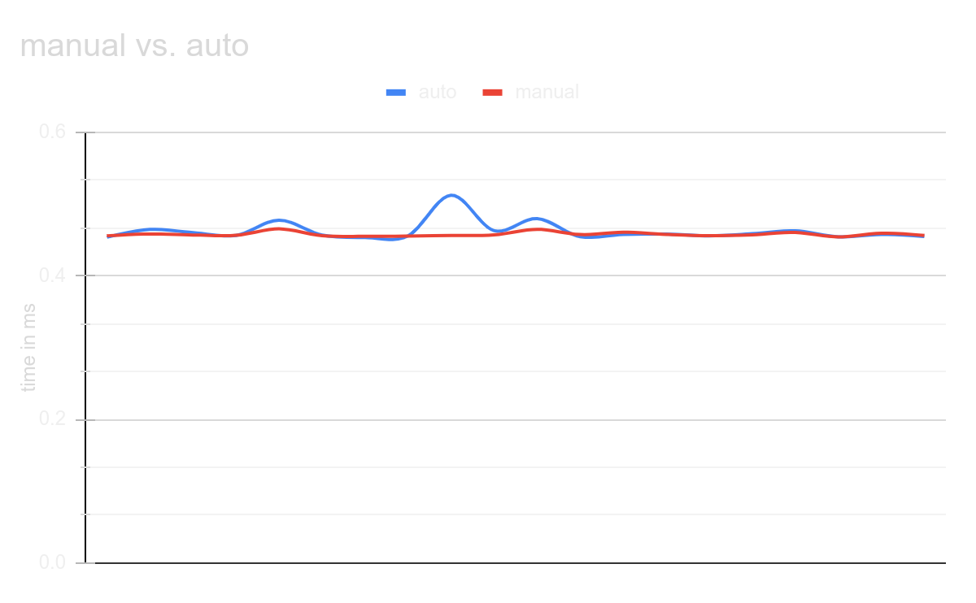
Experimental Results
Execution time (in ms) of a 1024*1024 input buffer
AUTO MANUAL
0.453748, 0.455682
0.46457, 0.458186
0.460088, 0.456807
0.456097, 0.456307
0.477421, 0.46533
0.456687, 0.455722
0.453297, 0.454896
0.455597, 0.455253
0.512179, 0.456135
0.462807, 0.45684
0.479661, 0.464707
0.454347, 0.457395
0.457544, 0.460674
0.458069, 0.45758
0.455576, 0.455699
0.458554, 0.457064
0.462642, 0.460217
0.454166, 0.454072
0.457571, 0.45936
0.454757, 0.456103
Tests run on an Intel i7-10750H (12) @ 5.000GHz, all under similar workloads Auto-Scheduler specifications: target=host autoscheduler=Mullapudi2016 autoscheduler.parallelism=32 autoscheduler.last_level_cache_size=16777216 autoscheduler.balance=40

Slide 8
An Alternate Approach: The DLR Method
Worklet: 24VI24KIIT
Dhrubajyoti Mandal
June 4, 2024

Slide 9
The DLR Method
The Double Line Rotation (DLR) Method is a one-pass method for realizing the high-speed rotation of images while preserving the image quality. This method employs the line coordinates in the target image. It finds the base-line equation in the target image and extracts all pixels that correspond to the base-line.
Extracting the pixels that correspond to the base-line is performed only once. The corresponding pixels in other lines of the target image are calculated by addition or subtraction from the base-line pixel coordinates.
Ref: Ashtari, A.H., Nordin, M.J. and Kahaki, S.M.M., 2015. Double line image rotation. IEEE Transactions on Image Processing, 24(11), pp.3370-3385.

Slide 10
The Breakdown
The DLR algorithm takes place in essentially three stages:
Base-Line Calculation
Unallocated Pixel Filling Strategy (some sort of interpolation basically)
Calculation of the Base-Line, Start-Line and Target Image Size

Slide 11
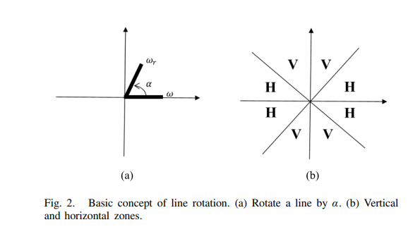
Base-Line Calculation
A base-line equation in the target image with an arbitrary slope of α is calculated. Then, all columns or rows from the original image, depending on α, are transformed to the corresponding coordinates in the target image.
The base-line is given by f(x) = Sx, S = tan(α).
The other corresponding lines (in the rotated image) can be computed by:
f(x) = Sx + b, b∈𝕫
Notes:
All pixels from the original line get transferred to the base-line. The angle of rotation, α is segmented into 8 areas and 2 groups. In the H areas, horizontal lines from the original image are used for rotation; in the V zones, vertical lines from the original image are employed. The m × n image T has m lines in V zones and n lines in H zones.

Slide 12
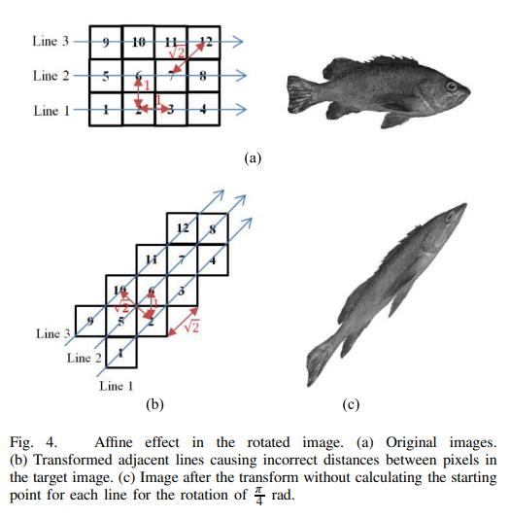
The Issue: An Affine-Skewed Effect
Heterogeneous distances between rotated pixels in the target image cause an affine image. To avoid the affine transform, all pixel distances in the target image must be the same multiple of the original image’ corresponding distance.
So, what we can do, is have a line f_{s}(x) determine the “starting point” of each of the other lines derived from the base-line. This line is later referred to as the “starting line” or the “start-line”, as f_{s}(s) = y/S_{b}, where S_{b} is the slope of the perpendicular to the base-line.

Slide 13
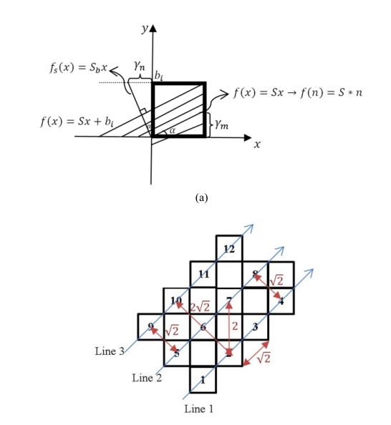
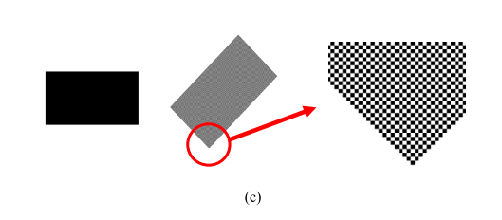
Choosing a “starting point” for each of the “lines” of the rotated image, the skewing effect can be fixed!
Notes:
Now, the issue here is a bunch of unallocated pixels, which we’ll look over later. For now though, we can check out the demonstration of the line derivation at https://www.desmos.com/calculator/ujpy5sqxfa

Slide 14
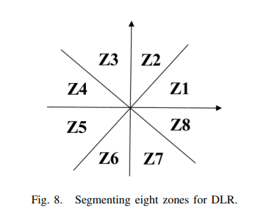
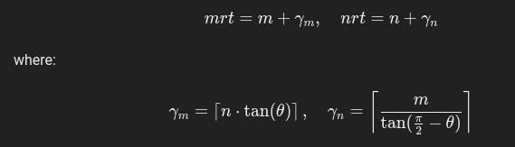
Calculation of the Base-Line, Start-Line and Target Image Size (Zone 1)
The base line is defined as f(x) = tan(α) x The new image dimensions are defined as follows:
For Zone 1, we have the ys defined, not the xs, so for that, using the equation of the start line f_{s}(s) = y/S_{b}, we can calculate the required mapping, for each line i of the image. For instance, the starting pixel of the rotated image for line i would be (f_{s}(i), i).

Slide 15
The DLR Method in Practice
Worklet: 24VI24KIIT
Dhrubajyoti Mandal
June 7, 2024

Slide 16
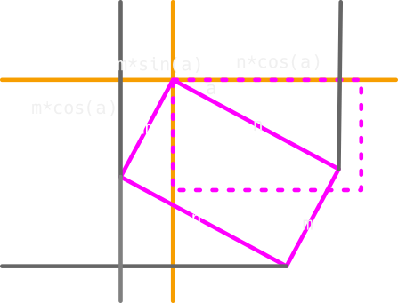
The Foundation
Calculating the new dimensions isn’t always as straightforward as it might seem.
For example, in the paper, where it is mentioned that mrt and nrt can be calculated using the following:
, hardly works. Instead, it’s best to find the new dimensions manually, zone wise.

Slide 17
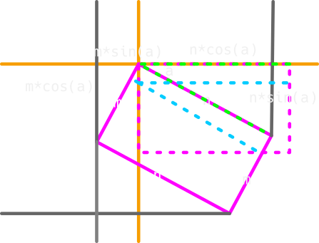
How The Mapping Works
The starting point, for each such incremental mapping is given by:
(f_{s}(i), i), where f_{s}(x) = x / tan(𝛼 + π/2)
From that point on, we can determine where the rest of the pixels will be placed.
In this example, we need to map n pixels over the span of n*cos(𝛼) in the x axis, and n*sin(𝛼) in the y axis. Consequently, we can determine, for each time we iterate over a pixel to be mapped, how much should the x and y change in the rotated image.

Slide 18
How The Mapping Works
rise = n * np.sin(alpha)
run = n * np.cos(alpha)
max_start_y = int(np.ceil(m * np.cos(alpha)))
fs = lambda y: y / np.tan(alpha + np.pi / 2)
y_incr = np.floor(n / rise)
x_incr = np.floor(n / run)
# more generally, if x_incr/y_incr > 1, (x_incr/y_incr) can be treated as a mod factor wrt x and vice-versa
if y_incr > x_incr:
mod_factor = y_incr // x_incr
for line in range(max_start_y):
a, b = int(np.ceil(fs(line))), line
for pixel in range(n):
# print(f"{(a + x_offset, b)} maps to {(pixel, line)}, i.e {img[line][pixel]}")
rot[b, a + x_offset] = img[line, pixel]
# ASHTARI et al.: DOUBLE LINE IMAGE ROTATION
rot[b + 1, a + x_offset] = img[line, pixel]
a += 1
if pixel > 0 and pixel % mod_factor == 0:
b += 1

Slide 19
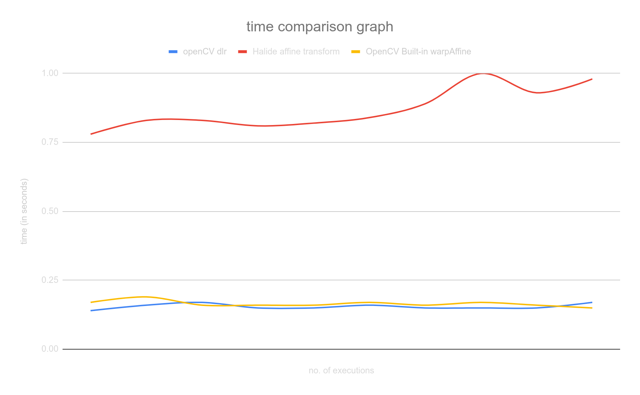
The Results
openCV dlr | Halide affine transform | OpenCV Built-in warpAffine
0.14 | 0.78 | 0.17
0.16 | 0.83 | 0.19
0.17 | 0.83 | 0.16
0.15 | 0.81 | 0.16
0.15 | 0.82 | 0.16
0.16 | 0.84 | 0.17
0.15 | 0.89 | 0.16
0.15 | 1 | 0.17
0.15 | 0.93 | 0.16
0.17 | 0.98 | 0.15
0.155 | 0.871 | 0.165
Tests run on an Intel i7-10750H (12) @ 5.000GHz, all under similar workloads Input is a 512*512 png image ColorSpace_ICC: RGB

Slide 20
Potential Issues with the Halide Implementation
Worklet: 24VI24KIIT
Dhrubajyoti Mandal
June 11, 2024

Slide 21
Synopsis
The current method evaluates pixels in an irregular range, with irregular loop increments. The issue here is that Halide operates on a pretty discrete domain, with regular updates in loop variables. So why is that an issue? Well, Halide operates through all the pixels of a particular input buffer via the .realise() function, following regular loop variable increments.
for line in range(max_start_y):
a, b = int(np.ceil(fs(line))), line
for pixel in range(n):
# print(f"{(a + x_offset, b)} maps to {(pixel, line)}, i.e {img[line][pixel]}")
rot[b, a + x_offset] = img[line, pixel]
rot[b + 1, a + x_offset] = img[line, pixel]
a += 1
if pixel > 0 and pixel % mod_factor == 0:
b += 1

Slide 22
Compiler Intrinsics - Exploiting SIMD
Worklet: 24VI24KIIT
Dhrubajyoti Mandal
June 14, 2024

Slide 23
Compiler Intrinsics
Compiler intrinsics allow us to create low-level, processor-specific code for maximum performance and control. Most functions are contained in libraries, but some functions are built in (that is, intrinsic) to the compiler. These are referred to as intrinsic functions or intrinsics. If a function is an intrinsic, the code for that function is usually inserted inline, avoiding the overhead of a function call and allowing highly efficient machine instructions to be emitted for that function.
Ref: https://learn.microsoft.com/en-us/cpp/intrinsics/compiler-intrinsics?view=msvc-170

Slide 24
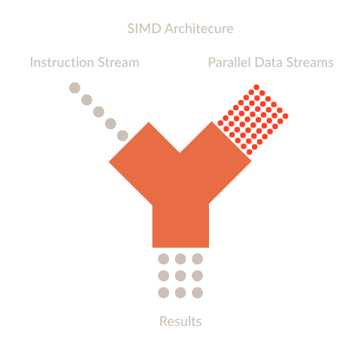
Arm Neon
The Arm Neon technology, also referred to as the Advanced SIMD (Single Instruction Multiple Data) architecture extension for implementation of the Armv8-A or Armv8-R architecture profiles.
Neon technology provides a dedicated extension to the Instruction Set Architecture, providing additional instructions that can perform mathematical operations in parallel on multiple data streams.
Ref: https://developer.arm.com/documentation/102474/0100/Overview?lang=en

Slide 25
The Catch?
NEON intrinsics are specific to ARM architecture, and they are not directly supported on x86 architecture - which, coincidentally, happens to be most of our developer machines.
What can be done?
Well, for starters, we could cross compile all the dependencies we have, for aarch64, and them compile them to an aarch64 binary and emulate that using a hypervisor like QEMU…
Or, we could emulate an entire arm device (such as a raspberry-pi 4b), install the binaries and dependencies out there, bring them back to our host machine and then run our program.
However, all these approaches lead to either having broken dependency cycles, or linking issues.

Slide 26
The Workaround
We can use the MMX and SSE intrinsics which are available for x86 architecture and provide similar SIMD capabilities.
These can be included in our usual cpp code via the <intrin.h> header, or <xmmintrin.h> for extra functionalities.
Once again, intrinsics are compiler and CPU specific, so no final results would turn out to be the same, however, we can expect to see a similar performance profile across the board.
Ref:
https://www.intel.com/content/www/us/en/docs/cpp-compiler/developer-guide-reference/2021-10/overview.html
https://www.intel.com/content/www/us/en/docs/intrinsics-guide/index.html

Slide 27
Implementation
for (int pixel = 0; pixel < n * 3; pixel += 12) { // Process 4 pixels (12 bytes) at a time
// Load 4 pixels at a time using SSE
__m128i pixels = _mm_loadu_si128(reinterpret_cast<const __m128i *>(&src_ptr[pixel]));
// Store these pixels in the destination image
_mm_storeu_si128(reinterpret_cast<__m128i *>(&dst_ptr[(a * 3) + x_offset * 3]), pixels);
_mm_storeu_si128(reinterpret_cast<__m128i *>(&dst_ptr_next[(a * 3) + x_offset * 3]), pixels);
a += 4; // Since we process 4 pixels at a time
if (pixel > 0 && pixel % mod_factor == 0) {
b += 2;
dst_ptr = rot.ptr<uchar>(b);
dst_ptr_next = rot.ptr<uchar>(b + 1);
}
}
The above code snippet shows how previously implemented algorithms, (in this case, the DLR) can be optimized with compiler intrinsics. This code isn’t fully benchmarked and tested yet, however, this method does bring in a promising compromise between code stability and predictability, and overall speed and optimization.

Slide 28
Getting Arm NEON to work on x86
Worklet: 24VI24KIIT
Dhrubajyoti Mandal
June 18, 2024

Slide 29
Cross compilation
With the help of cross compilation tools, and forcing static linking, we can get aarch64 features to work on x86 (albeit with emulation).
This results in slightly larger binaries, since all the dependencies are cramped into one single file, but that completely removes all previous errors related with linking, etc.
Performance details*
Benchmark (default, built-in OpenCV rotation function): 0.08 s
DLR implementation: 0.08 s
DLR implementation with Neon intrinsics: 0.074 s
* Highly experimental and subject to change All tests were performed on a 192*81, PNG grayscale image under similar workloads.

Slide 30
Continuing DLR… [Zone 2]
Worklet: 24VI24KIIT
Dhrubajyoti Mandal
June 21, 2024

Slide 31
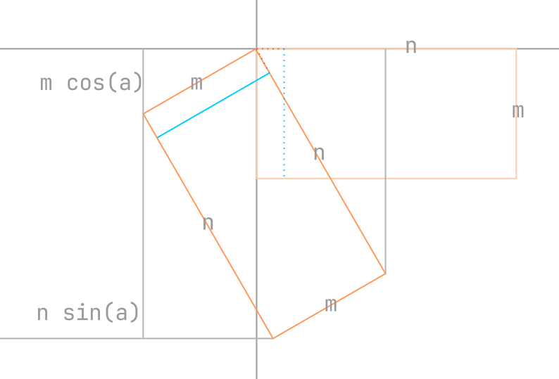
The approach
Similar to how it was done for zone 1, we first calculate the new dimensions of the m * n image, mrt * nrt according to the diagram shown alongside.
In this zone, the vertical lines are mapped instead of the horizontal ones.
Since this time, we know all the x coordinates, all starting points of the lines are given by: (x, f_{s}(x)), where: f_{s}(x) = tan(ɑ)x Then, it is a matter of mapping all (0 to m vertical px) over a span of m*cos(ɑ) in the x-axis and a span of m*sin(ɑ) in the y-axis.

Slide 32
Benchmarks and Initial Results
Worklet: 24VI24KIIT
Dhrubajyoti Mandal
June 25, 2024

Slide 33
Results
Before proceeding further, it is a good idea to see if we are even doing any good. As such, a series of tests were run against varying image sizes, and a trend was observed - images whose resolutions exceeded 1080p were processed much faster by the benchmark OpenCV built-in functions than the DLR approach.
The same was not true for smaller images, however.
The following slides will showcase a line chart of the benchmarking results. The x-axis represents the nth trial which a specific program was run, and the y-axis represents the time taken by said program in seconds.

Slide 34
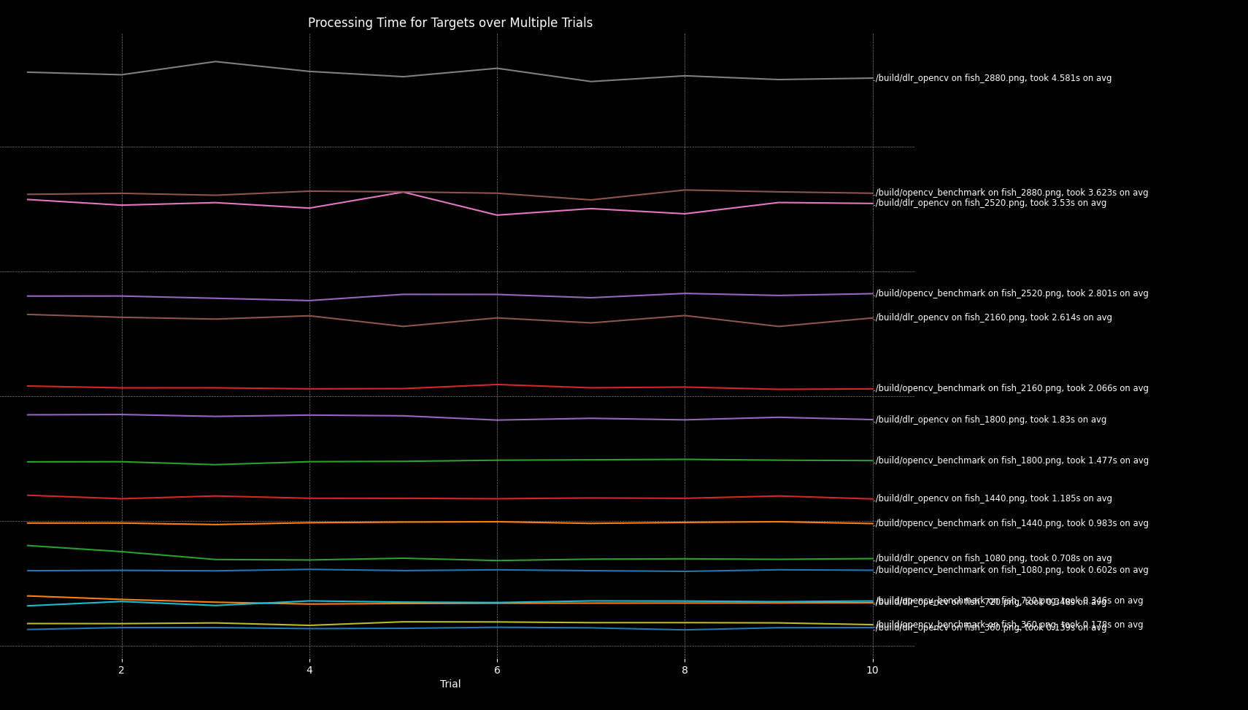
Results
This is the overall graph of all of the tests. The x-axis represents the nth trial which a specific program was run, and the y-axis represents the time taken by said program in seconds.

Slide 35
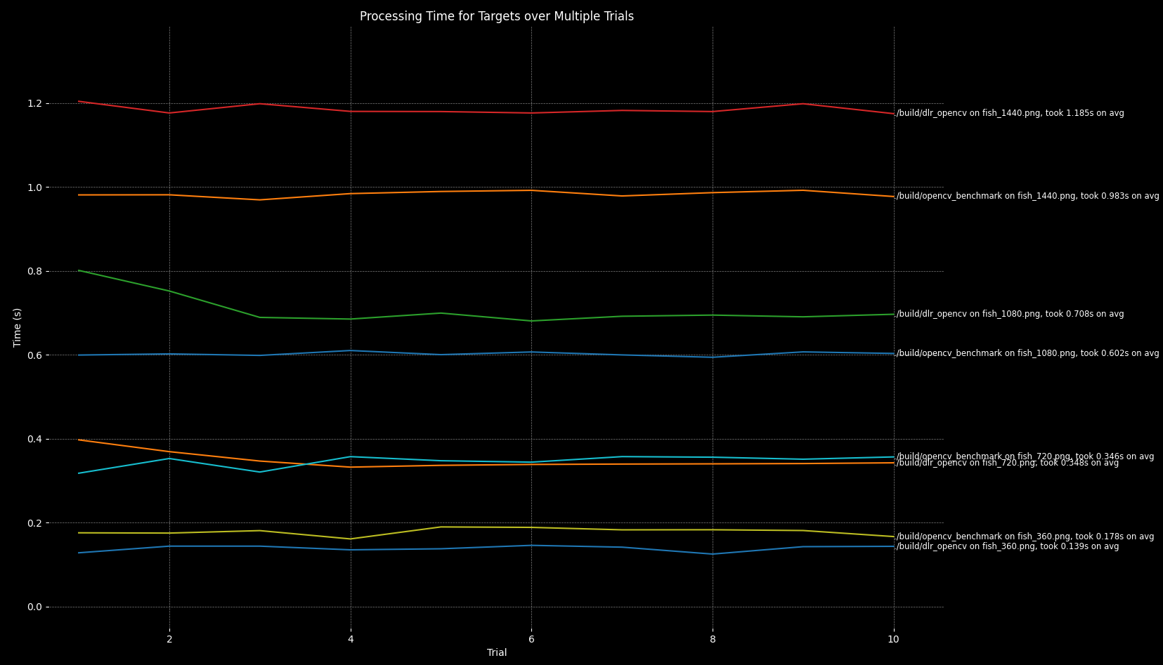
Results
Zooming in, we can better see when the DLR algorithm starts to fall off…

Slide 36
Analysis
Since for a lot of the tests, the DLR method did seem to perform extremely well, it is worth taking a moment to analyse why it starts to fall behind in larger images.
Turns out, the built-in OpenCV implementation for image rotation (the one we are using as our benchmark) uses multithreading under the hood, which explains how it manages to perform consistently well.
This is verified by checking the CPU usage and also tracking the number of subprocess each method spawns in its entire lifespan (confirming the use of multithreading).

Slide 37
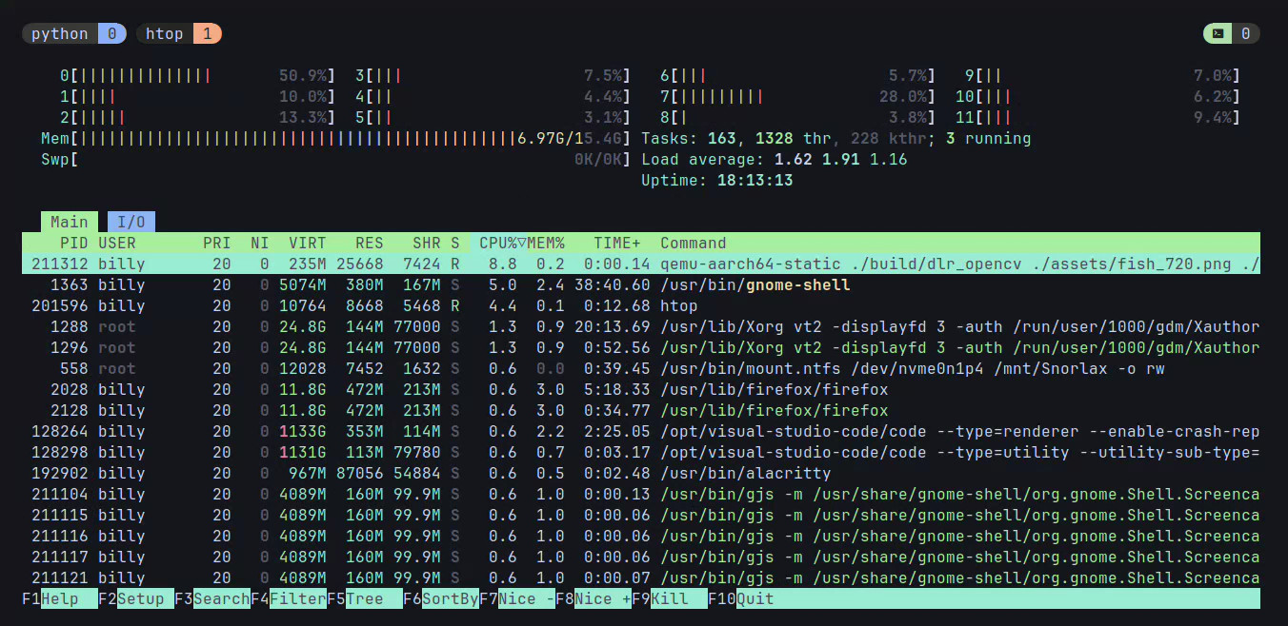
Analysis
Monitoring the resource usage here, we can see that for a 720p image, the DLR algorithm spawns a single process (it’s not using multithreading), and is not particularly heavy on the CPU

Slide 38
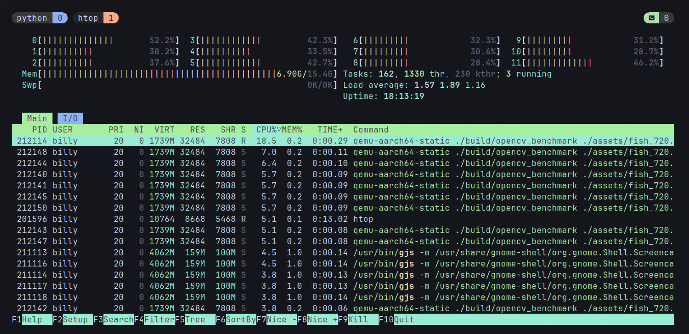
Analysis
Monitoring the resource usage here, we can see that for the same 720p image, the benchmark spawns a multiple processes (it is using multithreading), and is considerably particularly heavy on the CPU. This also explains the significant performance improvements it gets in larger images.

Slide 39
Key Takeaway
If we strictly want to compare which algorithm is better, we can use a custom version of the function used for benchmarking - warpAffine(), without any optimization or multithreading.
As far as increasing the performance of DLR itself is concerned, using multithreading might be the way to go, since this already is a fairly promising algorithm, which beats a lot of the other algorithms that have been discussed thus far.

Slide 40
Implementing a multithreaded approach
Worklet: 24VI24KIIT
Dhrubajyoti Mandal
June 28, 2024

Slide 41
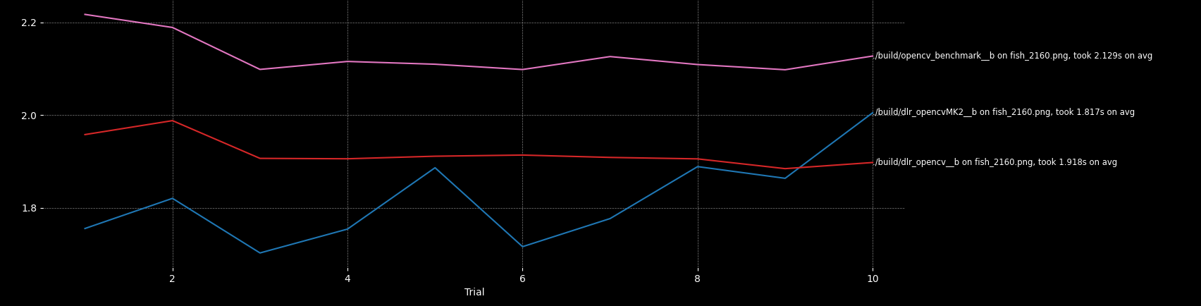
Key Takeaway
The hypothesis discussed in the previous section proved to be correct. Implementing a multithreaded approach significantly sped up the loops used for the mapping of rotated images in all benchmarking scenarios.
In this graph, the y axis represents time in seconds, and the x axis represents the nth trial.

Slide 42
Final Results: Existing and Current Algorithms
Worklet: 24VI24KIIT
Dhrubajyoti Mandal
Jul 04, 2024

Slide 43
Benchmark vs Current Algorithm
The key difference lies in the overall amount of computations performed. As claimed by DLR, the number of compute intensive computations is significantly reduced in the case of DLR, giving it the massive speed boost.
Algorithm | # float multiplications | # float additions/subtractions
Benchmark (OpenCV warpAffine) | 4 * mrt * nrt | 6 * mrt * nrt
Modified DLR | m cos(ɑ) or n sin(ɑ) | m cos(ɑ) (4n + 1) or n sin(ɑ) (4m + 1)
Note: The above data holds true if we’re ignoring the one time calculations (which are common to both cases, such as the calculation of the size of the image, etc.)

Slide 44
Benchmark Algorithm
Mat img = imread(argv[1]);
double rot_angle = stod(argv[3]);
Point2f center(img.cols / 2.0, img.rows / 2.0);
Mat rotation_mat = getRotationMatrix2D(center, rot_angle, 1.0);
// Calculate the size of the bounding box for the rotated image
Rect2f bbox = RotatedRect(Point2f(), img.size(), rot_angle).boundingRect2f();
// Adjust the transformation matrix
rotation_mat.at<double>(0, 2) += bbox.width / 2.0 - img.cols / 2.0;
rotation_mat.at<double>(1, 2) += bbox.height / 2.0 - img.rows / 2.0;
Mat rotated;
warpAffine(img, rotated, rotation_mat, bbox.size());

Slide 45
Benchmark Algorithm
// Calculate the size of the rotated image
int new_cols = static_cast<int>(abs(cols * alpha) + abs(rows * beta));
int new_rows = static_cast<int>(abs(rows * alpha) + abs(cols * beta));
Mat rotated(new_rows, new_cols, CV_8UC3, Scalar(0, 0, 0));
double c_x = cols / 2.0;
double c_y = rows / 2.0;
double new_c_x = new_cols / 2.0;
double new_c_y = new_rows / 2.0;
// Define matrix elements
double m11 = alpha;
double m12 = beta;
double m13 = (1 - alpha) * new_c_x - beta * new_c_y + c_x - new_c_x;
double m21 = -beta;
double m22 = alpha;
double m23 = beta * new_c_x + (1 - alpha) * new_c_y + c_y - new_c_y;

Slide 46
Benchmark Algorithm
// Parallelize the loop using OpenMP
#pragma omp parallel for collapse(2)
for (int y = 0; y < new_rows; y++) {
for (int x = 0; x < new_cols; x++) {
int x_ = static_cast<int>(round(m11 * x + m12 * y + m13));
int y_ = static_cast<int>(round(m21 * x + m22 * y + m23));
if (x_ >= 0 && x_ < cols && y_ >= 0 && y_ < rows) {
rotated.at<Vec3b>(y, x) = img.at<Vec3b>(y_, x_);
}
}
}

Slide 47
Modifications made to DLR
The key modifications made to the existing DLR algorithm are mostly:
A base line equation is not calculated. All computations are based on the starting line (f_{s}) alone, significantly reducing overall algorithm complexity.
A robust pixel mapping strategy is used, instead of relying on incrementing the base line equation. This solves the issue of how exactly a pixel is mapped, since that, in particular, is not very clearly mentioned in the original research paper.
Further, the new strategy generalises the algorithm even further by calculating the new image size only once (mrt and nrt), regardless of zone, and also exploiting the fact, that a starting point is always of the form: (f_{s} (i), i), to further ease out the logic.

Slide 48
The Algorithm Itself
def rotate(img, rot, x_offset, y_offset, delta_x, delta_y, delta_i, fs, outer_limit, last_px, horizontal, negate_coords=False, flip_range=False):
src_i = 0
shift = 1
for i in range(outer_limit):
x_, y_ = fs(i), i
range_ = range(last_px, -1, -1) if flip_range else range(last_px)
for px in range_:
try:
x, y, i_ = [floor(_) for _ in (x_, y_, src_i)]
if negate_coords: shift = -1
a, b = (px, i_) if not horizontal else (i_, px)
rot[shift * (y + y_offset), shift * (x + x_offset)] = img[a, b] # y, x
rot[shift * (y + y_offset) + 1, shift * (x + x_offset)] = img[a + b]
x_ += delta_x
y_ += delta_y
except IndexError: pass
src_i += delta_i

Slide 49
The Algorithm Itself
The arguments to the function are then calculated for each zone, separately. There are only a few tweaks that are to be made, so mostly, it’s just a re-written form of existing zones. Thus, for example, for zone 1 and 5, we’ll have the following scenario, and so on…
if (z1 := 0 <= angle <= 45) or (180 < angle <= 225):
x_offset = ceil(m * sin_alpha)
y_offset = 0
fs = lambda y: y / tan_alpha_ # starting line equation
delta_x = cos_alpha
delta_y = sin_alpha
delta_i = 1 / delta_x
outer_limit = ceil(m * cos_alpha)
last_px = n
rotate(img, rot, x_offset, y_offset, delta_x, delta_y, delta_i, fs, outer_limit, last_px, horizontal=True, negate_coords=not z1)

Slide 50
End of Slideshow.
Dhrubajyoti Mandal
Jul 04, 2024

