Slide 1

Fast Parallel Image Rotation Algorithm
Team
College Professor(s): Dr. Sujoy Datta / sdattafcs@kiit.ac.in
Students:
SUBHADEEP BHADRA / 2205336@kiit.ac.in
SOURAV KUMAR PARIDA / 22051032@kiit.ac.in
DHRUBAJYOTI MANDAL / 22053859@kiit.ac.in
Department: CSE

Slide 2
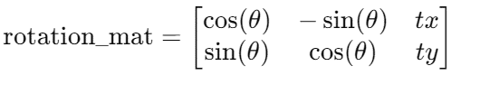
Implementation of Rotation Function warpAffine algorithm in Halide:
Initial parameters:
float rot_angle = 45;
Point2f center(img.cols / 2.0, img.rows / 2.0);
‘rot_angle’ is the rotation angle in degrees.
‘Center’ is the point around which the image will be rotated (the center of the image).
Calculate the Rotation Matrix:
Mat rotation_mat = getRotationMatrix2D(center, rot_angle, 1.0);
getRotationMatrix2D creates a 2x3 rotation matrix for rotating the image around the specified center point.
The scale factor is 1.0, meaning the image size remains unchanged apart from rotation.
Where (𝑡𝑥,𝑡𝑦) are the translation components.
Calculate Bounding Box:
Rect2f bbox = RotatedRect(Point2f(), img.size(), rot_angle).boundingRect2f();
‘RotatedRect’ calculates the rotated rectangle.
‘boundingRect2f’ computes the axis-aligned bounding box that contains the rotated rectangle.
Sourav Parida
May 28, 2024

Slide 3
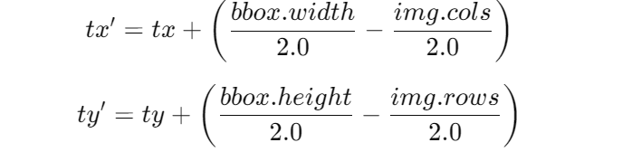
Implementation of Rotation Function warpAffine algorithm in Halide:
Adjust the Transformation Matrix:
rotation_mat.at<double>(0, 2) += bbox.width / 2.0 - img.cols / 2.0;
rotation_mat.at<double>(1, 2) += bbox.height / 2.0 - img.rows / 2.0;
Adjusts the translation components (tx and ty) of the rotation matrix to center the rotated image within the bounding box.
Without this adjustment, the image would not be correctly centered in the new bounding box.
This ensures the rotated image is correctly centered within its new bounding box.
Perform the Affine Transformation:
warpAffine(img, rotated, rotation_mat, bbox.size());
‘warpAffine’ applies the affine transformation to the image using the rotation matrix and outputs the rotated image.
The output image size is set to the bounding box size calculated earlier.

Slide 4
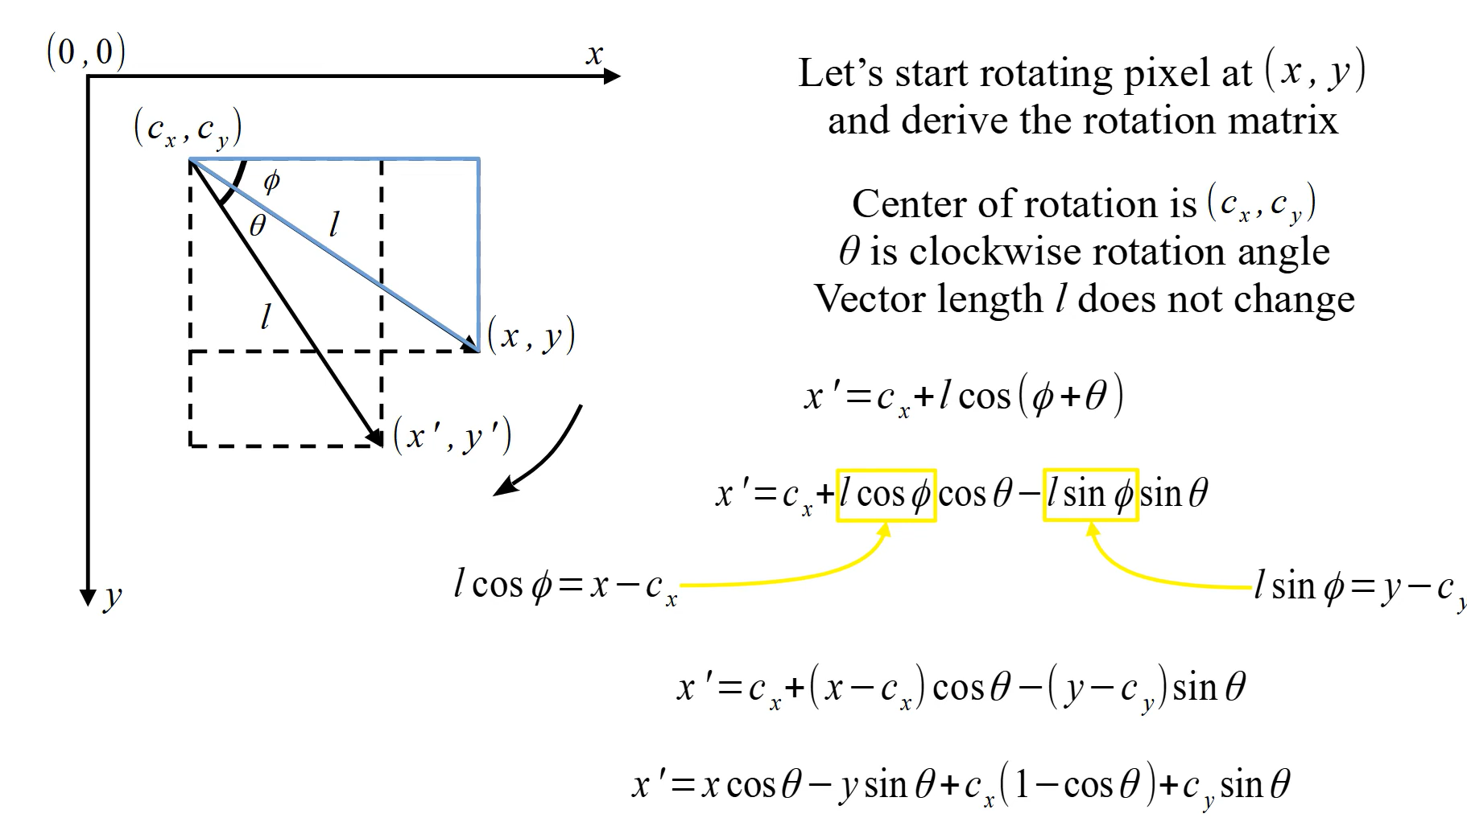
Mathmatics of Affine Transformation
Subhadeep Bhadra
May 28, 2024

Slide 5
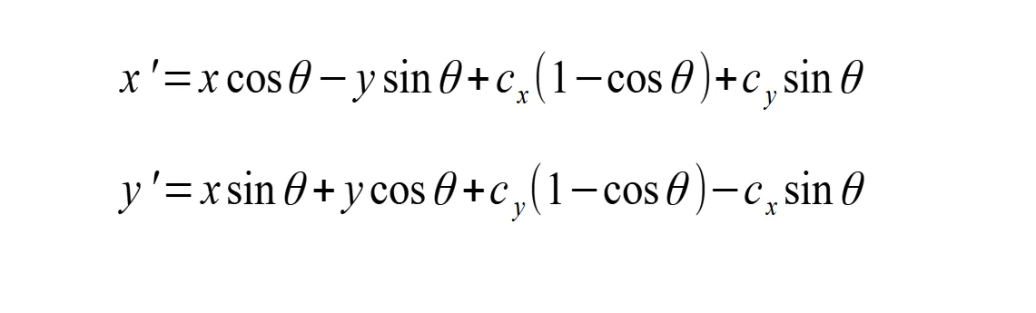
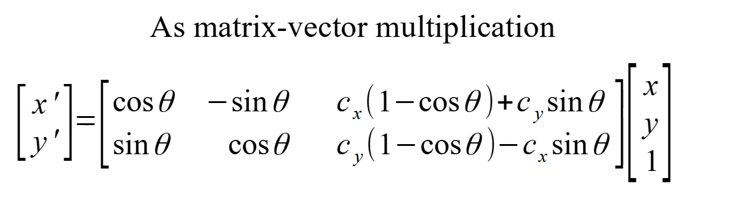
Rotation Of Image Around Any Point

Slide 6
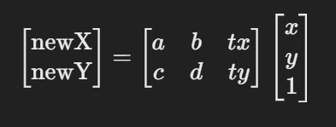
Affine Transformation With User defined Function
Translation
The calculation of the translation values tx and ty is essential for centering the rotated image within its dimensions.
float tx = cx - (cx * static_cast<float>(cos(radians)) - cy * static_cast<float>(sin(radians))) ;
cx and cy are the coordinates of the center of the original image.
cosTheta and sinTheta are the cosine and sine of the rotation angle in radians, respectively.
The expressions calculate the new coordinates of the center after rotation.
Affine-transformation matrix
Defining the transformation matrix and using the translated values i.e tx and ty.
matrix = {cosTheta, -sinTheta, tx},
{sinTheta, cosTheta, ty}
Getting the new value of x and y
Expr newX = matrix[0][0] * cast<float>(x) + matrix[0][1] * cast<float>(y) + matrix[0][2];
Expr newY = matrix[1][0] * cast<float>(x) + matrix[1][1] * cast<float>(y) + matrix[1][2];
Subhadeep Bhadra
May 31, 2024

Slide 7
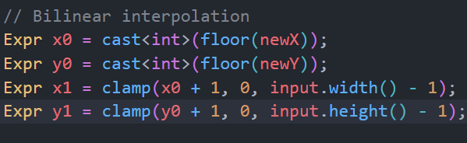
Affine Transformation With User defined Function
Bilinear Interpolation
clamp(value, min, max): This function ensures
that the resulting coordinates are within the
valid range of the image dimensions.
Used clamp function in x0 and y0.
Used the input function to get the pixels values, it took 3 arguments x, y and the channel index.And clamped it.
input(x0, y0, c): Top-left corner of the grid cell.
input(x1, y0, c): Top-right corner of the grid cell.
input(x0, y1, c): Bottom-left corner of the grid cell.
input(x1, y1, c): Bottom-right corner of the grid cell.
Lastly used the select () to black the out of bounded part.

Slide 8
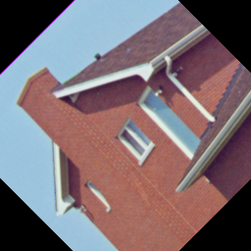
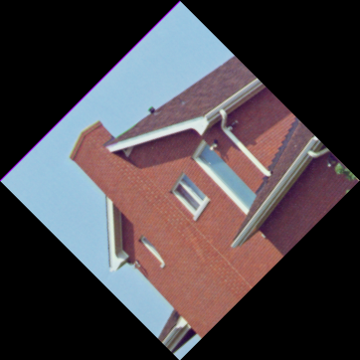
Comparison between user defined function and inbuild function
User defined Functions (affine_transform):
Parameters:-
(org_img, rotated_img, rotation_mat)
Sample Output:
Original dimensions: 256×256 pixels
Image dimensions: 256×256 pixels
In-built Functions (warpAffine):
Parameters:-
(org_img, rotated_img, rotation_mat, bbox.size())
Sample Output:
Original dimensions: 256×256 pixels
Image dimensions: 362×362 pixels
May 31, 2024
Sourav Parida

Slide 9
Comparison between user defined function and inbuild function
Drawbacks of User defined Functions (affine_transform):
The corners of the rotated image were trimmed because the bounding box of the rotated image was set to the same size as the original image.
Grayscale images cannot undergo rotation.
Time Comparison Table of Different Images Between User-Defined Affine Transform Function and Built-In Affine Transform Function.
Image source: https://web.archive.org/web/20110526212755/http://sipi.usc.edu/database/database.php?volume=misc
So the user defined function is not better than the existing warpAffine function.
Image |  |  |  |  | Time (sec)
Filename | Description | Size | Type |  | In User Defined | Inbuild (Warp-affine) | Difference
test_img_01 | Girl | 256 X 256 | Color |  | 2.797 | 0.554 | 2.243
test_img_02 | House | 257 X 256 | Color |  | 2.808 | 0.627 | 2.181
test_img_03 | Tree | 258 X 256 | Color |  | 2.763 | 0.593 | 2.17
test_img_04 | Jelly_beans | 259 X 256 | Color |  | 3.323 | 0.564 | 2.759
test_img_05 | Mandrill | 512 X 512 | Color |  | 3.07 | 0.664 | 2.406
test_img_06 | Girl | 513 X 512 | Color |  | 3.049 | 0.501 | 2.548
test_img_07 | Airplane-F16 | 514 X 512 | Color |  | 3.051 | 0.607 | 2.444
test_img_08 | Sailboat | 515 X 512 | Color |  | 2.745 | 0.59 | 2.155
 |  |  | Avg: |  | 2.95075 | 0.5875 | 2.36325

Slide 10
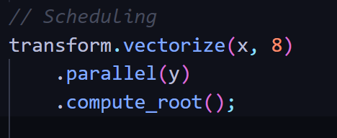
Scheduling Optimisation Technique
Optimisation Of The Affine Transformation
Using Vectorize function in the code. This directive tells Halide toprocess 8 pixels at a time along the x dimension. This can significantly speed up the computation by making use of the vector registers in the CPU.
Using Parallel function in the code.This parallelizes the computation along the y dimension. Each row of pixels can be processed in parallel and can be executed concurrently.
Using Compute_root computes the entire function at the root level, ensuring efficient use of memory and avoiding redundant and un-necessary computations.
Subhadeep Bhadra
June 4, 2024

Slide 11
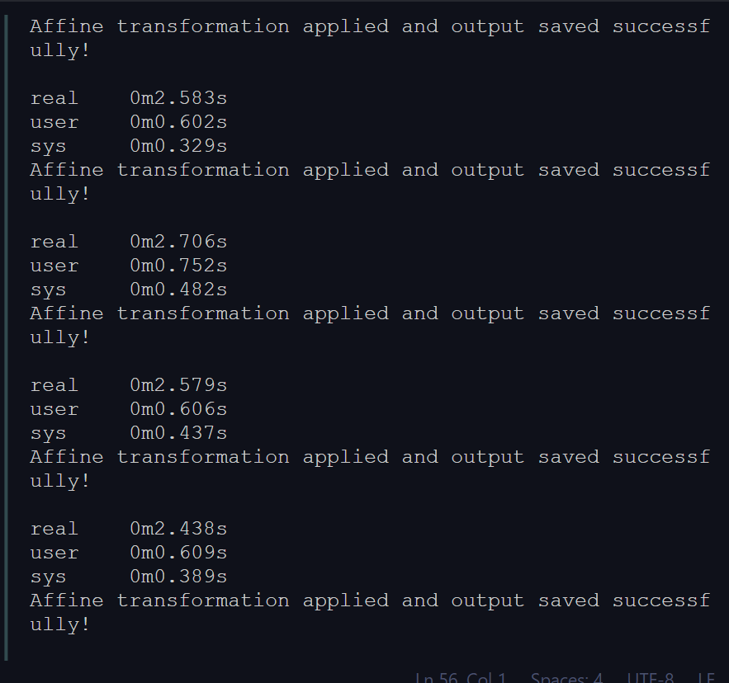
Time Consumption :-
Optimisation Of The Affine Transformation
Description | Size | Type | In-Built wrapAffine Function(sec) | Used Scheduling Technique(sec) | Without Scheduling Technique(sec)
Tree | 258 x 256 | Color | 0.593 | 1.718 | 2.763
House | 257 x 256 | Color | 0.527 | 1.814 | 2.808
Girl | 512 x 512 | Color | 0.554 | 1.919 | 2.790
Sailboat | 512 x 512 | Color | 0.590 | 1.891 | 2.159
Avg time of Optimised Code is approx 1.8355 sec
Avg time of inbuilt function is approx 0.566 sec
Avg time of without optimisation is approx 2.63 sec
First five iterations result of pictureTree

Slide 12
Algorithm: Affine Image Transformation Using Bilinear Interpolation
Initialization
Extract dimensions width, height, and channels from the input buffer.
Find the new height and width of the rotated image.
Declare Halide variables x, y, and c to represent the pixel coordinates and channel index.
Declare a Halide function transform to represent the transformation.
Affine Transformation Calculation
Formation of the affine transformation matrix and compute the transformed coordinates newX and newY using the affine transformation matrix:
Expr newX = matrix[0][0] * cast<float>(x) + matrix[0][1] * cast<float>(y) + matrix[0][2];
Expr newY = matrix[1][0] * cast<float>(x) + matrix[1][1] * cast<float>(y) + matrix[1][2];
Bilinear Interpolation Setup
Compute the integer coordinates surrounding the transformed coordinates using:
X0=cast<int>(floor(newX))
y0=cast<int>(floor(newY))

Slide 13
Algorithm: Affine Image Transformation Using Bilinear Interpolation
Bilinear Interpolation Calculation:
Compute the bilinearly interpolated pixel value using the surrounding pixel values and the weights:
value = (1 - a) * (1 - b) * input(clamp(x0, 0, input.width() - 1), clamp(y0, 0, input.height() - 1), c) +
a * (1 - b) * input(clamp(x1, 0, input.width() - 1), clamp(y0, 0, input.height() - 1), c) +
(1 - a) * b * input(clamp(x0, 0, input.width() - 1), clamp(y1, 0, input.height() - 1), c) +
a * b * input(clamp(x1, 0, input.width() - 1), clamp(y1, 0, input.height() - 1), c);
Boundary Handling:
Set the pixel to black if the transformed coordinates are out of bounds and the rest pixel will be remain same using:
transform(x, y, c) = select( newX >= 0 && newX < input.width() && newY >= 0 && newY < input.height(), cast<uint8_t>(clamp(value, 0.0f, 255.0f)),cast<uint8_t>(0);
Using Scheduling Techniques
.vectorize(x, 8) : This line applies vectorization. Vectorization leverages the capabilities of modern processors that can perform the same operation on multiple pieces of data simultaneously.
.parallel(y) : This line applies parallelization. Parallelization utilizes multiple cores or processors available in your computer to execute different parts of the computation concurrently.
.compute_root() : This likely refers to the concept of a computation to reduce un-necessary computation.

Slide 14
Affine Transformation With User defined Function
Realize Output:
Initialize the output buffer with the same dimensions and channels as the input:
excute the transformation and store the result in the output buffer made with the newHeight and
newWidth.
transform.realize(output).
References:
1. https://halide-lang.org/
2. Image source link : https://web.archive.org/web/20110526212755/http://sipi.usc.edu/database/database.php?volume=misc
2. Halide: A Language and Compiler for Optimizing Parallelism
3. Introduction to algorithms, by Cormen

Slide 15
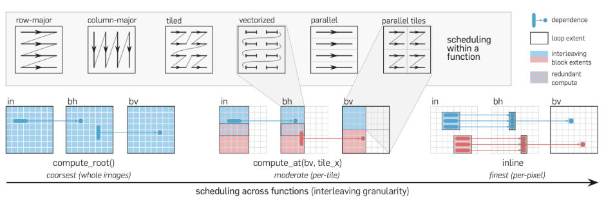
Comparison between Parallel ,vectorized and parallel tiled
• Tile: Tiling, in the context of image processing, refers to dividing a large image into smaller, manageable sections called tiles or blocks. Each tile represents a portion of the original image, typically of equal size.
• vectorize: vectorized scheduling enhances computational throughput by processing multiple data elements in parallel, thereby accelerating the overall execution time.
• parallel: parallelizes computation along the dimension given by the variable.
Sourav Parida
June 4, 2024

Slide 16
Comparison between Parallel ,vectorized and parallel tiled
Implemented the affine transformation using three methods: tiling, parallel processing, and vectorization. To evaluate their performance, I compared the following approaches:
Combining all three methods: tiling, parallel processing, and vectorization.
Using only parallel processing.
Using only vectorization.
The results of these comparisons demonstrate the efficiency and effectiveness of each approach.
Reference: https://digitalassets.lib.berkeley.edu/techreports/ucb/incoming/EECS-2023-228.pdf
Image |  |  |  |  | Time (sec)
Filename | Description | Size | Type |  | In User Defined | Inbuild (Warp-Affine) | tile & parallel & vectorize | parallel | vectorize
test_img_01 | Girl | 256 X 256 | Color |  | 2.797 | 0.554 | 2.573 | 3.265 | 2.298
test_img_02 | House | 257 X 256 | Color |  | 2.808 | 0.627 | 2.543 | 3.342 | 2.396
test_img_03 | Tree | 258 X 256 | Color |  | 2.763 | 0.593 | 2.418 | 3.025 | 2.313
test_img_04 | Jelly_beans | 259 X 256 | Color |  | 3.323 | 0.564 | 3.348 | 3.167 | 2.856
test_img_05 | Mandrill | 512 X 512 | Color |  | 3.07 | 0.664 | 3.592 | 3.058 | 2.704
 |  |  | Avg: |  | 2.9522 | 0.6004 | 2.8948 | 3.1714 | 2.5134

Slide 17
Hermite Expansion

Slide 18
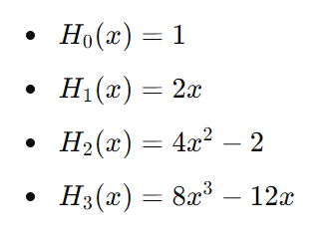
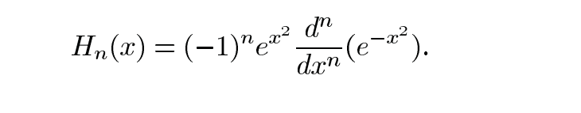

Define Hermite Polynomials
Image rotation with Hermite Expansion
Rodrigues' formula:
This is the "Hermite polynomials" where n >= 0 and some of the hermite polynomial for n=0 , n=1, n=2 and n=3 so on...
Recurrance Relation is given by.
Subhadeep Bhadra
June 07, 2024

Slide 19

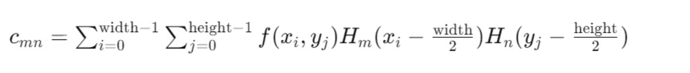
Discretize the Image
Image rotation with Hermite Expansion
Here the image is represented as a function 𝑓(𝑥,𝑦) defined on a grid. This can be expanded as a series of Hermite polynomials, where cmn is the expansion function:
Finding the expansion coefficients with this formula
The Hermite expansion coefficients are computed by summing over the product of the image pixel values and the Hermite polynomial values.

Slide 20

Rotate Image
Image rotation with Hermite Expansion
Define the Rotation Transformation
Apply the Transformation to the Hermite Polynomials
Transform the Hermite polynomial expansion to the rotated coordinates (𝑥′,𝑦′) (x′,y′):
Reference:
Accurate Image Rotation Using Hermite Expansions Wooram Park, Student Member, IEEE, Gregory Leibon, Daniel N. Rockmore, and Gregory S. Chirikjian, Senior Member, IEEE

Slide 21
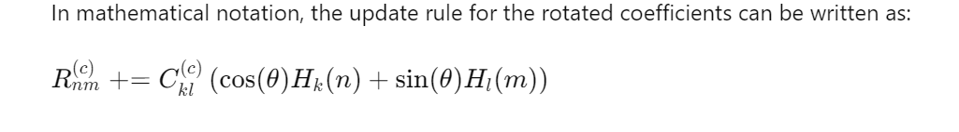
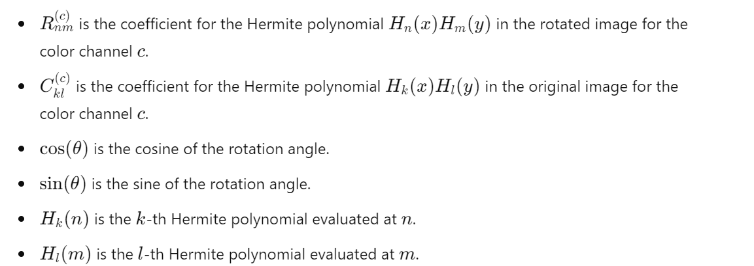

Slide 22
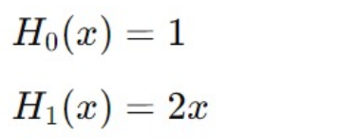

Implementation of Image Rotation Using Hermite Expansions
1st code
Hermite Polynomial Function:
// Base cases
if (n == 0) return Expr(1.0f);
if (n == 1) return 2.0f * x;
// Iterative calculation
Expr h0 = Expr(1.0f);
Expr h1 = 2.0f * x;
Expr h;
for (int i = 2; i <= n; ++i) {
h = 2.0f * x * h1 - 2.0f * (i - 1) * h0;
h0 = h1;
h1 = h;
}
return h1;
Sourav Parida
June 07, 2024

Slide 23

Implementation of Image Rotation Using Hermite Expansions
1st code
2. Hermite Expansion of an Image:
RDom r(0, width, 0, height): Define a reduction domain r that spans the entire image. This will be used to iterate over all pixel values in the image.
Sum the Hermite Polynomial Terms:
expansion(n, m) = sum(input(r.x, r.y) * hermite(n, cast<float>(r.x) - cast<float>(width) / 2.0f) * hermite(m, cast<float>(r.y) - cast<float>(height) / 2.0f));
This line computes the Hermite expansion coefficients c_{mn} for each pair (n, m) by summing the product of the input image pixel values input(r.x, r.y) and the Hermite polynomials evaluated at the centered coordinates (r.x - width/2) and (r.y - height/2).
The formula for computing the Hermite expansion coefficients Cmn​ in a discrete image is:
Note: Here typecasting error arises in n,m in this equation.

Slide 24
Implementation of Image Rotation Using Hermite Expansions
1st code
3. Rotate hermite:
int n, m;
Func rotated("rotated");
float angle_radians = angle * (float)M_PI / 180.0f;
float cos_theta = cos(angle_radians);
float sin_theta = sin(angle_radians);
rotated(n, m) = 0.0f;
for (int k = 0; k <= order; ++k) {
for (int l = 0; l <= order; ++l) {
rotated(n, m) += coeffs(k, l) *
cos_theta * hermite(n, k) *
sin_theta * hermite(m, l);
}
}
return rotated;
4. Reconstruct image:
Var x("x"), y("y"), c("c");
Func reconstructed("reconstructed");
Expr xc = cast<float>(x) - cast<float>(width) / 2.0f;
Expr yc = cast<float>(y) - cast<float>(height) / 2.0f;
RDom r(0, order + 1, 0, order + 1); // Iterate from 0 to order
reconstructed(x, y, c) = 0.0f;
for (int n = 0; n <= order; ++n) {
for (int m = 0; m <= order; ++m) {
reconstructed(x, y, c) += coeffs(n, m, c) *
hermite(n, xc) *
hermite(m, yc);
}
}
return reconstructed;

Slide 25

Implementation of Image Rotation Using Hermite Expansions
2nd Code
Hermite Polynomial Function:
Expr hermite(Expr n, Expr x) {
// Base cases
Expr h0 = Expr(1.0f);
Expr h1 = 2.0f * x;
Expr h = select(n == 0, h0,
n == 1, h1,
Expr());
// Iterative calculation
for (int i = 2; i <= 10; ++i) { // Limit the loop to a maximum of 10 to prevent infinite loops
h = select(n == i, 2.0f * x * h1 - 2.0f * (i - 1) * h0, h);
h0 = select(n == i, h1, h0);
h1 = select(n == i, h, h1);
}
return h;
}
2. Hermite Expansion of an Image:
// No change from 1st code.
3. Rotate hermite:
changed these variables from int to Var.
Var n("n"), m("m"), c("c");
4. Reconstruct image:
// No change from 1st code.
Error: Segmentation fault.
Possible reason :- Accessing out-of-bounds memory. As no clamp is used.
Sourav Parida
June 14, 2024

Slide 26
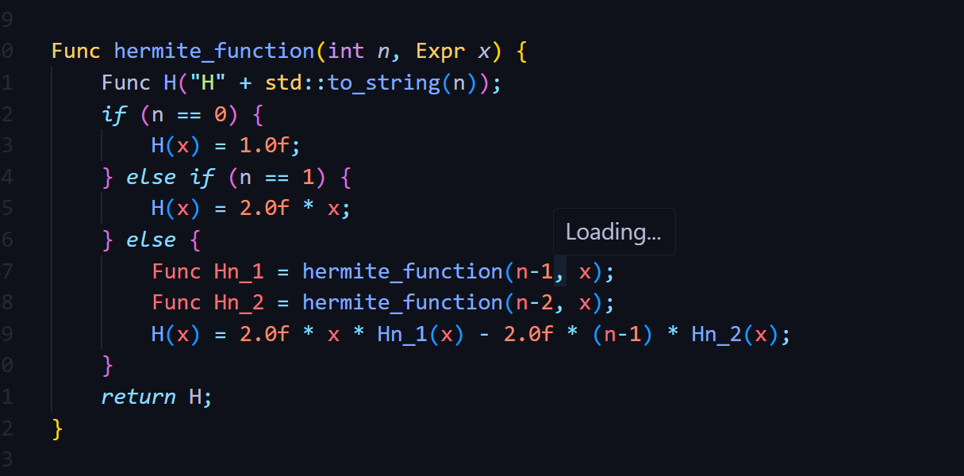
Using recursion implemented the hermite function
Subhadeep Bhadra
June 14, 2024

Slide 27
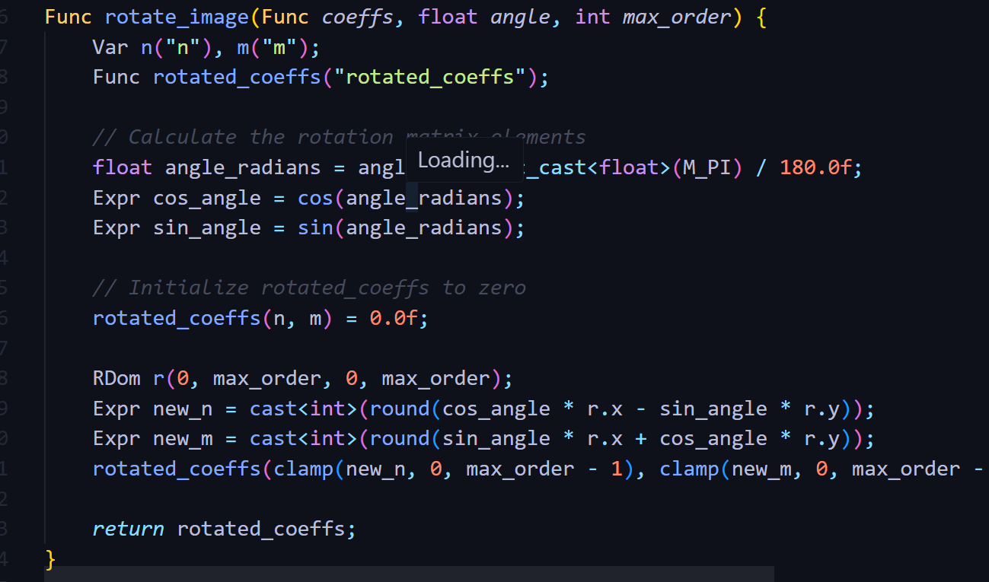
Rotate hermite
Subhadeep Bhadra
June 17, 2024

Slide 28
Implementation of Image Rotation Using Hermite Expansions
3rd Code
Hermite Polynomial Function:
Func hermite_function(int n, Expr x) {
Func H("H" + std::to_string(n)); Var t("t");
if (n == 0) {
H(t) = 1.0f;
} else if (n == 1) {
H(t) = 2.0f * t;
} else {
Func Hn_1 = hermite_function(n - 1, x);
Func Hn_2 = hermite_function(n - 2, x);
H(t) = 2.0f * t * Hn_1(t) - 2.0f * (n - 1) * Hn_2(t);
}
H.compute_root
return H;
}
2. Hermite Expansion of an Image:
Func hermite_expansion(Func image, int max_order, Expr rows, Expr cols, Expr channels) {
Var n("n"), m("m"), c("c");
Func coeffs("coeffs");
coeffs(n, m, c) = 0.0f;
RDom r(0, rows, 0, cols, 0, channels);
for (int n = 0; n < max_order; n++) {
for (int m = 0; m < max_order; m++) {
Func Hn = hermite_function(n, cast<float>(r.x) / (rows / 2.0f) - 1.0f);
Func Hm = hermite_function(m, cast<float>(r.y) / (cols / 2.0f) - 1.0f);
coeffs(n, m, r.z) += image(r.x, r.y, r.z) * Hn(r.x) * Hm(r.y);
}
}
return coeffs;
}
Sourav Parida
June 17, 2024

Slide 29
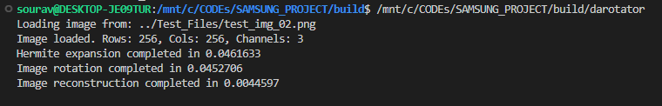
Implementation of Image Rotation Using Hermite Expansions
3rd Code
4. Reconstruct image: No changes from previous code.
3. Rotate hermite:
Func rotate_image(Func coeffs, float angle, int max_order, Expr channels) {
Var n("n"), m("m"), c("c");
Func rotated_coeffs("rotated_coeffs");
// Calculate the rotation matrix elements
float angle_radians = angle * static_cast<float>(M_PI) / 180.0f;
Expr cos_angle = cos(angle_radians);
Expr sin_angle = sin(angle_radians);
// Initialize rotated_coeffs to zero
rotated_coeffs(n, m, c) = 0.0f;
RDom r(0, max_order, 0, max_order, 0, channels);
Expr new_n = cast<int>(round(cos_angle * r.x - sin_angle * r.y));
Expr new_m = cast<int>(round(sin_angle * r.x + cos_angle * r.y));
rotated_coeffs(clamp(new_n, 0, max_order - 1), clamp(new_m, 0, max_order - 1), r.z) += coeffs(r.x, r.y, r.z);
return rotated_coeffs;
Problem: The Execution of code is stuck in the realize function of the halide.

Slide 30
Implementation of Image Rotation Using Hermite Expansions
4th Code using cpp and OpenCV.
1. Hermite:
double hermite(int n, double x) {
if (n == 0) return 1.0;
if (n == 1) return 2.0 * x;
return 2.0 * x * hermite(n - 1, x) - 2.0 * (n - 1) * hermite(n - 2, x);
}
2. HermiteExpansion:
std::vector<std::vector<double>> hermiteExpansion(const cv::Mat& channel, int order) {
int rows = channel.rows; int cols = channel.cols;
std::vector<std::vector<double>> coeffs(order, std::vector<double>(order, 0.0));
for (int m = 0; m < order; ++m) {
for (int n = 0; n < order; ++n) {
double sum = 0.0;
for (int i = 0; i < rows; ++i) {
for (int j = 0; j < cols; ++j) {
double x = (2.0 * i / rows) - 1.0;
double y = (2.0 * j / cols) - 1.0;
sum += static_cast<double>(channel.at<uchar>(i, j)) * hermite(m, x) * hermite(n, y);
}
}
coeffs[m][n] = sum / (rows * cols); // Normalizing by the number of pixels
}
}
return coeffs;
}
Sourav Parida
June 21, 2024

Slide 31
Implementation of Image Rotation Using Hermite Expansions
4th Code using cpp and OpenCV.
3. RotateChannelUsingHermite:
cv::Mat rotateChannelUsingHermite(const cv::Mat& imageChannel, double angle, int order) {
int rows = imageChannel.rows;
int cols = imageChannel.cols;
cv::Mat rotatedChannel(rows, cols, CV_64F, cv::Scalar(0.0));
double cosTheta = std::cos(angle);
double sinTheta = std::sin(angle);
for (int i = 0; i < rows; ++i) {
for (int j = 0; j < cols; ++j) {
double x = (2.0 * i / rows) - 1.0;
double y = (2.0 * j / cols) - 1.0;
double newX = cosTheta * x - sinTheta * y;
double newY = sinTheta * x + cosTheta * y;
// Convert newX, newY back to image pixel coordinates
int newI = static_cast<int>((newX + 1.0) * rows / 2.0);
int newJ = static_cast<int>((newY + 1.0) * cols / 2.0);
if (newI >= 0 && newI < rows && newJ >= 0 && newJ < cols) {
rotatedChannel.at<double>(newI, newJ) = static_cast<double>(imageChannel.at<uchar>(i, j));
}
}
}
// Normalize the channel to the range [0, 255]
double minVal, maxVal;
cv::minMaxLoc(rotatedChannel, &minVal, &maxVal);
rotatedChannel.convertTo(rotatedChannel, CV_8UC1, 255.0 / (maxVal - minVal), -minVal * 255.0 / (maxVal - minVal));
return rotatedChannel;
}

Slide 32
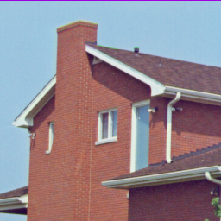
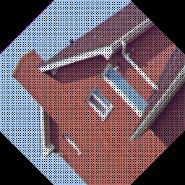
Implementation of Image Rotation Using Hermite Expansions
2nd Code using cpp and OpenCV.
4. RotateImageUsingHermite:
cv::Mat rotateImageUsingHermite(const cv::Mat& image, double angle, int order) {
std::vector<cv::Mat> channels(3);
cv::split(image, channels); // Split the image into B, G, R channels
// Rotate each channel separately
for (int i = 0; i < 3; ++i) {
channels[i] = rotateChannelUsingHermite(channels[i], angle, order);
}
cv::Mat rotatedImage;
cv::merge(channels, rotatedImage);
return rotatedImage;
}
Rotated Image using Hermite Expansion
Original Image

Slide 33
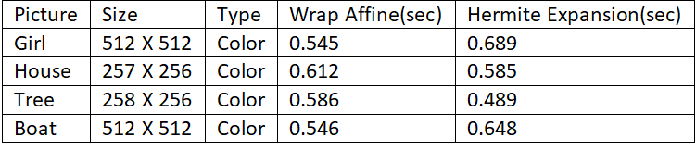
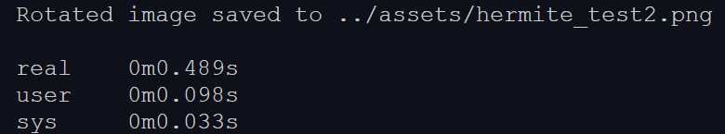
Time Consumption:-
Image rotation with Hermite Expansion using Cpp and OpenCV
Avg time of image rotation using hermite expansions is approx 0.602 sec
Avg time of wrap_affinefunction is approx 0.572 sec
Difference : 0.03 sec
Time of the rotation of image Tree (Best result)
Subhadeep Bhadra
June 21, 2024

Slide 34
Bresenham algorithm

Slide 35
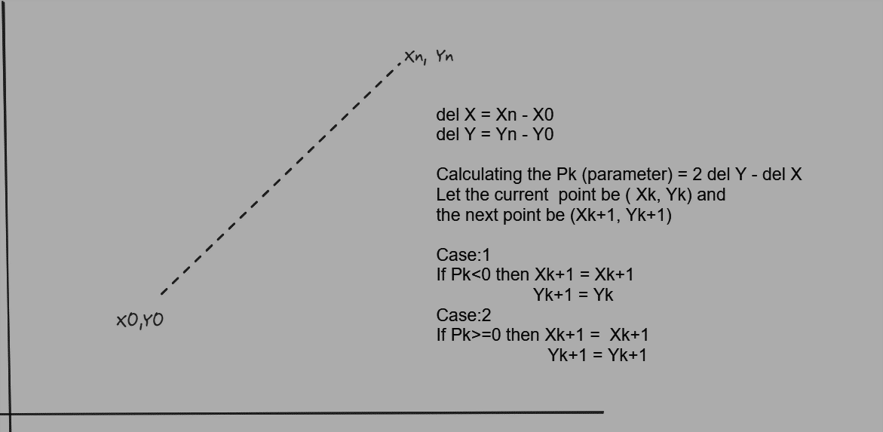
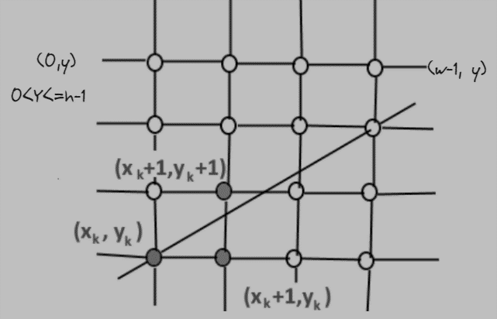
Bresenham algorithm
It determines the intermediate points that should be plotted to form a close approximation to a straight line between the start and end points.
Subhadeep Bhadra
June 25, 2024

Slide 36
Approach
At first we have to find all the points lying between the staring point (X0,Y0) and the end points (Xn,Yn) with the bresenham algorithm and store it in a data-structure.
After getting all the coordinates between the two respective points, we can use the rotation matrix to rotate the pixels and find the new x and y.
Lastly We can use the interpolation if there is any pixel is missing after rotation.

Slide 37
Implementation of Image Rotation Using Bresenham line algorithm
std::vector<cv::Point> bresenhamLine(int x0, int y0, int x1, int y1) {
std::vector<cv::Point> points;
int dx = std::abs(x1 - x0);
int dy = std::abs(y1 - y0);
int sx = (x0 < x1) ? 1 : -1;
int sy = (y0 < y1) ? 1 : -1;
int err = dx - dy;
while (true) {
points.push_back(cv::Point(x0, y0));
if (x0 == x1 && y0 == y1) break;
int e2 = 2 * err;
if (e2 > -dy) {
err -= dy;
x0 += sx;
}
if (e2 < dx) {
err += dx;
y0 += sy;
}
}
return points;
}
Explanation:
points: A vector to store the points on the line.
dx: The absolute difference between the x-coordinates of the two points.
dy: The absolute difference between the y-coordinates of the two points.
sx: The sign of the x increment. If x0 is less than x1, sx is 1; otherwise, it is -1.
sy: The sign of the y increment. If y0 is less than y1, sy is 1; otherwise, it is -1.
err: The error term, initially set to dx - dy.
Detailed Steps in Each Iteration
Current Point: Add the current point (x0, y0) to the points vector.
Check End Condition: If the current point matches the end point, break out of the loop.
Double the Error Term: Calculate e2 as 2 * err.
Adjust X: If e2 > -dy, adjust the error term by subtracting dy and move x0 by sx.
Adjust Y: If e2 < dx, adjust the error term by adding dx and move y0 by sy.
Sourav Parida
June 25, 2024

Slide 38

Optimizing performance
The primary cause of slow processing speeds in traditional image rotation methods is the fact that they are always serialized.
Halide offers a variety of scheduling methods that provide explicit control over how computations are performed, enabling significant performance optimizations.
Here’s a list of the various scheduling options that Halide provides:
.parallel(var);
.vectorize(var, width);
.tile(x, y, xo, yo, xi, yi, x_factor, y_factor);
.unroll(var, factor);
.fuse(var1, var2, fused_var);
.reorder(vars...);
Ref: https://halide-lang.org/tutorials/tutorial_lesson_05_scheduling_1.html
May 28, 2024
Dhrubajyoti Mandal
Notes:
Method: .parallel(var)
Description: Splits the computation of a function along a specified variable, allowing different portions to be computed concurrently on multiple CPU cores.
Method: .vectorize(var, width)
Description: Breaks down a computation into SIMD (Single Instruction, Multiple Data) operations that can be executed in parallel within a single CPU core.
Method: .tile(x, y, xo, yo, xi, yi, x_factor, y_factor)
Description: Divides the computation into small, manageable tiles that fit into the CPU cache, improving data locality and cache performance.
Method: .unroll(var, factor)
Description: Expands a loop by a specified factor, duplicating the loop body to reduce loop overhead and increase instruction-level parallelism.
Method: .fuse(var1, var2, fused_var)
Description: Combines two variables into a single loop, enabling joint scheduling and parallelization of the resulting fused loop.
Method: .reorder(vars...)
Description: Changes the nesting order of loops, potentially improving cache locality and exposing opportunities for vectorization and parallelism.
Comparison with Traditional Methods
Traditional image processing often relies on simple, straightforward loop-based computations with limited optimizations:
Single-threaded: By default, traditional loops are single-threaded, not utilizing multiple CPU cores.
No Vectorization: Without explicit SIMD programming, traditional loops miss out on the parallelism offered by SIMD instructions.
Poor Cache Usage: Large, unoptimized loops can lead to poor cache performance due to frequent cache misses.
Manual Optimization: Any parallelization, vectorization, or cache optimization requires manual effort and expertise, leading to complex and less maintainable code.

Slide 39
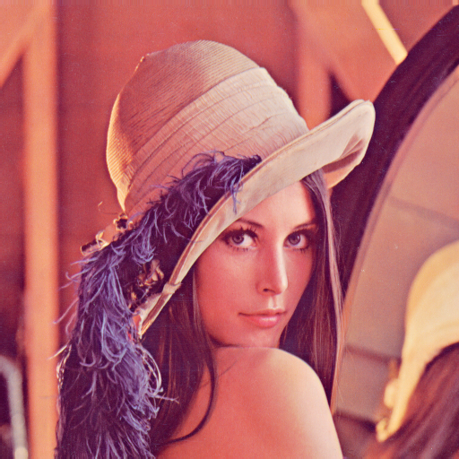
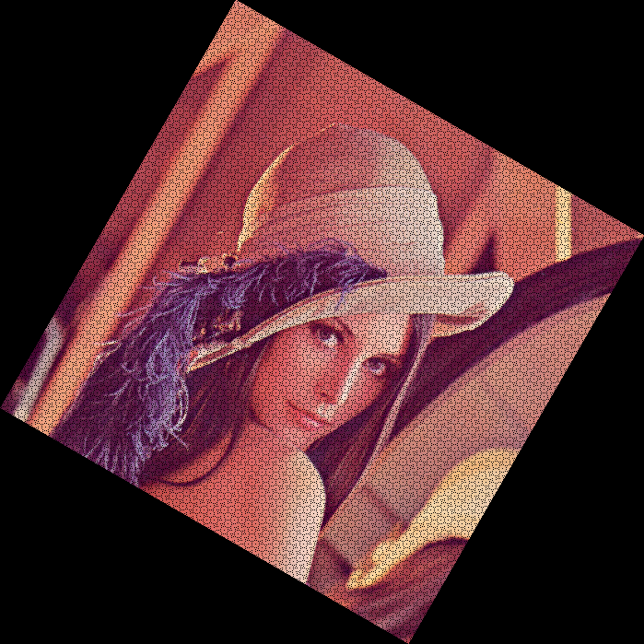
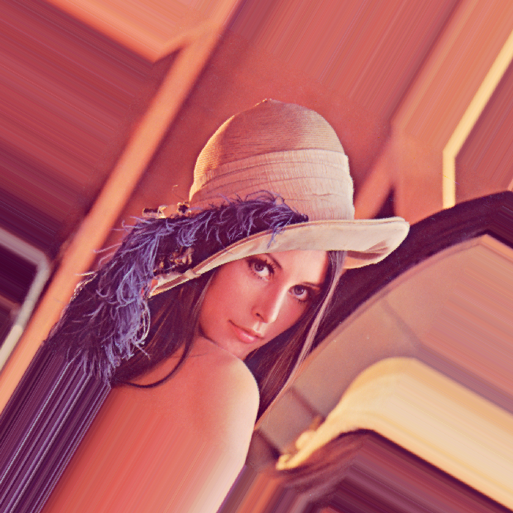
Interesting Observations
input image
output from Halide Avg execution time: 0.795s
output from OpenCV Avg execution time: 0.302s
Tests run on an Intel i7-10750H (12) @ 5.000GHz, all under similar workloads Input is a 512*512 png image ColorSpace_ICC: RGB Each of the output images turned out to be 699*699 px in dimensions
Angle of rotation: 30 degrees, about center of image Loop nest used in Halide: [using plain rotation matrix]
for c:
parallel y:
for x.x:
vectorized x.v0 in [0, 7]:
rotated(...) = ...
Notes:
Interestingly enough, even with no optimisation done, the average execution time remained the same. In some other examples, it even increased a lot of the times. The first program executing faster than the second one, despite the advanced scheduling in the second, can happen for several reasons:
Overhead of Parallelism: The overhead of managing threads and synchronization can sometimes outweigh the benefits of parallel execution, especially for relatively simple computations
Cache Behavior: Tiling is supposed to improve cache locality, but if the tile size does not align well with the cache size or if there are too many threads causing cache thrashing, performance can degrade.
Vectorization and Unrolling: These optimizations are beneficial for complex computations but might not show significant improvements for simple operations. The overhead of setting up these optimizations might not be worth it for such a straightforward calculation.
Processor and Memory Bandwidth: For very large data sizes, the memory bandwidth can become the bottleneck. The simple program might be benefiting from better cache and memory access patterns that are disrupted by the more complex scheduling in the second program.

Slide 40
Logs
$ echo "OpenCV" && for i in {1..20}; do time ./darotator; done
OpenCV
./darotator 0.29s user 0.02s system 98% cpu 0.317 total
./darotator 0.30s user 0.03s system 98% cpu 0.333 total
./darotator 0.31s user 0.02s system 98% cpu 0.331 total
./darotator 0.31s user 0.02s system 98% cpu 0.331 total
./darotator 0.30s user 0.01s system 98% cpu 0.321 total
./darotator 0.30s user 0.01s system 98% cpu 0.319 total
./darotator 0.29s user 0.02s system 98% cpu 0.312 total
./darotator 0.32s user 0.02s system 98% cpu 0.345 total
./darotator 0.30s user 0.02s system 98% cpu 0.320 total
./darotator 0.29s user 0.02s system 98% cpu 0.317 total
./darotator 0.30s user 0.02s system 98% cpu 0.325 total
./darotator 0.30s user 0.01s system 98% cpu 0.315 total
./darotator 0.30s user 0.02s system 98% cpu 0.326 total
./darotator 0.30s user 0.02s system 97% cpu 0.333 total
./darotator 0.31s user 0.01s system 98% cpu 0.319 total
./darotator 0.31s user 0.01s system 98% cpu 0.325 total
./darotator 0.30s user 0.02s system 98% cpu 0.328 total
./darotator 0.29s user 0.03s system 98% cpu 0.327 total
./darotator 0.31s user 0.01s system 98% cpu 0.331 total
./darotator 0.31s user 0.01s system 98% cpu 0.328 total AVG: 0.302s
$ echo "Halide -parallel(y) -vectorize(x, 8)" && for i in {1..20}; do time ./darotator; done
Halide -parallel(y) -vectorize(x, 8)
./darotator 0.81s user 0.02s system 100% cpu 0.831 total
./darotator 0.85s user 0.03s system 100% cpu 0.878 total
./darotator 0.82s user 0.02s system 100% cpu 0.842 total
./darotator 0.77s user 0.06s system 100% cpu 0.834 total
./darotator 0.82s user 0.03s system 99% cpu 0.849 total
./darotator 0.80s user 0.02s system 100% cpu 0.813 total
./darotator 0.79s user 0.03s system 100% cpu 0.815 total
./darotator 0.78s user 0.03s system 100% cpu 0.804 total
./darotator 0.77s user 0.04s system 100% cpu 0.816 total
./darotator 0.77s user 0.04s system 100% cpu 0.813 total
./darotator 0.79s user 0.03s system 100% cpu 0.818 total
./darotator 0.80s user 0.03s system 100% cpu 0.824 total
./darotator 0.79s user 0.02s system 100% cpu 0.806 total
./darotator 0.81s user 0.02s system 100% cpu 0.829 total
./darotator 0.81s user 0.03s system 100% cpu 0.833 total
./darotator 0.79s user 0.05s system 100% cpu 0.835 total
./darotator 0.77s user 0.06s system 100% cpu 0.823 total
./darotator 0.76s user 0.06s system 100% cpu 0.818 total
./darotator 0.76s user 0.04s system 100% cpu 0.800 total
./darotator 0.83s user 0.01s system 100% cpu 0.838 total
AVG: 0.795s
Notes:
These tests were only run on one single image, and thus have a lot of room for improvement. From here on, tests will be performed on images of varying sizes to get a more comprehensive overview of the program’s performance.

Slide 41
Further Optimization Scopes
Worklet: 24VI24KIIT
Dhrubajyoti Mandal
May 31, 2024

Slide 42
The Halide Auto-Scheduler
Oftentimes, it happens that manually designed schedules end up being worse than no optimization at all.
In order to get a reasonable start, we can use Halide’s Auto-Scheduler to give us a convenient starting point, which we can fine-tune later on.
**effective optimization requires a careful analysis of the system the program is running on itself, and finding the right balance between parallelism and memory efficiency.
Ref: https://halide-lang.org/tutorials/tutorial_lesson_21_auto_scheduler_generate.html
Notes:
For image rotation, there may be various scheduling decisions to make, such as tiling sizes, loop ordering, and parallelization strategies. The auto-scheduler can efficiently explore this vast space of possible schedules to find the optimal configuration for the target architecture.
Also, different hardware architectures may benefit from different scheduling strategies. The auto-scheduler can adapt the schedule to the specific characteristics of the target hardware.

Slide 43
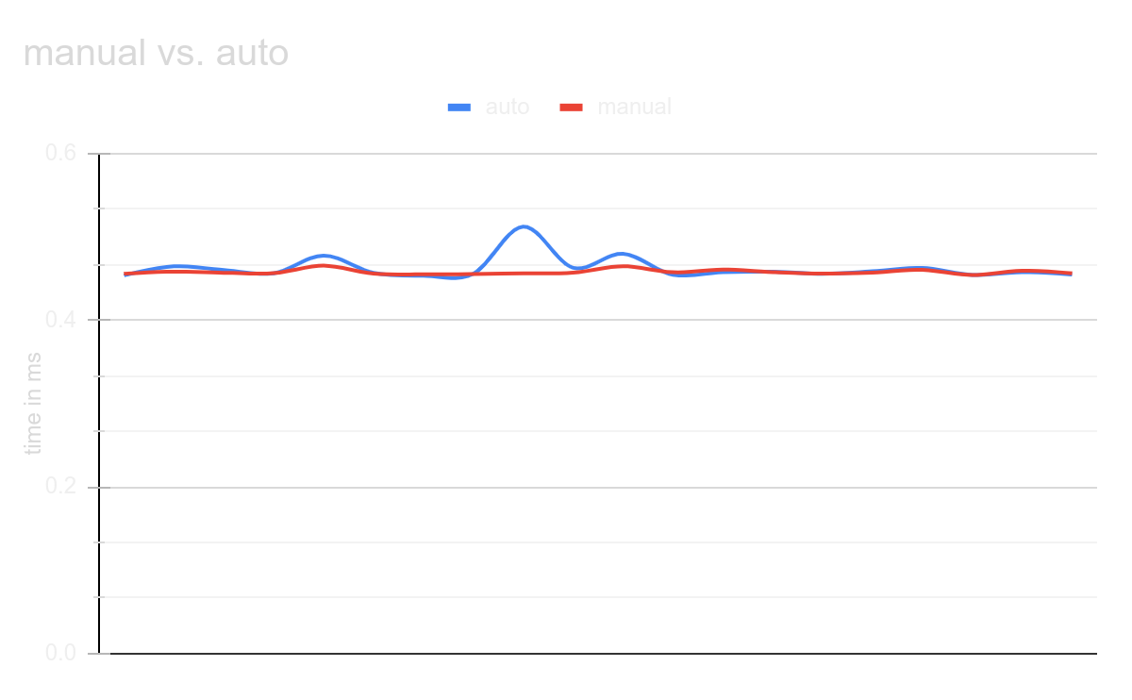
Experimental Results
Execution time (in ms) of a 1024*1024 input buffer
AUTO MANUAL
0.453748, 0.455682
0.46457, 0.458186
0.460088, 0.456807
0.456097, 0.456307
0.477421, 0.46533
0.456687, 0.455722
0.453297, 0.454896
0.455597, 0.455253
0.512179, 0.456135
0.462807, 0.45684
0.479661, 0.464707
0.454347, 0.457395
0.457544, 0.460674
0.458069, 0.45758
0.455576, 0.455699
0.458554, 0.457064
0.462642, 0.460217
0.454166, 0.454072
0.457571, 0.45936
0.454757, 0.456103
Tests run on an Intel i7-10750H (12) @ 5.000GHz, all under similar workloads Auto-Scheduler specifications: target=host autoscheduler=Mullapudi2016 autoscheduler.parallelism=32 autoscheduler.last_level_cache_size=16777216 autoscheduler.balance=40

Slide 44
An Alternate Approach: The DLR Method
Worklet: 24VI24KIIT
Dhrubajyoti Mandal
June 4, 2024

Slide 45
The DLR Method
The Double Line Rotation (DLR) Method is a one-pass method for realizing the high-speed rotation of images while preserving the image quality. This method employs the line coordinates in the target image. It finds the base-line equation in the target image and extracts all pixels that correspond to the base-line.
Extracting the pixels that correspond to the base-line is performed only once. The corresponding pixels in other lines of the target image are calculated by addition or subtraction from the base-line pixel coordinates.
Ref: Ashtari, A.H., Nordin, M.J. and Kahaki, S.M.M., 2015. Double line image rotation. IEEE Transactions on Image Processing, 24(11), pp.3370-3385.

Slide 46
The Breakdown
The DLR algorithm takes place in essentially three stages:
Base-Line Calculation
Unallocated Pixel Filling Strategy (some sort of interpolation basically)
Calculation of the Base-Line, Start-Line and Target Image Size

Slide 47
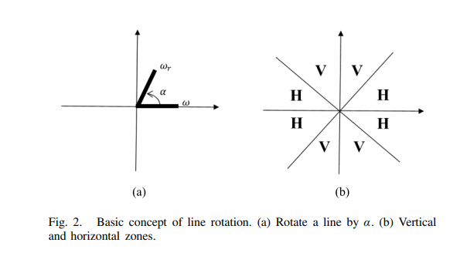
Base-Line Calculation
A base-line equation in the target image with an arbitrary slope of α is calculated. Then, all columns or rows from the original image, depending on α, are transformed to the corresponding coordinates in the target image.
The base-line is given by f(x) = Sx, S = tan(α).
The other corresponding lines (in the rotated image) can be computed by:
f(x) = Sx + b, b∈𝕫
Notes:
All pixels from the original line get transferred to the base-line. The angle of rotation, α is segmented into 8 areas and 2 groups. In the H areas, horizontal lines from the original image are used for rotation; in the V zones, vertical lines from the original image are employed. The m × n image T has m lines in V zones and n lines in H zones.

Slide 48
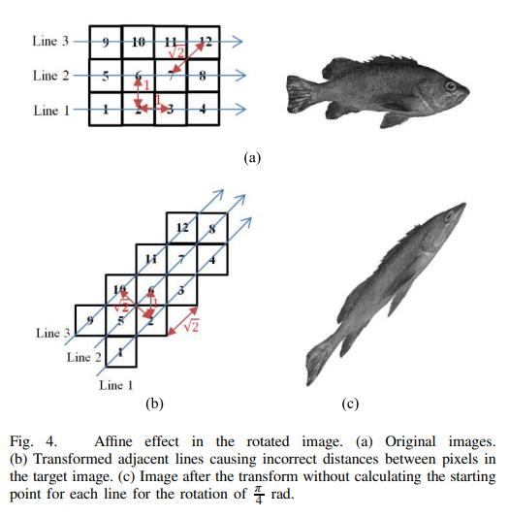
The Issue: An Affine-Skewed Effect
Heterogeneous distances between rotated pixels in the target image cause an affine image. To avoid the affine transform, all pixel distances in the target image must be the same multiple of the original image’ corresponding distance.
So, what we can do, is have a line f_{s}(x) determine the “starting point” of each of the other lines derived from the base-line. This line is later referred to as the “starting line” or the “start-line”, as f_{s}(s) = y/S_{b}, where S_{b} is the slope of the perpendicular to the base-line.

Slide 49
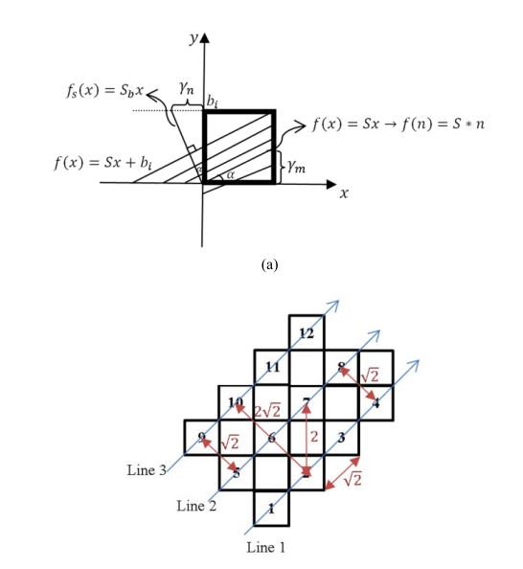
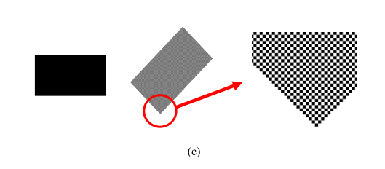
Choosing a “starting point” for each of the “lines” of the rotated image, the skewing effect can be fixed!
Notes:
Now, the issue here is a bunch of unallocated pixels, which we’ll look over later. For now though, we can check out the demonstration of the line derivation at https://www.desmos.com/calculator/ujpy5sqxfa

Slide 50
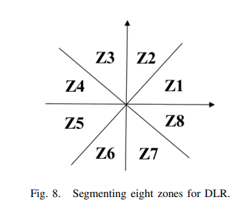
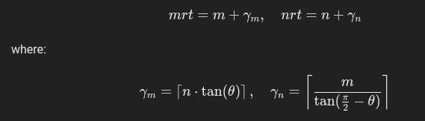
Calculation of the Base-Line, Start-Line and Target Image Size (Zone 1)
The base line is defined as f(x) = tan(α) x The new image dimensions are defined as follows:
For Zone 1, we have the ys defined, not the xs, so for that, using the equation of the start line f_{s}(s) = y/S_{b}, we can calculate the required mapping, for each line i of the image. For instance, the starting pixel of the rotated image for line i would be (f_{s}(i), i).

Slide 51
The DLR Method in Practice
Worklet: 24VI24KIIT
Dhrubajyoti Mandal
June 7, 2024

Slide 52
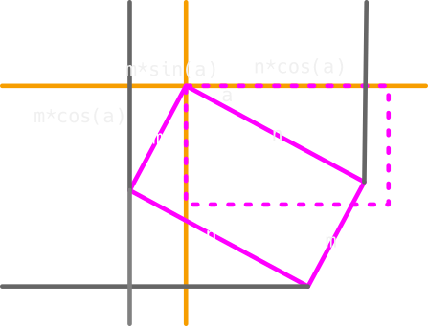
The Foundation
Calculating the new dimensions isn’t always as straightforward as it might seem.
For example, in the paper, where it is mentioned that mrt and nrt can be calculated using the following:
, hardly works. Instead, it’s best to find the new dimensions manually, zone wise.

Slide 53
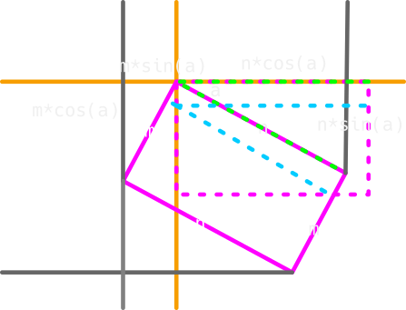
How The Mapping Works
The starting point, for each such incremental mapping is given by:
(f_{s}(i), i), where f_{s}(x) = x / tan(𝛼 + π/2)
From that point on, we can determine where the rest of the pixels will be placed.
In this example, we need to map n pixels over the span of n*cos(𝛼) in the x axis, and n*sin(𝛼) in the y axis. Consequently, we can determine, for each time we iterate over a pixel to be mapped, how much should the x and y change in the rotated image.

Slide 54
How The Mapping Works
rise = n * np.sin(alpha)
run = n * np.cos(alpha)
max_start_y = int(np.ceil(m * np.cos(alpha)))
fs = lambda y: y / np.tan(alpha + np.pi / 2)
y_incr = np.floor(n / rise)
x_incr = np.floor(n / run)
# more generally, if x_incr/y_incr > 1, (x_incr/y_incr) can be treated as a mod factor wrt x and vice-versa
if y_incr > x_incr:
mod_factor = y_incr // x_incr
for line in range(max_start_y):
a, b = int(np.ceil(fs(line))), line
for pixel in range(n):
# print(f"{(a + x_offset, b)} maps to {(pixel, line)}, i.e {img[line][pixel]}")
rot[b, a + x_offset] = img[line, pixel]
# ASHTARI et al.: DOUBLE LINE IMAGE ROTATION
rot[b + 1, a + x_offset] = img[line, pixel]
a += 1
if pixel > 0 and pixel % mod_factor == 0:
b += 1

Slide 55
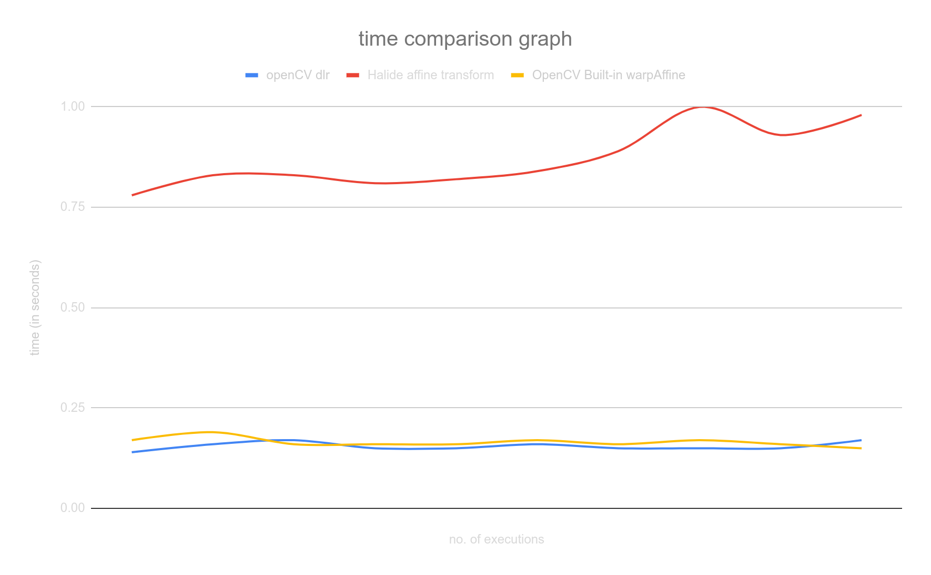
The Results
openCV dlr | Halide affine transform | OpenCV Built-in warpAffine
0.14 | 0.78 | 0.17
0.16 | 0.83 | 0.19
0.17 | 0.83 | 0.16
0.15 | 0.81 | 0.16
0.15 | 0.82 | 0.16
0.16 | 0.84 | 0.17
0.15 | 0.89 | 0.16
0.15 | 1 | 0.17
0.15 | 0.93 | 0.16
0.17 | 0.98 | 0.15
0.155 | 0.871 | 0.165
Tests run on an Intel i7-10750H (12) @ 5.000GHz, all under similar workloads Input is a 512*512 png image ColorSpace_ICC: RGB

Slide 56
Potential Issues with the Halide Implementation
Worklet: 24VI24KIIT
Dhrubajyoti Mandal
June 11, 2024

Slide 57
Synopsis
The current method evaluates pixels in an irregular range, with irregular loop increments. The issue here is that Halide operates on a pretty discrete domain, with regular updates in loop variables. So why is that an issue? Well, Halide operates through all the pixels of a particular input buffer via the .realise() function, following regular loop variable increments.
for line in range(max_start_y):
a, b = int(np.ceil(fs(line))), line
for pixel in range(n):
# print(f"{(a + x_offset, b)} maps to {(pixel, line)}, i.e {img[line][pixel]}")
rot[b, a + x_offset] = img[line, pixel]
rot[b + 1, a + x_offset] = img[line, pixel]
a += 1
if pixel > 0 and pixel % mod_factor == 0:
b += 1

Slide 58
Compiler Intrinsics - Exploiting SIMD
Worklet: 24VI24KIIT
Dhrubajyoti Mandal
June 14, 2024

Slide 59
Compiler Intrinsics
Compiler intrinsics allow us to create low-level, processor-specific code for maximum performance and control. Most functions are contained in libraries, but some functions are built in (that is, intrinsic) to the compiler. These are referred to as intrinsic functions or intrinsics. If a function is an intrinsic, the code for that function is usually inserted inline, avoiding the overhead of a function call and allowing highly efficient machine instructions to be emitted for that function.
Ref: https://learn.microsoft.com/en-us/cpp/intrinsics/compiler-intrinsics?view=msvc-170

Slide 60
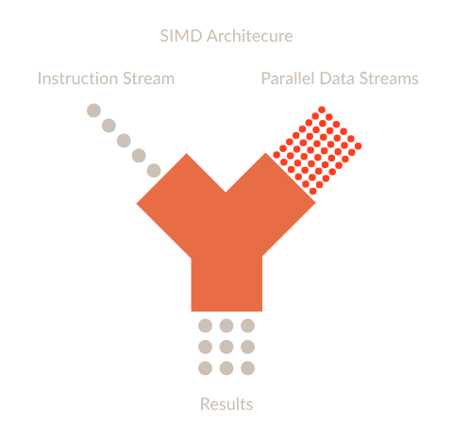
Arm Neon
The Arm Neon technology, also referred to as the Advanced SIMD (Single Instruction Multiple Data) architecture extension for implementation of the Armv8-A or Armv8-R architecture profiles.
Neon technology provides a dedicated extension to the Instruction Set Architecture, providing additional instructions that can perform mathematical operations in parallel on multiple data streams.
Ref: https://developer.arm.com/documentation/102474/0100/Overview?lang=en

Slide 61
The Catch?
NEON intrinsics are specific to ARM architecture, and they are not directly supported on x86 architecture - which, coincidentally, happens to be most of our developer machines.
What can be done?
Well, for starters, we could cross compile all the dependencies we have, for aarch64, and them compile them to an aarch64 binary and emulate that using a hypervisor like QEMU…
Or, we could emulate an entire arm device (such as a raspberry-pi 4b), install the binaries and dependencies out there, bring them back to our host machine and then run our program.
However, all these approaches lead to either having broken dependency cycles, or linking issues.

Slide 62
The Workaround
We can use the MMX and SSE intrinsics which are available for x86 architecture and provide similar SIMD capabilities.
These can be included in our usual cpp code via the <intrin.h> header, or <xmmintrin.h> for extra functionalities.
Once again, intrinsics are compiler and CPU specific, so no final results would turn out to be the same, however, we can expect to see a similar performance profile across the board.
Ref:
https://www.intel.com/content/www/us/en/docs/cpp-compiler/developer-guide-reference/2021-10/overview.html
https://www.intel.com/content/www/us/en/docs/intrinsics-guide/index.html

Slide 63
Implementation
for (int pixel = 0; pixel < n * 3; pixel += 12) { // Process 4 pixels (12 bytes) at a time
// Load 4 pixels at a time using SSE
__m128i pixels = _mm_loadu_si128(reinterpret_cast<const __m128i *>(&src_ptr[pixel]));
// Store these pixels in the destination image
_mm_storeu_si128(reinterpret_cast<__m128i *>(&dst_ptr[(a * 3) + x_offset * 3]), pixels);
_mm_storeu_si128(reinterpret_cast<__m128i *>(&dst_ptr_next[(a * 3) + x_offset * 3]), pixels);
a += 4; // Since we process 4 pixels at a time
if (pixel > 0 && pixel % mod_factor == 0) {
b += 2;
dst_ptr = rot.ptr<uchar>(b);
dst_ptr_next = rot.ptr<uchar>(b + 1);
}
}
The above code snippet shows how previously implemented algorithms, (in this case, the DLR) can be optimized with compiler intrinsics. This code isn’t fully benchmarked and tested yet, however, this method does bring in a promising compromise between code stability and predictability, and overall speed and optimization.

Slide 64
Getting Arm NEON to work on x86
Worklet: 24VI24KIIT
Dhrubajyoti Mandal
June 18, 2024

Slide 65
Cross compilation
With the help of cross compilation tools, and forcing static linking, we can get aarch64 features to work on x86 (albeit with emulation).
This results in slightly larger binaries, since all the dependencies are cramped into one single file, but that completely removes all previous errors related with linking, etc.
Performance details*
Benchmark (default, built-in OpenCV rotation function): 0.08 s
DLR implementation: 0.08 s
DLR implementation with Neon intrinsics: 0.074 s
* Highly experimental and subject to change All tests were performed on a 192*81, PNG grayscale image under similar workloads.

Slide 66
Continuing DLR… [Zone 2]
Worklet: 24VI24KIIT
Dhrubajyoti Mandal
June 21, 2024

Slide 67
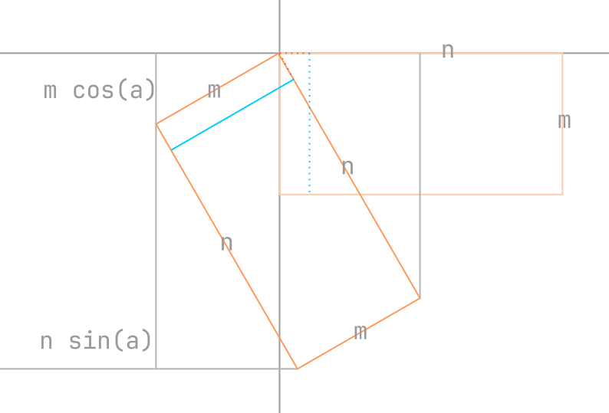
The approach
Similar to how it was done for zone 1, we first calculate the new dimensions of the m * n image, mrt * nrt according to the diagram shown alongside.
In this zone, the vertical lines are mapped instead of the horizontal ones.
Since this time, we know all the x coordinates, all starting points of the lines are given by: (x, f_{s}(x)), where: f_{s}(x) = tan(ɑ)x Then, it is a matter of mapping all (0 to m vertical px) over a span of m*cos(ɑ) in the x-axis and a span of m*sin(ɑ) in the y-axis.

Slide 68
Benchmarks and Initial Results
Worklet: 24VI24KIIT
Dhrubajyoti Mandal
June 25, 2024

Slide 69
Results
Before proceeding further, it is a good idea to see if we are even doing any good. As such, a series of tests were run against varying image sizes, and a trend was observed - images whose resolutions exceeded 1080p were processed much faster by the benchmark OpenCV built-in functions than the DLR approach.
The same was not true for smaller images, however.
The following slides will showcase a line chart of the benchmarking results. The x-axis represents the nth trial which a specific program was run, and the y-axis represents the time taken by said program in seconds.

Slide 70
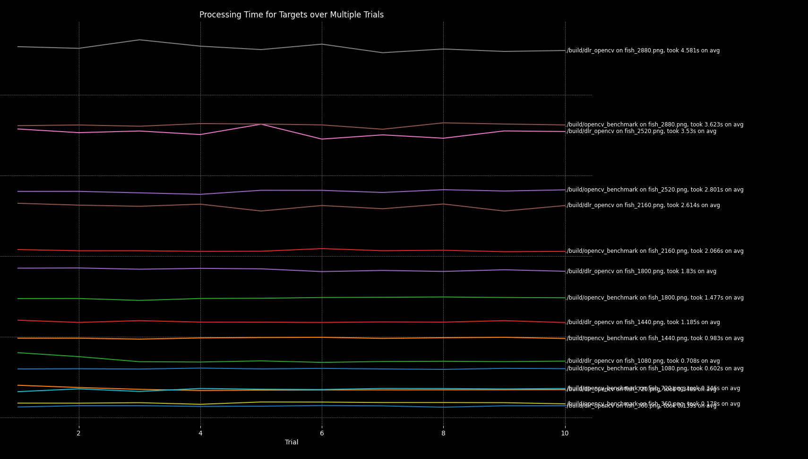
Results
This is the overall graph of all of the tests. The x-axis represents the nth trial which a specific program was run, and the y-axis represents the time taken by said program in seconds.

Slide 71
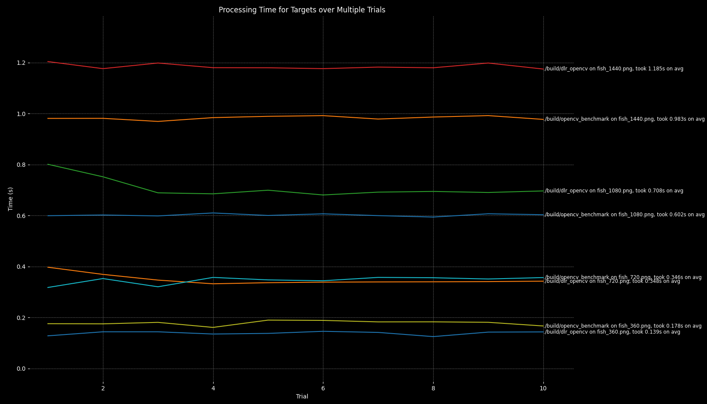
Results
Zooming in, we can better see when the DLR algorithm starts to fall off…

Slide 72
Analysis
Since for a lot of the tests, the DLR method did seem to perform extremely well, it is worth taking a moment to analyse why it starts to fall behind in larger images.
Turns out, the built-in OpenCV implementation for image rotation (the one we are using as our benchmark) uses multithreading under the hood, which explains how it manages to perform consistently well.
This is verified by checking the CPU usage and also tracking the number of subprocess each method spawns in its entire lifespan (confirming the use of multithreading).

Slide 73
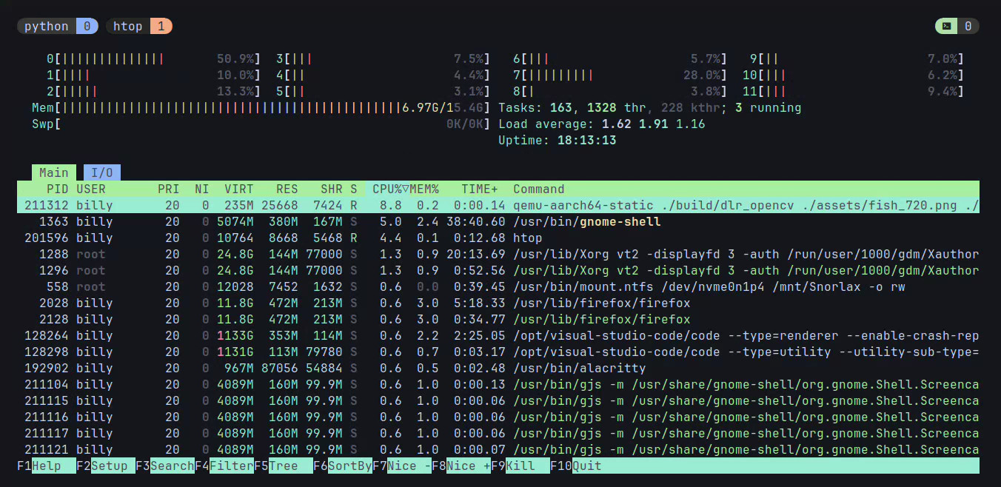
Analysis
Monitoring the resource usage here, we can see that for a 720p image, the DLR algorithm spawns a single process (it’s not using multithreading), and is not particularly heavy on the CPU

Slide 74
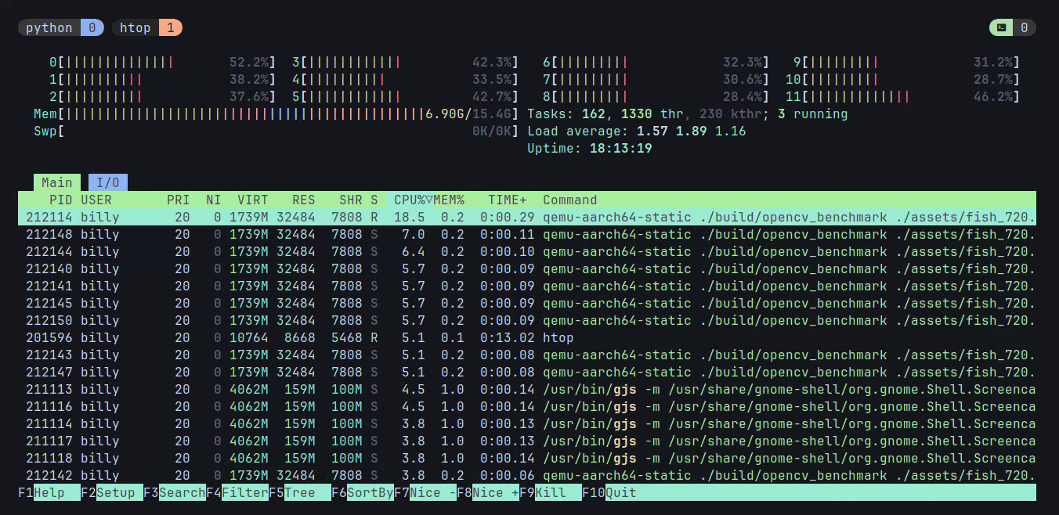
Analysis
Monitoring the resource usage here, we can see that for the same 720p image, the benchmark spawns a multiple processes (it is using multithreading), and is considerably particularly heavy on the CPU. This also explains the significant performance improvements it gets in larger images.

Slide 75
Key Takeaway
If we strictly want to compare which algorithm is better, we can use a custom version of the function used for benchmarking - warpAffine(), without any optimization or multithreading.
As far as increasing the performance of DLR itself is concerned, using multithreading might be the way to go, since this already is a fairly promising algorithm, which beats a lot of the other algorithms that have been discussed thus far.

Slide 76
Implementing a multithreaded approach
Worklet: 24VI24KIIT
Dhrubajyoti Mandal
June 28, 2024

Slide 77
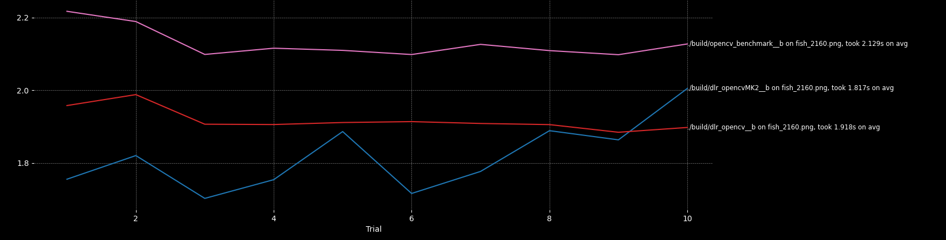
Key Takeaway
The hypothesis discussed in the previous section proved to be correct. Implementing a multithreaded approach significantly sped up the loops used for the mapping of rotated images in all benchmarking scenarios.
In this graph, the y axis represents time in seconds, and the x axis represents the nth trial.

Slide 78
Comparison between DLR and Warp Affine

Slide 79
Implementation of Image Rotation Using Bresenham line algorithm
cv::Mat rotateImage(const cv::Mat& image, double angle) {
int h = image.rows;
int w = image.cols;
double dc = std::cos(angle * CV_PI / 180.0);
double ds = std::sin(angle * CV_PI / 180.0);
// Calculate dimensions of the new image
int h_new = static_cast<int>(std::abs(h * dc) + std::abs(w * ds));
int w_new = static_cast<int>(std::abs(h * ds) + std::abs(w * dc));
cv::Mat rotatedImage = cv::Mat::zeros(h_new, w_new, image.type());
int cx = w / 2;
int cy = h / 2;
int cx_new = w_new / 2;
int cy_new = h_new / 2;
for (int y = 0; y < h; ++y) {
auto line = bresenhamLine(0, y, w - 1, y); // Get points of the line using Bresenham's algorithm
for (const auto& point : line) {
int x = point.x;
int y = point.y;
int x_new = static_cast<int>((x - cx) * dc - (y - cy) * ds + cx_new);
int y_new = static_cast<int>((x - cx) * ds + (y - cy) * dc + cy_new);
if (x_new >= 0 && x_new < w_new && y_new >= 0 && y_new < h_new) {
rotatedImage.at<cv::Vec3b>(y_new, x_new) = image.at<cv::Vec3b>(y, x);
}
}
}

Slide 80
Implementation of Image Rotation Using Warp Affine
Load Input Image: Load the input image using OpenCV’s imread function. Check if the image data is loaded successfully.
Set Rotation Angle and Center: Define the rotation angle.
Calculate the center of the image.
Calculate Rotation Matrix: Use OpenCV’s getRotationMatrix2D to get the rotation matrix.
Calculate Bounding Box for Rotated Image: Use OpenCV’s RotatedRect to calculate the size of the bounding box that can contain the rotated image.
Adjust the Transformation Matrix: Adjust the rotation matrix to account for the translation required to keep the image centered.
Perform the Affine Transformation (Rotation):Use OpenCV’s warpAffine to perform the rotation with bilinear interpolation.
Save the Rotated Image: Save the rotated image using OpenCV’s imwrite function.
Limitation : It uses floating point multiplications in the loops so it takes more time.
Sourav Parida
July 04, 2024

Slide 81
Implementation of Image Rotation Using DLR
Compute Rotation Parameters: Normalize the rotation angle to the range [0, 360) degrees. Convert the angle to radians.
Compute trigonometric values (sin_alpha, cos_alpha, tan_alpha, tan_alpha_).
Calculate Output Image Size: Determine the dimensions of the rotated image matrix (mrt, nrt).
Initialize the Rotated Image Matrix: Create an empty matrix (rot) with the computed dimensions and the same type as the input image.
Determine Rotation Zone and Set Parameters: Based on the angle, determine which zone (1-8) the angle falls into.
Set parameters such as offsets, function for x value (fs), deltas, and loop limits accordingly.
Perform Rotation Using the rotate Function: The rotate function is called with the appropriate parameters.
Use OpenMP for parallel processing to speed up the computations.
Iterate through each pixel in the source image, computing the corresponding destination coordinates in the rotated image.
Advantage : It uses floating point multiplications once while calculating the trigonometric values and in the loops it performs simple arithmetic additions.

Slide 82

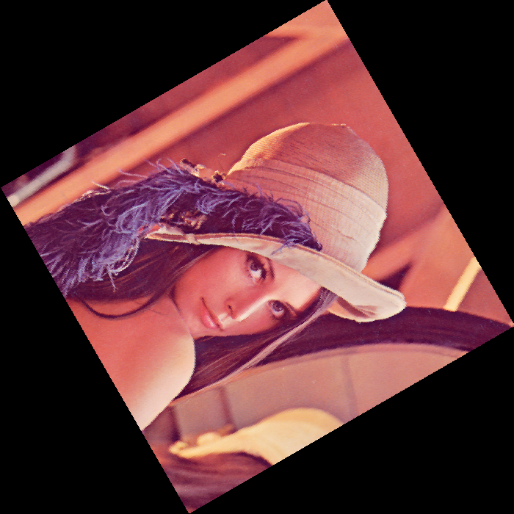
Comparison of DLR approach with Wrap Affine
Results for Low Dimension Pictures -:
Photo | Type | Dimension | Wrap_affine(sec) | DLR(sec)
Girl | Color | 512 x 512 | 0.5352 | 0.4489
House | Color | 257 x 256 | 0.5123 | 0.4287
Tree | Color | 258 x 256 | 0.5231 | 0.4213
Fish | Gray | 192 x 81 | 0.4421 | 0.4134
Average for Wrap_affine is 0.5031 sec
Average for DLR approach is 0.4280 sec
Subhadeep Bhadra
July 04, 2024

Slide 83
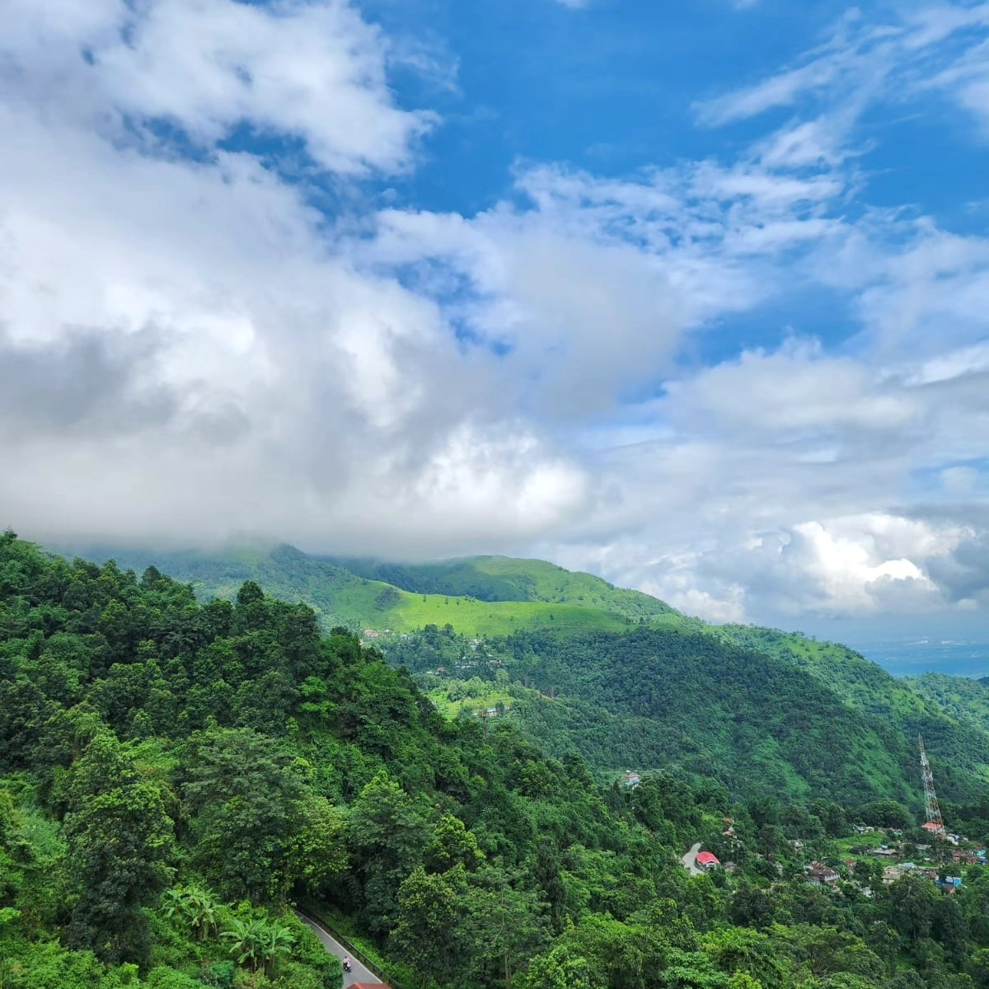
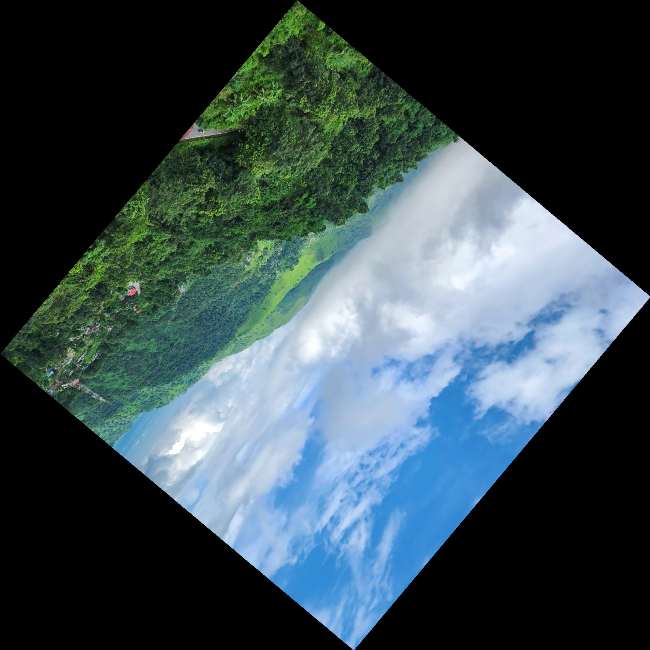
Results for High Dimension Pictures :-
Comparison of DLR approach with Wrap Affine
Landscape
Rotated Landscape
Photo | Type | Dimension | DLR(sec) | Wrap_affine(sec)
5am | Color | 3024 x 4032 | 1.972 | 2.210
Landscape | Color | 1200 x 1200 | 0.863 | 0.972
Kurseong | Color | 4160 x 2339 | 1.024 | 1.286
Church | Color | 4032 x 2268 | 1.563 | 1.612
Mountain | Color | 4096 x 2303 | 1.391 | 1.564
Down Hill | Color | 2268 x 4032 | 1.568 | 1.653
Average for DLR approach is 1.396 sec
Average for Wrap_affine is 1.549 sec

Slide 84
Final Results: Existing and Current Algorithms
Worklet: 24VI24KIIT
Dhrubajyoti Mandal
Jul 04, 2024

Slide 85
Benchmark vs Current Algorithm
The key difference lies in the overall amount of computations performed. As claimed by DLR, the number of compute intensive computations is significantly reduced in the case of DLR, giving it the massive speed boost.
Algorithm | # float multiplications | # float additions/subtractions
Benchmark (OpenCV warpAffine) | 4 * mrt * nrt | 6 * mrt * nrt
Modified DLR | m cos(ɑ) or n sin(ɑ) | m cos(ɑ) (4n + 1) or n sin(ɑ) (4m + 1)
Note: The above data holds true if we’re ignoring the one time calculations (which are common to both cases, such as the calculation of the size of the image, etc.)

Slide 86
Benchmark Algorithm
Mat img = imread(argv[1]);
double rot_angle = stod(argv[3]);
Point2f center(img.cols / 2.0, img.rows / 2.0);
Mat rotation_mat = getRotationMatrix2D(center, rot_angle, 1.0);
// Calculate the size of the bounding box for the rotated image
Rect2f bbox = RotatedRect(Point2f(), img.size(), rot_angle).boundingRect2f();
// Adjust the transformation matrix
rotation_mat.at<double>(0, 2) += bbox.width / 2.0 - img.cols / 2.0;
rotation_mat.at<double>(1, 2) += bbox.height / 2.0 - img.rows / 2.0;
Mat rotated;
warpAffine(img, rotated, rotation_mat, bbox.size());

Slide 87
Benchmark Algorithm
// Calculate the size of the rotated image
int new_cols = static_cast<int>(abs(cols * alpha) + abs(rows * beta));
int new_rows = static_cast<int>(abs(rows * alpha) + abs(cols * beta));
Mat rotated(new_rows, new_cols, CV_8UC3, Scalar(0, 0, 0));
double c_x = cols / 2.0;
double c_y = rows / 2.0;
double new_c_x = new_cols / 2.0;
double new_c_y = new_rows / 2.0;
// Define matrix elements
double m11 = alpha;
double m12 = beta;
double m13 = (1 - alpha) * new_c_x - beta * new_c_y + c_x - new_c_x;
double m21 = -beta;
double m22 = alpha;
double m23 = beta * new_c_x + (1 - alpha) * new_c_y + c_y - new_c_y;

Slide 88
Benchmark Algorithm
// Parallelize the loop using OpenMP
#pragma omp parallel for collapse(2)
for (int y = 0; y < new_rows; y++) {
for (int x = 0; x < new_cols; x++) {
int x_ = static_cast<int>(round(m11 * x + m12 * y + m13));
int y_ = static_cast<int>(round(m21 * x + m22 * y + m23));
if (x_ >= 0 && x_ < cols && y_ >= 0 && y_ < rows) {
rotated.at<Vec3b>(y, x) = img.at<Vec3b>(y_, x_);
}
}
}

Slide 89
Modifications made to DLR
The key modifications made to the existing DLR algorithm are mostly:
A base line equation is not calculated. All computations are based on the starting line (f_{s}) alone, significantly reducing overall algorithm complexity.
A robust pixel mapping strategy is used, instead of relying on incrementing the base line equation. This solves the issue of how exactly a pixel is mapped, since that, in particular, is not very clearly mentioned in the original research paper.
Further, the new strategy generalises the algorithm even further by calculating the new image size only once (mrt and nrt), regardless of zone, and also exploiting the fact, that a starting point is always of the form: (f_{s} (i), i), to further ease out the logic.

Slide 90
The Algorithm Itself
def rotate(img, rot, x_offset, y_offset, delta_x, delta_y, delta_i, fs, outer_limit, last_px, horizontal, negate_coords=False, flip_range=False):
src_i = 0
shift = 1
for i in range(outer_limit):
x_, y_ = fs(i), i
range_ = range(last_px, -1, -1) if flip_range else range(last_px)
for px in range_:
try:
x, y, i_ = [floor(_) for _ in (x_, y_, src_i)]
if negate_coords: shift = -1
a, b = (px, i_) if not horizontal else (i_, px)
rot[shift * (y + y_offset), shift * (x + x_offset)] = img[a, b] # y, x
rot[shift * (y + y_offset) + 1, shift * (x + x_offset)] = img[a + b]
x_ += delta_x
y_ += delta_y
except IndexError: pass
src_i += delta_i

Slide 91
The Algorithm Itself
The arguments to the function are then calculated for each zone, separately. There are only a few tweaks that are to be made, so mostly, it’s just a re-written form of existing zones. Thus, for example, for zone 1 and 5, we’ll have the following scenario, and so on…
if (z1 := 0 <= angle <= 45) or (180 < angle <= 225):
x_offset = ceil(m * sin_alpha)
y_offset = 0
fs = lambda y: y / tan_alpha_ # starting line equation
delta_x = cos_alpha
delta_y = sin_alpha
delta_i = 1 / delta_x
outer_limit = ceil(m * cos_alpha)
last_px = n
rotate(img, rot, x_offset, y_offset, delta_x, delta_y, delta_i, fs, outer_limit, last_px, horizontal=True, negate_coords=not z1)

Slide 92
Execution time Analysis
 | proposed |  |  |  | Affine |  |  |  | benchmark__b |  |  |  | Linear
Angle | 35 | 146 | 287 | avg | 35 | 146 | 287 | avg | 35 | 146 | 287 | avg | 35 | 146 | 287 | avg
5am.jpg | 2.57054 | 2.61029 | 2.20601 | 2.46228 | 3.98425 | 3.88824 | 3.40368 | 3.758723 | 2.92539 | 2.89878 | 2.85153 | 2.8919 | 2.95796 | 3.01006 | 2.70823 | 2.892083
church_bottom.jpg | 1.67227 | 1.74029 | 1.61923 | 1.677263 | 2.77613 | 2.84669 | 2.43628 | 2.686367 | 2.44978 | 2.13748 | 1.94356 | 2.17694 | 2.20043 | 2.21806 | 1.9048 | 2.107763
corridor.jpg | 1.93694 | 1.9074 | 1.80122 | 1.881853 | 3.01535 | 2.96423 | 2.94182 | 2.9738 | 2.39441 | 2.4344 | 2.04652 | 2.291777 | 2.31226 | 2.34262 | 1.95055 | 2.20181
landscape.jpg | 0.524083 | 0.519077 | 0.498786 | 0.513982 | 0.653922 | 0.710662 | 0.608422 | 0.657669 | 0.576589 | 0.609963 | 0.588504 | 0.591685 | 0.599534 | 0.613227 | 0.527086 | 0.579949
fish_1440 | 0.851922 | 0.843993 | 0.727725 | 0.80788 | 1.36342 | 1.34118 | 1.17759 | 1.294063 | 1.10809 | 1.1123 | 0.946743 | 1.055711 | 1.07287 | 1.08669 | 0.95106 | 1.036873
fish_2520 | 2.49659 | 2.49342 | 2.06504 | 2.351683 | 5.51566 | 4.35312 | 3.49849 | 4.455757 | 3.15916 | 3.40436 | 2.60607 | 3.05653 | 3.14112 | 3.15487 | 2.64292 | 2.979637
The Average values of above table
Angle | proposed | Affine | benchmark__b | Linear__b
5am.jpg | 2.46228 | 3.75872333 | 2.8919 | 2.89208333
church_bottom.jpg | 1.67726333 | 2.68636667 | 2.17694 | 2.10776333
corridor.jpg | 1.88185333 | 2.9738 | 2.291776667 | 2.20181
landscape.jpg | 0.513982 | 0.65766867 | 0.591685333 | 0.579949
fish_1440.png | 0.80788 | 1.29406333 | 1.055711 | 1.03687333
fish_2520.png | 2.35168333 | 4.45575667 | 3.05653 | 2.97963667
Pc Specifications:
Processor 10th Gen Intel(R) Core(TM) i7-1165G7 @ 2.80GHz 2.80 GHz
Installed RAM 16.0 GB (15.6 GB usable)
System type 64-bit operating system, x64-based processor
Tested on Linux WSL

Slide 93
This table presents a comparative analysis of various image rotation methods based on the number of multiplication, addition, and floating-point operations. The proposed algorithm demonstrates a significantly lower computational burden, indicating its enhanced simplicity, which contributes to a substantial increase in processing speed.
 | Multiplications | Additions | Floor
Affine | 4nm | 8nm
Benchmark_custome | 4nm | 4nm | 2nm
Bicubic | 68nm+4n | 37nm | 2nm
Lanczos | 4nm | 4nm | 2nm
Linear | 4nm+2n | 4nm+2nm | 2nm
Proposed | n | 10nm | 2nm +n

Slide 94
Thank you

