Slide 1
Face Expression Recognition via Measurable Features
Vasilis Gerontatis, BSc (Physics) MSc Student in Data Science and Machine Learning Module: DAMA 51

Slide 2
Problem Statement
The goal of this project is to analyse a dataset consisting of 210 instances from the Cohn-Kanade database, where each instance is represented by 25 facial measurements. These measurements capture key structural aspects of facial expressions, including eyebrow position, eye dimensions, mouth shape, and relationships between these components. The dataset is labelled with one of seven possible facial expressions: Neutral, Disgust, Sadness, Fear, Surprise, Anger, and Joy
What I Want to Accomplish
Feature Selection: Identify which facial measurements are the most critical for FER.
Evaluation Strategy: Define the best approach for training, testing, and validation.
Classification: Compare multiple machine learning classifiers to determine the most effective for FER.
Clustering: Analyse the dataset without labels and evaluate how well clustering methods can group expressions naturally.

Slide 3
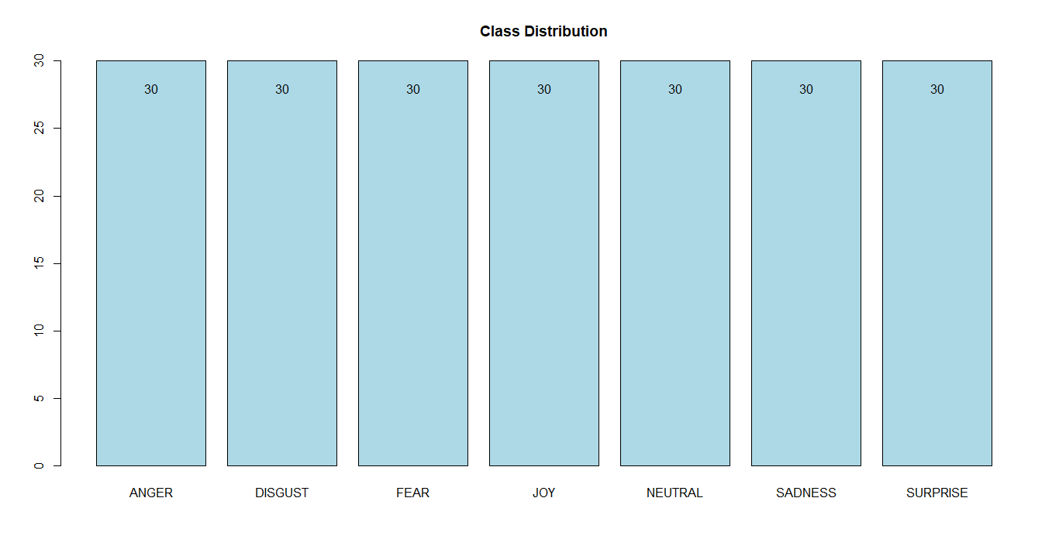
Exploring the Facial Expression Dataset
1. Check Class Distribution

Slide 4
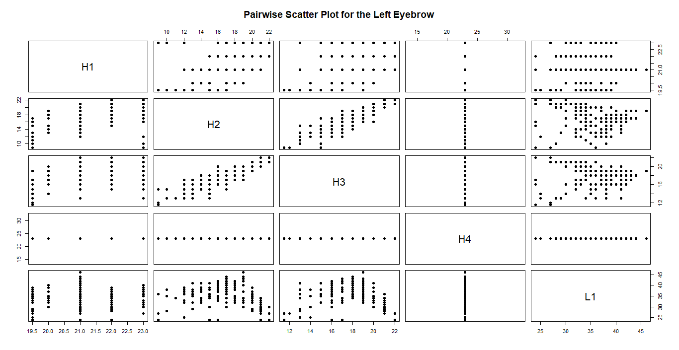
2. Check for Missing Values and cap Outliers
3. Create pairwise scatter plots for feature groups

Slide 5
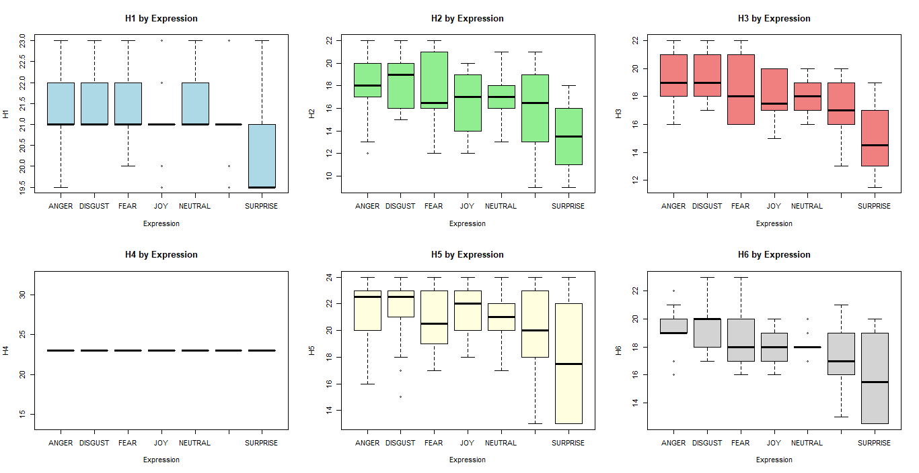
4. Plot boxplots of each feature grouped by Expression

Slide 6

Dataset Preprocessing
1. Compute the correlation matrix to identify highly correlated features and select to remove features with correlation > 0.9
2. Perform ANOVA to determine which features significantly vary across different expressions and select features with a p-value < 0.05
3. Combine the results from Correlation and ANOVA to retain only meaningful features.
Stratified train-test split (80%-20%) to maintain expression class distribution
5. Apply (PCA) to reduce dimensionality while retaining 80% variance.

Slide 7
Model Training & Evaluation
1. Evaluate three models: Naïve Bayes, Decision Tree, and K-Nearest Neighbours (KNN).
2. Naive Bayes (NB): Tune Laplace smoothing (fL), enable/disable kernel-based density estimation, and adjust smoothing bandwidth.
3. Decision Tree (DT): Optimize complexity parameter (cp), tree depth, minimum split size, and bucket size.
4. K-Nearest Neighbours (KNN): Tune k-value (kmax), distance metric (Manhattan vs. Euclidean), and kernel function for optimal performance.
5. Compare model performance before and after PCA

Slide 8
PCA appears to degrade model performance.
Naïve Bayes experiences the most significant decline in accuracy, dropping by 9.5%. This suggests that the original features contained crucial information that was lost during dimensionality reduction.
Decision Tree also suffer from PCA, with a 7.2% decrease in accuracy. This indicates that the raw features provided better decision splits than the transformed principal components.
KNN remains the most resilient model, exhibiting only a 4.8% drop in accuracy. This suggests that PCA had a smaller impact on its classification ability.
Model | Before PCA | After PCA | Change
Naïve Bayes | 69% | 59.5% | 🔻 -9.5%
Decision Tree | 52.4% | 45.2% | 🔻 -7.2%
KNN | 78.6% | 73.8% | 🔻 -4.8%

Slide 9
Naïve Bayes (NB) without PCA yielded the strongest outcomes for ANGER, DISGUST, JOY, NEUTRAL, SADNESS, and SURPRISE, though it faced challenges particularly with FEAR. On the other hand, when PCA was applied, NB achieved top performance in DISGUST, SADNESS, and SURPRISE, yet encountered more issues with ANGER, FEAR, JOY, and NEUTRAL.
Decision Tree (DT) prior to PCA showed the most effective results for FEAR, JOY, and SADNESS, but underperformed when it came to ANGER, DISGUST, NEUTRAL, and SURPRISE. After implementing PCA, DT handled DISGUST, NEUTRAL, and SURPRISE more successfully, but its accuracy dropped for ANGER, FEAR, JOY, and SADNESS.
K-Nearest Neighbours (KNN) before applying PCA managed ANGER, DISGUST, JOY, NEUTRAL, SADNESS, and SURPRISE effectively, though it struggled to classify FEAR accurately. Following PCA, KNN continued to do well on DISGUST, JOY, NEUTRAL, SADNESS, and SURPRISE, but showed weaker performance on ANGER and FEAR.
K-Nearest Neighbours (KNN) appears to be the most effective and stable model, as it achieved the highest performance and classified expressions with the greatest accuracy.

Slide 10
Clustering:
1. Reduce dimensionality by applying PCA and keeping the top components explaining ~80% of the variance
2. Apply and evaluate three clustering algorithms: K-Means, Gaussian Mixture Model (GMM), DBSCAN.
3. K-Means: Tune k.
4. Gaussian Mixture Model (GMM): Apply GMM on PCA-transformed data.
5. DBSCAN: Tune eps and minPts values.

Slide 11
K-Means imposed 4 clusters, but there are 7 true expressions. Average silhouette ~0.31 suggests moderate separation.
GMM chose 9 clusters on its own, more than actual expressions. Two clusters had very high silhouette (> 0.6), indicating strong internal cohesion. One had a negative average silhouette, a warning sign.
DBSCAN detected some very cohesive, small groups (silhouette ~0.7). 46 instances were labelled as noise, nearly 22% of the data.
Clustering algorithms struggle to distinguish facial expressions due to overlapping feature patterns and subtle differences between emotions, leading to mixed cluster compositions. This suggests unsupervised methods alone are insufficient for clearly separating all seven expressions.

