Slide 1
Face Expression Recognition via Measurable Features
Vasilis Gerontatis, BSc (Physics) MSc Student in Data Science and Machine Learning Module: DAMA 51

Slide 2
Problem Statement
The goal of this project is to analyse a dataset consisting of 210 instances from the Cohn-Kanade database, where each instance is represented by 25 facial measurements. These measurements capture key structural aspects of facial expressions, including eyebrow position, eye dimensions, mouth shape, and relationships between these components. The dataset is labelled with one of seven possible facial expressions: Neutral, Disgust, Sadness, Fear, Surprise, Anger, and Joy
What I Want to Accomplish
Feature Selection: Identify which facial measurements are the most critical for FER.
Evaluation Strategy: Define the best approach for training, testing, and validation.
Classification: Compare multiple machine learning classifiers to determine the most effective for FER.
Clustering: Analyse the dataset without labels and evaluate how well clustering methods can group expressions naturally.

Slide 3
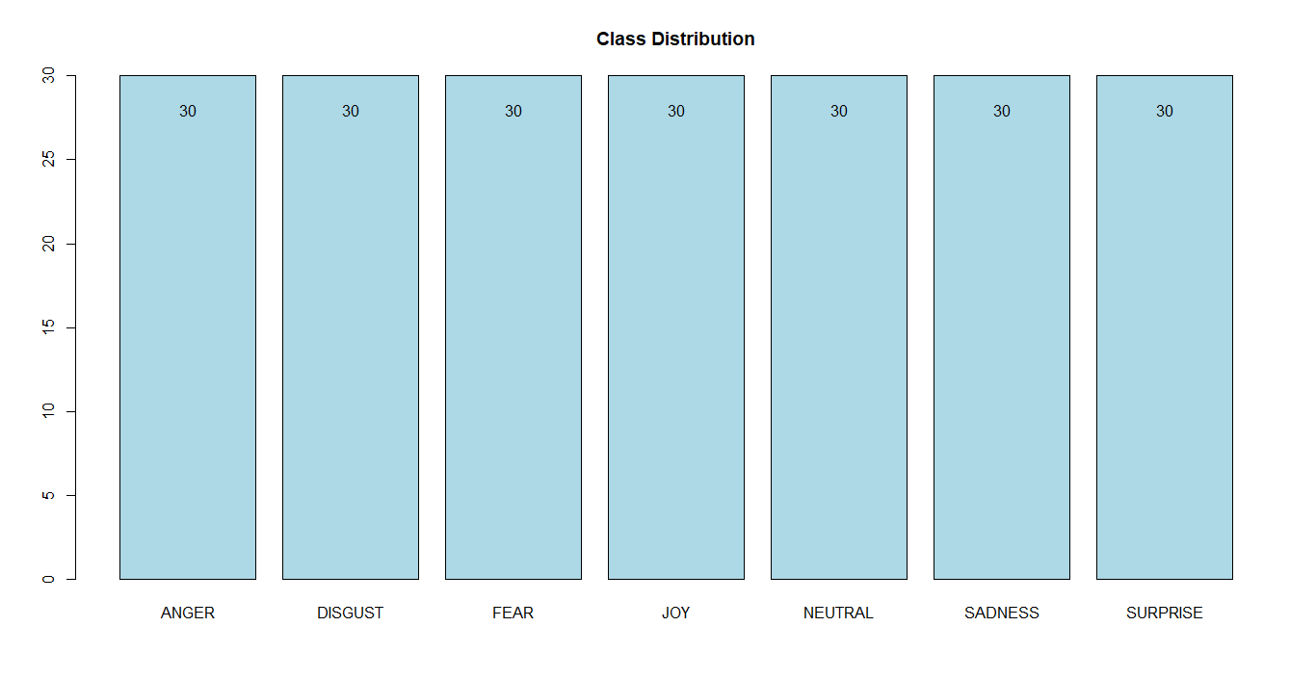
Exploring the Facial Expression Dataset
1. Check Class Distribution

Slide 4
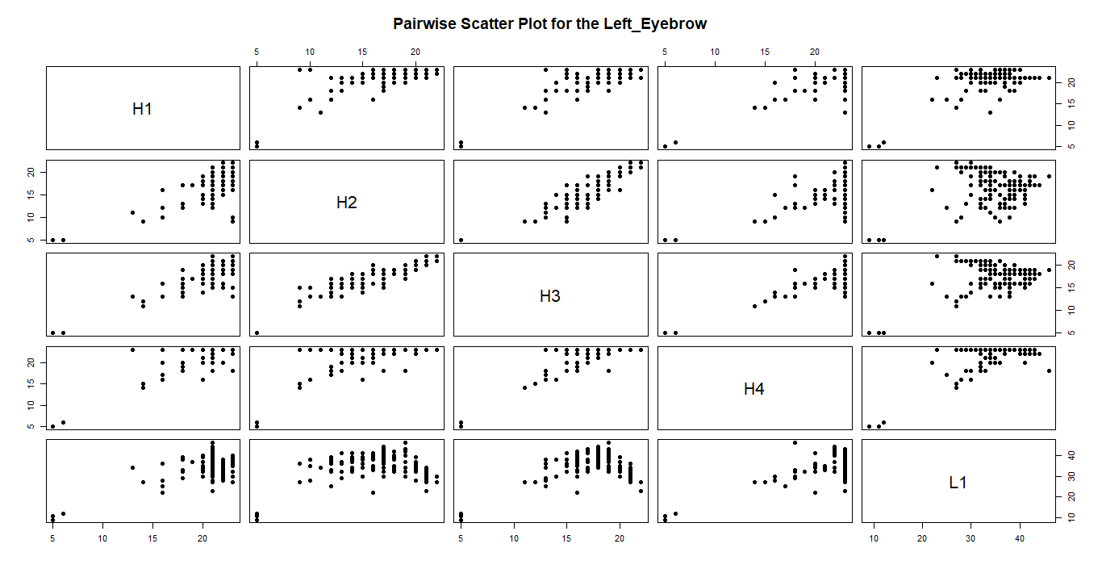
2. Check for Missing Values
3. Stratified train-test split (80%-20%) to maintain expression class distribution
4. Create pairwise scatter plots for feature groups

Slide 5
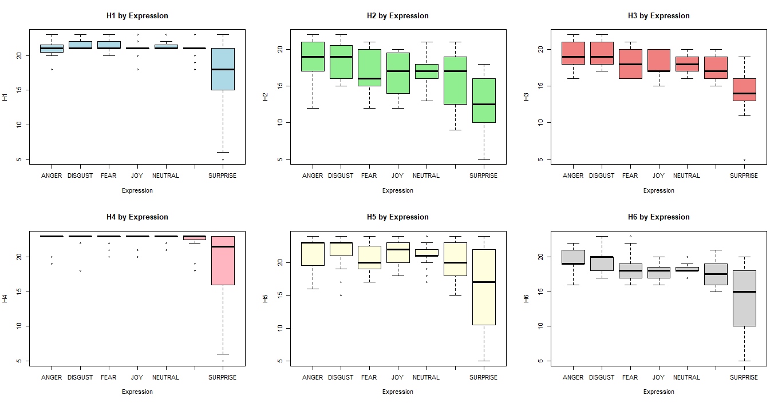
4. Plot boxplots of each feature grouped by Expression

Slide 6
Dataset Preprocessing
1. Perform ANOVA to determine which features significantly vary across different expressions and select features with a p-value < 0.05
2. Compute the correlation matrix to identify highly correlated features and select to remove features with correlation > 0.8
3. Combine the results from ANOVA and Correlation to retain only meaningful features.
4. Apply (PCA) to reduce dimensionality while retaining 80% variance.

Slide 7
Model Training & Evaluation
1. Evaluate three models: Naïve Bayes, Decision Tree, and K-Nearest Neighbours (KNN).
2. Naive Bayes (NB): Tune Laplace smoothing (fL), enable/disable kernel-based density estimation, and adjust smoothing bandwidth.
3. Decision Tree (DT): Select split decision metric, and optimize tree depth, minimum split size, and bucket size.
4. K-Nearest Neighbours (KNN): Tune k-value (kmax), distance metric (Manhattan vs. Euclidean), and kernel function for optimal performance.
5. Compare model performance with and without PCA

Slide 8
PCA appears to degrade model performance.
Naïve Bayes experiences the most significant decline in accuracy, dropping by 21.5%. This suggests that the original features contained crucial information that was lost during dimensionality reduction.
Decision Tree profits from PCA, with a 11.9% increase in accuracy. This indicates that the raw features provided worst decision splits than the transformed principal components.
KNN remains the most resilient model, exhibiting a 19.1% drop in accuracy. This suggests that PCA had an impact on its classification ability and the original feature space was more informative.
Model | Without PCA | With PCA | Change
Naïve Bayes | 66.7% | 45.2% | 🔻 -21.5%
Decision Tree | 33.3% | 45.2% | 🟢 +11.9%
KNN | 90.5% | 71.4% | 🔻 -19.1%

Slide 9
Naïve Bayes (NB) without PCA yielded the strongest outcomes for DISGUST, JOY, NEUTRAL, SADNESS, and SURPRISE, though it faced challenges particularly with ANGER, and FEAR. On the other hand, when PCA was applied, NB achieved top performance in DISGUST, JOY, NEUTRAL, and SURPRISE, yet encountered more issues with ANGER, FEAR, and SADNESS.
Decision Tree (DT) prior to PCA showed the most effective results for JOY, and SADNESS, but underperformed when it came to ANGER, DISGUST, FEAR, NEUTRAL, and SURPRISE. After implementing PCA, DT handled ANGER, DISGUST, and JOY more successfully, but its accuracy dropped for FEAR, NEUTRAL, SADNESS, and SURPRISE
K-Nearest Neighbours (KNN) before applying PCA managed ANGER, DISGUST, FEAR, JOY, NEUTRAL, SADNESS, and SURPRISE effectively, and had no struggles to classify accurately. Following PCA, KNN continued to do well on ANGER, DISGUST, JOY, NEUTRAL, SADNESS, and SURPRISE, but showed weaker performance on FEAR.
K-Nearest Neighbours (KNN) appears to be the most effective and stable model, as it achieved the highest performance and classified expressions with the greatest accuracy.

Slide 10
Clustering:
1. Reduce dimensionality by applying PCA and keeping the top components explaining ~80% of the variance
2. Apply and evaluate three clustering algorithms: K-Means, Gaussian Mixture Model (GMM), DBSCAN.
3. K-Means: Tune k.
4. Gaussian Mixture Model (GMM): Tune k.
5. DBSCAN: Tune eps and minPts values.

Slide 11
K-Means: With a silhouette score of ~0.34, K-Means achieved slightly better moderate separation than the other models. Its ARI of ~0.08 suggests a weak alignment with true classes.
GMM: GMM's silhouette score of ~0.32 indicates a level of moderate separation nearly identical to K-Means. Its ARI of ~0.07 similarly confirms a weak correspondence with the true classes.
DBSCAN: DBSCAN performed the worst with the lowest silhouette score (~0.23), indicating the poorest separation. Its minimal ARI of ~0.02 shows it had the most difficulty aligning with the true classes.
Clustering algorithms struggle to distinguish facial expressions due to overlapping feature patterns and subtle differences between emotions, leading to mixed cluster compositions. This suggests unsupervised methods alone are insufficient for clearly separating all seven expressions.

