Slide 1
Team Foxtrot – QA Cinema Project
Billy Mills, Erhan Aksu, Muhammad Rahman, Omar Malik and Shakir Ali

Slide 2
Built With
Git – Version Control
Source code Management – GitHub
Kanban Board/Project management – Jira
Full stack Development Technologies – M.E.R.N. Stack
Database Management – MongoDB
Back-End Programming – Node
API Development Platform – Express
Front-End Programming – React

Slide 3
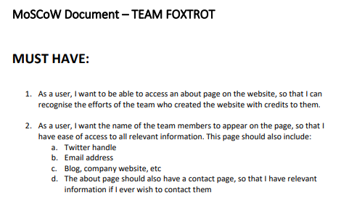
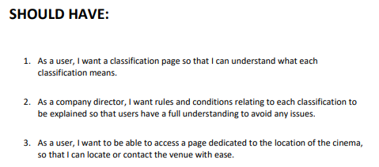
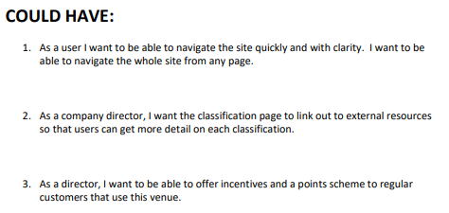
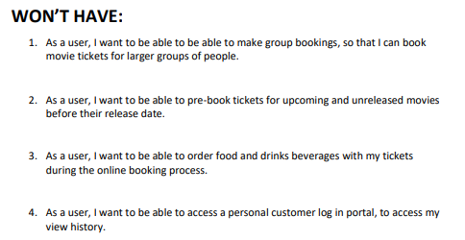
MoSCoW

Slide 4
Agile
Product Owner: Billy
Scrum Master: Omar
Developers: Erhan, Muhammad and Shak
1) What did I do yesterday that helped meet the Sprint Goal?
2) What will I do today to help meet the Sprint Goal?
3) Do I see any future impediments that prevents the team from meeting the Sprint Goal?

Slide 5
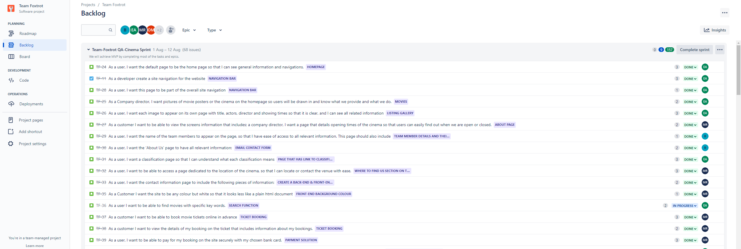
Jira

Slide 6
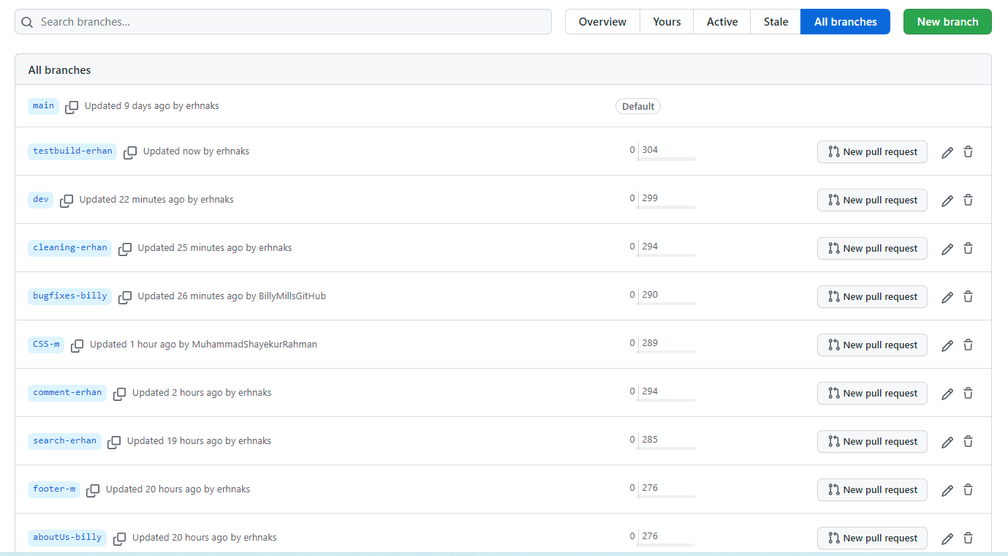
Version Control
Version control – Git
Using the Feature Branch Model
Main -> Dev -> Feature
Push and then merge
Naming feature branches

Slide 7
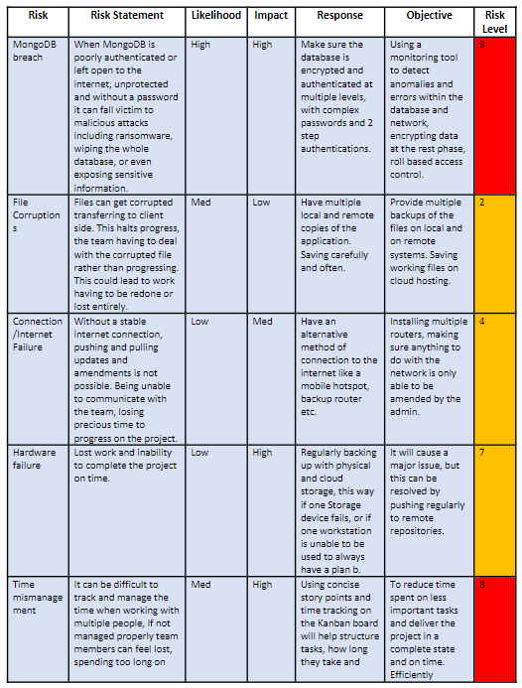
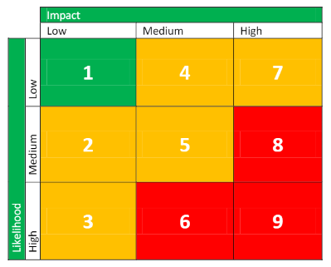
Risk Assessment
Risk Assessment with 13 risks
Created a key to indicate risk level
Key was created using likelihood and impact
Used a colour scheme in key to visually show risk level

Slide 8
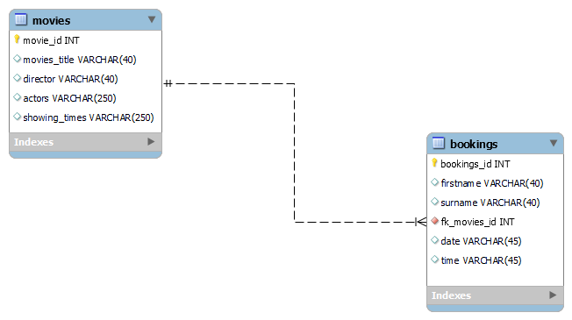
Entity Relationship Diagram

Slide 9
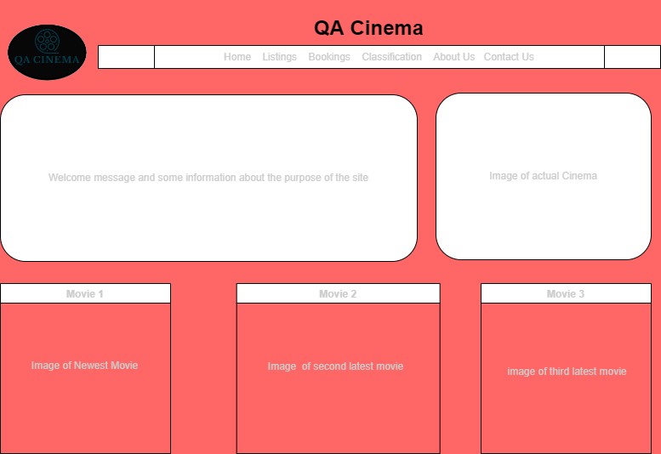
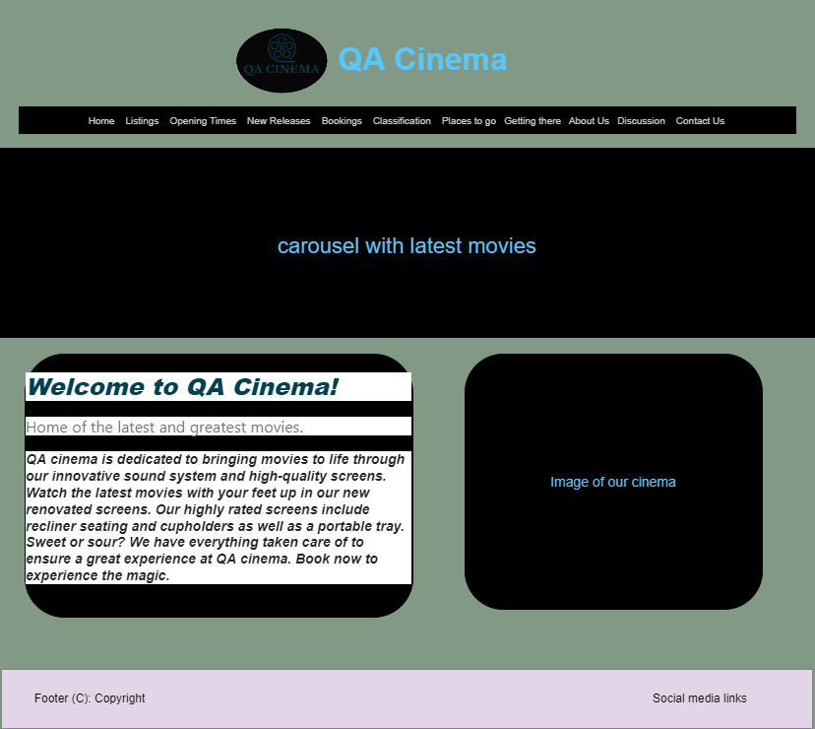
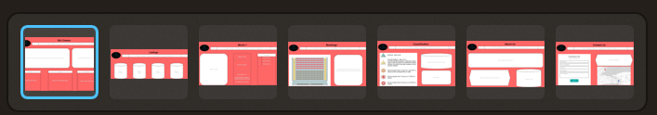
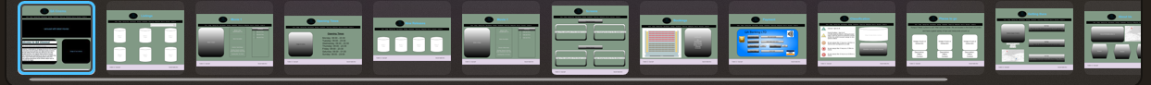
Wireframes

Slide 10

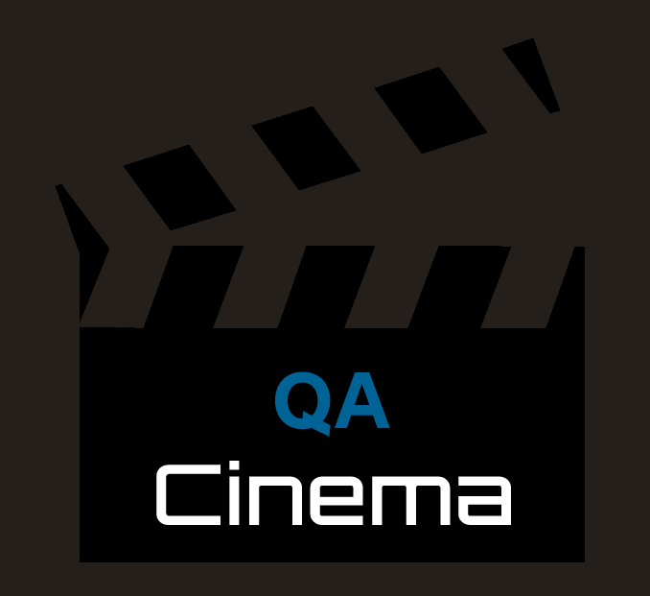
Company Logo

Slide 11
Live demo of our application

Slide 12
Conclusion
We all enjoyed working on the project and it was beneficial in solidifying our knowledge and skills.
Notes taken for future improvements:
Testing
Time

