Slide 1
Instalog Interim Progress Report 1
Jacob Snyder jrs213@case.edu
Billy O’Neal bro4@case.edu
Notes:
Jacob

Slide 2
Introduction
Diagnose and repair Windows installations
Log everything on a Windows machine
Registry
Files
Processes
Etc.
Generate and run fix scripts
Three user classes:
Home users
Administrators
Forum Experts
Notes:
Jacob

Slide 3
Updates
HiJackThis source code
Requirements and Specification
Scope Limit
Timeline
Demo
Notes:
Bill

Slide 4
HiJackThis Source Code
February 17 – TrendMicro releases HJT source code
Coded in VB6
Better to start from scratch than from this codebase
Notes:
Bill

Slide 5
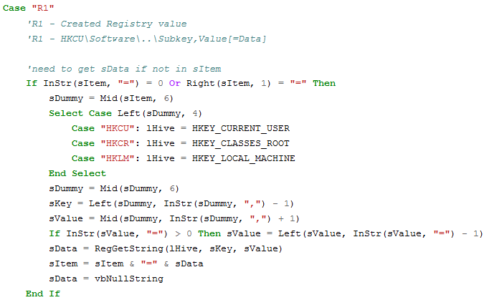
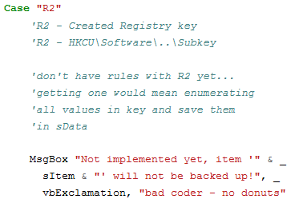
Notes:
Bill

Slide 6
Requirements and Specifications
Both documents completed
Formal requirements document is 10 pages
Formal specifications document is 93 pages
These documents describe the entire project down to the last detail
Notes:
Jacob

Slide 7
Scope Limit
Overestimated extent of project
Will only implement the scanning functionality, which includes:
Header
Running Processes
PsuedoHJT
Services and Drivers
Created Last 30
Find3M
Event Viewer
Machine Specifications
Restore Points
Installed Programs
Footer
Notes:
Bill

Slide 8
Scope Limit (cont.)
Remaining features will be finished after this course
Might add features (time permitting)
Scripting
GUI runs scripts
Spoofed DNS Check
MRC Upload, VirusTotal Upload
GUI builds scripts with “checkboxes” interface
Notes:
Bill

Slide 9
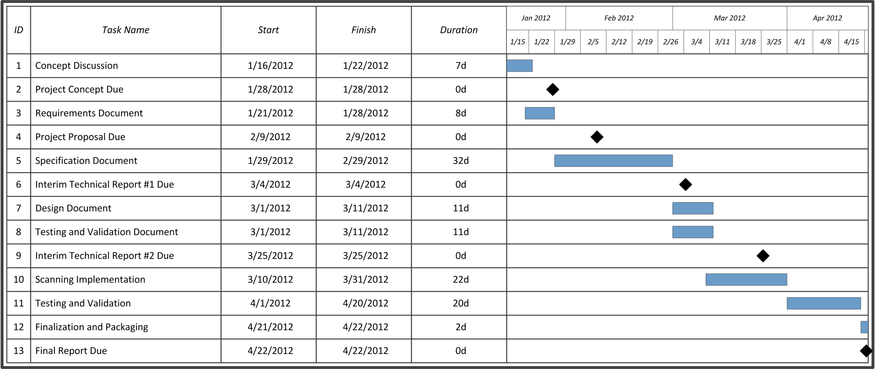
Timeline
On Schedule
Just began the design and implementation
Notes:
Jacob

Slide 10
Demo
Keep in mind, very limited time spent on development
Had to use “undocumented” Windows calls
Implemented running processes with whitelist support
Notes:
Bill

Slide 11
Questions?
More information available online:
http://code.instalog.org/ (forwards to bitbucket)
Updated documentation
Source Code
Issue Tracking
Wiki
Notes:
Jacob

