Slide 1
Instalog Interim Progress Report 2
Jacob Snyder jrs213@case.edu
Billy O’Neal bro4@case.edu http://code.instalog.org/
Notes:
Bill

Slide 2
Introduction
Diagnose and repair Windows installations
Log everything on a Windows machine
Registry
Files
Processes
Etc.
Generate and run fix scripts
Three user classes:
Home users
Administrators
Forum Experts
Scope limit of just scanning features for this class
Notes:
Bill

Slide 3
Outline
Design Document
“Scaffolding” implementation
Completed scanning sections
Testing and documentation
Remaining work
Timeline
Demo
Notes:
Bill

Slide 4
“Scaffolding” Implementation
Learn C++ (Jacob)
An easy runtime dynamic linker (Bill)
A wrapper around Win32 and NT error messages to convert them to C++ exceptions (Bill)
A wrapper around Win32 Processes Handles (Bill)
A wrapper around Win32 File Handles (Both)
A privilege granting wrapper (Bill)
Path manipulation functions (Jacob)
String functions including escaping and unescaping (Jacob)
Pre-defined output formats from the specification (Jacob)
Whitelisting support (Both)
A wrapper around the native registry (Bill)
Rudimentary scripting, reordering, and execution (Bill)
Common interface for developing and reporting progress back to user interfaces (Bill)
A wrapper around Win32 Service Control Manager (Jacob)
Notes:
Both (depending on who did what)

Slide 5
Completed Scanning Sections
Headers and Footers (Bill)
Running Processes (Both)
Services / Drivers (Jacob)

Slide 6
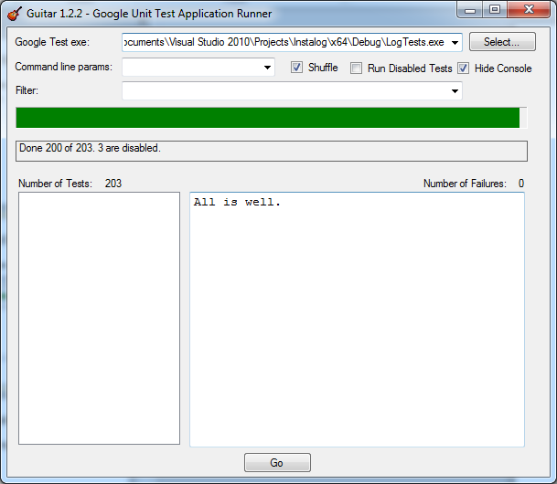
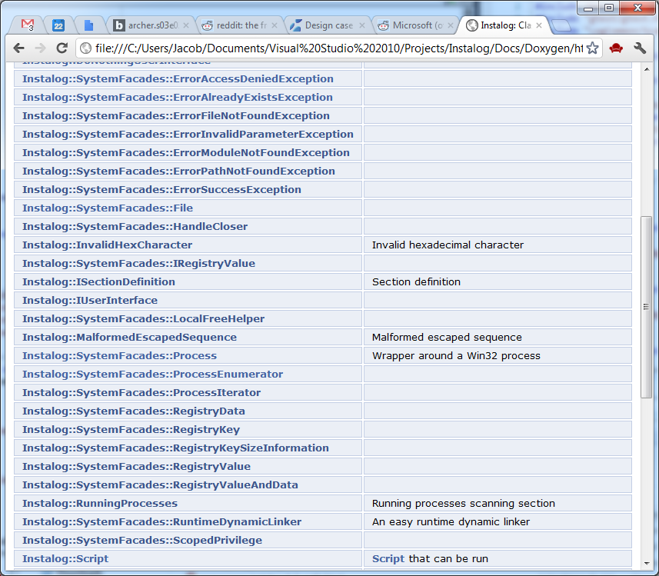
Testing and Documentation
Over two hundred unit tests
Extensive doxygen docs
Notes:
Jacob

Slide 7
Remaining Work
Pseudo HJT (in progress)
Created Last 30
Find3M
Event Viewer
Machine Specifications
Restore Points (in progress)
Installed Programs
Notes:
Jacob

Slide 8
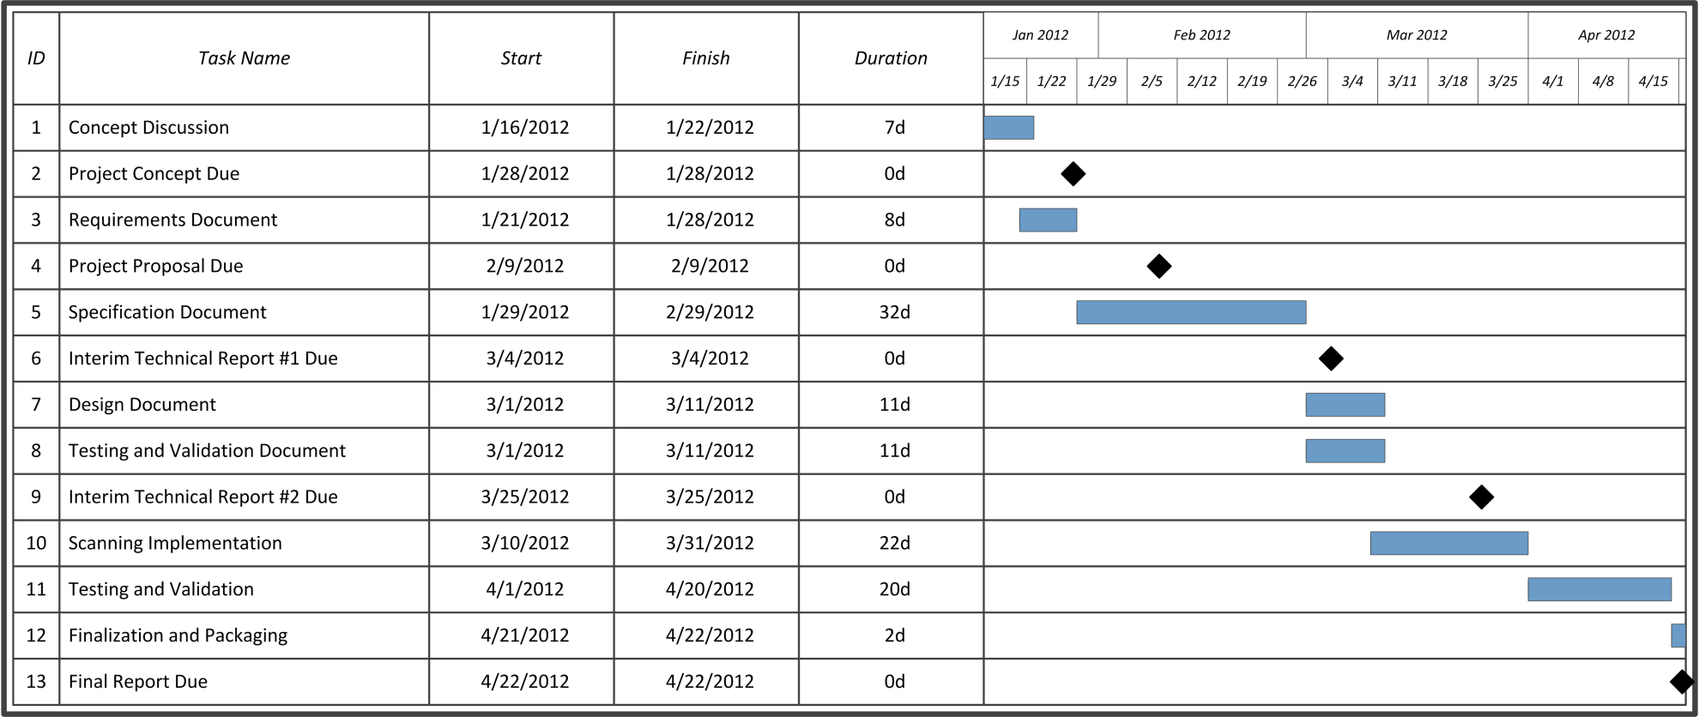
Timeline
Progress made on implementation, testing can slip back due to test-driven development
Notes:
Jacob

Slide 9
Demo
Header (Version info and such)
Proper script processing and running
Running process enumeration
Services / Drivers enumeration
Notes:
Bill/Jacob

Slide 10
Questions?
More information available online:
http://code.instalog.org/ (forwards to bitbucket)
Updated documentation
Source Code
Issue Tracking
Wiki
Notes:
??????

