Slide 1
Instalog
Jacob Snyder jrs213@case.edu
Billy O’Neal bro4@case.edu
Notes:
Jacob

Slide 2
Introduction
Log everything on a Windows machine
Registry
Files
Processes
Etc.
Why? (New) viruses!
Notes:
Jacob

Slide 3
History
Started with HJT by Merjin Bellekom
Left unmaintained by TrendMicro
Deckard’s System Scanner by Deckard
TDSS commandline bug
Today’s Jungle
OTL / OTS / OTA
DDS (Doesn’t Do Squat)
Notes:
Bill

Slide 4
Target Users
Joe User
Johnny Power-User
Jacob “Forum” Expert
Notes:
Jacob for the first – Bill for the second two

Slide 5
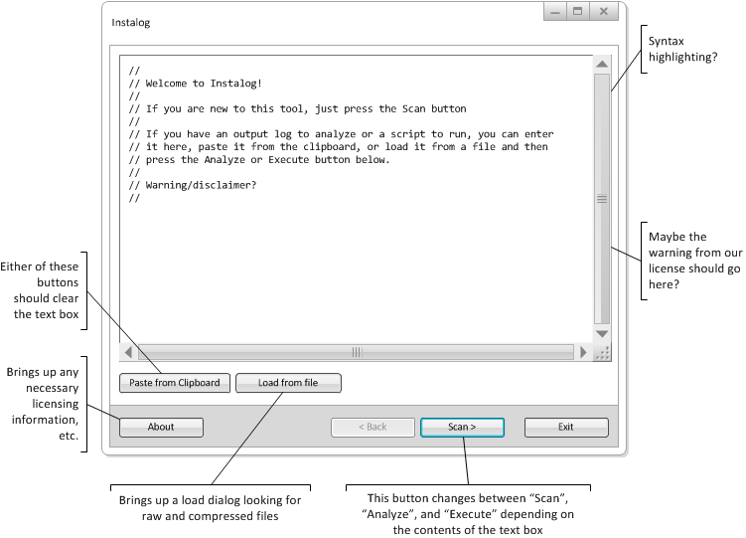
Main Screen

Slide 6
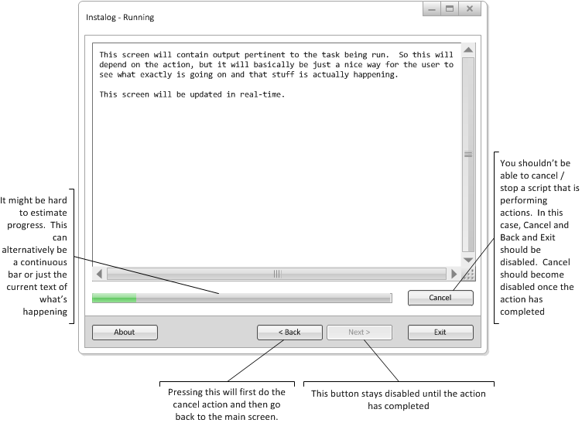
Scan or Fix Running

Slide 7
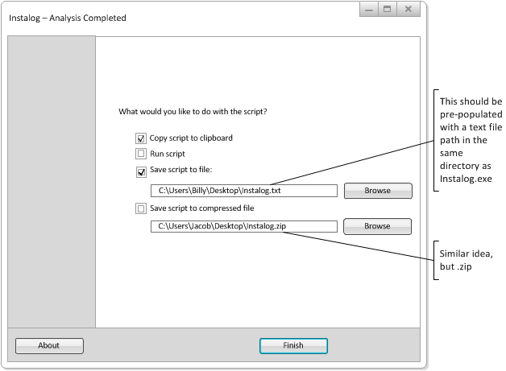
Save

Slide 8
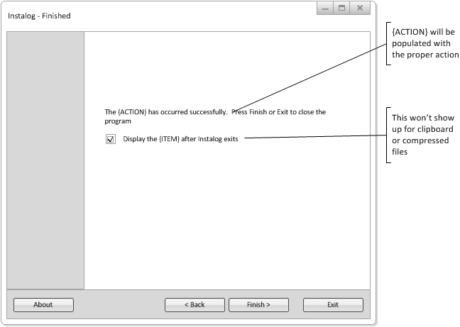
Finished

Slide 9
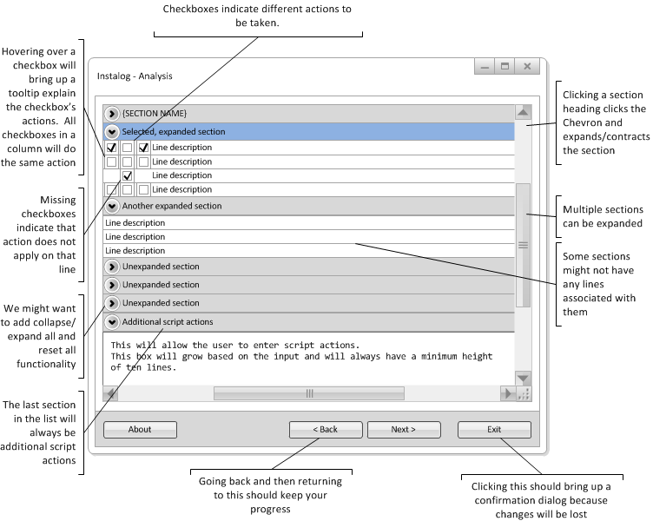
Analysis

Slide 10
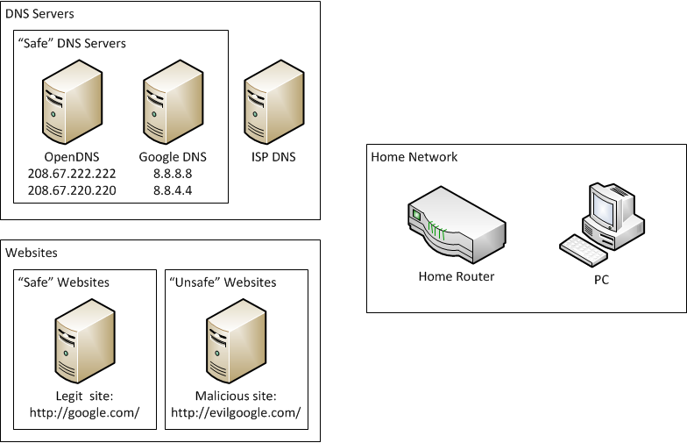
DNS “Hijack” Scenario

Slide 11
Log Sections
Header
Running Processes
Machine PsuedoHJT Report
n User PseudoHJT Reports (One for each loaded user registry on the system)
Mozilla Firefox (If Mozilla Firefox is installed)
Google Chrome (If Google Chrome is installed)
Created Last 30
Find3M Report
Event Viewer (If any relevant events need be reported)
Machine Specifications
Restore Points
Installed Programs
Footer

Slide 12
Additional Log Sections
DNS Check - Displayed if the :dnscheck scripting section is used.
Directory - Displayed if the :dirlook scripting section is used.
VirusTotal - Displayed if the :virustotal scripting section is used.
MRC Upload - Displayed if the :mrc scripting section is used.
Process Kill - Displayed if the :kill scripting section is used.
File Quarantine - Displayed if the :move scripting section is used.
Security Center - Displayed if the :securitycenter scripting section is used.
Registry 32 Bit - Displayed if the :reg32 scripting action is used.
Registry 64 Bit - Displayed if the :reg64 scripting action is used.

Slide 13
Timeline
February 12 - Initial draft of the specification finalized
February 19 - Initial draft design document finalized
March 4 - Logging and script actions implemented
March 25 - GUI implemented
April 22 - Testing on target systems and field testing conducted

