Slide 1
Instalog Interim Progress Report 2
Jacob Snyder jrs213@case.edu
Billy O’Neal bro4@case.edu http://code.instalog.org/
Notes:
Jacob

Slide 2
Introduction
Diagnose and repair Windows installations
Log everything on a Windows machine
Registry
Files
Processes
Etc.
Generate and run fix scripts
Three user classes:
Home users
Administrators
Forum Experts
Scope limit of just scanning features for this class
Notes:
Jacob

Slide 3
Outline
Design Document
“Scaffolding” implementation
Completed scanning sections
Testing and documentation
Remaining work
Timeline
Demo
Notes:
Bill

Slide 4
“Scaffolding” Implementation
An easy runtime dynamic linker
A wrapper around Win32 and NT error messages to convert them to C++ exceptions
A wrapper around Win32 Processes Handles
A wrapper around Win32 File Handles
A privilege granting wrapper
Path manipulation functions
String functions including escaping and unescaping
Pre-defined output formats from the specification
Whitelisting support
A wrapper around the registry
Rudimentary scripting, reordering, and execution
Framework for developing and reporting progress back to user interfaces
A wrapper around Win32 Service Control Manager

Slide 5
Completed Scanning Sections
Running Processes
Services / Drivers

Slide 6
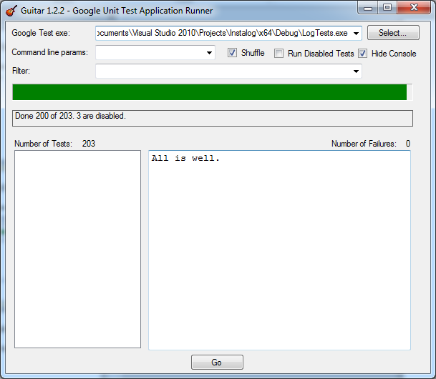
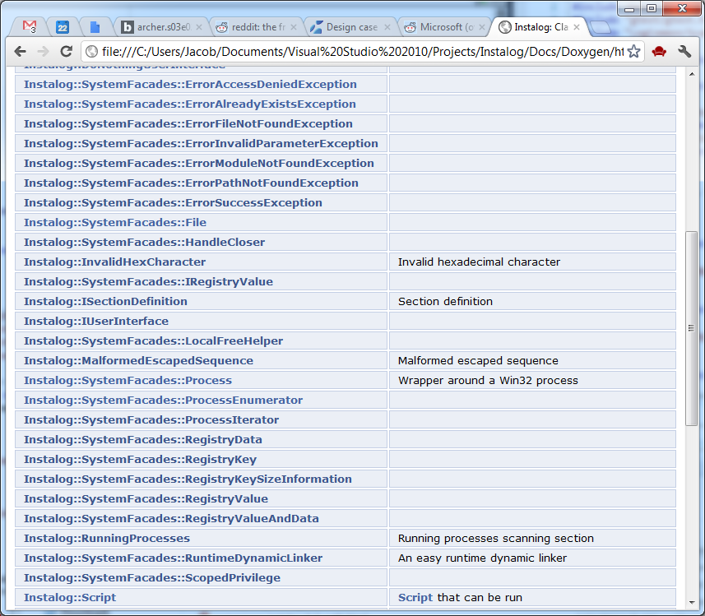
Testing and Documentation
Over two hundred unit tests
Extensive doxygen docs

Slide 7
Remaining Work
Pseudo HJT (in progress)
Created Last 30
Find3M
Event Viewer
Machine Specifications
Restore Points (in progress)
Installed Programs

Slide 8
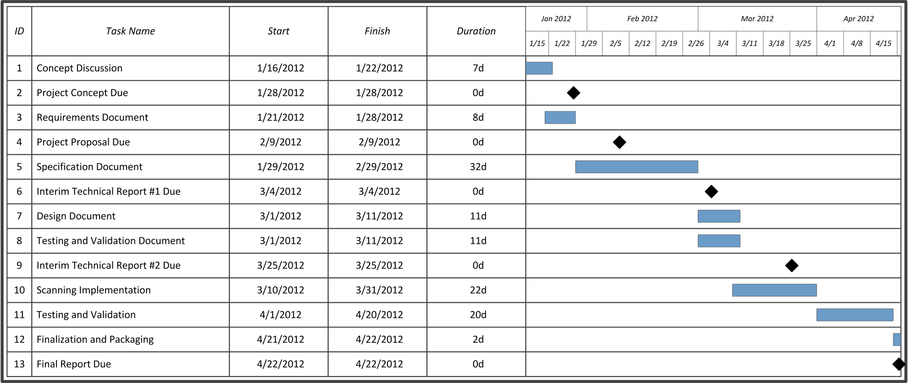
Timeline
Progress made on implementation, testing can slip back due to test-driven development
Notes:
Jacob

Slide 9
Demo
Proper script processing and running
Running process enumeration
Services / Drivers enumeration
Notes:
Bill

Slide 10
Questions?
More information available online:
http://code.instalog.org/ (forwards to bitbucket)
Updated documentation
Source Code
Issue Tracking
Wiki
Notes:
Jacob

