Slide 1
Tutorial: Packaging
These slides, so you get links: https://bit.ly/2GK3a9q
Michael Sarahan
Conda-build tech lead

Slide 2

Michael Sarahan, PhD Conda-build tech lead, Anaconda, Inc.
Chemistry, Materials Science PhD
Data analysis of electron microscope (STEM) data
Python user since 2005
Hired especially for Windows knowledge, branched out into build automation and enhancing binary compatibility
Helped Continuum (now Anaconda) embrace Conda-forge

Slide 3
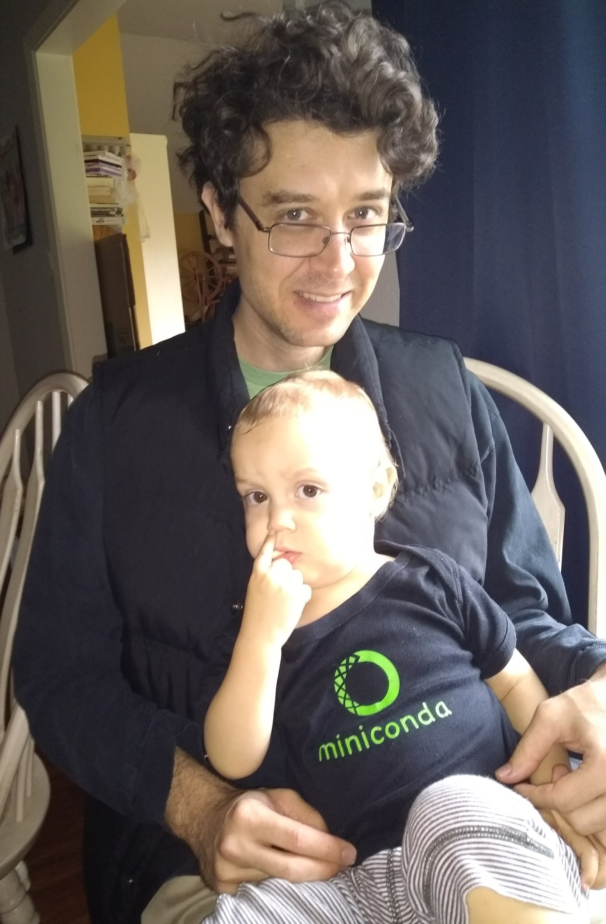
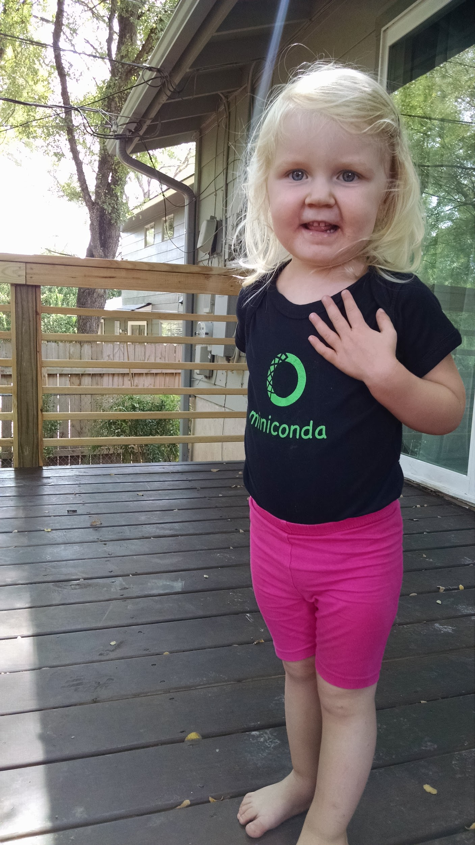
Getting started
Make sure you have Miniconda or Anaconda

Slide 4
Outline
Packaging fundamentals
Conda packaging
Compatibility and automation

Slide 5
What is a “package”?
In a broad sense, anything you install using your package manager
some kinds of packages have implied behavior and requirements
Unfortunate overloading: python “package”: a folder that python imports

Slide 6
Package Managers and Repos
NPM, apt, yum, dnf, chocolatey, pip, conda, homebrew, etc.
PyPI, anaconda.org, CRAN, CPAN
some form of dependency management
artifact and/or source repository

Slide 7
Implicit behavior & Requirements
Folder structure
Directly usable, or must be unpacked/installed?

Slide 8
Python packages
sound/ __init__.py formats/ __init__.py wavwrite.py effects/ __init__.py echo.py
Folders must have __init__.py file to make Python able to import them
__init__.py can be empty (and is, most of the time)
https://docs.python.org/3/tutorial/modules.html#packages

Slide 9
Python packages - why?
# import nested module
import sound.effects.echo
from sound.effects import echo
# import function or variable from nested module
from sound.effects.echo import somefunc
https://docs.python.org/3/tutorial/modules.html#packages

Slide 10
Let’s make a package
mypkg/ __init__.py subpkg/ __init__.py a.py

Slide 11
Let’s make a package
Windows
mkdir mypkg\subpkg
echo. > mypkg\__init__.py
echo . > mypkg\subpkg\__init__.py
echo . > mypkg\subpkg\a.py
Mac/Linux
mkdir -p mypkg/subpkg
touch mypkg/__init__.py
touch mypkg/subpkg/__init__.py
touch mypkg/subpkg/a.py

Slide 12
How Python finds packages
In python interpreter: import sys from pprint import pprint pprint(sys.path)
sys.path explanation: https://stackoverflow.com/a/38403654/1170370

Slide 13
How to get things on sys.path
PYTHONPATH environment variable (fragile)
Installing packages (destination: site-packages folder)
.pth files in sys.path locations

Slide 14
Find your site-packages folder
Windows: (install root)\Lib\site-packages
Mac/Linux: (install root)/lib/pythonX.Y/site-packages

Slide 15
Installing packages
Installing:
python setup.py install
pip install .
Development installs:
python setup.py develop
pip install -e .

Slide 16
Install | Development install
Copies package into site-packages | Adds a .pth file to site-packages, pointed at package source root
Used when creating conda packages | Used when developing software locally
Normal priority in sys.path | End of sys.path (only found if nothing else comes first)
https://grahamwideman.wikispaces.com/Python-+site-package+dirs+and+.pth+files

Slide 17
What about setup.py?
#!/usr/bin/env python from setuptools import setup setup(name='Distutils', version='1.0', description='Python Distribution Utilities', author='Greg Ward', author_email='gward@python.net', url='https://www.python.org/sigs/distutils-sig/', packages=['distutils', 'distutils.command'], )
https://docs.python.org/2/distutils/setupscript.html

Slide 18
What does setup.py do?
Version & package metadata
List of packages to include
List of other files to include
Lists of dependencies
Lists of extensions to be compiled

Slide 19
Let’s write setup.py
#!/usr/bin/env python from setuptools import setup setup(name='mypkg', version='1.0', # list folders, not files packages=['mypkg', 'mypkg.subpkg'], )

Slide 20
Setuptools
Separate library (ships with Python by default, though)
Adds entry point capability
provides find_packages function (use with caution)
creates eggs by default (people spend time fighting this later in the process)

Slide 21
Where does setup.py go?
mypkg-src
setup.py
mypkg/ __init__.py subpkg/ __init__.py a.py
New outer folder
setup.py alongside package to be installed
mypkg is what will get installed
mypkg-src is what gets linked to by develop

Slide 22
Try installing your package
cd mypkg-src
python setup.py install
python -c “import mypkg.subpkg.a”
Go look in your site-packages folder

Slide 23

Making packages the easy way
https://github.com/audreyr/cookiecutter
conda install -c conda-forge cookiecutter

Slide 24
Let’s make a project
cookiecutter https://github.com/conda/cookiecutter-conda-python
full_name [Full Name]: Mike Sarahan
email [Email Address]: msarahan@anaconda.com
github_username [github_username]: msarahan
repo_name [repository_name]: acon_demo
package_name [acon_demo]:
project_short_description [Short description]: acon demo
version [0.1.0]:

Slide 25
What did we get?
ls -R acon_demo
README.rst acon_demo conda.recipe setup.py tests
acon_demo/acon_demo:
__init__.py __main__.py cli.py
acon_demo/conda.recipe:
meta.yaml
acon_demo/tests:
__init__.py test_cli.py

Slide 26
Adding requirements in setup.py
#!/usr/bin/env python from distutils.core import setup setup(name='mypkg', version='1.0', # list folders, not files packages=['mypkg', 'mypkg.subpkg'],
install_requires=['click'], )

Slide 27
Requirements in requirements.txt
common mistake
requirements.txt often from pip freeze
Pinned way too tightly. OK for env creation, bad for packaging.
Donald Stufft (PyPA): Abstract vs. Concrete dependencies
https://caremad.io/posts/2013/07/setup-vs-requirement/

Slide 28
Requirements in setup.cfg (ideal)
[metadata] name = my_package version = attr: src.VERSION [options] packages = find: install_requires = click
Parseable without execution, unlike setup.py
http://setuptools.readthedocs.io/en/latest/setuptools.html#configuring-setup-using-setup-cfg-files

Slide 29
Break time!
Up next: producing redistributable artifacts

Slide 30
Redistributable artifacts
sdists
wheels
conda packages
eggs (deprecated)

Slide 31
When/how to use an sdist
Pure python (no compilation requirements)
Or, distributing source code that must be compiled prior to usage
python setup.py sdist

Slide 32
Wheels vs. Conda packages
Wheels | Conda packages
Employed by pip, blessed by PyPA | Foundation of Anaconda ecosystem
Used by any python installation | Used by conda python installations
Mostly specific to Python ecosystem | General purpose (any ecosystem)
Good mechanism for specifying range of python compatibility | Primitive support for multiple python versions (noarch)
Depends on static linking or other system package managers to provide core libraries | Can bundle core system-level shared libraries as packages, and resolve dependencies

Slide 33
Introducing conda-build
Orchestrates environment creation, activation, and build/test processes
Can build conda packages and/or wheels
Separate project from conda, but very tightly integrated
Open-source, actively developed https://github.com/conda/conda-build

Slide 34
Getting conda-build to work for you
Input: meta.yaml files
package:
name: mypkg
version: 1.0

Slide 35
Let’s use conda-build
conda install conda-build
Windows only: conda install m2-patch posix
conda build mypkg-src

Slide 36
What happened?
templates filled in, recipe interpreted
build environment created (isolated)
build script run
new files in build environment bundled into package
test environment created (isolated)
tests run on new package
cleanup

Slide 37
Obtaining recipes
Existing recipes (best)
https://github.com/AnacondaRecipes
https://github.com/conda-forge
Skeletons from other repositories (PyPI, CRAN, CPAN, RPM)
DIY

Slide 38
AnacondaRecipes
Official recipes that Anaconda uses for building packages
Since Anaconda 5.0, forked from conda-forge recipes.
Intended to be compatible with conda-forge long-term
Presently, ahead of conda-forge on use of conda-build 3 features
https://github.com/AnacondaRecipes

Slide 39
Conda-forge
Numfocus-affiliated community organization made up of volunteers
One github repository per recipe
Fine granularity over permissions
Heavy use of automation for building, deploying, and updating recipes
Free builds on public CI services (TravisCI, CircleCI, Appveyor)
https://conda-forge.org/

Slide 40
Skeletons
Read metadata from upstream repository
Translate that into a recipe
Will save you some boilerplate work
Might work out of the box (should not assume automatic, though)

Slide 41
conda skeleton pypi
conda skeleton pypi <package name on pypi>
conda skeleton pypi click
conda skeleton pypi --recursive pyinstrument
https://conda.io/docs/commands/build/conda-skeleton-pypi.html

Slide 42
conda skeleton cran
conda skeleton cran <name of pkg on cran>
conda skeleton cran acs
conda skeleton cran --recursive biwt
https://conda.io/docs/commands/build/conda-skeleton-cran.html

Slide 43
When all else fails, write a recipe
Only required section:
package:
name: abc
version: 1.2.3

Slide 44
Source types
url
git
hg
svn
local path
https://conda.io/docs/user-guide/tasks/build-packages/define-metadata.html#source-section

Slide 45
Source patches
patch files live alongside meta.yaml
create patches with diff, git diff, or git format-patch
https://conda.io/docs/user-guide/tasks/build-packages/define-metadata.html#source-section

Slide 46
Exercise: let’s make a patch
package:
name: test-patch
version: 1.2.3
source:
url: https://zlib.net/zlib-1.2.11.tar.gz
build:
script: exit 1
https://conda.io/docs/user-guide/tasks/build-packages/define-metadata.html#source-section

Slide 47
Exercise: let’s make a patch
Builds that fail leave their build folders in place
look in output for source tree in: */conda-bld/test-patch_<numbers>/work
cd there
https://conda.io/docs/user-guide/tasks/build-packages/define-metadata.html#source-section

Slide 48
Exercise: let’s make a patch
git init
git add *
git commit -am “init”
edit file of choice
git commit -m “changing file because …”
git format-patch HEAD~1
https://conda.io/docs/user-guide/tasks/build-packages/define-metadata.html#source-section

Slide 49
Exercise: let’s make a patch
copy that patch back alongside meta.yaml
modify meta.yaml to include the patch
https://conda.io/docs/user-guide/tasks/build-packages/define-metadata.html#source-section

Slide 50
Multiple sources
source: - url: https://package1.com/a.tar.bz2 folder: stuff - url: https://package1.com/b.tar.bz2 folder: stuff patches: - something.patch - git_url: https://github.com/conda/conda-build folder: conda-build
https://conda.io/docs/user-guide/tasks/build-packages/define-metadata.html#source-section

Slide 51
Build options
number: version reference of recipe (as opposed to version of source code)
script: quick build steps, avoid separate build.sh/bld.bat files
skip: skip building recipe on some platforms
entry_points: python code locations to create executables for
run_exports: add dependencies to downstream consumers to ensure compatibility
https://conda.io/docs/user-guide/tasks/build-packages/define-metadata.html#build-section

Slide 52
Requirements
build
host
run
https://conda.io/docs/user-guide/tasks/build-packages/define-metadata.html#requirements-section

Slide 53
Requirements: build vs. host
Historically, only build
Still fine to use only build
host introduced for cross compiling
host also useful for separating build tools from packaging environment
https://conda.io/docs/user-guide/tasks/build-packages/define-metadata.html#requirements-section

Slide 54
Requirements: build vs. host
If in doubt, put everything in host
build is treated same as host for old-style recipes (only build, no {{ compiler() }})
packages are bundled from host env, not build env
https://conda.io/docs/user-guide/tasks/build-packages/define-metadata.html#requirements-section

Slide 55
Post-build tests
Help ensure that you didn’t make a packaging mistake
Ideally checks that necessary shared libraries are included as dependencies
https://conda.io/docs/user-guide/tasks/build-packages/define-metadata.html#test-section

Slide 56
Post-build tests: dependencies
Describe dependencies that are required for the tests (but not for normal package usage)
test:
requires:
- pytest
https://conda.io/docs/user-guide/tasks/build-packages/define-metadata.html#test-section

Slide 57
Post-build tests: test files
Windows
Linux/Mac
run_test.pl, run_test.py, run_test.r, run_test.lua
run_test.bat
run_test.sh
https://conda.io/docs/user-guide/tasks/build-packages/define-metadata.html#test-section

Slide 58
Post-build tests
May have specific requirements
May specify files that must be bundled for tests (source_files)
imports: language specific imports to try, to verify correct installation
commands: sequential shell-based commands to run (not OS-specific)
https://conda.io/docs/user-guide/tasks/build-packages/define-metadata.html#test-section

Slide 59
Import tests
test:
imports:
- dateutil
- dateutil.rrule
- dateutil.parser
- dateutil.tz
https://conda.io/docs/user-guide/tasks/build-packages/define-metadata.html#test-section

Slide 60
Test commands
test: commands: - curl --version - curl-config --features # [not win] - curl-config --protocols # [not win] - curl https://some.website.com
https://conda.io/docs/user-guide/tasks/build-packages/define-metadata.html#test-section

Slide 61
Outputs - more than one pkg per recipe
package:
name: some-split version: 1.0
outputs:
- name: subpkg
- name: subpkg2
subpkg
subpkg2
https://conda.io/docs/user-guide/tasks/build-packages/define-metadata.html#outputs-section

Slide 62
Outputs - more than one pkg per recipe
Useful for consolidating related recipes that share (large) source
Reduce update burden
Reduce build time by keeping some parts of the build, while looping over other parts
Also output different types of packages from one recipe (wheels)
https://conda.io/docs/user-guide/tasks/build-packages/define-metadata.html#outputs-section

Slide 63
Outputs rules
list of dicts
each list must have name or type key
May use all entries from build, requirements, test, about sections
May specify files to bundle either using globs or by running a script
https://conda.io/docs/user-guide/tasks/build-packages/define-metadata.html#outputs-section

Slide 64
Outputs examples
https://github.com/AnacondaRecipes/curl-feedstock/blob/master/recipe/meta.yaml
https://github.com/AnacondaRecipes/aggregate/blob/master/ctng-compilers-activation-feedstock/recipe/meta.yaml
https://conda.io/docs/user-guide/tasks/build-packages/define-metadata.html#outputs-section

Slide 65
Exercise: split a package
Curl is a library and an executable. Splitting them lets us clarify where Curl is only a build time dependency, and where it also needs to be a runtime dependency.
Starting point:
https://github.com/conda-forge/curl-feedstock/tree/master/recipe
https://conda.io/docs/user-guide/tasks/build-packages/define-metadata.html#outputs-section

Slide 66
Exercise: split a package
Solution:
https://github.com/AnacondaRecipes/curl-feedstock/tree/master/recipe
https://conda.io/docs/user-guide/tasks/build-packages/define-metadata.html#outputs-section

Slide 67
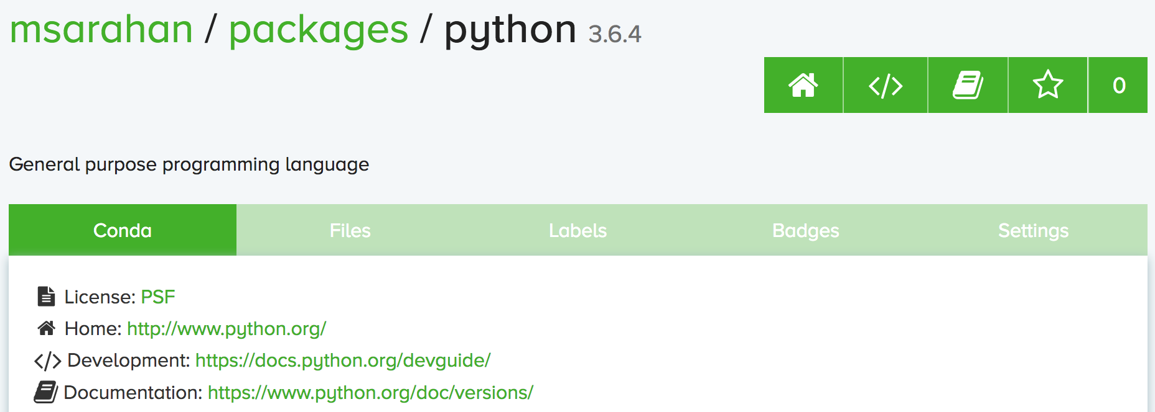
About section
Provide this stuff
https://conda.io/docs/user-guide/tasks/build-packages/define-metadata.html#about-section

Slide 68
Extra section: free-for-all
Used for external tools or state management
No schema
Conda-forge’s maintainer list
Conda-build’s notion of whether a recipe is “final”
https://conda.io/docs/user-guide/tasks/build-packages/define-metadata.html#extra-section

Slide 69
Break time!
Advanced recipe tricks coming next

Slide 70
Conditional lines (selectors)
some_content # [some expression]
content inside [] is eval’ed
namespace includes OS info, python info, and a few others
https://conda.io/docs/user-guide/tasks/build-packages/define-metadata.html#preprocessing-selectors

Slide 71
Exercise: limit a recipe to only Linux
package:
name: example_skip_recipe
version: 1.0 build:
skip: True
https://conda.io/docs/user-guide/tasks/build-packages/define-metadata.html#preprocessing-selectors

Slide 72
Exercise: limit a recipe to only Linux
package:
name: example_skip_recipe
version: 1.0 build:
skip: True # [not linux]
https://conda.io/docs/user-guide/tasks/build-packages/define-metadata.html#preprocessing-selectors

Slide 73
Intro to templating with Jinja2
Fill in information dynamically
git tag info
setup.py recipe data
centralized version numbering
string manipulation

Slide 74
How does templating save you time?
{% set version = "3.0.2" %} package: name: example version: {{ version }} source: url: https://site/{{version}}.tgz

Slide 75
Jinja2 templating in meta.yaml
Set variables:
{% set somevar=”someval” %}
Use variables:
{{ somevar }}
Expressions in {{ }} are roughly python
http://jinja.pocoo.org/docs/2.10/templates/

Slide 76
Jinja2 conditionals
Selectors are one line only. When you want to toggle a block, use jinja2:
{%- if foo -%}
toggled content
on many lines
{% endif %}
http://jinja.pocoo.org/docs/2.10/templates/

Slide 77
Exercise: use Jinja2 to reduce edits
package:
name: abc
version: 1.2.3
source:
url: http://w/abc-1.2.3.tgz
http://jinja.pocoo.org/docs/2.10/templates/

Slide 78
Exercise: use Jinja2 to reduce edits
{% set version=”1.2.3” %} package:
name: abc
version: {{ version }}
source:
url: http://w/abc-{{version}}.tgz
http://jinja.pocoo.org/docs/2.10/templates/

Slide 79
Variants: Jinja2 on steroids
Matrix specification in yaml files
somevar:
- 1.0
- 2.0
anothervar:
- 1.0
https://conda.io/docs/user-guide/tasks/build-packages/variants.html

Slide 80
All variant variables exposed in jinja2
In meta.yaml,
{{ somevar }}
And this loops over values
https://conda.io/docs/user-guide/tasks/build-packages/variants.html

Slide 81
Exercise: try looping
meta.yaml:
package:
name: abc
version: 1.2.3
build:
skip: True # [skipvar]
conda_build_config.yaml:
skipvar:
- True
- False
https://conda.io/docs/user-guide/tasks/build-packages/variants.html

Slide 82
Exercise: try looping
meta.yaml:
package:
name: abc
version: 1.2.3
requirements:
build:
- python {{ python }}
run:
- python {{ python }}
conda_build_config.yaml:
python:
- 2.7
- 3.6
https://conda.io/docs/user-guide/tasks/build-packages/variants.html

Slide 83
Exercise: try looping
meta.yaml:
package:
name: abc
version: 1.2.3
requirements:
build:
- python
run:
- python
conda_build_config.yaml:
python:
- 2.7
- 3.6
https://conda.io/docs/user-guide/tasks/build-packages/variants.html

Slide 84
Jinja2 functions
load_setup_py_data
load_file_regex
pin_compatible
pin_subpackage
compiler
cdt
Loading source data
Dynamic pinning
Compatibility control
https://conda.io/docs/user-guide/tasks/build-packages/variants.html#customizing-compatibility

Slide 85
Loading setup.py data
{% set setup_data = load_setup_py_data() %}
package:
name: abc
version: {{ setup_data[‘version’] }}
Primarily a development recipe tool - release recipes specify version instead, and template source download link
Centralizing version info is very nice - see also versioneer, setuptools_scm, autover, and many other auto-version tools

Slide 86
Loading arbitrary data
{% set data = load_file_regex(load_file='meta.yaml', regex_pattern='git_tag: ([\\d.]+)') %}
package:
name: conda-build-test-get-regex-data
version: {{ data.group(1) }}
Useful when software provides version in some arbitrary file
Primarily a development recipe tool - release recipes specify version instead, and template source download link

Slide 87
Dynamic pinning
Use in meta.yaml, generally in requirements section:
requirements:
host:
- numpy
run:
- {{ pin_compatible(‘numpy’) }}
https://conda.io/docs/user-guide/tasks/build-packages/variants.html#customizing-compatibility

Slide 88
Dynamic pinning
Use in meta.yaml, generally in requirements section:
requirements:
host:
- numpy
run:
- {{ pin_compatible(‘numpy’) }}
Pin run req based on what is present at build time
https://conda.io/docs/user-guide/tasks/build-packages/variants.html#customizing-compatibility

Slide 89
Dynamic pinning in practice
Used a lot with numpy:
https://github.com/AnacondaRecipes/scikit-image-feedstock/blob/master/recipe/meta.yaml
https://conda.io/docs/user-guide/tasks/build-packages/variants.html#customizing-compatibility

Slide 90
Dynamic pinning within recipes
Refer to other outputs within the same recipe
when intradependencies exist
when shared libraries are consumed by other libraries
https://github.com/AnacondaRecipes/aggregate/blob/master/clang/meta.yaml
https://conda.io/docs/user-guide/tasks/build-packages/variants.html#customizing-compatibility

Slide 91
Compilers
Use in meta.yaml in requirements section:
requirements: build: - {{ compiler(‘c’) }}
explicitly declare language needs
compiler packages can be actual compilers, or just activation scripts
Compiler packages utilize run_exports to add necessary runtime dependencies automatically
https://conda.io/docs/user-guide/tasks/build-packages/compiler-tools.html#anaconda-compiler-tools

Slide 92
Why put compilers into Conda?
Explicitly declaring language needs makes reproducing packages with recipe simpler
Binary compatibility can be versioned and tracked better
No longer care what the host OS used to build packages is
Can still use system compilers - just need to give conda-build information on metadata about them. Opportunity for version check enforcement.
https://conda.io/docs/user-guide/tasks/build-packages/compiler-tools.html#anaconda-compiler-tools

Slide 93
run_exports
“if you build and link against library abc, you need a runtime dependency on library abc”
This is annoying to keep track of in recipes.
https://conda.io/docs/user-guide/tasks/build-packages/define-metadata.html#export-runtime-requirements

Slide 94
run_exports
Downstream recipe
Upstream package “abc” (already built)
requirements:
host:
- abc
conda render obtains
dependencies
package:
name: abc
version: 1.0
build:
run_exports:
- abc 1.0.*
Downstream package
requirements:
host:
- abc 1.0 0
run:
- abc 1.0.*
Adds in upstream deps
https://conda.io/docs/user-guide/tasks/build-packages/define-metadata.html#export-runtime-requirements

Slide 95
run_exports
Add host or run dependencies for downstream packages that depend on upstream that specifies run_exports
Simplifies version tracking
https://github.com/AnacondaRecipes/libgdal-feedstock/blob/master/recipe/meta.yaml
https://conda.io/docs/user-guide/tasks/build-packages/define-metadata.html#export-runtime-requirements

Slide 96
Requirements: run_exports
“Strong” run_exports
build
host
run
“Weak” run_exports
https://conda.io/docs/user-guide/tasks/build-packages/define-metadata.html#export-runtime-requirements

Slide 97
Uploading packages: anaconda.org
Sign-up: https://anaconda.org/
Requirement: conda install anaconda-client
CLI: anaconda upload path-to-package
conda-build auto-upload: conda config --set anaconda_upload True
https://conda.io/docs/user-guide/configuration/use-condarc.html

Slide 98
Uploading packages: PyPI
Sign-up: https://pypi.org/account/register/
Twine: pip install twine
Upload with twine to Test PyPI: twine upload --repository-url https://test.pypi.org/legacy/ dist/*
Upload to PyPI: twine upload dist/*
https://pypi.python.org/pypi/twine

Slide 99
Questions?
Anaconda Survey: https://www.surveymonkey.com/r/conda

