Slide 1
Kishu: World's First Undoable Notebook
Zhaoheng (Billy) Li
zl20@illinois.edu
May 16th, 2025

Slide 2
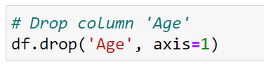


For all the notebook users out there…

Slide 3
Our notebook checkpointing system: Kishu

Slide 4
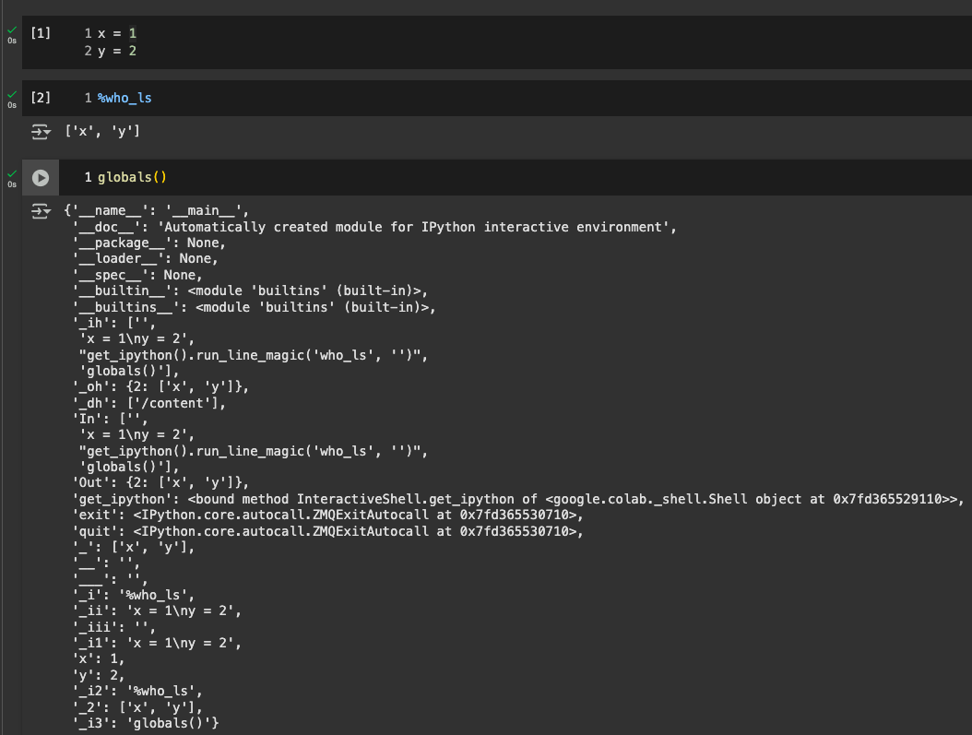
How do notebooks work?
A notebook’s session state tracks intermediate execution results.

Slide 5
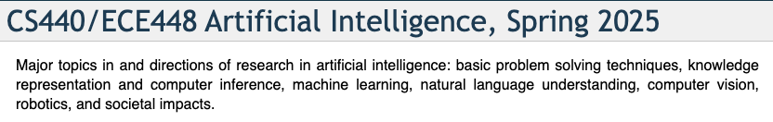

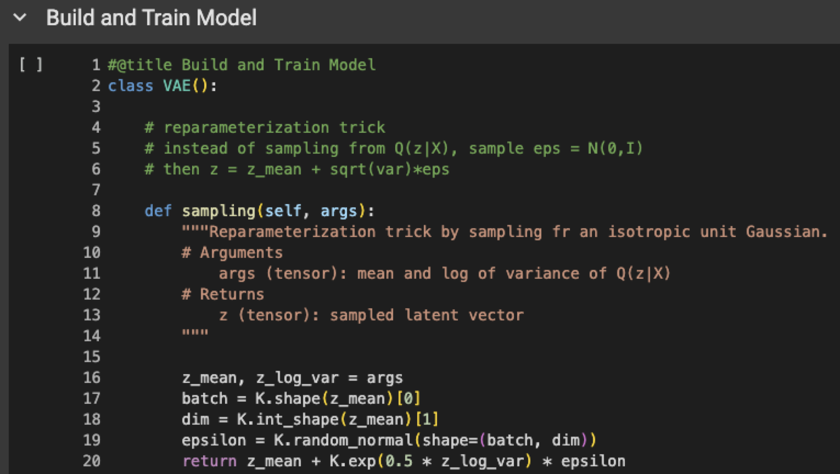
Session state enables iterative programming.
Incremental program composition is useful for tasks with trial and error.

Slide 6
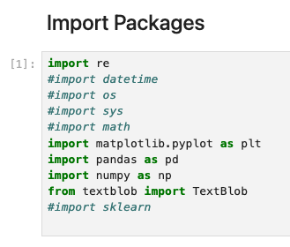
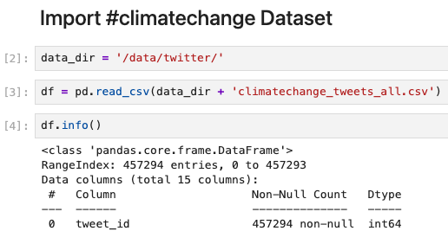
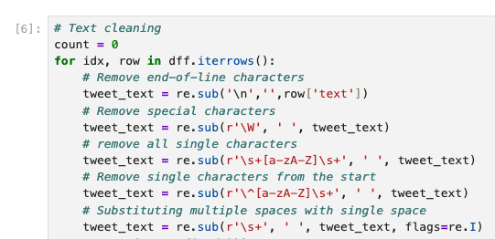
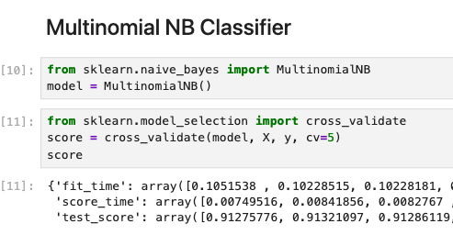
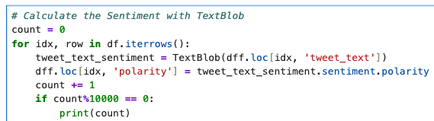
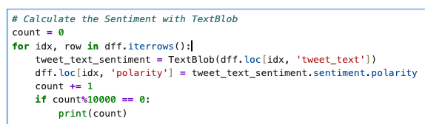
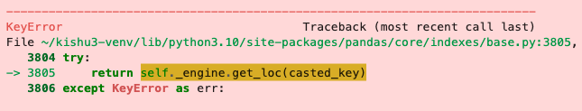
Session state enables iterative programming.
Import libraries
Load and check data
Data cleaning
Fit ML models
Feature engineering
Incremental program composition is useful for tasks with trial and error.

Slide 7
Oh no, I lost my notebook state

Slide 8


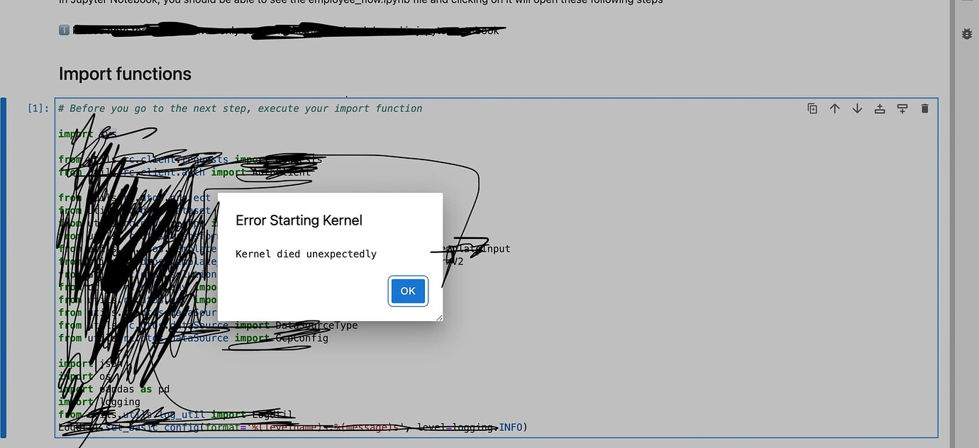
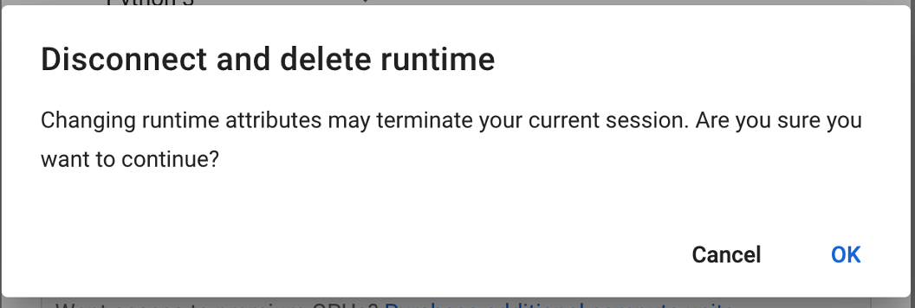
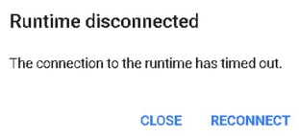
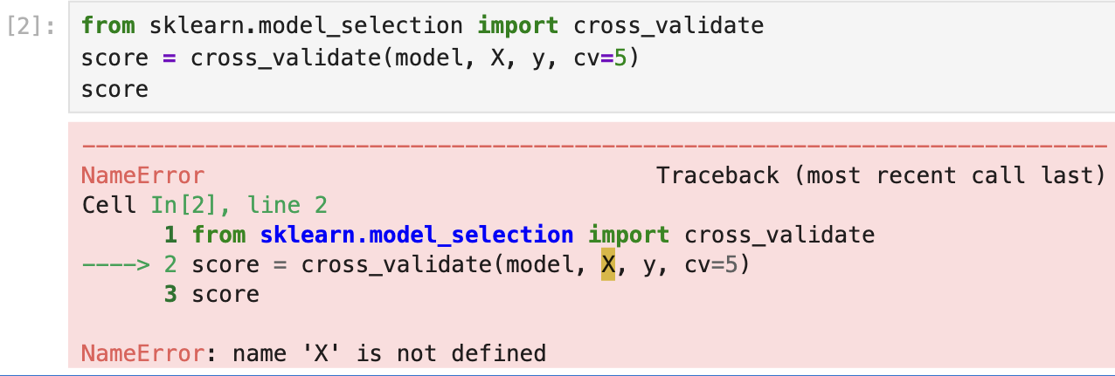



Notebook states can be lost.
+
Kernel crash
Switching machine
Session timeout
=
A notebook’s session state is stored entirely in memory.

Slide 9
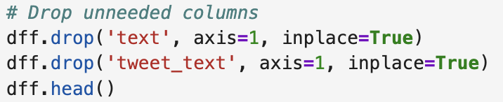
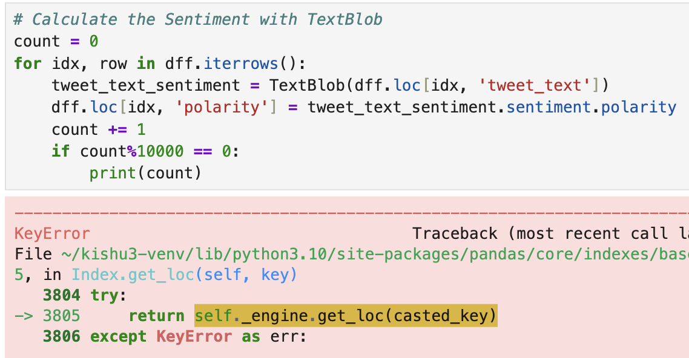
Notebook states can be lost.
X
Cannot ‘un-drop’ dataframe column
Past states are not recorded.

Slide 10
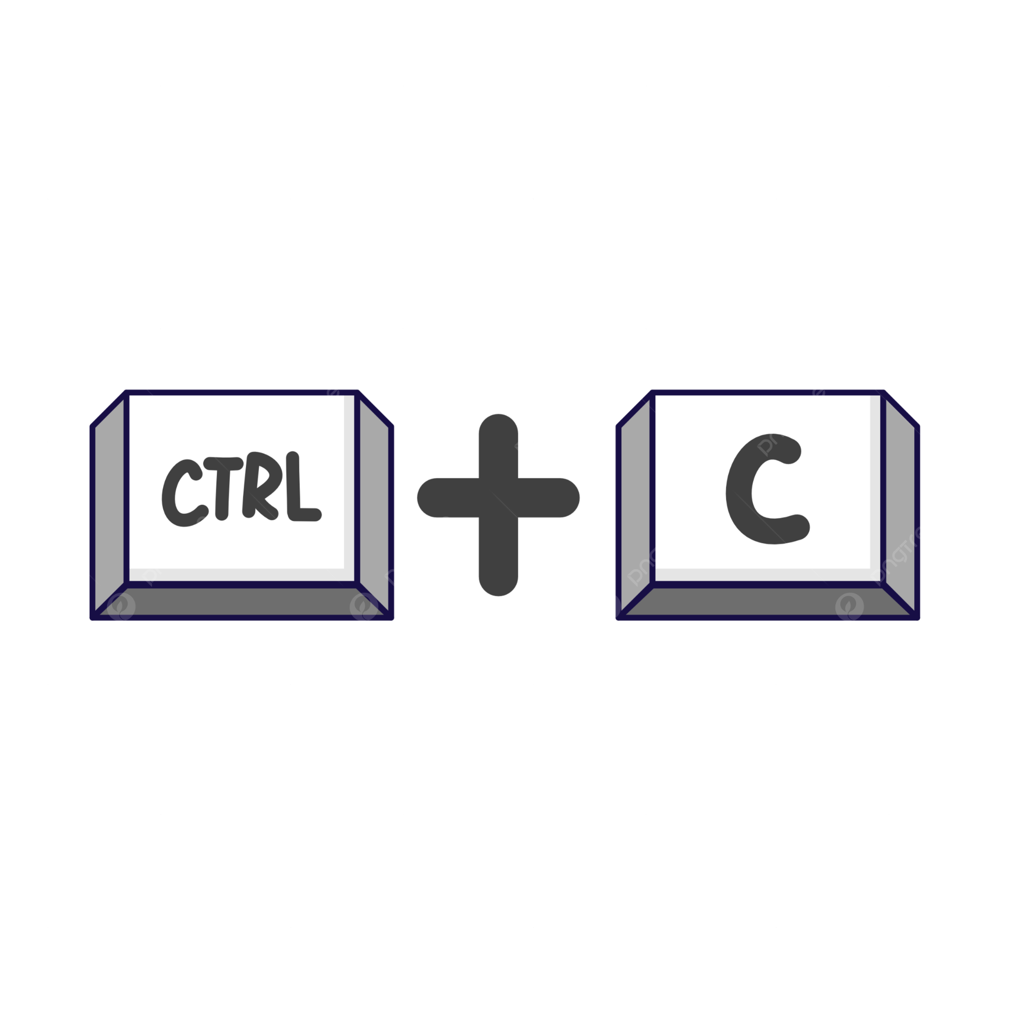
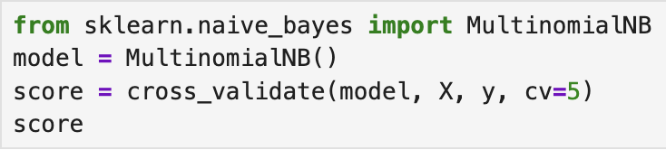
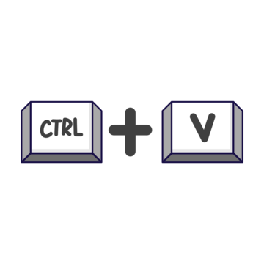
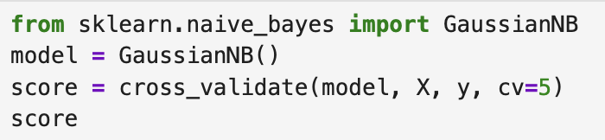
Notebook states can be lost.
X
Cannot ‘un-overwrite’ variables
Past states are not recorded.

Slide 11
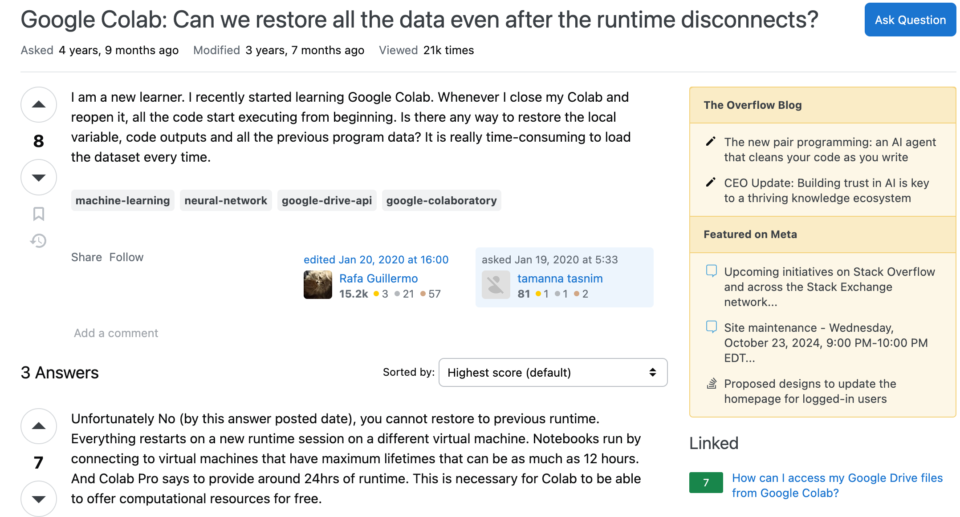
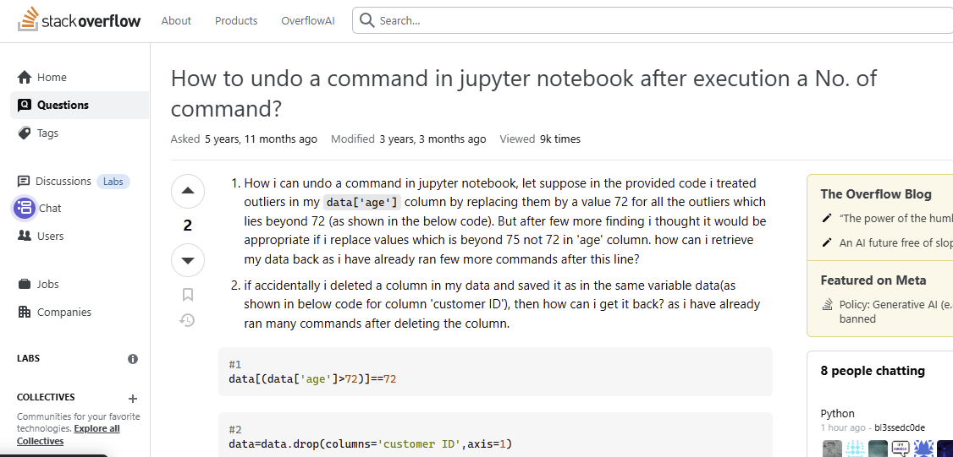

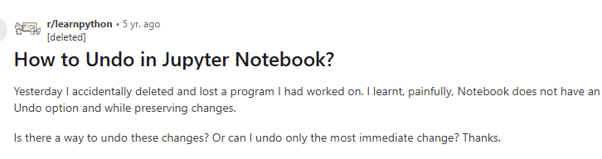
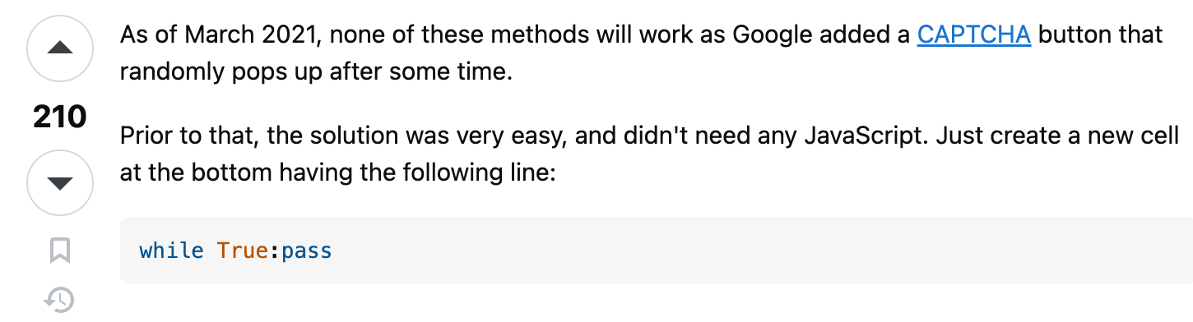
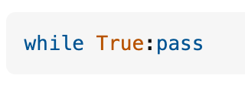
Users are aware of session state loss.

Slide 12
Existing state restoration approaches

Slide 13
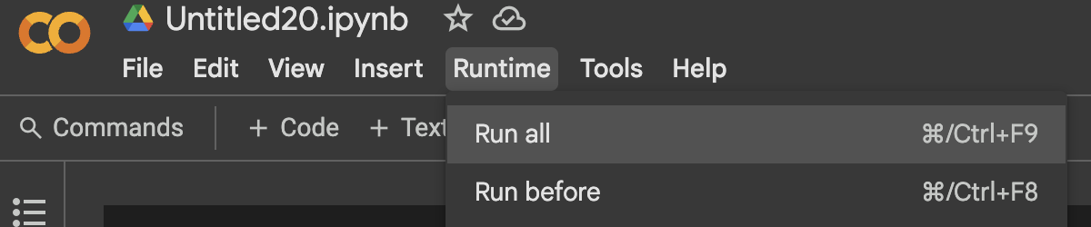

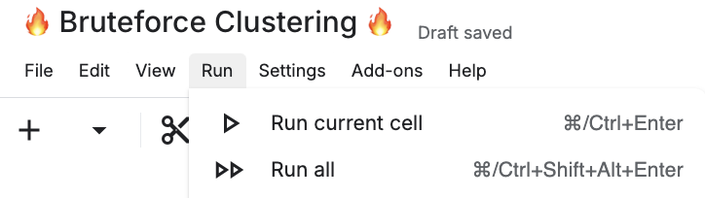
Rerunning cells
Google Colab
JupyterLab
Kaggle

Slide 14
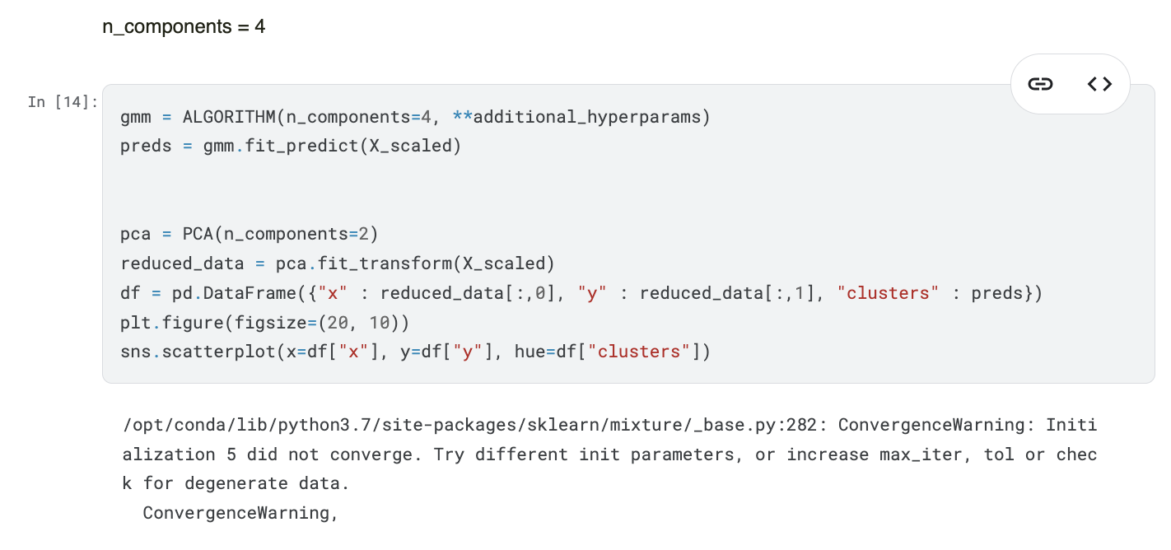
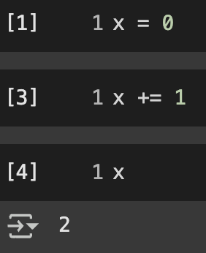
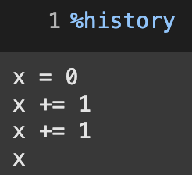
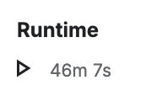
Rerunning cells
Can take a while.
current notebook cells
!= execution history.

Slide 15
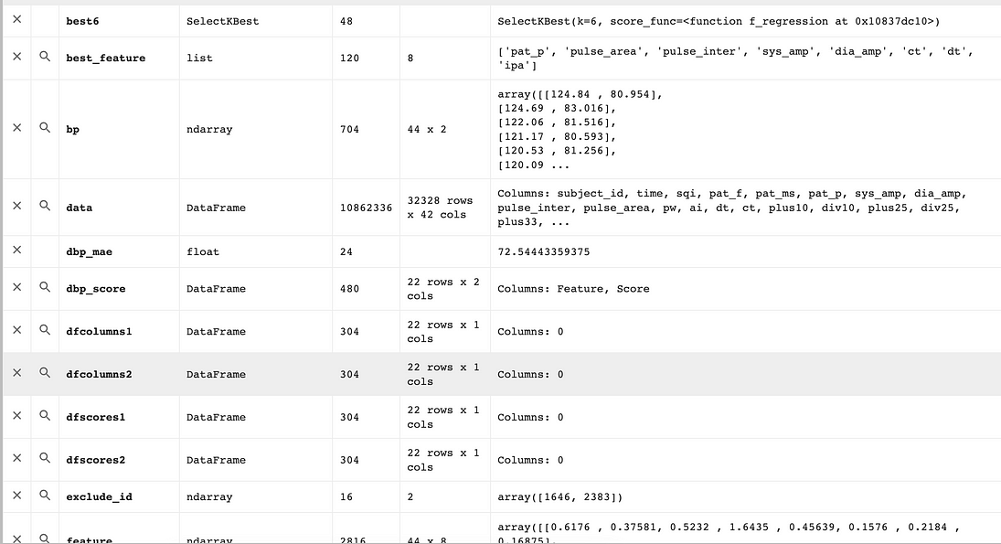



State dumping

Slide 16
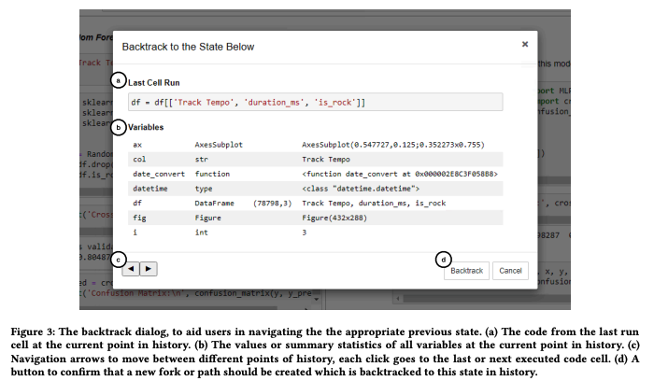
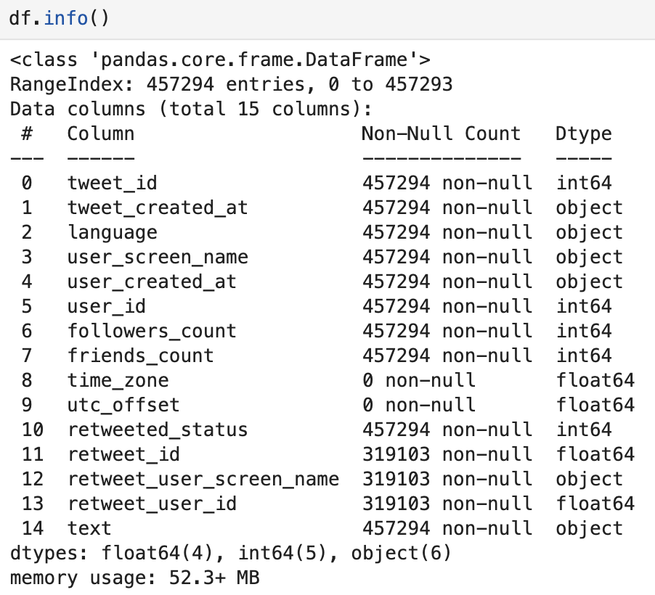

State dumping
[2]
…
…
…
[1] Weinman, Nathaniel, et al. "Fork it: Supporting stateful alternatives in computational notebooks, CHI 2021

Slide 17


OS-level checkpointing
Dump process memory with CRIU [2]
…
[2] Mario Juric, et al. "Checkpoint, Restore, and Live Migration for Science Platforms”, Arxiv preprint

Slide 18
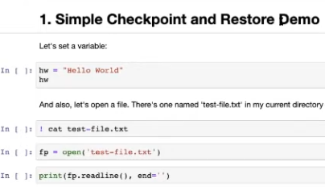
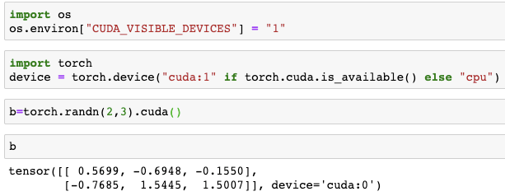
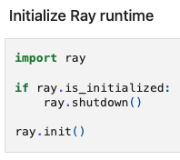


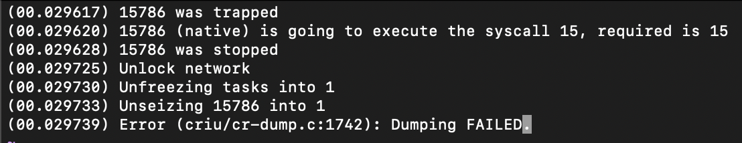


OS-level checkpointing
# load tensor onto GPU

Slide 19
Checkpointing state via OS-level tools
OS-level checkpointing only works for certain OSes.

Slide 20
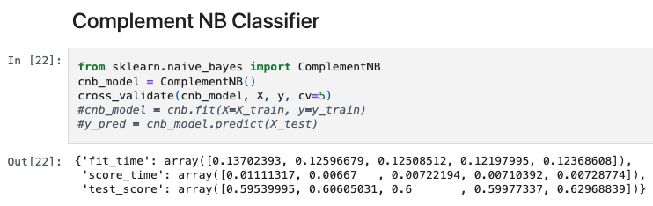
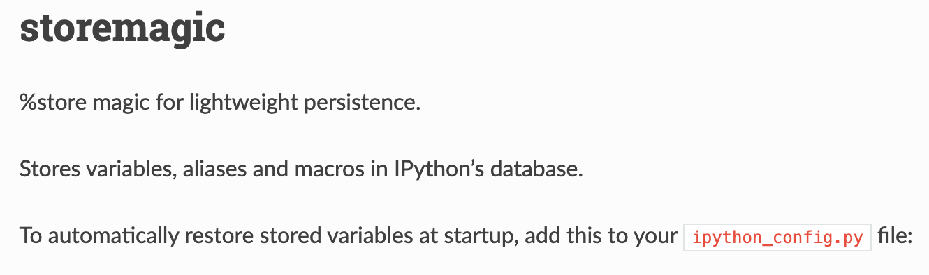
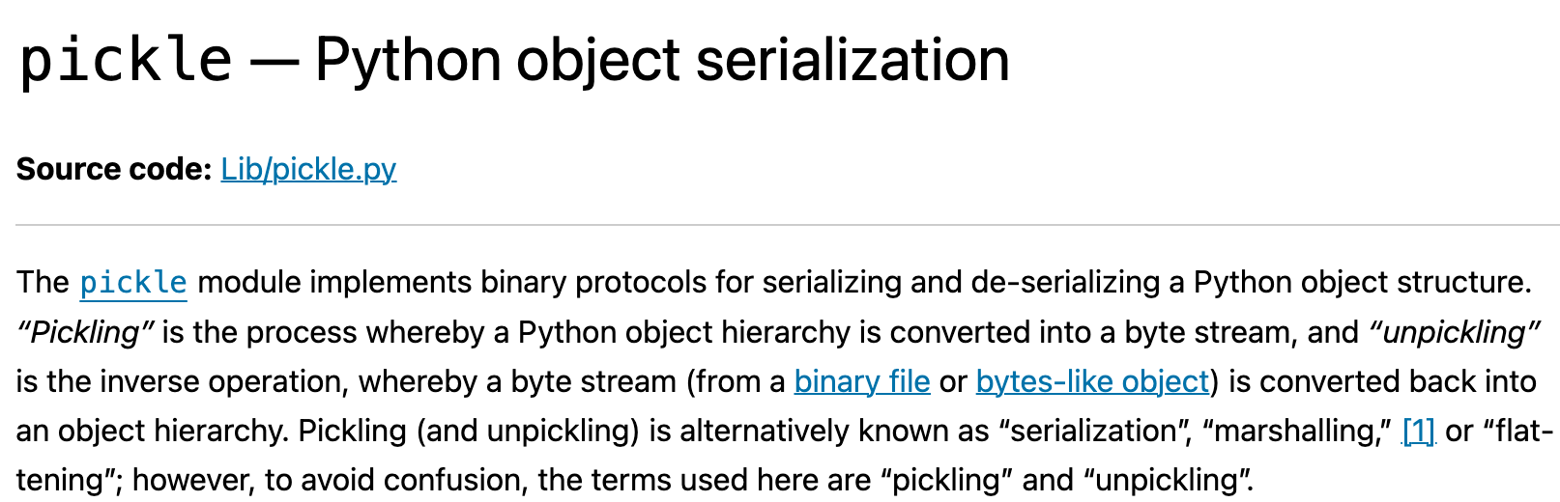

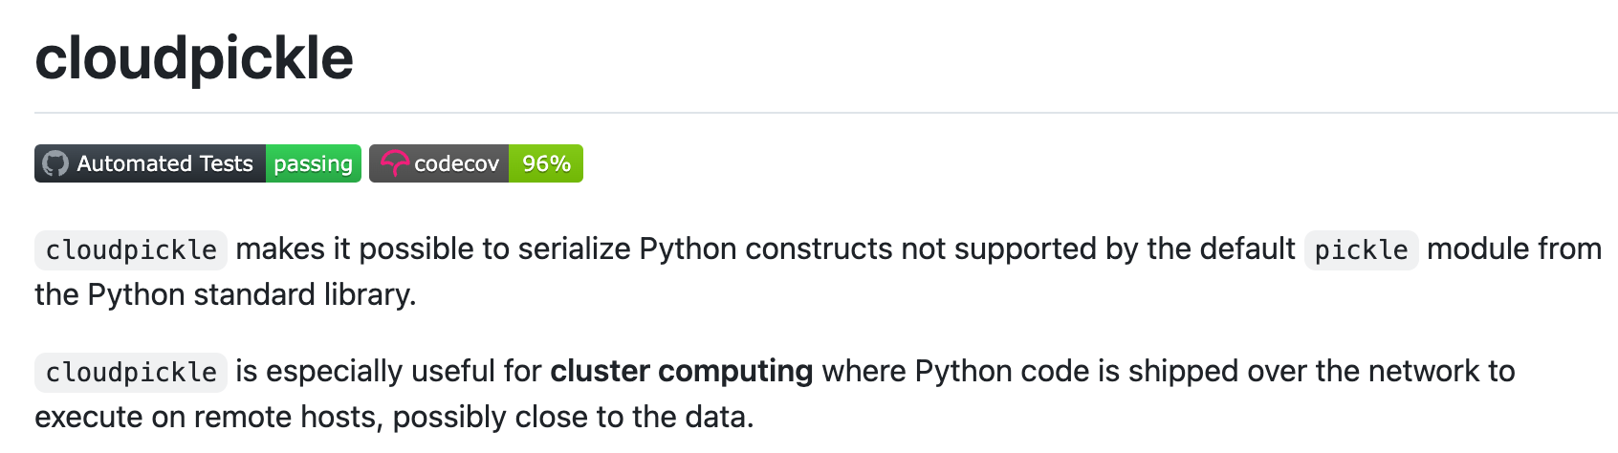
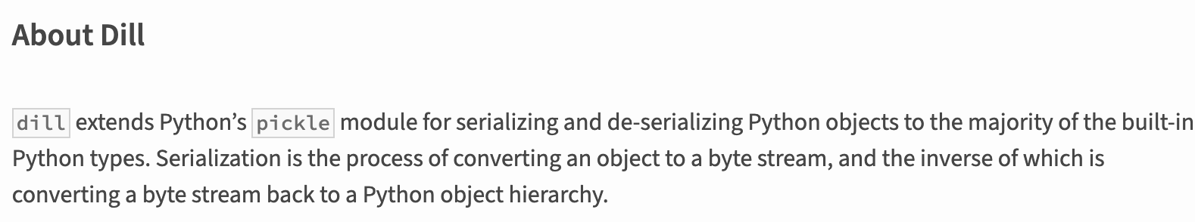
Manually storing changed data
If we know what cell executions do, we can manually save (only) changed data.

Slide 21
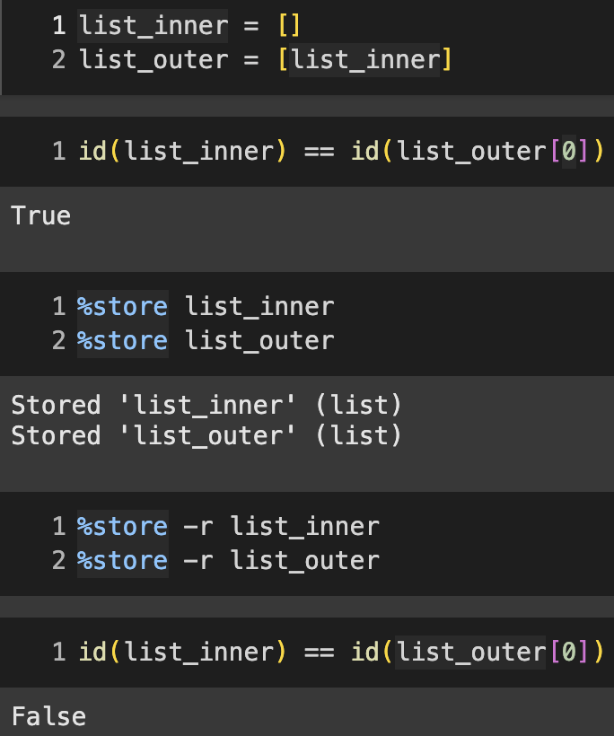
Manually storing changed data requires expertise.
list_outer
list_inner
list_outer
list_inner?
list_inner
Incorrect storage can break shared references.
Correctly storing changed data requires expertise.

Slide 22
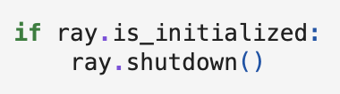
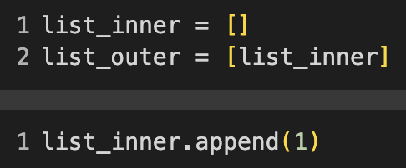
Manually storing changed data requires expertise.
Control flows
Updated despite not appearing in 2nd cell!
Hidden updates
Correctly identifying changed data requires expertise.

Slide 23


To sum up existing approaches…
Approach
Benefits
Problems
Rerun cells
convenient if exec. history is available
State dumping
Native to notebooks
OS-level tools
Incremental checkpoints
Manual storage
Native to notebooks and
incremental checkpoints
Challenging for users
Can we build a system that automates correct detection and storage of changed data?

Slide 24
Our approach

Slide 25
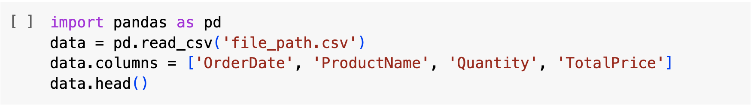
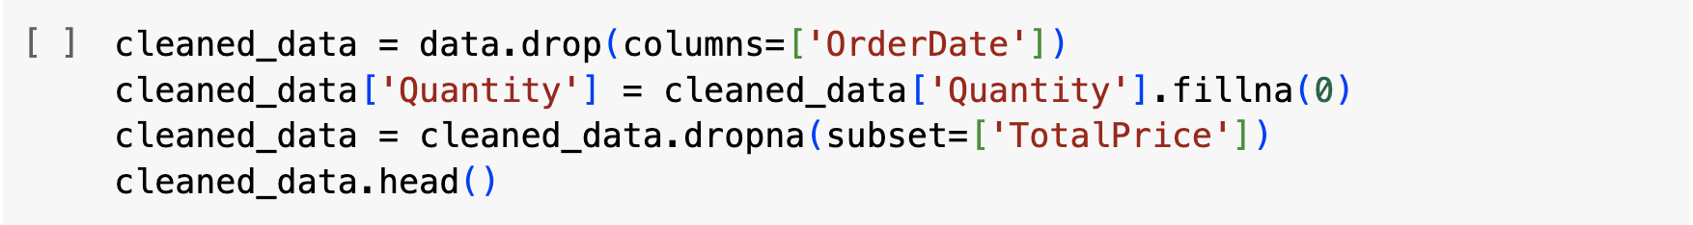
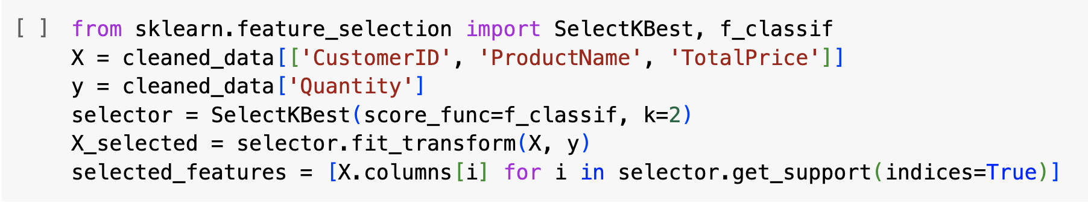
Our (potential) notebook checkpointing
Idea: we want to define state deltas at a granularity that makes correct detection and I/O easy.
# import data and create a dataframe
Our checkpointing system
Operation t1
State t1
State t1: {pd, data}
# drop a column and fill in null values
Operation t2
State t2 - State t1
“state deltas”
State t2: {pd, data, cleaned_data}
Undo: State t3 - State t1
# perform feature selection
Operation t3
State t3 - State t2
Resume (after crash):
State t3
State t3: {..., X, y, selector, ...}

Slide 26


Candidate: variable-level granularity
JupyterLab’s variable inspector displays data at variable-level granularity.
IPython’s built in %store line magic stores and loads variables.
It is very natural to think of notebook data in terms of variables.

Slide 27
I/O and detection for variable-level deltas is tricky.
How can we avoid breaking this shared reference?
Cells contain hidden updates.
Risks breaking shared references.

Slide 28

We treat ref.-sharing variables as single entity.
list_outer
list_inner
list_outer
list_inner
By treating reference-sharing variables as a single entity, we preserve shared references.

Slide 29

We treat ref.-sharing variables as single entity.
“Co-variables”
Cell2 updates
{list_inner, list_outer}.
Cells no longer contain hidden updates.
delta detection also becomes straightforward.

Slide 30

Tracking and storing Co-Variables
Co-var 1
Co-var 2
df
list1
obj
DataFrame
List
MyClass
data
idx
‘a’
‘b’
‘c’
‘d’
Reference graphs defined according to Pickle (__reduce__).
Our system incrementally maintains Co-Variable-tracking reference graphs.

Slide 31
Tracking and storing Co-Variables
Co-var 1
Co-var 2
df
list1
obj
DataFrame
List
MyClass
data
idx
‘a’
‘b’
‘c’
‘d’
Storing Co-variables incurs no risk of breaking shared references.
list1_obj.pkl
Co-variables can be stored like independent data tables.

Slide 32
Tracking and storing Co-Variables
Co-var 1
Co-var 2
df
list1
obj
Untouched data
MyClass
DataFrame
List
MyClass
data
idx
‘a’
‘b’
‘c’
‘d’
Users couldn’t have possibly reached Co-Variable {df} via referencing.
How can we systematically capture variable references in a cell execution?
Co-variables enable efficient delta detection.

Slide 33


Tracking and storing Co-Variables
The notebook’s session state is a dictionary!
We patch the Jupyter namespace to capture variable accesses…

Slide 34

Tracking and storing Co-Variables
Co-var 1
Co-var 2
Co-var 3
df
list1
obj
obj
Untouched data
MyClass
DataFrame
List
MyClass
data
idx
‘a’
‘b’
‘c’
‘d’
‘d’
To incremental checkpoint
…which we use to incrementally maintain the Co-variable-tracking reference graphs.

Slide 35
Incremental Checkpoint & Restore

Slide 36




Co-Variable granularity incremental C/R
timestamp
code
delta
inherit
Target
t1
(df, t1), (gmm, t1)
Needs updating
(gmm, t2)
Same object
t2
(df, t1)
Source
t3
(plot, t3)
(df, t1), (gmm, t2)
restore/check-out t1
t4
(gmm, t4)
(df, t1)
t5
(plot, t5)
(df, t1), (gmm, t4)

Slide 37

Handling unserializable data
timestamp
code
delta
inherit
t1
(df, t1), (gmm, t1)
load
t2
(gmm, t2)
(df, t1)
rerun
Target
t3
(plot, t3)
(df, t1), (gmm, t2)
restore/check-out t1
t4
(gmm, t4)
(df, t1)
t5
(plot, t5)
(df, t1), (gmm, t4)
We restore unserializable data via cell replay.

Slide 38
System Demo

Slide 39
Short demo of our notebook C/R system: Kishu
https://pypi.org/project/kishu/
https://github.com/illinoisdata/kishu

Slide 40
Other Things we are Exploring

Slide 41


Object-level deduplication
dff was logically updated.
Avoid storing within-Co-Variable unchanged data with Object-level Deduplication.

Slide 42
Full-fletched GUI

Slide 43
Conclusion

Slide 44
Conclusion
We built Kishu, a new incremental C/R system for computational notebooks.
It helps notebook users undo cell executions and version notebook states.
It addresses delta detection and storage challenges - granularity, how to profile, etc.

Slide 45

Thank you for listening!
Try Kishu:
https://github.com/illinoisdata/kishu
Read our papers here:
Kishu: Time-Traveling for Computational Notebooks
ElasticNotebook: Enabling Live Migration for Computational Notebooks
Enhancing Computational Notebooks with Code+Data Space Versioning
Transactional Python for Durable Machine Learning: Vision, Challenges, and Feasibility
pip install jupyterlab-kishu

